Slide 1


LEVERS
IN HUMANBODY
Dr. Jay Soni (P.T.)
B.P.T., M.P.T. (Musculoskeletal conditions),
Fellowship in Sports Rehabilitation,
Assistant Professor, College of Physiotherapy, SVDU

Slide 2
OBJECTIVES
At the end of the lecture, student should learn,
What is lever ?
Which are the different parts of the lever ?
Which are the different types of lever?
Different examples of levers in Human Body & at home
Importance of levers in physiotherapy

Slide 3
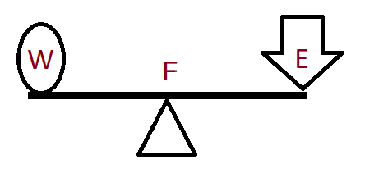
DEFINITION
A lever is a rigid bar which is capable of movement about a fixed point called fulcrum (F).

Slide 4
DEFINITION
Lever has three Parts
W=Weight or Load,
F= Fulcrum,
E= Effort

Slide 5
DEFINITION
Work is done when a force or effort (E), is applied at one point on the lever,
which acts upon another weight (W), located at a second point on the lever.

Slide 6
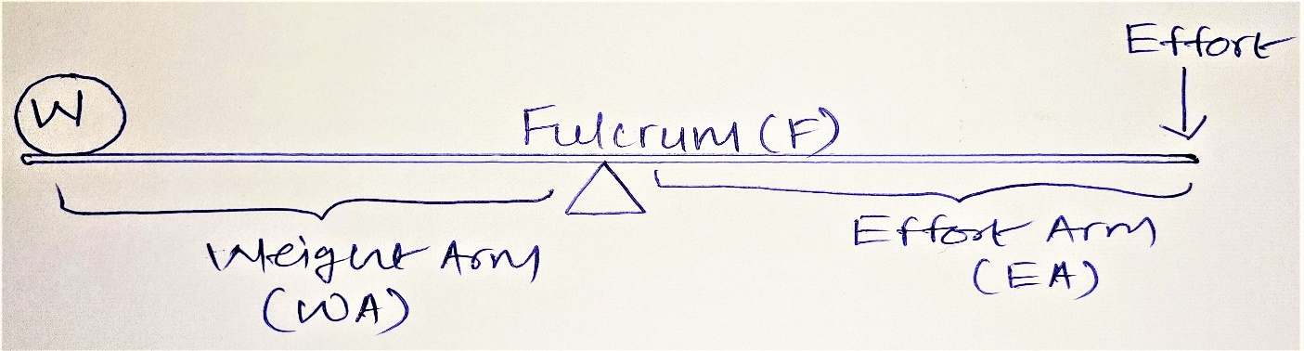
DEFINITION
What is Effort arm and what is weight arm?
The perpendicular distance from the fulcrum to the effort (E) is called as effort’s arm and The perpendicular distance from the fulcrum to the Weight (W) is called weight’s arm.

Slide 7
What are the different parts of Human body which from lever?
Fulcrum is formed by Joint
Weight is of weight of limb / body / Gravitational Force / Resistance
Effort is Contraction of Muscles

Slide 8
TYPES OF LEVER
1. First order Lever
2. Second order Lever
3. Third order Lever
These types are based on the relative Position of Fulcrum (F), Weight (W), Effort (E)

Slide 9
MNEMONICS
Father Went to England
The first character of each word defines that fulcrum/weight/effort is located in middle position
In 1st order lever Fulcrum is located in between weight and effort the same way in 2nd order and third order lever weight and effort is located in middle, respectively.

Slide 10
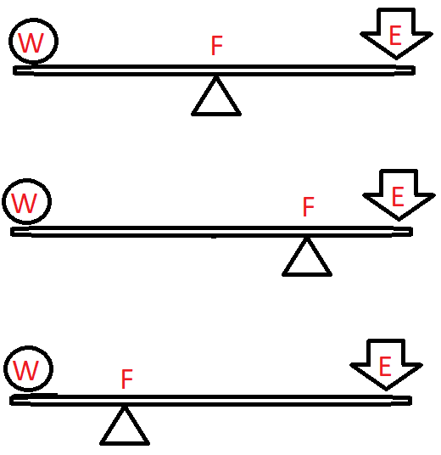
FIRST ORDER OF LEVER
The fulcrum is between the effort and the weight.
It may be situate centrally, or towards either the effort or weight , consequently the effort’s and the weight’s arms may be equal, or one may exceed the other in length.

Slide 11
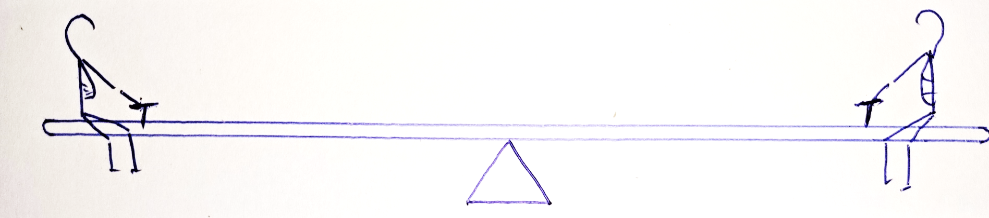
FIRST ORDER OF LEVER
Example:
In day to day life, 1st order lever example is Seesaw

Slide 12
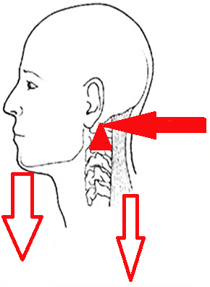
FIRST ORDER OF LEVER
Example in Human Body, Nodding Movement of Head
Where Fulcrum is Atlanto-
Occipital joint,
Weight is weight of skull,
Effort is Posterior neck Muscles

Slide 13
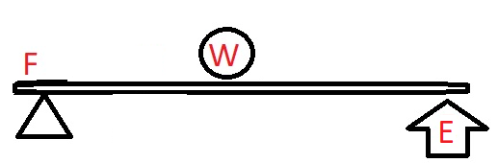
SECOND ORDER OF LEVER
In 2nd order lever, Weight is located between Effort and Fulcrum

Slide 14
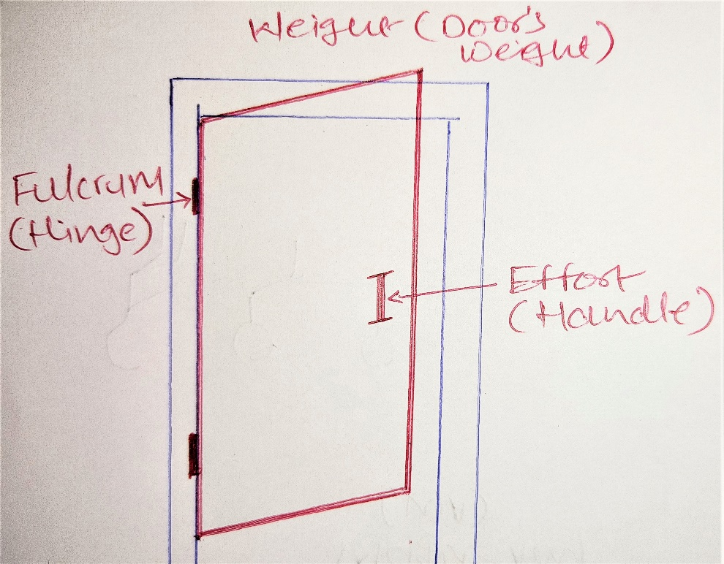
SECOND ORDER OF LEVER
Example:
In day to day life, 2nd order lever example is opening or closing door

Slide 15
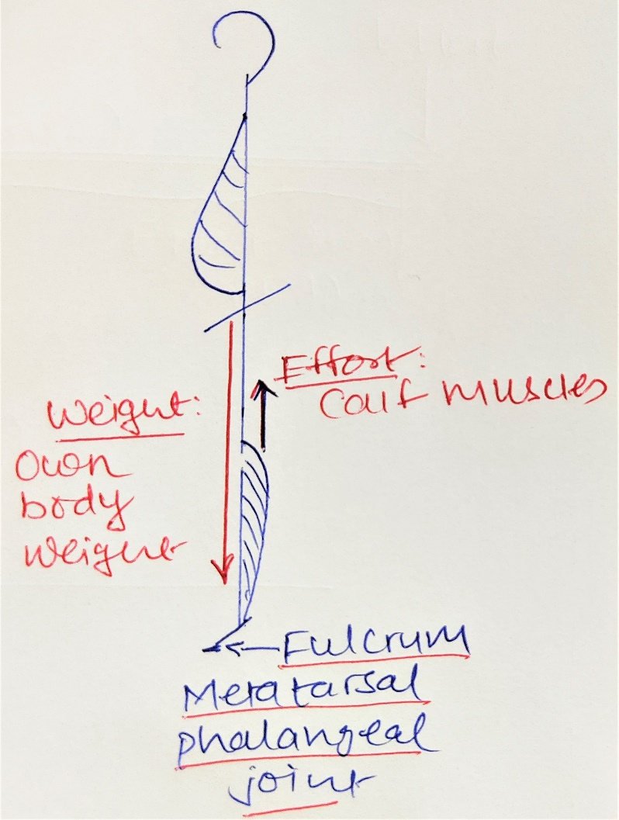
SECOND ORDER OF LEVER
Example in Human Body is raising on toes.
Where Fulcrum is Metatarsal Phalangeal joint, weight is Patient’s own body weight and Effort is produced by contraction of Calf muscles.

Slide 16
MECHANICAL ADVANTAGE
Mechanical Advantage of lever depends on two factors, i.e. The force exerted (E) or Weight (W), and its perpendicular distance from the fulcrum (i.e. Weight’s arm or Effort’s arm).
The product of these two factors is known as the Moment of Force

Slide 17
MECHANICAL ADVANTAGE
If the length of effort’s arm greater than the weight’s arm, it requires less effort to achieve a similar result so that an advantage will be gained by the use of the lever. This is known as Mechanical Advantage.

Slide 18
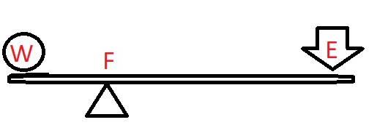
MECHANICAL ADVANTAGE
Example of lever gives mechanical Advantage
It is obtained in the 1st order lever when the fulcrum is nearer to the weight than to the effort.
In all levers of the 2nd order
Mechanical Advantage is never gained in 3rd order lever

Slide 19
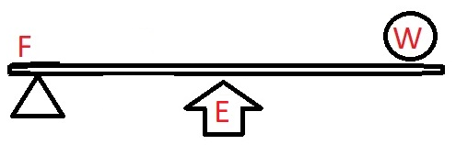
THIRD ORDER OF LEVER
The effort is between the fulcrum and the weight.
Mechanical advantage is reduced but more movement is possible, therefore it is also known as lever of velocity.

Slide 20
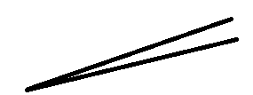
THIRD ORDER OF LEVER
Example in day to day life is Forceps

Slide 21
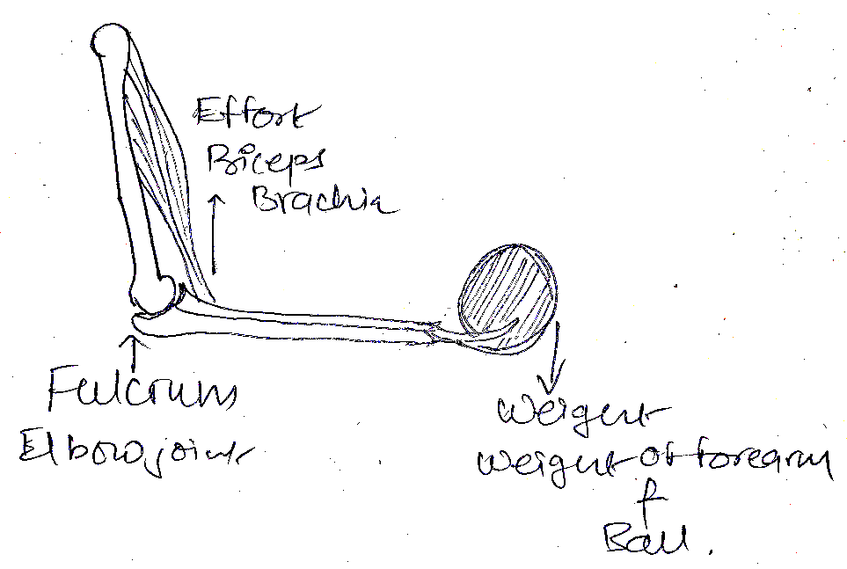
THIRD ORDER OF LEVER
Example in human body is elbow flexion
Where Fulcrum is elbow joint
Effort is biceps contraction acting applied at insertion site
weight is weight of
forearm and
object in the hand

Slide 22
LEVER IN PHYSIOTHERAPY
A system of levers is the means by which the human body achieves movement and resilience.
A knowledge of lever principle is necessary for the understanding of a method of progression in the strengthening muscles.

Slide 23
LEVER IN PHYSIOTHERAPY
As the strength of the muscle increases, the resistance or weight which is to be overcome must also be increased until such time as no further progression is possible or desirable.
As the insertion of the muscle, constituting the effort factors, are at fixed points in relation to the joint, the only factors capable of variation are the weight and its perpendicular distance from the fulcrum.

Slide 24
LEVER IN PHYSIOTHERAPY
Added resistance to the muscle action can be applied, either by increasing the weight to be overcome or by increasing the length of weight’s arm.
The latter is usually referred to as increasing the leverage.

Slide 25
LEVER IN PHYSIOTHERAPY
For example, abduction of the arm at the shoulder joint with elbow flexed reduces the leverage, and relatively weak muscles can perform the movement, whereas when the elbow is straight and the leverage is increased a more powerful contraction is required.

