Slide 1
SHOULDER COMPLEX BIOMECHANICS
By Dr Neha Mukkamala

Slide 2
OBJECTIVES
The student at the end of the lecture should be able to:
Identify the bones and joints of the shoulder complex
Explain the motions of the shoulder girdle
Enumerate ligaments of the Sternoclavicular and Acromioclavicular joints
Explain the kinematics of the Sternoclavicular, Acromioclavicular and Scapulothoracic joints

Slide 3
Functions of Shoulder
To put the hand in a position for function
It stabilizes the upper extremity for:
hand motions
lifts and pushes objects
elevates the body
assists with forced respiration
bears weight when walking with crutches and handstands

Slide 4
Mobility is at the cost of stability
Only bony attachment of the upper extremity to the trunk is at the Sternoclavicular joint
Stabilization of the shoulder is primarily dependent on muscles and ligaments

Slide 5
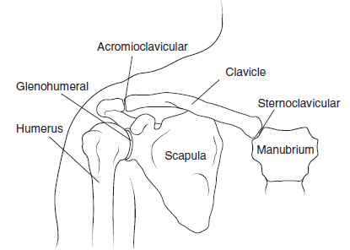
Bones and Joints of the Shoulder Girdle Complex

Slide 6
Bones
Manubrium
Clavicle
Scapula
Humerus

Slide 7
Joints
Sternoclavicular joint
Acromioclavicular joint
Glenohumeral joint
Scapulothoracic joint

Slide 8
Manubrium
Clavicle
Increases glenohumeral mobility to permit greater motion in reaching and climbing activities

Slide 9
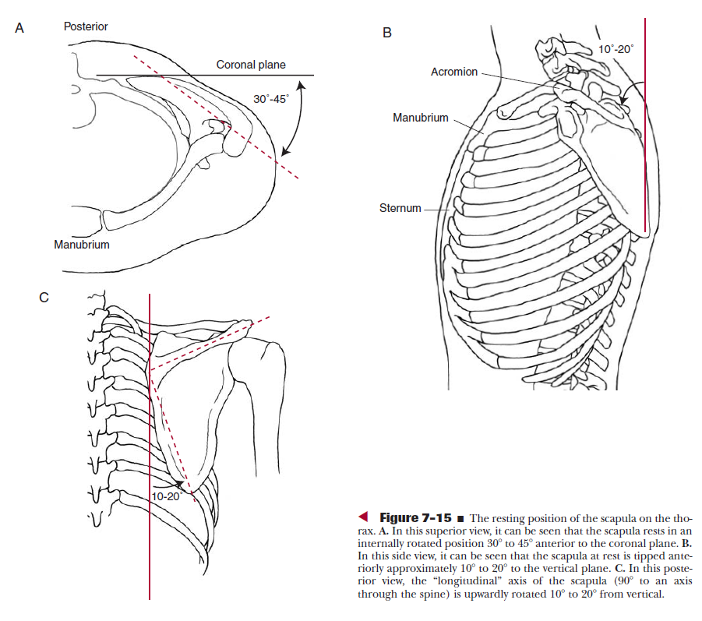
Scapula resting position

Slide 10
Scapula
Anatomical resting position: Medial border is 5-6cm from the thoracic spinous processes and between T2 and T7. 30⁰-45⁰ anterior to the frontal plane. This is the plane of the scapula or Scapular plane. It is tipped 10⁰ to 20⁰
in the sagittal plane.
It provides a place for the muscles controlling the Glenohumeral (GH) joint to venture from
Provides a stable base from which the GH joint can function
Provides GH joint more motion

Slide 11
Humerus
Positioned medially and superiorly in the frontal plane and rotated posteriorly in the transverse plane

Slide 12
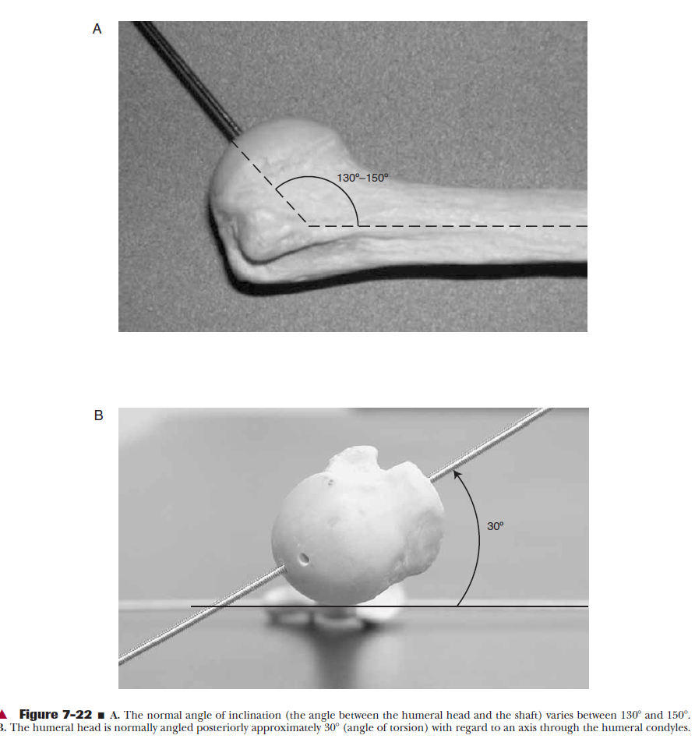

Slide 13
Angle of inclination- An axis through the humeral head and neck in relation to a longitudinal axis through the shaft of the humerus forms an angle of 130 to 150 degree in the frontal plane.This is known as the angle of inclination of the humerus.
Angle of torsion- In the transverse plane, the axis through the humeral head and neck in relation to the axis through the humeral condyles forms an angle called the angle of torsion. In humerus it is 30⁰ posteriorly called as retroversion

Slide 14
Shoulder Girdle movements
Shoulder girdle refers to the scapula, clavicle and manubrium.
There is coupling between the motions of clavicle and scapula.
Motions at the AC and SC joints produce movement of the scapula on the thorax.
The SC joint is responsible for the majority of the scapula’s movement and AC joint produces minimal movement.

Slide 15
Shoulder Girdle movements
Elevation
Depression
Protraction
Retraction
Upward rotation
Downward rotation
Scapular tilting

Slide 16
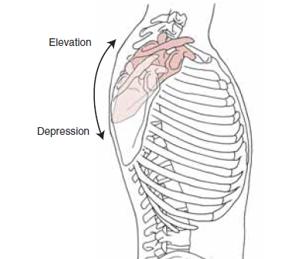
Shoulder Girdle Elevation

Slide 17
Shoulder Girdle Elevation
Primarily used to describe scapular motion
Scapula slides upward on the thorax relative to its resting position
Shrugging the shoulders produces this motion
There must also be elevation of the clavicle at the SC joint for scapular elevation
Because of this SC motion, the distal end of the clavicle and acromion process move superiorly (towards the ear) approx 60⁰

Slide 18
Shoulder Girdle Depression
Primarily used to describe scapular motion
It is the reverse movement of elevation
Scapula slides downward on the thorax relative to its resting position
From the resting position only 5⁰ to 10⁰ of depression occurs
It stabilizes the scapula and elevates the body during upper extremity weight bearing like maneuvre on parallel bars, walking with crutches, wheelchair transfers

Slide 19
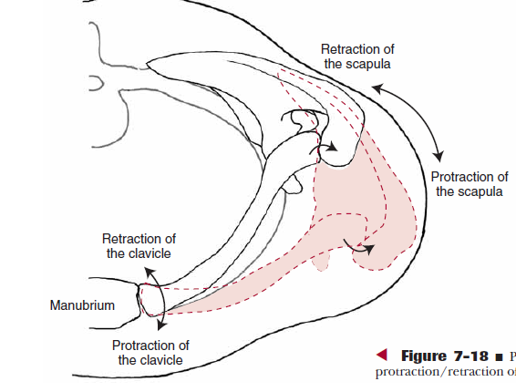
Shoulder Girdle Protraction & Retraction

Slide 20
Shoulder Girdle Protraction
Both scapula and clavicle play important roles in producing this motion
The lateral end of the clavicle and scapula move anteriorly around the rib cage, with the medial border of the scapula moving away from the midline
Also called abduction of the scapula

Slide 21
Shoulder Girdle Retraction
It is the opposite motion of protraction
The lateral end of the clavicle and scapula move posteriorly around the rib cage, with the medial border of the scapula comes towards the midline
Also called adduction of the scapula
The total range for scapular protraction and retraction at the SC joint is 25⁰
It also includes concurrent motions of protraction and retraction of the clavicle at the SC joint and medial and lateral rotation at the AC joint.

Slide 22
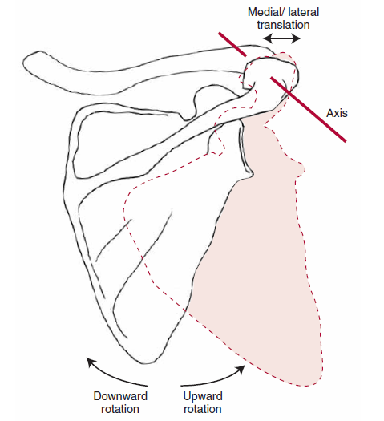
Shoulder Girdle Upward & Downward rotation

Slide 23
Shoulder Girdle Upward rotation
Glenoid fossa moves to face superiorly and inferior angle of scapula slides laterally and anteriorly on the thorax
Max range occurs with full shoulder flexion

Slide 24
Shoulder Girdle Downward rotation
Glenoid fossa moves to face inferiorly
Complete range occurs with max shoulder extension
The total range of upward and downward rotation is 60⁰
Upward rotation is accompanied by elevation of SC and AC joints and downward rotation is accompanied by depression of these joints

Slide 25
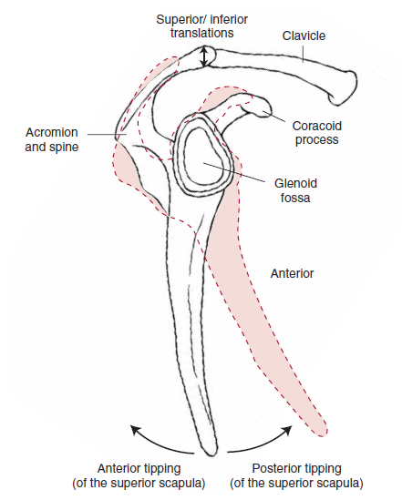
Scapular tilting

Slide 26
Scapular tilting
Anterior and posterior tilting is rotation of the scapula along a medial-lateral axis.
Anterior tilting occurs when the superior border of the scapula tilts forward with its inferior angle moving away from the thorax.
It occurs when the hand is put behind the back and lifted away from the back.
The scapula will posteriorly tilt as the humerus is elevated during shoulder flexion and abduction.
Posterior tilting is accompanied by posterior rotation of clavicle at SC & AC joints

Slide 27
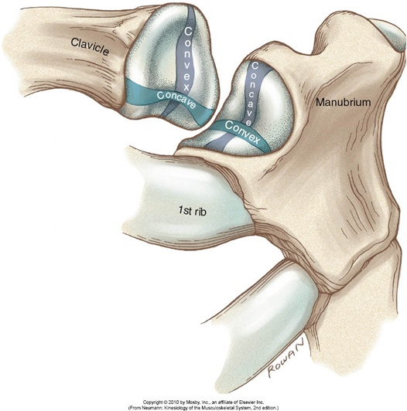
STERNOCLAVICULAR JOINT

Slide 28
STERNOCLAVICULAR JOINT
The SC joint is a complex saddle joint with three degrees of motion: elevation & depression, protraction & retraction, rotation. This joint has a synovial capsule, a joint disk, and three major ligaments.
The three ligaments are the sternoclavicular ligaments, the costoclavicular ligament, and the interclavicular ligament.

Slide 29
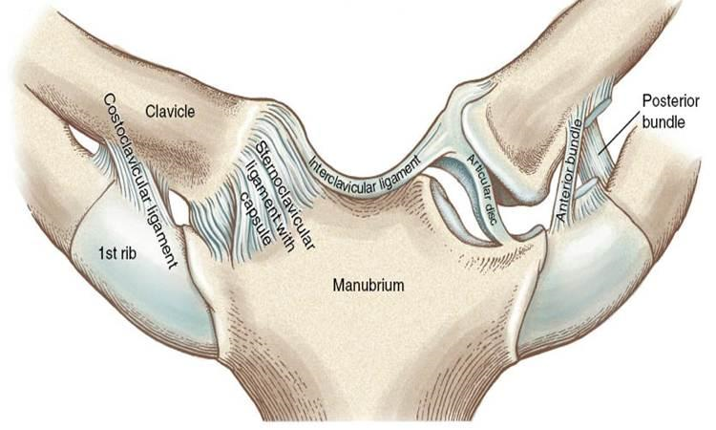

Slide 30
The fibrocartilagenous articular disk lies between the two joint surfaces
It serves as a hinge for motion
It adds stability to the joint and reduces the risk of the clavicle sliding over the manubrium
It increases stability by increasing congruency between the two joint surfaces
It reduces joint stresses by improving shock absorbency

Slide 31
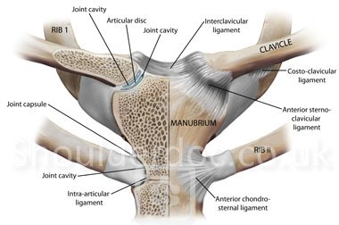

Slide 32
1. ANTERIOR AND POSTERIOR STERNOCLAVICULAR ligaments, checks anterior and posterior translatory movement of the medial end of the clavicle.
2. The COSTO-CLAVICULAR ligament is a very strong ligament found between the clavicle and the first rib. The costoclavicular ligament restricts clavicular elevation, rotation, medial and lateral movements.
The costoclavicular ligament counters the superiorly directed forces applied to the clavicle by the sternocleidomastoid and sternohyoid muscles.
3. INTERCLAVICULAR ligament resists upward clavicular displacement at the SC joint.

Slide 33
Sternoclavicular Motions
The three degrees of freedom at the SC joint are elevation/depression, protraction/retraction, and rotation of the clavicle.
The motions of elevation/depression and protraction/ retraction should be visualized by referencing movement of the lateral end of the clavicle.
Clavicular rotation is long axis rolling motion of the entire clavicle

Slide 34
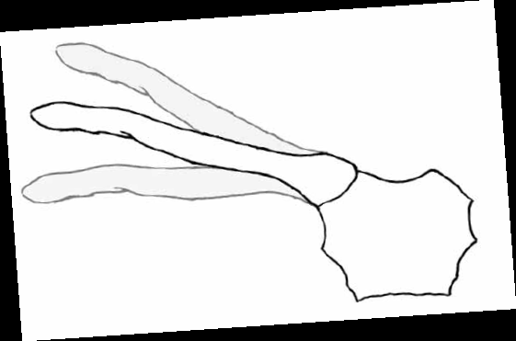
Elevation
Depression

Slide 35
1. Elevation and Depression of the Clavicle
AXIS: Anteroposterior (A-P) axis.
PLANE: Frontal
MOTION: With elevation, the lateral clavicle rotates upward, and with depression, the lateral clavicle rotates downward.
Elevation is limited by costoclavicular ligament and Subclavian muscle and depression by interclavicular ligament, superior capsule, and first rib.
RANGE: Clavicular elevation = 30º to 45º
Depression = 5º to 10º

Slide 36
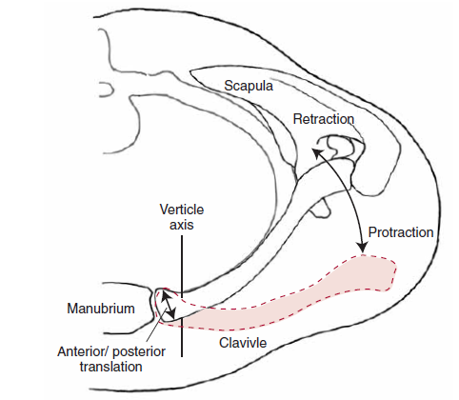
Protraction & retraction

Slide 37
2. Protraction and Retraction of the Clavicle
AXIS: Vertical (superoinferior) Axis.
PLANE: Transverse
MOTION: With protraction, the lateral clavicle rotates anteriorly, and with retraction, the lateral clavicle rotates posteriorly.
The posterior SC ligament and Costoclavicular ligament limit protraction and anterior SC ligament limits retraction.
RANGE: Protraction =15º to 20º
Retraction =15º to 30⁰

Slide 38
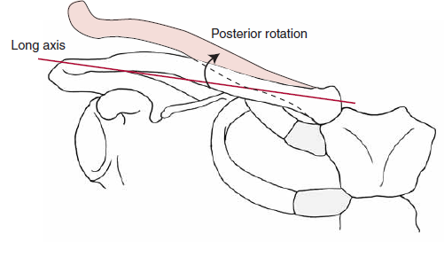
Rotation

Slide 39
3. Rotation of the Clavicle
Posterior rotation of the clavicle occurs as a spin.
MOTION: The clavicle rotates posteriorly from neutral, bringing the inferior surface of the clavicle to face anteriorly.
This is also known as backward or upward rotation.
It is essential for full upward rotation of the scapula and full shoulder elevation.
If rotation is prevented elevation of the arm is limited to 110⁰
RANGE: Posterior rotation is around 40⁰ to 50⁰

Slide 40
Kinematics and Kinetics
KINEMATICS: Deals with types of motion, without regard for the forces that produce that motion
Includes descriptors such as type of motion, direction of motion, and quantity of motion
OSTEOKINEMATICS: Concerns movements of bony partners that make up the joint. eg: flexion, abduction and their respective axes and planes
ARTHROKINEMATICS: focuses on the minute movements occuring within the joint and between the joint surfaces.
Eg: Roll, slide, spin
KINETICS : concentrates on the forces that produce or resist movement.

Slide 41
SC Arthrokinematics

Slide 42
SC Arthrokinematics
During elevation, superior roll of the clavicle with an inferior slide of the convex clavicle.
During depression, inferior roll of the clavicle with a superior slide on the sternum.
During protraction and retraction, clavicle’s surface is concave. It rolls anteriorly in protraction, and also slides anteriorly. In retraction, it rolls and slides posteriorly.
During rotation, spin of the clavicular head occurs about the disc.

Slide 43
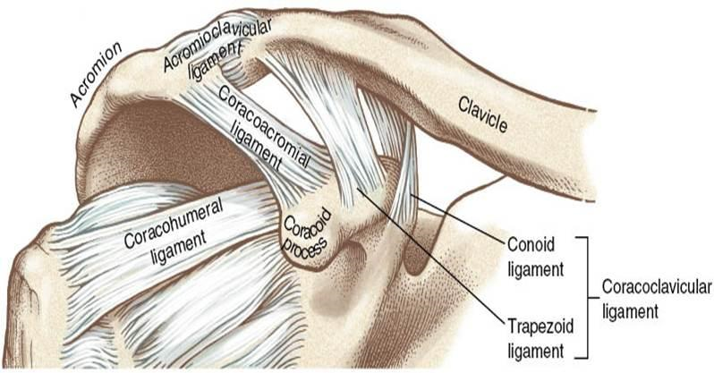
Acromioclavicular Joint

Slide 44
Acromioclavicular Joint
Plane synovial joint with three degrees of freedom. It has a joint capsule and two major ligaments.
The primary function: to allow the scapula to maintain contact with the thorax throughout its movement.
The AC joint motions are more subtle and provide for key adjustments of the scapula to allow continuity between the scapula and thorax during scapular movements.

Slide 45
Acromioclavicular and the coracoclavicular ligaments are the two ligaments.
The superior and inferior acromioclavicular ligaments reinforce the joint capsule.
The coracoclavicular ligament,is divided into a lateral portion, the trapezoid ligament, and a medial portion, the conoid ligament. Both portions limit upward rotation of the scapula at the AC joint.

Slide 46
Acromioclavicular Motions are described as the scapular movements of elevation-depression, abduction-adduction and upward/downward rotation.
Isolated movement of the AC joint is difficult to identify, during full arm elevation, AC joint contributes 20⁰ to 30⁰ of upward rotation of scapula

Slide 47
Scapulothoracic Joint
This is not a true joint as there are no bony articulations, the moving surfaces are called a false joint or a functional joint.
Normal function of the ST joint is essential for mobility and stability of the upper extremity.

Slide 48
Functions
Increasing the ROM of the shoulder to provide greater reach
Maintaining favourable length-tension relationship for the deltoid muscle to function above 90 degree of GH elevation to allow better shoulder joint stability
Provide GH stability for work in the overhead position
Providing for injury prevention through shock absorption of forces applied to the outstretched arm
Permitting elevation of the body as in walking with crutches, performing seated push-ups.

Slide 49
Scapulothoracic Joint kinematics
In full arm elevation (flexion or abduction) the scapula rotates upward 60⁰
Scapula’s motion results directly from movement SC and AC joints.

Slide 50
Motions of the Scapula
Elevation/Depression
Protraction/Retraction
Upward/Downward Rotation

Slide 51
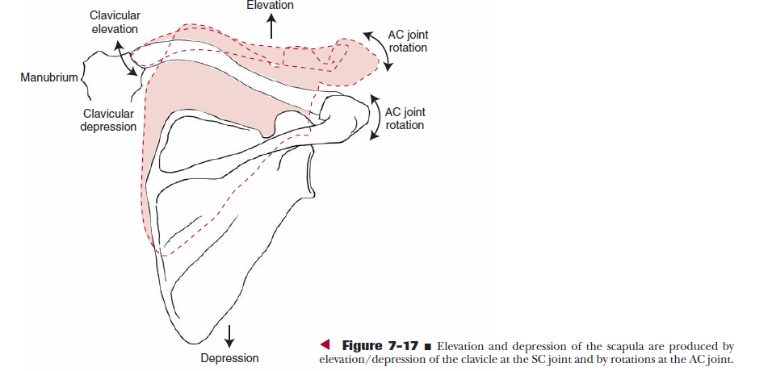
Scapular elevation and depression

Slide 52
Scapular elevation and depression
It’s the result of large motion of elevation at the SC joint and lesser motion at the AC joint.
Degrees of motion are 10 cm in elevation and 2cm in depression.

Slide 53
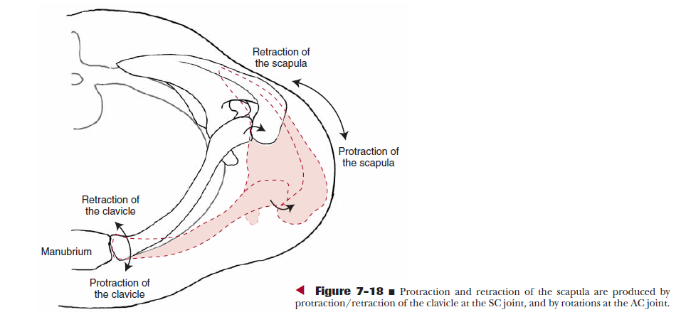
Scapular protraction and retraction

Slide 54
Scapular protraction and retraction
Both SC and AC joints move the scapula around the thoracic cage along a vertical axis.
The forward movement of the scapula occurs at the SC joint and adjustment to maintain the scapula on ribs occurs at the AC joint.
Degrees of motion are 10 cm in protraction and 5cm in retraction

Slide 55
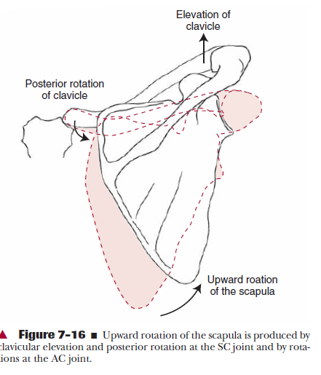
Scapular upward and downward rotation

Slide 56
Scapular upward and downward rotation
Upward rotation of the ST joint occurs around AP axis and provides 60⁰ of total shoulder elevation
This gives GH joint greater ability to position the hand for function in overhead activities.
Requires combined activity of SC and AC joints.
As the SC joint elevates the clavicle to raise the scapula, the AC joint upwardly rotates the scapula to complete scapular upward rotation and simultaneously maintain the scapula on the thorax.
The motions are reversed for downward rotation.

Slide 57
THANK YOU

