Slide 1
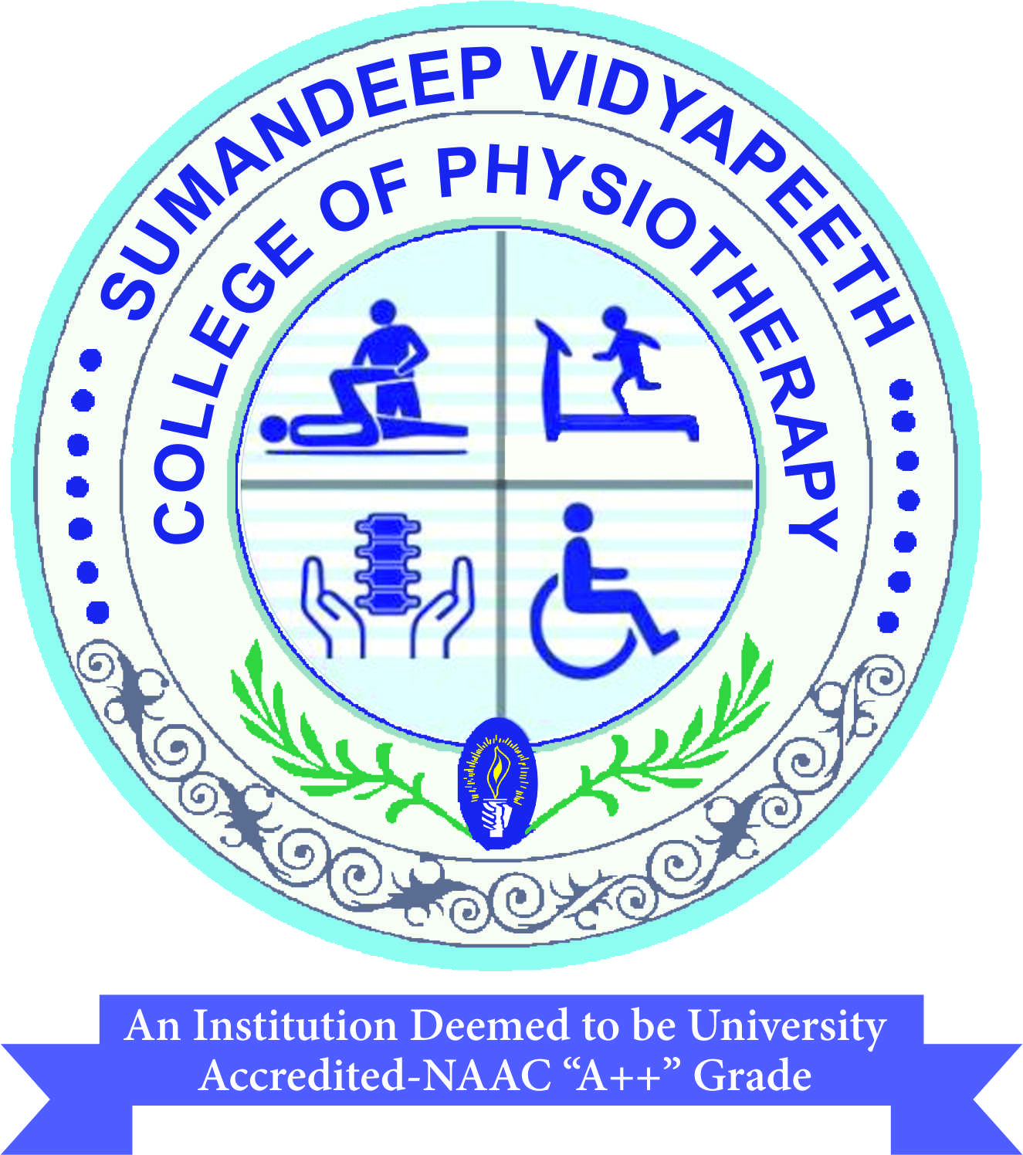

Superficial Heat
Dr Niketa Patel
BPT, MPT in Musculoskeletal Sciences, (PhD)
Fellowship in Sports Rehabilitation,
Assistant Prof.
COP, SVDU

Slide 2
Objectives
Definition of Heat
Different methods of heat transfers
Body temperature and its regulation
Mechanisms to cool down and warm up body.

Slide 3
Heat
Definition: A form of energy associated with the motion of atoms or molecules and capable of being transmitted through solid and fluid media by conduction, through fluid media by convection, and through empty space by radiation.

Slide 4
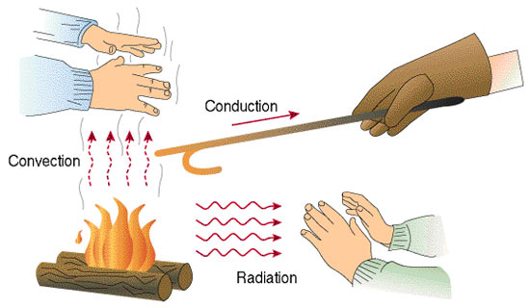
Heat transfer
Heat transfer takes place by 3 methods:
Conduction
Convention
Radiation

Slide 5
Thermal Energy Transfer
Thermal energy transfer is heat moving from a warmer object to a cooler object.
Thermal energy is energy possessed by an object or system due to the movement of particles within the object or the system.
This is known as thermal energy transfer.

Slide 6
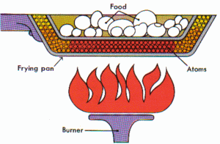
CONDUCTION
Heat is transferred from one particle of matter to another in an object without the movement of the object.
Conduction = CONTACT

Slide 7
Example of Conduction of
Heat
When you stir a hot soup with a spoon, the dipped end of spoon becomes hot.
Why?

Slide 8
Because the fast-moving particles of the fire collide with the slow-moving particles of the cool pot.
Because of these collisions, the slower particles move faster and heat is transferred.
Then the particles of the pot collide with the particles in the water, which collide with the particles at one end of the spoon.

Slide 9
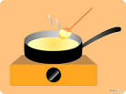
As the particles move faster, the metal spoon gets hotter. This process of conduction is repeated all along the metal until the entire spoon is hot.

Slide 10
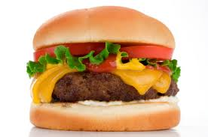
A piece of cheese melts as heat is transferred from the meat to the cheese (Contact)

Slide 11
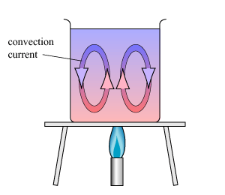
CONVECTION
Convection is the movement that transfers heat within fluids (liquids and gases).
Heat is transferred
by currents within the
Fluids (liquids and
gases).

Slide 12
CONVECTION (contd…)
Convection = VENTS (through air and liquid particles)

Slide 13
CONVECTION (contd…)
Have you ever noticed that the air near the ceiling is warmer than the air near the floor? Or that water in a pool is cooler at the deep end?
Examples: air movement in a home, pot of heating water. Why?

Slide 14
CONVECTION (contd…)
When the water at the bottom of a pot is heated, its particles move faster, and they also move farther apart. As a result, the heated water becomes less dense. A less dense fluid will float on top of a more dense one. Therefore, the heated water rises in the pot. The surrounding cooler water flows into its place.
This flow creates the circular motion as seen on which is known as convection currents.

Slide 15
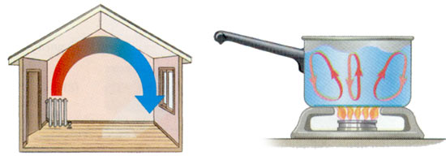

Slide 16
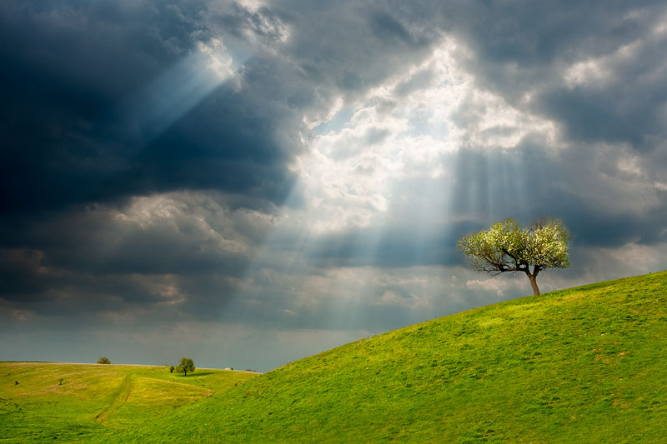
RADIATION
Radiation is the transfer of energy by electromagnetic waves
Radiation does NOT require medium to transfer thermal
energy.
Radiation = Radiates.
(heat coming from the
sun)

Slide 17
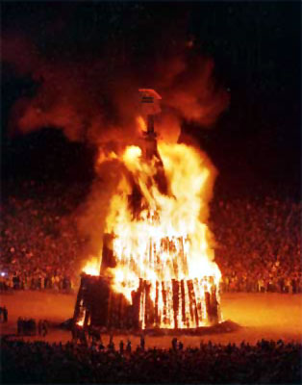
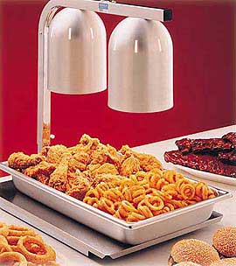
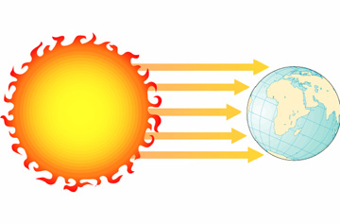
Examples of Radiation heat transfer
Radiation may come from other sources.
Examples:
Fire
Heat Lamps
Sun

Slide 18
Body temperature
The temperature within the deep tissues of the body (core temperature) is normally maintained within a range of 36.0°C to 37.5°C.
Body temperature reflects the difference between heat production and heat loss.

Slide 19
  Body heat is generated in the tissues of the body, transferred to the skin surface by the blood, and then released into the environment surrounding the body.

Slide 20
Body Temperature
Regulation
Body cells work best if they have the correct
  Temperature
  Water levels
  Glucose concentration
  Body has mechanisms to keep the cells in a constant environment.

Slide 21
It is called HOMEOSTASIS
DEFINITION: The maintenance of a constant environment in the body is called Homeostasis

Slide 22
All mammals maintain a constant body temperature.
Human beings have a body temperature of about 37ºC.
  E.g. If your body is in a hot environment your body temperature is 37ºC
  If your body is in a cold environment your body temperature is still 37ºC

Slide 23
Animals with a large surface area compared to their volume will lose heat faster than animals with a small surface area.

Slide 24
The thermoregulatory center is in the hypothalamus and functions to modify heat production and heat losses as a means of regulating body temperature.
  The thermoregulatory center in the hypothalamus regulates the core body temperature, not the surface temperature.

Slide 25
This center integrates input from cold and warm thermal receptors located throughout the body and generates output responses that conserve body heat or increase its dissipation = thermostatic set point.
  When body temperature begins to rise above the normal range, heat-dissipating behaviors are initiated.

Slide 26
When the temperature falls below the normal range, heat production is increased.
A core temperature greater than 41°C or less than 34°C usually indicates that the body’s ability to thermoregulate is impaired.

Slide 27
The bigger the Volume : Surface Area ratio
is, the faster heat will be lost.

Slide 28
What mechanisms are there to cool the body down?
Sweating:
When your body is hot, sweat glands are stimulated to release sweat.
The liquid sweat turns into a gas (it evaporates)
To do this, it needs heat.
It gets that heat from the skin.
As the skin loses heat, it cools down.

Slide 29
Sweating
v
The skin

Slide 30
2. Vasodilatation:
Our blood carries most of the heat energy around our body.
There are capillaries underneath the skin that can be filled with blood if body gets too hot.

Slide 31
This brings the blood closer to the surface of the skin so more heat can be lost.
  This is why you look red when you are hot!

Slide 32
This means more heat is lost from the surface
of the skin
If the temperature rises, the blood vessel dilates (gets bigger).

Slide 33
What mechanisms are there to warm the body up?
Vasoconstriction
This is the opposite of vasodilatation.
The capillaries underneath the skin get constricted (shut off).
This takes the blood away from the surface of the skin so less heat can be lost.

Slide 34
Piloerection
This is when the hairs on your skin “stand up” .
It is sometimes called “goose bumps” or “chicken skin”!
The hairs trap a layer of air next to the skin which is then warmed by the body heat
The air becomes an insulating layer.

Slide 36
THANK YOU

