Slide 1


Pulmonary function test
Dr. Nirali Pandya (PT)

Slide 2
Introduction
Pulmonary function tests or lung function tests are useful in assessing the functional status of the respiratory system both in physiological and pathological conditions.
Lung function tests are based on the measurement of volume of air breathed in and out in quiet breathing and forced breathing. These tests are carried out mostly by using spirometer.

Slide 3
Pulmonary function test helps in evaluation of mechanical function of the lungs
When perform test actual result are compare with the predicted value expected of person’s gender, age, height.

Slide 4
indications
DIAGNOSTIC
Evaluation of signs & symptoms‐
BLN, chronic cough, exertional dyspnea
Screening at risk patients
Measure the effect of diseases on pulmonary function
To assess preoperative risk
Monitor pulmonary drug toxicity

Slide 5
indications
PROGNOSTIC
Assess severity
Follow response to therapy
Determine further treatment goals
Evaluating degree of disability

Slide 6
types
BED SIDE PULMONARY FUNCTION TESTS
• STATIC LUNG VOLUMES & CAPACITIES – VC, IC, IRV, ERV, RV, FRC.
• DYNAMIC LUNG VOLUMES –FVC, FEV1, FEF 25‐75%, PEFR, MVV.

Slide 7
Lung volumes
The lung has four volumes:
Tidal Volume,
Inspiratory reserve volume (IRV),
Expiratory reserve volume (ERV),
Residual volume (RV)

Slide 8
Lung volumes
TV is the normal breath.
IRV is the maximal amount of air that can be inhaled from the end of a normal inspiration.
ERV is the maximal amount of air that can be expired after a normal exhalation.
RV is the volume of gas that remains in the lungs at the end of a maximum expiration.

Slide 9
Lung capacities
A lung capacity is two or more volumes added together.
The capacities include :
Total lung capacity (TLC),
Vital capacity (VC),
Inspiratory capacity(IC)
Functional residual capacity (FRC).

Slide 10
Total lung capacity
TLC is the amount of gas the lung contains at the end of a maximum inspiration.
It is made up of all four lung volumes.
An increased TLC is seen with hyperinflation such as emphysema.
A decrease in TLC may be seen in restrictive lung disease such as pulmonary fibrosis, atelectasis, neoplasms, pleural effusions, and hemothorax, as well as in restrictive musculoskeletal problems such as spinal cord injury, kyphoscoliosis, or as secondary to morbid obesity or pregnancy.

Slide 11
Vital capacity
VC is the maximum amount of gas that can be expelled from the lungs by forceful effort following a maximum inspiration.
It contains the IRV, TV, ERV.
A decrease in VC can occur as a result of absolute reduction in distensible lung tissue. This is seen in pneumonectomy, atelectasis, pneumonia, pulmonary congestion, occlusion of a major bronchus by a tumor or foreign object, or restrictive lung disease.

Slide 12
IC and FRC
IC is the maximal amount of air that can be inspired from the resting expiratory level. It contains the IRV and the TV.
FRC is the volume of air remaining in the lungs at the resting expiratory level. It contains the ERV and the RV.
An increase in FRC represents hyperinflation of the lungs.

Slide 13
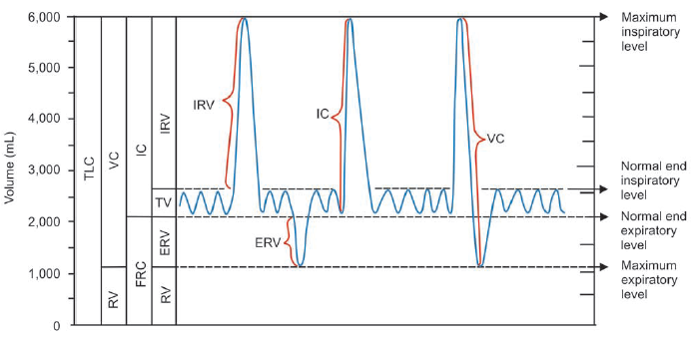
Spirogram

Slide 14
Helium dilution method
Respirometer is filled with air containing a known quantity of helium. Initially, the subject breathes normally. Then, after the end of expiration, subject breathes from respirometer. Helium from respirometer enters the lungs and starts mixing with air in lungs.
After few minutes of breathing, concentration of helium in the respirometer becomes equal to concentration of helium in the lungs of subject. It is called the equilibration of helium. After equilibration of helium between respirometer and lungs, concentration of helium in respirometer is determined.
FRC =V (C1 – C2)/C2.

Slide 15
Nitrogen washout method
Subject is asked to breathe normally. At the end of normal expiration, the subject inspires pure oxygen through a valve and expires into a Douglas bag. This procedure is repeated for 6 to 7 minutes, until the nitrogen in lungs is displaced by oxygen. Nitrogen comes to the Douglas bag.
FRC =C1 × V/C2
Where,
V = Volume of air collected
C1 = Concentration of nitrogen in the collected air
C2 = Normal concentration of nitrogen in the air.

Slide 16
Whole body plethysmography
Whole body plethysmograph is the instrument used to measure the lung volumes including residual volume.
Plethysmography is based on Boyle’s law of gas, which states that the volume of a sample of gas is inversely proportional to the pressure of that gas at constant temperature.
Subject sits in an airtight chamber of the whole body plethysmograph and breathes normally through a mouthpiece connected to a flow transducer called pneumotachograph.

Slide 17
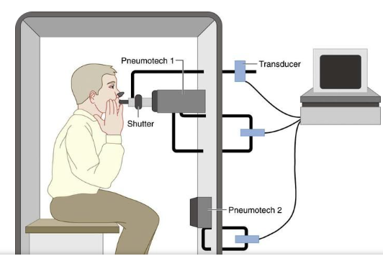
Whole body plethysmography

Slide 18
Whole body plethysmography
It detects the volume changes during different phases of respiration. After normal breathing for few minutes, the subject breathes rapidly with maximum force. During maximum expiration, the lung volume decreases very much. But volume of gas in the chamber increases with decrease in pressure.
By measuring the volume and pressure changes inside the chamber, volume of lungs is calculated by using the formula:
P1 × V = P2 (V – Δ V)

Slide 19
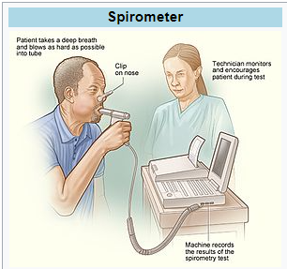
Spirometer

Slide 20
Spirometer
FEV1- the volume expired in the first second of maximal expiration after a maximal inspiration.
FVC – the maximum volume of air which can be exhaled after a maximal inspiration.
FEF 25-75% – the average flow rate in L/sec during the middle half of an FVC.
Peak expiratory flow rate (PEFR) - the maximal flow rate attainable during an FVC maneuver

Slide 21
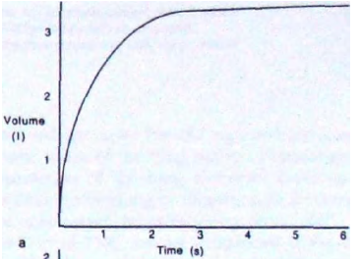
spirogram
In the normal spirogram the major part of the vital capacity (FVC) is expelled in 1 s (FEV,).

Slide 22
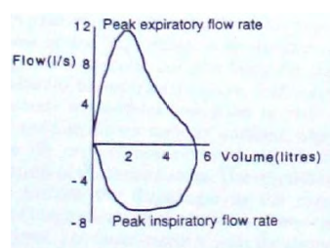
Peak expiratory flow rate

Slide 23
Flow volume curve
The flow volume curve is helpful in diagnosing lung disease, since it is independent of effort.
The curve demonstrates that flow rises to a high value and then declines over most of expiration.

Slide 24
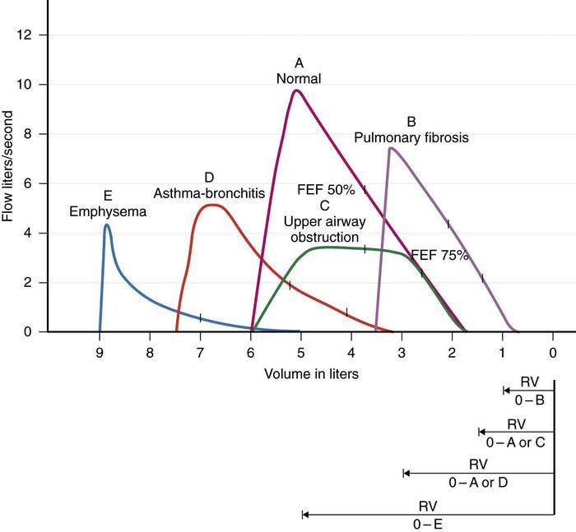
Flow volume curve

Slide 25
Flow volume curve
In restrictive lung disease the maximum flow rate is decreased, as is the total volume exhaled.
In obstructive lung disease, the flow rate is low in relation to lung volume, and a scooped out appearance is often seen.

Slide 26
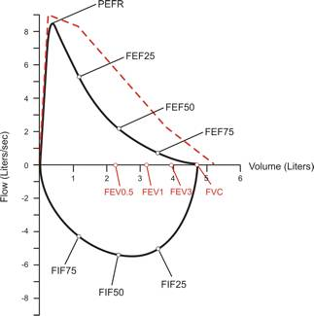
Flow volume loop
It is a graphic analysis of the flow generated during a forced expiratory volume maneuver followed by a forced inspiratory maneuver.

Slide 27
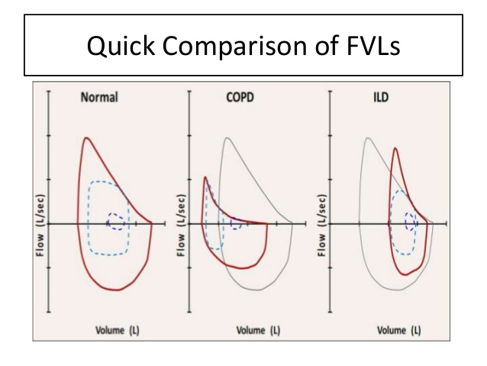
Flow volume loop

Slide 28
Maximal voluntary ventilation
It measures the maximal breathing capacity of the patient.
It reflects strengths and endurance of the respiratory muscles.
The patients is asked to pant for 15 secs into the spirometer tubing.
This is often examined preoperatively with the other results to determine a patient’s prognosis for success after surgery, such as his or her ability to cough, to take deep breaths and to enhance airway clearance.

Slide 29
PFT findings
 |  | OBSTRUCTIVE | RESTRICTIVE
1 | FEV1 |  |  or Normal
2 | FVC |  or Normal | 
3 | FEV1/FVC |  | Or Normal
4 | RV |  | 
5 | TLC |  | 
6 | FRC |  | 

Slide 30
References
Donna Frownfelter and Elizabeth Dean. Principles and practice of Cardiopulmonary Physical Therapy. 3rd ed.
Jennifer A. Pryor and S. Ammani Prasad. Physiotherapy for Respiratory and Cardiac Problems. 3rd ed.

Slide 31
THANK YOU

