Slide 1
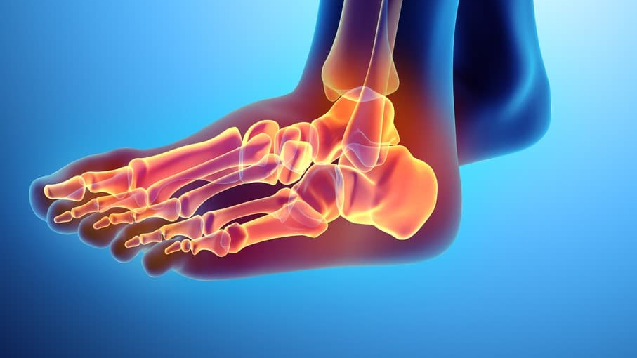
PLANTAR FASCIITIS
DR PURVI PATEL

Slide 2
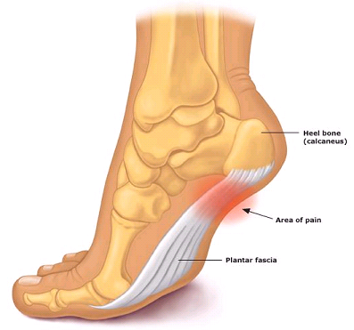
INTRODUCTION
Plantar fasciitis is a common painful disorder affecting the heel and underside of the foot.
This is a common cause of pain in the heel.
The pain is caused by degenerative irritation at the insertion of the plantar fascia on the medial process of the calcaneal tuberosity.

Slide 3
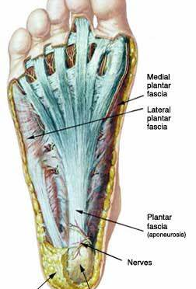
ANATOMY
The planter fascia is a thickened fibrous aponeurosis that originates from the medial tubercle of the calcaneus, runs forward to insert into the deep, short transverse ligaments of the metatarsal heads, dividing into 5 digits bands at the metatarsophalangeal joint.

Slide 4
PATHOPHYSIOLOGY
Excessive stretching of the planter fascia can result in microtrauma of this structure either along its course or where it inserts.
The development of micotrauma with resulting damage at fascia.
This microtrauma, if repetitive can result in chronic degeneration of the planter fascia fibers. The loading of the degenerative and healing tissue at the planter fascia may cause planter pain particularly with the first few steps after sleep or other periods of inactivity.

Slide 5
EPIDEMIOLOGY
It is more common in 40-60 years of age and women are more affected than men

Slide 6


SYMPTOMS
Pain : is worst early in the morning and often improves with activity.
It can triggered by long period of standing or getting up from seated position.

Slide 7
EXAMINATION
HISTORY :
Planter\ calcaneal pain
Heel pain and tightness after standing up from bed in the morning or after being seated for prolong period
Barefoot walking on hard surface cause increase heel pain
Heel pain occur after prolonged standing / walking/ running

Slide 8
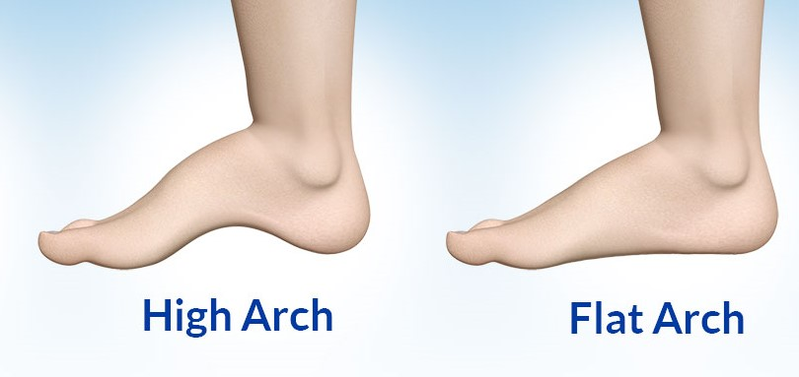
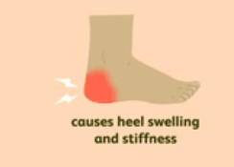
OBSERVATION :
High arch
Flat foot
Local swelling in the bottom of the foot may be present , which may mean there is tearing in the planter fascia
Abnormal gait

Slide 9
PALPATION : There is marked tenderness over the medial aspect of the calcaneal tuberosity, at the site of attachment of planter fascia.
Tight achilles tendon or calf
PAIN is felt over the inner aspect of the sole or heal In all weight bearing situations.
Discomfort in the proximal planter fascia with passive ankle/ first toe dorsiflexion

Slide 10
MANAGMENT
CONSERVATIVE TREATMENT :
Reduce pain and inflammation
by taking off the irritating focus of the strain of weight bearing. E.g. heel raised walking while getting down from bed in the morning or after long sitting.
Modalities- US, ice, heat
Relieving strain from the fascia by providing an appropriate wedge in the shoe.
Faradism can be effective to induce contraction in the intrinsic muscle.

Slide 11
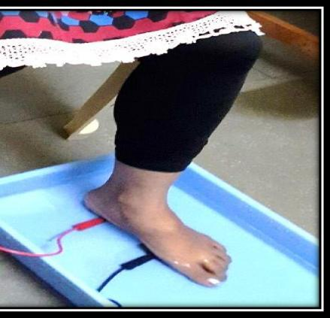
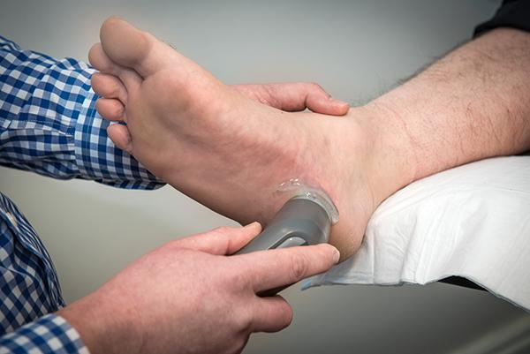

Slide 12
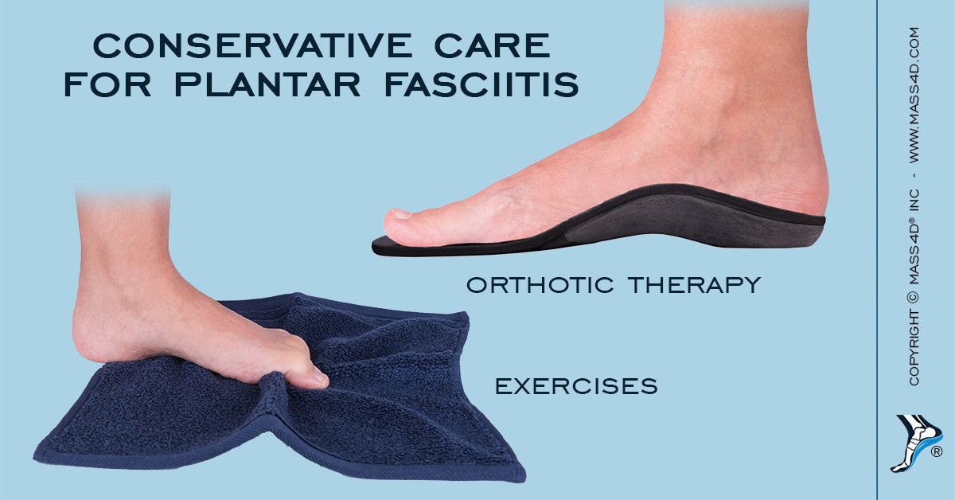
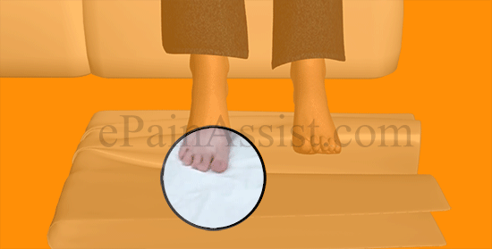

Slide 13
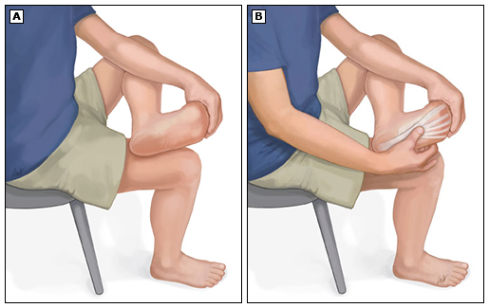
Strengthening exercises to the intrinsic muscles as toe curling , calf strengthening resistive exercise.
Plantar fascia stretching
Rest and activity modification

Slide 14
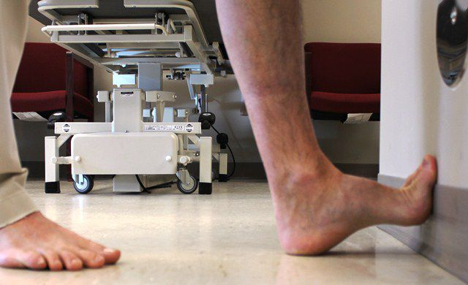
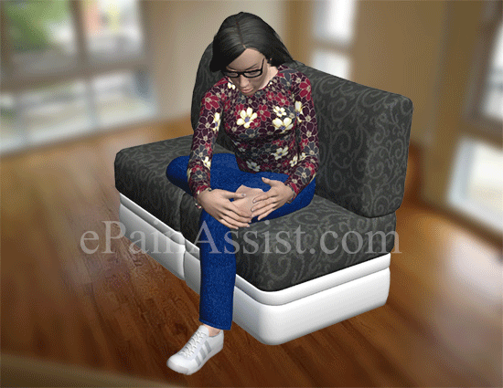

Slide 15
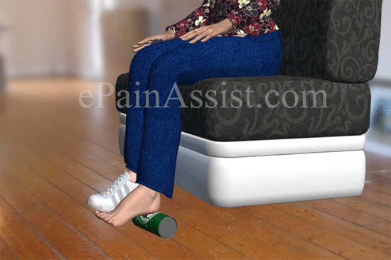
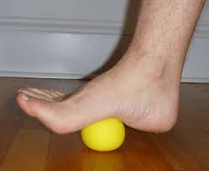

Slide 16
DRUG THERAPY
Acetaminophen or nonsteroid anti- inflammatory drugs
Corticosteroid injections

Slide 17
SIX OR MORE MONTHS OF CONSERVATIVE TREATMENT INEFFECTIVE
Treatment option for chronic recalcitrant planter fasciitis
Planter fasciotomy

Slide 18
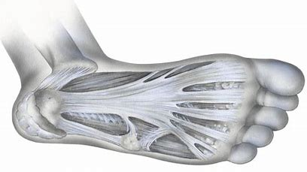
THANK YOU

