Slide 1


Chondromalacia Patella

Slide 2
Definition
Chondromalacia patella is defined as softening of the articular cartilage of the patella of diverse (many and different) origin.
Most commonly, it is recognized as involving the extensor mechanism of the knee and accordingly is often referred to as chondromalacia of the patella, patellofemoral syndrome, or runner's knee

Slide 3
The undersurface of the patella is covered with hyaline cartilage that articulates with the hyaline cartilage covered femoral groove (trochlear groove).
Post-traumatic injuries, microtrauma wear and tear, and iatrogenic injections of medication can lead to the development of chondromalacia.

Slide 4
Etiology
Chondromalacia is associated with abnormal (microtrauma) wear and tear of the patellofemoral joint's hyaline cartilage.
Lateral positioning of the patella in the patella-femoral joint is a frequent cause of chondromalacia.
It is also seen as a complication of injuries, immobilization, and surgical procedures that lead to quadriceps atrophy. The cause is the micro-trauma created by the decreased pull of the quadriceps muscle on the patella.

Slide 5
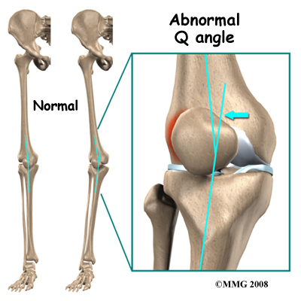
Flat feet cause an increased valgus orientation of the knee cause increased lateral wear of the patellofemoral joint.

Slide 6
Epidemiology
Women are more affected
Active young adults who participate in running sports or workers who increase stress in their patellofemoral joint by repeated stair climbing and/or kneeling have a higher incidence of chondromalacia.

Slide 7
Symptoms
Anterior knee pain is the most common chief complaint of patients with chondromalacia. This pain is usually made worse with activities that increase the stress on the patellofemoral joint, for example, stair climbing, squatting, and running.
Spontaneous Pain in front of knee/ beneath the knee cap
Aggravated by activity/descending stairs/standing after prolonged sitting with knees flexed

Slide 8
Signs
Mal-alignment /tilting of patella
Quadriceps wasting
Effusion
Crepitus on moving the knee
Tenderness under the edge of the patella

Slide 9
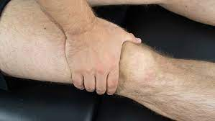
Special test
Clarke’s sign(Patellar grind test)

Slide 10
Outerbridge’s grading system
Grade 1 – softening and swelling
Grade 2 – fissuring
Grade 3 – fibrillation
Grade 4 – erosive changes and exposure of the subchondral bone

Slide 11
Imaging
X Rays –
  Lateral view with knee half flexed
  Skyline views at 30⁰, 60⁰ & 90⁰ of flexion
Axillary radiograph determines which facet is involved
Diagnosis is made easy only with Arthroscopy
Arthroscopy is useful to find other causes of anterior knee pain. Also to know presence and extent of the lesion and probing of patella with soft probe.

Slide 12
Treatment
Conservative
  Medical / Pharmacological
  Physiotherapy
Operative

Slide 13
Conservative Rx
Ice Application
Physiotherapy
Avoid stressful activities
Stretching and strengthening quadriceps 15 mins 4 times/day – Quad sets, (bicycling, pool running, swimming, flutter kick)
Aspirin / Ibuprofen / Naproxen
Support for a valgus foot
Steroids best avoided

Slide 14
Physiotherapy Aim
To relief pain
To restore soft tissue (muscle) imbalance
To strengthen the weak muscle
To stabilize and protect the joint
To prevent recurrence

Slide 15
To reduce pain
Thermotherapy (Heat or Cold)
U.S. therapy (3Mhz,Continous mode and 0.8W/cm2)
Soft tissue and joint mobilization

Slide 16
Strengthening exercise
Target muscles –
  Hip – Extensor, abductor
  Knee – quadriceps
Mode of strengthening –
  Sand bag/ weight cuff
  Theraband
  Functional training
Type of exercise –
  PRE with OCK and CKC mixed

Slide 17
Joint Mobilization
Target joint –
  Patello-femoral joint
Techniques –
  Oscillatory or stretch technique
Dosage:
  Grade I or 2 for pain relief
  Grade 3 or 4 for ROM
  10 x 3 sets
Glides (based on the abnormal position) –
  Medial, Infero-medial or any other combinations

Slide 18
Strengthening Exercises
Short-arc extensions
  Patient position – sitting up or lying down.
  Use a rolled-up towel to support your thigh while you keep your leg and foot in air for 5-10 seconds.
  Lower your foot as you bend your knee slowly.
  Repeat 10 times for each leg, twice a day.

Slide 19
Strengthening Exercises
Straight-leg raises
  Patient position – supine
  Lift your whole lower limb at the hip with the knee extended, and keep it up in the air for 5-10 seconds, then lower slowly.
  Repeat 10 times for each leg, twice a day.

Slide 20
Strengthening Exercises
Quadriceps isometric exercises –
  Patient position – sitting with extended legs.
  Tighten your quadriceps muscles by pushing the knees down onto the floor.
  Hold for 5-10 seconds. Repeat 10 times each leg, twice a day.

Slide 21
Strengthening Exercises
Stationary bicycling –
  Low tension setting improves ex tolerance without stressing knee.
  Adjust seat high enough so that your leg is straight on the down stroke.
  Start with 15 minutes a day & work up to 30 minutes a day.

Slide 22
Thank you

