Slide 1


Biomechanics of Thorax
Dr. Priyanshi Pandya (PT)

Slide 2
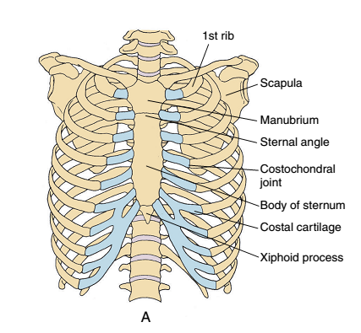
Introduction
The thorax, consisting of the thoracic vertebrae, the ribs, and the sternum has several important functions.

Slide 3
Function
It provides a base for the muscle attachment of the upper extremities, the head and neck, the vertebral column, and the pelvis.
The thorax also provides protection for the heart, lungs, and viscera. Therefore, there needs to be a certain amount of inherent stability to the thorax.
The structure of the rib cage significantly increases the stability of the thoracic spine in flexion/extension, lateral bending, and rotation.

Slide 4
The most important function of the chest wall is its role in ventilation.
The process of ventilation depends on the mobility of the bony rib thorax and the ability of the muscles of ventilation to move it.

Slide 5
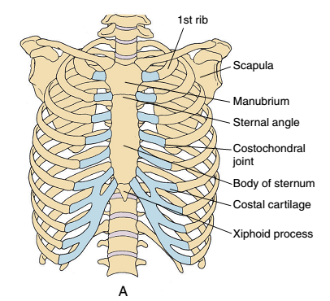
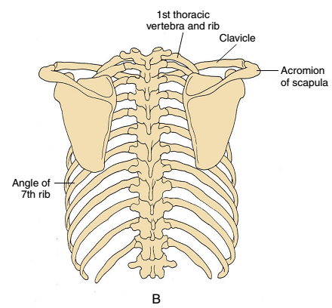
Rib cage

Slide 6
The rib cage is a closed chain that involves many joints and muscles.
The anterior border of the rib cage is the sternum, the lateral borders are the ribs, and the posterior border is formed by the thoracic vertebrae.
The superior border of the rib cage is formed by the jugular notch of the sternum, by the superior borders of the first costocartilages, and by the first ribs and their contiguous first thoracic vertebra.
The inferior border of the rib cage is formed by the xiphoid process, the shared costocartilage of ribs 6 through 10, the inferior portions of the 11th and 12th ribs, and the 12th thoracic vertebra

Slide 7
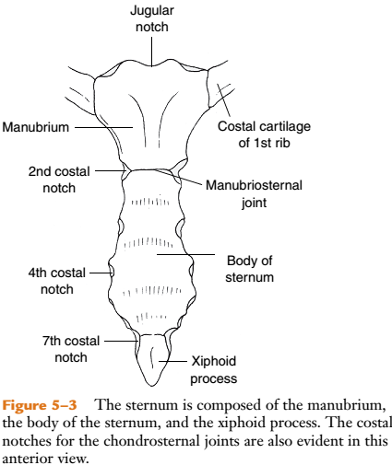
Sternum
The sternum is an osseous protective plate for the heart and is composed of the manubrium, body, and
xiphoid process

Slide 8
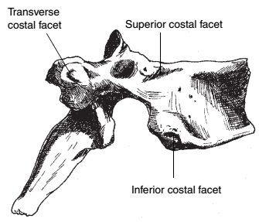
Vertebrae
There are 12 thoracic vertebrae that make up the posterior aspect of the rib cage
Vertebral body and transverse processes have total of 6 costal articulating surfaces.
4 on the body (a superior and an inferior costal facet,or demifacet, on each side)
1 costal facet on each transverse process

Slide 9
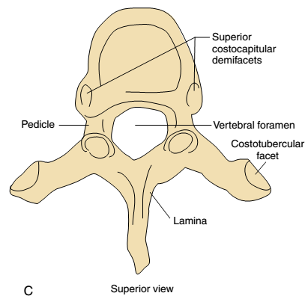
Thoracic vertebrae

Slide 10
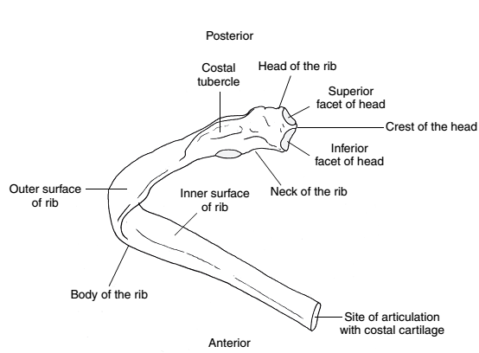
Ribs
The rib cage also includes 12 pairs of ribs. The ribs are curved flat bones.
The posteriorly located head of each rib articulates with thoracic vertebral bodies and the costal tubercles of ribs 1 to 10 also articulate with the transverse processes of a thoracic vertebra.
Anteriorly, ribs 1 to 10 are joined either
directly or indirectly to the sternum through their costal cartilages

Slide 11
True ribs
Ribs 1 through 7 are classified as vertebrosternal (or “true”) ribs because each rib, through its costo-cartilage, attaches directly to the sternum.

Slide 12
False ribs
The costo-cartilage of ribs 8 through 10 articulates with the costocartilage of the superior rib, indirectly articulating with the sternum via rib 7. These ribs are classified as vertebrochondral (or “false”) ribs.
The 11th and 12th ribs are called vertebral (or “floating”) ribs because they have no anterior attachment to the sternum

Slide 13
Articulations of the Rib Cage
The articulations that join the bones of the rib cage include the
  Manubriosternal,
  Xiphisternal,
  Costovertebral,
  Costotransverse,
  Costochondral,
  Chondrosternal and
  Interchondral joints

Slide 14
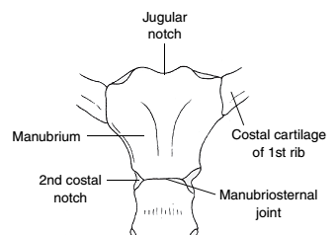

Manubriosternal and Xiphisternal Joints
The manubrium and the body of the sternum articulate at the manubriosternal joint.
Also known as the sternal angle or the angle of Louis and is readily palpable as a horizontal ridge at the level of the
second ribs’ anterior attachments.
The manubriosternal joint and xiphisternal joint are synchondrosis.
The xiphoid process joins the inferior aspect of the sternal body at the xiphisternal joint.

Slide 15
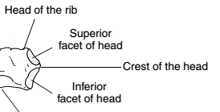
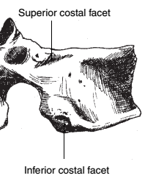
Costovertebral Joints
The typical costovertebral joint is a synovial joint formed by the head of the rib, two adjacent vertebral bodies, and the interposed intervertebral disc.
Ribs 2 through 9 have typical costovertebral joints
Each rib’s superior facet articulates with the inferior facet of the vertebrae above it. Each rib’s inferior facet articulates with the superior facet of its own numbered vertebrae
Ribs 1, 10, 11, and 12 are atypical ribs because they articulate with only one vertebral body and are numbered by that body.

Slide 16
Ligaments
Costovertebral joint is divided into two cavities by interosseous or intra-articular ligament, it extends from the crest of the head of the rib and attaches to annular fibrosus of the inter vertebral disc.
The radiate ligament is located within the capsule, with firm attachments to the anterolateral portion of the capsule.
The superior band, which attaches to the superior vertebra; the intermediate band, which attaches to the intervertebral disc; and the inferior band which attaches to inferior vertebra.
A fibrous capsule surrounds the entire articulation of each costovertebral joint.
The atypical costovertebral joints of ribs 1, 10, 11, and 12 are more mobile than the other. The interosseous ligament is absent in these joints.

Slide 17
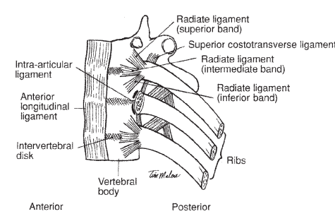

Slide 18
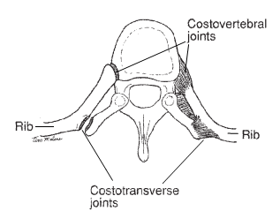

Slide 19
Costotransverse Joints
The costotransverse joint is a synovial joint formed by the articulation of the costal tubercle of the rib with a costal facet on the transverse process of the corresponding vertebra.
There are 10 pairs of CT joints articulating vertebrae T1 through T10 with the rib of the same number.

Slide 20
Ligaments
The costotransverse joint is surrounded by a thin, fibrous capsule.
Lateral costotransverse ligament,
  short, stout band located between the lateral portion of the costal tubercle and the tip of the corresponding transverse process
Costotransverse ligament,
  short fibers that run within the Costotransverse foramen between the neck of the rib posteriorly and the transverse process at the same level.
Superior costotransverse ligament
  Runs from the crest of the neck of the rib to the inferior border of the cranial transverse process.

Slide 21
Costochondral and Chondrosternal Joints
The costochondral joints are formed by the articulation of the 1st through 10th ribs antero-laterally with the costal cartilages.
This joint is synchondrosis and has no ligament support.
The chondrosternal joints are formed by the articulation of the costal cartilages of ribs 1 through 7 anteriorly with the sternum.

Slide 22
Costochondral and Chondrosternal Joints
Rib 1 attaches to the lateral facet of the manubrium, rib 2 is attached via two demifacets at the manubriosternal junction, and ribs 3 through 7 articulate with the lateral facets of the sternal body.
The chondrosternal joints of ribs 1, 6, and 7 are synchondroses.
The chondrosternal joints of ribs 2 through 5 are synovial joints.
The chondrosternal joints of ribs 1 through 7 have capsules.

Slide 23
Ligaments
Ligamentous support for the capsule includes anterior and posterior radiate costosternal ligaments.
The sternocostal ligament is an intra-articular ligament, similar to the intra-articular ligament of the costovertebral joint, that divides the two demifacets of the second chondrosternal joint.
The costoxiphoid ligament connects the anterior and posterior surfaces of the seventh costal cartilage to the front and back of the xiphoid process.

Slide 24
Interchondral Joints
The costal cartilages of ribs 7 through 10 each articulate with the cartilage immediately above them to form the interchondral joints.
The interchondral joints are synovial joints and are supported by a capsule and interchondral ligaments.

Slide 25
Kinematics of the ribs and manubrio-sternum
Movement of the thorax is possible by
  Types and angles of articulation
  Movement of the manubrio-sternum
  The elasticity of the costal cartilages

Slide 26
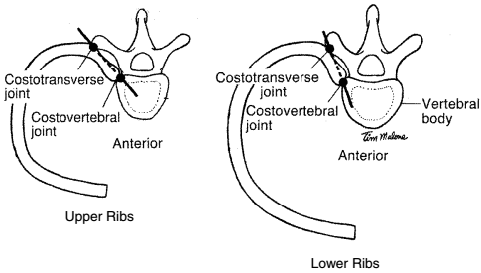
Ribs
The costovertebral and costotransverse joints are mechanically linked, with a single axis of motion for elevation and depression passing through the centres of both joints.

Slide 27
This axis for the upper ribs lies close to the frontal plane, allowing thoracic motion predominantly in the sagittal plane.
The axis of motion for the lower ribs is nearly in the sagittal plane, allowing for thoracic motion predominantly in the frontal plane.
The axis of motion for the 11th and 12th ribs passes through the CV joint only, because there is no CT joint present. The axis of motion for these last two ribs also lies close to the frontal plane.

Slide 28
Pump handle movement
During inspiration, the costovertebral joint moves superiorly and posteriorly, elevating the first rib.
In the upper ribs 2-7, most of the movement occurs at the anterior aspect of the rib.
The costal cartilage becomes more horizontal.
The movement of the ribs pushes the sternum ventrally and superiorly
The excursion of the manubrium is less than that of the body of the sternum because the first rib is the shortest, with the caudal ribs increasing in length until rib 7.
The greatest effect of the motion of the upper ribs and sternum is the increase in the anteroposterior (A-P) diameter of the thorax. This combined rib and sternal motion that occurs in a predominantly sagittal plane has been termed the “pump-handle” motion of the thorax.

Slide 29
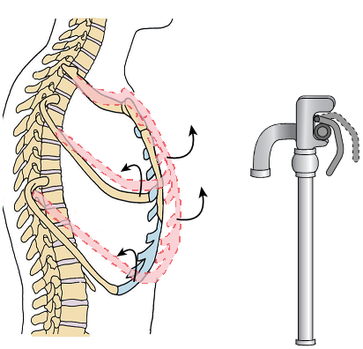

Slide 30
Bucket handle movement
Elevation of ribs 8 through 10 occurs about an axis of motion lying more towards the sagittal plane.
The lower ribs have a more angled shape and an indirect attachment anteriorly to the sternum.
It allow the lower ribs more motion at the lateral aspect of the rib cage.
The greatest effect of the elevation of the lower ribs is the increase in the transverse diameter of the lower thorax. This motion that occurs in a more frontal plane has been termed the “bucket-handle” motion of the thorax

Slide 31
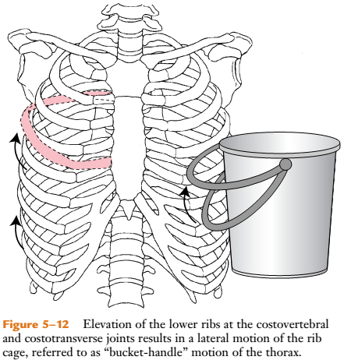

Slide 32
THANK YOU

