Slide 1


NORMAL DEVELOPMENT OF CHILD
Dr. Dhwani Chanpura
Assistant Professor
College of Physiotherapy
Sumandeep Vidyapeeth

Slide 2
NORMAL DEVELOPMENT
Child development is a process where every child goes through. This process involves learning and mastering skills like sitting, walking, talking,etc,...These skills, called developmental milestones, appear at predictable time periods.

Slide 3
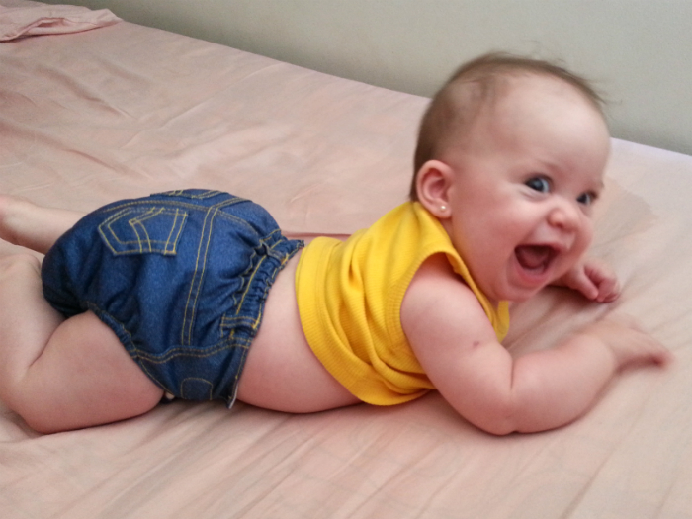
1) Gross Motor Milestone:
3 Months
Prone
Head compensates when held in ventral suspension.
Lifts head when resting on forearm.
On verge of rolling to supine.
Head rotates and extends.

Slide 4

Supine
Symmetrical head and arm posture.
Rolls part way to side.

Slide 5
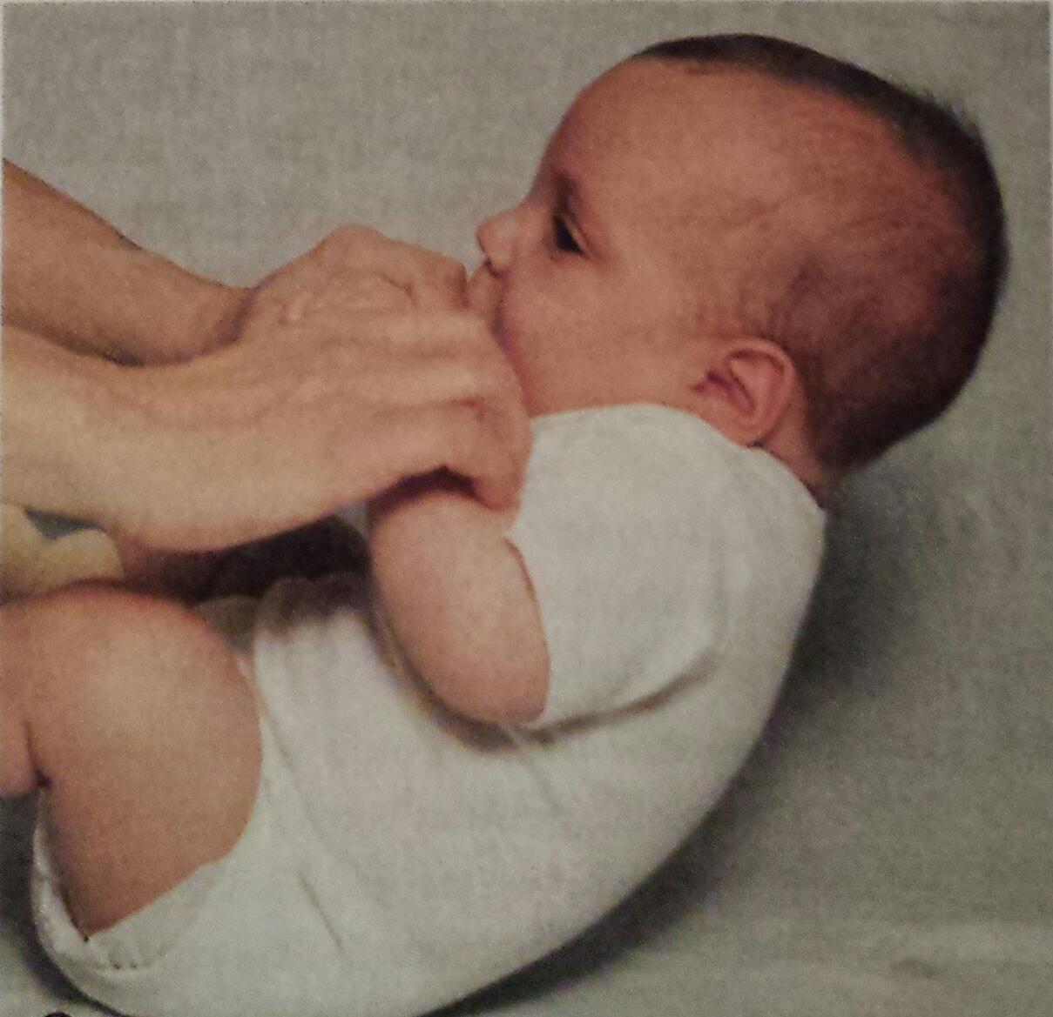
Supported Sitting
Slight head lag when pulled to sitting
Head steady lumbar curve

Slide 6
Supported Standing
Bears small fraction of weight on legs briefly

Slide 7

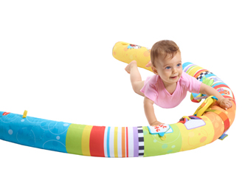
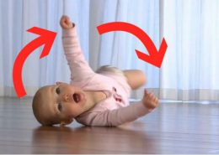

6 Months

Slide 8
6 Months
Prone:
Legs and arms extended, weight on Hands.
Lifts arm with stimultion
Rolls to supine
Circular pivoting

Slide 9

Supine
Lifts Head
Rolls to prone

Slide 10
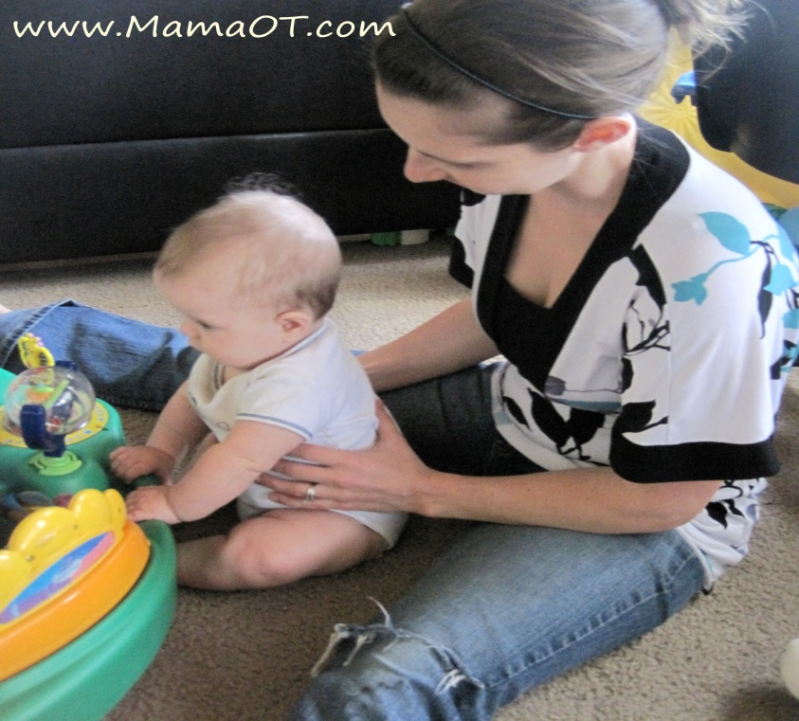
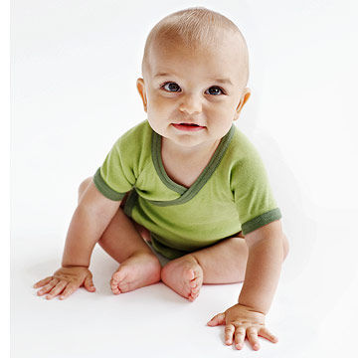
Supported Sitting
Lifts head and assists in pull to sitting
Holds head erect when leaning forward
Active in supported sitting
Sit momentarily, leaning on hands

Slide 11
Supported Standing
Bears large fraction of weight on legs and bounces.

Slide 12

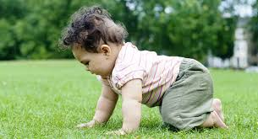
9 Months
Prone
Assumes hand knee creeping position
Creeps on all fours

Slide 13

Sitting
Sits independently, unsupported
Assumes sitting without assistance

Slide 14
Standing
Pulls to standing at rail or furniture
Lowers to floor at rail or furniture

Slide 15
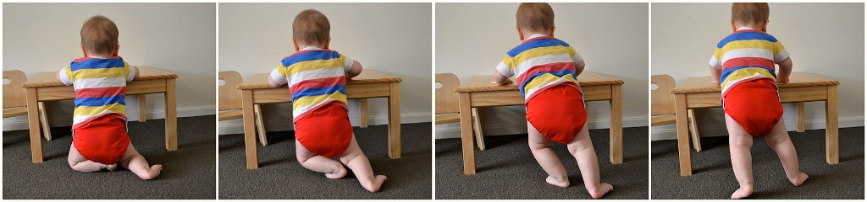

Slide 16
12 Months
Pivots in sitting-
Cruises at rail
Walks with one hand held
Creeps or hitches upstairs

Slide 17

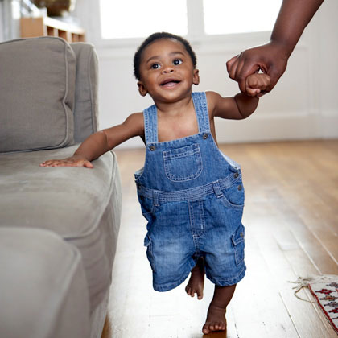
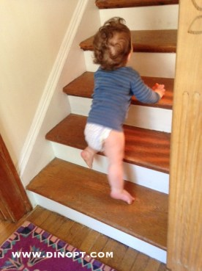

Slide 18
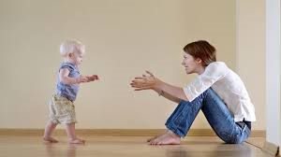
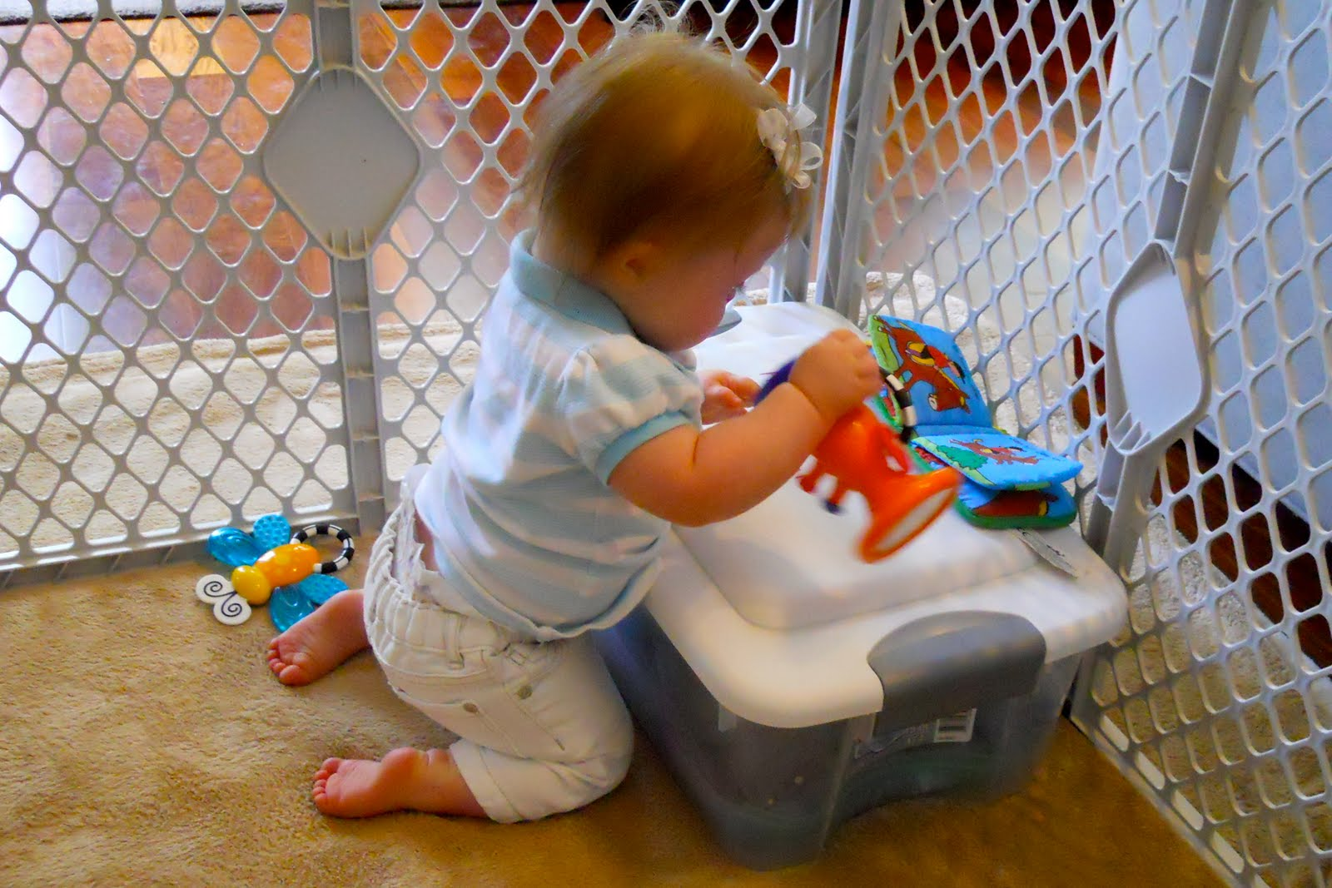
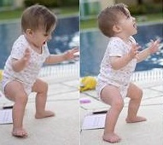
15 Months

Slide 19
15 Months
Walks alone several steps
Assumes and maintain kneeling balance
Falls by sitting
Rises to standing independently

Slide 20
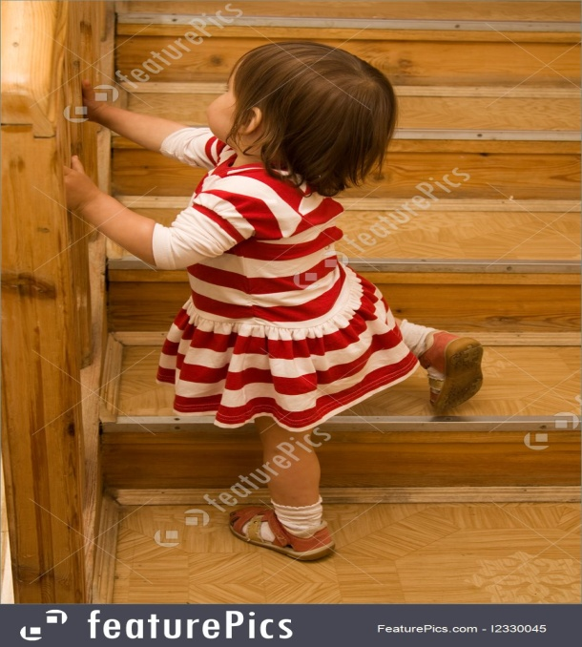
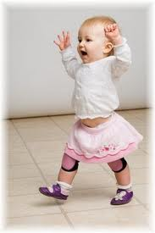
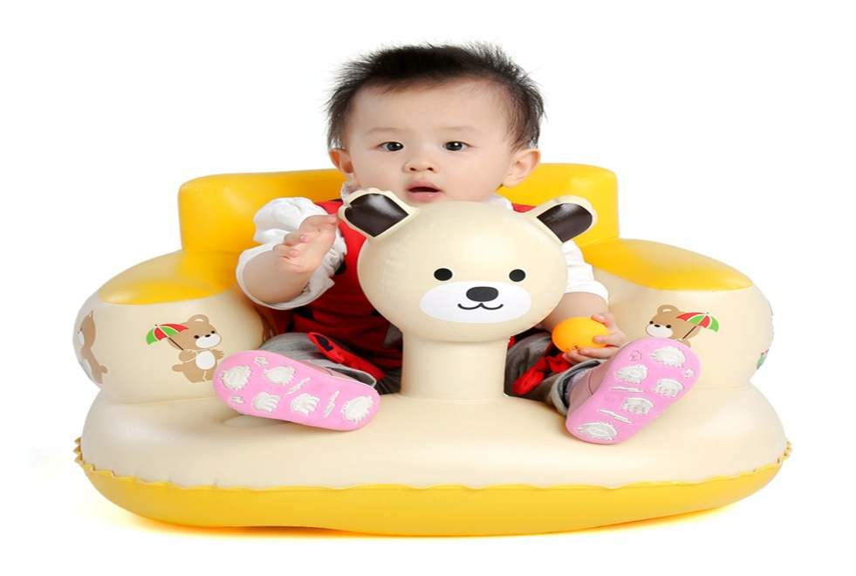
18 Months

Slide 21
18 Months
Walks alone, seldom falls
Upstairs with one hand
Seats self in small chair

Slide 22

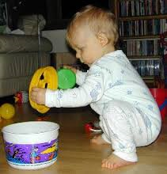
21 Months

Slide 23
21 Months
Upstairs holding one rail
Downstairs with one hand help
Squat in play

Slide 24
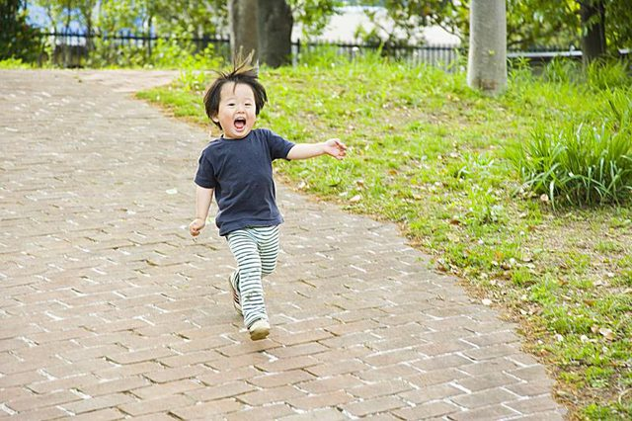

2 Years

Slide 25
2 Years
Runs fairly well
Upstairs and downstairs alone
Kicks in standing

Slide 26
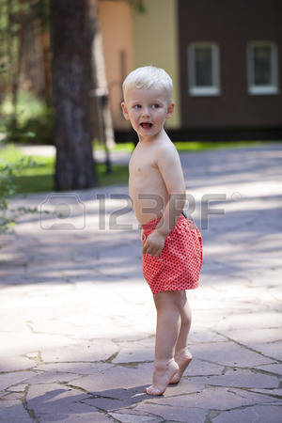
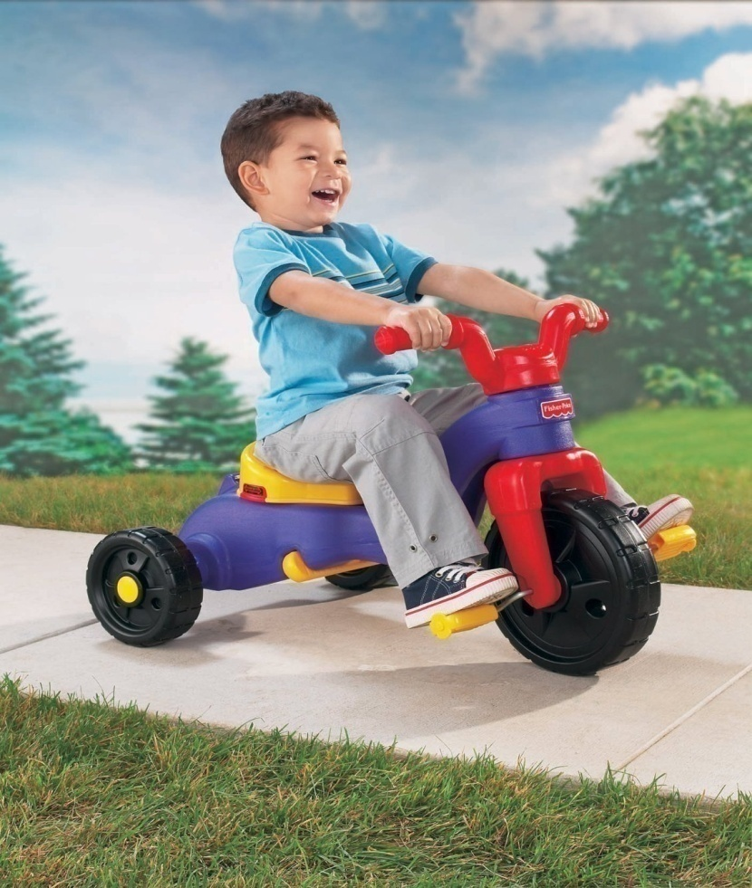
3 Years

Slide 27
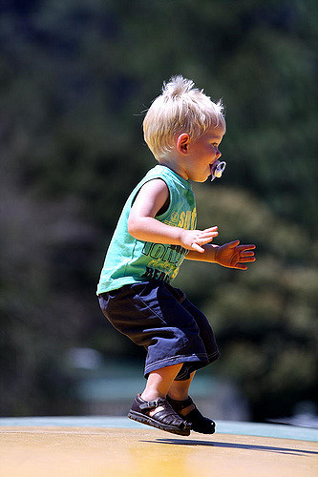


Slide 28
3 Years
Walks on tip toe
Runs on toes
Rides tricycles
Jumps on both feet
Upstairs alternate feet
Momentary one foot standing

Slide 29
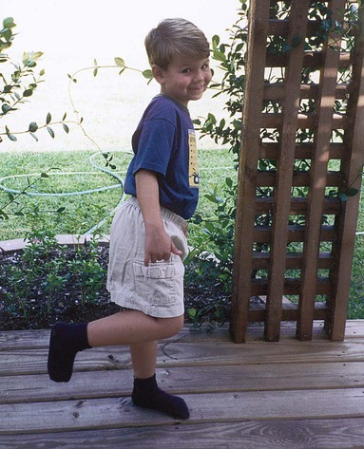
4 Years
Downstairs alternating feet
One foot standing balance 4-8 sec
Skips on one foot

Slide 30
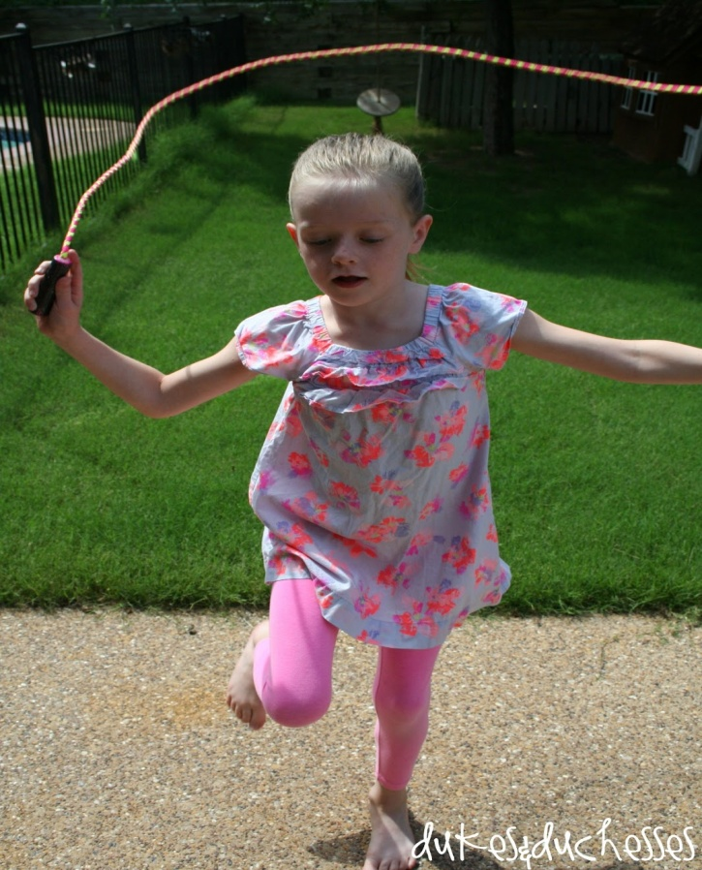
5 Years
Skips with alternating feet
One foot standing balance, 8 sec plus
Walking broad- full length

Slide 31
6 Years
Jump from height of 12’’landing on to toes
Stands on alternating feet , eyes close

Slide 32


Slide 33
Fine Motor Milestone

Slide 34
3 Months
Hand Use
Hold toy actively (1/2 inch peg)
Arms activate on sight of toy
Symmetrical head and arm posture(supine)

Slide 35
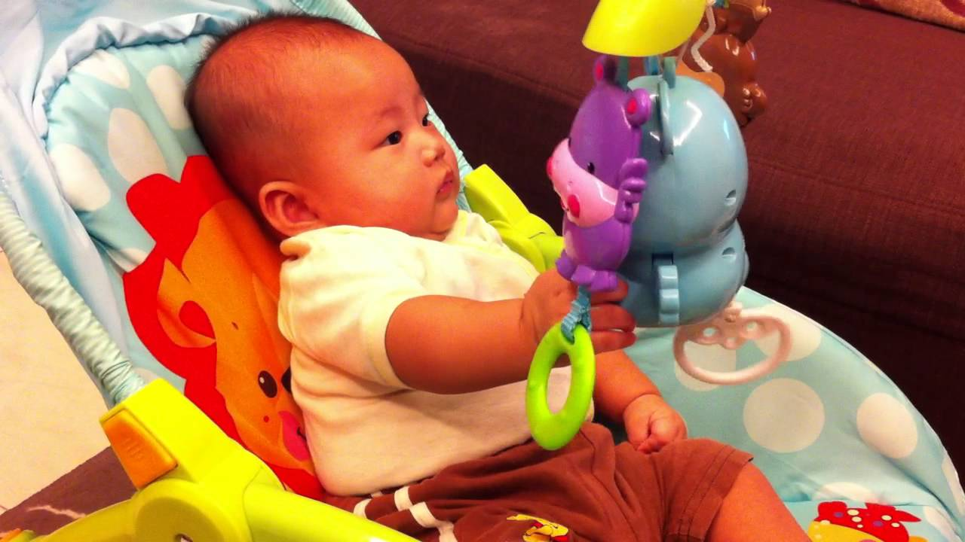

Slide 36
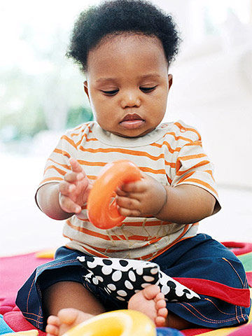
6 Months
Hand Use
Reaches purposefully
Transfer objects
Drops objects

Slide 37
9 Months
Hand Use
Extended reach and grasp
Opposed grasp
Feeding
Finger feeding

Slide 38
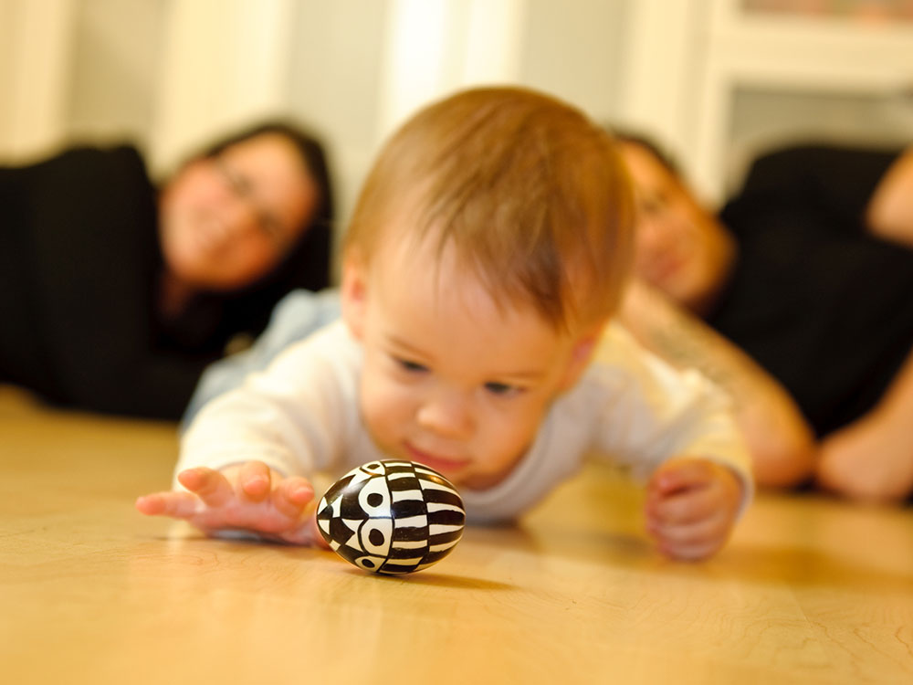
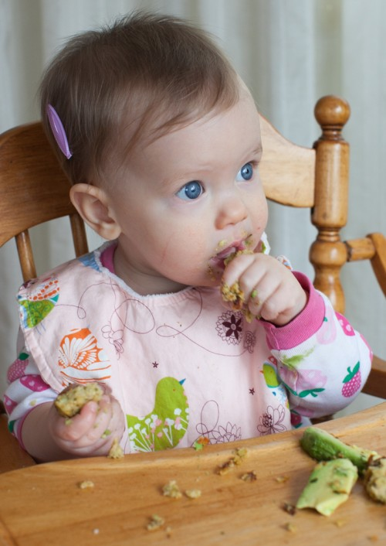

Slide 39
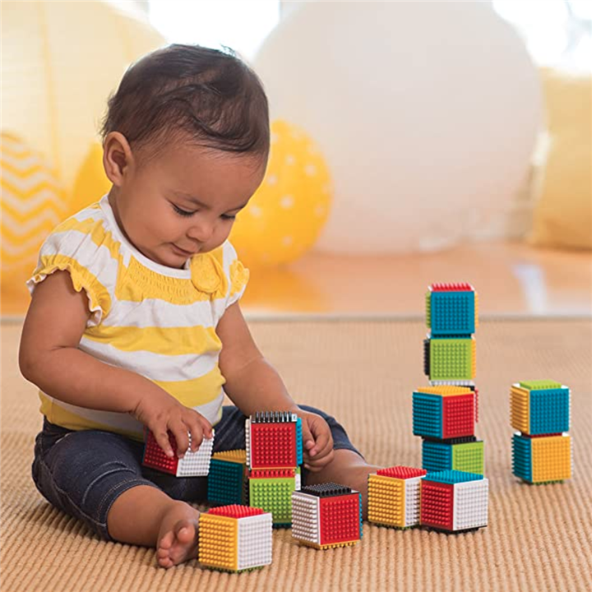
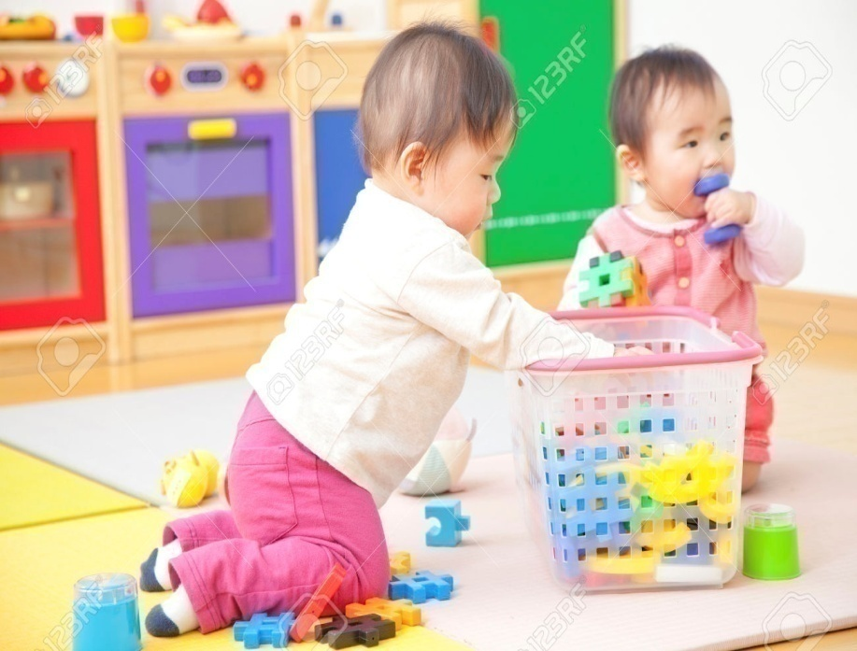
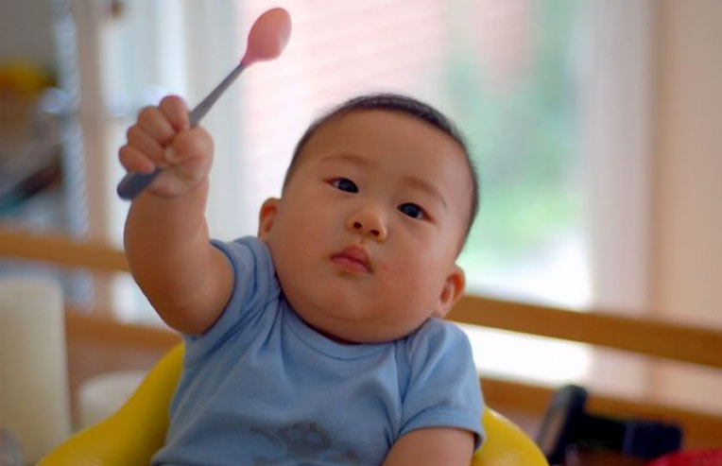
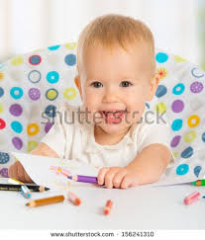
1 Year

Slide 40
1 Year
Hand Use
Voluntary release
Bring one block over another
Rolls ball imitatively
Puts cube in container

Slide 41
Feeding
Grasp spoon
Chews food
Dressing
Cooperates with dressing
Writing
Contacts paper with crayon

Slide 42

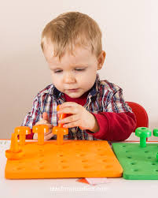
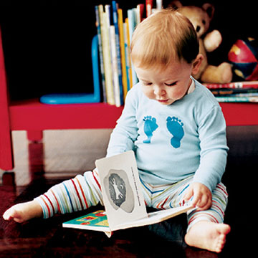
18 Months

Slide 43
18 Months
Hand Use
Builds 3 block tower (1 inch block)
Places peg in hole (1 inch peg)
Turn pages (2 or 3 at a time)

Slide 44
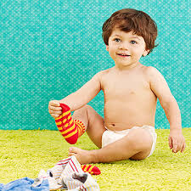
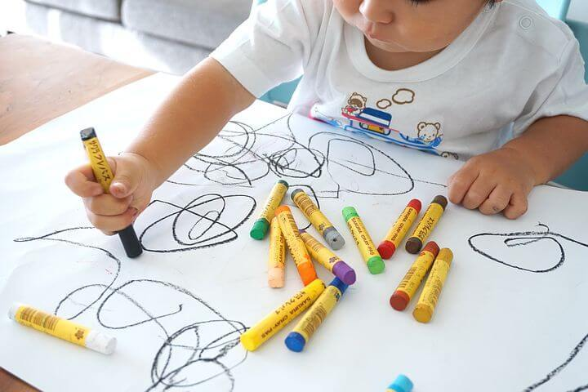
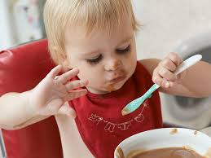

Slide 45
Feeding
Fills spoon with food
Dressing
Removes socks
Writing
Picks up crayon and scribbles

Slide 46

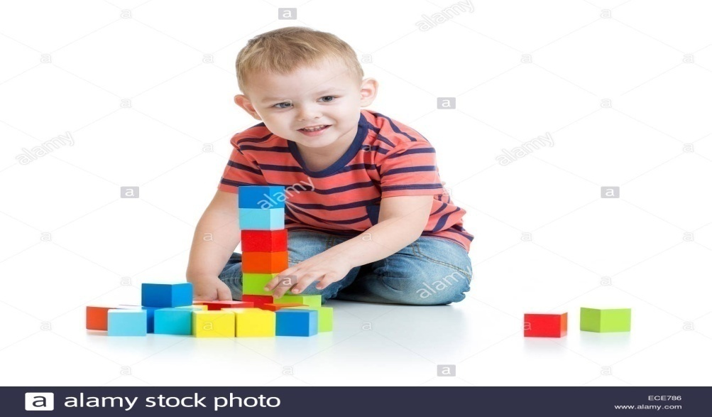
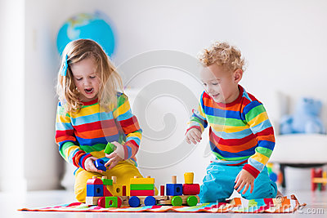
2 Years

Slide 47
2 Years
Hand Use
Build 6 block tower (1 inch block)
Build 3 block train (1 inch block)
Turn pages (1 at a time)
Throw ball inaccurately
Strings bed (1 inch beans)

Slide 48
Feeding
Drinks from cups
Drinks from glass( 2 inch diameter)
Dressing
Removes shoes( laces undone)
Removes pants(assistance over hips)

Slide 49
2^{1/2} Years
Writing
Imitates vertical stroke
Grooming
Washes and dries hands partially

Slide 50
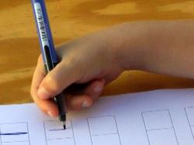

Slide 51
3 Years
Hand Use
Builds 9 block tower(1 inch block)
Builds 3 block bridge
Feeding
Feeds self independently

Slide 52
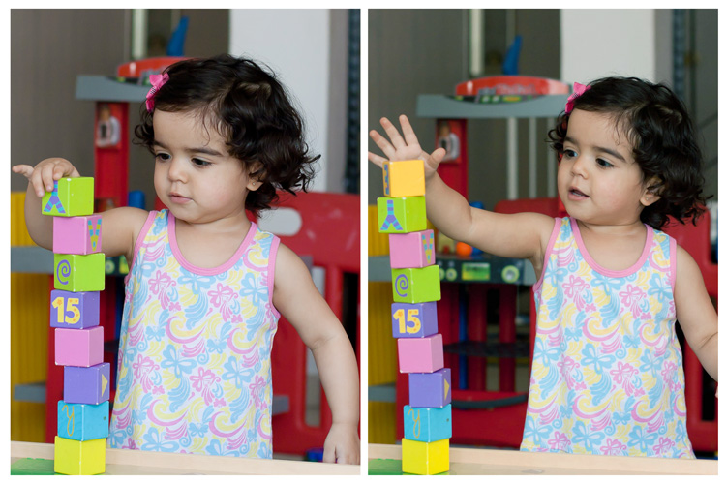
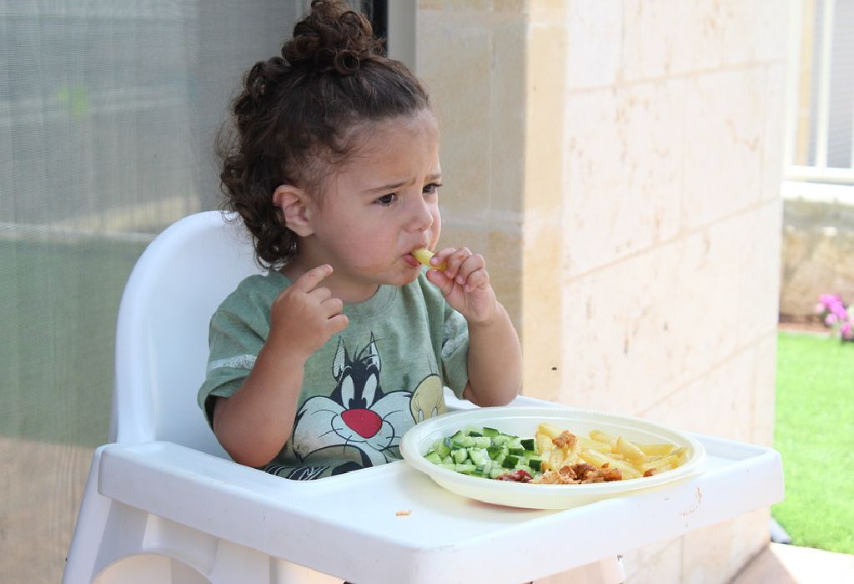

Slide 53
Dressing
Unbuttons medium shirt buttons
Unlaces shoes
Removes clothing completely( no back or small fastening)
Puts on underpants
Puts on socks
Puts on shoes

Slide 54
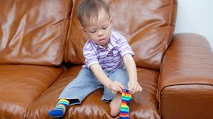

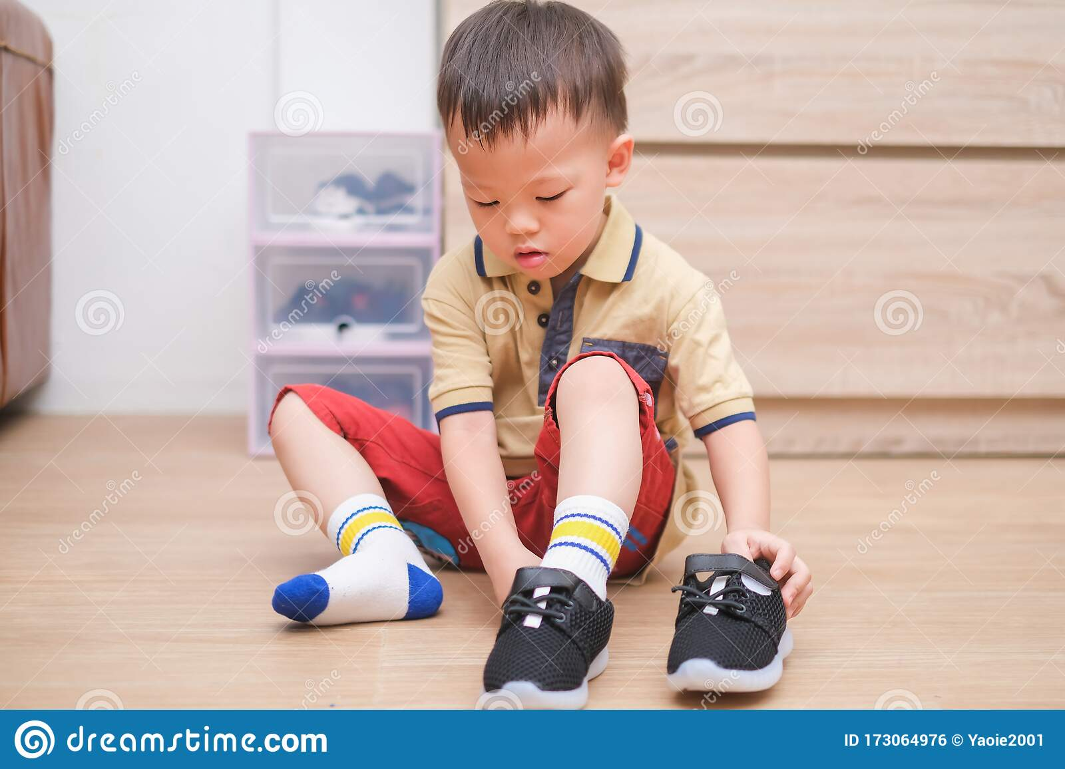

Slide 55
Writing
Imitates horizontal stroke
Copies circle
Grooming
Washes and dries hands

Slide 56
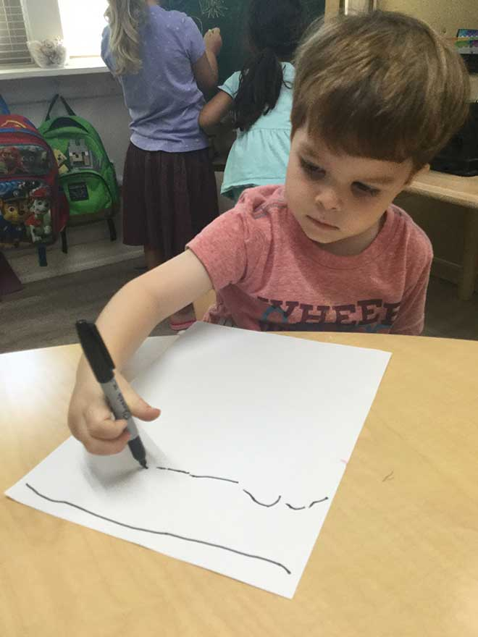
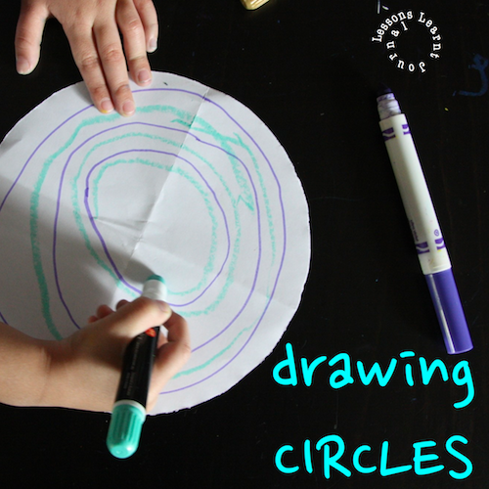

Slide 57
4 Years
Dressing
Buttons large buttons on shirts
Laces shoes
Writing
Copies cross vertical and horizontal lines

Slide 58
Grooming
Brushes teeth
Washes and dries face
Takes responsibility for toilet

Slide 59
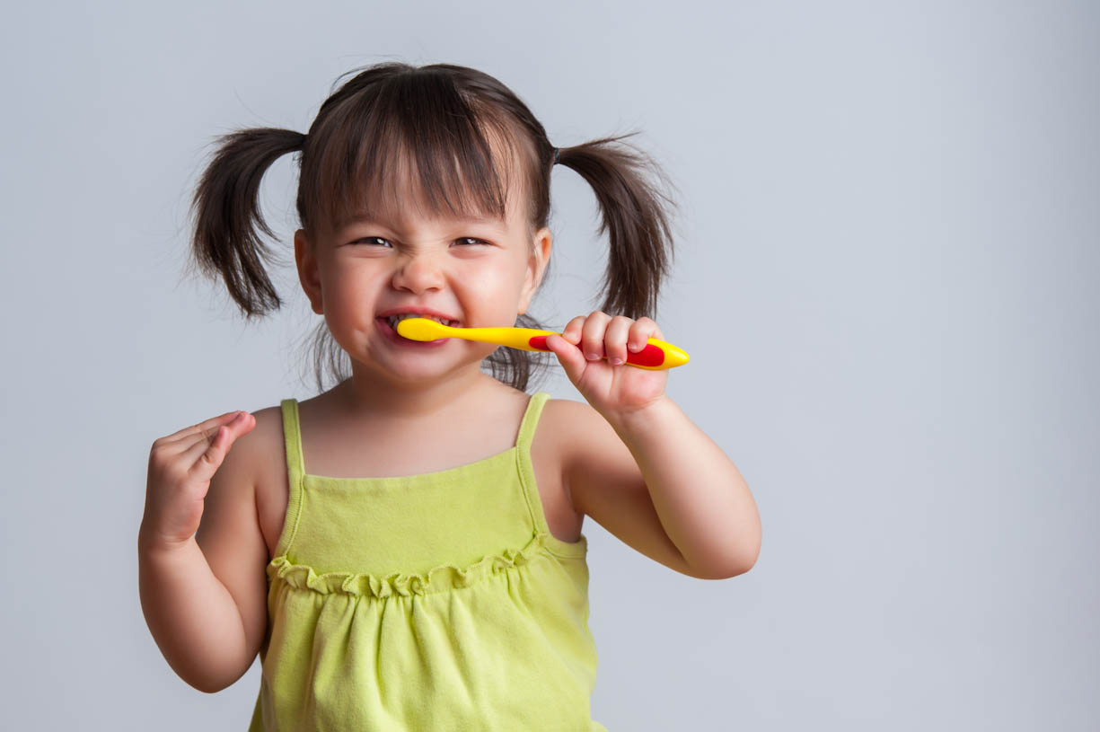


Slide 60
5 Years
Dressing
Buttons medium buttons on shirt
Dress self (except for bows and small buttons)
Writing
Imitates square
Draws recognizable man

Slide 61
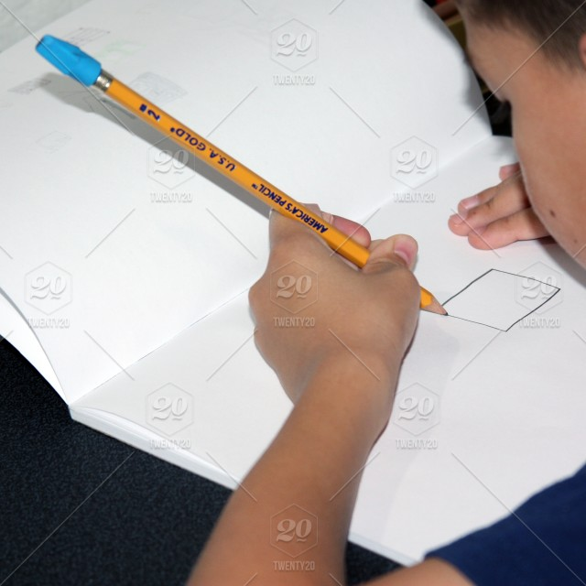
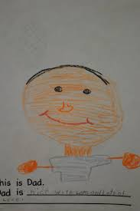

Slide 62
6 Years
Feeding
Cuts bread (chapatti)
Ties bows on shoes
Buttons small buttons on shirt
Writing
Copies printing
Grooming
Combs and brushes hair
Blows and cleans nose

Slide 63

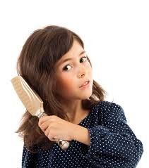

Slide 64
Language Milestone

Slide 65
AGE MILESTONE
1 months Turns head to sound.
3 months Cooing
6 months Monosyllables
9 months Bisyllables
12 months Two words with meaning
18 months Ten words with meaning
24 months Simple sentence
36 months Telling a story

Slide 66
Personal Social Milestone

Slide 67
6 weeks
Smiles responsively
Coos responsively

Slide 68
3 months
Recognizing mother

Slide 69
6 months
Enjoy bath
Playing boo and chew on items

Slide 70
9 months
Show objects to mother
Mirror image

Slide 71
12 months
Comes when called
Finds hidden object
Waves bye bye
Gives toys on request

Slide 72
18 months
Cups: Lifts drink put down
Self spoon feeding
Pulls at dirty nappy
Does dusting, sweeping

Slide 73
2-2^{1/2} years
Plays alone: tantrums, demanding
Day by day puts on shoes. Socks and Pants
Turns door handles
Uses spoon and fork

Slide 74
3 to 3 ½ years
Goes toilet unassisted
Dresses/ undresses with minimum assistance
Knows some nursery rhymes
Handles knife and fork
Plays with peers

Slide 75
4 to 5 years
Wipes own bottom
Eats using knife and fork
Dresses- except for tie and laces
Imaginative play
Plays in group
Shares toy
Obeys rules

Slide 76

THANK YOU

