Slide 1



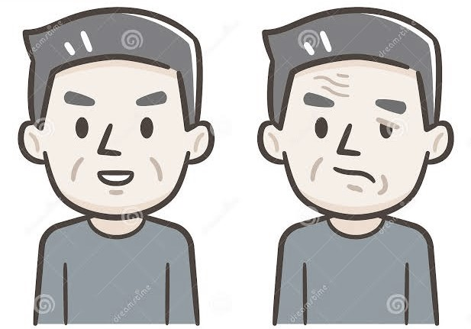
PHYSIOTHERAPY IN BELL’s PALSY
Dr Hunita Dhanju,
Assistant Professor,
COP, SVDU

Slide 2
OBJECTIVES
At the end of the lecture one should be able to:-
Define bell’s palsy
Enumerate etiology and predisposing factors
Describe Physiotherapy assessment and management in detail

Slide 3
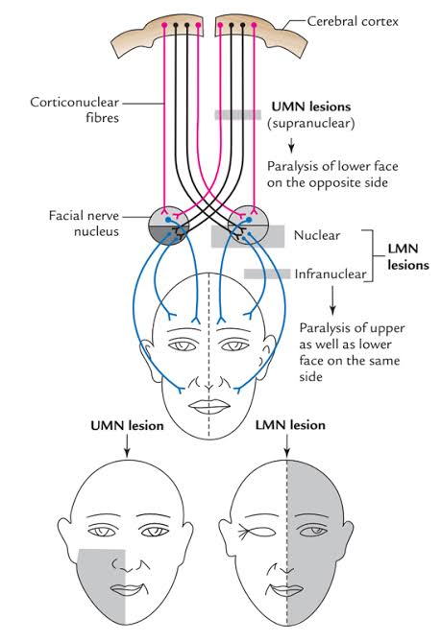

Slide 4
INTRODUCTION
Bell's palsy is defined as an idiopathic, unilateral facial nerve paralysis of the infranuclear/lower motor neuron type which cause the paralysis of one side of face.

Slide 5
ETIOLOGY
Cause is unknown but it frequently follows viral infection or immunization:
  Herpes simplex
  Herpes zoster
  Cytomegalo virus
  Inactivated intranasal influenza vaccine was associated with an increased incidence of bell’s palsy.

Slide 6
PREDISPOSING FACTORS
Predisposing factors found in a minority of cases include :
Pregnancy
Hypertension
Diabetes
Lymphoma
Genetic predisposition

Slide 7
PATHOLOGY
As a result of inflammation of the facial nerve and oedema, pressure is produced on the nerve where it exits the skull within its bony canal and blocking the transmission of neural signals (conduction block) or damaging the nerve (axonal degeneration)

Slide 8
ASSESSMENT
History:
H/o sudden onset
Exposure to cold
Ear ache
H/O ENT surgery
Weakness of one side of upper and lower face
Progression of weakness with in 48 hours.
H/O hypersensitivity to the sound, decreased production of tears, tinnitus, and altered taste.

Slide 9
LEFT SIDED BELL’s PALSY
Facial Palsy: Techniques for reanimation of paralyzed face, 2021

Slide 10
ON OBSERVTION
Loss of wrinkles from forehead
Difficulty in closing eyes
Obliterated nasolabial fold
Deviation of mouth to the opposite site
Drooping of mouth on the same side
Drooling of saliva

Slide 11
ON OBSERVATION contd.
Bell's phenomenon is an upward and outward movement of the eyeball, when an attempt is made to close the eyes.
It is visible due to incomplete closure of eye

Slide 12
ON EXAMINATION
Corneal reflex: blink reflex
The corneal reflex is an involuntary blinking of the eyelids elicited by stimulation of the cornea.
MMT of face muscle: Non-functional, weak functional and Functional
Sensory examination: taste sensation to the anterior 2/3rd of the tongue

Slide 13
PROBLEM LIST
Facial asymmetry
Reduced facial muscles strength
Affected taste sensations
Difficulty in closing the eye
Difficulty in chewing food, drinking fluids

Slide 14
SCALES USED FOR BELL’s PALSY
House-Brackmann grading system
Sunnybrook facial grading scale

Slide 15
ELECTRODIAGNOSIS
Nerve excitability test (NET)
Maximum stimulation test (MST)
SD Curve
Electromyography

Slide 16
MANAGEMENT

Slide 17
MANAGEMENT
Medical management
Surgical management
Physiotherapy management

Slide 18
MEDICAL MANAGEMENT
Oral steroids are used to reduce inflammation. Early treatment (within 3 days after the onset) is necessary for benefit with a greater probability of recovery.
Antiviral drugs are not effective. Though combination of both drugs shown to be effective.

Slide 19
SURGICAL MANAGEMENT
Nerve decompression surgery
Tarsorrhaphy

Slide 20
PHYSIOTHERAPY
MANAGEMENT
GOALS
To educate patient about the condition
To maintain muscle properties
Re-educate muscle action
To improve muscle strength
To improve facial symmetry

Slide 21
PHYSIOTHERAPY
MANAGEMENT
ELECTROTHERAPY
EXERCISES
THERAPEUTIC MASSAGE
ACCUPUNCTURE
BIOFEEDBACK
KINESIOTAPING
ORTHOSIS

Slide 22
ELECTROTHERAPY

Slide 23
ELECTRICAL STIMULATION
The only form of electrical current used on face is interrupted galvanic current
Electrical stimulation is give on the facial motor points
It is given to maintain the muscle properties, particularly to prevent atrophy till reinnervation occurs
Use of faradic current on the face could lead to secondary contractures of the face and patient may not tolerate this current on face.

Slide 24
THERAPEUTIC ULTRASOUND
Ultrasound given over the nerve trunk in front of the tragus of ear and in area between mastoid process and mandible
Parameters- 1 mHz, 0.5 W/cm², 5 minutes
Ultrasound therapy has particular efficiency when applied early in the course of the paralysis. The efficiency of ultrasound therapy proved to be less marked when applied with delay

Slide 25
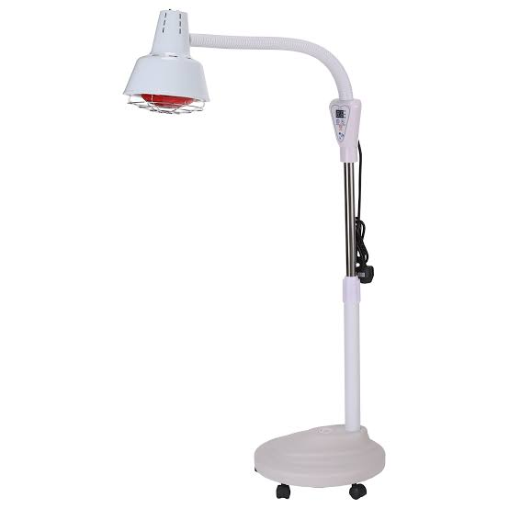
INFRARED RADIATION (IRR)
Infra red is applied to warm the muscles and improve the function, but must ensure that eyes are protected with wet cotton wool while applying infra-red to face

Slide 26
SHORT WAVE DIATHERMY (SWD)
SWD can be safely applied for the treatment of facial palsy. The technique used may be monopolar or bipolar.

Slide 27
ACUPUNCTURE
Acupuncture is an ancient art of healing where various diseases of the body are cured by inserting very fine needles in the specific points of the body
Acupuncture helps in the neurophysiological recovery of the facial nerve

Slide 28
BIOFEEDBACK
EMG biofeedback
Mirror feedback

Slide 29
EXERCISES

Slide 30
EXERCISES
Active assisted movements of facial muscles
Progressing to active movements of facial muscles
  Raise your eyebrows
  Close your eyes
  Flare your nostrils
  Show your teeth
  Pout
  Smile
PNF- Stretch, repeated contractions, maximal resistance, slow reversal

Slide 31
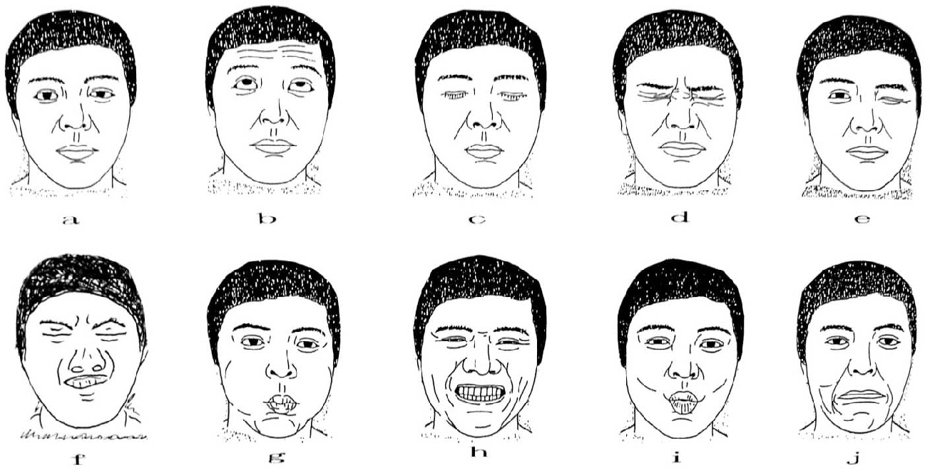
Facial Muscles Exercises

Slide 32
THERAPEUTIC MASSAGE
Stroking
Kneading
Friction
These techniques applied daily help to maintain lymphatic and blood flow and prevent contractures.

Slide 33
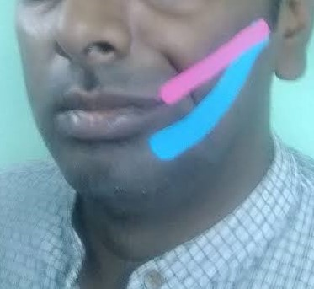
KINESIOTAPING
Kinesiotaping is a dynamic taping used to facilitate the movement
Kinesiotaping is effective in improving the muscle function

Slide 34
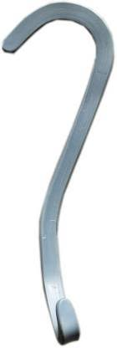
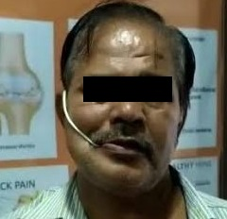
ORTHOSIS
Facial palsy splint
Right Facial palsy splint

Slide 35
ADVICES
To prevent the corneal infection- the eyes should be protected by covers, goggle or taped shut during sleep and for rest periods. Artificial tear drop or eye ointments may be recommended
Drinking water with straw
Blow balloons
Chewing gum

Slide 36
ADVICES
Patient should perform following movements in front of mirror to have proper feedback and to reduce unwanted movements like synkinesis.
Closing the eyes and then open wide
Smiling
Whistling and blowing
Showing teeth
Dilating nostrils

Slide 37
COMPLICATIONS
Chronic loss of taste (ageusia),
Corneal infections
Synkinesis: result of aberrant re-innervation by regenerating axons Axon destinated for one muscle regrow to innervate another leads to abnormal twitching of face muscle.
Crocodile tear syndrome

Slide 38
PROGNOSIS
Prognosis is age related. good prognosis in younger compared to elder.
Diabetic patients have poor prognosis.
Most people with Bell's palsy start to regain normal facial function within 3 weeks and complete recovery is possible within 4-6 months.
Condition may recur in 6% of cases.

Slide 39
REFERENCES
Tzou C, Rodriguez A. Facial Palsy: Techniques for reanimation of the paralyzed face. 1st Edition. 2021
Peregrino B, Guadalupe E, Magna S, Marisol. Pedro S etal. Efficacy of electrotherapy in Bell’s palsy treatment: A systematic review. Journal of Back and Musculoskeletal Rehabilitation. 2020;33(5):865-874
Sun Z. Tian Y. Tan Y etal. Effectiveness of Kinesio taping on peripheral facial paralysis Systematic Review. Journal of Medicine. 2020;99(46)

Slide 40
REFERENCES
Kwon H, Choi J, Lee M, Byung S, Jon K. Acupuncture for the sequelae of Bell’s palsy: a randomized controlled trial; 2016; 16:246-253
Tuncay F, Borman P, Samim E: Role of electrical stimulation added to conventional therapy in patients with idiopathic facial (Bell) palsy. Journal of Physical Medicine Rehabilitation 2015;94:222-228

Slide 41
THANK YOU

