Slide 1


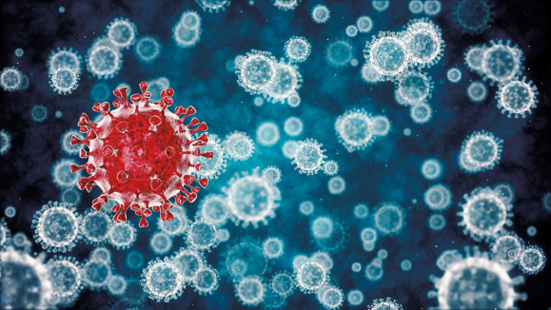
Effect of COVID-19 on the Nervous System
Dr. Nalina Gupta,
Professor, College of Physiotherapy,
Sumandeep Vidyapeeth Deemed-to-be-University, Vadoada, Gujarat, India

Slide 2
COVID-19: A Pandemic
In December 2019, SARS CoV-2 in Wuhan, China
On March 11, 2020, WHO officially announced COVID-19, a pandemic
Coronaviruses constitute a single stranded RNA virus with respiratory, hepatic, enteric and neurological manifestations.
Before SARS CoV-2, there were six coronaviruses known to infect humans.
Two of these had led to major epidemics and deaths due to respiratory disease (SARS-CoV 2002-03, MERS 2012)

Slide 3
Both SARS CoV and MERS had been associated with occasional CNS and PNS manifestations.
The minimum prevalence of CNS complications ranged from 0.04% for SARS to 0.20% for MERS
The prevalence of PNS complications ranged from 0.05%for SARS to 0.16% for MERS
In SARS CoV-2 also, in addition to the systemic and respiratory symptoms, there are reports of patients developing neurological symptoms also

Slide 4
Reported Common Neurological manifestations in SARS CoV-2
CNS
PNS
Headache
Dizziness
Myalgia
Malaise
Dysexecutive syndrome- inattention, disorientation, or poorly organised movements
Impaired consciousness
Anosmia
Ageusia
Paresthesia

Slide 5
Reported common neurological disorders in SARS CoV-2
Encephalitis and other encephalopathies
Acute disseminated encephalomyelitis
Acute Cerebrovascular disease: Ischaemic stroke, Cerebral venous sinus thrombosis
Guillane Barre Syndrome
Rhabdomyolysis and other muscle diseases
Taste and smell dysfunctions

Slide 6
Encephalitis
It is the inflammation of the brain parenchyma usually caused by an infection or body’s immune defense.
Data from 8 adults aged 24-78 years (as of May 2020)
Mostly neurological symptoms started from the time of respiratory symptoms onset to 17 days afterwards. In one, confusion preceded cough and fever and two had only fever
Common features were- irritability, confusion, reduced consciousness, seizures, neck stiffness, psychotic symptoms, and one had ataxia, oscillopsia, hiccups and bilateral facial weakness.
No specific treatment exists for SARS-CoV2 encephalitis

Slide 7
Other Encephalopathies
It is a pathobiological process that develops over hours to days and manifest as changed personality, behaviour, cognition or consciousness.
Common neurological symptoms were headache, dizziness, impaired consciousness, dysexecutive syndrome and seizures in children with SARS CoV2 infection.

Slide 8
Acute Disseminated Encephalomyelitis and Myelitis
It is a syndrome of multifocal demyelination, typically occurring weeks after an infection.
Neurological symptoms- dysphagia, dysarthria, and encephalopathy 9 days after the onset of headache and myalgia or seizures and reduced consciousness
Both improved
66 years old male presented with fever, fatigue, and then acute flaccid paraparesis with incontinence. Examination showed hyporeflexia and a sensory level at T10. He was treated with dexamethasone and intravenous immunoglobulin, and was discharged for rehabilitation.

Slide 9
Peripheral Nervous system and Muscle diseases
Guillain-Barre syndrome is an acute polyradiculopathy characterised by rapidly progressive, symmetrical limb weakness, areflexia on examination, sensory symptoms, and, in some patients, facial weakness, although several variants exist.
19 reported cases with median age of 63 years and range of 23-77 years
Neurological symptoms started usually after 7 days of respiratory and systemic symptoms- weakness of all four limbs with or without sensory loss, paraparetic variant, lower limb paresthesia, facial nerve involvement, dysphagia, autonomic dysfunction, Miller fisher variant, loss of smell and taste, abducen palsy, acute vestibular syndrome.

Slide 10
Cerebrovascular manifestations
Ischaemic stroke
Cerebral hemorrhage
Cerebral venous sinus thrombosis
Most of the patients were old with co-morbidities but younger stroke patients have also been reported
Cerebrovascular manifestations occurred at a median of 10 days after the respiratory illness

Slide 11
How does COVID-19 affect the Nervous System?

Slide 12
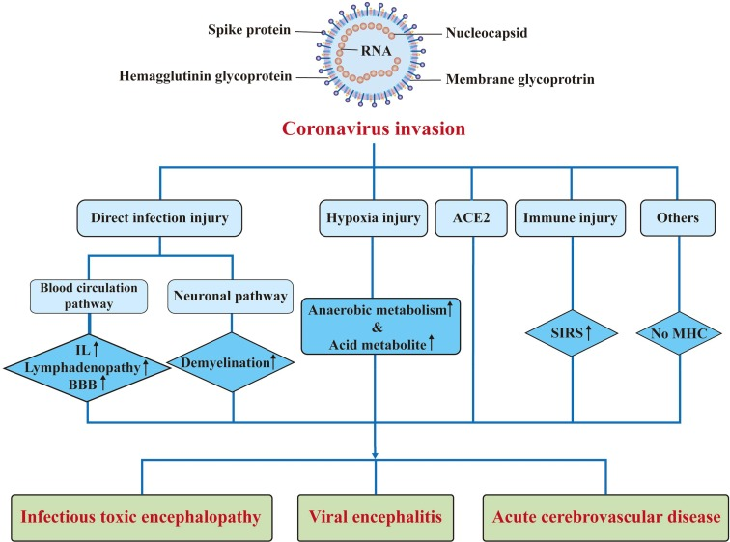
Pathogenesis of nervous system injury caused by coronaviruses. ACE2: angiotensin-converting enzyme 2; BBB: blood brain barrier; IL: interleukin; MHC: major histocompatibility complexes; SIRS: systemic inflammatory response syndrome.

Slide 13
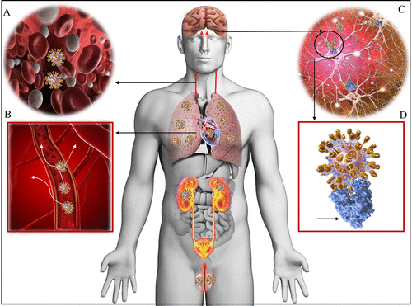
Figure 1. Tissue distribution of ACE2 receptors in humans. Viremia (A) disseminates the COVID-19 virus throughout the body via the bloodstream (B). Neurotropism may occur via circulation and/or an upper nasal trancribrial route that enables the COVID-19 to reach the brain (C) and bind and engage with the ACE2 receptors (D, blue). COVID-19 docks on the ACE2 via spike protein (D, golden spikes). Shown are lungs, heart, kidneys, intestines, brain, and testicles that are well-known to express ACE2 receptors and are possible targets of COVID-19.

Slide 14
*
Patients with SARS CoV2 infection must be evaluated early for neurological symptoms
There has to be an approach to investigate and distinguishing confirmed, probable and possible cases
Since there may be mild or asymptomatic infections, patients with pre-existing neurological conditions may also get affected in the hospital
Case-control studies will be needed to help establish whether SARS-CoV-2 is causal or coincidental in such patients

Slide 15
Challenge for Neuro-physiotherapy
Challenge for Neuro-physiotherapy
Patients with pre-existing neurological conditions
COVID-Negative
COVID-Positive
Patients developing neurological symptoms due to COVID-19

Slide 16
Body temperature, oxygen saturation
Individuals may be asymptomatic, yet carrying the virus…
General hygiene standards – Hand washing, use of disinfectants, PPEs
Use of masks (FFP2/KN95 Masks) by staff and surgical mask by patients. Mask, FFP2 masks in symptomatic areas
Emphasize on “hands off “ remote coaching/supervised treatments than “hands-on” treatments
Limiting contact time as 10 minutes
Maintaining a distance of 1.5 meters between patient and staff and between patients
Virtual visits and teletherapy where applicable/outpatient basis/after discharge

Slide 17
Post Intensive Care Syndrome (PICS)
Specific problems in the post-acute phase
Muscle weakness
Fatigue
Joint stiffness
Dysphagia
Neuropsychological problems- post traumatic stress with body image and cognitive issues
Impaired mobility and functioning
Post Viral Fatigue Syndrome (PVFS)

Slide 18
Patients with prolonged ICU admission will have a very low functional capacity for physical activity, possibly in combination with mental and/or cognitive problems.
Reduced physical functioning can be observed in patients with COVID-19 who were admitted in the hospital but not in the ICU and even the ones who were ill at home.
Use of patient specific functioning scale
Checking of oxygen saturation and Borg’s RPE before and after the physical activity or exercise
In case of PICS, ADLs must be performed at low to moderate intensity for shorter duration

Slide 19
Treatment for limited cognitive functions e.g. anxiety and reduced body awareness
Thorough neurological assessment must be done post COVID-19

Slide 20
Thank you

