Slide 1


POLIOMYELITIS
Dr. Hardik Suthar PT
COP, SVDU

Slide 2
Poliomyelitis is an endemic and epidemic infectious viral disease.
It is transmitted by droplet infection and by oral ingestion.
In the non-immune, there are three distinct phases of disease
Initial incubation period
Prodormal non-paralytic stage
Definitive paralytic phase
Infection is due to destruction of anterior horn cells of spinal cord and the brain stem for which virus has selective affinity.
The result is flaccid paralysis with normal sensations.

Slide 3
VIROLOGY
Ultramicroscopic spherical virus of 24mu to 27mu in diameter.
Three types of viruses :-
  Type I – Brunchilde
  Type II – Lansing
  Type III – Leon

Slide 4
PATHOLOGY
Virus makes entry into tonsil-pharyngeal lymphoid tissue, Payer’s patches and in corresponding regional lymph nodes.
The virus multiplies and disseminates throughout the body
The antibody, when present, inactivates the virus while it is in circulation in blood.
During this phase, mild symptoms like sore throat, gastrointestinal upsets, transient fever may be present.
During phase of major illness, there is widespread entry of virus into the neurones throughout the CNS giving rise to inflammatory reaction of nervous tissue and meninges.

Slide 5
There may be associated symptoms like fever, malaise, nausea and vomiting. Pain and tenderness in spine and limbs.
Inflammatory cells in acute stage are polymorphs which are later replaced by lymphocytes.
Degeneration of anterior horn cells begins with loss of Nissl’s granules and the nucleus.
Short term unconsciousness, impaired sphincter control, unilateral facial paralysis and irregularity of respiration due to involvement of respiratory centre may be present.

Slide 6
STAGES OF DISEASE
Acute phase
Convalescent phase
Chronic or residual phase

Slide 7
ACUTE PHASE
The child is restless and irritable due to pain and muscular tenderness.
Joints of affected limb may be painful.
General malaise, headache and bowel upsets may be present with low grade fever and sore throat.

Slide 8
CONVALESCENT (RECOVERY) PHASE
There is either spontaneous recovery of affected muscles or various grades of paralysis may develop.

Slide 9
CHRONIC (RESIDUAL) PHASE
There is no hope of further recovery
The pattern of paralysis is organized in affected muscles
The degree of paralysis depends upon the extent of neuronal damage and efficacy of physiotherapy management during convalescent phase.

Slide 10
COURSE OF RECOVERY
Maximum spontaneous recovery occurs during the 3rd,4th and 5th week after the onset and it is due to reversal of acute neuronal disturbances.
The spurt of recovery is considerable during 1st 6 months, it becomes slow from 6 – 10 months and by 12 months 92 – 95 % of total possible recovery is attained. It becomes negligible from 16 months onwards.

Slide 11
Early spontaneous recovery occurs due to :-
Reversal of sublethal injury
Resolution of temporary interruption
Reversal of function at higher levels of CNS
Return of cells to normal morphology
Re-routing of functional pathways
Axonal sprouting
Neuronal hypertrophy and hypertrophy of surviving muscle fibers

Slide 12
EXAMINATION
Posture
Degree of consciousness, squint, spontaneous nystagmus, facial paralysis, disinclination to move or change the position, feeble cry or cough, dimished respiratory excursion and accumulation of secretions.
Spinal rigidity
Strength of muscles :- intercostals, diaphragm and abdominals.
Extremities :- MMT

Slide 13
Reflexes and Sensations
  Tendon reflexes disappear which confirms lower motor neuron lesion.
  Plantar reflex is absent or generally flexor
  Absent abdominal reflex indicates involvement of abdominal muscles
  Sensations are normal.
Degrees of contractures and deformities should be accurately assessed and recorded.

Slide 14
TREATMENT
Acute Phase (First 3 – 5 weeks)
  Relief of pain
  Supportive medication for pain relief and relaxation
  Relaxation of painful spasms :- Hot packs but excessive heating should be avoided.

Slide 15
  Prevention of Contractures :- Proper positioning. Whenever possible relaxed passive movements should be allowed.
    Common sites for early contractures :-
    Hip – flexion and abduction
    Knee – flexion
    Ankle and foot – plantarflexion, varus or valgus
    Shoulder – abduction
    Elbow - flexion

Slide 16
  Avoidance of activity :- avoid any type of unnecessary physical activity.
  Least exerting transfers
  Muscle power assessment
  If respiratory involvement :- Tracheostomy or Intermittant Positive Pressure Respirator may be necessary. PT management would include postural drainage and improving vital capacity.

Slide 17
Recovery Phase :-
  Divided into two phases :-
    Early convalescence
    Late convalescence
  Early convalescence (3 weeks – 6 months)
    In department -
      PNF
      Pool therapy
      Assisted exercises
      Unnecessary splinting should be avoided to reduce the effects of immobilisation
      Appliance should be given to those who start standing with support.

Slide 18
At home :-
  Method of preventing contractures and deformities
  Parents should be warned against any weight bearing activities on affected limb at this stage
  Parents should be instructed to bring the child regularly for physiotherapy to the department.

Slide 19
Late convalescence ( 6 months – 1 year)
  Resistance should be applied gradually such as in cycling or by using braces during walking
  Aerobic programme such as swimming, fast walking should be initiated
  Limb length discrepancy should be assessed and compensated.

Slide 20
Chronic or Residual phase (1year – 18 months):-
  Making patient functionally independent
  Specific muscular exercises which emphasis on functional exercises
  These movements should be made stronger by graduated resistance
  Use of additional aids or supports to facilitate functional and physical work.
  Stop the posture, position or activities that put compressive or stretching forces on involved muscles and joints.
  Advices on prevention of contractures and deformities.

Slide 21
  Functional recovery :-
    During phase of recovery, functional activity should not be replaced by trick movements.
    Proper and adequate support should be provided by orthosis.
    When recovery phase is over, compensatory mechanisms to perform functional activities should be encouraged and strengthened by resistive programme of exercise.
    Avoid pain or fatigue during functional activities.

Slide 22
Surgery :-
  Common surgical procedures are :-
    Release of soft tissue contractures
    Correction / Prevention of deformities by tendon transfers or bony stabilization techniques
    Tendon transfers to improve function
    Correction of limb length discrepancy

Slide 23
PREVENTION OF LATE EFFECTS
Late complications :-
  Joint pains and Degenerative joint disease
  Myofascial pains
  Gradually decreasing endurance
  Gradually decreasing strength in affected and unaffected muscles.
  High incidence of fractures.
  Increasing respiratory insufficiency
  Compressive neuropathy
  Decreased ability to ambulation and in performing ADLs.

Slide 24
Due to –
  Lack of regular check up
  Discontinuation of exercises
  Discontinuing supportive aids
  De-conditioning following immobilization
  Disregarding the advices to avoid sustained posture and activities causing excessive stretch and or joint compression
  Sedentary life style with increased body weight

Slide 25
PHYSIOTHERAPY MANAGEMENT :-
Education of patient regarding complications and measures for it.
Insist on follow up visits at regular intervals.
Energy conservation
Maintaining proper posture
Exercises for improving strength, endurance and flexibility. But it should not result in overuse of weak muscles.

Slide 26
Regular use of aid and appliances.
Emphasis on respiratory exercises.
Prevention of compressive neuropathy.
Control of body weight.
Prevention of injury or fracture by advising to avoid any strenuous exercises after muscle fatigue.

Slide 27
Post polio syndrome
Post polio syndrome (PPS) is a neurologic disorder characterized by new and progressive muscular weakness, pain, and fatigue many years after the acute paralytic polio. Halstead introduced the term "post-polio syndrome" in 1986

Slide 28
A period of partial or complete functional recovery after acute paralytic poliomyelitis, followed by an interval (usually 15 y or more) of stable neurologic function
Gradual or sudden onset of progressive and persistent new muscle weakness or abnormal muscle fatigability (decreased endurance), with or without generalized fatigue, muscle atrophy, or muscle or joint pain; sudden onset may follow a period of inactivity, or trauma or surgery; less commonly, symptoms attributed to PPS include new problems with breathing or swallowing.
Symptoms persist for at least a year

Slide 29
Pathophysiology
One possible cause of postpolio syndrome (PPS) is decompensation of a chronic denervation and reinnervation process to the extent that the remaining healthy motor neurons can no longer maintain new sprouts; thus, denervation exceeds reinnervation.
Second possible mechanism for PPS is motor neuronal loss due to reactivation of a persistent latent virus. I

Slide 30
Clinical symptoms
Fatigue
Muscle weakness
Muscle pain
Gait disturbance
Respiratory disturbance
Swallowing problems (dysphagia)
Autonomic dysfunction
Flat back syndrome

Slide 31
Rehabilitation
A multidisciplinary rehabilitation approach involving tailored physiotherapy exercises.
The basic management principles
  energy conservation and pacing one's activities. Although basic,
  activity modifications .
  Psychological interventions, such as cognitive behavior therapy.
TO IMPROVE AND MAINTAIN ENDURANCE
  exercise every other day, and the perceived rate of exertion should be less than "very hard." Loads should be held for only 4-5 seconds, and there should be a 10-second rest between bouts and a 5-minute rest between sets. The patient should perform about 3 sets of 5-10 repetitions.

Slide 32
Strengthening programs
  isokinetic strength,
  improved cardiorespiratory status,
  Electrical stimulation has been used to strengthen weakened muscles or to reeducate muscles weakened through disuse, as well as to decrease pain.
TO REDUCE PAIN
  For myofascial pain, consider heat, electrical stimulation, trigger point injections, stretching exercises, biofeedback, muscle relaxation exercises, or static magnetic fields for trigger points

Slide 33
TO IMPROVE GAIT
For gait disturbances, assistive devices can be used, but sometimes patients refuse because of the philosophy of "not giving in." Treatment also can involve limitation of ambulation to shorter distances and the use of orthotics for joint protection
AFO
KFO
SWEDISH KNEE CAGE
AS PER THE REQUIREMENT OF PATIENTS

Slide 34
MULTIDISIPLINARY PROGRAMME
SPEECH THERAPIST
OCCUPATIONAL THERAPIST
ORTHOPEDICS
PULMONOLOGIST ORTHOTIST
AS A TEAM MEMBER

Slide 35
P- MAINTAING STRENGTH IN POLIO
I- HOME BASED EXERCISES
C- WITHOUT HOME BASED EXERCISES
O- CHANGE IN FUNCATION

Slide 36
TYPE OF THE STUDY | RANDOMISEDD CONTROL TRIAL
YEAR OF PUBLICATION | 2012
LEVEL OF EVIDANCE | HIGH
AUTHOR | Deirdre Murray^{12*}, Dara Meldrum
AIM | The effects of a home-based arm ergometry exercise programme on physical fitness, fatigue and activity in polio survivors: protocol for a randomised controlled tria
METHOD | This is a prospective, single blinded, randomised controlled trial. There are two arms; exercise intervention using arm ergometers and control. Polio survivors meeting eligibility criteria will be recruited and randomly allocated to intervention or control groups. Participants allocated to the intervention group will receive a small arm ergometer and a polar heart rate monitor. They will carry out a home-based moderate intensity (50-70% HRMax) aerobic exercise programme for eight weeks, following instruction by the treating physiotherapist.

Slide 37
WAS META ANALYSIS USED? | NO
CONCLUSION | The home-based exercise programme, utilising affordable items of equipment, has the potential to facilitate aerobic exercise in Polio survivors, allowing this patient group to take advantage of the benefits of exercise.

Slide 38
P- patient with poliomyelitis
I- low-intensity exercises, electrical muscle stimulation and heat therapy
C-
O- Change in muscle strength

Slide 39
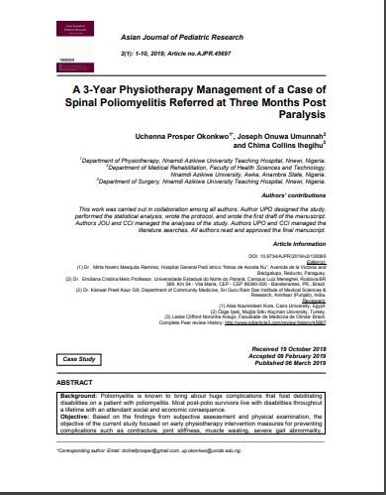

Slide 40
P- Patient with poliomyelitis
I- muscle strengthening
C-
O- Change in muscle strength

Slide 41
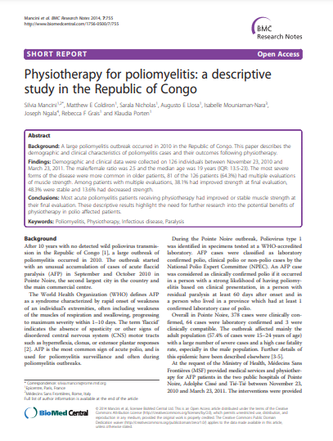

Slide 42
THANK YOU

