Slide 1


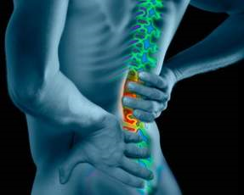
Lumbar spondylosis
Maitri shukla
MPT

Slide 2
Definition
Lumbar Spondylosis is degenerative condition.
spondylosis results in degenerative changes which affect the synovial joints of vertebra , affects the apophyseal joints and intervatrebarl disc of spine.
It is known as spinal osteoarthritis .

Slide 3
Etiology
Age :most common 45 years onwards
Women >men
Poor posture
Occupational stress
Obesity
Back trauma

Slide 4
Pathophysiology
Intervertebral disc
The water content of centre of the disc decreases with age and as a result the discs become hard, stiff, and decreased in size. This, in turn, results in strain on all the surrounding joints and tissues, causing the sensation of stiffness.
Decreased shock absorbing qualities
Annulus fibrosis becomes separates and cracks at different site increased risk of disc herniation .

Slide 5
Vertebral body
Abnormal bone growths known as bone spurs or osteophytes can form in the vertebrae. It can compress nerves coming out of the spinal cord and/or decreased blood supply to the vertebrae.

Slide 6
Ligaments
Degenerative changes make the ligaments weaken .
In degenerative spondylosis, one of the main ligaments (known as the ligamentum flavum) can thicken or buckle, making it weaken reducing canal space .

Slide 7
Apophyseal joint
Osteophyte form at the margin of articular surface
Capsular thickening
Reduced lumen of intervertebral foramen
Compress the nerve root

Slide 8
Clinical features
Pain
Gradual onset of pain
across lumbar and sacrum region ,between sacroiliac joint
Sharp ,stabbing type of pain
it may radiate down
It may be unilateral or bilateral radiation of pain in buttocks.
It radiate in dermatome pattern
Prolong standing and walking increase the pain and sitting and supine lying position decrees the pain
Morning stiffness may be thaere

Slide 9
Paraesthesia
Feeling numbness in dermatomal distribution
Creeping ants sensation or pin and needle sensation

Slide 10
Back muscle spasm may be there
Tightness of the muscle seen especially hamstrings .

Slide 11
Muscle weakness
Degenerative changes of spine make the spinal canal narrow.
Narrowing of the spinal canal compress the nerve root or nerve which make the lower limb muscle weaken supplied by that root (mayotomes)

Slide 12
Limitation of movements
There is limitation in lumbar spine movement.
All movement of the spine is performed at facet joint .
degeneration of facet joint ,and osteophyte formation and pain limits the movements of the spine .

Slide 13
Investigation
X ray
Usually seen narrowing of disc space
Lipping of vertebral body

Slide 14
Investigations
Radiographs (X-rays)
A CT Scan may help reveal bony changes sometimes associated with spondylosis.
An MRI is a sensitive imaging tool capable of revealing disc, ligament, and nerve abnormalities.
Facet blocks work in a similar manner
The physician compares the patient's symptoms to the findings to formulate a diagnosis and treatment plan.

Slide 15
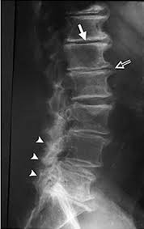
Degenerative changes
Disc degeneration

Slide 16
Examination
History
Onset
Progression
Duration
Observation
Posture abnormalities
Pain examination
Muscle spasm and tightness
Limitation of movements and limiting factor
muscle strength
Reflexes
Sensation
Bowel bladder involvement

Slide 17
Management
Physical Therapy Management in Lumbar Spondylosis
Goals
Relief of pain .
Restoration of movements.
Strengthening of muscles.
Education of posture.
Analysis of precipitating factors to reduce recurrence of the patient's problems.

Slide 18
Rest and Support- Lumbar Supports are designed to limit spine motion, stabilize, correct deformity, and reduce mechanical forces. They may further have effects by massaging painful areas and applying beneficial heat; however, they may also function as a placebo.
Education of posture- Head, neck and shoulders should be supported by the back rest of chair with a small pillow in the lumbar spine, the feet supported and the arm resting on arm rests or on a pillow in the lap.

Slide 19
Relaxation- by soft tissue techniques. Teach self relaxation techniques,e.g like deep breathing exercises and physiological relaxation (and hydrotherapy
Modalities- Hot or cold packs on the affected area, ultrasound and electric stimulation are some of the other treatments which are used to decrease pain and reduce muscle spasm.
Traction- Gentle intermittent joint distraction and gliding techniques may inhibit painful muscle responses and provide synovial fluid movement within the joint for healing.

Slide 20
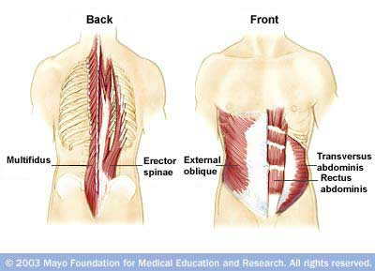
Core stability exercises

Slide 21
Core strengthening exercises
Drawing – in maneuver(Abdominal hollowing exercise) for transverse abdominis activation:
Patient position- training may be easiest in quadruped position in order to use the effect of gravity on the abdominal wall.hook lying (with knees 70 to 90 deg. And feet resting on exer. Mat), prone lying or semireclined positions may be used if more comfortable for the patient
It is important to start training in sitting and standing as soon as possible for functional activities.

Slide 22
Procedure- have the patient assume a neutral spinal position and attempt to maintain it while gently drawing in and hollowing the abdominal muscles. Instruct the patient to breath in and out then gently draw the belly button in towards the spine to hollow out the abdominal region

Slide 23
Multifidus activation:
Patient position & procedure: prone or side lying. Place your palpating digits (thumbs or index fingers) immediately lateral to the spinous processes of the lumbar spine. Instruct the patient to swell the muscle out against your digits. Palpate for consistency of muscle contraction at each level.

Slide 24
Other static exercises
Posterior pelvic tilting: it activates the rectus abdominis muscle, which is used primarily for dynamic trunk flexion activity. It is used mostly for awareness of movement of the pelvis and lumbar spine.
Abdominal strengthening exercises: curl- ups- first instruct the patient to perform drawing maneuver to cause a stabilizing contraction of the abdominal muscles and then lift the head, progress by lifting the shoulder until the scapulae and thorax clear the mat, keeping the arms horizontal.
Double Knee to chest

Slide 25
Management guidelines
Impairment based diagnostic criteria
General: stage of recovery
Acute with inflammation (0-4) weeks
Subacute(4-12) weeks
Chronic pain syndrome(> 6)months

Slide 26
Acute phase- pain/ neurological symptoms
Inflammation
Inability to perform ADLs
Guarded posture (directional preferences)

Slide 27
Plan of care | Intervention
Educate the patient | Engage patients in all activities to learn self management. Inform patient of anticipated progress & precautions
Decrease acute symptoms | Modality, massage, traction, manipulation as needed. Rest only for 1st couple of days
Teach awareness of neck & pelvic position & movements | Kinesthetic training- pelvic tilt, neutral spine
Demonstrate safe posture | Practice position & movements and experience effect on spine. Provide passive support/ bracing if needed
Initiate neuromuscular activation and control of stabilizing muscles | Core activation tech- drawing in maneuver, multifidus .
Teach safe performance of basic ADLs- progress to IADLs | Roll, sit, stand, walk with safe posture .progress tolerance to sitting > 30 min standing>15 min walking >1 mile

Slide 28
Chronic spinal problems:
Pain
Flexibility and strength imbalances
Generalized reconditioning
Inability to perform high intensity physical demands

Slide 29
Plan of care | Intervention
Emphasize spinal control in high intensity and repetitive activities | Practice active spinal control in various transitional activities that challenges balance
Increase mobility in tight muscles/ joints / fascia | Joint mobilization/ manipulation, muscle inhibition, self stretching.
Improve muscle performance, dynamic trunk & extremity strength, coordination & endurance | Progress dynamic trunk & extremity resistance exc. Emphasizing functional goals
Increase cardiopulmonary endurance | Progress intensity of aerobic exercises
Emphasize habitual use of techniques of stress relief/ relaxation and posture correction | Motions & postures to relieve stress. Ergonomic changes at work and home
Teach safe progression to high level/ high intensity activities | Activity specific training consistent with desired functional outcomes
Teach healthy exer. Habits for self maintenance | Engage patient in all activities and educate as to benefits of maintaining fitness level & safe body mechanics

Slide 30
Extension bias- extension approach
Patients with an extension bias often assume a flexed posture or a flexed posture with lateral deviation of the trunk or neck, but during the examination sustained or repetitive extension maneuvers reduce or relieve their symptoms.
These patients would benefit from early interventions that emphasize extension of the involved segments.
If extention of the spine causes a change in sensation or causes pain to radiate down an extremity, reassess the patient’s condition to determine if extention is contraindicated.

Slide 31
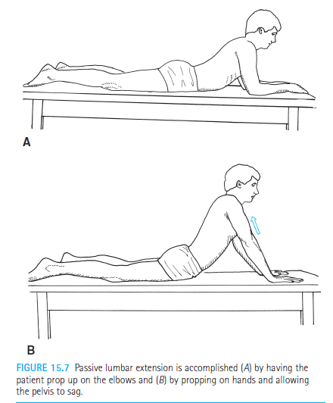
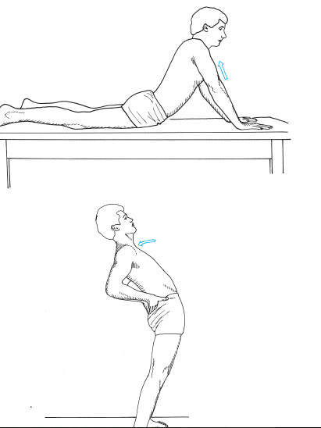
Techniques to Increase Lumbar Extension

Slide 32
Flexion bias-flexion approach
Patients may present with a flexed posture and be unable to extend because of increased neurological symptoms and decreased mobility; these patients would benefit from early interventions that emphasize flexion of the involved segments to relieve symptoms.
The patients may have a medical diagnosis of spondylosis or spinal stenosis, may have sustained an extension load injury, or may have swollen facet joints so symptoms increase with extension. The flexed position reduces or relieves the symptoms.
If flexion of the spine causes a change in sensation or causes pain to radiate down an extremity, reassess the patient’s condition to determine if flexion is contraindicated.

Slide 33
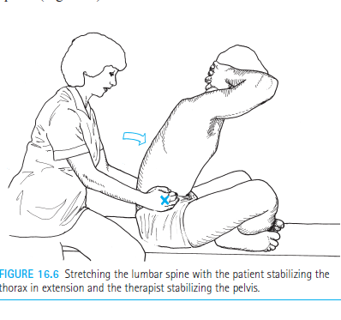
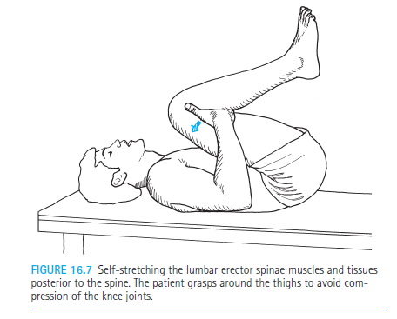

Slide 34
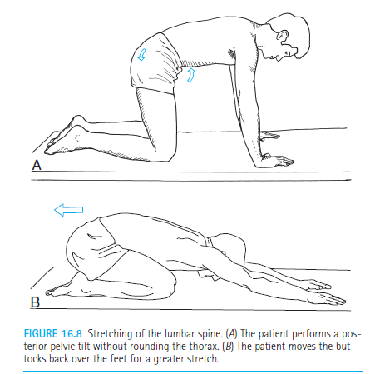

Slide 35
P- patients with chronic low back pain
I-core stability exercise and general exercise
C-general exercise
O-improvement in core stability ex. Group

Slide 36
Rct | Yahya Javadian et al Caspian J InternMed2015; 6(2):98 -102 | The aim of this study was to investigate the effect of core stability exercise on the translation and rotation of lumbar vertebrae in sagittal plane in patients with nonspecific chronic LBP (NSCLBP) | Results :Thirty patie nts aged 18 -40 years old with clinical diagnosis of NSCLBP entered the study. Compared with baseline values, mean value of translation and rotation of the lumbar vertebra reduced significantly in both groups (P<0.05), except L3 translation in the control group. At the endpoint, mean translation value of L4 (P=0.04) and L5(P=0.001) and rotation of the L5 (P=0.01) in the treatment group was significantly lower than the control group. | Concltion patients presented with NSCLBP due to lumbar segmental instability, core stability exercises plus general exercises are more efficient than general exercises alone in the improvement of excessive lumbar vertebrae translation and rotation. clution

Slide 37
Traction for Low Back Pain With or Without Sciatica:
An Updated Systematic Review Within the Framework of the Cochrane Collaboration
P- LS
I- Traction
C- traction vs placebo
O- reduction in pain

Slide 38
Systamatic Review 1 a level of evidence (Includes RCTs) | Judy Clarke Maurits van Tulder, Stefan Blomberg. SPINE Volume 31, Number 14, pp 1591–1599 ,2006 | Aim:To determine if traction is more effective than reference treatments, placebo/sham traction, or no treatment for low back pain (LBP). | Results:A total of 24 RCTs (2177 patients) were included. There were 5 trials considered high quality. For mixed groups of patients with LBP with and without sciatica, we found: (1) strong evidence that there is no statistically significant difference in short or long-term outcomes between traction as a single treatment, (continuous or intermittent) and placebo, sham, or no treatment; (2) moderate evidence that traction as a single treatment is no more effective than other treatments; and (3) limited evidence that adding traction to a standard physiotherapy program does not result in significantly different outcomes. | Conclusion-the literature allows no firm negative conclusion that traction, in a generalized sense, is not an effective treatment for patients with LBP.

Slide 39
Lumar spondylosis is
A. degenerative condition
B. Infective condition
C. Acute condition
D. Chronic condition

Slide 40
Most commonly involved structure which gives pain is
Vertebras
Discs
Apophyseal joint
B and C both

Slide 41
Pain is increases in
Prolong standing and walking
Lying
Turning
Non of above

Slide 42
Common finding in radiographs of lumbar sondylosis
Lipping
Reduced joint space
Osteophyte formation
All of above

Slide 43
Most common age for lumbar spondylosis is
>35
>45
>55
>25

