Slide 1

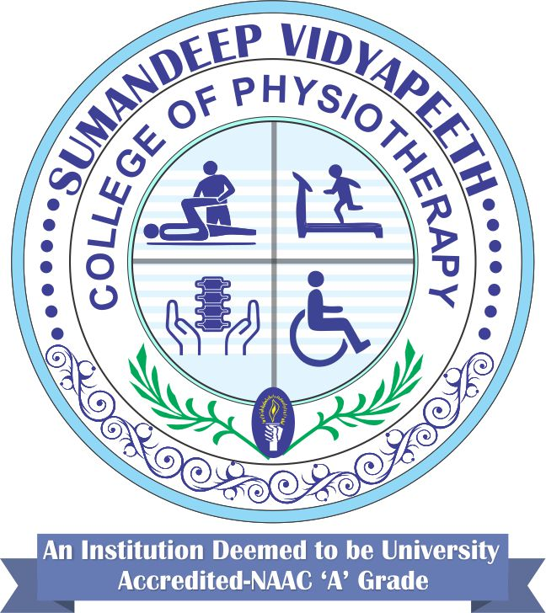
CRANIAL NERVE EXAMINATION
Dr.Pinal Modi

Slide 2
CRANIAL NERVE EXAMINATION
Cranial Nerve I – Olfactory nerve
Type of nerve - Sensory nerve
Function – Smell
Testing – test sense of smell on each side (nostril) separately – Use Familiar substances that smells (e.g. coffee)

Slide 3
Cranial Nerve II – Optic nerve
Type of nerve – Sensory nerve
Function – Vision
Testing – two aspects are tested
1.Visual acuity – tested by Snellen’s chart, in general
2.Visual field – visual field checked by confrontation method

Slide 4
Cranial Nerves III, IV & VI – Oculomotor, Trochlear, Abducens
Type of nerve – All are motor nerves
Function – Movement of eyeballs (extra ocular muscle contraction)
Testing – Hold the face of the subject (not to permit movement of head / face) – Move the finger in all 4 directions, Up and down, right and left – Ask the subject to follow the finger- Observe the eye movements

Slide 5
Cranial nerve V – Trigeminal nerve
Type of nerve – Both Motor and Sensory nerve
Function – Muscles of Mastication and Sensation (face)
Testing:
Motor (Muscles of mastication)- Masseter, Temporalis – Clench the teeth – palpate the masseter and temporalis, Lateral Pterygoid – Opens the jaw, Medial and Lateral Pterygoids – side to side movements of jaw
Sensory- Test the facial sensations – Ophthalmic (forehead), Maxillary (cheeks) and Mandibular (jaw) branches

Slide 6
Cranial Nerve VIII – Vestibulocochlear / Auditory / Acoustic nerve
Type of nerve – Sensory nerve
Function – Hearing (Cochlear) and Balance (Vestibular)
Testing – Hearing
Rub the fingers against the ear to be tested
Tuning fork tests - Webber test and Rinne test – to differentiate between conductive loss and sensorineural loss
Balance and Nystagmus – complains of dizziness and inability to hold the eyeballs in a fixed position

Slide 7
Cranial nerve IX and X – Glossopharyngeal nerve and Vagus nerve
Type of nerve – Both Motor and Sensory nerve
Function – muscles supplied by Pharynx and Larynx (motor) and Posterior one third of tongue (sensory for glossopharyngeal)
Testing – ask subject to open the mouth and say “Aahh” – Observe the Uvula is at centre while saying aahh

Slide 8
Cranial Nerve XI – Spinal Accessory nerve
Type of nerve – Motor nerve
Function – Neck Muscles movement – Upper fibres of Trapezius and Sternocleidomastoid muscles
Testing – Check for neck flexion and rotation

Slide 9
Cranial Nerve XII – Hypoglossal nerve
Type of nerve – Motor nerve
Function – Tongue Muscles movement
Testing – Check for tongue movements – Protrusion, Side to side etc.

Slide 10
VII CRANIAL (FACIAL) NERVE EXAMINATION
VII cranial nerve is a mixed nerve
Motor, Sensory and Parasympathetic nerves components are present in it.
Motor – Muscles of facial expression
Sensory – Anterior two thirds of tongue
Parasympathetic – Salivary glands (submandibular and sublingual) and lacrimation

Slide 11
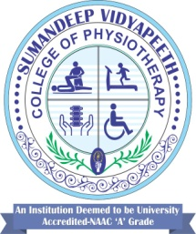
On Observation
Sagging of the eyebrow
Teary and red eye on affected side (inability to close eye)
Asymmetrical blinking
Drooping of the face
Absence of (flattening of) Nasolabial fold on affected side
Deviation of mouth towards unaffected side (asymmetrical smiling)

Slide 12
On examination
Motor Examination:
Assess the action / function and strength of muscles of Facial Expression
1. Occipito frontalis – Lift the eye brow – asymmetry of forehead wrinkles, inability furrow the eyebrow, reduction in the level of eyebrow rise
2. Corrugator Supercilii – frowning of eyes – absence of fold, inability to move eyebrow close to midline
3. Orbicularis Occuli – close the eyes tightly – inability to close the eyes completely and or tightly- unable to bury the eyelashes between eyelids

Slide 13
Presence of Bell’s Phenomenon:
Subject is unable to close the eyes, but while attempting to close the eyes (forceful closure of eyes) the eye balls will move upwards and lateral. (Sir Charles Bell, who first described the anatomy of the facial nerve and asymmetrical lesion / weakness of facial nerve between in 1818 to 1821)

Slide 14
4. Zygomatic – smile or laugh – raise the corner of the mouth – asymmetrical smiling
5. Orbicularis Oris – Pout or pucker the lips, Purse the lips
6. Buccinator – Puff out the cheeks – hold air in the mouth against resistance.
7. Elevators of upper lip / mouth – Show Upper teeth
8. Depressors of mouth and Platysma - Grimace the face and or show lower teeth – asymmetrical grimacing, Show both Upper and lower teeth – say Cheese

Slide 15
To assess strength of muscles
Ask subject to do the above movements
Observe the ability to complete the movement
If able to complete the movement then apply resistance

Slide 16
Functional deficits due to Facial muscles weakness
Inability to express emotions
Difficult to close eyes and blink
Difficulty in blowing, smiling, whistling
Difficult to eat, drink
Difficult to speak clearly
Difficult to laugh
Aesthetics of appearance – psycho social problems

Slide 17
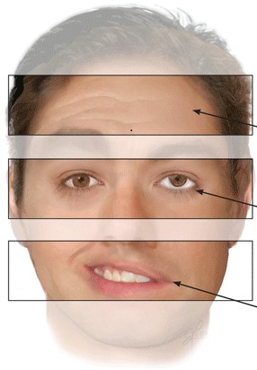
Absence of Wrinkles
Absence of Eye closure
Absence of Nasolabial fold
Deviation of Mouth
Drooping of Lips (angle)

Slide 18
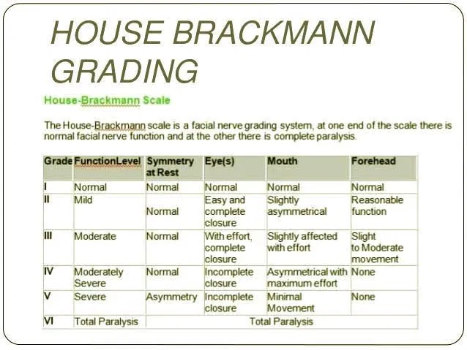
The House-Brackmann scale is the most widely used tool for grading the degree of facial paralysis and for predicting recovery. Grades are I to VI, with grade I indicating normal function, and grade VI, complete paralysis.

Slide 19
THANK YOU

