Slide 1
Peripheral nerve lesions
G PALANI KUMAR
College of Physiotherapy

Slide 2
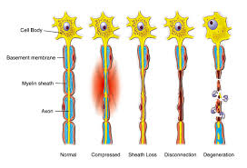
Nerve degeneration

Slide 3
Ulnar nerve lesion
Ulnar nerve is the branch of medial cord of brachial plexus with root value- C_{8,} T ₁
Causes:
Pressure caused by falling asleep with arm over the back of a chair, or due to axillary crutch.
Traumatic- elbow #/ dislocation
Pressure on the nerve due to callus formation or scar tissue
Injury at wrist due to glass cut injury

Slide 4
Clinical features:
Lesion at forearm:pt. c/o weak power grasp (holding hammer).
On examination: a) MMT: paralysis of FCU and medial half of FDP causes weak wrist flexion and ulnar deviation, the tendon of FCU does not tighten on making a fist weakness of flexion movement of terminal phalanx.
b)Observation: There appears flattening the medial border of forearm.

Slide 5
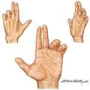
Deformity in ulnar nerve lesion

Slide 6
c)Sensory examination: Anesthesia on the ulnar side of hand, on both palmar and dorsal aspects and on the little, ring and part of the middle finger (palmar cutaneous, dorsal cutaneous, superficial terminal branches).
Patient c/o loss of ability to move the fingers away and together (loss of abduction/ adduction), unable to perform fine movements of hand( in case of wrist level lesion)

Slide 7
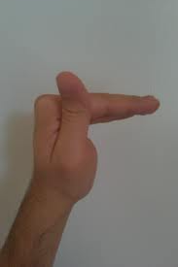
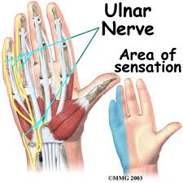

Slide 8
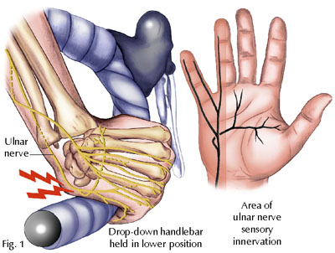

Slide 9
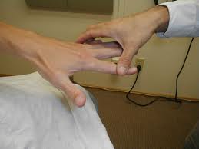
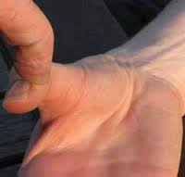
Testing intrinsic muscles

Slide 10
Lesion at elbow: this spares the intrinsic muscles called as ULNAR PARADOX.
On examination:a) MMT: Weakness of abductor digitiminimi, flexor digitiminimi, opponensdigitiminimi, 3& 4 lumbrical, palmar and dorsal interossi and adductor pollicis muscles
b) Deformity: Ulnar claw hand- hyperextension of MCP jt. and flexion of IP jt. Due to intact FDP this is called as ulnar paradox.
c) Observation: Due to intermetacarpal spaces are hollowed.

Slide 11
d) Sensory examination: Wrist level lesion- sensory loss limited to medial one and half fingers unless dorsal and palmar cutaneous branches are injured.
e) Vasomotor changes: skin areas with sensory loss are warmer due to arteriolar dilatation, and due to loss of sweating due to loss of sympathetic supply. Long standing cases show trophic changes.

Slide 12
f) Fromet’s sign: tests the adductor pollicis muscle. When the pt. attempts to grasp a book firmly between thumb and other fingers of paralyzed hand, the terminal phalanx of this hand flexes at interphalageal joint by flexor pollicislongus muscle.

Slide 13
Physiotherapy management
Splint: in case of degeneration of nerve causing muscle paralysis a functional splint may be given which consists of a light padded bar across the dorsal aspect of proximal phalanges of 3 & 4 fingers and a similar one over the upper end of metacarpals. These are attached to another padded bar in the palm of hand by a small spring which pulls the metatarsophalangeal joints into flexion but allows the patient to extend the joints.

Slide 14
Electrical stimulation using i.d.c. can be started using 100ms pulse duration for denervated muscles.
Active exercises- grip strengthening- lumbrical grasp and abduction- adduction of fingers, opposition action of little finger, abduction and flexion of little finger.

Slide 15
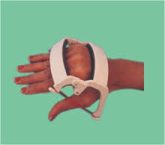
Splint

Slide 16
Median nerve lesion
Causes:
Compression of the nerve in the carpal tunnel
Cut injury at the level of wrist.

Slide 17
C/c:
Elbow level lesion: Pt. c/o- loss of ability to perform gross movements of hand, unable to bend the wrist, inability to pronate the forearm, unable to make a fist (lesion at elbow which paralyzes the long wrist flexors), unable to pick up a pin with thumb and index finger.
Wrist level lesion: unable to pick up a pin with thumb and index finger, inability to oppose the thumb.

Slide 18
On Observation-
Ape thumb deformity: wasting and weakness of thenar muscles of hand, the thumb is adducted and laterally rotated so that the first metacarpal lies in the same plane as the other metacarpals.
Hand is adducted, flexion at interphalangeal joint at index and middle finger is lost, so these fingers remain straight while making a fist (elbow level lesion)

Slide 19
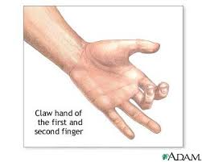
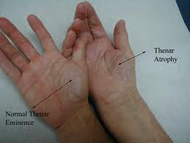
Observation findings

Slide 20
Vasomotor changes: the skin on lateral three and half digits is warm, dry and scaly, nails crack easily
Trophic changes are seen in long standing cases.

Slide 21
MMT examination-
Hand is adducted due to the paralysis of flexor carpi radialis, flexion of the wrist is weak, forearm in a supine position due to loss of pronation movement, flexion at interphalangeal joint at index and middle finger is lost, so these fingers remain straight while making a fist (elbow level lesion.

Slide 22
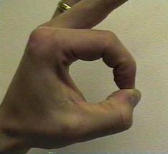
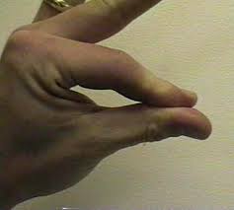
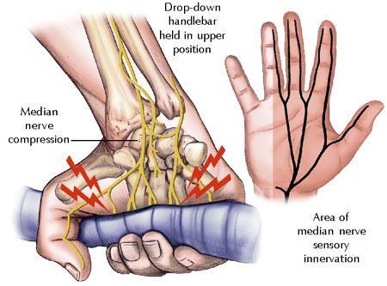

Slide 23
Sensory examination-
Sensory loss: loss of sensation on lateral three and half digits including nail beds and distal phalanges on dorsum of hand.
Pen test for abductor pollicisbrevis muscle: lay the hand flat on a table with palm directed upwards. The patient is unable to touch with his thumb a pen held in front of the palm.

Slide 24
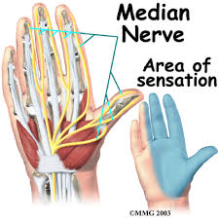
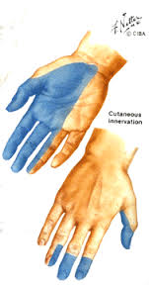
Area of sensory loss

Slide 25
Physiotherapy management
Passive movements to all the movements of the thumb
Instruct the patient regarding the care of anesthetic area.
Electrical stimulation using i.d.c. starting with 100 ms pulse duration for denervated muscles as recovery happens switch on to short duration i.d.c.

Slide 26
Active exercises for wrist flexion, grip strengthening exercises-cylindrical grasp, spherical grasp, pincer grasp, finger opposition exercises, active ROM exercises for digits.
Splint: consists of a strap round the wrist and another round the proximal part of thumb. The 2 hands are connected by an elastic band which pulls the thumb into partial opposition and yet allows the patient to extend and abduct the thumb.

Slide 27
Carpal tunnel syndrome
Carpal canal at the wrist joint is crowded with flexor tendons and median nerve. Any tension in this canal like flexor tenosynovitis, carpal dislocation can compress median nerve in this canal.
C/c:
burning and aching sensation in hand more at night
Difficulty in moving wrist and hand
Abnormal sensation over front of thumb, 2, 3 and ring finger

Slide 28
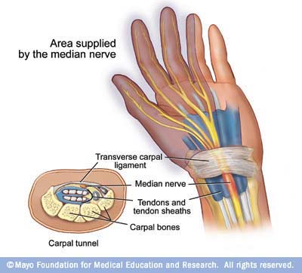
Brief anatomy of carpal tunnel

Slide 29
History:
H/o of-
flexor tenosynovitis
malunited radial #
carpal bone dislocation

Slide 30
Examination:
atrophy of lateral part of thenar eminence
pain, paraesthesia along the palmar aspect of thumb, index, middle finger, lateral half of ring finger
Loss of vibratory sense.
stiffness of wrist

Slide 31
weakness of abductor pollicisbrevis, opponenspollicis
phalen’s: done by performing acute volar wrist flexion for a minute.
Reverse phalen’s: holding the wrist and fingers in extension for 1 minute, maintenance of extension position resulted in prolonged sensory response.
Tinel’s sign

Slide 32
Physiotherapy management
A splint to prevent hyper flexion or hyperextension of wrist
Ultrasonic exposure, gentle passive movements/ active movements/ active assisted movements in pain free range.

Slide 33
Radial nerve lesion
C/C:
inability to raise the wrist while grasping objects, and inability to grasp heavy objects
Inability to straighten the elbow

Slide 34
History: pt. gives h/o-
  Pressure due to usage of axillary crutch
  Sleeping in abnormal position
  # of shaft of humerus
  Radial head dislocation

Slide 35
Observation:
Wrist drop/ finger drop
Trophic changes- over the lateral, dorsal aspect of thumb, dorsum of distal portion of thumb, index, middle, lateral half of ring finger

Slide 36
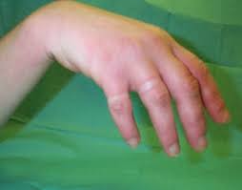
Wrist drop

Slide 37
Examination:
Axilla level: weakness- long head, medial head, lateral head of triceps, extensor carpi radialislongus and brevis, extensor digitorum, extensor indicis, supinator, extensor pollicislongus and brevis
Spiral groove: weakness of- medial and lateral head of triceps + above muscles

Slide 38
Elbow level: weakness of- all the above except medial and lateral head of triceps
Below elbow: extensor carpi radialislongus is spared so pt. has weakness of extensor digitorum, extensor indicis, extensor pollicisbrevis and longus.
Sensory loss: dorsum of proximal aspect of thumb, index, middle finger and proximal part over the dorsum of ring finger (laterally)
Reflex examination: Diminished brachioradialis and triceps jerk.

Slide 39
Physiotherapy management
Cock up splint
Electrical stimulation of muscles supplied by radial nerve depending on level of injury using i.d.c.
Gripping exercises, active/ active assisted exercises to re-educate movements

Slide 40
Is electrical stimulation helpful in preventing atrophy in denervated muscle
P- weakness of muscles due to nerve injury
I- Electrical stimulation of paralysed muscles
C- ------
O- prevent muscle atrophy

Slide 41
Electrical stimulation of denervated muscle: is it worthwhile?
Med Sci Sports Exerc. 1996 Dec;28(12):1463-9
Eberstein A1, Eberstein S.

Slide 42
Aim of the present study is to evaluate the effect of electric current on denervated muscle atrophy
Type of study Low level evidence (animal studies) | Citation Department of Orthopedics, Sixth People's Hospital, Affilicated Shanghai Jiao Tong University, Shanghai, P. R. China 200233. | Method Sixteen subjects with denervated muscles were subjected to ES with JR II nerve and muscle recovery instrument The muscle histology, ultrastructure, fibrillation potential amplitude were observed | Result Electric stimulation could protect mitochondria and sarcoplasmic reticulum from the degeneration, however no effect was found on fibrillation potential | Conclusion The electric stimulation is an effective method to prevent and treat muscle atrophy.

