Slide 1

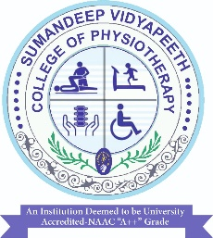
Physiological Effects
and
Therapeutic uses of Aerobic Exercise

Slide 2
PHYSIOLOGICAL EFFECTS OF EXERCISES

Slide 3
The rapid increase in energy requirements during exercise
requires equally rapid circulatory adjustments to meet the
increased need for oxygen and nutrients to remove end-
products of metabolism such as carbon dioxide and lactic acid
and to dissipate excess heat.
The shift in body metabolism occurs through a coordinated
activity of all the systems of the body: neuromuscular,
respiratory, cardiovascular, metabolic, and hormonal.

Slide 4
Cardiovascular
Response to
Exercise

Slide 5
Exercise Pressure Response
■ Stimulation of small myelinated and unmyelinated fibers in
skeletal muscle involves a sympathetic nervous system (SNS)
response.
■ The SNS response includes
■ Generalized peripheral vasoconstriction in non-exercising
muscles,
■ Increased myocardial contractility,
■ An increased heart rate,
■ An increased systolic blood pressure.
■ This results in a marked increase and redistribution of the
cardiac output.

Slide 6
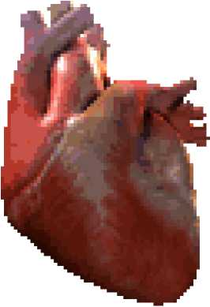
Effect on heart:
The frequency of SA node depolarization
increases, as does the heart rate.
There is a decrease in vagal stimuli as well as
an increase in SNS stimulation.
Increase in myocardial contractility.

Slide 7
Peripheral Effects
■ Net Reduction in Total Peripheral Resistance
■ Generalized vasoconstriction occurs that allows blood to
be shunted from the nonworking muscles, kidneys, liver,
spleen, and splanchnic area to the working muscles.
■ A locally mediated reduction in resistance in the working
muscle arterial vascular bed
■ Veins of the working and nonworking muscles remain
constricted

Slide 8
■ Increased Cardiac Output
The cardiac output increases because of the:
■ Increase in myocardial contractility,
■ Increase in stroke volume,
■ Increase in heart rate
■ Increase in the blood flow through the working muscle
■ Increase in the constriction of the capacitance vessels on
the venous side of the circulation in both the working and
nonworking muscles, raising the peripheral venous
pressure

Slide 9
■ Increase in Systolic Blood Pressure
■ The increase in systolic blood pressure is the result of the augmented cardiac output.

Slide 10
Respiratory
Response to
Exercise

Slide 11
■
Respiratory changes occur rapidly, even before the initiation of exercise.
■ Gas exchange (O2, CO2) increases across the alveolar-capillary membrane by the first or second breath.
■ Increased muscle metabolism during exercise results in more O2 extracted
from arterial blood resulting in
■ Increase in venous PCO₂ and H+ ion
■ Increase in body temperature,
■ Increased epinephrine, and
■ Increased stimulation of receptors of the joints and muscles.
Any of these factors alone or in combination may stimulate the respiratory system.

Slide 12
Minute ventilation (Defined as the amount of air breathed per minute) increases as respiratory frequency and tidal volume increase.
Alveolar ventilation, occurring with the diffusion of gases across the capillary-alveolar membrane

Slide 13
Therapeutic effects
or uses of aerobic
exercise

Slide 14
Improvement in Cardiovascular and Respiratory
Function
Increased maximal oxygen uptake resulting from both central
and peripheral adaptations
Decreased minute ventilation at a given absolute submaximal
intensity (therefore to reduced dyspnea)
Decreased myocardial oxygen cost for a given absolute
submaximal intensity
Decreased heart rate and blood pressure at a given
submaximal intensity
Increased exercise threshold for the accumulation of lactate in
the blood or for the onset of disease signs or symptoms (e.g.,
angina pectoris, ischemic ST-segment depression,
claudication)

Slide 15
Reduction in Coronary Artery Disease Risk Factors
Reduced resting systolic/diastolic pressures
Increased serum high-density lipoprotein cholesterol and
decreased serum triglycerides
Reduced total body fat, reduced intra-abdominal fat
Reduced insulin needs, improved glucose tolerance
Reduced blood platelet adhesiveness and aggregation

Slide 16
Decreased Morbidity and Mortality
Primary prevention (i.e., interventions to prevent the initial occurrence)
Higher activity and/or fitness levels are associated with lower death
rates from coronary artery disease and
Lower incidence rates for combined cardiovascular diseases,
coronary artery disease, stroke, type 2 diabetes, osteoporotic
fractures, cancer of the colon and breast etc.
Secondary prevention (i.e., interventions after a cardiac event [to
prevent another])
Reduction in postmyocardial infarction patients who participate in
cardiac rehabilitation exercise training, especially as a component of
multifactorial risk factor reduction

Slide 17
Other uses
Decreased anxiety and depression
Enhanced physical function and independent living in older
persons
Enhanced feelings of well-being
Enhanced performance of work, recreational, and sport
activities
Reduced risk of falls and injuries from falls in older persons
Prevention or mitigation of functional limitations in older
adults
Effective therapy for many chronic diseases in older adults

