Slide 1
RADIATION SAFETY
Prepared By:
Ms. Mital Thakkar
Assistant Professor
Department of Management
SVDU

Slide 2
INTRODUCTION
Radiation protection, also known as radiological protection, is defined by the International Atomic Energy Agency (IAEA) as "The protection of people from harmful effects of exposure to ionizing radiation, and the means for achieving this". Exposure can be from a source of radiation external to the human body or due to internal irradiation caused by the ingestion of radioactive contamination.

Slide 3
Radiation protection aims to reduce unnecessary radiation exposure with a goal to minimize the harmful effects of ionizing radiation. In the medical field, ionizing radiation has become an inescapable tool used for the diagnosis and treatment of a variety of medical conditions. As its use has evolved, so have the cumulative doses of lifetime radiation that both patients and medical providers receive. Most radiation exposure in medical settings arises from fluoroscopic imaging, which uses x-rays to obtain dynamic and cinematic functional imaging. Formal radiation protection training helps reduce radiation exposure to medical staff and patients

Slide 4
The purpose of radiation protection is to provide an appropriate level of protection for humans without unduly limiting the beneficial actions giving rise to radiation exposure. Radiation protection is to prevent the occurrence of harmful deterministic effects and to reduce the probability of occurrence of stochastic effects (e.g. cancer and hereditary effects).

Slide 5
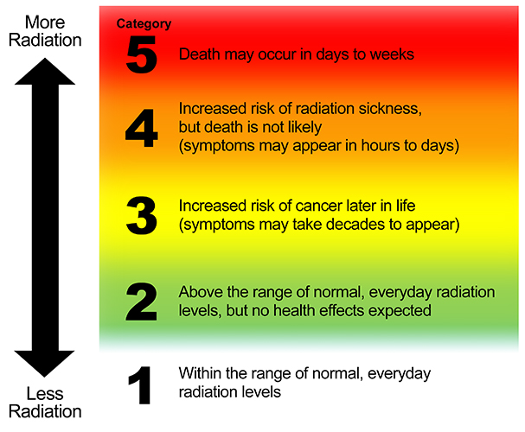
RADIATION HAZARDS

Slide 6
Ionising radiations can cause dermatitis, burns, cell damage, cataracts and changes to blood. Microwaves and radio frequencies can cause heating of any exposed part of the body, infra-red rays can cause skin burns and cataracts and UV light can cause skin burns, skin cancer, conjunctivitis and arc eye.
Exposure to very high levels of radiation, such as being close to an atomic blast, can cause acute health effects such as skin burns and acute radiation syndrome (“radiation sickness"). It can also result in long-term health effects such as cancer and cardiovascular disease. Exposure to low levels of radiation encountered in the environment does not cause immediate health effects, but is a minor contributor to our overall cancer risk.

Slide 7
REGULATION
The guiding principle of radiation safety is “ALARA”. ALARA stands for “as low as reasonably achievable”. This principle means that even if it is a small dose, if receiving that dose has no direct benefit, you should try to avoid it. To do this, you can use three basic protective measures in radiation safety: time, distance, and shielding

Slide 8
TIME
“Time” simply refers to the amount of time you spend near a radioactive source. Minimize your time near a radioactive source to only what it takes to get the job done. If you are in an area where radiation levels are elevated,
complete your work as quickly as possible, and then
leave the area.
There is no reason to spend more time around it than necessary

Slide 9
DISTANCE
Distance” refers to how close you are to a radioactive source. Maximize your distance from a radioactive source as much as you can. If you increase your distance, you decrease your dose.
How long you need to stay inside will depend on
the type and magnitude of the incident and
the amount of damage to critical infrastructure, like roads and bridges.

Slide 10
SHIELD
To shield yourself from a radiation source, you need to put something between you and the radiation source. The most effective shielding will depend on what kind of radiation the source is emitting. Some radionuclides emit more than one kind of radiation.
If you are in a multistory building, move to the center floors.
If you are in a single story building, stay in the center away from windows, doors, and exterior walls.
You can also take shelter in a basement.

Slide 11
CONTINUE
Use of Protective Barriers These barriers are against scatter radiation not against primary beam. Barrier used are; a) Aprons: Should have a minimum of 0.25mm lead covering. ➢ Material used is lead rubber covered with cloth or plastic impregnated with metallic lead. ➢ Aprons should not be folded as protective material tend to separate, should keep flat.
. Use of Protective Barriers b) Gloves and Goggles: The lead equivalent of gloves should not be less than 0.33mm. ➢ Gloves should be checked by radiography for cracks which can easily be missed on visual inspection. ➢ Lead goggles should be used during fluoroscopic examination c) X ray room and equipment: Room should be away from public places ➢ Equipment should be checked for possible leakage.
Room should also be well coated with lead along with free from any leakage.  The wall of room should be at least 22cm thick and should be of concrete into which iron may be introduced.  Warning signs must be placed near X ray room regarding potential hazards.
Reduction of Exposure factors and unnecessary Radiography  Correct exposure factors must be used in first attempt. Repeated exposures definitely enhance exposure level.  Many time owners demand radiography when it is not justified, unnecessary exposure should be avoided.
4) Use of Radiation Monitoring Devices  Radiation monitoring devices like “film badges” should be worn all the time by individuals involved in radiographic work.  Ideally one film badge should be at belt level to monitor whole body exposure while other at neckline to estimate exposure to skin of head neck and eyed.  Radiation monitoring badges available in rings, clips and wrist badges.

Slide 12
CONTINUE
Use of Radiation Monitoring Devices  Radiation monitoring devices like “film badges” should be worn all the time by individuals involved in radiographic work.  Ideally one film badge should be at belt level to monitor whole body exposure while other at neckline to estimate exposure to skin of head neck and eyed.  Radiation monitoring badges available in rings, clips and wrist badges.
X-ray beam Filtration and Shielding of tube head a) Filtration: Aluminum filters of at least 2.5mm thickness should be used to absorb the soft X rays to reduce the amount of scatter radiation. By this exposure dose can be reduced upto three to four times. b) X-ray tube head: It should be well shielded from all sides except the exit window.
Age and Sex of involved Personnel  Persons under 18 years of age should not be involved in radiography because of the sensitivity of the growing tissues.  Pregnant females should not be involved because of extreme sensitivity of embryos at certain stages of development.
Practice ALARA  ALARA means “ As LOW As Reasonably Achievable”.  Any type of ionizing radiation poses some risk. As exposure increases so does risk.  Limit your exposure whenever possible.

Slide 13
What is radiation survey?
Surveys provide a direct measure of area radiation levels and detect the presence of radioactive material inadvertently spilled on a person, surface or piece of equipment. Surveys are therefore an indication of the radiation hazard present either during or after an experiment.

Slide 14
CONTNIUE
individuals are required to survey themselves and their work areas on an “as used” or “daily basis”. The DMPRS recommends frequent surveys of hands and other skin areas to identify and rectify contamination, thus preventing significant doses and internal exposures. An operating survey meter should be accessible whenever working with radiation.The Permit Holder of a radiation laboratory is required to have a radiation survey conducted under the following conditions:
1. After each day of radioactive material usage/experimentation.
2. After transfer of radioactive material from stock solutions.
3. After each experimental run if there is a possibility of a change in radiation levels or contamination.
4. After a minor radioactive spill clean-up or emergency.

Slide 15
What is a Radiation Emergency?
A radiation emergency is defined as any unplanned event involving nuclear materials or radiation producing devices that may result in an increased exposure of individuals to ionizing radiation. The Radiation Safety Office should be promptly notified of any radiation incident to assure the proper response is taken to minimize personnel exposure, contain radioactive contamination, and address any injury from possible overexposure to sources of radiation.

Slide 16
some examples of different types of radiation emergencies.
Nuclear Emergencies
Dirty Bomb or Radiological Dispersal Device (RDD)
Radiological Exposure Device (RED)
Nuclear Power Plant Accident
Transportation Accidents
Occupational Accident

Slide 17
Protect yourself, your family, and your pets in a radiation emergency.
Get inside or take shelter,
Stay inside to reduce your exposure to radiation, and
Stay tuned for further instructions on what to do.
Because radioactive materials become weaker over time, staying inside for at least 24 hours can protect you and your family until it is safe to leave the area. If you have loved ones in schools, day cares, hospitals, nursing homes, or other facilities during a radiation emergency, stay where you are!

Slide 18
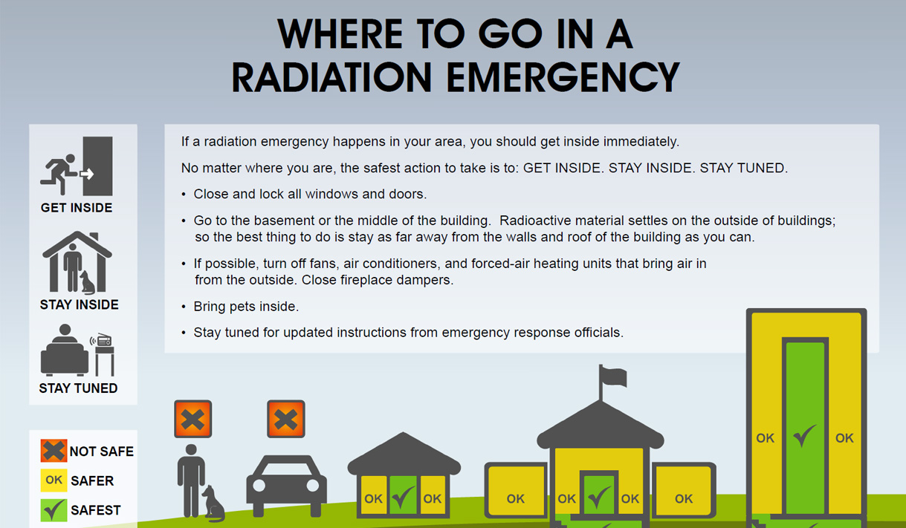

Slide 19


