Slide 1
FIRE SAFETY SERVICE
Prepared by :
Ms. Mital Thakkar
Assistant Professor
Department of Management, SVDU

Slide 2
Definition
Fire safety - Fire is most dangerous and occurence accidents ,so all staff must know what is fire and how to prevent and control it.
Fire-It is the heat and light which are formed by chemical reaction between vapor of combustible matter with oxygen in suitable degree of heat.

Slide 3
Three Components Interact To Create Fire
Fuel -
Is any combustible material that can be used as the source of ignition of the fire , as well as to keep it burning.
Oxygen-
Is an oxidising agent that reacts with the fuel to startand continue to fire. Lower concentration of oxygen result in slower fuel combustion.

Slide 4
Heat -
Fire require oxygen and fuel reacting with each other at a temperature exceeding a threshold temperature, referred to as the "flash point ".
Different materials and chemicals have different flash points, some at low temperatures and some high.
Lower the flash point temperature of a compound , the more easily the compound ignites.

Slide 5


Slide 6
Classes Of Fire -
Class A -
  Wood, paper, cloth, trash, plastic.
  Solids that are not metals.
Class B -
  Flammable liquid gasoline ,oil, grease, acetone
  Includes flammable gases.
Class C -
  Electrical -energized electrical equipments.
  As long as its "plugged in."

Slide 7
Class D -
  Metals - Potassium, Sodium , aluminium, magnesium.
  Requires Metal -X , foam and other special extinguishing agents.
Class K-
  Kitchen oils, deep fat fryers and others.
  Recently recognized by NFPA 10.
  Fires involving combustible vegetable or animal non satured cooking fats in commercial cooking equipment.

Slide 8
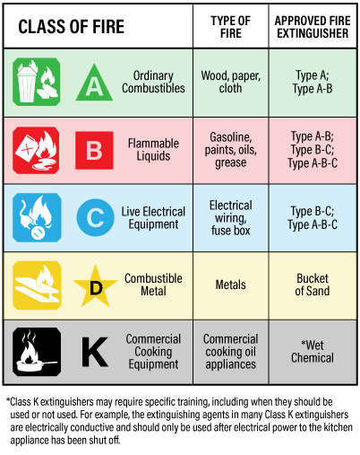

Slide 9
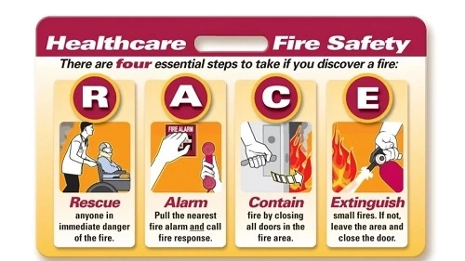
Controlling A Fire
RACE
R: Rescue
A: Alarm
C: Contain
E: Extinguish

Slide 10
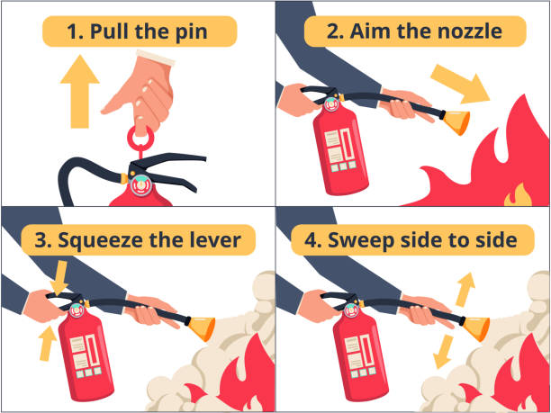
Fire Extinguisher
PASS
P: Pull
A: Aim low
S: Squeeze
S: Sweep

Slide 11
Controlling Fire
Pull nearest fire alarm and call your emergency contact e.g. security
Control fire with fire extinguisher
Do not run with burning articles
Evacuate patients in danger
Close all doors in area of fire
Remove combustible items away
Shut off unnecessary electrical equipment

Slide 12
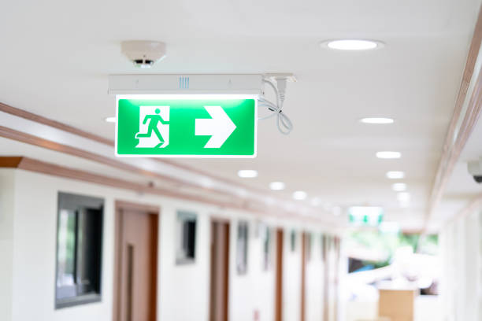
Fire Exit
Only means of escape
Free from furniture
Fire doors Automatically close in fire
Don’t block or prop the fire doors

Slide 13
Fire Evaluation Plan
Know the location of Exits
Don’t run
Walk in single pathways
DON’T PANIC
Evacuation… if fire cannot be controlled
Ambulatory patients….Wheelchair patients…Bedfast Patients.

Slide 14
Guidelines for Patient Evacuation
Patients nearest the fire and smoke will be moved first through the smoke/fire doors to a place of safety.
Ambulatory patients will be instructed to link hands and will be led to a place of safety beyond fire doors. One assigned person will head up the chain and another will bring up the rear.
Non-ambulatory patients will be moved with life support equipment when possible. Oxygen shall not be used when going through a fire area. Patients can be moved by wheelchairs and stretchers or placed on a blanket and pulled to a place of safety. Also, various emergency carries can be utilized to move non-ambulatory patients.
When possible, patients' records will be moved during evacuation (see Hospital Evacuation Plan).

Slide 15
Escape Plan
Make sure everyone knows the plan
Practice regularly
Don’t use Elevators…

Slide 16
Regulation As Per National Building Code,2005
All high rise buildings need to get NOC as per the zoning regulations
Road…12m wide
Entrance width and clearance…not less than 6m or 5m, respectively
At least 40% occupants to be trained
Open spaces

Slide 17
General Recommendation
Not to use cellars for generators and transformers
Canteens, Dormitories and pathological lab…not allowed in cellars
Regular training
Creating rural fire services
Augmentation of Municipal Hydrant system
Establishment of Disaster Control Room
Passing reference to NBC rules.

Slide 18
Evacuation Procedures for Patients with Special Needs
Very Obese Patients: When possible, place obese patients in a room near the fire/smoke doors and plan on moving them to an adjacent wing (smoke compartment). Move obese patients in their specialty bed
Ventilator-Dependent Patients:
Ventilator and move the patient to a safe area with an emergency electrical outlet. Keep the patient attached to portable oxygen.

Slide 19
If the ventilator does not have a battery back-up, remove the patient from the ventilator and manually ventilate “bag” the patient while transporting to an area of safety.
If the hospital becomes uninhabitable, ventilator-dependent patients must be evacuated directly to the nearest acute care hospital.
Bed bound patients:
Nursing staff shall be knowledgeable in evacuating patients using lifts, carries or movement of patient on a blanket to a safe area.

Slide 20
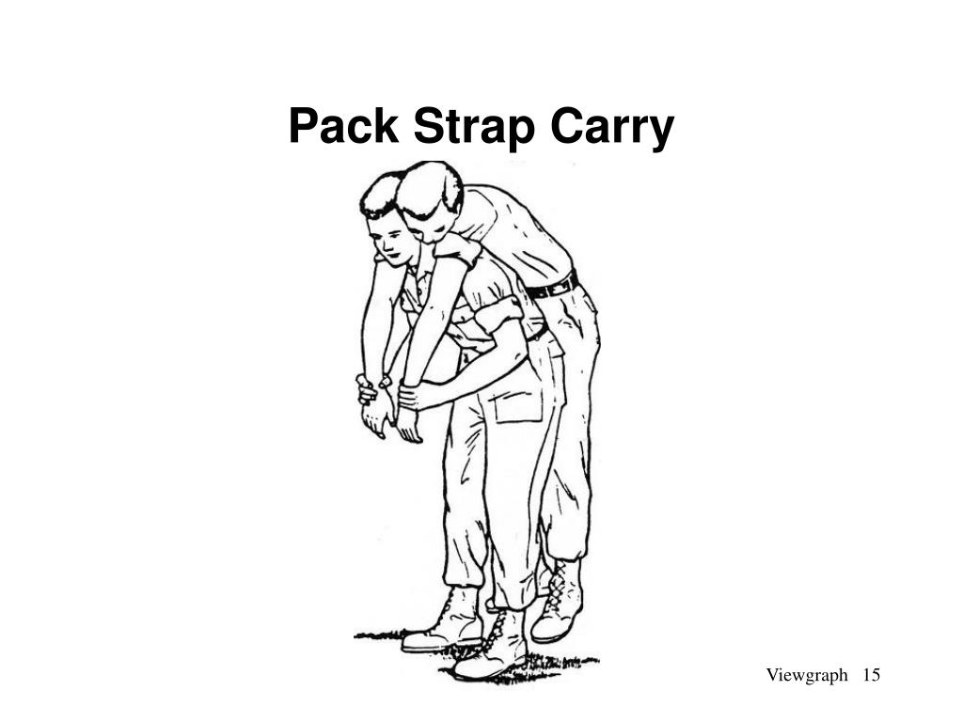
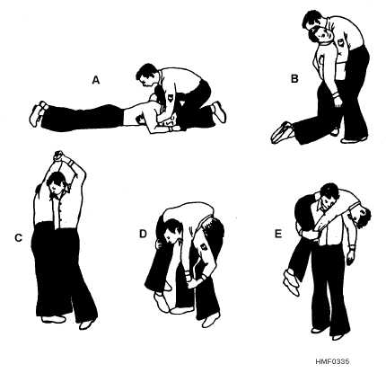

Slide 21
Hip Carry:
Place your left hand to the patient's left hand. Duck your head under the patient's left arm and put the patient's arm around your neck. Pull to a half sitting position. Reach around the patient's back with your right arm, and with your left arm behind the patient's knees, clasp securely to your hips and walk off.

Slide 22
Cradle Drop Carry:
Place a blanket on the floor at the edge of the bed. Pull the patient to edge of bed. Kneel on your left knee and put your arms beneath the patient's back and thigh. Pull the patient off the bed and onto your knee. Lower the patient’s head to the floor first and then the legs.

Slide 23
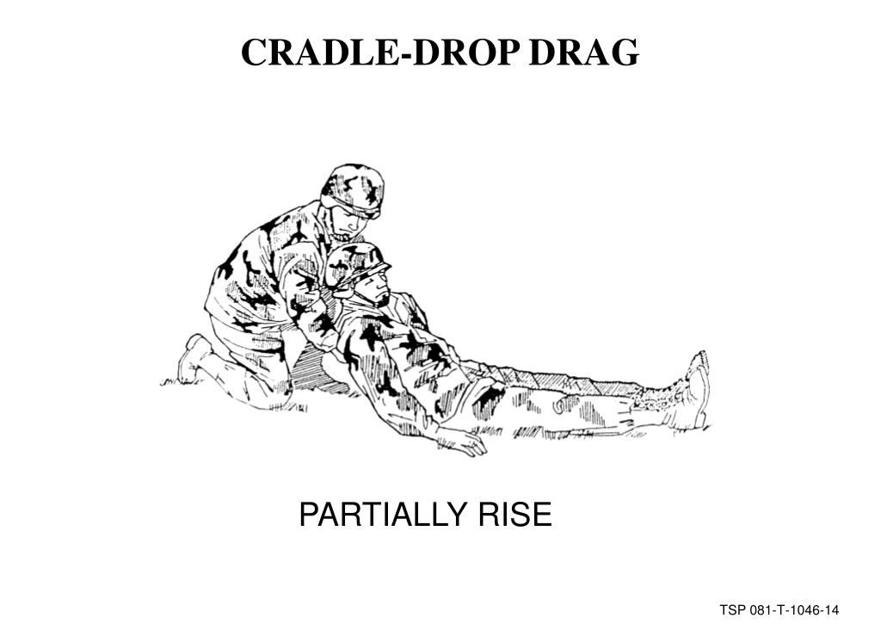
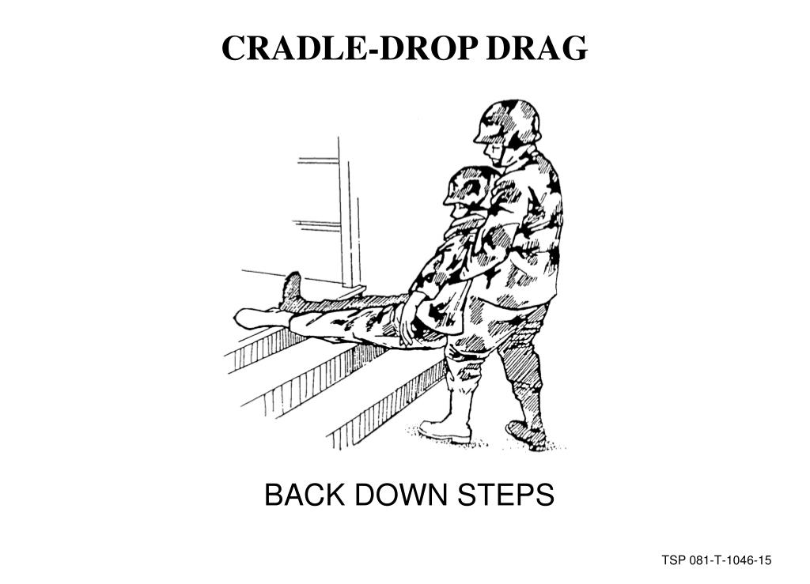

Slide 24
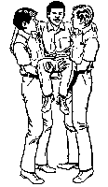
Swing Carry:
This carry takes two people. Bring the patient to a sitting position. The patient's arms are placed around the necks of the movers. The movers lock arms behind the patient's back and beneath the patient’s thighs. Lift and carry off.

Slide 25
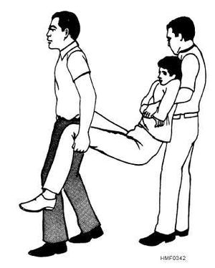
Extremity Carry:
This carry takes two people. Pull the patient to a sitting position in the proper manner. The person grasps the patient around the chest and under arms. The second person swings patient's legs off bed. The second person then backs between the patient’s legs and grasps beneath the patient’s knees. Lift the patient and walk off.

Slide 26
Departmental Responsibilities
Hospital Administration
Administrator will report to scene of the fire and, if necessary, give the order to evacuate.
Administrator will determine the area to which patients will be relocated.
Administrator will request additional personnel to report to fire scene to assist with evacuation.

Slide 27
Nursing Service :
Nursing Service Administrator will report to fire scene and supervise evacuation.
If after hours, weekends, or holidays, the House Manager will report to the fire scene and, if necessary, give the order to evacuate.
If Nursing Supervisors are not in their unit when the alarm sounds, they will immediately report back to their unit.
If the order for evacuation is given, care must be taken by Nursing personnel that all patients are accounted for.
If patients know of the existence of fire, reassure them that the alarm has been turned in and that the emergency plan is in operation. Let the patients know that the situation is under control and that there is no cause for panic.

Slide 28
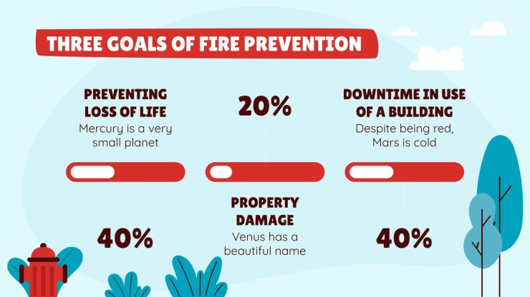
Fire Prevention Goals
Life safety
Property Protection
Protection of Operations

Slide 29
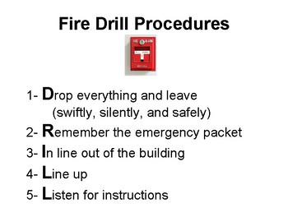
Fire Drills
Practice
Unannounced basis

Slide 30
Thank You

