Slide 1

Subject: Oral Radiology
Topic: Intra oral Radiographic Techniques:
Periapical Radiography
Dr. Akansha Budakoti
S.Lecturer
Dept. of Oral Medicine and Radiology

Slide 2
INTRODUCTION
“Image receptor is placed inside the mouth and x-rays are directed from outside the mouth”
Intra-oral
Radiography
Extra-oral
Radiography
“Image receptor is placed outside the mouth and x-rays, too, are directed from outside the mouth”

Slide 3
Intra-oral Radiography
Periapical
Bitewing
Occlusal

Slide 4


Intra-oral Periapical Projection
“To record images of teeth; periapical and
periodontal alveolar bone”
Two Techniques
‘Paralleling Cone’
Technique
‘Bisecting angle’
Technique
(Long cone technique)
(Short cone
technique)

Slide 5
Paralleling Cone Technique of
Intra-oral Periapical Radiography
First described by Edmund C. Kells in 1896
1. Patient Position: Patient can be either sitting upright or reclined in the dental chair provided that the head is not tilted to the side.
2. Placement of Image Receptor: Parallel to the long axis of the tooth to be radiographed. Special devices are used to achieve and maintain the correct receptor position.

Slide 6
Requirements for Receptor Holders:
~ Should be rigid
~ Should be autoclavable
~ Should be small and lightweight
~ Should maintain parallelism
between tooth and receptor
~ Should align the central ray
perpendicular
to the receptor
Types of Receptor Holders:
~ Artery forceps with a bite
block
~ ‘Snap-a ray’ instrument
~ ‘XCP’ device

Slide 7
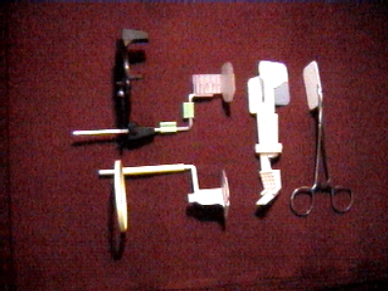
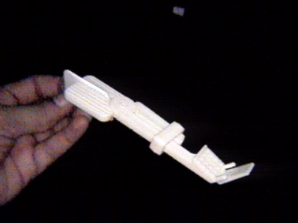
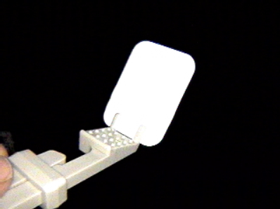
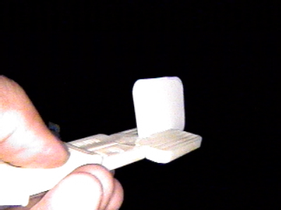
Snap-A-Ray Instrument

Slide 8
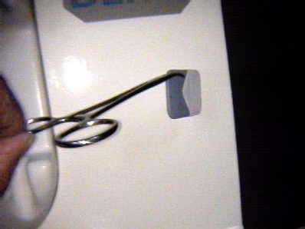
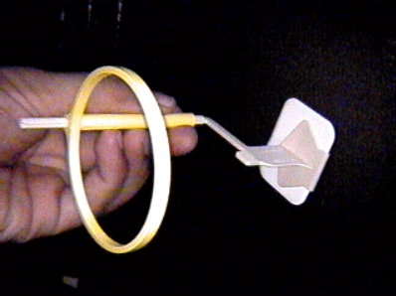
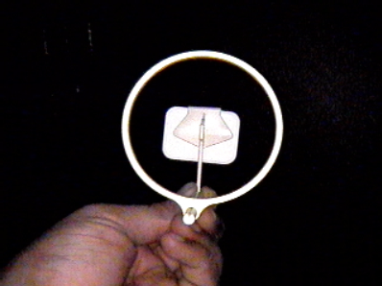
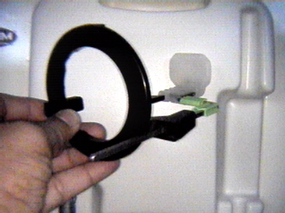
Artery forceps
or
needle holder
XCP (extension cone paralleling) Instruments

Slide 10
3. Direction of the Central Ray: Perpendicular to both- image receptor and long axis of the tooth in both -vertical and horizontal planes.
Horizontal
Vertical

Slide 11
Advantages: Related to image quality
Better image quality i.e. sharper image with least
image size and shape distortion.
Detection of early caries at the D-E junction and at
the proximal surfaces possible due to perfect
superimposition of buccal cusps over the lingual
cusps.
Detection of early periodontal disease possible due to
perfect superimposition of buccal alveolar crest over
the lingual alveolar crest.
Avoids superimposition of zygomatic process of
maxilla over the periapical region of maxillary molars.

Slide 12
Advantages: Related to image quality
Reproducible
Less cone cutting
Min short n elongation
Aautomatic angulations.

Slide 13
Limitations:
Difficult to master.
Uncomfort to patient
Long cone required
Difficult to practice in endodontics.
Needs special receptor holders.
More number of exposures needed.

Slide 14
Bisecting - Angle Technique of
Intra-oral Periapical Radiography
First described by Weston Price in 1904
Independently described by Cieszynski in 1907
Also called as technique based on Principle
of Isometric Triangulation
Patient Position: Patient; sit upright in dental chair with sagittal plane perpendicular to floor.
For maxillary teeth, the ala-tragus line is kept parallel to floor. For mandibular teeth, lower border of mandible is kept parallel to floor

Slide 15
Placement of Image Receptor: Image receptor is placed close to teeth making an angle at occlusal level with long axis of the tooth to be radiographed.
The receptor extends beyond the occlusal plane by 5 mm. Receptor position is maintained either with patient’s finger or with a holder.

Slide 16
Image size < Object size
Image size > Object size
Image size = Object size

Slide 17
3. Direction of the Central Ray: Central ray is directed perpendicular to the teeth in the horizontal plane.
Angulation in the vertical plane:
Teeth Angulation
Maxillary Mandibular
Incisors + 40 -15
Canines + 45 - 20
Premolars + 30 - 10
Molars + 20 - 05

Slide 18
4. Point of Entry / Centering Point:
¶ Maxillary ‘line of concentration’ (MYLOC) is the imaginary ala-tragus line.
Hi!
¶ Mandibular ‘line of concentration’ (MRLOC) is an imaginary line 1 cm above the inferior border of mandible.

Slide 19
Centering Points for Maxillary Teeth
11
18
12
16, 17
13
14, 15

Slide 20
Centering Points for Mandibular Teeth
44, 45
Bye!
41
48
43
42
46, 47

Slide 21
Bisecting-Angle Technique of Intra-oral Periapical Radiography
Advantages:
Easy to master.
Easy to practice in endodontics.
Does not need special receptor holders.
Less number of exposures needed for a FMRS.
Simple
If accurate: same sixe of object n image
Disadvantages:
distortion, short n elongation with change in vertical angulation,
Zygomatic buttress shadow
Pdl-poorly seenn
Angulations assesed
Cone cutting
Non reproducible
Overlapping: horizantal angulation

Slide 22
Advantages of
bisecting
angle technique
Advantages of
paralleling
cone technique
T
H
E
R
E
F
O
R
E
Paralleling cone technique is the technique
of choice for periapical radiography.
Bisecting angle technique is to be used only when the paralleling cone technique is not feasible.

Slide 23
REFERENCES
Oral Radiology principles and interpretation : Stuart. C , Michael J . Pharoah. 8th edition
Textbook of dental and maxillofacial radiology : Freny R Karjodkar. 2nd edition

Slide 24
THANK YOU

