Slide 1
TOOTH ERUPTION AND SHEDDING

Slide 2
Etymology
Erumpere – Latin word – “to break out”
Also used elsewhere:
  Dermatology - skin
  Geography – volcanic eruptions
  Literature – sudden violent outburst
  Tooth eruption refers to cutting of tooth through gums.

Slide 3
DEFINITION
Eruption refers to the axial or occlusal movement of the tooth from its developmental position in the jaw to its functional position in occlusal plane.
Eruption is defined as the process by which developing teeth emerge through the soft tissues of the jaws and the overlying mucosa to emerge into the oral cavity, to their functional position in the occlusion

Slide 4
Dentition:
Diphodont: Two sets of dentition in humans
  Primary / Deciduous – 6months to 6 years
  Mixed dentition - 6 to 12 years
  Secondary / Permanent dentition- >12 years

Slide 5
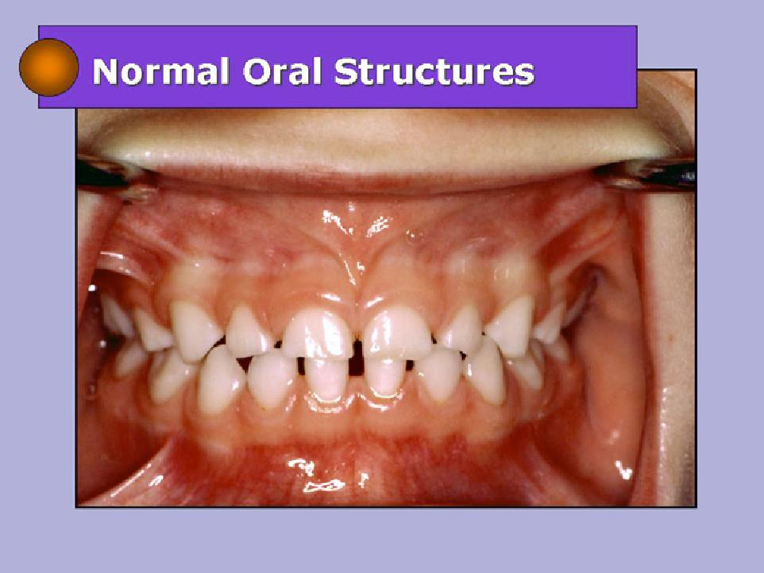
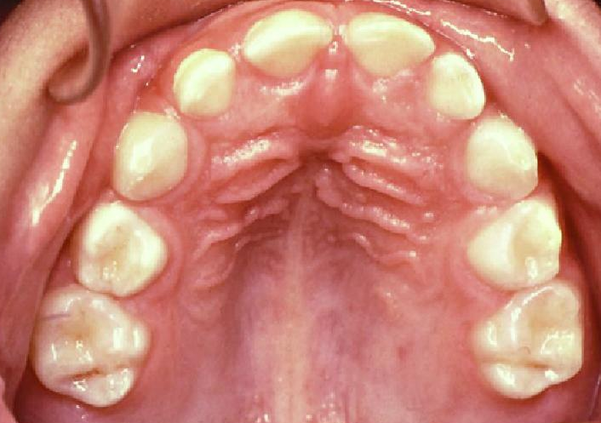

Primary dentition:
2 to 6 years of age
Mixed dentition:
6 to 12 years
Permanent dentition: > 12 years

Slide 6
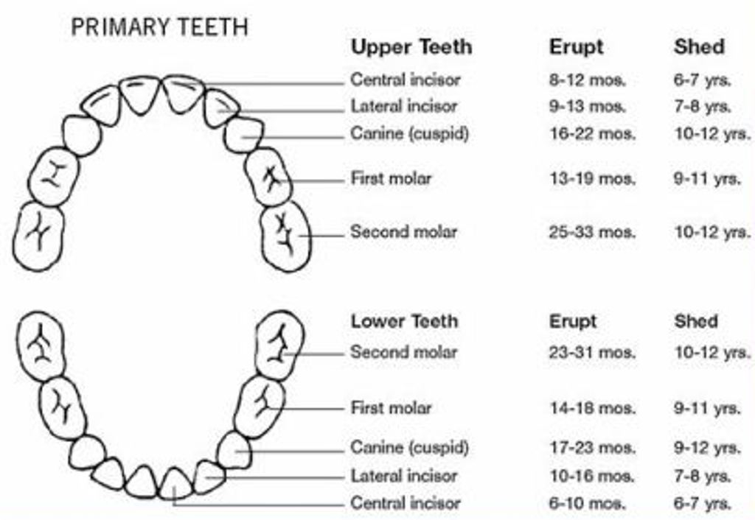
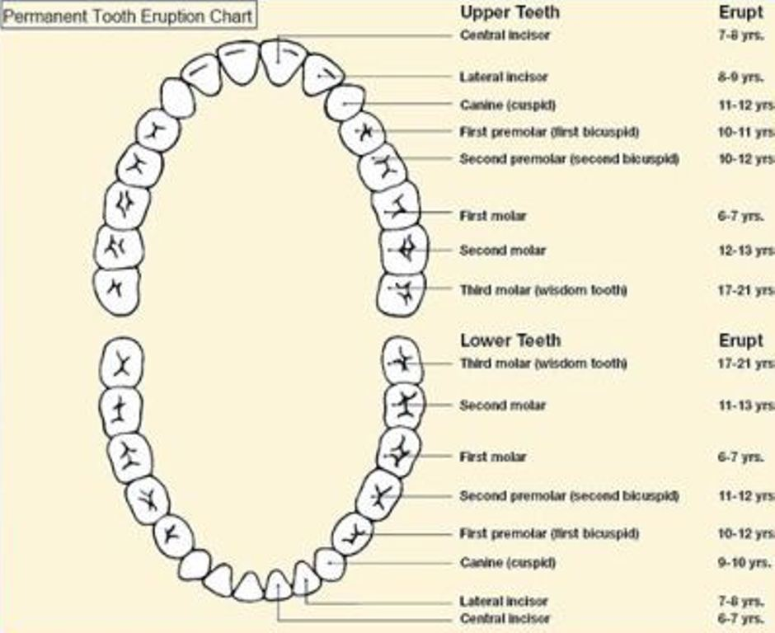

Slide 8
Types of tooth movement
Pre- eruptive
Eruptive
Post eruptive

Slide 9
PRE-ERUPTIVE TOOTH MOVEMENT
Made by the deciduous and permanent tooth germs within tissues of the jaw before they begin to erupt.

Slide 10
Pre-Eruptive stage: deciduous teeth
Initially good deal of space
As the tooth buds grow in size, they get crowded, but the jaw growth also occurs at the same time

Slide 11
Pre-eruptive stage: permanent teeth
Permanent incisors, canines in bony crypts lingual to deciduous teeth
Molars distal to the primary tooth

Slide 12

Pre-eruptive stage: permanent teeth
Permanent anterior tooth germs develop lingual to the primary anterior teeth and later as primary teeth erupt, the permanent crowns lie at the apical 3rd of primary roots.

Slide 13

Pre-eruptive stage: permanent teeth
Premolars tooth germs are finally positioned between the divergent roots of deciduous molars.

Slide 14
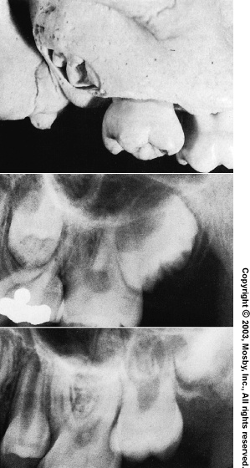
Pre-eruptive stage: permanent teeth
Permanent molar tooth germs develop from backward extension of dental lamina.
Upper molar tooth germs develop first with their occlusal surface facing distally and changes its position only when the maxilla has grown sufficiently.

Slide 15
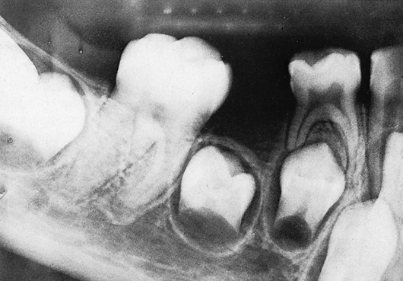
Pre-eruptive stage: permanent teeth
In the mandible,molar tooth germs has mesial inclination → vertical → sufficient jaw growth

Slide 16
Why pre-eruptive tooth movement?
Total bodily movement of tooth germ
Growth in a part of the tooth germ, while the other germs remains fixed leading to change in the centre of the tooth germ
Bone remodeling

Slide 17
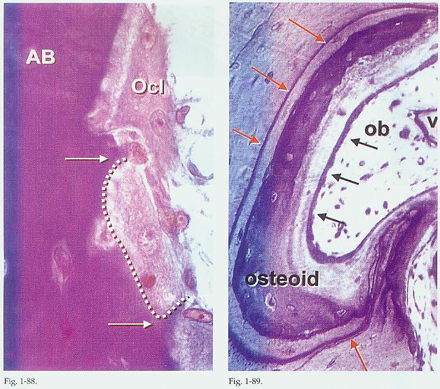
HISTOLOGIC FEATURES
Remodeling of the bony wall of crypt by selective deposition and resorption of bone by osteoblasts and osteoclasts.
Normal skeletal morphogenesis might be involved in determining tooth position.

Slide 18
ERUPTIVE TOOTH MOVEMENT
The axial or occlusal movement of the tooth from its developmental position within the jaw to its final functional position in the occlusal plane.
The actual eruption of the tooth, when it breaks through the gum, is only one stage of eruption.

Slide 19
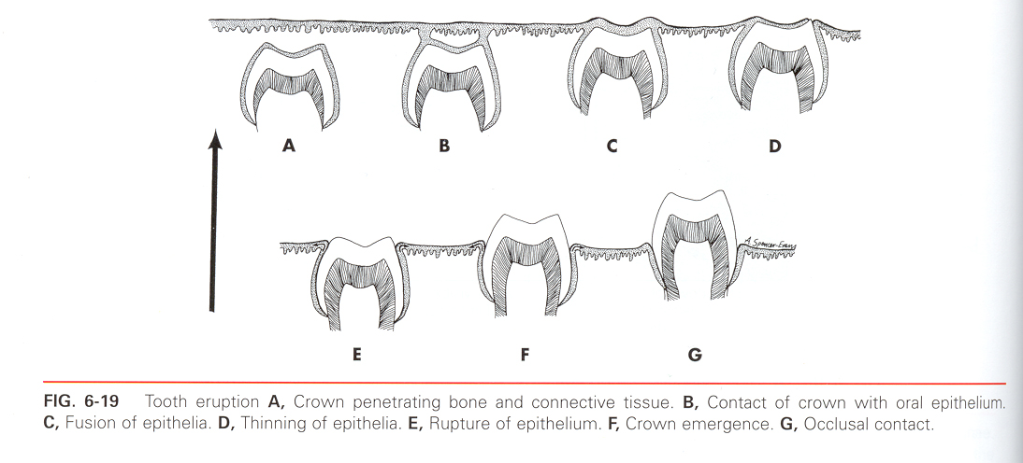
STAGES OF TOOTH ERUPTION

Slide 20
ERUPRTIVE TOOTH MOVEMENT
Intraosseous phase: 1-10μ/day
Extraosseous phase: 75μ/day
Environmental factors
  Muscle forces form tongue, lip and cheeks
  Contact of erupting teeth with other teeth
  Habits like thumb sucking, lip sucking etc

Slide 21
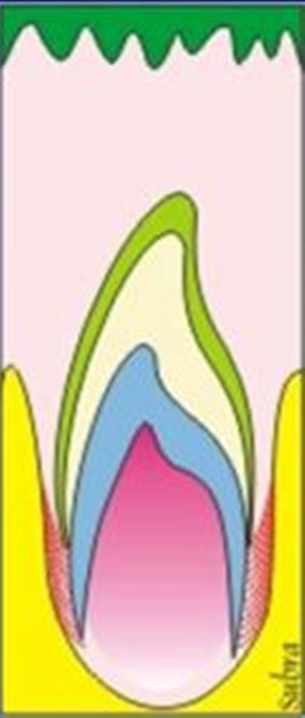
Stages: Root Formation
Root formation
Space is required for root formation
Proliferation of epithelial root sheath
Initiation of root dentin and pulp
Increase in fibrous tissue of the follicle

Slide 22
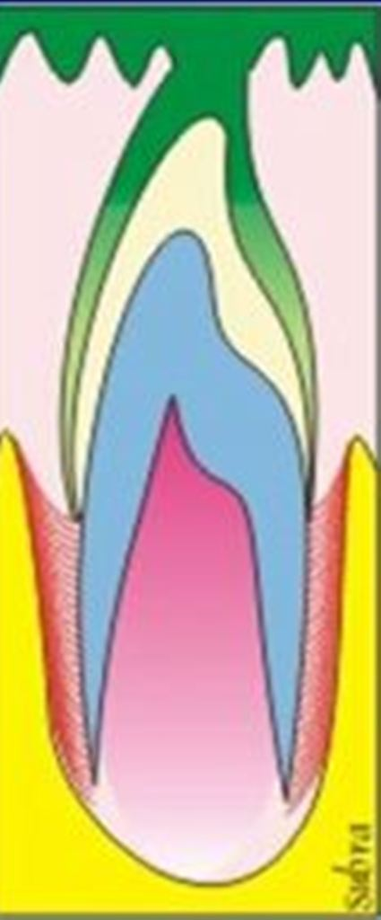
Stages: Movement
Occurs incisally or occlusally
Main reason for movement is that the roots can form normally
Reduced enamel epithelium fuses and contacts the oral epithelium

Slide 23
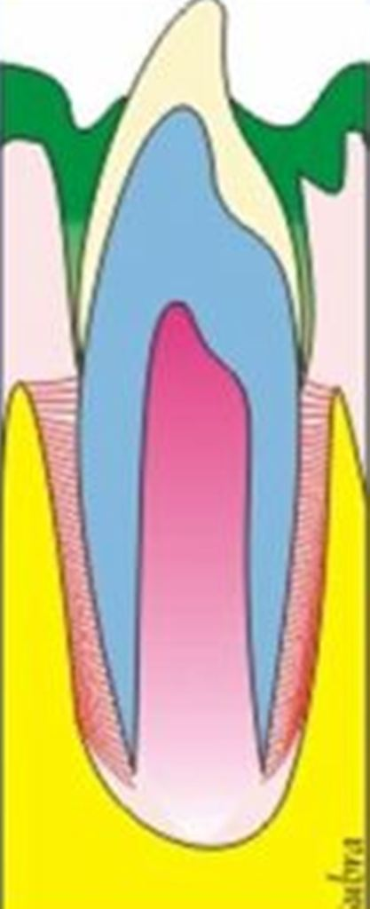
Stages: Emergence
Penetration of the tooth’s crown tip through the fused epithelial layers allowing entrance of the crown into the oral cavity

Slide 24
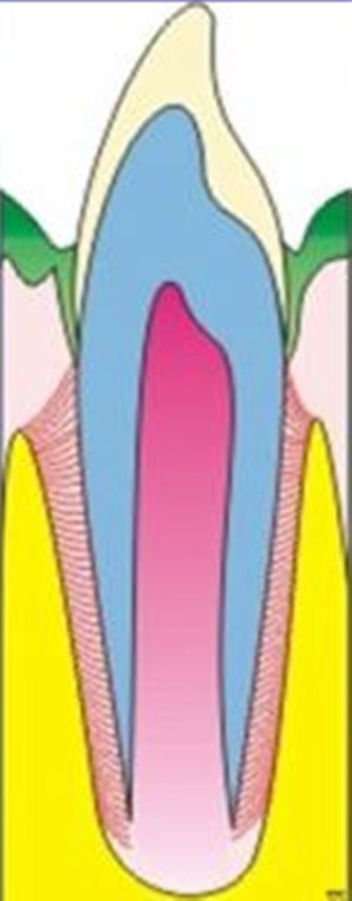
Stages: Post Eruptive movement
Intraoral incisal or occlusal movement of the erupting tooth continues until clinical contact with the opposing crown occurs

Slide 25
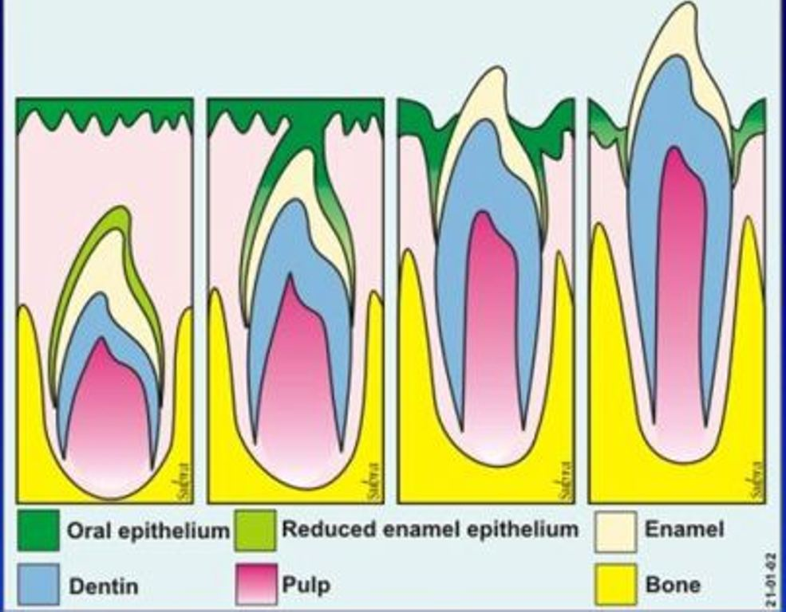
Histological changes of eruptive tooth movement

Slide 26
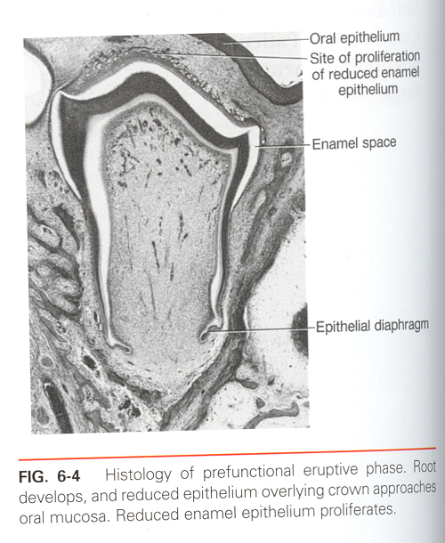
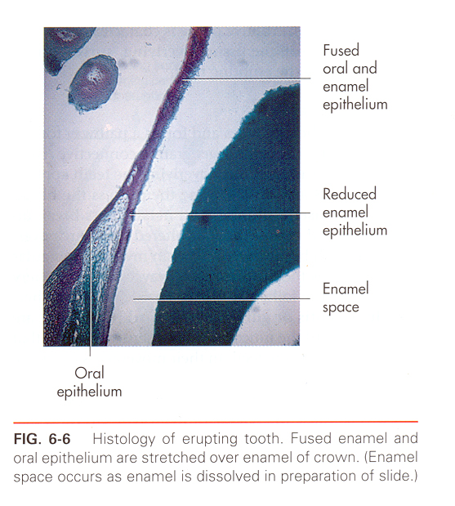
HISTOLOGIC FEATURES

Slide 27
HISTOLOGIC FEATURES
Significant developmental events occur associated with eruptive tooth movement like..
        Root Formation
        PDL Remodelling
        Dentogingival Junction

Slide 28
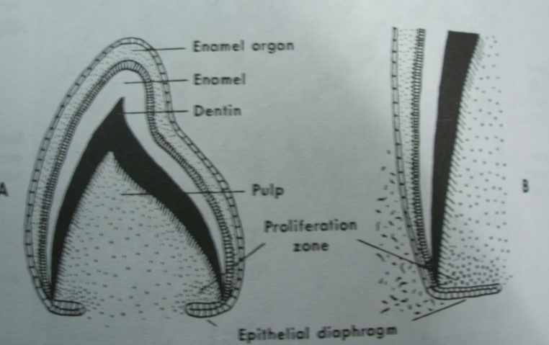
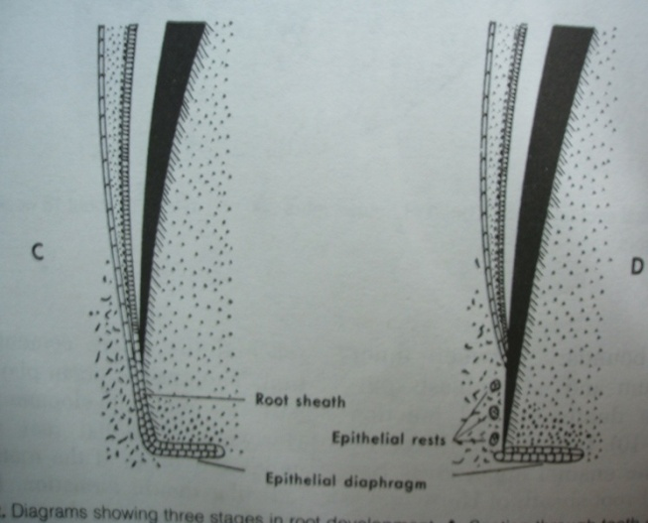
a). ROOT FORMATION
Root formation is initiated by the growth of the HERS which initiates the differentiation of odontoblasts from the dental papilla.
The odontoblasts then form root dentin and overall increase in length of tooth occurs.

Slide 29
b). PDL REMODELLING
After the onset of root formation, cementum, PDL and the bone lining of crypt wall forms.
The remodeling of the PDL fiber bundles is achieved by fibroblasts.

Slide 30
The fibroblasts of the PDL possess as part of their cytoskeleton intermediate filaments that consists of contractile proteins.
They exhibit frequent cell to cell contact and further specialization involving the cell membrane called as FIBRONEXUS.
Fibronectin is a sticky glycoprotein that can stick to a number of extracellular components including collagen.

Slide 31
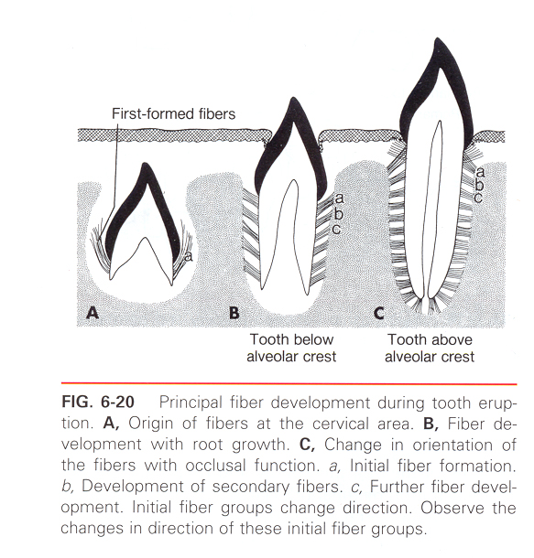

Slide 32
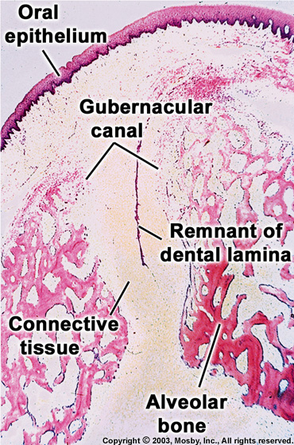
THE GUBERNACULAR CANAL and its contents, THE GUBERNACULAR CORD, which may have an influence on eruptive tooth movement.

Slide 33
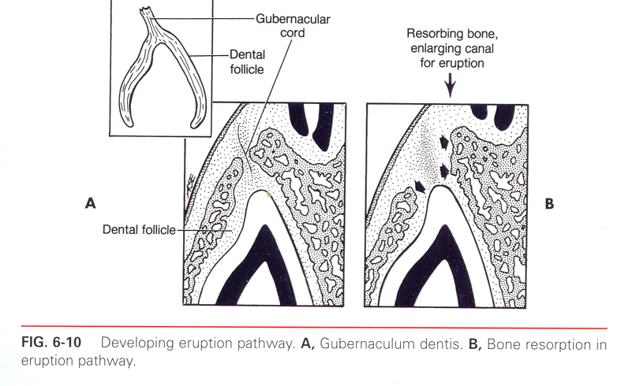
As the successional tooth erupts, Gubernacular canal gets widened by local osteoclastic activity, delineating the eruptive pathway of the tooth.

Slide 34
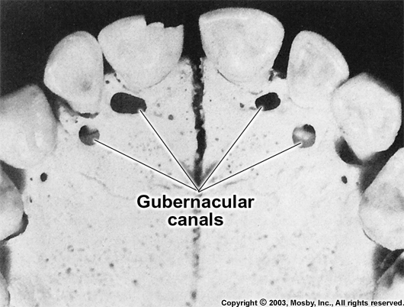
In the dried skull, holes can be seen in the jaws on the lingual aspects of the deciduous teeth.
Gubernacular cord have a function in guiding the permanent tooth as it erupts.

Slide 35
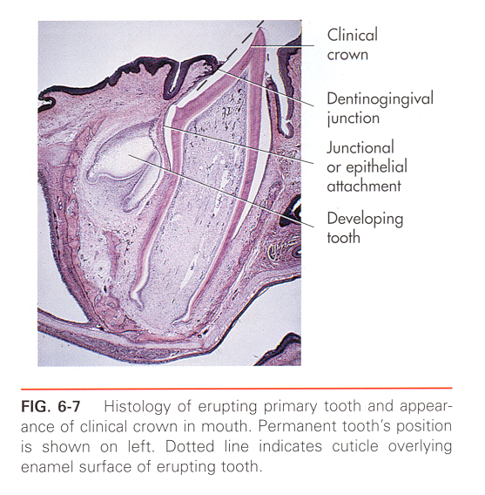
The central cells of this epithelial mass degenerate and forms an epithelium line canal through which the tooth erupts without any hemorrhage.
The epithelial cell mass is also involved in the formation of DENTOGINGIVAL JUNCTION

Slide 36
POST ERUPTIVE TOOTH MOVEMENTS
Post eruptive movements are those made by the tooth after it has reached its functional position in the occlusal plane.
They may be divided into three categories:-
- Accomodation for growth.
- Compensation for occlusal wear.
- Accomodation for interproximal wear.

Slide 37
ACCOMMODATION FOR GROWTH
Mostly occurs between 14 to 18 years by formation of new bone at the alveolar crest and base of socket to keep pace with increasing height of jaws.
COMPENSATION FOR OCCLUSAL WEAR
Compensation primarily occurs by continuous deposition of cementum around the apex of the tooth which occurs only after tooth moves.

Slide 38
ACCOMMODATION FOR INTERPROXIMAL WEAR
- Compensated by mesial or approximal drift.
- Mesial drift is the lateral bodily movement of teeth on both sides of the jaw.

Slide 39
Several factors control mesial drift
Contraction of the transseptal fibers:-
As the proximal surfaces of adjacent teeth become worn from functional tooth movement, the transseptal fibers of the periodontal ligament become shorter (due to contraction) and thereby maintain tooth contact.

Slide 40
(b) Adaptability of bone tissue:-
The side of pressure on PDL fibers causes bone resorption, whereas pull on the fibers causes bone apposition (formation).
Therefore, as the contact areas of the crowns wear, the teeth tend to move mesially, thereby maintaining the contact.

Slide 41
(c) Anterior component of occlusal force:
An anteriorly directed force is generated when teeth are clenched, due to the mesial inclination of most teeth and the forward-directed force generated from inter-cuspal forces. Eliminating opposing teeth results in elimination of biting forces, causing a slowing down of the mesial migration.
(d) Pressure from soft tissues:
Buccal mucosa and tongue push teeth mesially.

Slide 42
Mechanisms of Tooth Eruption
Root growth
  Cushion hammock ligament
Bone remodelling
Pulp growth
Vascular pressure (Pulp Constriction)
Hydrostatic (tissue fluid) pressure
Gubernacular cord
Dental follicle
Periodontal ligament traction

Slide 43
Root Growth Theory
Growth of the root into the bone forces the crown through the gums – [ Carlson, 1944]
CONTRADICTION:
Experimental studies pinning of erupting tooth resulted in root growth
Rootless tooth erupt [ Gowgiel, 1961]
Eruptive movements of teeth do not coincide with the total length of their roots

Slide 44
Root Growth Theory –contradictions
Eruption occurs even after root completion
Eruption occurs even after surgical removal of hertwig’s epithelial root sheath, periapical tissue and apical papilla
Impacted and unerupted permanent tooth with completely formed roots erupt after surgical exposure

Slide 45
Cushion Hammock Ligament Theory
Sicher in 1942
A ligament anchored in alveolar bone → ‘cushion hammock’ on which tooth rests → growth of the root apically on the hammock → eruption
Contradiciton
No histological evidence of the ligament.

Slide 46
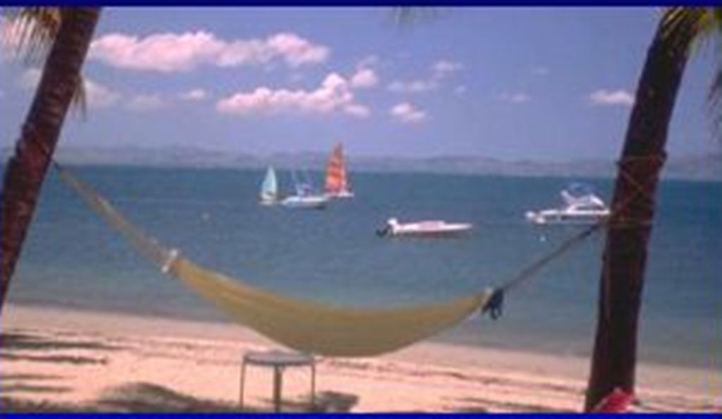

Slide 47
Bone Remodeling Theory
Remodeling of the alveolar bone pushes the tooth outward
Evidence:
Even if a tooth is prevented from erupting, eruptive pathways forms within the bone by widening of the gubernacular canal
Contradictions:
Eruprive pathway forms only if dental follicle is retained, not otherwise

Slide 48
Bone Remodeling Theory - contradiction
Fibers run in a reverse direction than what the theory proposes and new bone cannot exert force on the fibers already inserted into the bone
In Vit A and Vit D deficiency, there is increased alveolar bone or osteoid but eruption rates are not increased
Incompletely formed root is pinned to the bone, bone resorption takes place as root grows

Slide 49
Pulp Growth Theory (Eccles, 1965)
Growth of pulp produces eruptive forces.
Contradictions:
Teeth with extripated pulps erupt normally
Vit D deficiency results in increased in rate of eruption
Eruption occurs even after surgical removal of hertwig’s epithelial root sheath, periapical tissue and apical papilla

Slide 50
Pulp Constriction Theory
Dentin continues to form → pressure from pulp →eruption of the tooth
Contradictions:
Rootless teeth erupt
Teeth with extirpated pulps erupt normally
Vitamin A deficiency results in the pulp constriction but there is no increased eruption
Protein defiency → eruption rate not decreased

Slide 51
Hydrostatic Pressure Theory
Presence of blood vessels in the apical region causes formation of tissue fluid which exert a steady pressure which result in the tooth movement.
Contradictions:
Eruption occurs even after removal of hertwig’s epithelial root sheath, periapical tissue and apical papilla

Slide 52
Gubernacular Cord Theory
Gubernacular cord pulls the teeth from underlying tissues.
Contradictions:
Does not explain tooth movement after eruption
Surgical removal of cord does not impede tooth movement
Does not explain tooth movement of deciduous teeth

Slide 53
Dental follicle Theory:
Follicular cells express factors which recruit osteoclasts (thro’s OSF) that permit bone remodeling around the erupting tooth.
Evidences:
In ostropetrotic animals (which lack osteoclast differentiation), eruption is prevented
Immunihistochemical findings of cellular activity around REE and dental follicle

Slide 54
Dental follicle Theory:
Experiment
  Molar removed, follicle stripped, molar replaced → no eruption
  Crown removed, follicle intact →eruptive pathway still forms within bone

Slide 55
Ligament Traction Theory
Force for the eruptive tooth movement resides in the PDL which pulls the tooth out
Evidences:
Experiment by interfering with collagen synthesis by denying Vit C slows down or stops tooth movement.
If a continuously growing tooth (e.g. rodent incisor), is cut and a barrier is placed between 2 halves, the distal half continues to erupt in spite of dissociating from the growing root and apical vasculature.

Slide 57
Ligament Traction Theory
Mechanism: Forces necessary for generating tooth eruption may be derived by:
  Randomly oriented fibers become ordered
  Contraction of collagen due to crosslinking
  Contraction of collagen due to GAG turnover
  Remodeling of PDL collagen by fibroblasts
  Tractional forces due to locomotive and contractile properties of myofibroblasts (have wavy nucleus, microtubules and microfilaments)

Slide 58
Conclusion:
Tooth eruption is a multifactorial phenomena
Force to move the tooth is generated by myofibroblasts of the PDL
Dental follicle and bone remodeling are important to accommodate the erupting tooth

Slide 59
Applied aspects of eruption
Timing of eruption
Premature eruption – natal teeth and neonatal teeth
Delayed eruption
Unerupted tooth (embedded)
Impacted tooth

Slide 60
REFERENCES
TENCATE- A textbook on Oral Histology.
ORBAN’S- A textbook on Oral Histology.
Vincent Provenza- Oral Histology & Inheritance.
Critical Reviews in Oral Biology & Medicine -13(4):323-335,2002

Slide 61
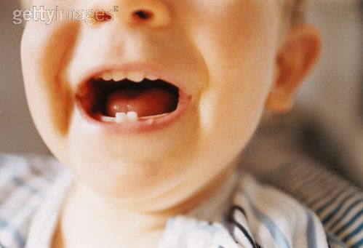
  THANK YOU

