Slide 1
BDS Year 3 Regular batch
Academic Year 2022-2023
Subject: Dental Anatomy & Oral Histology
Topic: Salivary Gland Diseases
Dr. Rashmi Bhavasar
Professor
Dept. of Oral Pathology and Microbiology

Slide 2


Slide 3
Glands
Special type of cells, which are specialized to produce products to be used elsewhere in the body.

Slide 4
GLANDS classified As:
According to distribution
Exocrine
Endocrine
secrete their products into blood or lymph→ lack ductal system
E.g.-thyroid gland
secrete their products via ducts onto epithelial surface. Eg.-salivary gland

Slide 5
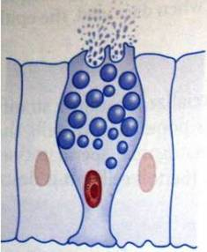
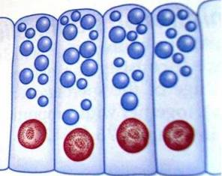
According to structures
Unicellular
Multicellular
develop as diverticulae from epithelial surface.
Distal part- secretory elements.
Proximal parts form ducts
interspersed amongst other non secretory epithelial cells.
Notes:
Unicellular glands- mucus cells, goblet cells

Slide 6

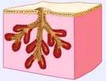
According to branching of duct
Simple
Compound
Single duct
Multiple ducts
Notes:
Simple duct –in glands of large intestine

Slide 7



According to secretory units
Tubular
Alveolar or acinar
Tubulo alveolar or tubuloacinar
Notes:
Tubular or alveolar-sweat glands

Slide 8
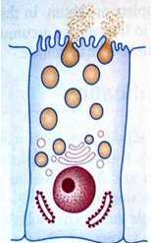
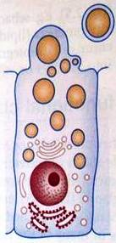
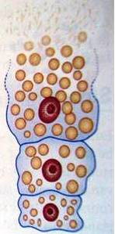
According to mechanism of secretions
Apocrine
Holocrine
Merocrine
Part of apical cytoplasm lost
Milk fat by mammary gland
Entire secretory cell shed
Sebaceous gland
No part of the cell is lost
Sweat gland
Notes:
Merocrine also called eccrine

Slide 9
According to Nature of secretions
Serous
Mucous
Mixed
Thin watery protein rich secretion
Pancreas, parotid gland
Viscous, rich in carbohydrates
Labial Glands
Both the types of secretions
Submandibular gland

Slide 10
Salivary glands:
A multicellular, exocrine, compound,
tubuloacinar & merocrine gland
Secrete saliva which has many
functions in the oral cavity

Slide 11
Oral cavity is kept moist by a film of fluid called
SALIVA
Important function is to maintain the well being of the mouth

Slide 12
Saliva
Oral Fluid
Secretions
Desquamated oral epithelial cells
Microorganisms and their products
Food debris
Inflammatory cells& serum components

Slide 13
Composition of Saliva
Volume
Electrolytes
Secretory proteins
Immunoglobulins
Small organic
Other components
Flow rate: Whole Parotid Submandibular
Resting
Stimulated
pH

Slide 14
Functions of Saliva
Protection & Lubrication
Buffering & remineralization
Mucosal Integrity
Dilution & Cleansing
Antimicrobial Action
Deglutition
Digestion
Taste
Phonation
Excretion

Slide 15
Protects the teeth from acids produced by microorganisms
Bicarbonate
Phosphate
Proteins
Mucins
Water
Muicns
Ca2
Phosphate
Gustin (carbonic anhydrase)
Zn2
Water
Buffer
Bouls
formation
Protection against
demineralization
PRPs
Statherin
Phosphate
Taste
Remineralization
Amylase
Protease
Lipase
DNAse
RNAse
Food
Functions
of saliva
Teeth
Digestion
Lubrication
Mucins
PRG
Micro-organisms
Anti-bacterial
Anti-Viral
Lysozyme
Lactoferrin
Calprotectin
Lactroperoxidase
Immunoglobulins
Chromogranin A
Anti-Fungal
Cystains
Histatins
VEGh
SLPI
Cystatins
Mucins
Immunoglobulins
SLPI
Histatins
Chromogranins A
Immunoglobulins

Slide 16
Major glands
Parotid: so-called watery serous saliva rich in amylase, proline-rich proteins
  Stenson’s duct
Submandibular gland: more mucinous
  Wharton’s duct
Sublingual: viscous saliva
  ducts of Rivinus; duct of Bartholin

Slide 17
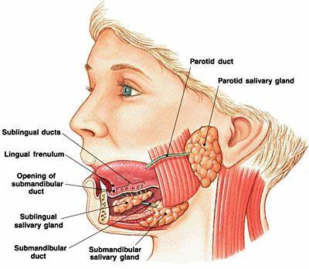
https://r.search.yahoo.com/_ylt=AwrKDxPX6Stj8fcX7HbGHAx.;_ylu=c2VjA2ZwLWF0dHJpYgRzbGsDcnVybA--/RV=2/RE=1663851095/RO=11/RU=http%3a%2f%2fsimplyknowledge.com%2fpopular%2fgk_detail%2fsalivary-glands/RK=2/RS=zzSrO3ZMR10e9gdcP6LJh2BOJ18-

Slide 18
Minor glands
Minor salivary glands are not found within gingiva and anterior part of the hard palate
Serous minor glands: Von Ebner below the sulci of the circumvallate and follate papillae of the tongue
Glands of Blandin-Nuhn: anterior ventral tongue (near apex)
Palatine, glosso palatine glands are pure mucus- Palate
Weber glands- Lateral border of the tongue

Slide 19
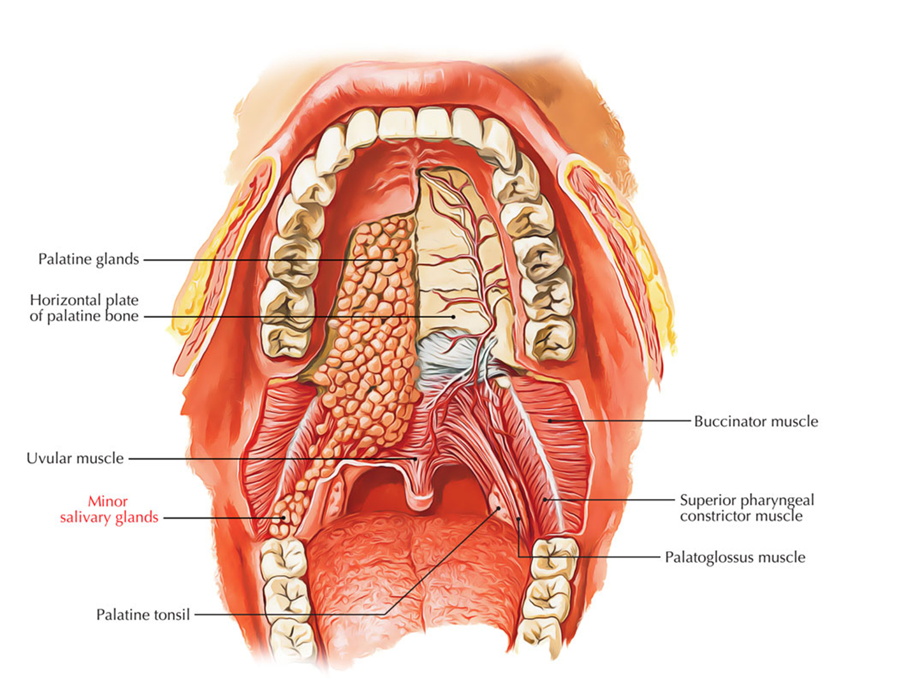

Slide 20
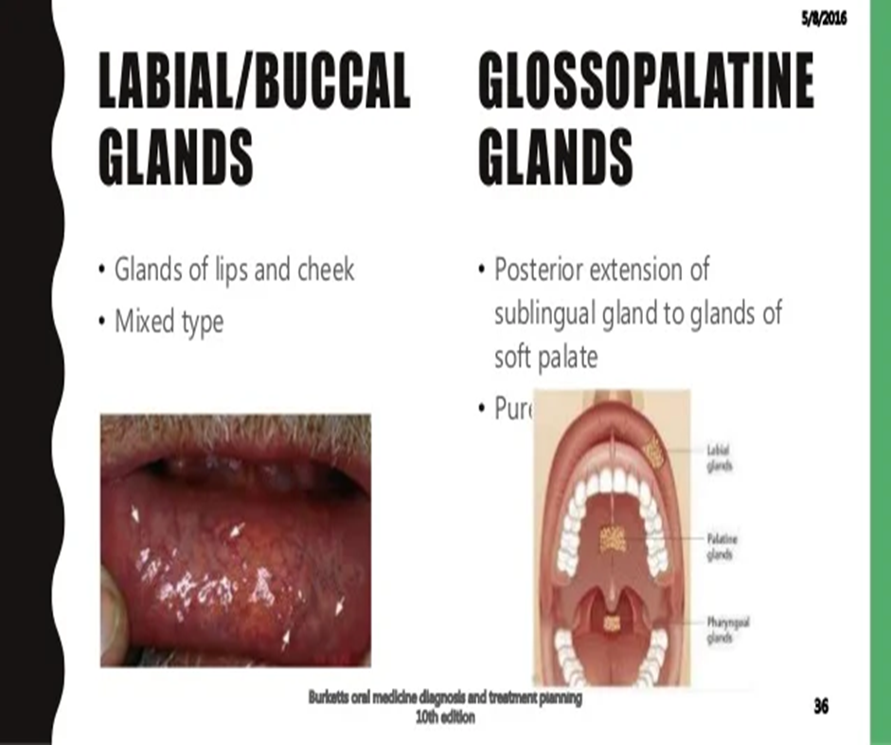
https://r.search.yahoo.com/_ylt=AwrKDxMt7ytjUoIWAmPGHAx.;_ylu=c2VjA2ZwLWF0dHJpYgRzbGsDcnVybA--/RV=2/RE=1663852461/RO=11/RU=https%3a%2f%2fwww.slideshare.net%2fapurva3011990%2fsaliva-in-dentistry/RK=2/RS=WUZAOqVcMbVPYU1owbAaRjRo3e8-

Slide 21
Microanatomy
The Secretory Unit
Acinus (serous, mucous, mixed)
Myoepithelial cells
DUCTS
Intercalated duct
Striated duct
Excretory duct

Slide 22
Acinar cells
At around the 7-8th month in utero, secretory cells (acini) begin to develop around the ductal system.

Slide 23
Acinar cells of Salivary Glands
Classified as either:
Serous cells: produce a thin watery secretion
Mucous cells: produce a more viscous secretion

Slide 24
Serous cells
Serous cells: secrete polysaccharides
They have all the features of a cell specialized for the synthesis, storage, and secretion of protein
  Rough endoplasmic reticulum (ribosomal sites--cisternae)
  Prominent Golgi--carbohydrate moieties are added
  Secretory granules--exocytosis

Slide 25
Serous cells
The secretory process is continuous but cyclic
There are complex foldings of cytoplasmic membrane
The junctional complex consists of:
  Tight junctions (zonula occludens)-->fusion of outer cell layer
  Intermediate junction (zonula adherens)-->intercellular communication
  Desmosomes-->macula adherens

Slide 26
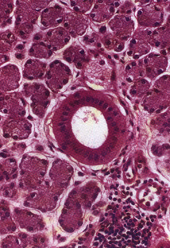

Slide 27
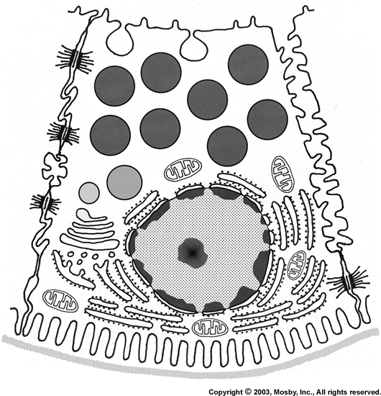

Slide 28
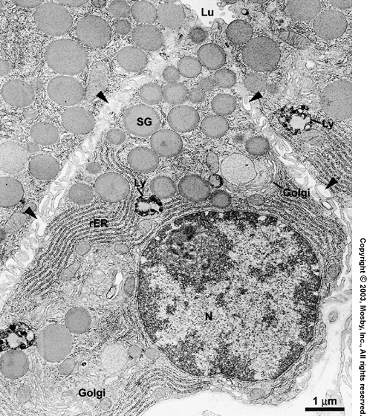

Slide 29
Mucous cells
Production, storage, and secretion of proteinaceous material; smaller enzymatic component
-more carbohydrates-->mucins=more prominent Golgi
-less prominent (conspicuous) rough endoplasmic reticulum, mitochondria
-less interdigitations

Slide 30

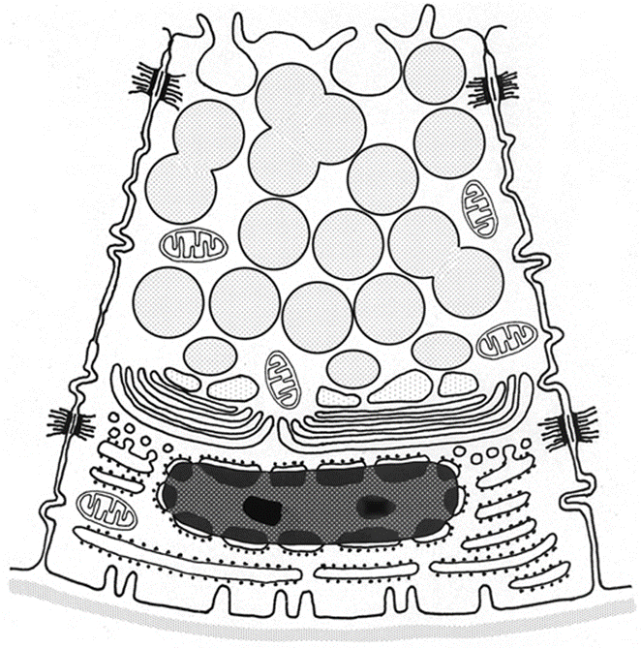

Slide 31
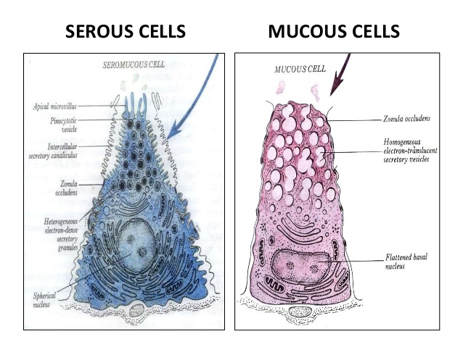

Slide 32
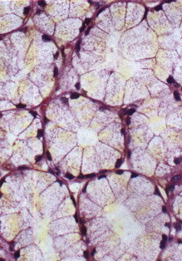

Slide 33
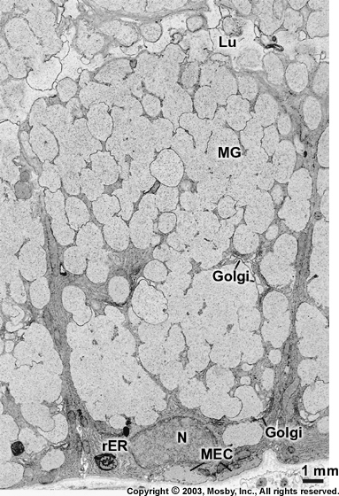

Slide 34
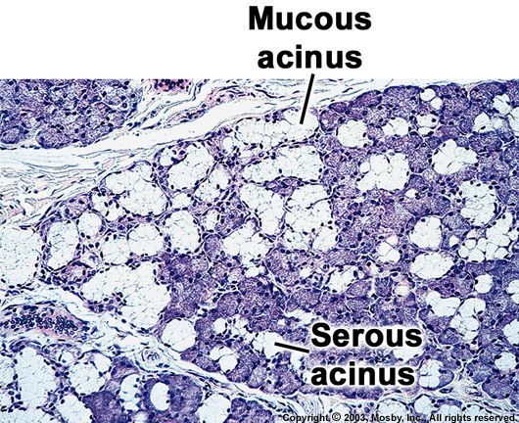

Slide 35
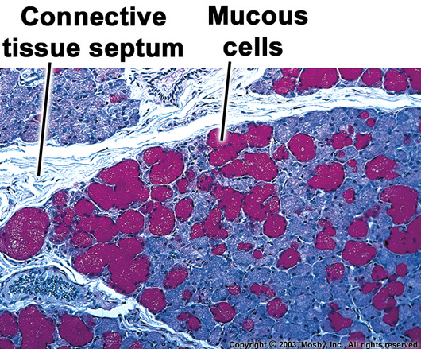

Slide 36
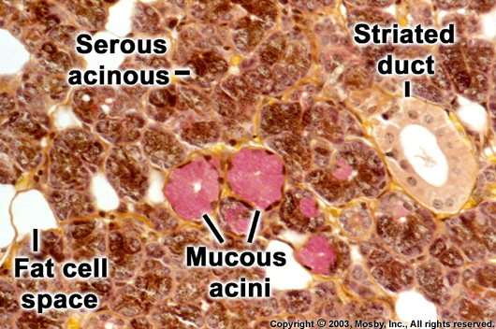

Slide 37
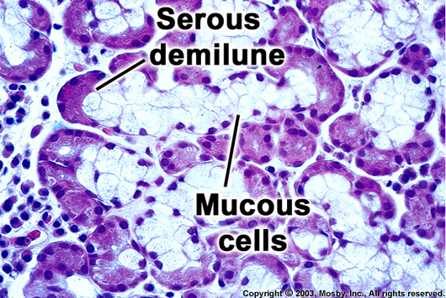

Slide 38
Myoepithelial cells
One, two or even three myoepithelial cells in each salivary and piece body
Four to eight processes
Desmosomes between myoepithelial cells and secretory cells
Myofilaments frequently aggregated to form dark bodies along the course of the process

Slide 39
Myoepithelial cells
The myoepithelial cells of the intercalated ducts are more spindled-shaped and fewer processes
Ultrastructurally very similar to that of smooth muscle cells
Functions of myoepithelial cells
  Support secretory cells
  Contract and widen the diameter of the intercalated ducts
  Contraction may aid in the rupture of acinar cells of epithelial origin

Slide 40
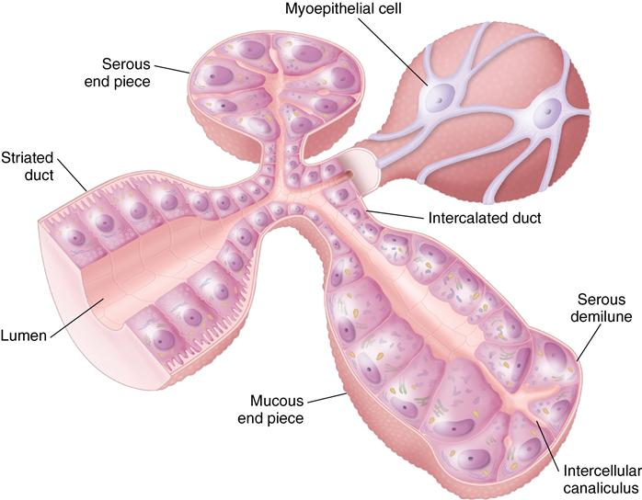

Slide 41
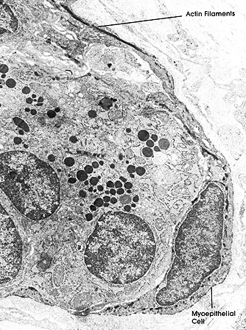

Slide 42
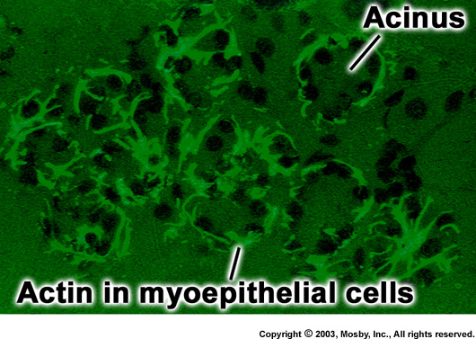

Slide 43
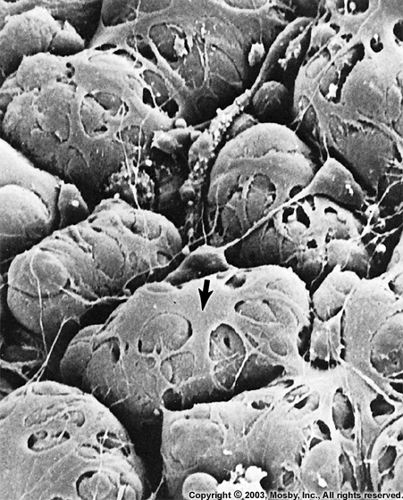

Slide 44
Ducts
Intercalated ducts: produce isotonic saliva
Striated duct : modify and form a hypotonic saliva
Excretory Duct: saliva is poured in the oral cavity

Slide 45
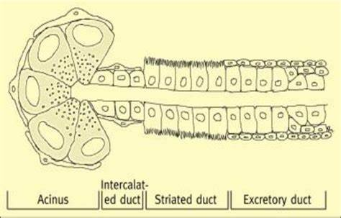
https://in.images.search.yahoo.com/images/view;_ylt=Awr1TjpBODVjNJUH0te9HAx.;_ylu=c2VjA3NyBHNsawNpbWcEb2lkA2I0ZDg3ZDUzY2U3M2YzNDliYzg4NTMxZGM3NmIxYWE3BGdwb3MDNgRpdANiaW5n?back=https%3A%2F%2Fin.images.search.yahoo.com%2Fsearch%2Fimages%3Fp%3Dintercalated%2Bduct%2Bcells%2Bin%2Bsalivary%2Bglands%26type%3DE211IN1250G0%26fr%3Dmcafee%26fr2%3Dpiv-web%26tab%3Dorganic%26ri%3D6&w=850&h=544&imgurl=www.researchgate.net%2Fprofile%2FNehal_Waheeb2%2Fpublication%2F305044218%2Ffigure%2Fdownload%2Ffig1%2FAS%3A381601562284032%401467992310163%2FFigure3-Salivary-gland-structure-acini-are-surrounded-by-myoepithelial-cells-The.png&rurl=https%3A%2F%2Fwww.researchgate.net%2Ffigure%2FFigure3-Salivary-gland-structure-acini-are-surrounded-by-myoepithelial-cells-The_fig1_305044218&size=413.6KB&p=intercalated+duct+cells+in+salivary+glands&oid=b4d87d53ce73f349bc88531dc76b1aa7&fr2=piv-web&fr=mcafee&tt=Figure3.+Salivary+gland+structure%3A+acini+are+surrounded+by+...&b=0&ni=21&no=6&ts=&tab=organic&sigr=I.v5sJZu9XbF&sigb=udVEeFboFafZ&sigi=.3wviq__6KIK&sigt=VExQ4OpPDTil&.crumb=D6gxA6z3U0w&fr=mcafee&fr2=piv-web&type=E211IN1250G0

Slide 46
Intercalated Ducts
Small diameter
Lined by small cuboidal cells
Nucleus located in the center
Well-developed RER, Golgi apparatus, occasionally secretory granules, few microvilli
Myoepithelial cells are also present
Intercalated ducts are prominent in salivary glands having a watery secretion (parotid).

Slide 47
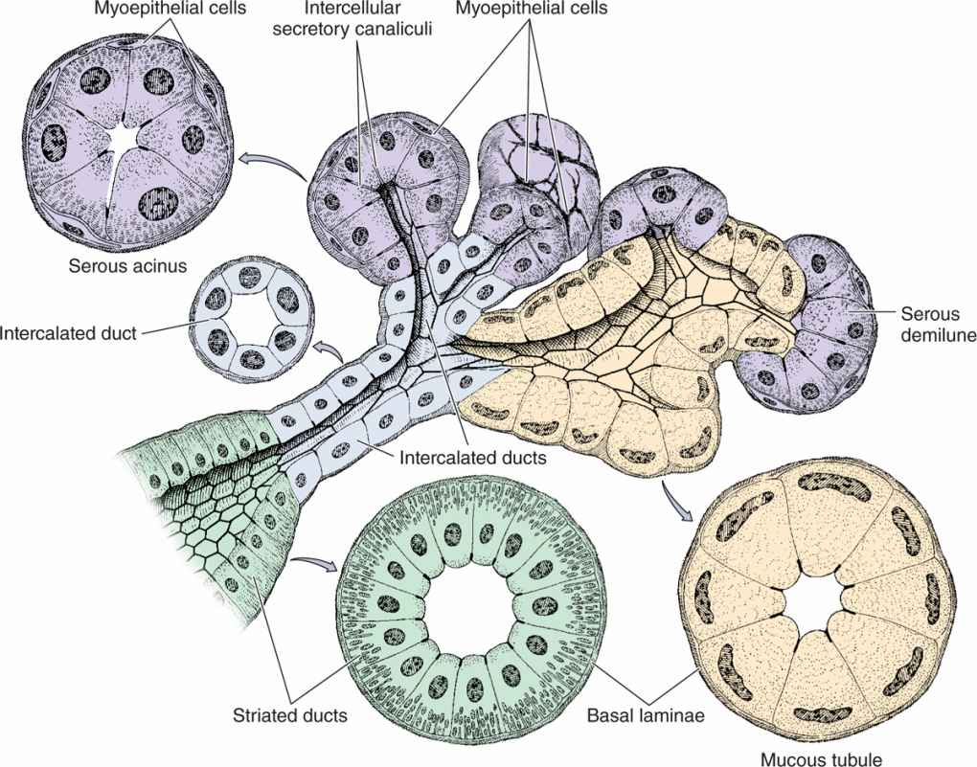

Slide 48
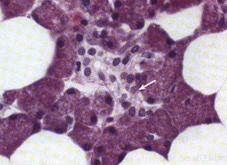

Slide 49
Striated Ducts
Columnar cells
Centrally located nucleus
Eosinophilic cytoplasm
Prominenty striations
  Indentations of the cytoplasmic membrane with many mitochondria present between the folds
Some RER and some Golgi, short microvilli
Modify the secretion
  Hypotonic solution=low sodium and chloride and high potassium
Basal cells

Slide 50
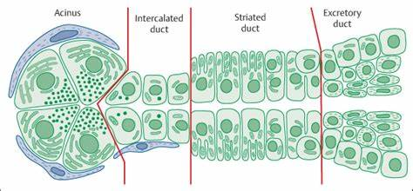

Slide 52
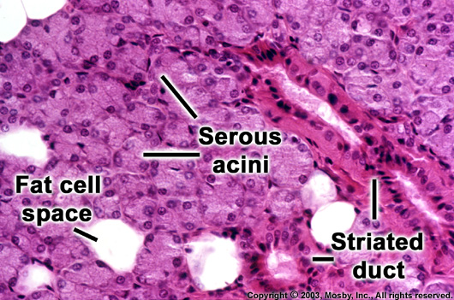

Slide 53
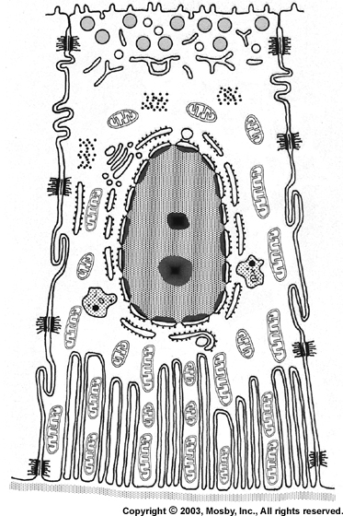

Slide 54
Terminal excretory ducts
Near the striated ducts they have the same histology as the striated ducts
As the duct reaches the oral mucosa the lining becomes stratified
Goblet cells, basal cells, clear cells.
Alter the electrolyte concentration and add mucoid substance.

Slide 55
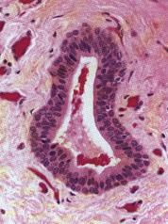

Slide 56
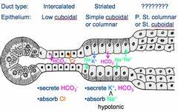

Slide 57
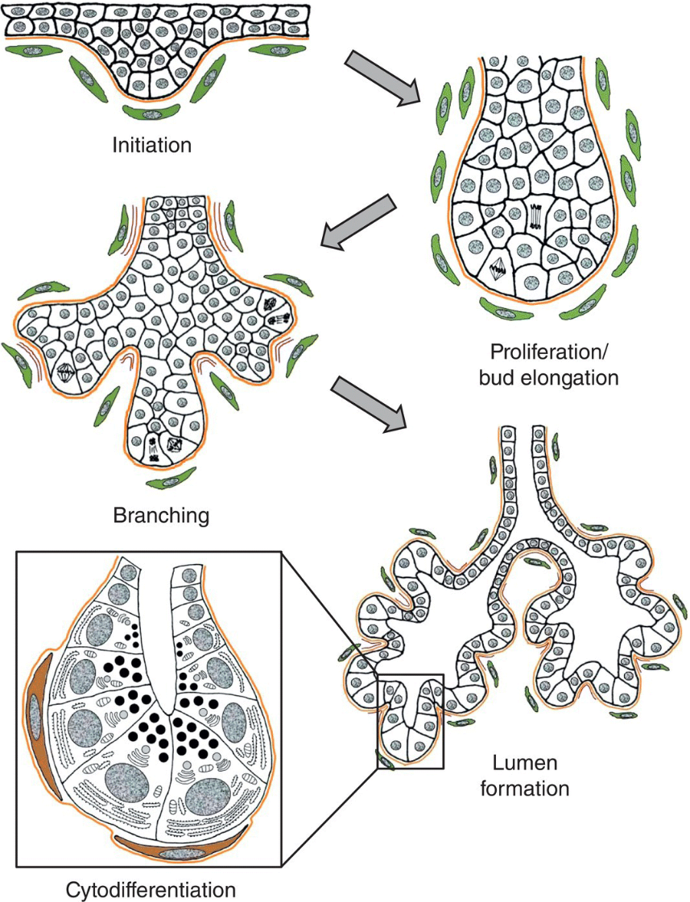
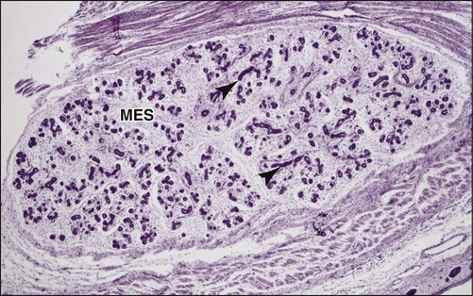
Development of Salivary Glands
pocketdentistry.com-salivary-glands-salivary-secretion-and-saliva
pocketdentistry.com%2F11-salivary-glands

Slide 58
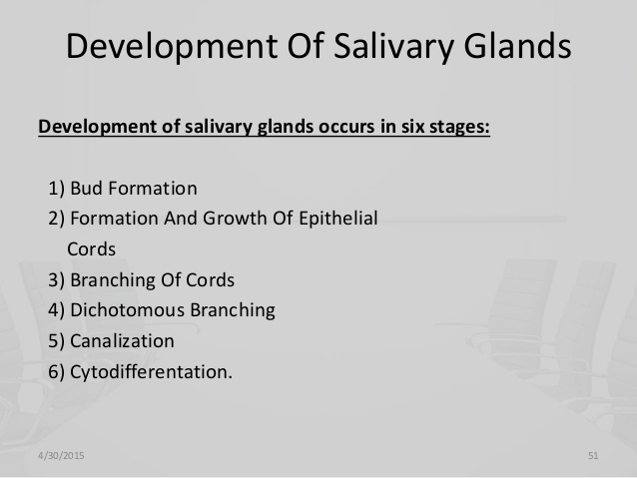

Slide 59
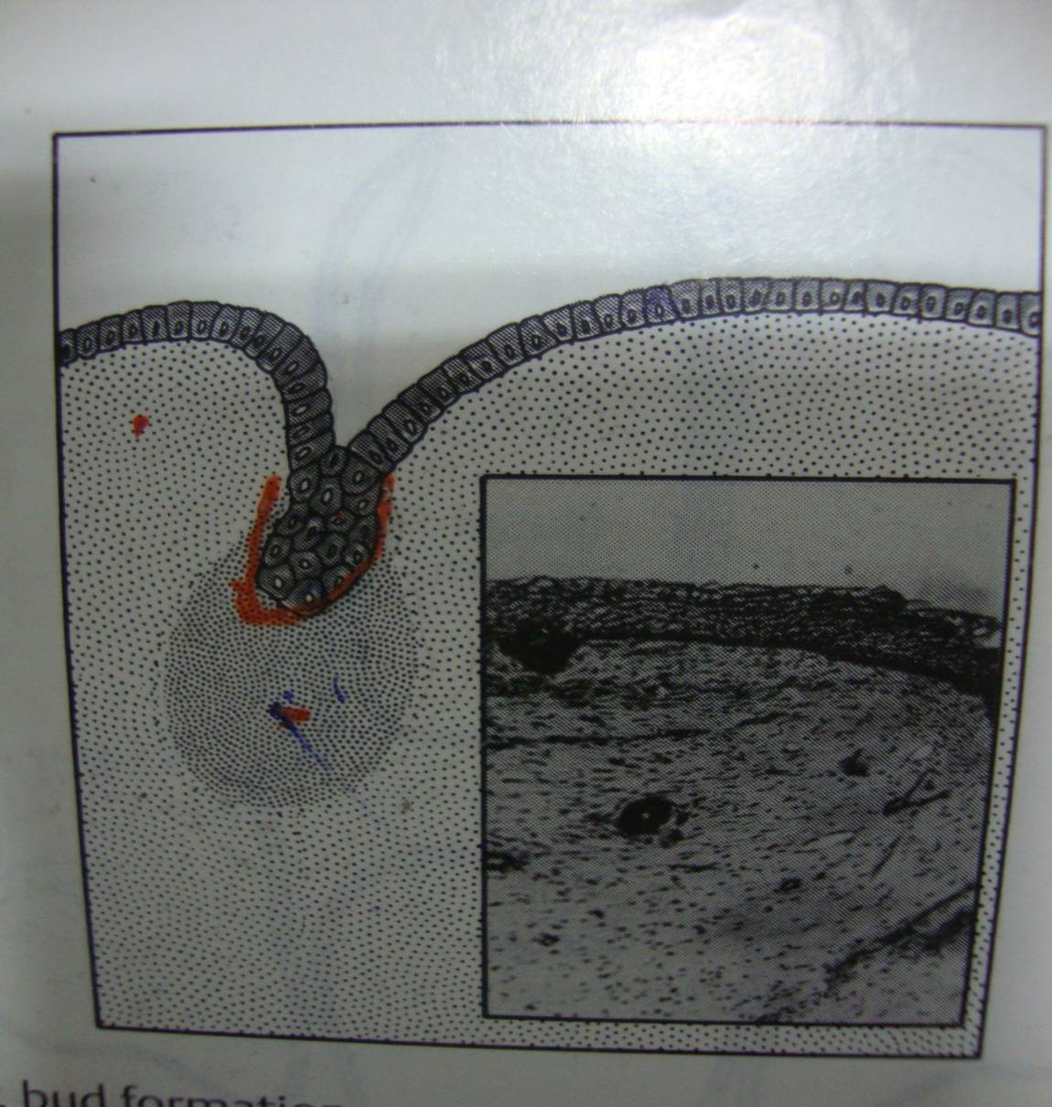
STAGES OF DEVELOPMENT
STAGE 1
BUD STAGE

Slide 60
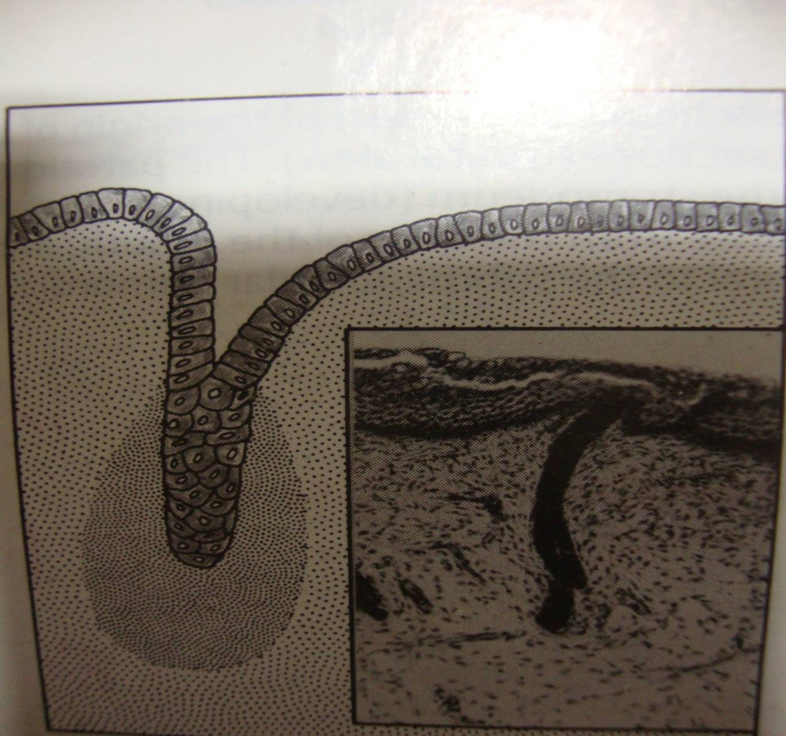
STAGE 2 CORD STAGE

Slide 61
Embryology
The epithelial buds of each gland enlarge, elongate and branch initially forming solid structures.
Branching of the glandular mass produces arborization.
Each branch terminates in one or two solid end bulbs.

Slide 62
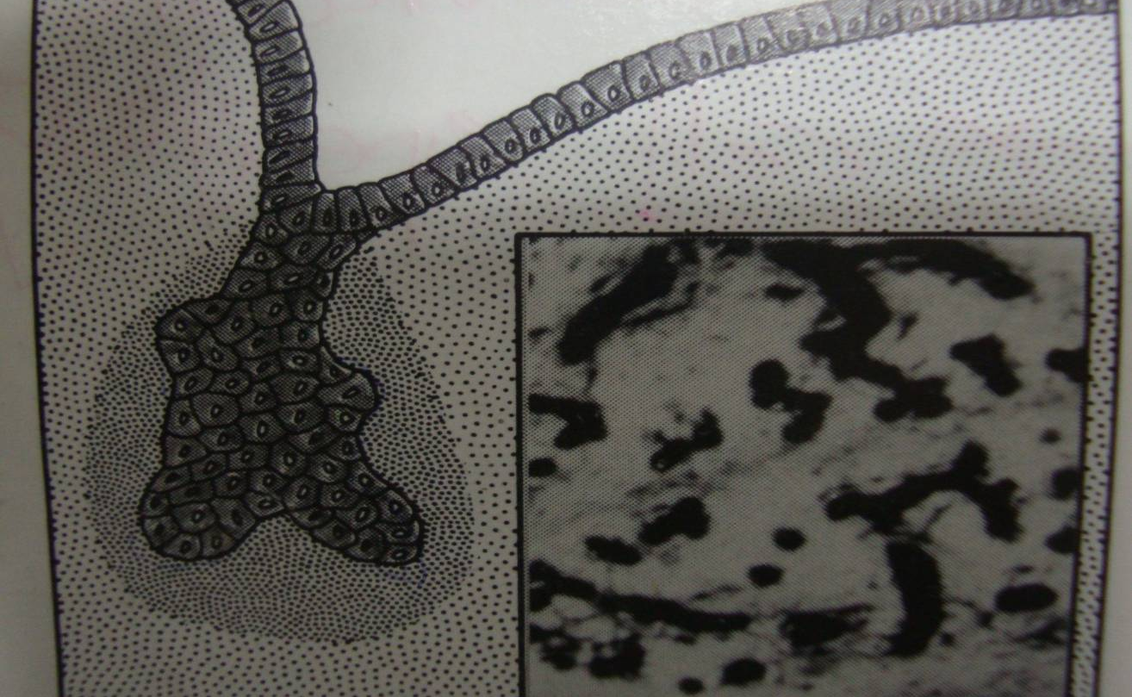
STAGE 3 (TERMINAL BULB)

Slide 63
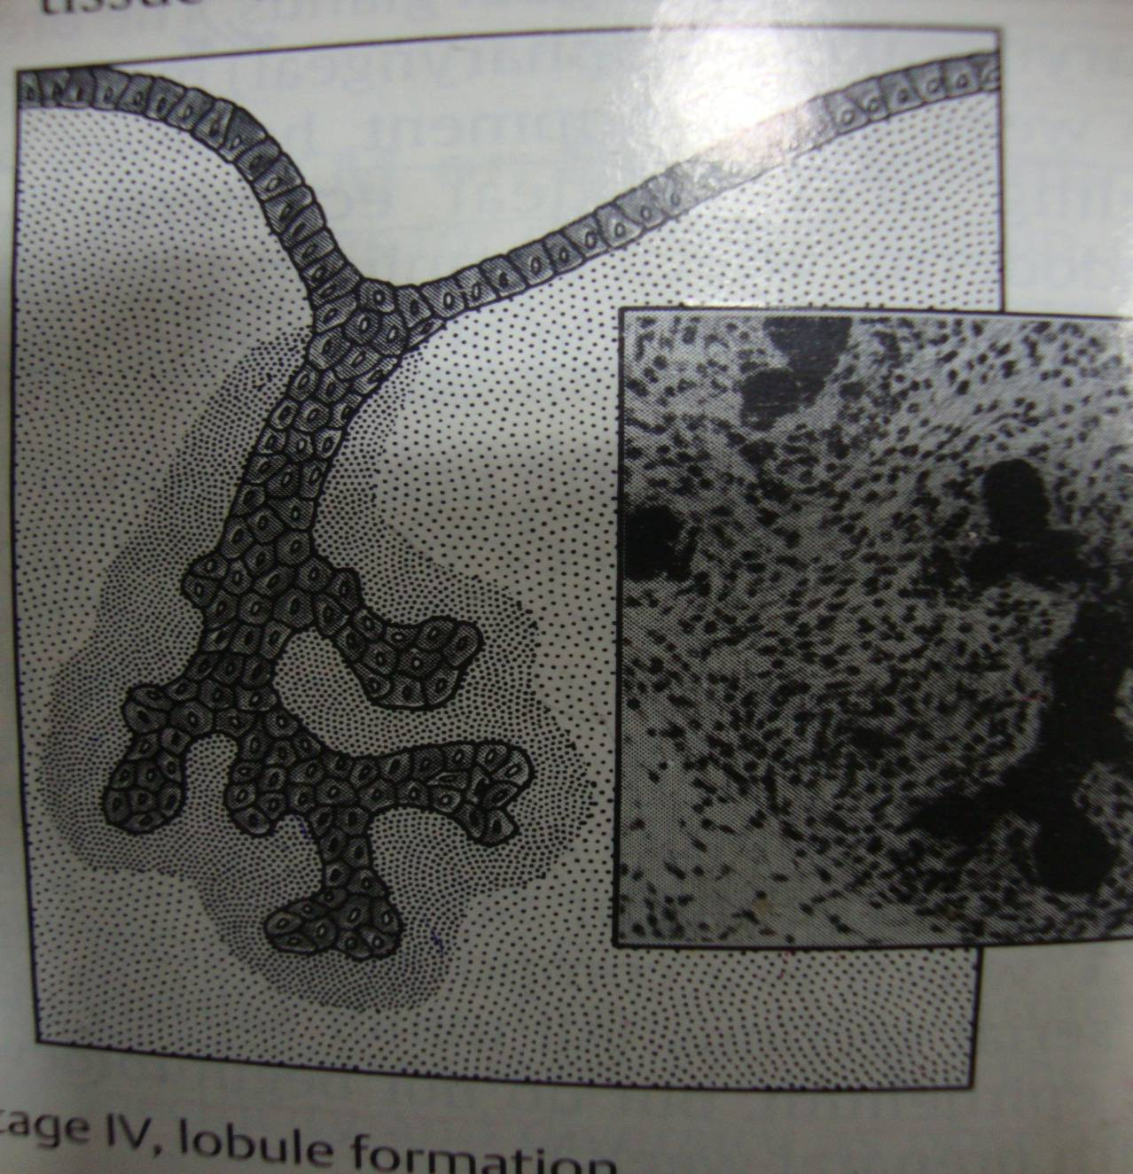
STAGE 4 ( LOBULE STAGE )

Slide 64
Embryology
Elongation of the end bulb follows and lumina appears in their centers, transforming the end bulbs into terminal tubules.
These tubules join the canalizing ducts to the peripheral acini.

Slide 65
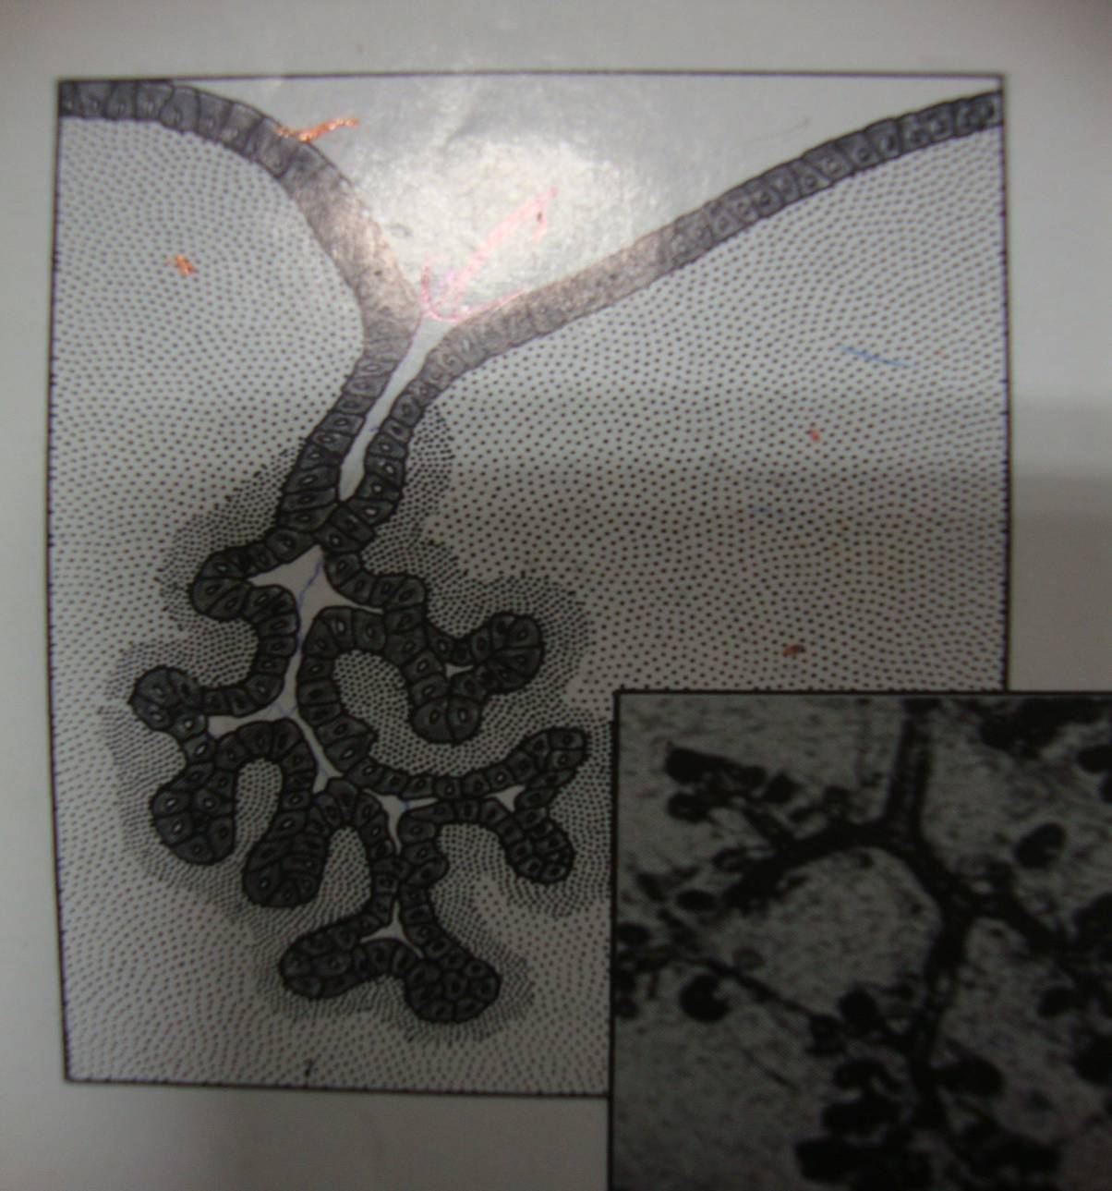
STAGE 5 ( DUCT CANALISATION)

Slide 66
Duct Canalization
Canalization results from mitotic activity of the outer layers of the cord outpacing that of the inner cell layers
Canalization is complete by 6th month post conception.

Slide 67
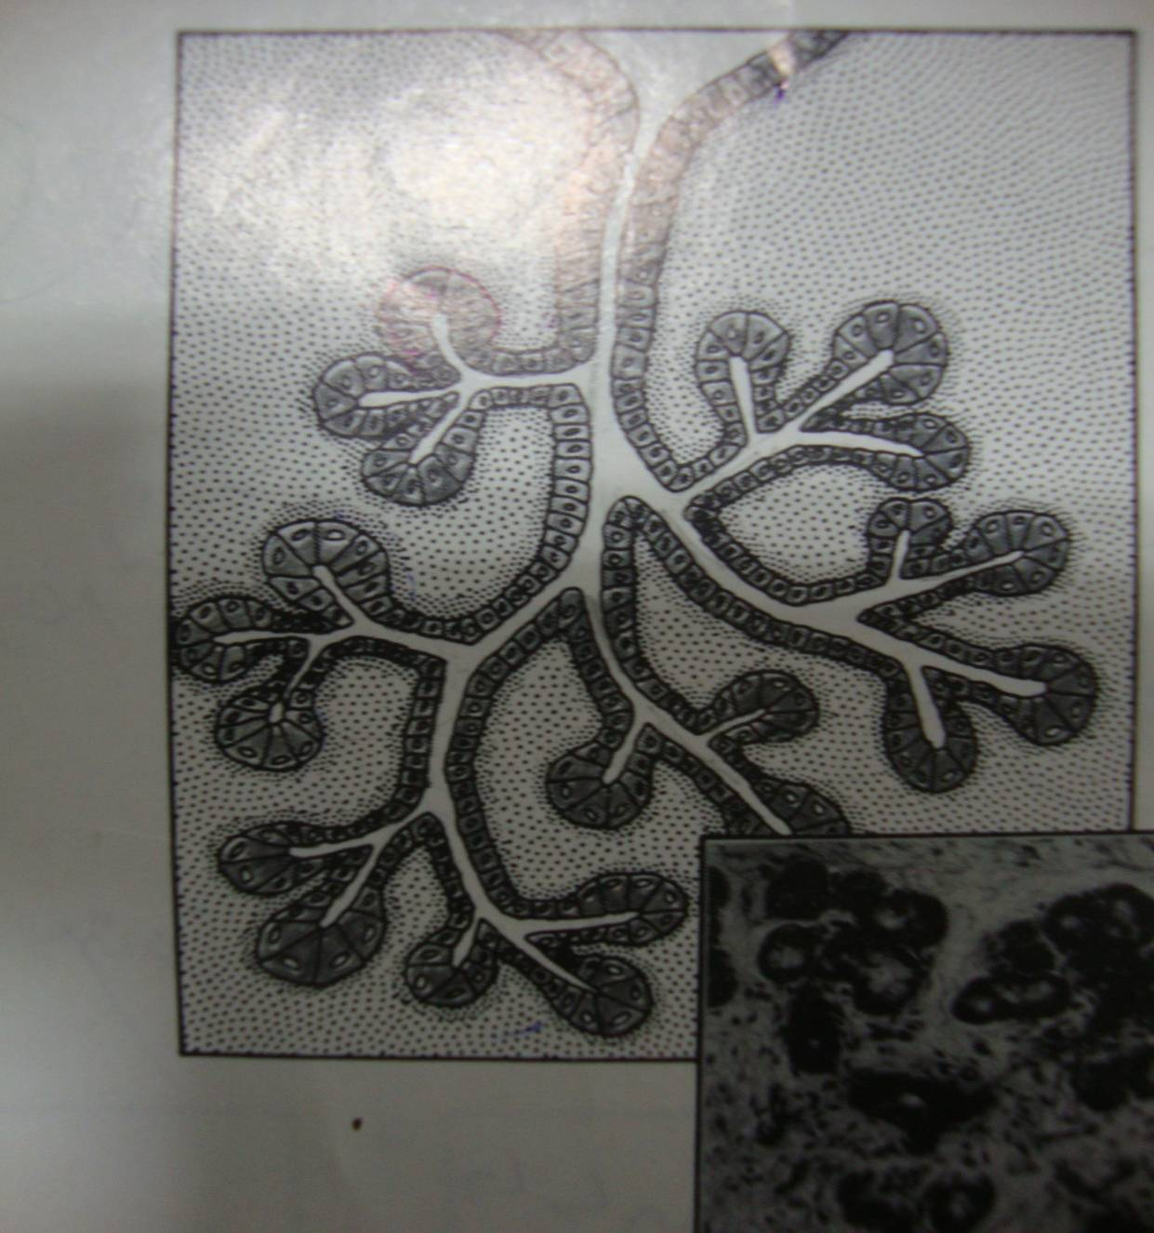
STAGE 6 ( CYTODIFFERENTIATION)

Slide 68
Embryology
The parotid anlagen are the first to develop, followed by the submandibular gland, and finally the sublingual gland.
Parenchymal tissue (secretory) of the glands arises from the proliferation of oral epithelium.
The stroma (capsule and septae) of the glands originates from mesenchyme that may be mesodermal or neural crest in origin.

Slide 69
Although the parotid anlagen are the first to develop, they become encapsulated after the SMG and SLG.
This delayed encapsulation is critical because after the encapsulation of the SMG and SLG but before encapsulation of the parotid, the lymphatic system develops.

Slide 70
Therefore, there are intraglandular lymph nodes and lymphatic channels entrapped within the parotid gland (PG).
PG is also unique because its epithelial buds grow, branch and extend around the divisions of the facial nerve.

Slide 71
thank you

