Slide 1
TUMORS OF SALIVARY GLANDS

Slide 2
CANALICULAR ADENOMA
CLINICAL FEATURES :
Uncommon neoplasm
ORIGIN – intraoral accessory salivary glands
SEEN – upper lip
Other areas – palate, buccal mucosa, lower lip.
AGE – 34-65yrs
GENDER – female (1.8:1)

Slide 3
Slowly growing, well-circumscribed, firm nodule, not fixed.
HISTOLOGICAL FEATURES:
Single layers of cell of long columnar or cuboidal cells.
Arranged parallel forming long canals.
Cystic spaces are enclosed by these cords.
Space filled with eosinophilic coagulum.
Stroma is loose fibrillar with delicate vascularity.
TREATMENT:
Enucleation or surgical excision
Recurrence is RARE.

Slide 4
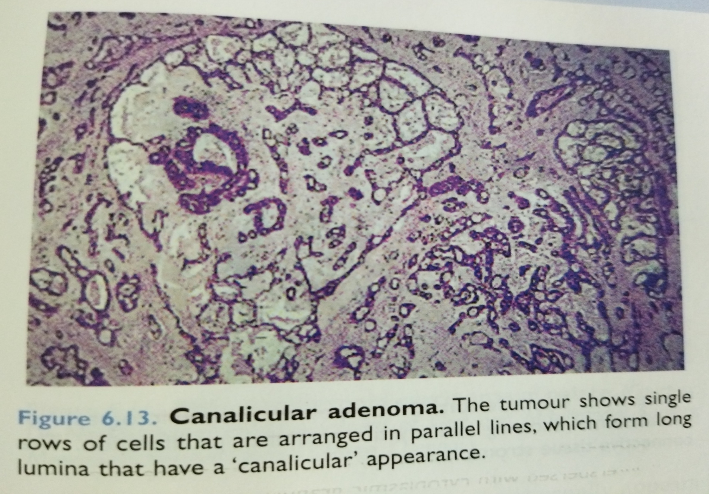

Slide 5
SEBACEOUS ADENOMA:
CLINICAL FEATURES:
Rare benign tumor
AGE : 22-90 yrs. (58 yrs)
GENDER : men
0.42-3.0cm diameter
Encapsulated or sharply circumscribed, greyish –white/pinkish-white/yellowish-grey.

Slide 6
HISTOLOGICAL FEATURES:
Sebaceous cell nests with minimal atypia and pleomorphism.
No tendency to invade local structures.
Sometimes microcystic, Ectatic salivary ducts with focal sebaceous differentiation.
Fibrous stroma.

Slide 7
DUCTAL PAPILLOMA
Arise from salivary gland ductal system.
Three types :
1. inverted ductal papilloma:
Minor SG of adults.
Lower lip> buccal vestibule.
Arise from excretory ducts near mucosal surface.
Clinically seen as submucosal nodules, pits or indentation in overlying surface mucosa.

Slide 8
Histologically ,
Basaloid or squamous cells arranged in thick, bulbous papillary proliferations.
Project into the ductal lumen.
Some tumors communicate with exterior mucosal surface through constricted opening.

Slide 9
2. Intraductal papilloma:
Ill defined lesion
58 years
Minor SGs
Lower lip> upper lip> palate> buccal mucosa.
Clinically , submucosal swelling
Arise in excretory ducts in deeper layers compared to inverted one.

Slide 10
Histologically,
Unicystic dilated structure.
Lined by single or double layer of cuboidal or columnar cells
Extend into the cystic lumen as papillary projections having thin fibrovascular cores.

Slide 11
3. Sialadenoma papilliferum
Both exophytic and endophytic growth components.
56 years.
Male
Exophytic papillary growth
Histologically, parakeratotic –stratified squamous epithelium, fibrovascular cores, inflammatory infiltration lymphocytes, plasma cells and neutrophils.

Slide 12
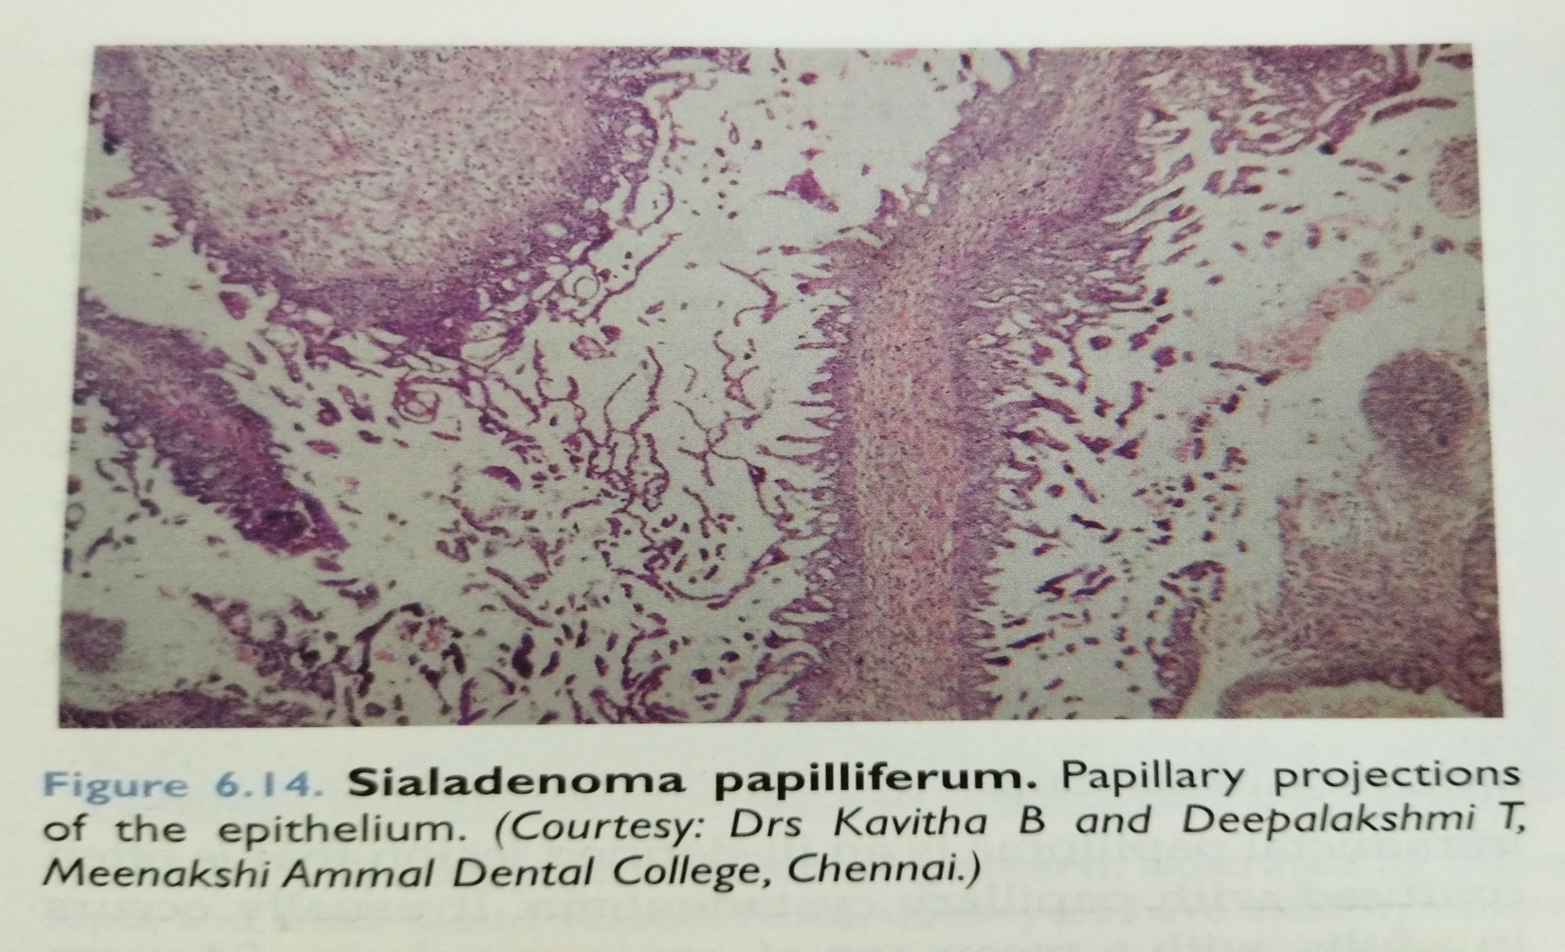

Slide 13
CYSTADENOMA
Benign neoplasm
Types : papillary and mucinous
Papillary : cystic space is filled with papillary projections.
Mucinous : mucous cells are predominant in the lining epithelial cells.
Both major and minor SG.
Females
Older age
Slow growing, painless, compressible swelling.

Slide 14
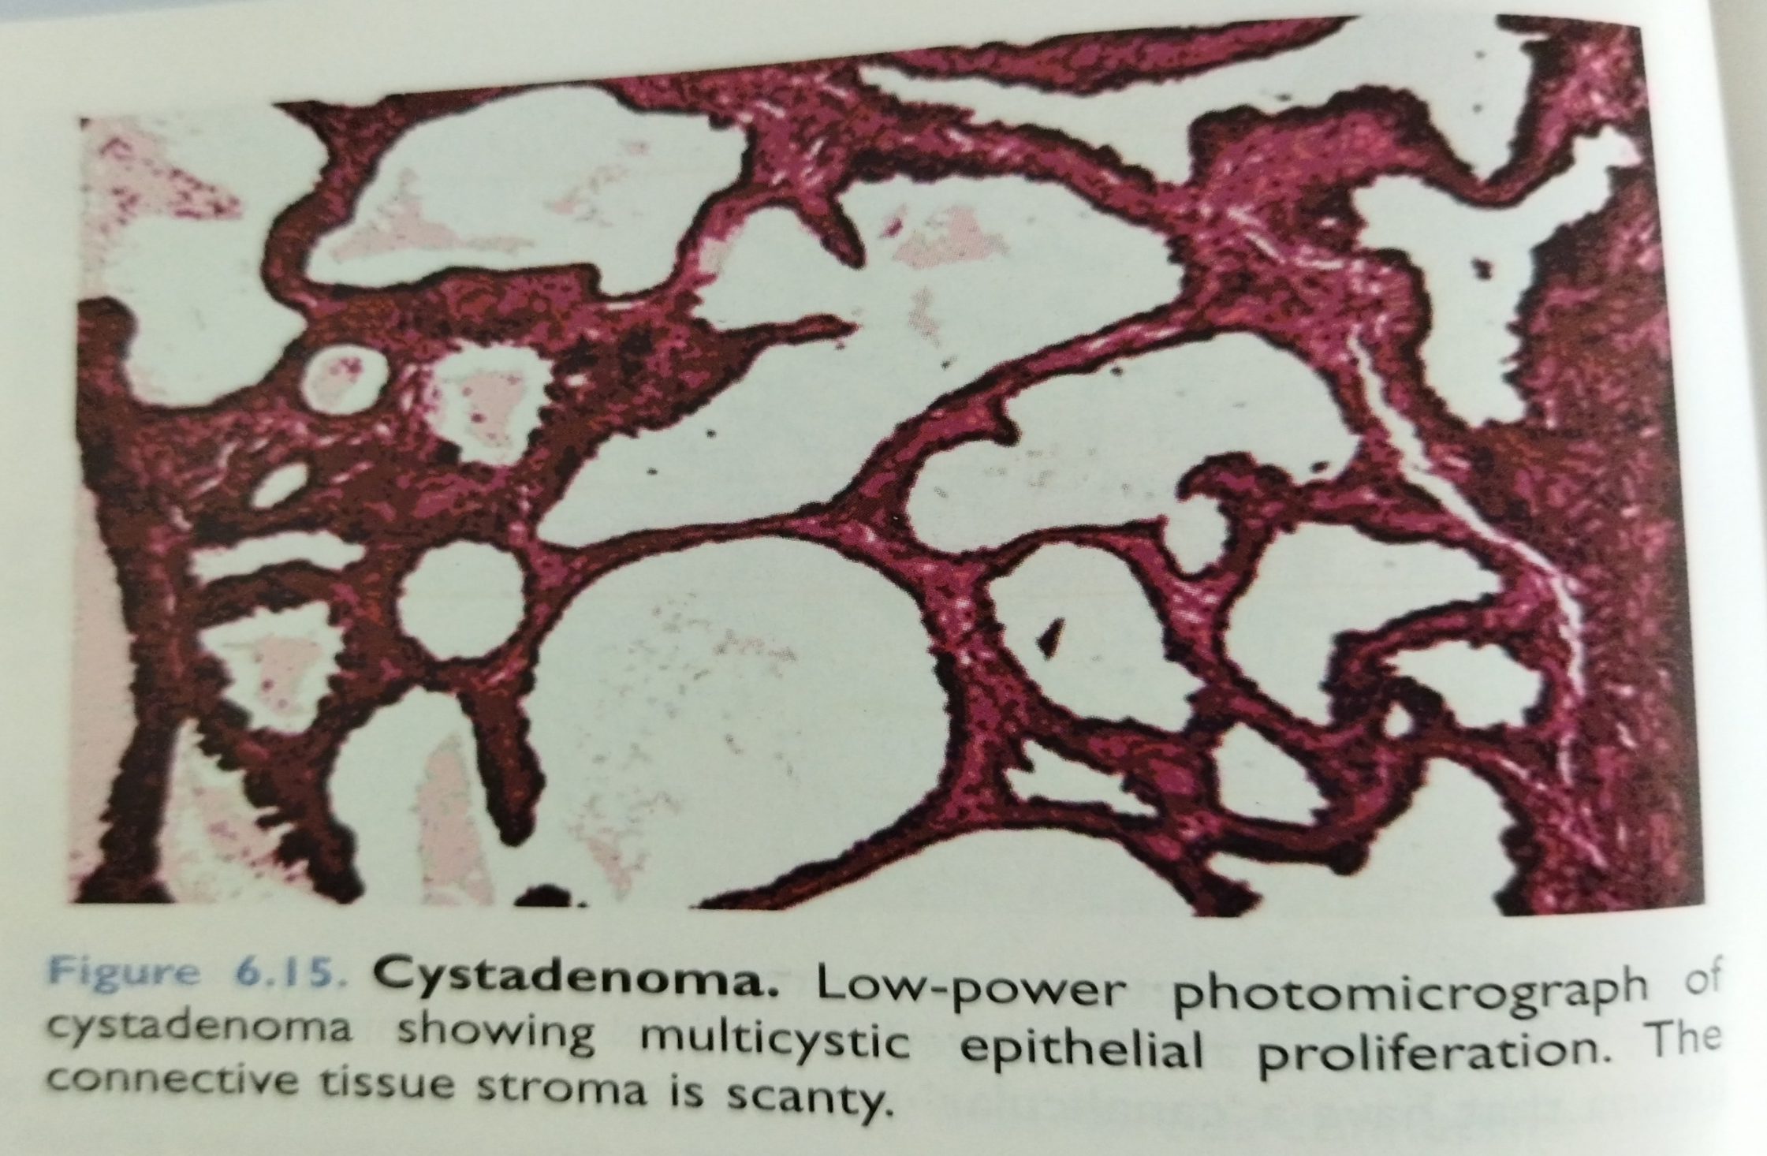

Slide 15
Histologically,
Flat to tall columnar cells line the cystic structures.
Limited papillary growth with central connective tissue stroma
Scattered inflammatory infiltration
Low recurrence.

