Slide 1

Zygomatico Maxillary Complex Fractures
Dr. Amit Mahajan
Professor
Department Of Oral And Maxillofacial Surgery

Slide 2
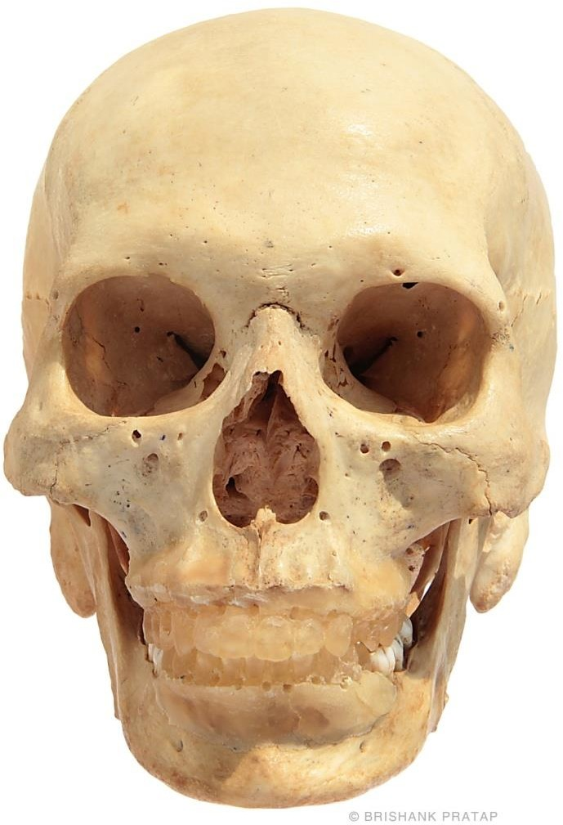
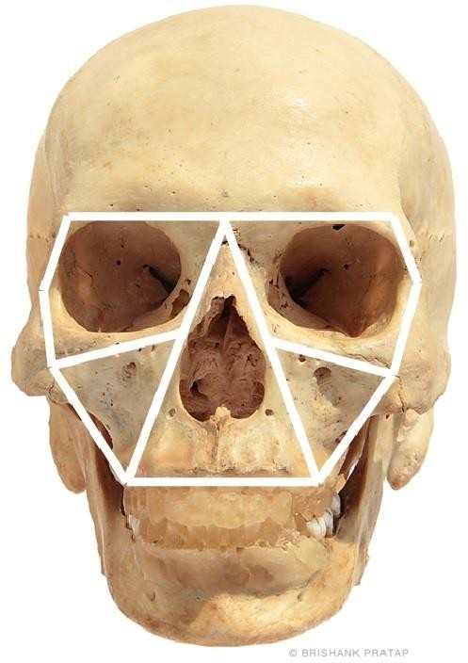

Slide 3
Midface
Includes
  Shell like thin bones
  Strong reinforced areas called buttresses
It is a cellular shock absorbing structure.
  Located within this complex compartmental which tolerate higher forces.
system are buttresses

Slide 4
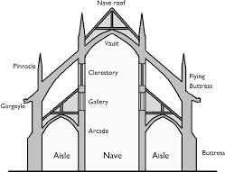
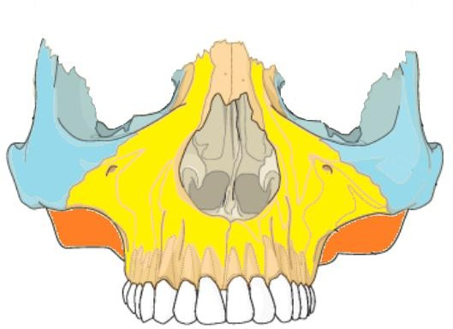
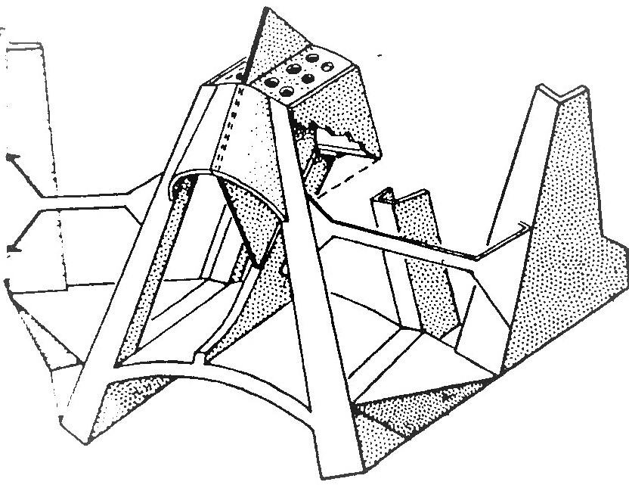

Slide 5
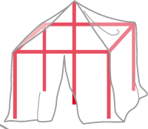
Biomechanics
Midface equates to a tent where
Tent poles represent the bony midface.
Tarpaulin represents the overlying soft tissues.

Slide 6
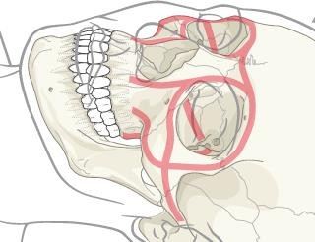

Slide 7
Biomechanics
Midface occlusal surfaces experience load conditions of equal magnitude as the mandible.
Soft tissue contraction of the masseter sling develop equal forces at origin and insertion.
Soft tissue attachments contribute to stability that includes the fascia.

Slide 8
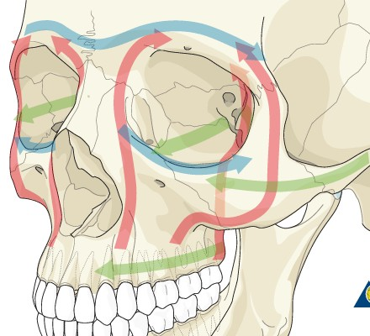
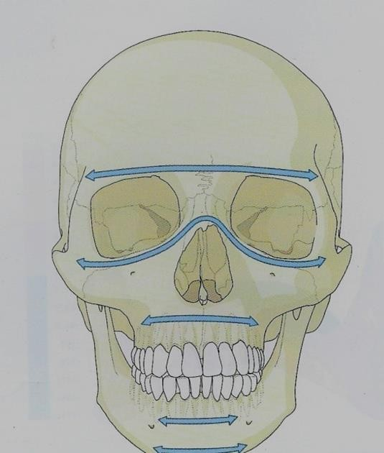
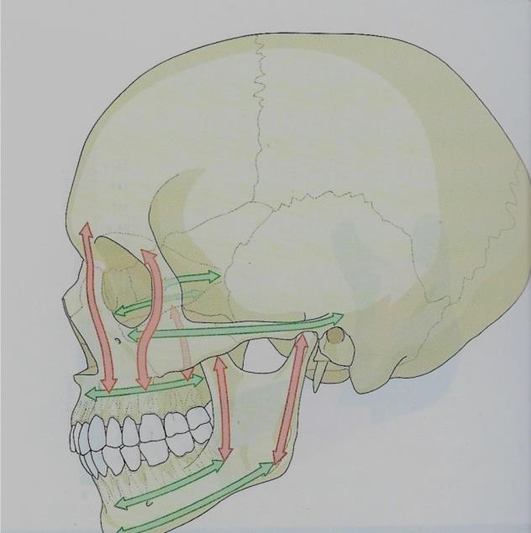
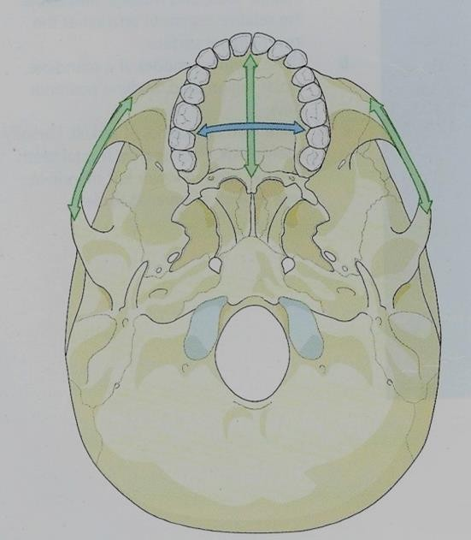
Buttresses
Vertical (Red)
Transverse (Blue)
Sagittal (Green)

Slide 9
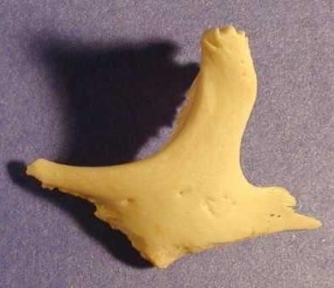
Zygomatico maxillary complex fractures

Slide 10
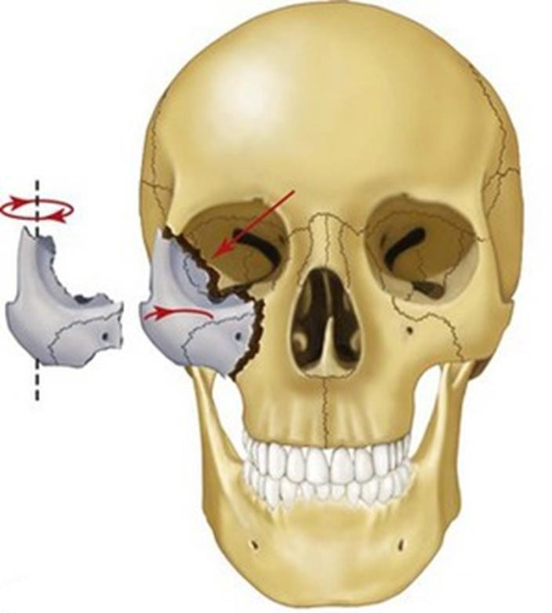
Terminology
Zygomaticomaxillary complex
Zygomaticomaxillary compound
Zygomatico-orbital
Zygomatic complex
Malar
Tetrapod

Slide 11
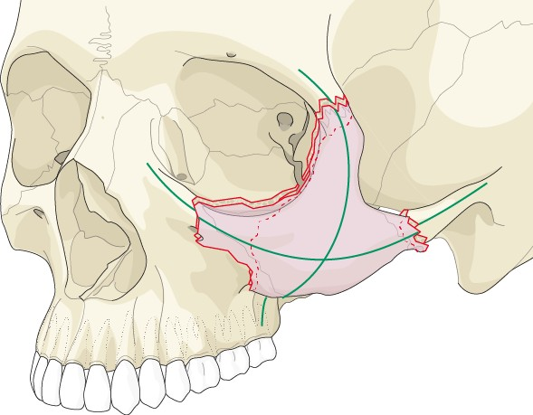
Zygomaticomaxillary complex (ZMC) fracture
All four buttresses involved:
  Frontozygomatic
  Infraorbital rim
  Zygomaticomaxillary
  Zygomatic arch
Always an orbital component:
  Lateral wall
  Orbital floor

Slide 12
Fracture pattern
Fracture patterns depend on direction and magnitude of force.
The inferior orbital fissure is the key to remembering the usual lines of ZMC fractures
Three fracture lines extend from the inferior orbital fissure in an
anteromedial, superolateral and inferior direction

Slide 13
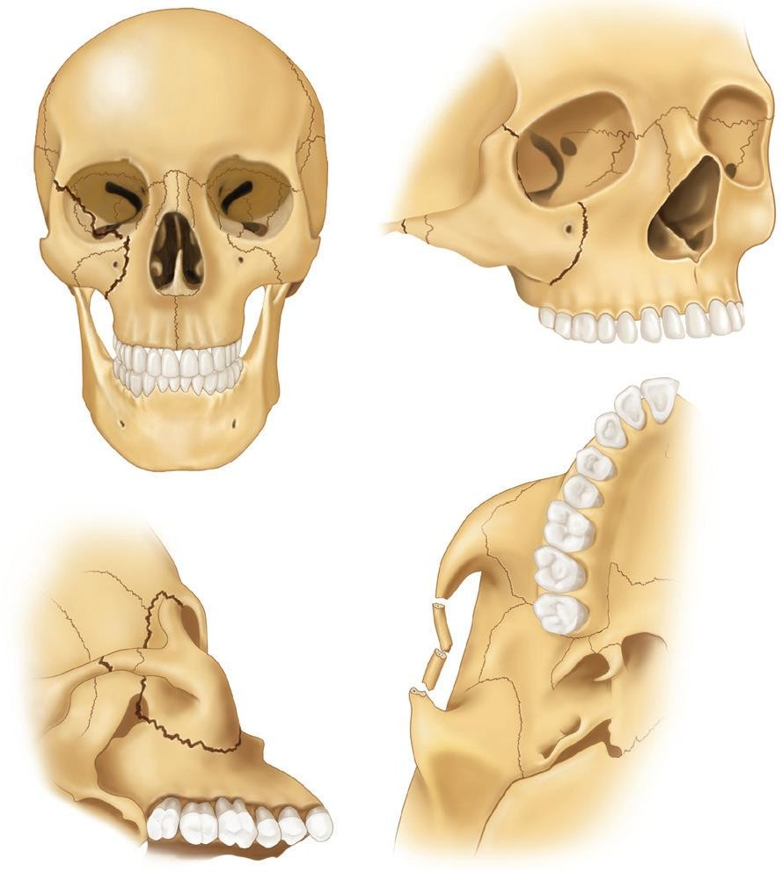

Slide 14
Rowe and Killey (1968)
Type V: Displacement of the complex en bloc
  Medial
  Inferior
  Lateral (rare)
Type VI: Displacement of orbitoantral partition
  Inferiorly
  Superiorly
Type VII: Displacement of orbital rim segments
Type VIII: Complex comminuted fractures

Slide 15
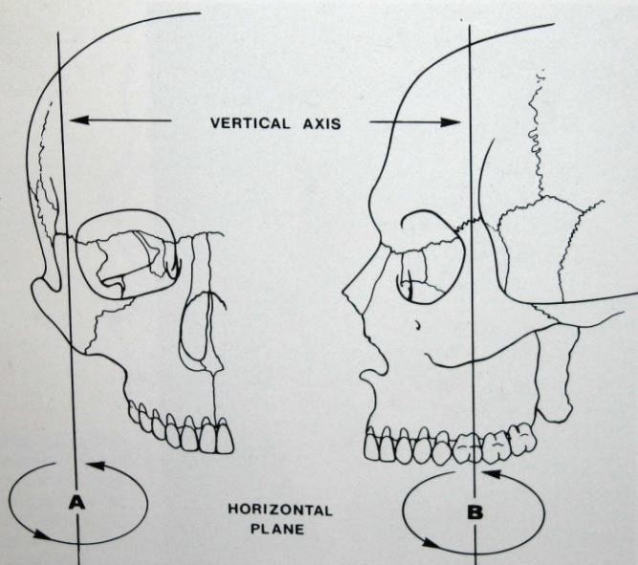
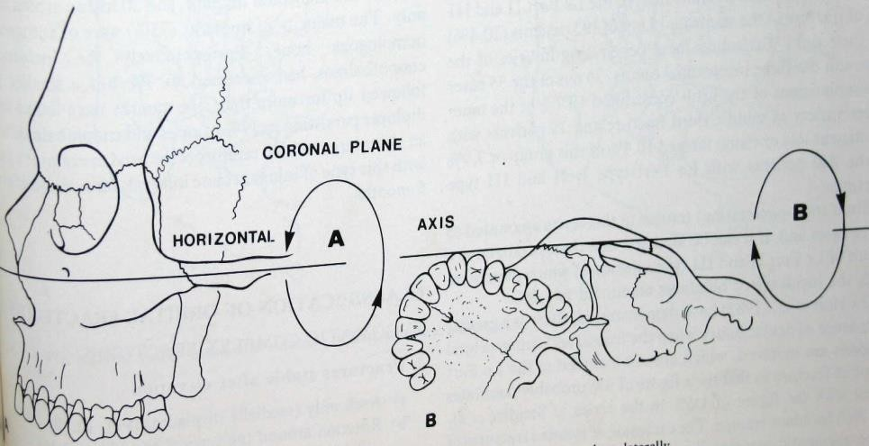
Fracture patterns along the imaginary axis

Slide 16
Rowe’s Classification
Fractures stable after elevation
  Arch only (medially displaced)
  Rotation around the vertical axis
    medially
    laterally

Slide 17
Rowe’s Classification
Fractures unstable after elevation
  Arch only (inferiorly displaced)
  Rotation around the horizontal axis
    medially
    laterally
  Dislocation en bloc
    Inferiorly
    Medially
    Postero-laterally
  Comminuted fractures

Slide 18
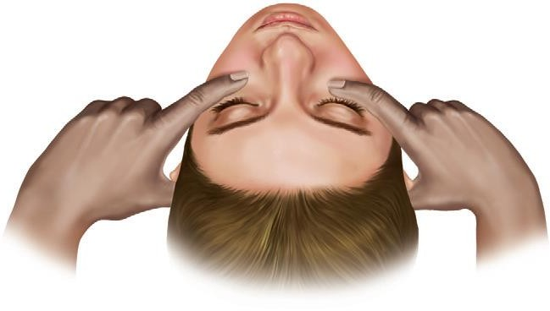

Slide 19
Signs & Symptoms
Periorbital ecchymosis and edema
Flattening of the malar prominence
Flattening over the zygomatic arch
Pain
Ecchymosis of the maxillary buccal sulcus.
Deformity at the zygomatic buttress of the maxilla.
Deformity of the orbital margin

Slide 20
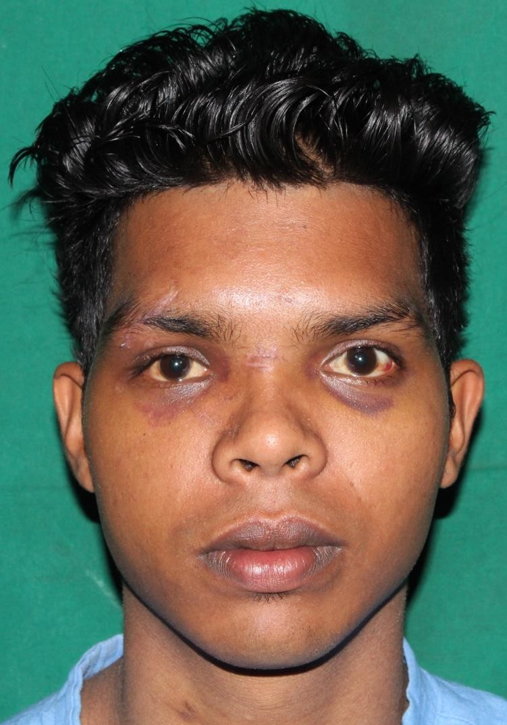
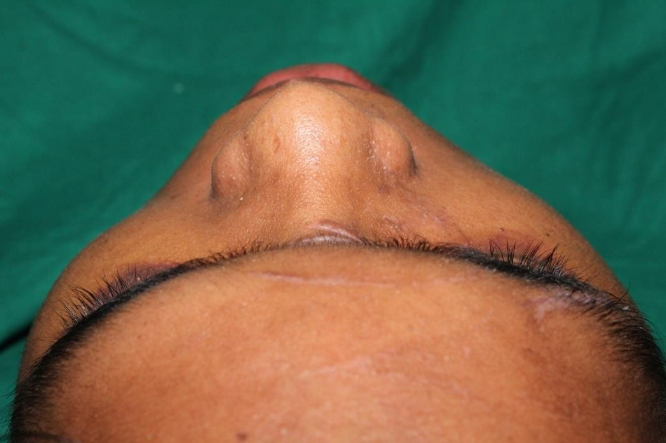

Slide 21
Signs & Symptoms
Trismus.
Abnormal Nerve Sensibility
Epistaxis.
Subconjunctival Ecchymoses
Crepitation from Air Emphysema
Displacement of the Palpebral Fissure
Unequal Pupillary Levels
Diplopia
Enophthalmos

Slide 22
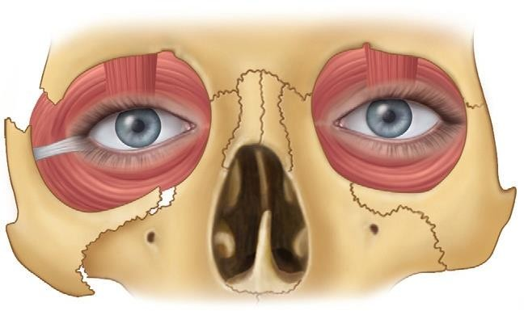

Slide 23
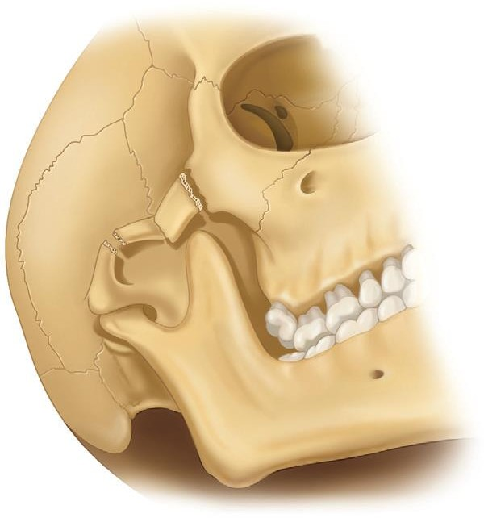
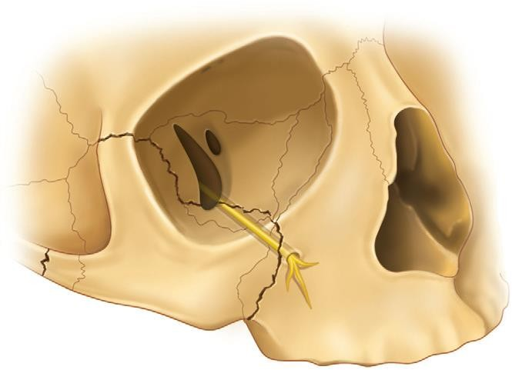

Slide 24
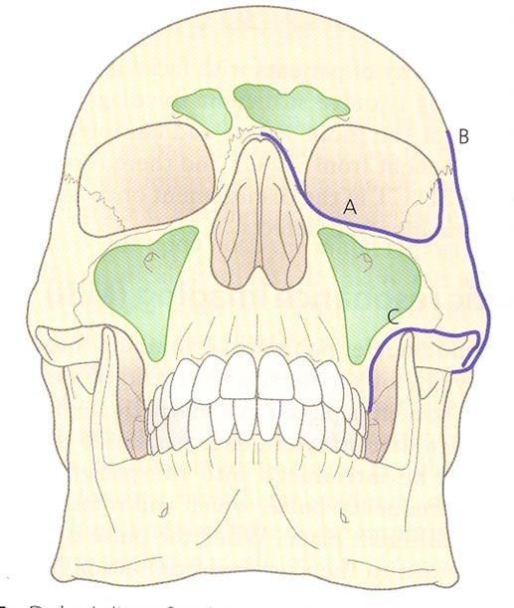
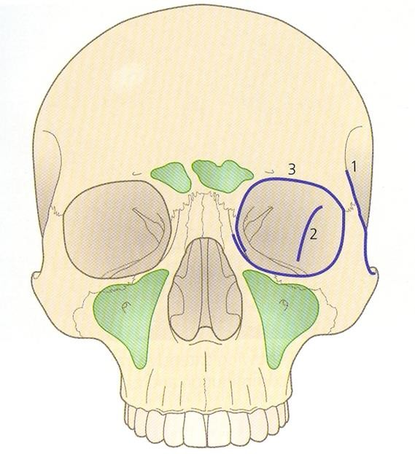
X-rays
Dolan’s line for occipitomental projection
A Orbital line B Zygomatic line C Maxillary line
Dolan’s lines for the modified Caldwell
projection

Slide 25
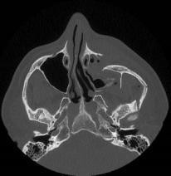
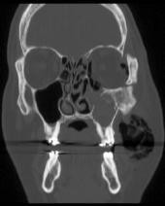
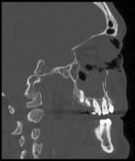
Diagnosis
CT scan:
  Axial, coronal, sagittal
Need to assess buttresses looking for:
  Comminution
  Displacement
Assess orbital floor

Slide 26
No fixation: Stable after reduction
Gilli’s temporal approach
Dingmans approach
Percutaneous approach (Posswillo’s elevator)
Carroll-girard screw
Upper buccal sulcus (Keen’s approach)
Lateral coronoid (Quinn’s approach)
Intranasal / transantral

Slide 27
Fixation: unstable after reduction
Temporary support (unstable #’s)
  Antral pack
  Inflatable balloon
Indirect fixation
  Zyg - Zyg
  Zyg – palatal
  Naso – zyg
  Fronto – zyg
  Cranio – zyg
Direct fixation
  Transosseous wiring
  Bone plates

Slide 28
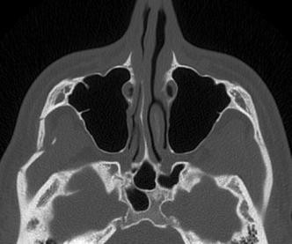
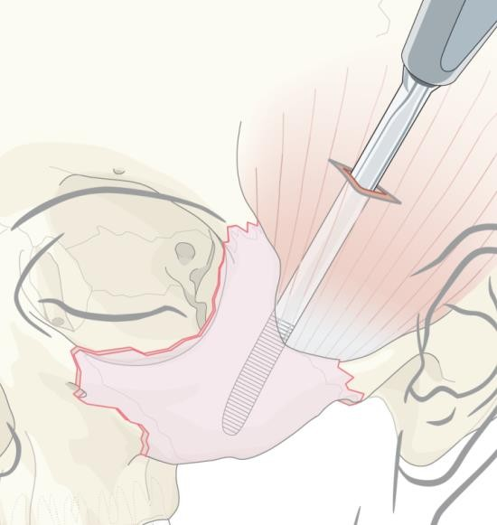
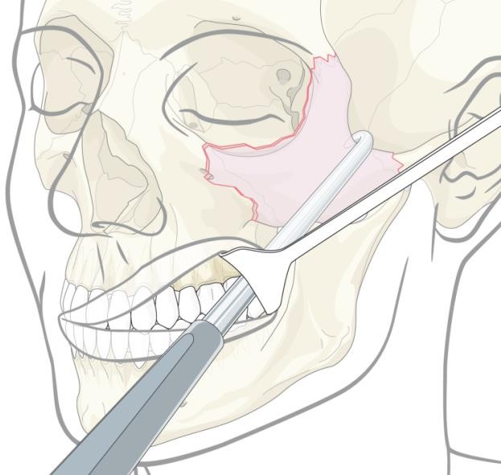
Isolated zygomatic arch (not a ZMC fracture)
Frequent comminution with inward displacement at mid arch:
  Localized contour deformity
No orbital component
Usually elevation only with no fixation

Slide 29
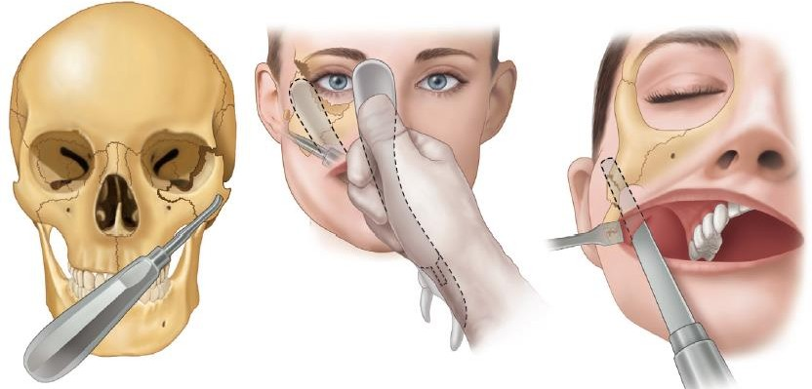

Slide 30
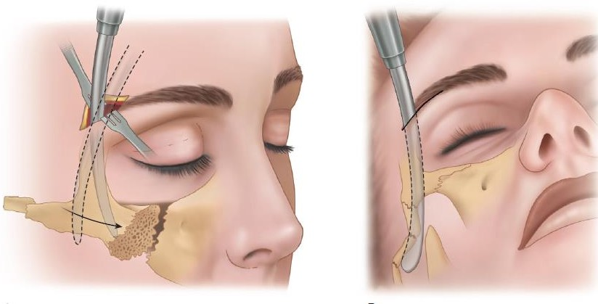
Dingman’s approach

Slide 31
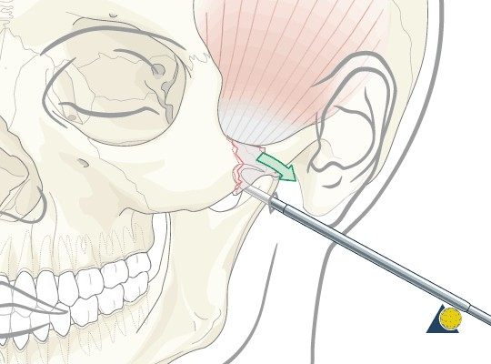
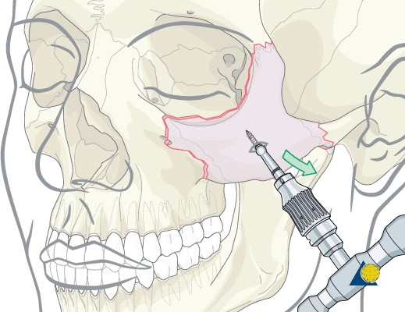
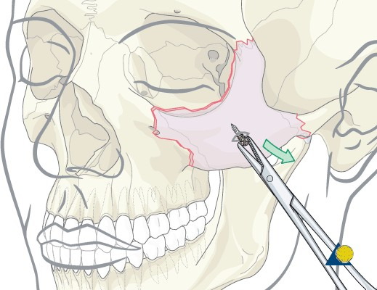
Percutaneous techniques
Posswillo’s bone Zygomatic hook
Bone screw

Slide 32
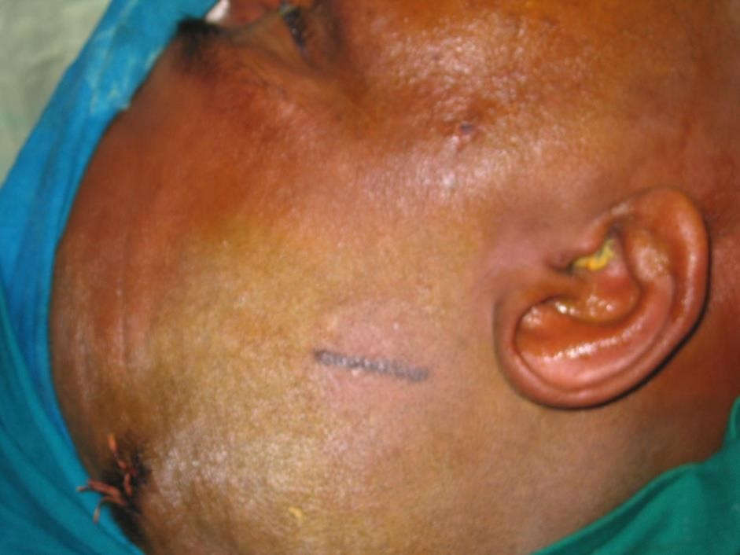
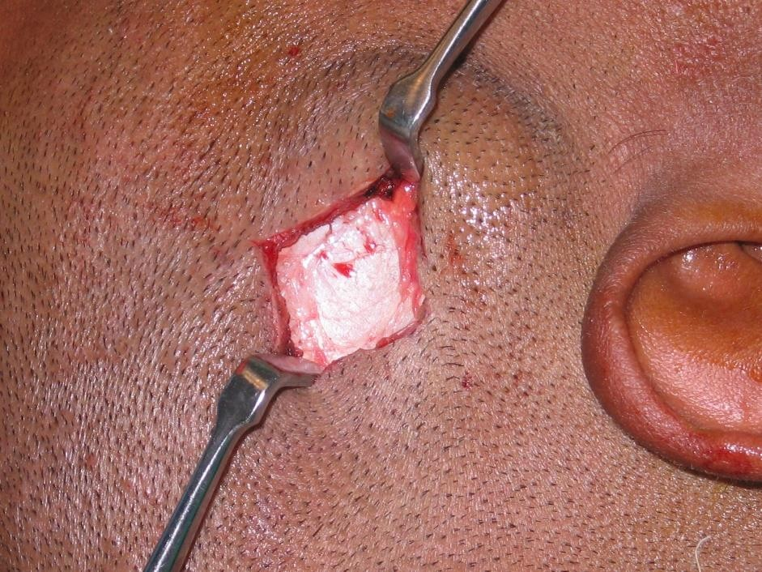
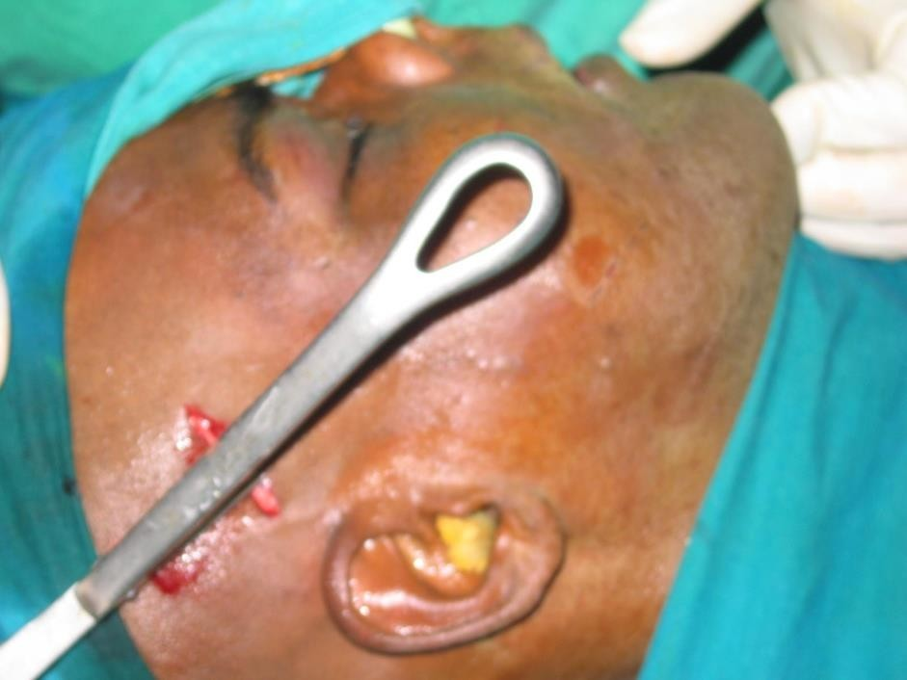
Gilles Temporal Approach

Slide 33
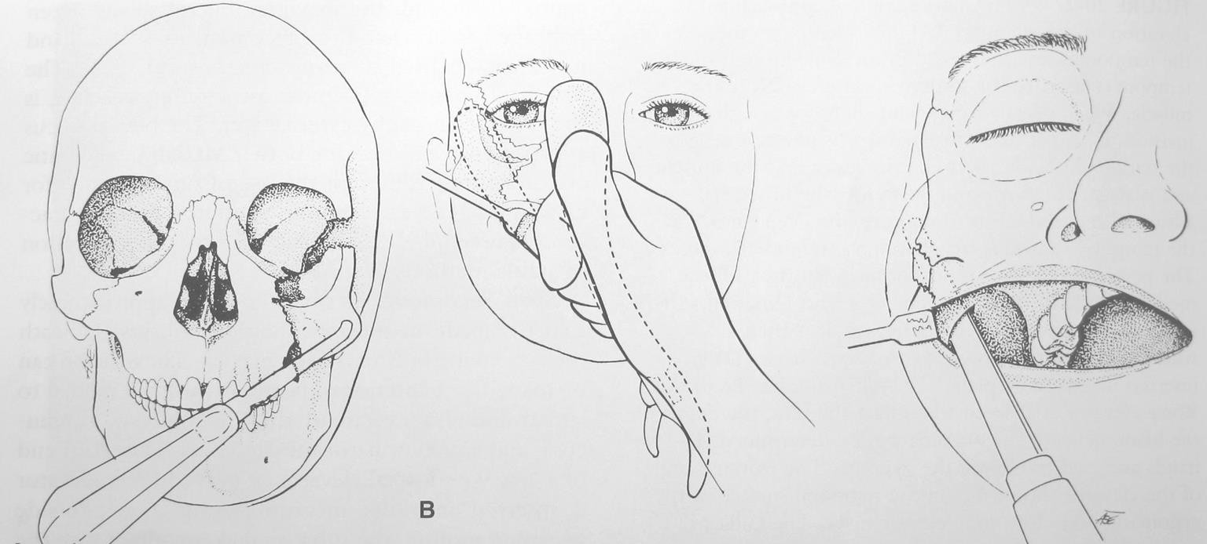
Keen’s Technique

Slide 34
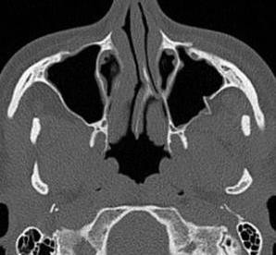
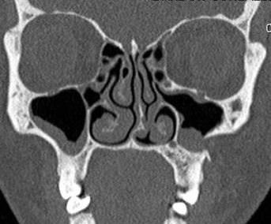
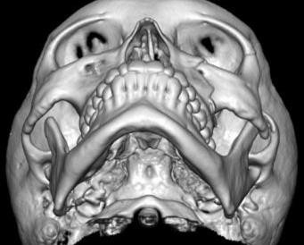
Single-point fixation
Usually at zygomaticomaxillary buttress:
Minimally displaced fracture with rotation
No displacement at FZ suture or lateral wall
Simple fractures

Slide 35
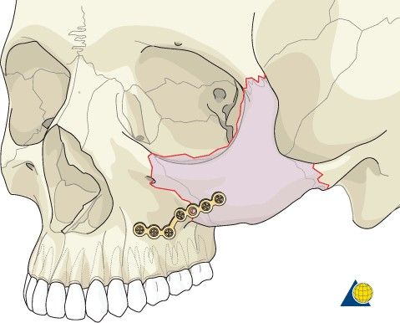
One point fixation

Slide 36
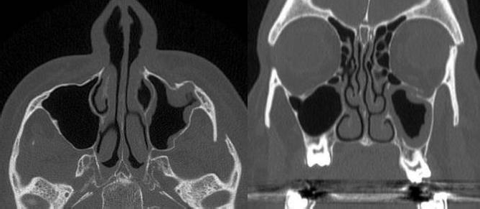
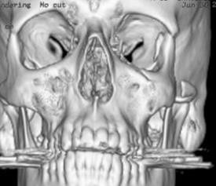
Two-point fixation
Frontozygomatic and zygomaticomaxillary buttresses:
Comminution may be present at one but not both buttresses
Where there is no indication for orbital floor exploration

Slide 37
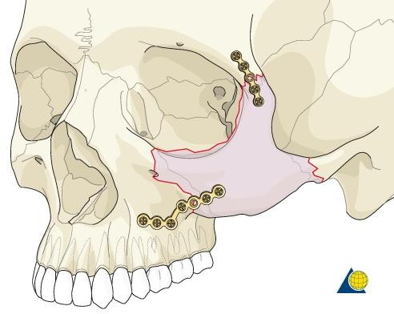
Two point fixation

Slide 38
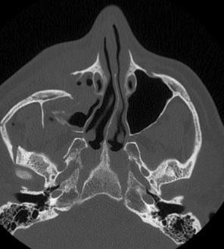
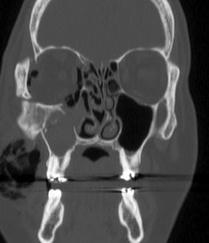
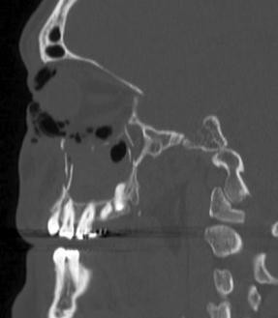
Three-point fixation
FZ and ZM buttresses and infraorbital rim:
Comminution of buttresses, often outwardly displaced arch
High velocity injury with loss of soft-tissue support
Need for orbital floor exploration

Slide 39


Three point fixation

Slide 40



Four-point fixation
FZ, ZM, and infraorbital rim buttresses and zygomatic arch:
Displaced and/or comminuted fractures with loss of anatomic reference points
Panfacial fractures

Slide 41

Four point fixation

Slide 42
Conclusion
For precise anatomical reduction
Reconstruction should be started in the area that gives maximum information.
Fixation of fractures with different plates and screws for three-dimensional stability.
Wide exposure and using the buttresses.
Immediate use of bone grafts when necessary.
Careful management of lacerations and incisions.
Immediate definitive repair within 48–72 hours to prevent scarring.

