Slide 1
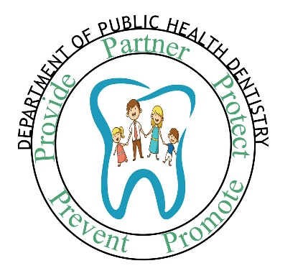
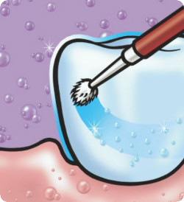

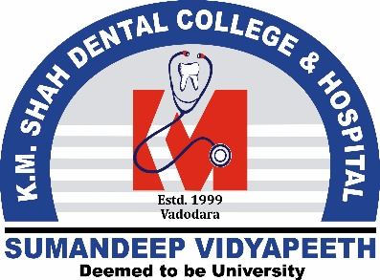
TOPICAL FLUORIDES-I
DEPARTMENT OF PUBLIC HEALTH DENTISTRY
Target Group
IV BDS
Dr. Ramya R Iyer
Professor
Department of Public Health Dentistry,
KMSDC&H
ACADEMIC
YEAR: 2022-23

Slide 2
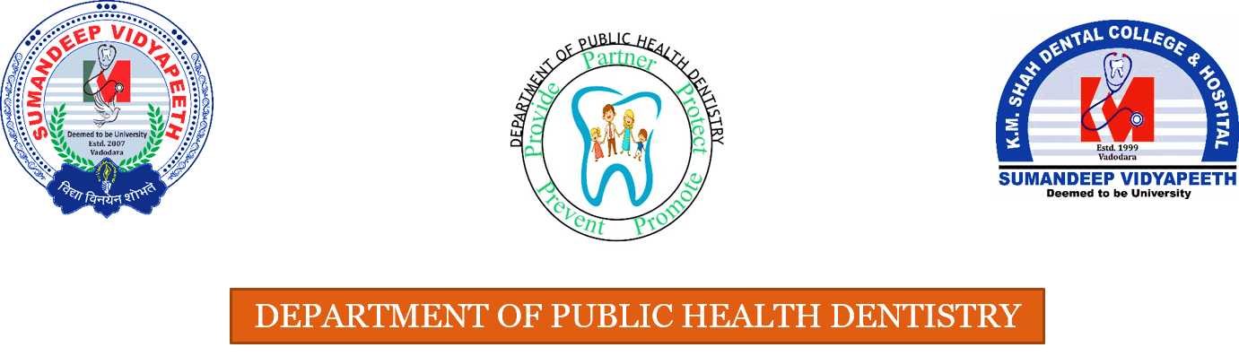
GENERAL OBJECTIVE
To describe the describe the role of Topical Fluorides in Dental Caries Prevention

Slide 3
SPECIFIC OBJECTIVES
To describe the mechanism of action of topical fluorides in caries prevention
To describe Topical Fluoride Delivery methods and explain its effectiveness in caries prevention
To describe topical fluoride delivery methods in school based preventive programs

Slide 4
CONTENTS
INTRODUCTION
RATIONALE OF TOPICAL FLUORIDES
MODE OF ACTION
CLASSIFICATION OF TOPICAL FLUORIDES
PROFESSIONALLY AND SELF- APPLIED TOPICAL FLUORIDES
EVIDENCE
CONCLUSION

Slide 5
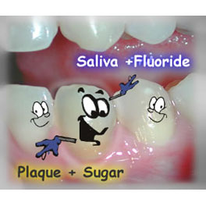
INTRODUCTION
Fluorides and anti- caries effect – Beyond the pre- eruptive effect
A low ambient level of fluoride is required to prevent dental caries
-The need for post- eruptive exposure to fluoride
Bader JD, Shugars DA,Bonito AJ. A systematic review of selected caries prevention and management methods. Community Dent Oral Epidemiol2001;29:399-411.

Slide 6
RATIONALE OF TOPICAL FLUORIDES
Post- eruptive mechanism of action of fluoride
-Demineralization- Remineralization Cycle
Topical effects of fluoride in water- inadequate
Dijkman TG, Arends J. The role of ‘ CaF ₂ - like’ material in topical fluoridation of enamel in situ. Acta Odontol Scand1988;46:391-7.

Slide 7
DEMINERALIZATION- REMINERALIZATION CYCLE
The pH in the oral cavity falls within seconds of ingestion of dietary sugars.
The pH can stay low for up to two hours.
Low pH leads to demineralization of the tooth structure.
When pH returns to normal/neutral, remineralization can occur.
The original mineral apatite structure of teeth is rich in carbonate, has relatively little fluoride and is relatively soluble.
Cycles of partial demineralization and remineralization in a fluoride-rich environment can create fluoride-rich, low-carbonate apatite, which is up to 10X less soluble than the original apatite structure.
Demineralization
Remineralization
Demineralization
Remineralization

Slide 8
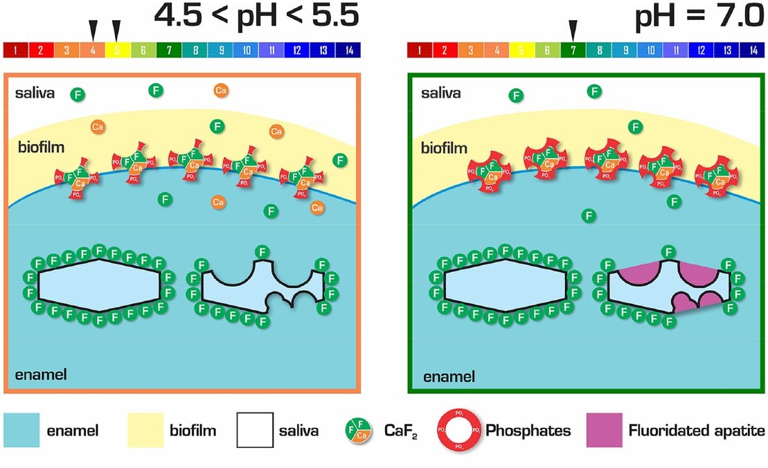
Fluoride Mode of Action: Once There Was an Observant Dentist. J.M. Ten Cate JM, Buzalaf MAR . J Dent Res2019;98(7): 725-31

Slide 9
Fluoride’s Role In Remineralization
  When bacteria metabolize carbohydrate and produce acid, fluoride is released from dental plaque in response to lower pH levels at the tooth interface (Tatevossian, 1990).
  To be more acid resistant and contain more fluoride and less carbonate, the demineralized enamel crystal structure takes up released plaque fluoride and salivary fluoride along with calcium phosphate.

Slide 10
Anti- bacterial effect of fluoride
  Fluoride concentrates in plaque disrupts enzyme systems
    Fluoride inhibits bacterial metabolization of carbohydrates to produce acid and affects the bacterial production of adhesive polysaccharides (Hamilton, 1990).
    When fluoride is constantly present, mutans strep produces less acid (Bowden, 1990).

Slide 11


Summary of mechanisms of action of topical fluorides
promotes remineralization
inhibits demineralization
anti- bacterial effect

Slide 12
CLASSIFICATION OF TOPICAL FLUORIDES
Self- Applied
Fluoride dentifrices
Fluoride rinses
Professionally Applied
Gel and Foam
Fluoride gel products
Topical solutions
Fluoride varnish
Fluoride containing prophylaxis paste
Bader JD, Shugars DA,Bonito AJ. A systematic review of selected caries prevention and management methods. Community Dent Oral Epidemiol2001;29:399-411.

Slide 13
CARIES REDUCTION BY TOPICAL FLUORIDES- WHAT DOES THE EVIDENCE SAY?
METHOD | CARIES REDUCTION
Professionally applied topical fluoride | 30%- 40%
Self- applied topical fluoride | 20%- 50%
Bader JD, Shugars DA,Bonito AJ. A systematic review of selected caries prevention and management methods. Community Dent Oral Epidemiol2001;29:399-411.

Slide 14

PROFESSIONALLY APPLIED TOPICAL FLUORIDES

Slide 15
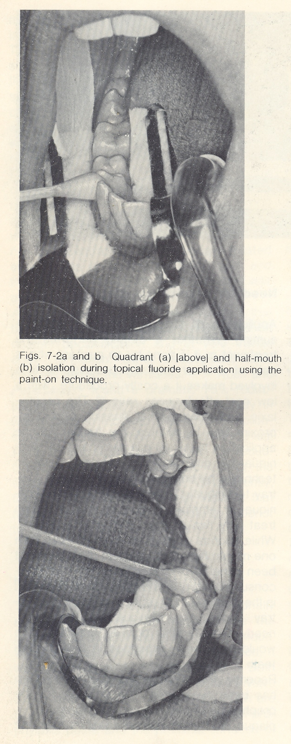
SODIUM FLUORIDE SOLUTION
Method of Preparation :
To prepare 2% NaF –20 gms of NaF is dissolved in 1 liter distilled water
Technique of application :
(Knutson & Feldman technique 1948)
Prophylaxis
Isolation
2% NaF applied
Allowed to dry 3 – 4 min
Knutson JW. Technic of application of sodium fluoride solution to the teeth. Odontologia (Lima). 1967 Jan-Dec;15(1):102-3.

Slide 16
NaF applied once
Choking off phenomenon
Repeated on other quadrants
Instructed not to eat, drink or rinse for 30 min
No. of applications :
2nd, 3rd, 4th applications are done at weekly interval.
Application is recommended at 3, 7, 11 & 13 years.
Knutson JW. Technic of application of sodium fluoride solution to the teeth. Odontologia (Lima). 1967 Jan-Dec;15(1):102-3.

Slide 17
Advantages :
Chemically stable
Acceptable taste
Non-irritant to gingiva
Does not discolor teeth
Inexpensive
Disadvantages :
4 visits within a short time
Knutson JW. Technic of application of sodium fluoride solution to the teeth. Odontologia (Lima). 1967 Jan-Dec;15(1):102-3.

Slide 18
STANNOUS FLUORIDE SOLUTION
Method of Preparation :
To prepare 8% SnF – 0.8 gms is dissolved in 10 ml of distilled water in a plastic container and shaken.
Technique of application :
(Muhler Tech)
Prophylaxis
Teeth are isolated with cotton rolls
Solution applied continuously keeping
the teeth moist for 4 min
Harris No, Hester Wr, Muhler Jc, Allen Mf. Stannous Fluoride Topically Applied In Aqueous Solution In Caries Prevention In A Military Population. Techn Docum Rep No. Sam-tdr-64-26. Amd Tr Rep.1964 May:1-7.

Slide 19
No. of application :
6mts or 12 mts.
Disadvantages :
Unstable
Metallic taste
Gingival irritation
Causes brown pigmentation of teeth particularly in hypocalcified area
Causes staining on margins of restorations
Harris No, Hester Wr, Muhler Jc, Allen Mf. Stannous Fluoride Topically Applied In Aqueous Solution In Caries Prevention In A Military Population. Techn Docum Rep No. Sam-tdr-64-26. Amd Tr Rep.1964 May:1-7.

Slide 20
ACIDULATED PHOSPHATE FLUORIDE (APF)
SOLUTION
Brudevold et al developed APF formula in 1960s
Method of preparation :
20 gms of NaF is dissolved in 1 litre of 0.1 molar phosphoric acid
To this 50% hydro fluoride acid is added to adjust the pH at 3 & fluoride concentration at 1.23%
Newbrun E. Finn Brudevold: discovery of acidulated phosphate fluoride in caries prevention. J Dent Res. 2011 Aug;90(8):977-80. Epub 2011 May 17.

Slide 21
Technique of application (Brudevold technique )
Prophylaxis
APF solution continuously and repeatedly applied with cotton applicators
Teeth are kept moist for 4 min
Floss is passed through interproximal embrasures
Repeated for remaining quadrant
Instructed not to drink, eat or rinse for 30 min
Newbrun E. Finn Brudevold: discovery of acidulated phosphate fluoride in caries prevention. J Dent Res. 2011 Aug;90(8):977-80. Epub 2011 May 17.

Slide 22
No. of application :
1 or 2 per year
Advantages :
Stable
Cheap
50% more effective than NaF
Disadvantages :
Teeth must be kept wet for 4 min
Acidic, sour and bitter to taste
Newbrun E. Finn Brudevold: discovery of acidulated phosphate fluoride in caries prevention. J Dent Res. 2011 Aug;90(8):977-80. Epub 2011 May 17.

Slide 23
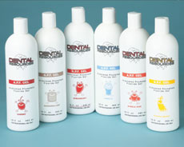
APF (Acidulated Phosphate Fluoride)Gel
Method of preparation :
A gelling agent methylcellulose or hydroxy-ethyl cellulose is to be added to the solution and pH is adjusted between 4 – 5
Jiang H, Tai B, Du M, Peng B. Effect of professional application of APF foam on caries reduction in permanent first molars in 6-7-year-old children: 24-month clinical trial.
J Dent.2005 Jul;33(6):469-73. Epub 2004 Dec 20.

Slide 24
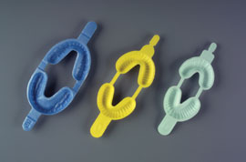
Technique of application :
Prophylaxis
Application of APF gel done using trays that fit U/L dental arches
A disposable foam-lined tray is preferred
Patient is seated upright in chair
Minimum amount of APF gel should be dispensed in tray – 5 ml
Jiang H, Tai B, Du M, Peng B. Effect of professional application of APF foam on caries reduction in permanent first molars in 6-7-year-old children: 24-month clinical trial. J Dent.2005 Jul;33(6):469-73. Epub 2004 Dec 20.

Slide 25
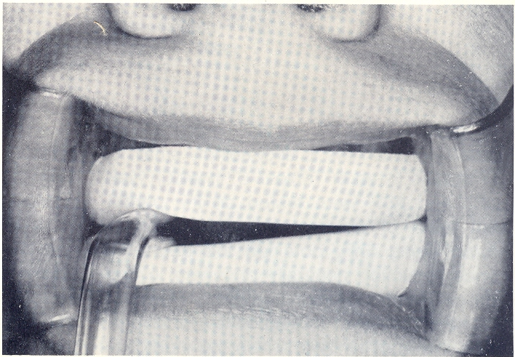
U/L trays are inserted into the mouth and pt is asked to exert slight pressure using light biting forces in order to cause the gel to flow inter-proximally
The gel is kept in mouth for 4 min
Instructed not to drink, eat or rinse for 30 min
Jiang H, Tai B, Du M, Peng B. Effect of professional application of APF foam on caries reduction in permanent first molars in 6-7-year-old children: 24-month clinical trial. J Dent.2005 Jul;33(6):469-73. Epub 2004 Dec 20.

Slide 26
APF Foam
Advantages:
Much lighter than conventional gel; <1 g foam per mouth required.
Suctioning is not required
Evans D. APF foam does reduce caries in primary teeth. Evid Based Dent. 2007;8(1):7.

Slide 27
Fluoride varnish
The lacquer-based product adheres to the dental enamel forming a depot from which fluoride is slowly released.
Substantivity
Commercially available:
Duraphat (2.26% F), fluorprotector( 0.7% F), carex(1.8% F)
Quock RL, Warren-Morris DP. Fluoride varnish: the top choice for professionally applied fluoride. J Mich Dent Assoc. 2011 May;93(5):42-8.

Slide 28
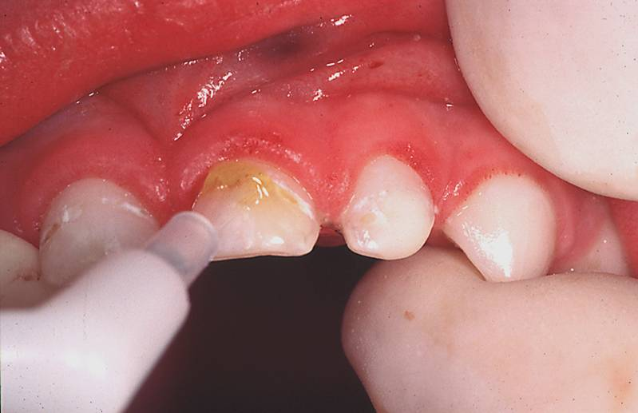
Technique of application :
Prophylaxis
Teeth are dried
A drop of varnish is taken on brush and painted thin on the teeth
Quock RL, Warren-Morris DP. Fluoride varnish: the top choice for professionally applied fluoride. J Mich Dent Assoc. 2011 May;93(5):42-8.

Slide 29
Technique of application :
Painted first on lower arch & then on upper arch
Pt is made to sit with mouth open for 4 min
Pt is instructed not to rinse or drink or brush teeth for 1 hour
Pt is instructed to take liquids or semisolid food and avoid eating solid food
Quock RL, Warren-Morris DP. Fluoride varnish: the top choice for professionally applied fluoride. J Mich Dent Assoc. 2011 May;93(5):42-8.

Slide 30
No. of application :
Semiannual application
Advantages :
Forms a water tight protective film insulating against thermal and chemical influences
Varnish remains on tooth for several days
Disadvantages :
Pt co-operation is required
Expensive
Quock RL, Warren-Morris DP. Fluoride varnish: the top choice for professionally applied fluoride. J Mich Dent Assoc. 2011 May;93(5):42-8.

Slide 31
WHAT DOES THE EVIDENCE SAY ABOUT THE VARIOUS TOPICAL FLUORIDE FORMULATIONS ?
LEVEL OF EVIDENCE- 1a
Characteristics | NaF | SnF | APF
Percentage | 2% | 8% | 1.23%
Fluoride concentration | 9200 ppm | 19500 ppm | 12300 ppm
pH | Neutral | 2.4-2.8 | 3
Frequency of application | 4 at weekly intervals( 3,7, 11, 13) | Biannually | Biannually
Adverse effects | No | Tooth pigmentation, gingival irritation | No
Caries reduction | 30% | 32% | 28%
Marinho VC. Cochrane reviews of randomized trials of fluoride therapies for preventing dental caries. Eur Arch Paediatr Dent. 2009 Sep;10(3):183-91.

Slide 32
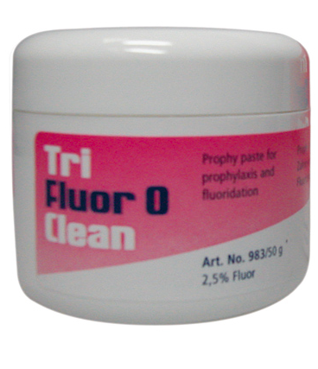
Fluoride containing prophylaxis pastes
Rationale- Replenishes the fluoride lost
Axelsson P. Current role of pharmaceuticals in prevention of caries and periodontal disease. Int Dent J. 1993 Oct;43(5):473-82. Review.

Slide 33
DESIRABLE TO KNOW- RECENT EVIDENCE RELATED TO SILVER DIAMINE FLUORIDE
Journal Article | Aim | Electronic Databases | Conclusions | Level of Evidence (CEBM)
Effectiveness of silver diamine fluoride in caries prevention and arrest: a systematic literature review. Violeta Contreras et al. Gem. Dent. May 2017 | To assess the scientific evidence regarding effectiveness of silver diamine fluoride in preventing and arresting caries in primary dentition and first permanent molars | Pubmed, ScienceDirect, Scopus 7 publications included after eligibility and quality assessment | More studies needed to understand effectiveness of SDF Suitable as a preventive procedure in community settings At 30-38% concentration arrests caries | 1 a

Slide 34
Conclusion
Topical fluorides: 21st century method of delivering fluoride.
Marinho VC. Cochrane reviews of randomized trials of fluoride therapies for preventing dental caries. Eur Arch Paediatr Dent. 2009 Sep;10(3):183-91.

Slide 35
THANK YOU

