Slide 1
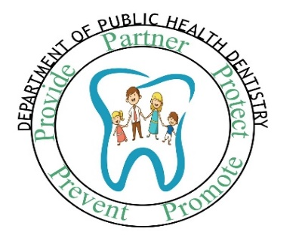
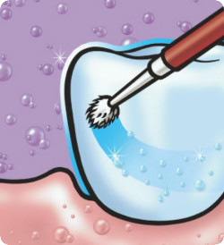


TOPICAL FLUORIDES- II
DEPARTMENT OF PUBLIC HEALTH DENTISTRY
Target Group
IV BDS
Dr. Ramya R Iyer
Professor
Department of Public Health Dentistry
KMSDC&H
ACADEMIC
YEAR: 2022-23

Slide 2
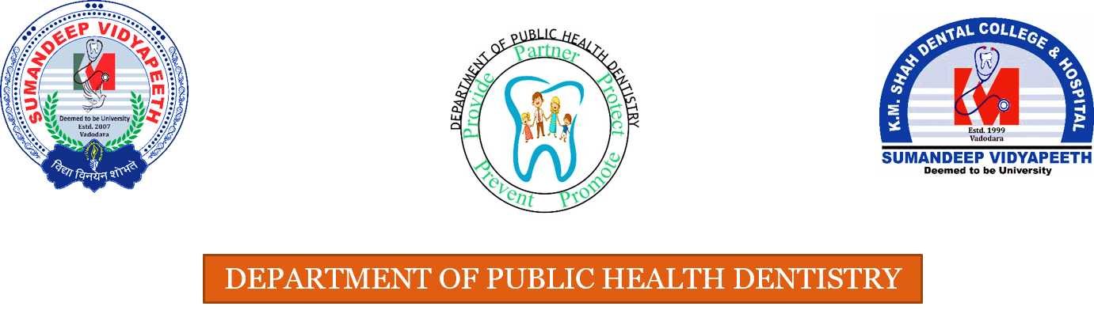
GENERAL OBJECTIVE
To describe the describe the role of Topical Fluorides in Dental Caries Prevention in Community and School based Program

Slide 3
SPECIFIC OBJECTIVES
To describe topical fluoride delivery methods in school based preventive programs

Slide 4



Summary of mechanisms of action of topical fluorides
promotes remineralization
inhibits demineralization
anti- bacterial effect

Slide 5
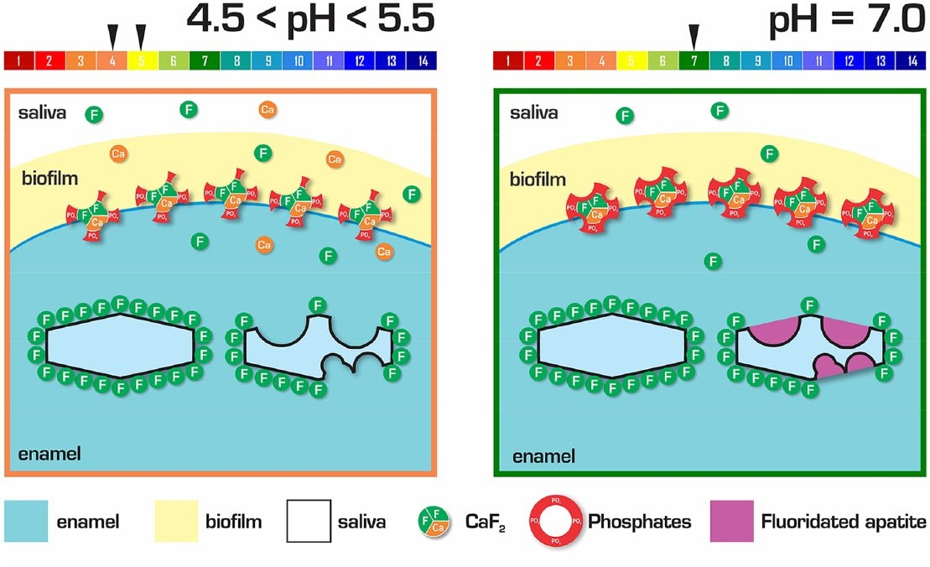

Slide 6
CLASSIFICATION OF TOPICAL FLUORIDES
Self- Applied
Fluoride dentifrices
Fluoride rinses
Professionally Applied
Gel and Foam
Fluoride gel products
Topical solutions
Fluoride varnish
Fluoride containing prophylaxis paste
Bader JD, Shugars DA,Bonito AJ. A systematic review of selected caries prevention and management methods. Community Dent Oral Epidemiol2001;29:399-411.

Slide 7
CARIES REDUCTION BY TOPICAL FLUORIDES- WHAT DOES THE EVIDENCE SAY?
METHOD | CARIES REDUCTION
Professionally applied topical fluoride | 30%- 40%
Self- applied topical fluoride | 20%- 50%
Bader JD, Shugars DA,Bonito AJ. A systematic review of selected caries prevention and management methods. Community Dent Oral Epidemiol2001;29:399-411.

Slide 8

SELF-APPLIED TOPICAL FLUORIDES

Slide 9
Fluoridated Toothpastes
The most common forms of topical F
In addition to the abrasive and flavoring agent, F is added to the toothpaste as the preventive (therapeutic) agent
The toothpaste usually contain about 1000 to 1100 PPM of F, and has offered 15% to 30 % reduction in dental caries (as per evidence available from reference cited in foot note)
Young children should be supervised during brushing to avoid excessive F consumption.
Marinho VC. Cochrane reviews of randomized trials of fluoride therapies for preventing dental caries. Eur Arch Paediatr Dent. 2009 Sep;10(3):183-91.

Slide 10
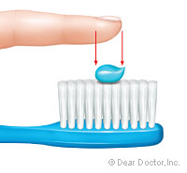
School Tooth brushing programme
ADA and CDC recommends the use of toothpastes with fluoride for older children and adults. “Children under age two should not use fluoride toothpaste unless a dentist recommends it”.
For those aged 2 to 5 years, a pea-sized amount is recommended.
A ‘pea-sized’ portion weighs approximately 0.75 g and
contains about 0.4 mg of fluoride

Slide 11
EFFECT OF DIFFERENT CONCENTRATIONS OF FLUORIDES IN DENTIFRICES: Evidence: 1a (CEBM)
AIM | Data bases Searched | Conclusions
To determine and compare the effects of toothpastes of different fluoride concentrations (parts per million (ppm)) in preventing dental caries in children, adolescents, and adults. | -Cochrane Oral Health's Trials Register (to 15 August 2018); the Cochrane Central Register of Controlled Trials (CENTRAL; 2018, Issue 7) in the Cochrane Library (searched 15 August 2018); MEDLINE Ovid (1946 to 15 August 2018); and Embase Ovid (1980 to 15 August 2018). The US National Institutes of Health Ongoing Trials Register (ClinicalTrials.gov) and the WHO I Clinical Trials Registry Platform were searched for ongoing trials (15 August 2018) -Including studies with 1100 ppm to 2400 pm | Cochrane Review supports the benefits of using fluoride toothpaste in preventing caries when compared to non-fluoride toothpaste. Evidence for the effects of different fluoride concentrations is more limited, but a dose-response effect was observed for D(M)FS in children and adolescents. . The choice of fluoride toothpaste concentration for young children should be balanced against the risk of fluorosis.
Walsh T, Worthington HV, Glenny AM, Marinho VC, Jeroncic A. Fluoride toothpastes of different concentrations for preventing dental caries. Cochrane Database Syst Rev. 2019 Mar 4;3(3):CD007868. doi: 10.1002/14651858.CD007868.pub3. PMID: 30829399; PMCID: PMC6398117.

Slide 12
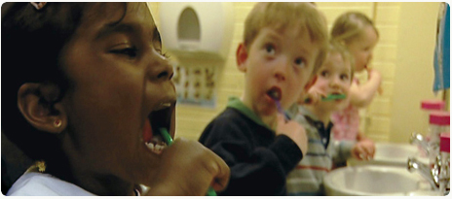
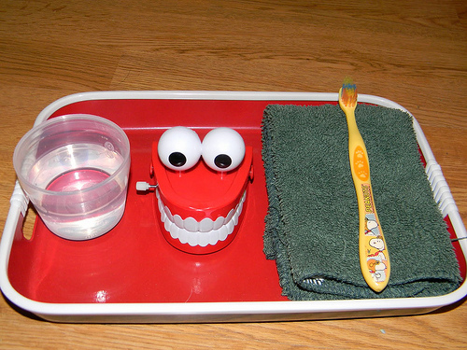
School Tooth brushing programme
Daily teacher-supervised tooth-brushing with fluoride toothpaste can be effectively targeted into socially deprived communities and a significant reduction in dental caries can thereby be achieved especially among caries-susceptible children.
Jackson RJ, Newman HN, Smart GJ, Stokes E, Hogan JI, Brown C, Seres J The effects of a supervised toothbrushing programme on the caries increment of primary school children, initially aged 5-6 years. Caries Res. 2005 Mar-Apr;39(2):108-15

Slide 13
Evidence for effectiveness of School Tooth brushing programme:Level of Evidence- 1b
What was assessed | Conc of F | No. of children | Type of study and method | Results
Caries increment following once a day tooth brushing at school, Supervised by trained class teachers | 1450 ppm of fluoride | 517 children | Randomized controlled trial Visual assessment only using the BASCD criteria. | For children in the intervention group, the overall caries increment (2.60) was significantly less (10.9%; p < 0.001) than for children in the non-intervention group (2.92). Difference in caries increment greatest for the proximal surfaces (21.4%; p < 0.01).
Jackson RJ, Newman HN, Smart GJ, Stokes E, Hogan JI, Brown C, Seres J The effects of a supervised toothbrushing programme on the caries increment of primary school children, initially aged 5-6 years. Caries Res. 2005 Mar-Apr;39(2):108-15

Slide 14
Fluoride Mouth rinse programs
Most common fluoride compound used in mouthrinse : sodium fluoride.
0.05% sodium fluoride (2.0 mg fluoride in 10 ml) for daily rinsing for persons > 6 years old.
0.20% sodium fluoride (9.0 mg fluoride in 10 ml) are used in supervised, school-based weekly rinsing programs.
Fluoride mouthrinse programs are not recommended for children less than 6 years of age.
Frequency and dosage of fluoride mouth rinse in community programs stated as per evidence based clincal recommendations of the CDC (see ref below).
CDC. Recommendations for using fluoride to prevent and control dental caries in the United States. MMWR2001;50(RR14):1-42. Available from: http://www.cdc.gov/mmwr/preview/mmwrhtml/rr5014a1.htm

Slide 15
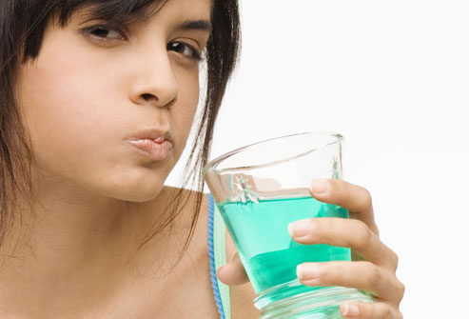
Fluoride Mouth rinse programs
Supervised regular use of fluoride mouthrinse is effective.
Rinsing frequencies is associated with a reduction in caries increment in children. (as per evidence available from reference cited in foot note)
There is a need for complete reporting of side-effects and acceptability data in fluoride mouthrinse trials (i.e evidence of good quality lacking to understand side effects and acceptability parameters of F mouth rinse use.
Marinho VC, Higgins JPT, Logan S, Sheiham A. Fluoride mouthrinses for preventing dental caries in children and adolescents (Cochrane Review). In Cochrane Library 2003; Issue 3. Oxford: Update Software.
Marinho VC, Chong LY, Worthington HV, Walsh T. Fluoride mouth rinses for preventing dental caries in children and adolescents. Cochrane Database Syst Rev2016;29:7(7): CD002284.

Slide 16
Fluoride Mouth-rinse Programs
Versus
Fluoride Varnish Programs
No Statistically significant difference in caries increment in 2 years among children participating in Fluoride Mouth-rinse Program Or Fluoride Varnish Program
LEVEL OF EVIDENCE: 1b
RESEARH DESIGN: CLINICAL TRIAL- Conducted Public Dental Clinics in low SE area in Denmark with an elevated level of caries compared to the city average
Keller MK , Klausen BJ, Twetman S. Fluoride varnish or Fluoride mouthrinse? A comparative study of two school based programs. Community Dent Health 2016; 33(1): 23-6.

Slide 17
Caries Preventive Programs in School and/or Community Settings
Caries Prevention
Fluoride Mouth rinse Program
Silver Diamine Fluoride
ART
Sealant Program
Fluoride Varnish Program
Fluoride Tooth-brushing Program

Slide 18
Conclusion
Topical fluorides: 21st century method of delivering fluoride.
Marinho VC. Cochrane reviews of randomized trials of fluoride therapies for preventing dental caries. Eur Arch Paediatr Dent. 2009 Sep;10(3):183-91.

Slide 19
THANK YOU
DEPARTMENT OF PUBLIC HEALTH DENTISTRY

