Slide 1
Defluoridation
Target group: Presented by:
Final Year BDS Dr Mayur Mishra
2022-2023 Reader
Public Health Dentistry

Slide 2
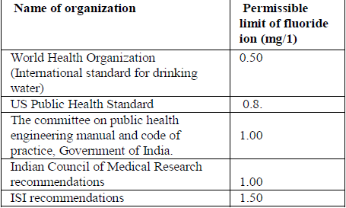
Introduction
Fluoride, a normal constituent of natural waters has dual significance. At optimum concentration it has a protective effect on teeth. At concentrations exceeding a certain limit, it acts as a cumulative toxin, adversely affecting every tissue and organ in the body.

Slide 3
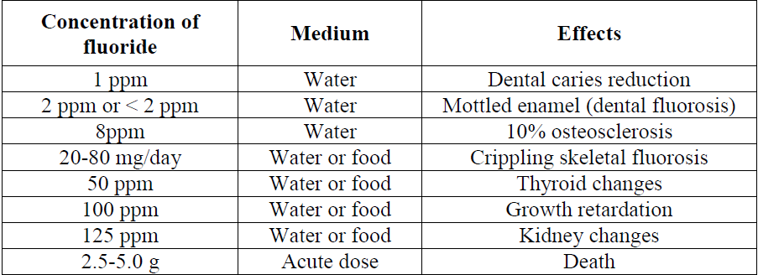
Effects of fluoride
Source: A. Tewari et al Journal of Chemical and Pharmaceutical Research2009, 1 (1):31-37

Slide 4
Alternatives
Provision of a new and alternate source of water with acceptable fluoride levels
Transporting water from a distant source
Blending high fluoride with low fluoride water
Dual water sources
Rainwater harvesting

Slide 5
Definition
Water defluoridation is defined as the downward adjustment of fluoride ion concentration in a public drinking water supply so that the level of fluoride is maintained at the normal physiological limit of 1ppm to prevent dental caries with minimum possibility of causing dental fluorosis

Slide 6
Concept of integrated fluoride mitigation
identification
mitigation

Slide 7
identification
Fluoride
in water
Skeletal &
non skeletal
fluorosis
QCRA
(quantitative chemical
risk assessment)
Fluoride
In
food
Nutritional
status
Overall
Fluoride
intake
Dental
fluorosis

Slide 8
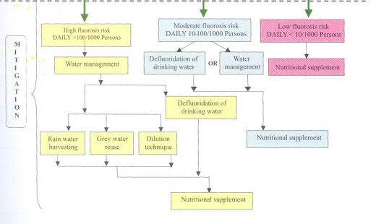
Mitigation

Slide 9
The defluoridating agents may be divided into four basic types depending upon the process of removal of fluoride.
Adsorption technique
Ion-exchange technique
Precipitation technique, and
Other techniques, which include electro chemical defluoridation and Reverse Osmosis.

Slide 10
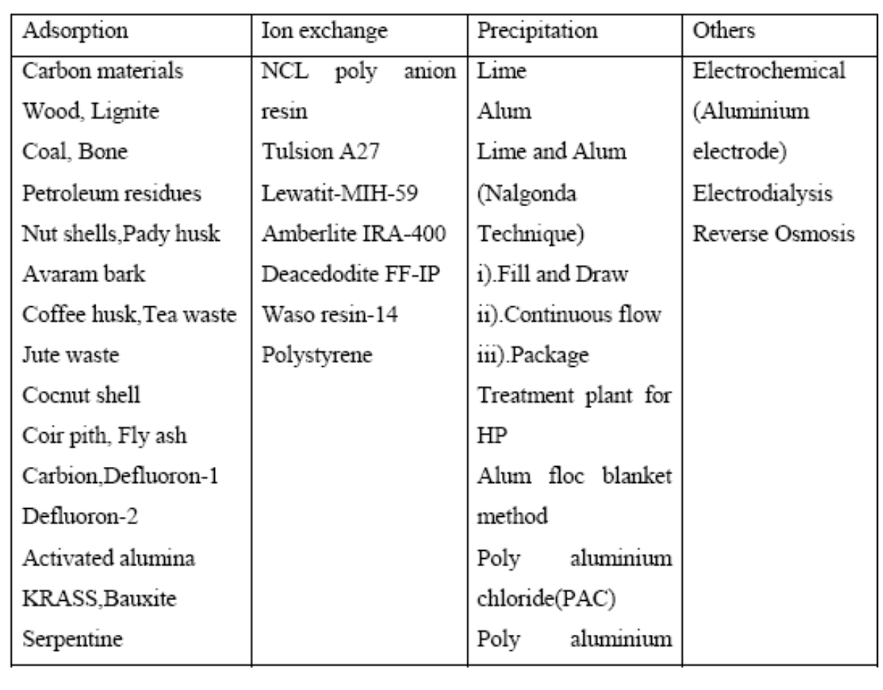

Slide 11
Desirable characteristics of defluoridation process
1) Cost effective
2) Easy to handle or operate by the people.
3) Independent of input fluoride concentration alkalinity, pH, temperature.
4) Not affect taste of water.
5) Not add other undesirable substances (eg.Aluminium) to treated water.

Slide 12
Nalgonda Technique of defluoridation
The Nalgonda Technique was developed by the National Environmental Engineering Research Institute (NEERI) at Nagpur in 1974 and reported by Bulusu in 1988.
The process comprises addition in sequence of sodium aluminate (filter alum), lime and bleaching powder to the fluoride water followed by flocculation, sedimentation and filtration.
The technique is extremely useful both for domestic as well as for community water supplies.

Slide 13
Mechanism:
Rapid mix : Rapid mixing is an operation by which the coagulant is rapidly and uniformly dispersed through out a single or multiple phase system. It is rapidly mixed for a period of 30 to 60 seconds with a speed of 10 to 20 rpm so that the coagulant is rapidly and uniformly dispersed. This helps in the formation of microflocs and results in proper utilization of the chemical coagulant, preventing localization of concentration and premature formation of hydroxides which leads to reduced utilization of coagulant.

Slide 14
Flocculation: Flocculation is the second stage of the formation of settleable particles (floes) from destabilized colloidal sized particles and is achieved by gentle and prolonged mixing for a period of 10-15 minutes with a speed of 2 - 4 rpm.

Slide 15
Sedimentation : It is the separation from the water by gravitational setting of suspended particles that are heavier than water.
Factors that influence sedimentation are:
a) Size, shape, density, and nature of the particles.
b) Viscosity, density and temperature of water.
c) Surface overflow rate.
d) Velocity of flow.
e) Effective depth of settling zone

Slide 16
Filtration : Filtration is the process of separating suspended and colloidal impurities from water by passage through a porous media. The flocculated water is allowed to settle and filter through fullers earth candles overnight. Treated water will be available for drinking and cooking with desired level of fluoride 1 ppm or less.

Slide 17
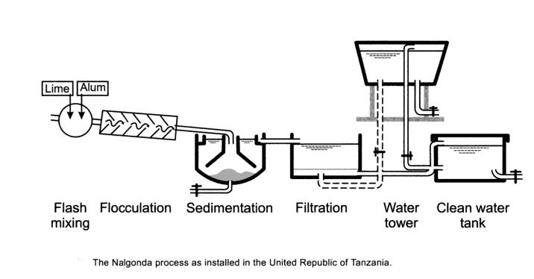

Slide 18
Salient features of Nalgonda technique
• No'regeneration of media
• No handling of caustic acids and alkalies
•Only readily available chemicals used
• Adaptable for domestic use
•Simplicity of design, construction, operation and maintenance.
• Highly efficient removal of fluoride to desirable levels.
• It is effective even when dissolved solids are above 1500 mg/l and hardness above 600 mg/litre.
• Little wastage of water and least disposal problem.
• Needs minimum of mechanical and electrical equipment.
• No energy except muscle power for domestic equipment.

Slide 19
Disadvantages of Nalgonda technique
Desalination may be necessary when the total dissolved solids exceed 1500 mg/l.
Hardness of the raw water in the range of 200 mg/l to 600 mg/l requires precipitation softening and beyond 600 mg/l becomes a cause for rejection or adoption of desalination.
Generation of higher quantity of sludge compared to electrochemical defluoridation.
The large amount of alum needed to remove fluoride.
Careful pH control of treated water is required.
High residual aluminium is reported in treated water by some authors.

Slide 20
Modifications for Nalgonda technique.
Poly Aluminium Chloride: It is evident that for higher concentrations of fluoride, the removal efficiency of fluoride is higher with Poly Aluminium Chloride (PAC) when compared with Alum. However, since Alum is more affordable and accessible than PAC this alternative is not worth considering .
Poly Aluminium Hydroxy Sulphate(PAHS): A polymeric aluminum compound, poly-aluminium-hydroxy-sulphate(PAHS) is found to require less flocculation time and settling time. Detention time of 20 to 30 minutes will suffice for complete settlement of all flocks. Cost of PAHS is much less than the alum.

Slide 21
Domestic defluoridation filters
These are stainless steel candle filters adopting the Nalgonda technique. The equipment consists of water filter of any size and make, fitted with candle filters and an additional mixing device which can be used as domestic defluoridation filters.

Slide 22
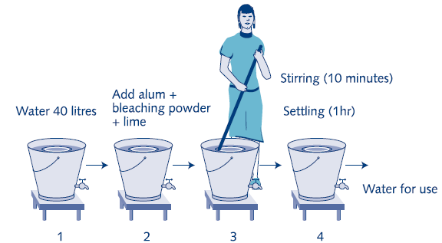

Slide 23
Defluoridation in the two bucket system
The designed defluoridator consists of two buckets equipped with taps and a sieve on which a cotton cloth is placed.
Alum and lime are added simultaneously to the raw water bucket where it is dissolved/ suspended by stirring with a wooden paddle.
The villagers are trained to stir fast while counting to 60 (1 minute) and then slowly while counting to 300 (5 minutes). The flocs formed are left for settling for about one hour. The treated water is then tapped through the cloth into the treated water bucket from where it tapped as needed for drinking and cooking.

Slide 24
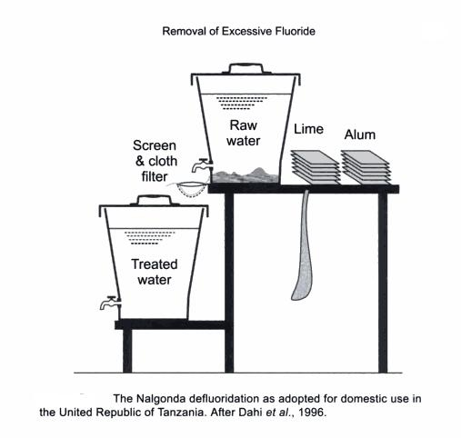
The use of two buckets should thus ensure that the treated water is separated from the fluoride containing sludge directly after the defluoridation.
All physico-chemical processes are thus performed in the raw water bucket, while the treated water bucket is kept only for the storage of the defluoridated water.

Slide 25
IISc
The Indian Institute of Science (IISc), Bangalore developed a simple defluoridation technique which uses Magnesium oxide, lime and Sodium bisulphate. Magnesium oxide removes dissolved fluoride ions from water samples by precipitating fluoride as insoluble Magnesium fluoride.
MgO + H2O Mg(OH)2
Mg(OH)2 +2NaF MgF2+2NaOH

Slide 26
adsorption methods
In the adsorption method, raw water is passed through a bed containing defluoridating material. The material retains fluoride either by physical, chemical or ion exchange mechanisms. The adsorbent gets saturated after a period of operation and requires regeneration.
A wide range of materials has been tried for fluoride uptake. Bauxite, magnetite, kaolinite, serpentine, various types of clays and red mud are some of the naturally occurring materials studied.

Slide 27
Bone char as a defluoridating material.
Bone char consists of ground animal bones that have been charred to remove all organic matter. Major components of bone charcoal are calcium phosphate, calcium carbonate and activated carbon.
The fluoride removal mechanism involves the replacement of carbonate of bone char by fluoride ion. The method of preparation of bone charcoal is crucial for its fluoride uptake capacity and the treated water quality. Poor quality bone char can impart bad taste and odour to water.

Slide 28
In the USA in the past, a few defluoridation plants were using bone char. Now they have been largely replaced by activated alumina. Bone char is considered as an appropriate defluoridating material in some developing countries. The ICOH domestic defluoridator was developed in Thailand and uses crushed charcoal and bone char.
Notes:
Icoh: interational commision for occupation health

Slide 29
Field trials in Thailand, Sri Lanka and some African countries have shown very encouraging .Reports from Sri Lanka have shown that with 300 gm charcoal and 1 kg bone char an ICOH filter can defluoridate on an average 450 litres of water containing 5 mg/l F- at a flow rate of 4 litres per hour.

Slide 30
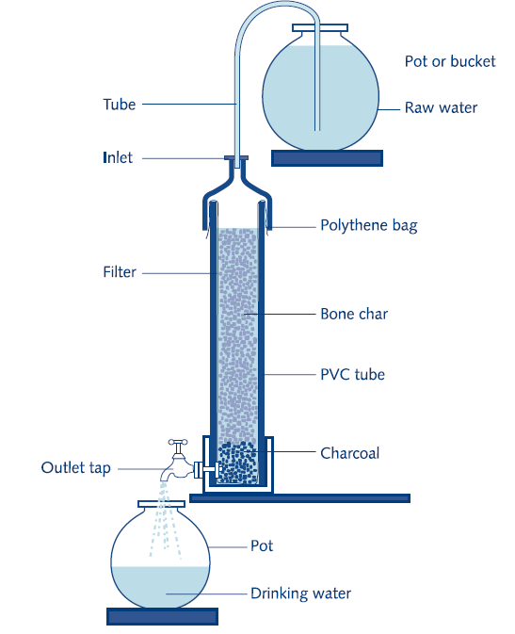
Bone char domestic defluoridator developed by ICOH-Thailand

Slide 31
Activated alumina as a defluoridating material. Activated alumina or calcined alumina, is aluminium oxide, Al2O3.
It is prepared by low temperature dehydration (300-600°C) of aluminium hydroxides. Activated alumina has been used for defluoridation of drinking water since 1934(US), just after excess fluoride in water was identified as the cause of fluorosis.

Slide 32
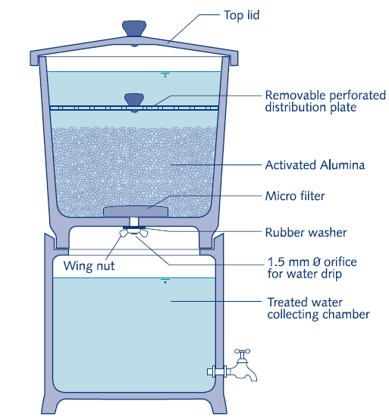
Activated alumina-based domestic defluoridation filter

Slide 33
Calcined clay.
Freshly fired brick pieces are used in Sri Lanka for the removal of fluoride in domestic defluoridation units .
The brick bed in the unit is layered on the top with charred coconut shells and pebbles. Water is passed through the unit in an upflow mode. The performance of domestic units has been evaluated in rural areas of Sri Lanka. It is reported that efficiency depends on the quality of the freshly burnt bricks.

Slide 34
The unit could be used for 25-40 days, when withdrawal of defluoridated water per day was around 8 litres and raw water fluoride concentration was 5 mg/l. As PVC pipes are costly, a defluoridator made out of cement and bricks has also been recommended.

Slide 35
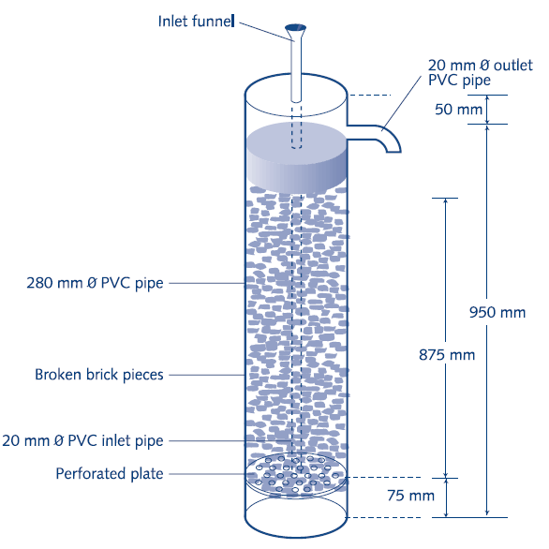
Domestic defluoridation unit using brick pieces

Slide 36
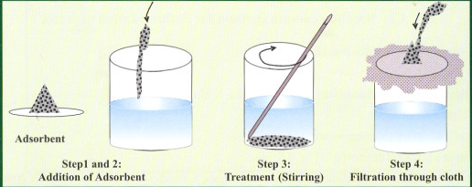
Technique 1: Direct contact or loose sorbent

Slide 37
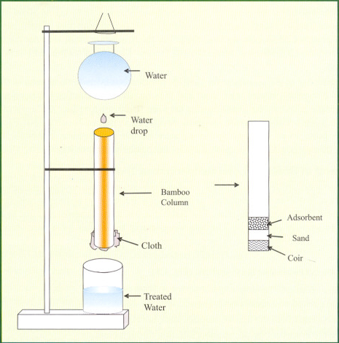
Technique 2: bamboo column

Slide 38
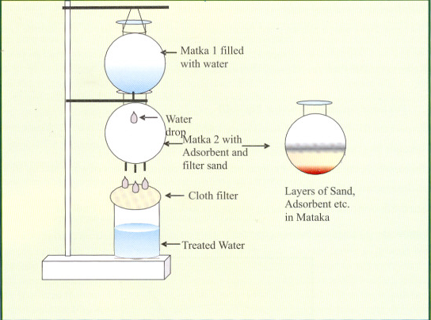
Technique 3: stacked matka (earthen pot)

Slide 39
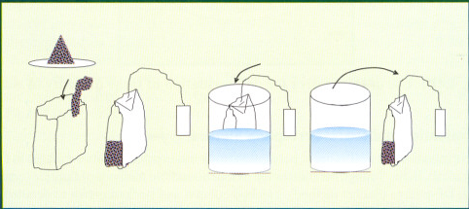
Technique 4 : defluoridation pudiya (DF- Pudiya)

Slide 40
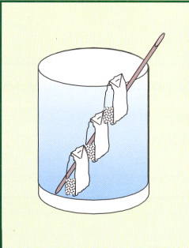
For larger quantity of water

Slide 41
Natural adsobents
Many natural adsorbents from various trees were tried as defluoridation agents. Seeds of the Drumstick tree, roots of Vetiver grass and Tamarind seeds were few among them. The seeds of the drumstick tree (Moringa oleifera) adsorb fluoride from water. Drumstick seeds act as a coagulant. They have long been a traditional method for purification of turbid water in both India and Africa.
Researchers at „M. S. Swaminathan Research Foundation‟ (MSSRF) had shown drumstick seeds to have remarkable defluoridation efficiency, which was higher than that of activated alumina. But, these results were not reproducible.

Slide 42
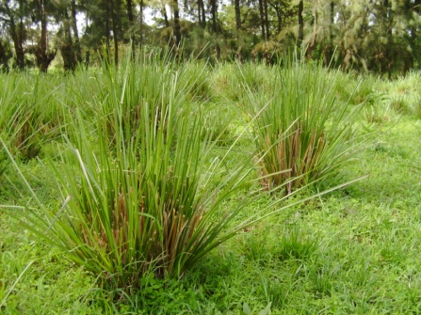
The roots of Vetiver grass (Vetiveria zizanoides) are another product that have traditionally been used for water purification. The roots were effective at defluoridation and could remove as much as 70% of the fluoride from a sample. The defluoridation efficiency was higher than activated alumina, and the price was comparable.
But, the quantity of grass needed is so high that, a family would need to rise acres of Vetiver grass every year in order to provide enough material for defluoridation.

Slide 43
Tamarind seeds were successfully tested for defluoridation by sorption. Since maximum defluoridation is achieved at an optimum pH of 7, post defluoridation pH adjustment is not required. Tamarind seeds, which are otherwise considered a kitchen- waste, can be obtained at much cheaper price.

Slide 44
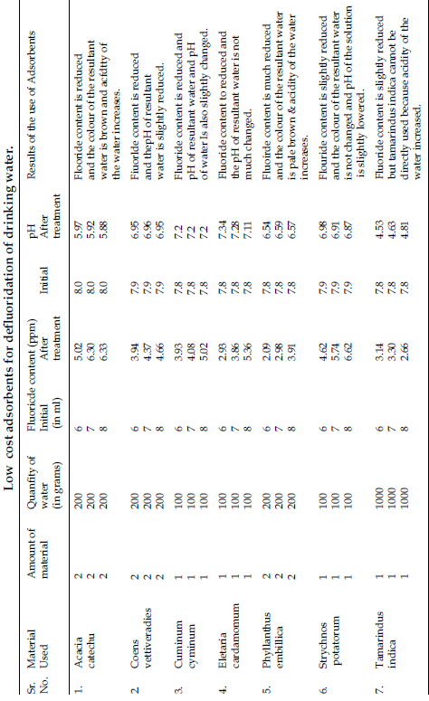
Source: D. Santhi, V. Umayoru Bhagan, R. Lekshmana Sarma. Defluoridation of drinking water using locally available low cost adsorbents. Jr. of Industrial Pollution Control 200;21(2);397- 400

Slide 45
Ion exchange
These are commercially produced resins which are expensive and uneconomical in most circumstances.
a) Carbion : It is a cation exchange resin of good durability and can be used on sodium and hydrogen cycles. Synthetic chemicals, namely, anion and cation exchange resins have been used for fluoride removal. Some of these are Polyanion (NCL), Tul-sion A-27, Deacedite FF (IP), Amberllte IRA 400, Lewatit MIH-59, and Amberlite XE-75.
These resins have been used in chloride and hydroxy form. The fluoride exchange capacity of these resins depends upon the ratio of fluoride to total anions in water.

Slide 46
b)Defluoron 1: a sulphonated saw dust impregnated with 2% alum solution.
c) Defluoron - 2 : This was developed in 1968 to overcome the problem of Defluoron - 1. It is a sulphonated coal using aluminium solution as regenerant. Although it was successful in removing fluorides, regeneration and maintenance of the plant required skilled operation.

Slide 47
Reverse Osmosis and Electro dialysis
In reverse osmosis, the hydraulic pressure is exerted on one side of the semi permeable membrane which forces the water across the membrane leaving the salts behind. The relative size of the pollutants left behind depends on the pressure exerted on the membrane.
In electro dialysis, the membranes allow the ions to pass but not the water. The driving force is an electric current which carries the ions through the membranes.

Slide 48
Advantages :
• Does not require addition of chemicals
• No need to pre & post-treatments
• Low volume of sludge.
• Units can be designed for any capacity.
• Units are designed for specific locations & fluoride content of water. But can be operated with varying fluoride concentrations by slightly altering the operating parameters.
• The electrochemical reactor occupies less floor space.
• Operator friendly
• Requires less electric energy (0.3 to 0.6kwh/1000 lts)

Slide 49
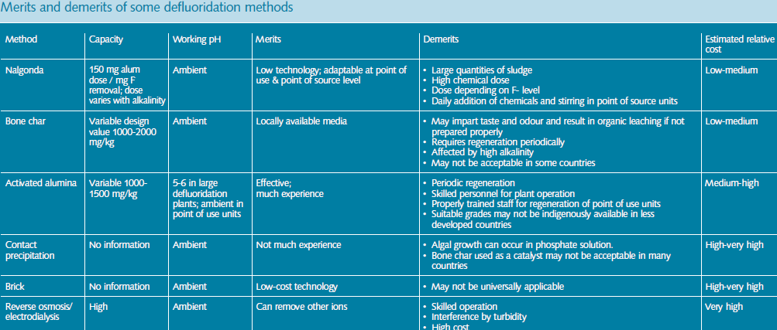

Slide 50
STATUS OF INDIA
UNICEF has worked closely with the Government and other partners in defluoridation programmes in India, where excessive fluoride has been known for many years to exist in much of the nation's groundwater. In the 1980s, UNICEF supported the Government's Technology Mission in the effort to identify and address the fluoride problem.
Government of India launched a massive programme, namely „Technology Mission on Safe Drinking Water‟ in 1986 with the goal of providing potable water to the people living in rural India. It was renamed as „Rajiv Gandhi National Drinking water Mission‟ in 1991.

Slide 51

NATIONAL PROGRAM FOR PREVENTION AND CONTROL OF FLUOROSIS
11th Five Year Plan has emphasized the need and laid down framework for this program.
Goal: To prevent and control fluorosis in the country.
In the beginning the program for prevention and control of Fluorosis can be implemented in 5 districts selected from each of the 5 zones of the country.
The program will be expanded to cover about 100 districts of 19 states depending on available resources.

Slide 52
Conclusion
Several physical and chemical defluoridation methods have been designed to treat high fluoride waters.
However ion exchange and chemical treatments are cost intensive, while physical methods suffer limitations like frequent change of defluoridant beds and inability to reduce fluoride to non-toxic levels.
Biological defluoridation methods/technically design upgraded methods can serve as a best alternative to the conventional methods of defluoridation.
Community should adopt such methods of defluoridation which would be cost effective and efficient.

Slide 53
References
1.Piddennavar Renuka, Krishnappa Pushpanjali. Review on Defluoridation Techniques of Water. Ijes 2012;2(3) ;86-94
2.Pandey PK, Pandey M, Sharma R. Defluoridation of Water by a Biomass: Tinospora cordifolia,Journal of Environmental Protection, 2012,;3; 610-616
3. Puthenveedu Sadasivan Pillai Harikumar*, Chonattu Jaseela, Tharayil Megha. Defluoridation of water using biosorbents. Natural Science 2012; 4;245-251

Slide 54
4.Tewari A, Dubey A. Defluoridation of Drinking Water : Efficacy and Need. Journal of Chemical and Pharmaceutical Research2009, 1 (1):31-37
5.Leela Lyengar. Technologies for fluoride removal. 499-516. Available on http://www.samsamwater.com/library/TP40_22_Technologies_for_fluoride_removal.pdf (assessed on 11/10/2016)
6.GL He* , Y Chang* and RD Ji. Mechanisms of defluoridation of drinking water by tricalcium phosphate. 1stInternational Workshop on Fluorosis Prevention and Defluoridation of Water.33-39

Slide 55
7.Eli Dahi, Felix Mtalo, Balthazar Njau, Henrik Bregnh. Defluoridation using the Nalgonda Technique in Tanzania. 22nd WEDC Conference.266-269
8.Pranati Eswar and Devaraj C G. Water defluoridation: Field studies in India. Available on http://www.nacd.in/ijda/volume-03-issue-02/120-water-defluoridation-field-studies-in-india (assessed on 11/10/2016)
9.D. Santhi, V. Umayoru Bhagan, R. Lekshmana Sarma. Defluoridation of drinking water using locally available low cost adsorbents. Jr. of Industrial Pollution Control 200;21(2);397- 400

Slide 56
10.Daw RK. Experiences with domestic defluoridation in India. Available at wedc.lboro.ac.uk/resources/conference/30/Daw.pdf (18/10/2016)
11.Peter S. Essential of community and preventive dentistry. 4th edi.2009. 436-456
12.National oral health program. Accessed on http://www.nohpindia.com (17/07/2016)

Slide 57
Thank you….

Slide 58
Continues Cumulative Evaluation System
Defluoridation means
Upward adjustment of F
Upward adjustment of F, PH
Downward adjustment of F
Downward adjustment of F, PH
2. Nalgonda technique is given by
IISc
NEERI
ICOH
UNICEF

Slide 59
Continues Cumulative Evaluation System
3. NOT A STAGE OF NALGONDA TECH
RAPID MIX
FLOCCULATION
SEDIMENTATION
PRECIPITATION
4. NOT A DEFLUOROTING AGENT
ALUM
BONE CHAR
ALUMINA
SULPHATE

Slide 60
Continues Cumulative Evaluation System
5. NATUAL DEFLUORATING AGENT
VETIVER GRASS
BONE CHAR
ALUMINA
SULPHATE

