Slide 1

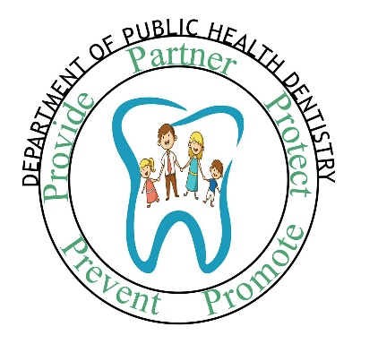
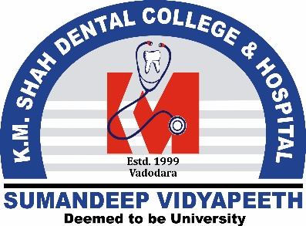
EPIDEMIOLOGY OF DENTAL CARIES- II
DEPARTMENT OF PUBLIC HEALTH DENTISTRY
Dr. Pranav R. Kurup
MDS (Sr Lecturer)
Department of Public Health Dentistry
KMSDC&H
Sumandeep Vidyapeeth Deemed University
ACADEMIC
YEAR: 2022-23

Slide 2
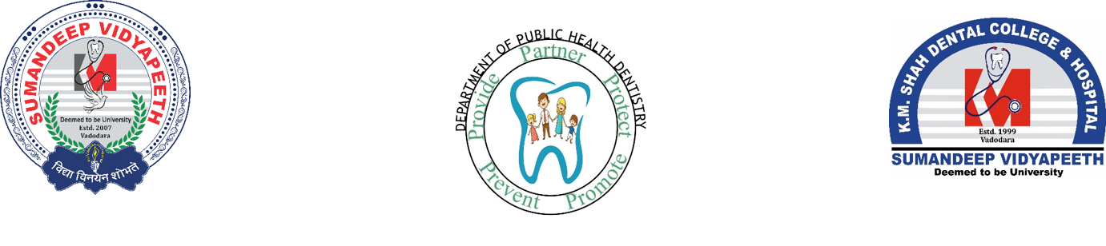
General Objective
At the end of the class, the learner must be able to able to understand the role of sugar in causation of dental caries

Slide 3
Specific Objectives
At the end of the class, the learner must be able to:
Explain why carbohydrates could play an important role in causation of caries
Explain the how factors such as frequency, form of sugar, pattern of sugar intake play an important role in dental caries.

Slide 4
….contd.
Specific Objectives
At the end of the class, the learner must be able to:
List and describe various landmark epidemiological studies that ascertained the relationship between diet and caries
List the non- cariogenic foods which can be suggested in place of cariogenic foods.

Slide 5
CONTENTS
RECAP of Salient Aspects Covered in Previous Class
Introduction of Role of Diet and Dental Caries
Landmark Studies on Association Between Diet and Dental Caries
Recent Evidence
Conclusions
Suggested Further Reading

Slide 6
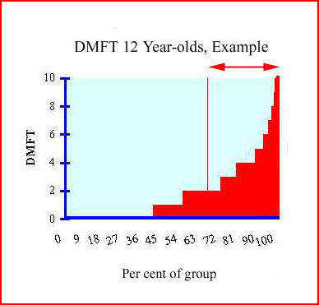
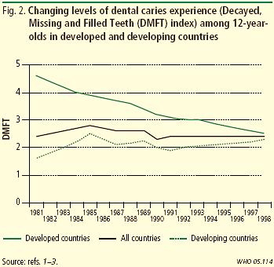
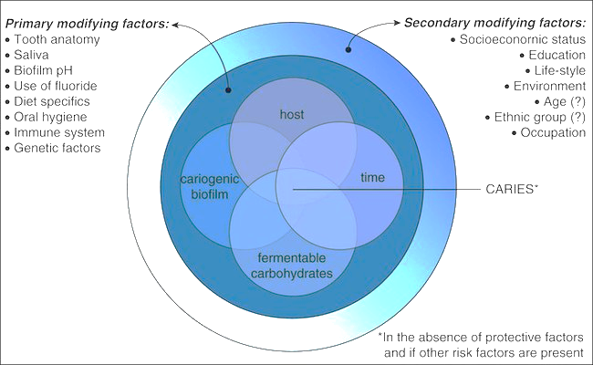
RECAP-Epidemiology of dental caries-I
Disease Frequency (Rates/ Ratios)
Disease Magnitude (Index Scores)
Disease Distribution (Time, Place, Persons, Teeth)
Disease Etiology
Disease Trends
Population Strategy
Population strategies are the basis for all dental
public health programs, for example water fluor-
idation and dental health education
These are
programs aimed at a whole population, regardless
of individual risk, and whose effectiveness is best
measured at population level.
Targeted (Geographic/ Setting- based) Approach
Schools, or school districts, or even
whole Village/ Taluk can be identified as being the target group
If this can be done with easily-available data
then there are no administrative costs to identifying
the targeted areas.
High- Risk Approach
Targeting individuals at high risk .
risk
Assessment models are far from precise at individ-
ual levels; there are practical problems in
treating the identified individuals successfully

Slide 7
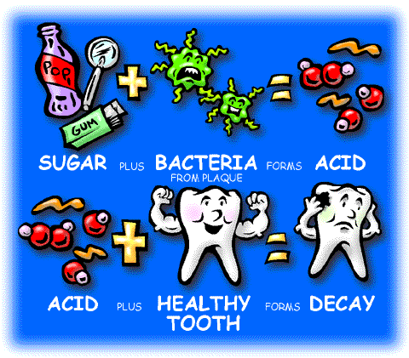
Diet in the Basic Equation of Caries
Sugary Food
Time
Bacteria
Tooth

Slide 8
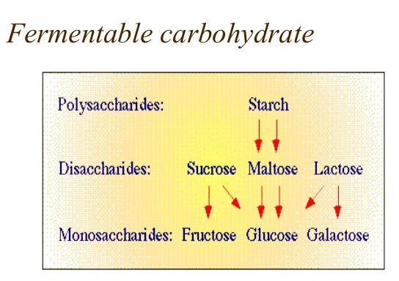
CLASSIFICATION OF CARBOHYDRATES

Slide 9
DIET AND DENTAL CARIES
SUGAR- THE ARCH CRIMINAL
Stephan’s Curve: The curve on a graph, first described by Robert Stephan in 1943, showing the fall in pH below the critical level of pH 5.5, at which demineralization of enamel occurs following the intake of fermentable carbohydrates, acidic liquids, or sugar in the presence of acidogenic bacteria.

Slide 10
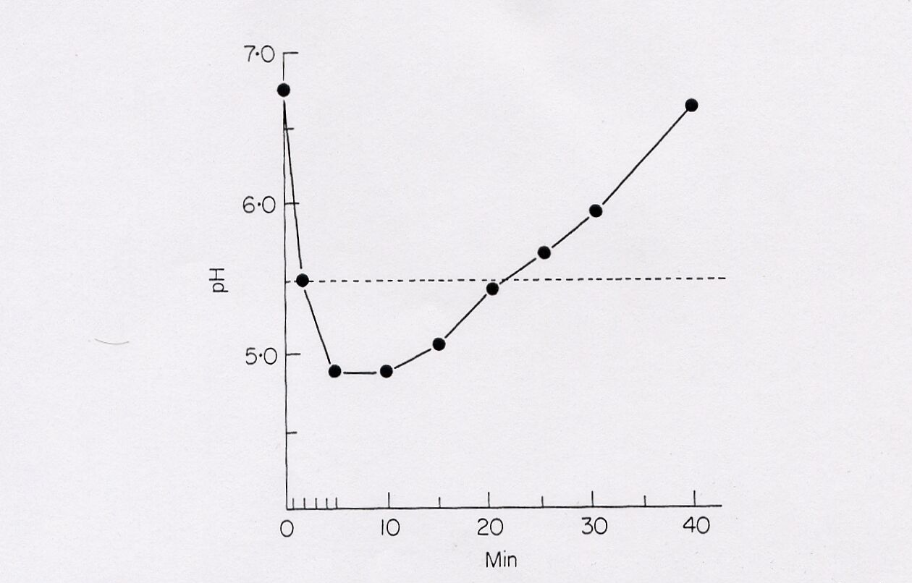
STEPHAN’S CURVE
10% glucose rinse
Dental
plaque pH
Critical pH for tooth enamel dissolution
Minutes
Jenkins GN. The physiology and biochemistry of the mouth, 4th Edition. Oxford: Blackwell Scientific Publications, 1978. Page 388.

Slide 11
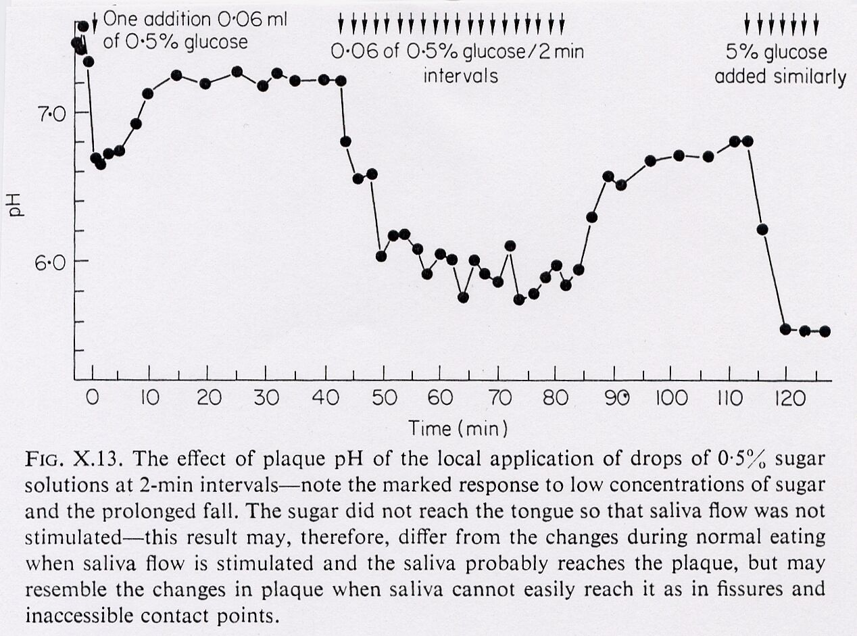
Jenkins GN. The physiology and biochemistry of the mouth, 4th Edition. Oxford: Blackwell Scientific Publications, 1978. Page 389.

Slide 12
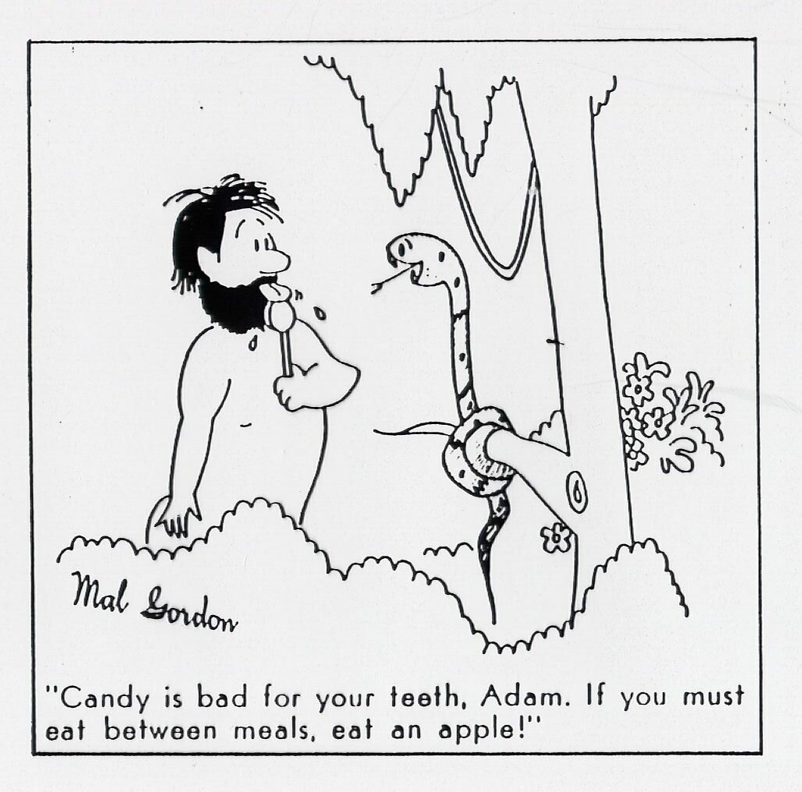

Slide 13
The Vipeholm Study
Conducted from 1945 - 1953 at the Vipeholm Hospital in Lund, Sweden, an institute for the mentally-deficient.
The aim of the Vipeholm Study (Gustaffson, et al.1954) was to determine the relationship between diet, frequency of sugar intake and dental caries.
The variables included the type of sugar ingested (sticky or non-sticky form) and the frequency of sugar intake (at meals or in between meals).
The subjects (436 patients) were split into one control group and six main test groups, where the 'bread' and '24-toffee' groups were further divided into two separate groups according to gender.
Gustafsson et al. (1954). The Vipeholm dental caries study. Acta Odontlogica Scandinavica 11:232-364.

Slide 14
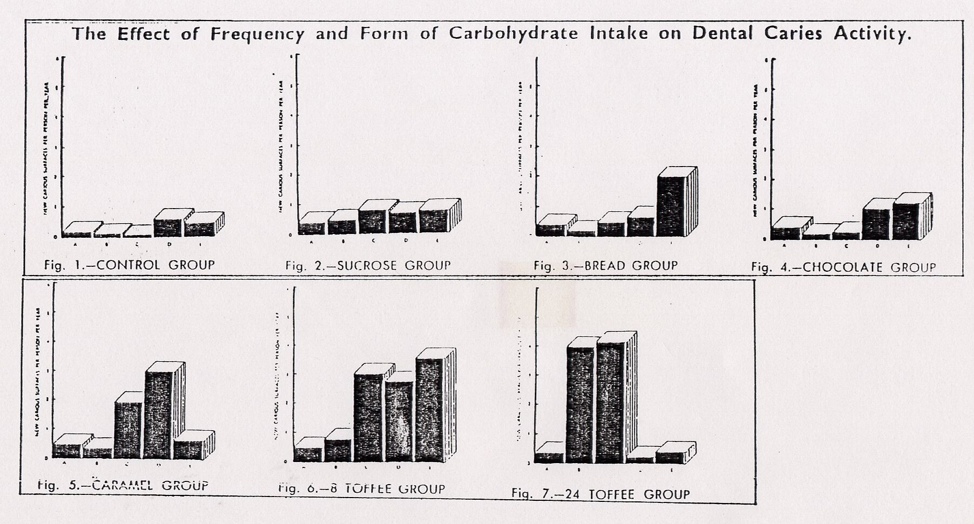
Gustafsson et al. (1954). The Vipeholm dental caries study. Acta Odontlogica Scandinavica 11:232-364.

Slide 15
Main conclusions from the Vipeholm Study are:
1. Increase in carbohydrate increases the caries activity.
2. Sugar consumption in between meals has a larger effect on increasing dental caries activity than sugar consumption during meals.

Slide 16
Other conclusions include:
a)The risk of caries activity is greater if the sugar is consumed in the form that will be retained on the surface of teeth.
The increase in dental caries activity disappears on withdrawal of sugar rich foods.

Slide 17
Hopewood House study
Conducted by Sullivan (1958) and Haris (1964)
Study was conducted in New South Wales, Australia.
Study subjects were of 3-14 years.
Provided with diet rich foods.
Drinking water was having low amount of fluoride.
Cheese, sugar and refined carbohydrates were totally excluded.
Lilienthal et al Med J Aust, June 1953

Slide 18
Findings
Significant caries reduction inspite of poor oral hygiene and low level of fluoride in drinking water.
Mean DMFT of 13 yr old institutional children: 1.6 vs 10.7 of general child population
53% caries free as opposed to 0.3% caries free in general child population.
Lilienthal et al Med J Aust, June 1953

Slide 19
Conclusions
Dental caries can be reduced by restricting the carbohydrates intake even in presence of unfavorable oral hygiene practices.
Lilienthal et al Med J Aust, June 1953

Slide 20
TURKU SUGAR STUDIES
Scheinin, Makinen, 1958
Carried out in Turku, Finland, to compare the cariogenicity of Sucrose, Fructose and Xylitol.
2 year study.
Comparative cariogenicity of sucrose (35), fructose (38) and xylitol (52) among 125 subjects
E Newbrun, C Hoover, G Mettraux, and H Graf. J Am Dent Assoc1980, Vol 101, No 4, 619-626.

Slide 21
Findings
After 1 year
Sucrose and fructose had equal carcinogenicity whereas Xylitol produced almost no caries.
After 2nd year
Caries had continued to increase in Sucrose group but remained unchanged in Fructose group whereas Xylitol produced almost o caries.
Lilienthal et al Med J Aust, June 1953

Slide 22
Conclusions
Fructose was less cariogenic than sucrose.
Xylitol was no cariogenic .
“ Sucrose is the Arch Criminal”
Lilienthal et al Med J Aust, June 1953

Slide 23
TRISTAN DA CUNHA STUDY
It is a remote island in South Atlantic region.
No dental caries in the region because of consumption of raw diet.
After volcanic eruption in 1964, they migrated to England.
After 1964, their caries rate was 80%.
E Newbrun, C Hoover, G Mettraux, and H Graf. J Am Dent Assoc1980, Vol 101, No 4, 619-626.

Slide 24
HEREDITARY FRUCTOSE INTOLERANCE (HFI)
It is a disorder of fructose and sucrose metabolism.
Reduced levels of Fructose-1- Phosphate Aldolase.
Consumption of Fructose caused Nausea, Vomiting, sweating, cramps, coma and even death.
Dental caries in these patients were low.
E Newbrun, C Hoover, G Mettraux, and H Graf. J Am Dent Assoc1980, Vol 101, No 4, 619-626.

Slide 25
RECENT EVIDENCE
Title of article and Journal & Year of Publication | Level of Evidence | Method and Results | Conclusion
Newton JT, Awojobi O, Nasseripour M, Warburton F, Di Giorgio S, Gallagher JE, Banerjee A. A Systematic Review and Meta-Analysis of the Role of Sugar-Free Chewing Gum in Dental Caries JDR Clin Trans Res. 2020 Jul;5(3):214-223. | 1a | Twelve studies of interventions of SFG for dental caries outcomes were included. SFGs were found to significantly reduce caries increment, giving a preventative fraction (PF) of 28% (95% CI, 7% to 48%). Including the 8 trials that used xylitol gum only as the basis of the intervention, the PF was 33% (95% CI, 4% to 61%). No adverse effects were recorded. There was a high level of heterogeneity among the trials included. | The findings of this review provide tentative evidence that chewing SFG reduces caries increment in comparison to nonchewing controls. However, there is a considerable degree of variability in the effect and the trials included were generally of moderate quality. There is a need for future research to explore the acceptability and feasibility of the use of SFG as a public health

Slide 26
CONCLUSIONS
Sugar is the arch criminal for Dental Caries
Fermentable Carbohydrates is a modifiable risk factor; removal of the link can disrupt the causation of dental caries.
Risk assessment and preventive strategies for dental caries must consider include Diet- content & frequency.
Sugar substitutes hold a promise in reduction of dental caries.

Slide 27
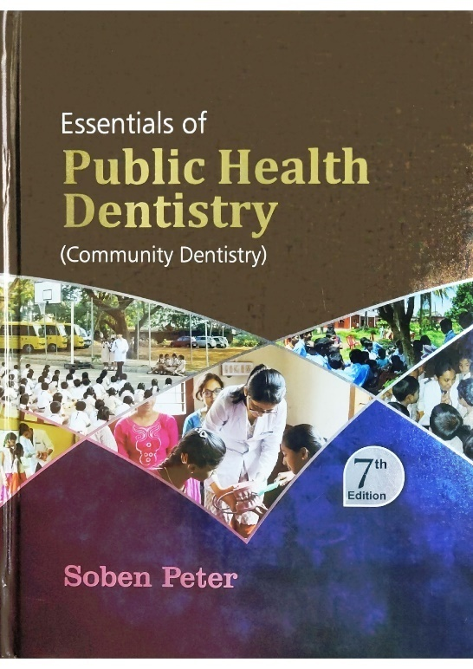
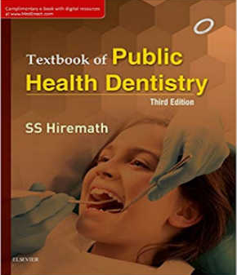
Suggested FURTHER READING

Slide 28
MCQs
1. Refined carbohydrates:
Can lead to dental caries
Can protect the tooth from caries
Does not have caries related effects
Cleanses the debris on teeth through masticatory excursions

Slide 29
MCQs
2. The most cariogenic sugar is:
Glucose
Lactose
Fructose
Sucrose

Slide 30
MCQs
3. Vipeholm study was conducted by :
Haris and Sulivan
Gutafson et al
Scheinin and Makinen
None of the above

Slide 31
MCQs
4. The pH of plaque below which demineralization occurs is
6.5
5.5
4.5
3.5

Slide 32
MCQs
5. Sucrose is a
Sugar alcohol
Polysaccharide
Disaccharide
Monosaccharide

Slide 33
THANK YOU!

