Slide 1
Prevention of Hospital-Acquired Infections
Prepared By:
Mrs. Mital Thakkar
Assistant Professor
Department of Management
SVDU

Slide 2
Learning objectives
Introduction to HAIs
Factors affecting HAIs
Sources of HAIs
Types of HAIs
Different types of HAIs
Prevention of HAIs
Organizational structure for HAIs/Infection Control
Surveillance of HAIs
Vaccination of Healthcare Workers(HCWs)

Slide 3
DEFINITION
( Hospital Acquired Infections= Nosocomial Infections= Healthcare Associated Infections )
CDC defines HAI as a localized or systemic condition resulting from an adverse reaction to the presence of an infectious agent(s) or its toxin(s) without any evidence of its being present or in incubation at the time of admission.
An infection is attributed as HAI if date of event occurs on or after 3rd calendar day (CL) of admission where day of admission is counted as CL 1.

Slide 4
DEFINITION Cont.
It also includes
  Infections appearing after discharge and
  Occupational infections among healthcare workers.
It does not include
  Colonization or
  Inflammation resulting from tissue response to injury or non‑infectious agents.

Slide 5
Factors Affecting HAI
Immune status
Hospital environment
Hospital organisms
Diagnostic or therapeutic interventions
Transfusion
Poor hospital administration

Slide 6
Sources of HAI
Endogenous source- patient’s own flora
Exogenous source
  Environmental sources
  Health care workers
  Other patients

Slide 7
MAJOR TYPES OF HAIs
Catheter-associated urinary tract infection (CAUTI)
Central line-associated blood stream infection (CLABSI)
Ventilator-associated pneumonia (VAP)
Surgical site infection (SSI).

Slide 8
Prevention of HAI
The preventive measures for HAIs can be broadly categorized into:
  Standard precautions
  Transmission-based or specific precautions.

Slide 9
Standard Precautions
Set of work practices used to minimize transmission of HAIs.
Measures to be used when providing care to/handling –
  All individuals
  All specimens (blood or body fluids)
  All needles and sharps

Slide 10
Components of Standard Precautions
Hand hygiene
Personal protective equipment
Biomedical waste including sharp handling
Spillage cleaning
Disinfection
Respiratory hygiene and cough etiquette

Slide 11
Hand Hygiene
Hands are the main source of transmission of infections during healthcare.
Hand hygiene is therefore the most important measure to avoid the transmission of harmful microbes and prevent healthcare-associated infections.

Slide 12
Types of Hand Hygiene Methods- Hand Rub
Alcohol based (70–80% ethyl alcohol) and chlorhexidine (2–4%) based hand rubs are available.
Duration - 20–30 seconds.
Advantage: After a period of contact, it gets evaporated of its own hence drying of hands is not required separately
Indications:
  Indicated during routine rounds in the wards or ICUs
  In all the moments or situations requiring hand hygiene, except when the hands are visibly dirty or soiled, when it will be ineffective.

Slide 13
Types of Hand Hygiene Methods- Hand Wash
Antimicrobial soaps (liquid, gel or bars) are available.
If facilities are not available, then even ordinary soap and water can also be used.
Duration - 40–60 seconds.
Indications:
  When the hands are visibly soiled with blood, excreta, pus, etc.
  Before and after eating
  After going to toilet
  Before and after shift of the duty.

Slide 14
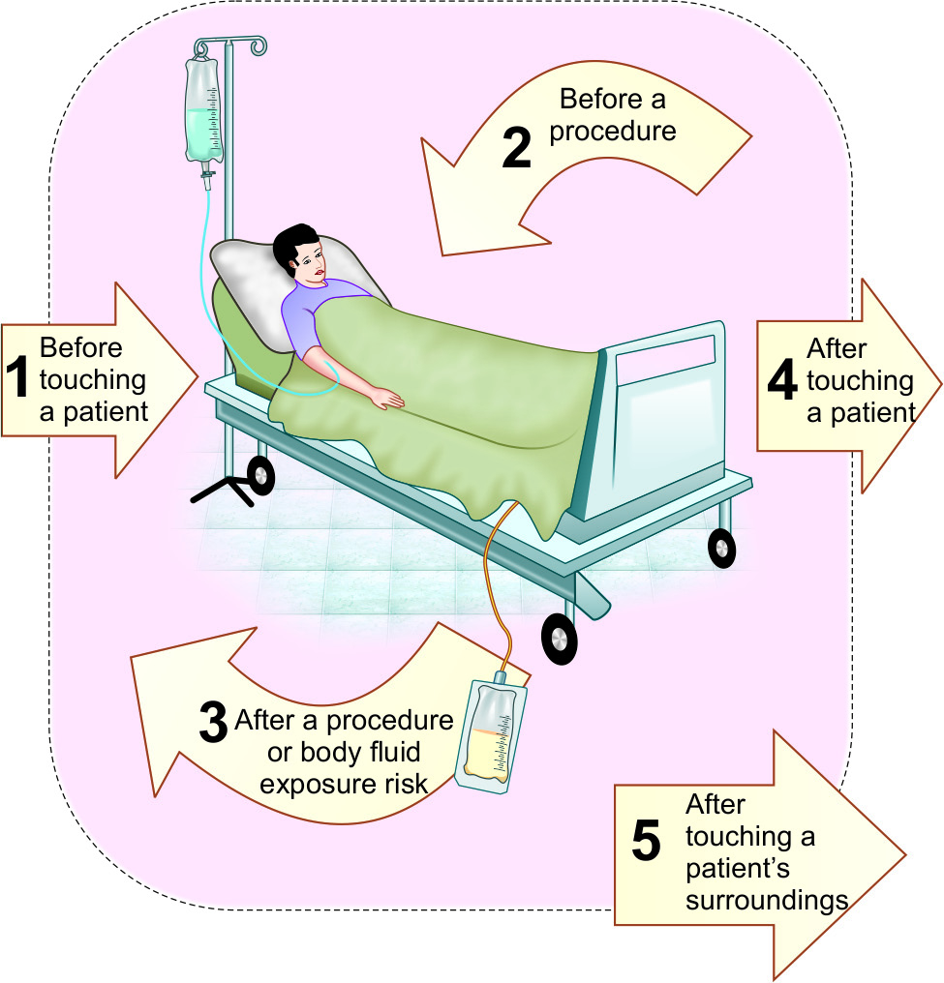
Five Moments for Hand Hygiene

Slide 15
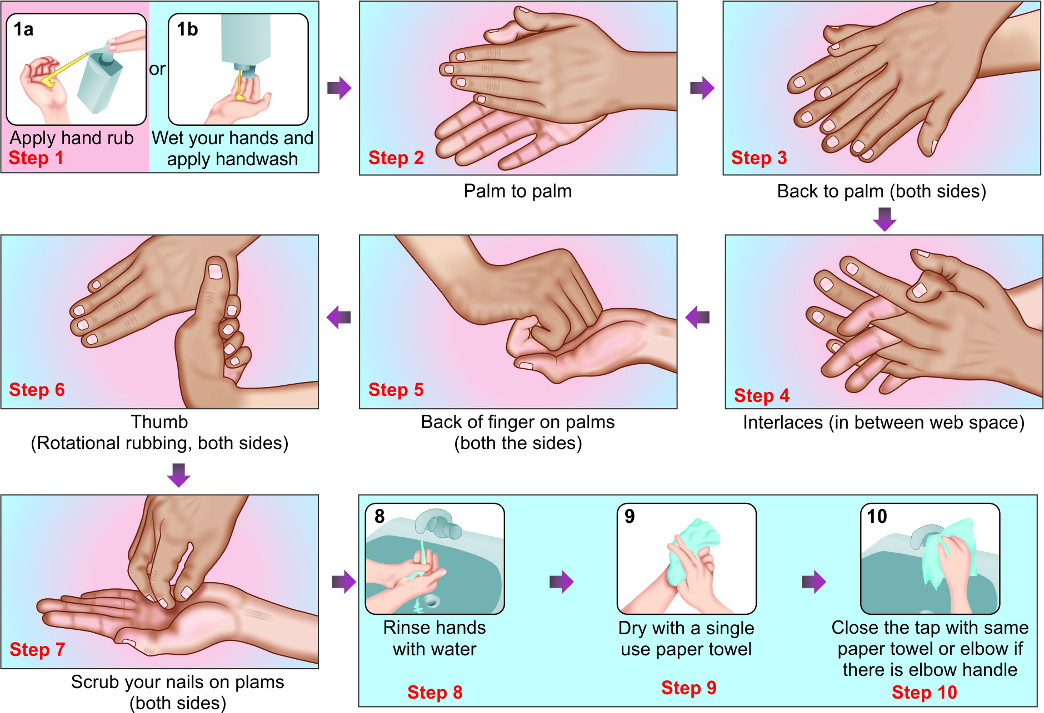
Steps of hand rubbing and hand washing (WHO)

Slide 16
Personal Protective Equipment (PPE)
Used to protect the skin and mucous membranes of HCWs from exposure to blood and/or body fluids
From the HCW’s hands to the patient during sterile and invasive procedures.

Slide 17
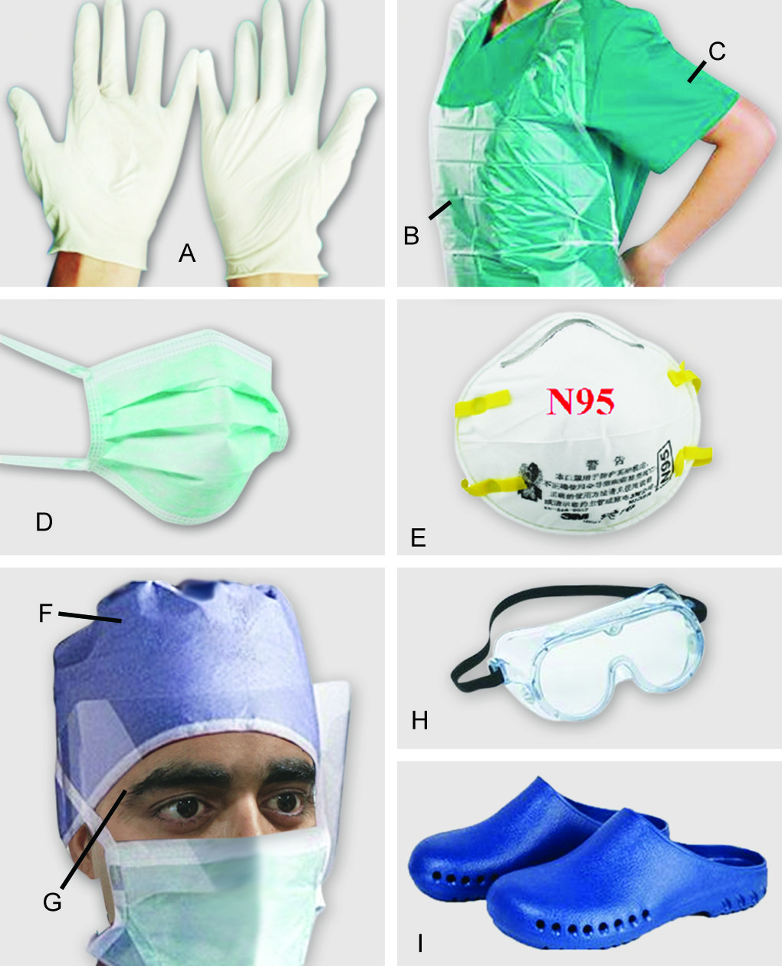
Personal protective equipment (PPE)
Personal protective equipment (PPE):
A. Gloves;
B. Plastic apron;
C. Gown;
D. Surgical mask;
E. N95 mask;
F. Cap;
G. Face shield;
H. Goggles;
I. Surgical shoes

Slide 18
Personal protective equipment (PPE)
Gloves (non-sterile) | Used when there is a risk of infection to HCWs (e.g. while touching blood, body fluids, secretions, excretions of patients, items/equipment or environment).
Gloves (sterile) | Used when there is a risk of infection to HCWs as well as to the patients (during surgeries /invasive procedures).
Plastic apron | Used during surgeries
Gown | Used during surgeries and when soiling is likely to be expected.

Slide 19
Personal protective equipment (PPE)
Surgical mask | Used during surgeries and while handling patients on droplet precautions
N95 mask | Used while handling patients on airborne precaution (tuberculosis).
Cap, face shield, goggles | Used when spillage of blood is suspected, e.g. during major cardiac surgeries etc.
Surgical shoes | Used mainly in ICUs and operation theatres to protect HCWs and environment from transmission of organisms.

Slide 20
Selection of appropriate PPE
Level of risk associated with contamination of skin, mucous membranes, and clothing by blood and body fluids during a specific patient care activity or intervention
Route of transmission of suspected organisms— contact, droplet and inhalation

Slide 21
Donning and Doffing
Donning (wearing)
Doffing (removing)
Gown
Mask or respirator
Goggles or face shield
Gloves
Gloves
Goggles or face shield
Gown
Mask or respirator

Slide 22
Spill management for blood and body fluids
Spill management of blood and body fluids: Bring the spill kit to the site of spillage, wear appropriate PPE (gloves and gown); put no entry sign board near the spill area.
If spillage is small (<10 mL):
  Wipe up spill immediately with absorbent material and discard into appropriate bin
  Wipe the area with 10% sodium hypochlorite and allow to dry
  Remove PPE and perform hand hygiene
If spillage is large (>10 mL):
  Place disposable paper towels over spill to absorb the spillage
  Pour 10% sodium hypochlorite on top of absorbent paper towels and leave for 15 minutes.
  Remove the absorbent papers; put fresh disposable paper towels to clean the area and then discard these into appropriate waste bin.

Slide 23
Respiratory hygiene and cough etiquette
Should be followed by anyone with signs and symptoms of a respiratory infection, regardless of the cause.
  Cover the nose/mouth with single-use tissue paper when coughing, sneezing, wiping and blowing noses
  If no tissues are available, cough or sneeze into the inner elbow rather than the hand
  Follow hand hygiene after contact with respiratory secretions and contaminated objects/materials
  Keep contaminated hands away from the mucous membranes of the eyes and nose

Slide 24
Respiratory hygiene and cough etiquette
In high-risk areas of airborne transmission such as pulmonary medicine OPD:
  Give mask to the patients with cough and make separate queue away from the general queue
  Sputum collection should be done in an open space or in a well- ventilated room

Slide 25
Transmission-based precautions
(specific precautions)
Contact Precautions
Droplet Precautions
Airborne Precautions

Slide 26
Specific precautions
Type | Indication | Isolation | Gloves | Gown | Mask | Eye protection | Handling of equipment | Visitors
Contact | MDROs, C.difficile Diarrheal pathogens Highly contagious skin infections | Essential | Essential | Essential | Surgical mask- Required if infectious agent is also transmitted by droplet | As required** | Single use or reprocess before reuse on next patient | Same precautions as for staff

Slide 27
Specific precautions
Type | Indication | Isolation | Gloves | Gown | Mask | Eye protection | Handling of equipment | Visitors
Droplet | Respiratory syncytial virus, Mycoplasma Parainfluenza Pertussis Plague, Meningococcus | Essential | As required* | If soiling likely | Surgical mask is essential | As required** | Same as contact | Restrict visitor numbers and precautions same as for staff

Slide 28
Specific precautions
Type | Indication | Isolation | Gloves | Gown | Mask | Eye protection | Handling of equipment | Visitors
Airborne | Pulmonary TB, Chicken pox Measles SARS | Essential (negative pressure) | As required* | If soiling likely | N95 respirator essential | As required** | Same as contact | Restrict visitor numbers and precautions same as for staff

Slide 29
Organizational Structure of HAI
(Hospital infection control committee)
Core Committee members
Chairperson: MS
Member Secretary: HOD, Dept. of Microbiology
Hospital Infection Control Officer
Nursing Superintendent
Infection Control Nurses
Infection Control Lab technician
Data entry operators
Other Committee members
HODs of all clinical departments
Biomedical waste management in-charge
ART Clinical In Charge
CSSD in-charge
Linen and Laundry in-charge
Central store in-charge
Engineer representative
Pharmacy in-charge
Sanitary Superintendent
Kitchen in-charge

Slide 30
HICC Activities
1. Education
2. HAI Surveillance
3. Staff Health Care (Needle stick injury & Hepatitis B vaccination)
4. Hand Hygiene Audit
5. Bundle care audit
6. Antimicrobial Stewardship Programme
7. Environmental Surveillance (water, air , surface and milk)
8. Staff Surveillance for MRSA and other MDROs
9. AMR Surveillance
10. Formulating Disinfectant policy
HICC Meeting, once monthly

Slide 31
HAI SURVEILLANCE (FYI)
HAI Surveillance - system that monitors the HAIs in a hospital.
Provides endemic/baseline HAI rate
Comparing HAI rates within and between hospitals.
Identifies the problem area.
Timely feedback to the clinicians.

Slide 32
Hospital-acquired infection surveillance(FYI)
HAIs for which surveillance is conducted:
Catheter-associated urinary tract infection (CAUTI)
Central line-associated blood stream infection (CLABSI)
Ventilator-associated event (VAE)
Surgical site infection (SSI).
ICNs under the supervision of the officer in-charge of HICC conduct HAI surveillance.
HAI surveillance diagnostic criteria: very objective

Slide 33
Vaccination of Healthcare Workers
Vaccine | Indication | Schedule
Hepatitis A | Laboratory & primate worker | 2 doses of 1 mL IM at 0, 6 months
Hepatitis B | Occupational exposure to blood, blood products, or bodily secretions | 3 doses of 1 mL IM at 0, 1 & 6-12 months
Influenza A | Persons attending high-risk patients (e.g. elderly) | Inactivated vaccine: 1 dose of 0.5 mL IM annually
 |  | Live attenuated vaccine: Intranasal dose of 0.2 ml annually

Slide 34
Vaccine | Indication | Schedule
MMR (Measles, Mumps, Rubella) | Adults born after 1957 with no proof of immunity: •Documented vaccination with 2 doses •Laboratory evidence of lack of immunity •Laboratory confirmation of disease | 2 doses of 0.5 mL SC at 0 & at least 1 month later
Polio | Laboratory and other HCP who come in contact with live virus | 3 doses of 0.5 mL SC: •1st two doses 4-8 weeks apart •3rd dose 6-12 months after the 2nd dose.

Slide 35
Vaccine | Indication | Schedule
Varicella | Adults with no proof of immunity: •Laboratory evidence of lack of immunity •HX of clinically diagnosed or verified varicella/zoster •Documentation of vaccination | 2doses of 0.5 mL SC at time 0 weeks & 4-8 weeks later
TDAP (combined Tetanus, Diphtheria and Acellular Pertussis) | HCP with direct patient contact | 0.5mL IM one-time dose

