Slide 1
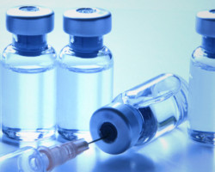
UNIVERSAL
IMMUNIZATION
PROGRAMME

Slide 2
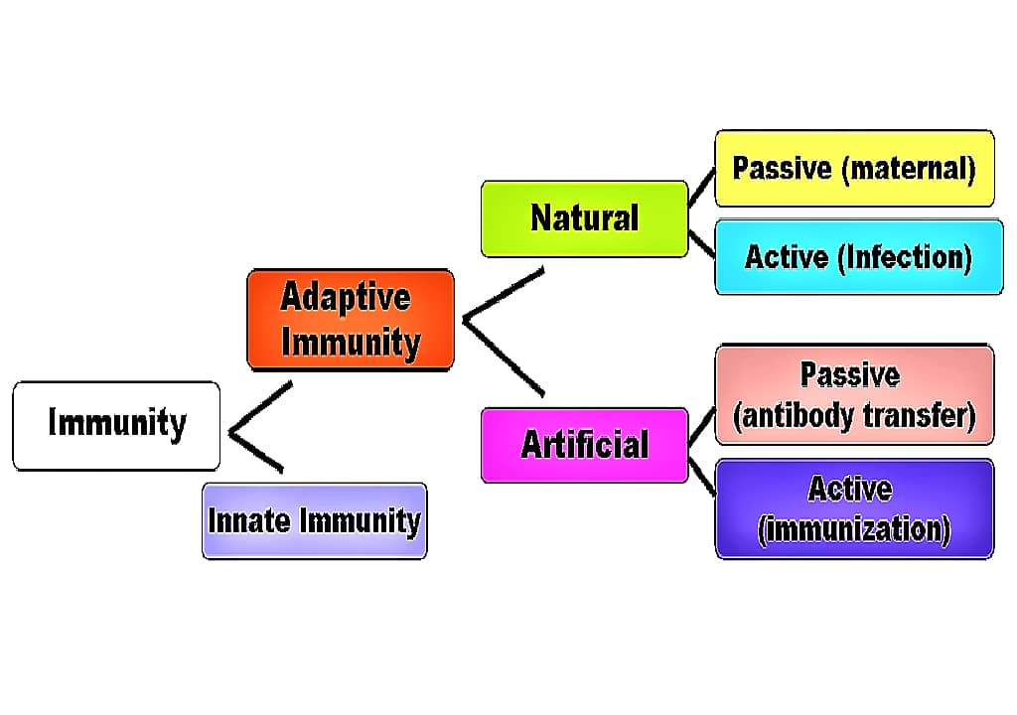
What is IMMUNITY?

Slide 3
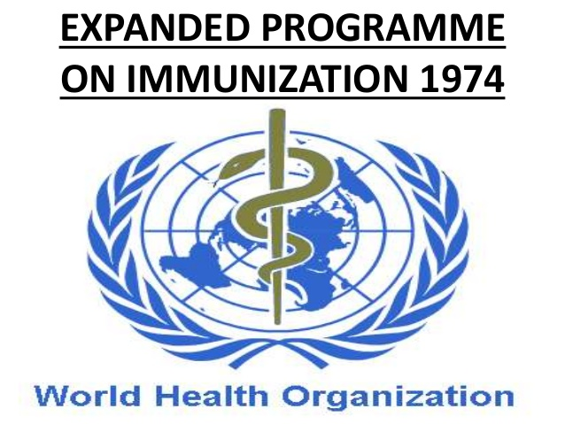
MILESTONES OF UIP:
Under Global Smallpox Eradication Program, it was experienced that immunization is the most powerful and cost-effective weapon for the prevention and control and even eradication of a disease.
May 1974, WHO officially launched a global immunization program, known as Expanded Program of Immunization (EPI) for the prevention and control of six major killer disease of children namely tuberculosis, diphtheria, pertussis, tetanus, poliomyelitis and measles, all over the world.
It was called Expanded because:
Number of diseases covered are more.
Services are extended to all corners of the world, irrespective of cast, creed, community and ability to pay for it.
The child is immunized much before it is born.

Slide 4
Beneficiaries were all expectant mothers and children up to 16 years of age.
Immunization was recommended from 3rd month of infancy and for pregnant mothers, 3 doses of TT, respectively during 16-24 weeks, 24-32 weeks and during 36 weeks.
Government of India launched same program with same schedule on 15t January 1978 with the same objectives of reducing child morbidity and mortality rates and to achieve self sufficiency in the production of vaccines.

Slide 5
WHO launched a social target of achieving Health for all by 2000 AD.
In 1983, the schedule was revised and recommended only 2 doses of TT during pregnancy, 1st dose during 16-24 weeks and 2nd dose during 24-36 weeks and commencing routine immunization as early as 6 weeks during infancy and services were concentrated to under 5.
In October 1985, UNICEF emphasized the goal of achieving universal immunization 10 years early by 1990 so the global program was renamed as 'Universal Child Immunization-1990'.

Slide 6
On 19 November 1985, GOI renamed Expanded Program of Immunization(EPI) program, modifying the schedule as 'Universal Immunization Program' dedicated to the memory of Late Prime Minister Mrs Indira Gandhi.
Impetus was added to the existing program by shifting from under 5 to under 1 year of age and the quality of services was also improved. It was recommended to give 1" dose of TT to the pregnant mother in the first contact and 2"d dose after 1 month and BCG and OPV to the new born as early as at birth.
Global alliance for vaccines & immunization (GAVI) is a global network.

Slide 7
Objectives of UIP were:
To increase immunisation coverage.
To improve quality of service.
To achieve self sufficiency in vaccine production & manufacturing of cold chain equipment’s.
To establish reliable cold chain equipment & establish a good surveillance network.
To introduce a district wise system monitoring & evaluation.
To train health personnel.
Elimination of neonatal tetanus
Eradication of paralytic poliomyelitis

Slide 8

Strategy under UIP was:
100% coverage of expectant mothers with 2 doses of TT
At least 85% coverage of infants with 3 doses DPT and OPV 1 dose each of BCG and Measles vaccine, before the child celebrates its 1st birthday.
During 1992 , immunization program become a component of Child Survival and Safe Motherhood (CSSM) program. It was recommended to cover 100% among infant also.
In 1995, Pulse Polio Immunization Program was launched as a strategy to eradicate poliomyelitis.
In 1997, immunization activities have been an important component of National Reproductive and Child Health Program.(RCH)

Slide 9
In 2012, GOI declared 2012 as the "Year of Intensification of Routine Immunization".
In 2013, GOI along with other S-E Asia regions, declared commitment towards measles elimination and congenital rubella syndrome control by 2020.
In 2014, India was certified as "Polio free country".

Slide 10
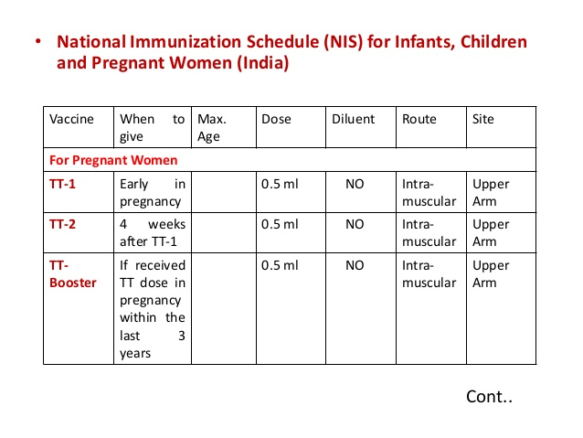

Slide 11
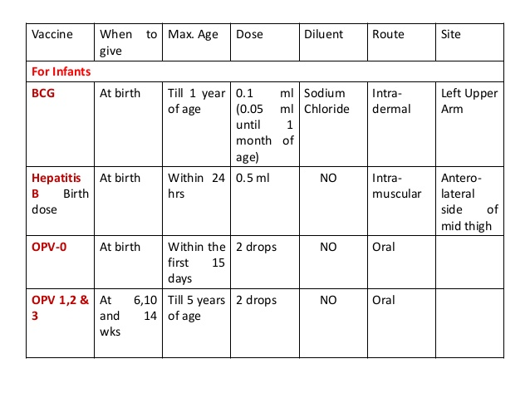

Slide 12
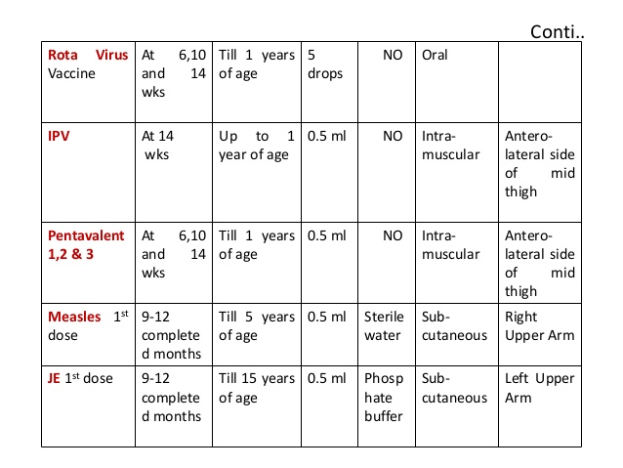

Slide 13
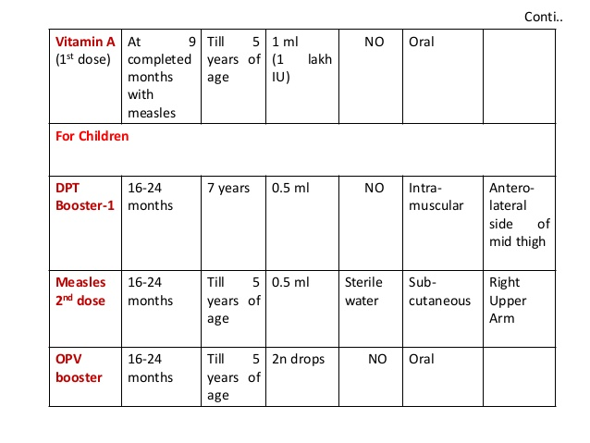

Slide 14
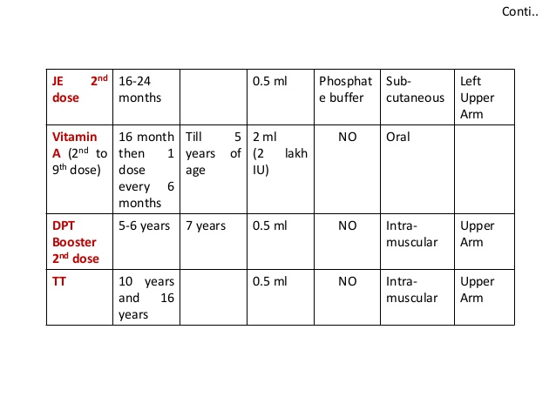

Slide 15

NEW VACCINES
In April 2016, India introduced the use of fractional dose IPV (fIPV) into the routine immunization programme in eight states (Odisha, Andhra Pradesh, Telangana, Karnataka, Tamil Nadu, Puducherry and Maharashtra). Since March 2017 has been scaled up nationwide in all 26 states. Two fractional doses of IPV 0.1m1, will be given intradermally at 6 and 14 weeks.
On 5 Feb 2017, The Ministry of Health and Family Welfare launched Measles Rubella (MR) vaccination campaign in the country, following the campaign, Measles-Rubella vaccine will be introduced in routine immunization, replacing the currently given two doses of measles vaccine, at 9-12 months and 16-24 months of age in five States/UTs (Karnataka, Tamil Nadu, Pondicherry, Goa and Lakshadweep)

Slide 16
In March 2016, the Rotavirus vaccine was first introduced in four states namely Haryana, Himachal Pradesh, Andhra Pradesh and Odisha.
On 18 Feb 2017, Union Minister for Health and Family Welfare announced the expansion of the Rotavirus vaccine under its UIP in five additional states of Assam, Tripura, Madhya Pradesh, Rajasthan and Tamil Nadu.
On 13 May 2017, Union Minister for Health and Family Welfare, announced the introduction of pneumococcal conjugate vaccine (PCV) in the UIP. Currently, the vaccine is being rolled out to approximately 21 lakh children in Himachal Pradesh and parts of Bihar and Uttar Pradesh in the first phase. This will be followed by introduction in Madhya Pradesh and Rajasthan next year, and eventually be expanded to the country in a phased manner.

Slide 17
Implementation of Routine Immunization
RI targets to vaccinate 27 million new born each year with all primary doses and ~100 million children of 1-5 year age with booster doses of UIP vaccines. In addition, 30 million pregnant mothers are targeted for TT vaccination each year.
To vaccinate this cohort of 157 million beneficiaries, —10 million immunization sessions are conducted, majority of these are at village level.
As per Coverage Evaluation Survey (2009), 89.8% of vaccination in India is provided through Public sector (53% from outreach session held at Anganwadi centre (25.6%), sub centre (18.9%) etc.) while private sector contributed to only 8.7%.

Slide 18
In may 2017, ministers of health from 194 countries endorsed a new resolution on strengthening immunization to achieve the goals of global vaccine action plan.(GVAP)
ASHA and AWW support ANM by mobilizing eligible children to session site thus try to ensure that no child is missed. ASHA is also provided an incentive of Rs. 150/session for this activity.
To ensure potent and safe vaccines are delivered to children, a network of 27,000 cold chain points have been created across the country where vaccines are stored at recommended temperatures.

Slide 19
Components:
1. Strategy and policy:
Directed towards achieving an acceptable, affordable and sustainable standard of health through an appropriate health system.
Provision of universal immunization of children against vaccine preventable diseases is one of the major goals under this policy.
Country developed a comprehensive Multi Year Strategic Plan for Immunization in 2005 with an addendum in 2010 to achieve these targets of improving access and utilization of immunization in the country.
Ministry of Health and Family Welfare also revised the National Vaccine Policy in 2011.
Goal - develop a long term plan to strengthen the UIP.

Slide 20

2. Cold Chain System, Vaccines and Logistics:
Cold Chain is a system of storing and transporting vaccine at the recommended temperature range from the point of manufacture to point of use.
The vaccines are supplied by manufacturers directly to four Government Medical Store Depots (at Karnal, Mumbai, Chennai and Kolkata) and state and regional vaccine stores.
Transportation of vaccines from States/Regional stores to divisions and districts is done in cold boxes using insulated vaccine vans.

Slide 21
Vaccines carriers with icepacks are used to transport vaccines from PHCs to the outreach sessions in the village.
At the PHCs and CHCs, cold chain handlers, who are health personnel (pharmacists, male and female multi-purpose health workers, etc) have been tasked with proper storage and handling of vaccines and daily upkeep of Ice Lined Refrigerators (ILRs) and Deep Freezers (DFs) including temperature charting.
The performance and efficiency of the cold chain system at different levels is monitored continuously, through supervisory visits, review meetings.

Slide 22
3. Injection safety and waste disposal:
To ensure safe injection practices, Government of India endeavours to ensure continuous supply of injection safety equipment's (syringes, reconstitution syringes, hub cutters and waste disposal bags).
Disposal of immunization waste is strictly as per Central Pollution Control Board (CPCB) guidelines for biomedical waste disposal.

Slide 23
4. AEFI Surveillance System in India:
(Adverse Event Following Immunization)
The WHO defines AEFI as "a medical incident that takes place after an immunization, causes concern, and believed to be caused by immunization".
AEFI surveillance in country monitors immunization safety, detects and responds to adverse events following immunization; corrects unsafe immunization practices, reduces the negative impact of the event on health and contributes to the quality of immunization activities.

Slide 24
5. Strategic communication:
Strategic Communication refers to policy-making and guidance for consistent information activity through coherent messaging.
The issue of media advocacy, proactive planning and effective media response is emerging as one of the key elements of strategic communication support to achieving full Routine Immunization coverage in the country.

Slide 25
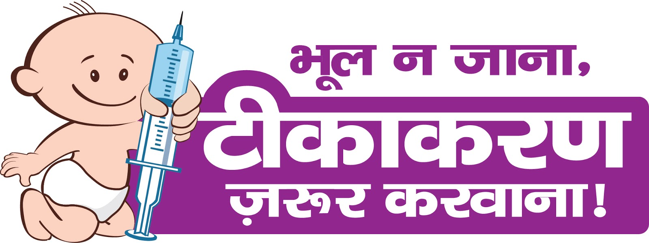
Development of RI Logo
The new logo of the baby holding the syringe, indicating RI as his right, has been developed in purple colour. This will give RI a distinct identity.

Slide 26
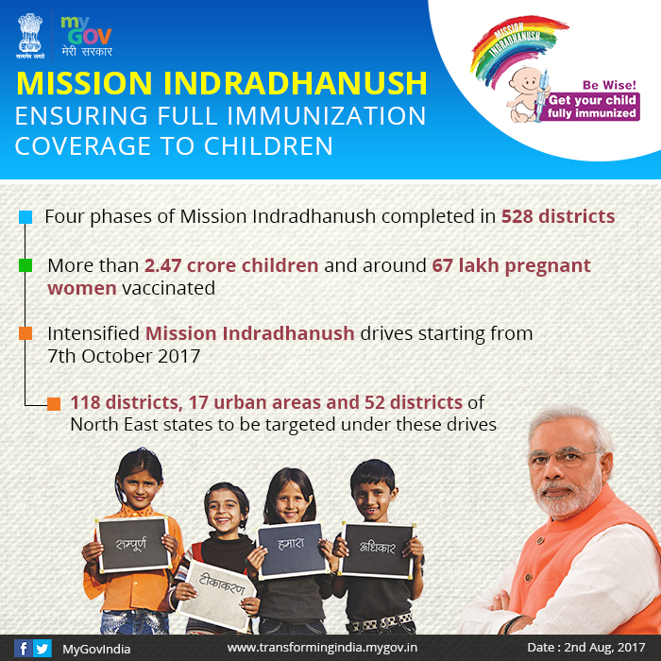

Slide 27
6. Immunization Trainings :
The Immunization Programme runs due to the coordinated efforts of different cadres of health staff working in the states at different levels (states, districts, PHCs and CHCs).
In the year of Intensification of Routine Immunization (2012-13), the Government of India has supported the training of approximately 12,50,000 frontline workers (ANMs, LHVs, Anganwadi workers and ASHAs) in 9 high priority states — UP, MP, Rajasthan, Bihar, Chhattisgarh, Jharkhand, Haryana, Gujarat and West Bengal.
The objective is to motivate and strengthen the capacity of frontline workers to reduce dropouts and left outs and improve the quality of services. The process followed is a cascade model.

Slide 28
7. Monitoring and evaluation:
• UIP performs monitoring and evaluation at three levels.
There is a regular reporting system from the health sub-centre to PHC, district, state and national level.
To evaluate immunization coverage, country conducts period population based surveys. These include National Family Health Survey (NFHS), District Level Health Survey (DLHS), Annual Health Survey (AHS) and UNICEF Coverage Evaluation Survey (CES).
In between periodic surveys and administrative reporting, country also plans targeted studies and surveys to evaluate the performance of various components under UIP.

Slide 29
Schemes:
Routine Immunization:
Objectives:
To rapidly increase immunization coverage.
To improve the quality of services.
To establish a reliable cold chain system to the health facility level.
Monitoring of performance.
To achieve self sufficiency in vaccine production.

Slide 30
• Scope and eligibility:
India has one of the largest Universal Immunization Programs (UIP) in the world in terms of the quantities of vaccines used, number of beneficiaries covered, geographical spread and human resources involved
Under the UIP, all vaccines are given free of cost to the beneficiaries as per the National Immunization Schedule.
All beneficiaries' namely pregnant women and children can get themselves vaccinated at the nearest Government/Private health facility or at an immunization post (Anganwadi centres/ other identified sites) near to their village/urban locality on fixed days.
The UIP covers all sections of the society across the country with the same high quality vaccines.

Slide 31
Achievements:
The biggest achievement of the immunization program is the eradication of small pox.
One more significant milestone is that India is free of Poliomyelitis caused by Wild Polio Virus (WPV) .
Vaccination has contributed significantly to the decline in the cases and deaths due to the Vaccine Preventable Diseases (VPDs).

Slide 32
• Coverage:
As per the Coverage Evaluation Survey (CES-2009), 61% of children in the country are Fully Immunized with all vaccines.

Slide 33
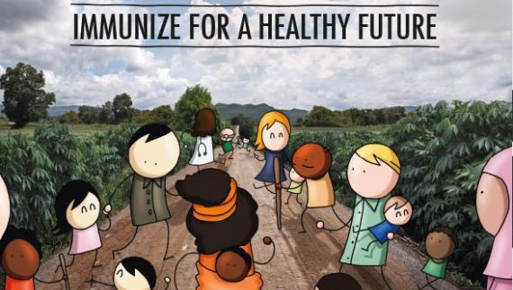
THANK YOU

