Slide 1
MIGRANT HEALTH

Slide 2
INTRODUCTION
Health and Human rights has explicit intrinsic connections and has emerged as powerful concepts within the rights based approach especially so in the backdrop of weakening public health system, unregulated growth of the private sector and restricted access to healthcare systems leading to a near-total eclipse of availability and accessibility of universal and comprehensive healthcare.
A rights-based approach to health uses International Human Rights treaties and norms to hold governments accountable for their obligations under the treaties. It recognizes the fact that the right to health is a fundamental right of every human being and it implies the enjoyment of the highest attainable standard of health and that it is one of the fundamental rights of every human being and that governments have a responsibility for the health of their people which can be fulfilled only through the provision of adequate health and social measures. It gets integrated into research, advocacy strategies and tools, including monitoring; community education and mobilization; litigation and policy formulation.

Slide 3
Human spatial mobility started about two decades ago for various systemic, economic and individual reasons, but there is a lack of systematic information and health-risk assessment among the mobile population.
The specific socio-demographic structure, that is, age, sex, education, attainment, occupation and income, determines the context in which migration takes place and their health-risks are predetermined by certain factors at the destination areas.

Slide 4
Government-related factors such as national policies, public service system, community development, development and housing;
Employer-related factors such as work site safety, living conditions, insurance coverage, women worker’s maternal and reproductive health benefit, etc;
Health-sector related factors such as health/preventive network, service coverage and approaches, service items and prices; and
Individual-related factors like social support at the destination, health awareness, health beliefs, health behaviour and help seeking behaviour, impacts the individual and collective health risk of migrants.

Slide 5
The International Organization for Migration (IOM) defines a migrant as any person who is moving or has moved across an international border or within a State away from his/her habitual place of residence, regardless of (a) the person’s legal status, (b) whether the movement is voluntary or involuntary, (c) what the causes for the movement are or (d) what the length of the stay is.
According to the 1967 Protocol of the1951 Refugee Convention, a refugee is a person who, ‘owing to a well-founded fear of persecution for reasons of race, religion, nationality, membership of a particular social group or political opinions, is outside the country of his nationality and is unable or, owing to such fear, is unwilling to avail himself of the protection of that country.’ The 1984 Cartagena Declaration states that refugees also include persons who flee their country ‘because their lives, security or freedom have been threatened by generalised violence, foreign aggression, internal conflicts, massive violations of human rights or other circumstances which have seriously disturbed public order’.

Slide 6
Refugees are therefore a sub-set of migrants who are specially defined by their reasons for displacement and fear of consequences if they return and who are afforded special protection and entitlements by international agreements. A person who seeks safety from persecution or serious harm in a country other than his or her own and awaits a decision on the application for refugee status under relevant international and national instruments is classified as an asylum seeker. In case of a negative decision, the person must leave the country and may be expelled, as may any non-national in an irregular or unlawful situation, unless permission to stay is provided on humanitarian or other related grounds

Slide 7
Migrants are disadvantaged relative to the native population
They often have a lowsocio-economic statuswith no access to either healthcare or social services
They suffer from mental and emotional vulnerability and low self-esteem
Lack of provision of social goods, education and health, impedes the integration of migrants into the local population.

Slide 8
The vulnerability of the migrants and their health and human rights has to be assessed from the framework of
accessibility of health and health services in relation to the availability of services; stigma and discrimination, discrimination on the basis of sex and gender roles and economic affordability,
quality of available services and the prior conditions of health like right to safe and healthy working conditions, right to adequate food, physical accessibility of health services, culturally sensitive and good quality health services, and the right to seek and receive health related information.

Slide 9
Refugees and illegal migrants often get caught up in the internal geopolitics of the host countries and have no legitimate right that can protect them. They are denied basic rights.
Delay in health-seeking is also due to associated costs, inability to miss work, problems of transportation. Many are unfamiliar with the local health-care systems and have linguistic or cultural difficulties communicating their problems.

Slide 10
Local bias stigmatizes migrants and may be used as an excuse by host communities to supply inferior care, impede integration, restrict the migrant’s career and educational mobility and ultimately act as a socially and culturally indenturing force.
Bias also acts as a self-perpetuating force, sustaining the migrant’s negative conditions and thus allowing for more bias to continue.

Slide 11
Types of Migration
Internal and International.
Both the types can be either voluntary or forced. Migration is voluntary or forced on the basis of the factors that propel migration at the point of origin. In the case of voluntary migration, the decision to migrate is taken as a part of an informed choice made by the prospective migrant, while in the case of forced migration, conflict, political violence, armed conflict, development-induced displacement, are major reasons for migration. From the vulnerability point of view, the conditions prior to migration are important.

Slide 12
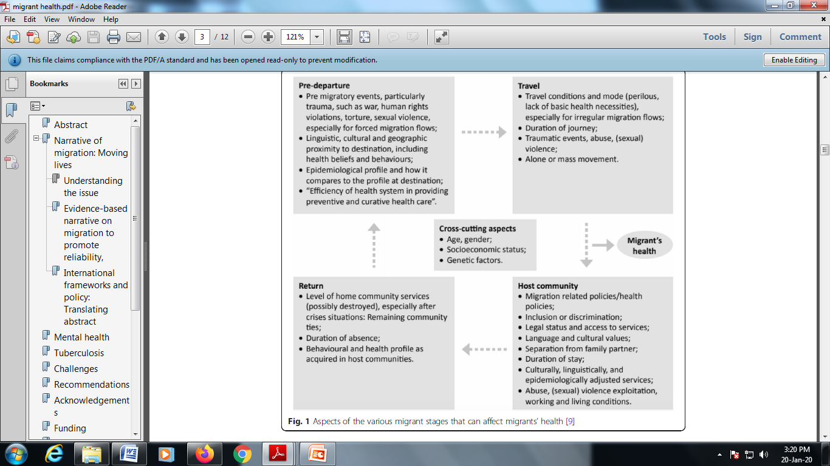

Slide 13
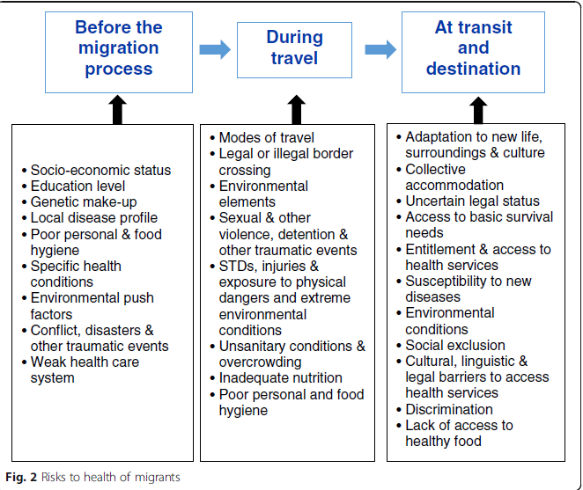

Slide 14
Internal Migration in India
During the 2001 census period, 14.4 million people migrated within the country for work purposes either to cities or areas with higher expected economic gains. The National Commission on Rural Labour (NCRL) estimates the number of internal labour migrants in rural areas in India alone at around 10 million (including roughly 4.5 million inter-state migrants and 6 million intra-state migrants).

Slide 15
A large number of migrants also work in the urban informal manufacturing construction, services or transport sectors and are employed as casual labourers, head loaders, rickshaw pullers and hawkers.
Migration may include both voluntary and forced movement of people. Displacement implies the use of force or generation of conditions that displaces people from their source of origin.

Slide 16
Causes of IDPs
Political causes, including secessionist movements
Identity-based autonomy movements
Localized violence
Environmental and development-induced displacement
Religion-based violence and displacement

Slide 17
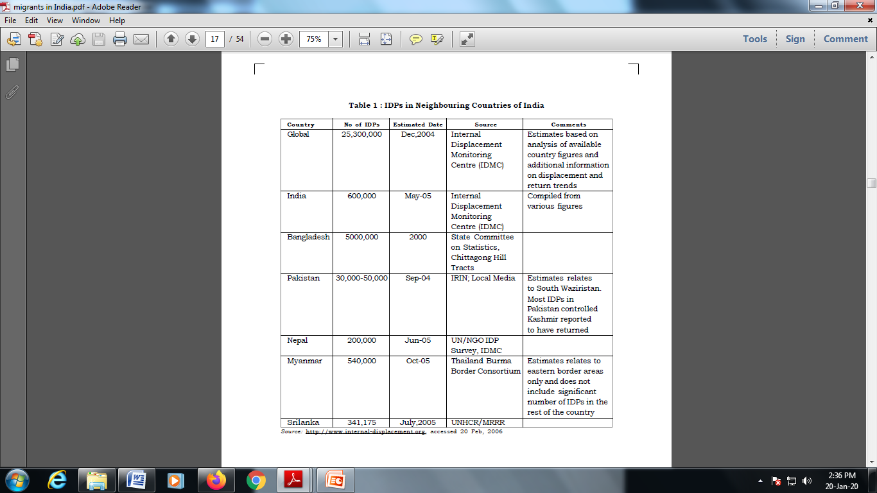

Slide 18
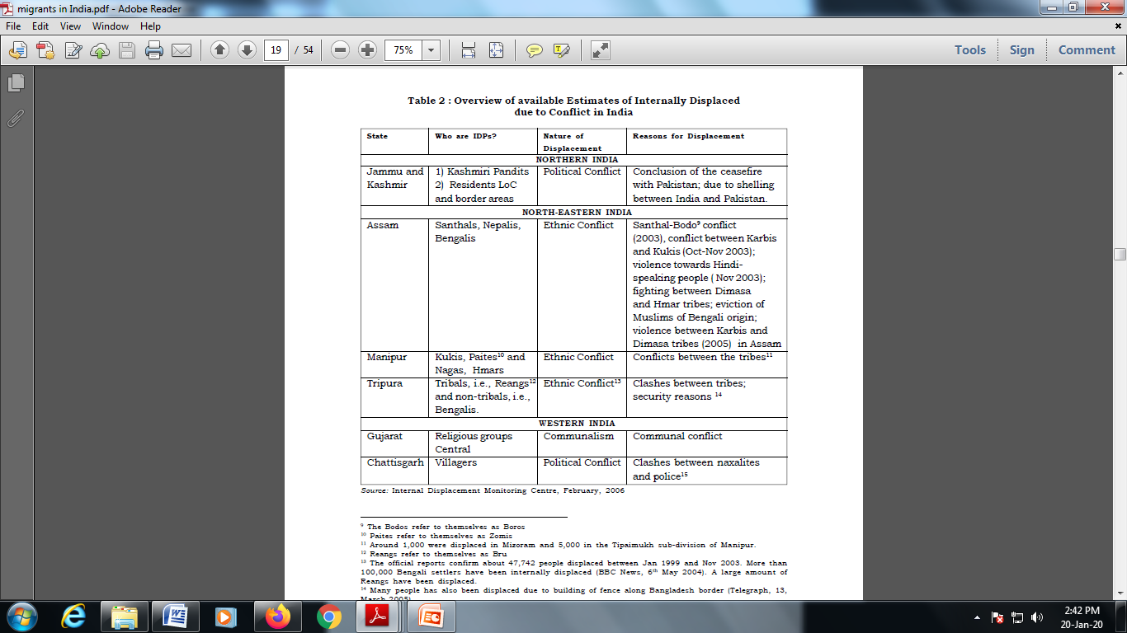

Slide 19
International Migrants in India
The bulk of these migrants were from Bangladesh, followed by Pakistan and Nepal.
Restrictions on legal entry at in most countries of destination, enforced through strict visa regimes and carrier sanctions, mean that a large proportion of migrants travel with illegal documents, often using long, torturous and dangerous routes to countries of destination.
Since the movement of population is illegal, the estimates of entry of migrants to the countries of their destination remain largely undocumented.

Slide 20
When migrants enter another country illegally and subsequently lose any legal immigration status, his or her vulnerability to abuse and exploitation increases sharply.
Irregular migrant workers are easy victims of abuse and exploitation by employers, migration agents, corrupt bureaucrats and criminal gangs.
They often live on the margins of society, trying to avoid contact with authorities and have little or no legal access to prevention and healthcare services.
Migrant workers predominate in the lower income labour market with higher risks of exposure to unsafe working conditions.
Many often they do not approach the health system of the host countries in the fear of their status being discovered.

Slide 21
Migrant Women and Children
Migration among women and children and its associated vulnerability poses complex public health challenge. In the migratory pattern within India, women and children have always featured as “associated” migrants with the main decision to migrate being taken by the male of the household. Internally migration within and outside the States of India, has always thrown out higher figures of female migrants citing, ‘Marriage’ and ‘Moved with household’ as the two most important reasons to move among women.

Slide 22
As associated migrants, women suffer greater vulnerability due to reduced economic choices and lack of social support in the new area of destination. In the case of semi/ low-skilled or unskilled women migrants, this can translate into their entry into the low paying, unorganized sector with high exposure to exploitation and abuse.

Slide 23
Women migrant labour now accounts for 46 per cent of the overall international migration from developing countries because of globalization
Female migration to India constitutes 48 per cent of the total in-migration from other countries.
Migration among women has been high from Bangladesh and Nepal as compared to other neighbouring countries.
Women and children in an irregular situation are doubly vulnerable owing to their lack of proper legal status and high risk of sexual exploitation.

Slide 24
Health implications for those on the move
Overcrowded living conditions which facilitate increased transmission of infectious diseases
Poor nutritional status( and consequent lowered immunity) due to lack of food before, during and after displacement
Inadequate quantities and quality of water to sustain health and allow personal hygiene
Poor environmental sanitation
Inadequate Shelter

Slide 25
Migrant labour ismore susceptible to HIV/ AIDS infection.
Most of the workers have multiple partners and indulge in high risk behaviour with a very low pattern of condom usage.
They also reported high alcohol.
Health Problems in the Context of Trafficking:
Mental trauma
Physical trauma
Communicable disease
Violence, including sexual abuse

Slide 26
The Human Rights of Migrants
The Vienna Declaration and the Programme of Action (1993) attached great importance to the promotion and protection of the human rights of persons belonging to vulnerable groups, including migrant workers.
A special protection ‘regime’ was created for the refugees to protect them from refoulement, to recognize their civil, social, economic and cultural rights, and place them under the protection of individual states and of the UNHCR.

Slide 27
The Hague Declaration focused on adopting a more humane approach to migrants and migration.
Migrants now have rights under two sets of international instruments: first, the core human rights treaties such as the International Covenant on Civil and Political Rights (ICCPR), whose provisions apply universally, and thus protectmigrants; and second the new Convention on Migrant Workers (CMW) and the ILO Conventions which specifically apply to migrants, and in particular to migrant workers.
But with the Convention of Migrant Workers (CMV), the provisions for the protection of the migrants received formal sanction. The CMW was adopted by the General Assembly at its 45th session on 18 December 1990.

Slide 28
Part III of CWM contains that there has to be equal treatment between all migrant workers and nationals to their families, giving them equal treatment in respect of their basic economic and social rights, including remuneration, work and employment conditions, social security, emergency medical care, and access to education for the children of migrant workers.
Part IV of CWM is only for regular migrants and relates to access to educational institutions and service, vocational guidance and training, housing, social and health services, and participation in cultural life. They are given the right to form trade union and rights to political participation. They also have a right to family reunification.

Slide 29
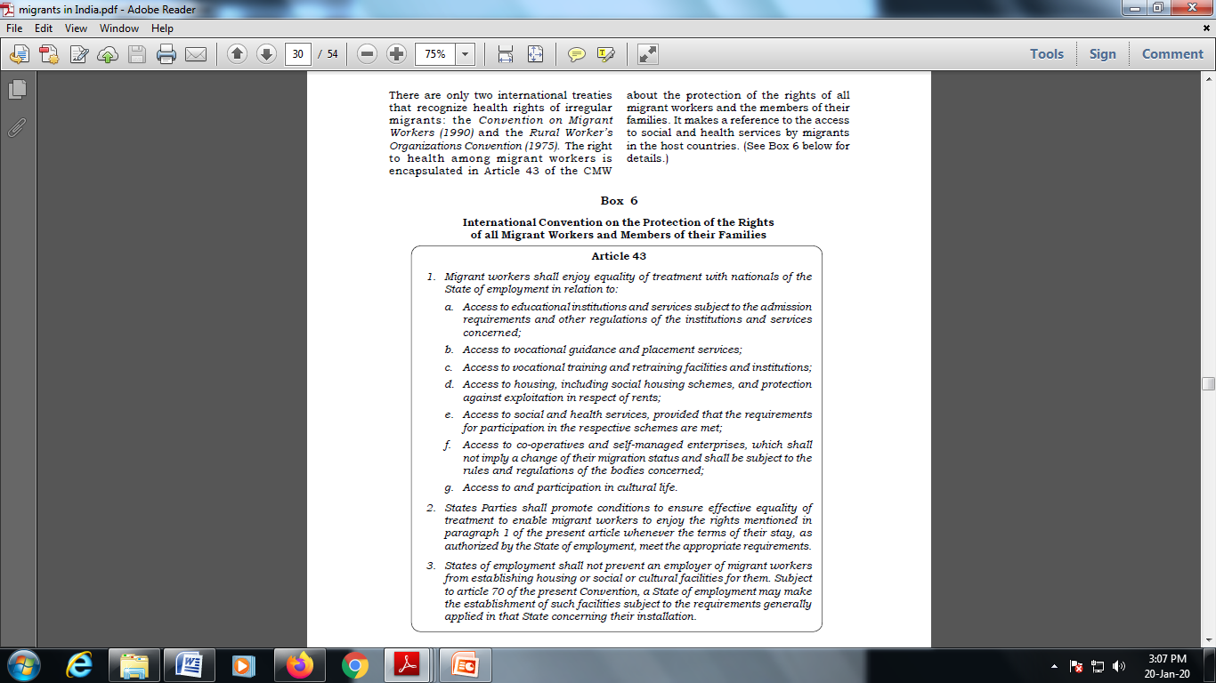

Slide 30
The Programme of Action of the 1994 International Conference on Population and Development made several references to migrants and their health.
The Beijing Platform for Action (1995) recognized the barriers of displaced immigrant and migrant women, including women migrant workers and urged governments to protect the human rights of women migrants and protect them from violence and exploitation and introduce measures for the empowerment of documented women migrants.

Slide 31
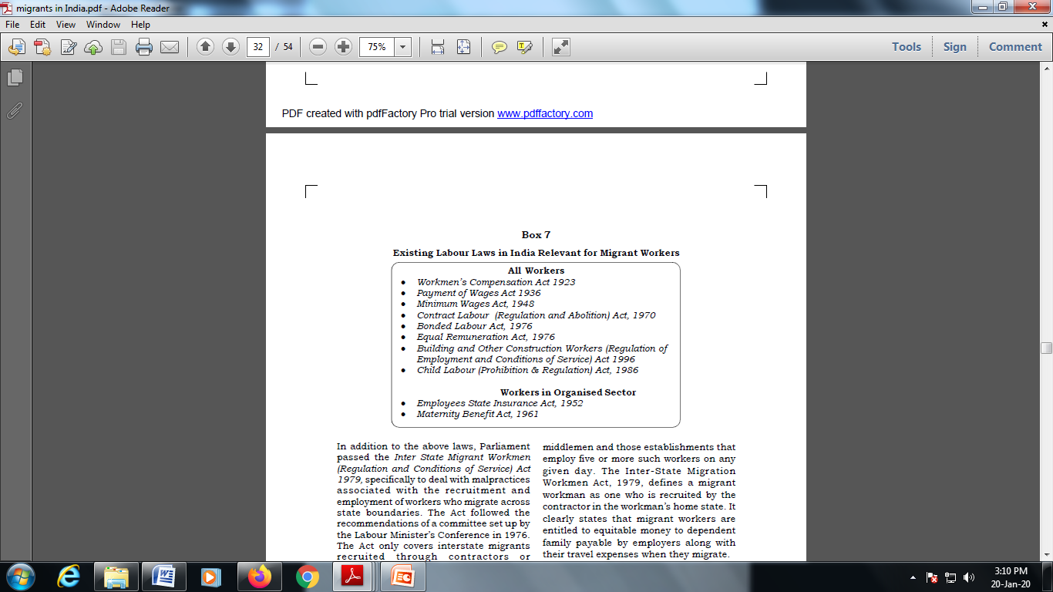
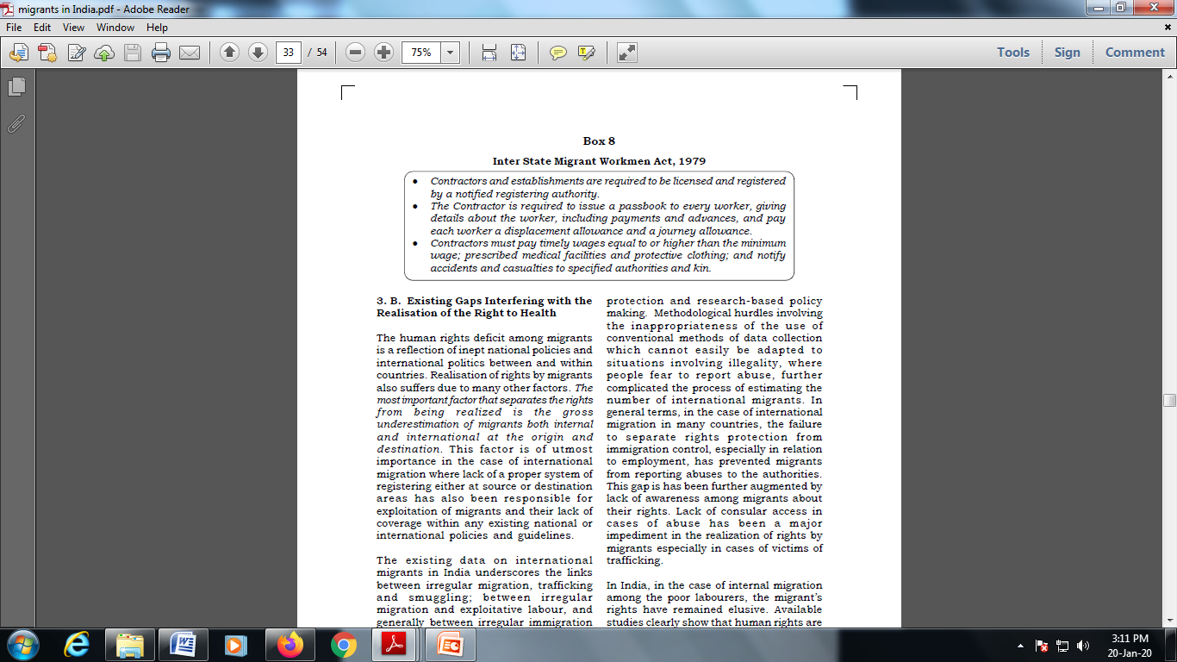
Migrants Rights in India

Slide 32
Integrating Health and Migration- Achieving a Balance
Receiving Population
Improved disease protection
Better resource utilization
Infrastructure support l Reduced morbidity and mortality
Improved health and productivity

Slide 33
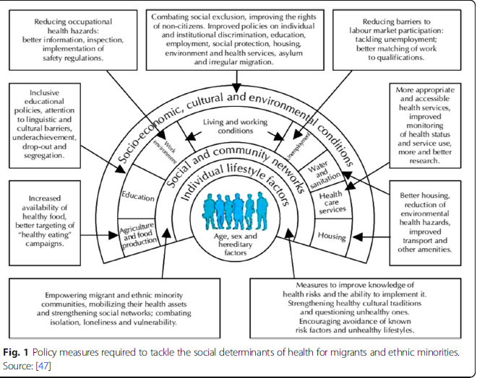

Slide 34
Migrant Population
Timely and safe movement
Targeted health intervention
Reduced morbidity and mortality
Better health care access reduced stigma

Slide 35
Priority Areas
Organisational reform/institutional development
Primary health service provision for migrants/refugees
Behavioral change of health providers and health seekers
Research (collecting evidence on migrant’s health)

Slide 36
RECOMMENDATIONS
A rights based approach to migration includes the following elements:
Before any new law, policy or practice is introduced; it should be reviewed to ensure its consistency with the state’s national, regional and international human rights obligations, and international labour standards.
There should be an assessment of the human rights impact to ensure that the policy measures, for instance anti trafficking measures, comply with respect for human rights
There should be systematic data collection and its disaggregation by sex, geographic origin, age and ethnicity, to enable discrimination or potential discrimination to be identified, and eliminated
Existing national laws should be reviewed to see if they protect migrants and citizens equally.
Employment contracts,made under bi-lateral agreements, should reflect labour and human rights

