Slide 1
Nature & Scope Of HRM
Mr. Sanjay B. Panna

Slide 2
Course Content
Nature, Scope, Semantics, Functions, Personnel Policies, HRM Model, Evolution, Human Capital Management, External Forces, Internal Forces, HRM and environment scanning.

Slide 3
INTRU..
Human: refers to the skilled workforce in an organization.
Resource: refers to limited availability or scarce.
Management: refers how to optimize and make best use of such limited or scarce resource so as to meet the organization goals and objectives.

Slide 4
Definition:-
Human resource management (HRM or HR) is the strategic and coherent approach to the effective and efficient management of people in a company or organization such that they help their business gain a competitive advantage.
It is designed to maximize employee performance in service of an employer's strategic objectives.

Slide 5
Nature Of HRM:
Simply put, HRM refers to the application of management principles to management of people in an organization.
HRM comprises the following:
  HRM consists of people-related functions as hiring, training and development, performance review, compensation, safety and health, welfare, industrial relations and the like.
  More important functions of HRM are the building of human capital. Human capital refers to the stock of employee skills, knowledge and capabilities that may not show up in a balance sheet but have significant impact on a firm’s performance.

Slide 6
Nature Of HRM:
HRM necessitates alignment of HR policies and practices with the organization's strategies—both corporate as well as functional.
As stated above, HRM involves the application of management principles and functions to doubles and deliverables of people management.
HRM assumes that it is the people who make the difference. They alone are capable of generating value and adding to the competitive advantage to organizations.
HR activities, both doables and deliverables, are not the sole responsibility of the HR specialists. Line managers are equally responsible for carrying out the activities.
HR functions are not confined to business establishments only. They are applicable to non-business organizations too, such as education, health care, recreation and the like.

Slide 7
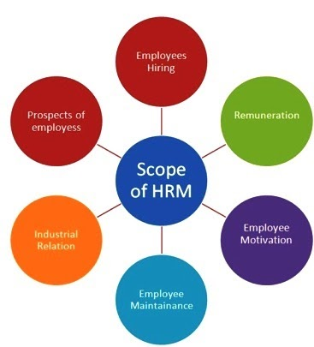
Scope Of HRM

Slide 8
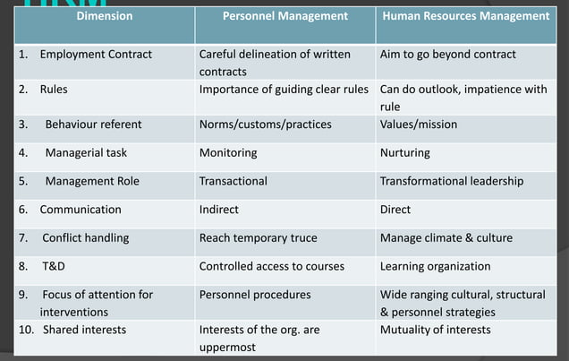
Semantics Of HRM:-

Slide 9
Functions Of HRM:
1. Societal Objectives
1. Legal compliance
2. Benefits
3. Union-management relations
2. Organizational Objectives
1. Human resource planning
2. Employee relations
3. Selection
4. Training and development
5. Appraisal
6. Placement
7. Assessment
3. Functional Objectives
1. Appraisal
2. Placement
3. Assessment
4. Personal Objectives
1. Training and development
2. Appraisal
3. Placement
4. Compensation
5. Assessment

Slide 10
PERSONNEL POLICIES:-
Policies are plans of action. Organizations need to evolve HR policies as they ensure consistency and uniformity in treating people. They help motivate and build loyalty. Policies become benchmarks to compare and evaluate performance.

Slide 11
PERSONNEL POLICIES:-
Policy of hiring people with due respect to factors like reservation, sex, marital status, and the like.
Policy on terms and conditions of employment—compensation policy and methods, hours of work, overtime, promotion, transfer, lay-off, and the like.
Policy with regard to medical assistance—sickness benefits, ESI and company medical benefits.
Policy regarding housing, transport, uniform and allowances.
Policy regarding training and development—need for, methods of, and frequency of training and development.
Policy regarding industrial relations—trade-union recognition, collective bargaining, grievance procedure, participative management, and communication with workers.

Slide 12
HRM Model:-
It is time that we understand the theoretical perspectives on HRM—its defining features, popularity called models. Five major models have been identified and all these serve four purposes.
1. They provide an analytical framework for studying HRM (for example, situational factors, stakeholders, strategic choice levels, competence).
2. They legitimize certain HRM practices; a key issue here being the distinctiveness of HRM practices: “It is not the presence of selection or training but a distinctive approach to selection or training that matters”.
3. They provide a characterization of HRM that establishes variables and relationship to be researched.
4. They serve as a heuristic device—something to help us discover and understand the world for explaining the nature and significance of key HR practices.
The five HR models are: (i) The Fombrun, (ii) The Harvard, (iii) The Guest, (iv) The Warwick, and (v) Dave Ulrich.

Slide 13
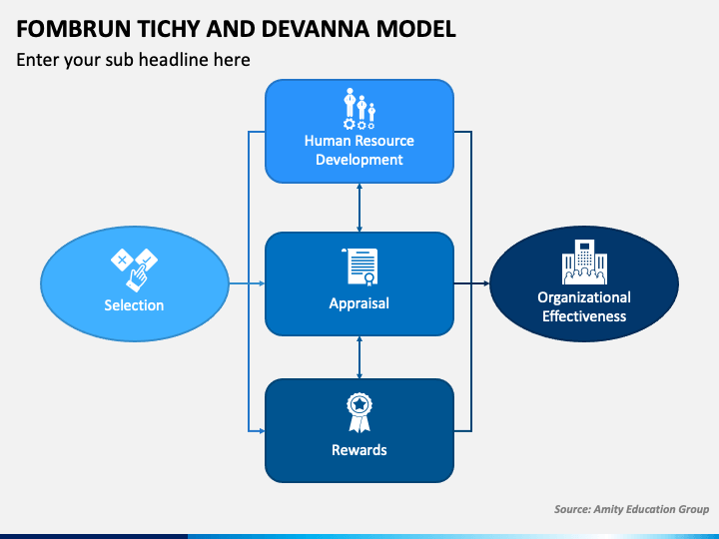
The fombrun, Tichy and Devanna Model

Slide 14
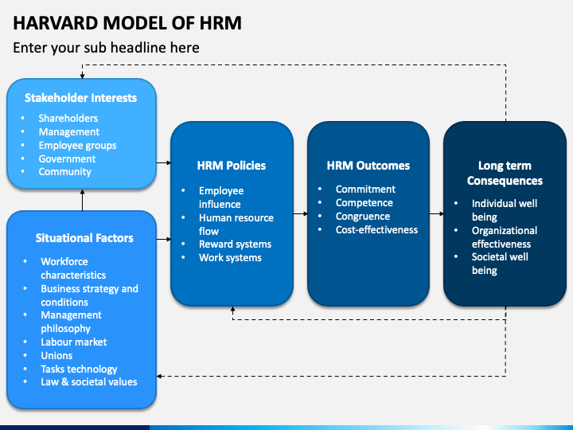
The Harvard Model

Slide 15
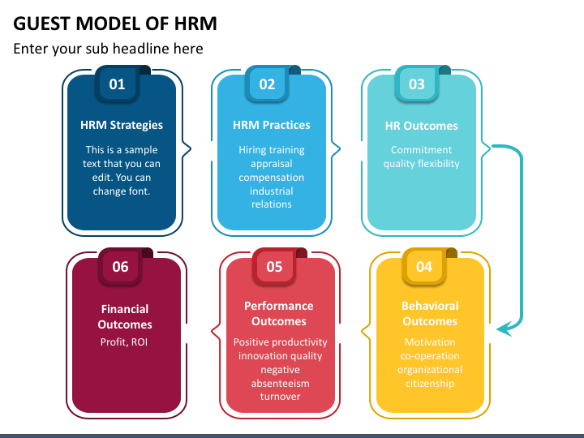
The Guest Model

Slide 16
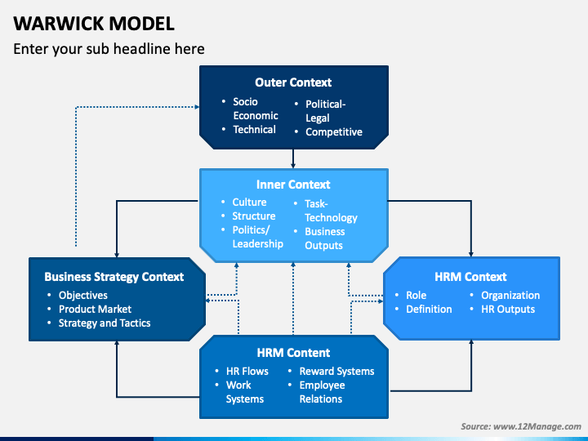
The Warwick Model

Slide 17
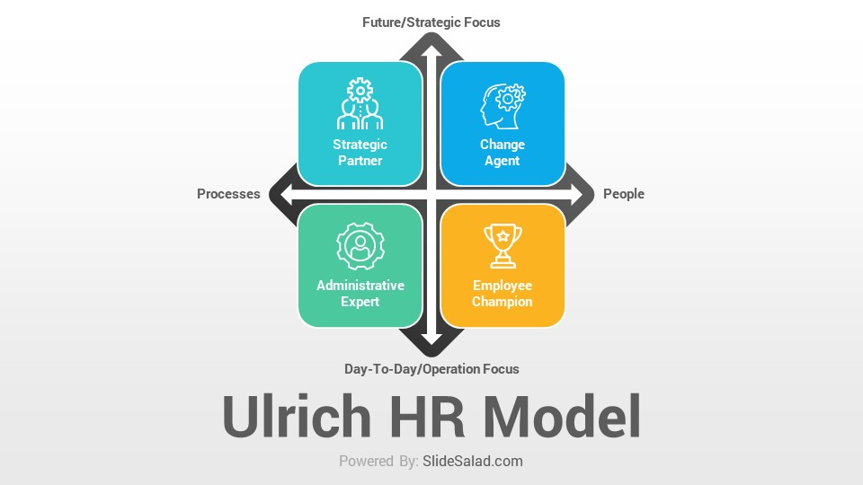
The ulrich Model

Slide 18
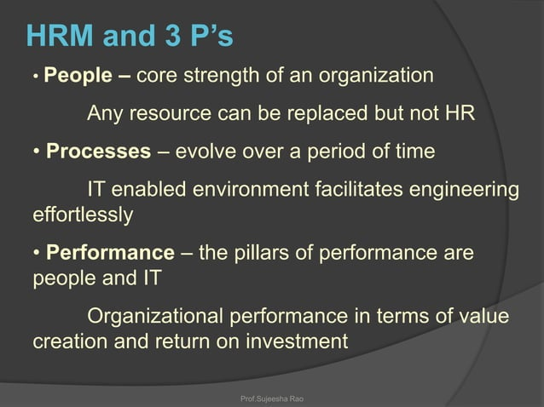

Slide 19
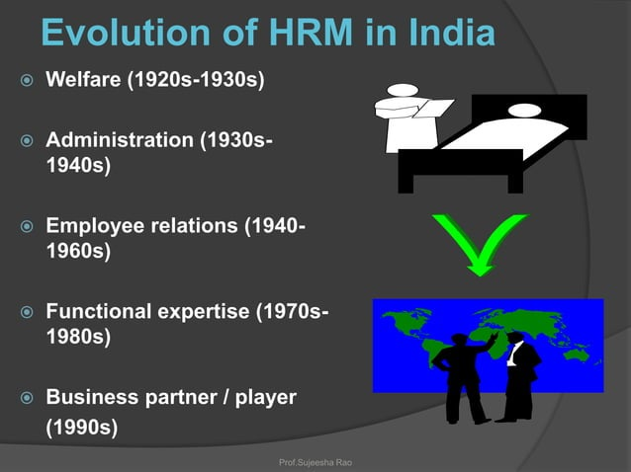

Slide 20
Human Capital Management
The term HRM is now sought to be replaced by Human Capital Management (HCM), often called talent management.
Human capital is understood as the experience that an individual brings to an organization in the form of knowledge, skills, abilities, and values that he or she has accumulated over time. Consequently, the employees of an organization are viewed as an asset or a resource that can be improved through investment in the same way as other assets or resources such as building and equipment.
Organizations do not own capital but can rent it from their employees. As a result, human capital is highly precarious and is in constant danger of being lost when an employee exits the organisation.
HRM treats people as an organisational resource. The term ‘human resource’ implies an available supply that can be drawn on and used to accomplish a task. Resources appear as costs in traditional accounting practices.
HCM recognizes that people are investors of their personal human capital and this provides the main source of value for an organization.

Slide 21
HCM demands action by an organization on the following:-
Focusing on knowledge and insight rather than on metrics and standards.
Acknowledging complexity and not trying to understand everything through cause and effect.
Using best–fit, not just basic or best practices.
Focusing on creating value through intangible capability.
Integrating people and business strategy, driving and accelerating the business plan.
Managing a large proportion of the people management agenda through strategic programmers.
Gaining energy from the outside-in, matching potential capability with investors’ and customers’ needs.
Measuring strategic differentiators that indicate potential transformation.
Using informal, longitudinal and focused, strategic, external benchmarking.
Focusing on long-term stretch objectives, and learning from their outcomes.
Reporting to employees, managers and the Board.
HR acting as a strategic partner.

Slide 22
Context of HRM:
Context of HRM refers to the environment within which HR professionals need to function. Environment may be understood as all those forces which have their bearing on the functioning of the HR department. The forces are— political–legal, economic, technological, cultural, unions, and professional bodies. Then there are strategy and task, leadership, management and organizational culture. Some of these are external to the firm and others are internal.
Before examining these forces, it is useful to understand the utility of analyzing the environment in which HR managers need to work. Analysis of the environment is useful for the HR manager and his/her team in order to become proactive and not remain reactive to the environment. Reactive strategy serves the purpose when the environment is fairly stable and competition is less severe. Both of these have become things of the past. Today’s business environment is characterized by change and intense competition. Proactive steps are vital for any organization if it has to survive in such an environment.

Slide 23
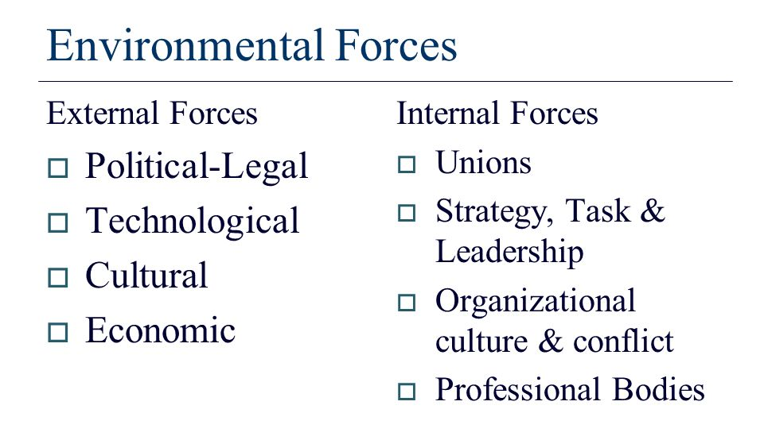

Slide 24
External forces:
1.Economic factors are those factors which give shape and form to the development of economic activities and include factors like nature of economic system, general economic conditions, various economic policies, and various factors of production including human resources.
Out of these, factors that influence human resource management practices are population and workforce, workforce market conditions, national income, and inflationary pressures.

Slide 25
External forces:
2.Cultural factors are quite comprehensive and affect various aspects of organizational operations, including human resource management. From human resource management point of view, attitudes, beliefs, desires, expectations, and customs of the society at a given point of time are important.
These factors determine-
(i) expectations of the society from organizations,
(ii) views towards social status of jobs,
(iii) views towards achievement of work,
(iv) views towards authority structure, responsibility, and organizational positions,
(v) workforce mobility, and
(vi) role of unions in managing human resources. In the light of various socio- cultural factors, organizations can do better if they follow human resource management practices in accordance with the needs of these factors.

Slide 26
External forces:
3.Technological factors consist of sum total of knowledge providing ways to do things. These include inventions and techniques which affect the ways of doing things, that is, designing, producing, and distributing products and services. Technology affects an organization in two ways- (i) defining nature of jobs and (ii) affecting human resource management practices.
4.Political-legal factors include political system, role of government in business, various government policies related to business operations, laws formulated by governments, both central and state levels.

Slide 27
Internal Forces:
Unions:
Though a trade union in an organization is a separate entity, it has been treated as an internal factor because organization’s employees (particularly operatives) are members of the trade union. Trade union affects recruitment of employees, their development, compensation, maintenance, and industrial relations.
Generally, agreement between management and labour is reached through collective bargaining. Outcome of the collective bargaining depends on the relative bargaining position of the management and labour. If trade union is in relatively better bargaining position, outcome of the collective bargaining goes in its favour.
In such a situation, the organization has to adopt human resource management practices according to wishes of the trade union though such practices may have adverse impact on the organization. Bargaining position of a trade union depends on the strength of its members as well as support of trade unions of other organizations at the same location and apex body of trade unions at national level.

Slide 28
Internal Forces:
Organization’s Strategy:
Human resource management issues are not independent issues but these are derived; these are derived from organization’s strategy. Every organization sets its strategy either explicitly or implicitly. Strategy is a way in which an organization, reacting to its environment, deploys its principal resources and marshals its main efforts in pursuit of its purpose.
Human resource is one of the principal resources of any organization. Therefore, it must be deployed and utilized keeping in view the requirements of the strategy. Its implication is that HR strategy should be chalked out in the light of organization strategy.
How strategy affects human resource management practices can be seen by analyzing how strategy works in an organization. Strategy operates at three levels- corporate level, business level, and functional level. At the corporate level, strategic decision involves deciding ‘what business should we be in’.

Slide 29
Internal Forces:
Organizational Culture:
Organizational culture is another factor that shapes human resource management practices. Organizational culture is the set of assumptions, beliefs, values, and norms that are shared by an organization’s members. There are two types of elements which define the culture of an organization- abstract elements and material elements. Abstract elements are internally- oriented and include values, beliefs, attitudes, and feelings.
Material elements are externally- focussed and include buildings, personnel dresses, products, etc. Every organization, being a social entity, develops within it a cultural system with some unique modes of behaviour. These unique modes distinguish an organization from others.
Organizational culture is very important factor which affects organizational processes and practices including human resource management practices. To understand the differences in human resource management practices in different types of organizational culture, it can be divided into two groups- high-performing culture and low-performing culture.

Slide 30
Internal Forces:
Professional Association:
For every major profession, there is a professional association. A professional association consists of organizations and individuals whose membership is based on common professional, scientific, or technical aims. The representative body of professionals is needed to regulate and develop the professional activities.
For this purpose, the association prescribes code of ethics to ensure adoption of ethical practices of its members. For example, in India, there is National Institute of Personnel Management which has provided a code of ethics to its members that aims at governing their behaviour in performing their duties related to managing human resources.

Slide 31
SCANNING THE ENVIRONMENT
Environmental scanning involves general surveillance of the environment to determine trends and projections of factors that will affect the fortunes of the organization. The scan focuses on the firm’s task environment. Elements outside the task environment are not ignored, but are paid less attention.
Environmental scanning focuses on task environment. HR department is in the best position to scan environment (task). HR department obtains environmental information and feeds it to key decision makers.
Scanning is done to prevent information overload for decision makers. It should focus on providing relevant information for planning and decision making. With regard to HRM, the relevant areas to be scanned for planning and decision-making are the labor market, legal environment, constitutional provisions and technology. This does not mean that other elements, such as globalization, should be ignored. But it does mean that the four factors identified tend to have a major impact on HR decisions. If a company has overseas operations, these four factors in other countries of operations need to be examined.

Slide 32
SCANNING THE ENVIRONMENT
The HR department is in the best position to scan the environment for human-resources and labor-market issues. HR department obtains environmental information and feeds it to key decision makers.
In fact, the department may play a major role in making the decision. The department also has the responsibility of obtaining internal organizational information for consideration by strategic decision makers. But the role of the HR department is confined to a boundary spanning role in that it helps link the organization to its environment through environmental scanning.

Slide 33
THANK YOU..

