Slide 1
HOSPITAL ARCHITECTURE, PLANNING & MAINTENANCE
Mr. Sanjay Panna

Slide 2
HOSPITAL ARCHITECTURE, PLANNING & MAINTENANCE
The art and science of Medicine: Medical care, challenges, Hospital planning
The hospital: Introduction, classification, Requirements and standards, role of hospital

Slide 3
Intro..
Health is social value. This is reflected in provision of services, which need to consider ethical and philosophical issues as well as medical-scientific and medical-behavioral issues.
Medicine deals with health and disease.
Phases are discernible in its history;
  Primitive ignorance and superstition with resulting fear of disease
  Accumulation of experience in managing disease
  Gradual growth of verifiable knowledge of the cause of illness
  With knowledge applied to the control of disease

Slide 4
The art and science of Medicine :
The twenty-first century may prove to be the golden age of medicine. This is period of revolutionary change in medical therapy.
Before 1900, there were few drugs which were specific treatment for specific diseases. however, the drug industry has become one of the largest industries. Today, the strength and purity of drugs are rigidly standardized.

Slide 5
Development in medical care:
Surgeries:
  Open heart surgery
  Brain surgery
  Organ transplantation
  Hip and joint replacement
  BMT and IVF
  Prosthetics
Radio-diagnosis
Anesthesia
Medicine

Slide 6
Hospital:
An integral part of a social and medical organization. The functions of which is to provide for the population complete health care both preventive and curative and whose opd services reach out to the family and its home environment; the hospital is also center for biosocial research.
Hospitals arouse strong emotions. for the general public the perception is different. Most people fear the prospect of entering a hospital, even as visitor.

Slide 7
Culture , health and illness:
In most societies people suffering from physical discomfort or emotional distress have a number of ways of helping themselves or of seeking help from other people.
Different type of societies, one may see free health care needs, while other may see as a commodity to be brought only by those who can afford it.
In major countries, the main institutional structure of scientific medicine is the hospital. The ill person is removed from family, friends and community at a time of personal crisis.

Slide 8
Medical Care
Medical care cannot be separated from the buildings in which it is delivered. The quality of space in such building affects the outcome of medical care.
Hospital also improve by learning from their experience. Good architecture can be created in expansion or renovation projects, as well as in new facilities.

Slide 9
Challenges
In addition to the share size and complexity of its technical planning problems, hospital design presents a challenge to administrator, hospital consultant and architects.
No matter how complex a hospital may be, its map must be easy to understand by all its users.
The physical form of the hospital will change over a period of time as it responds to internal and external forces and will acquire complexity as it ages.
The availability of medical personnel and economic resources have to be analyzed to make an efficient medical and social service possible.
The hospitals should invariably be designed in support of the needs of the health centers and other healthcare units rendering primary care at the peripheral level.
The IP care has three broad levels: critical or intensive, intermediate and minimal.

Slide 10
Hospital Planning:
An efficient hospital requires a well- balanced organization for compassionate care within an adequate technical and environmental framework.
Planning involves and requires understanding and evaluation of the current cultural mainstreams, the economic and technological conditions, and the goals of the community.
Total project cost considerations are planning, financing, construction, and equipment.
A hospital emerges in three interdependent processes: Analysis-Planning-Programming, designing and construction.

Slide 11
The hospital
Growth

Slide 12
Introduction
Since many health problems require a level of medical treatment and personal care that extents beyond the range of services normally available in the patient’s home or in the physician’s office, modern society has developed formal institutions for patient care intended to help meet the more complex health needs of its members.
The hospital, the major social institution for the delivery of health care in modern world, offers considerable advantages to both patient and society.
From the standpoint of the individual, the sick or injured person has access to centralized medical knowledge and technology that will render treatment which is through and efficient from the standpoint of society, hospitalization both protects and family from many of the disruptive and injured into medically supervised institutions where their problems are less disruptive for society as a whole.

Slide 13
The hospital as a social institution
Historically, hospitals has passed through four distinct phases of development:
  As a centers of religious practice
  As poor houses
  As death houses
  As centers of medical technology.

Slide 14
Modern Hospital
The hospital is an integral part of a social and medical organization, the function of which is to provide for the population complete health care, both curative and preventive, and whose outpatient services reach out to the family and its home environment: the hospital is also a center for the training of health workers and for biosocial research.
Functions:
  Patient care
  Education
  Research
  Community outreach services

Slide 15
Classification of Hospitals
According to various criteria:
  Length of stay
  acute/short-tem vs. long-tem
  Type of services
  Type of control
  Level of care

Slide 16
Statistical Indicators
Hospital size or activity is commonly described by using a variety of statistical indicators.
  Numbers of beds
  Inpatient admissions
  Outpatient visits
  procedures

Slide 17
Hospital requirements and standards:
The basic minimum requirements for health care institutions some standard are mandatory.
  1. Licensure
  2. Accreditation
  3. Other Standards

Slide 18
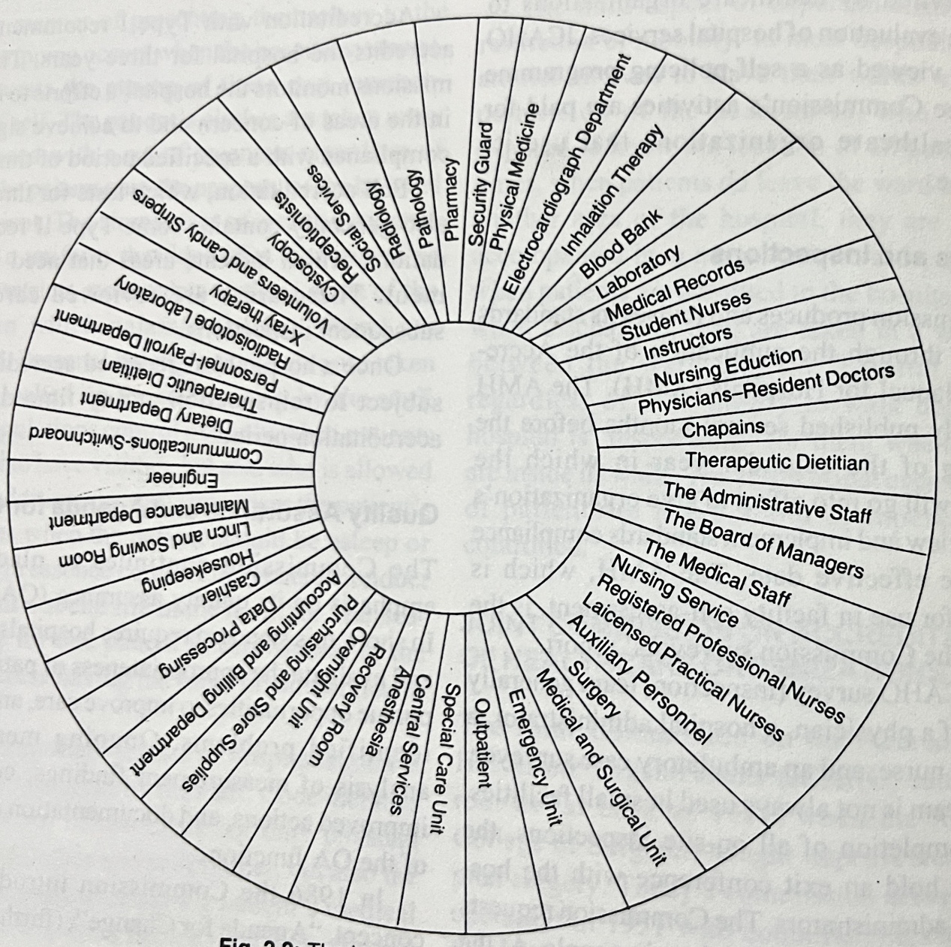
THE HOSPITAL –A Multiple Service Unit

Slide 19
The hospital’s changing role
Health delivery systems are changing at an increasingly faster pace. England is experiencing some shifting from socialized medicine to private care. In the us the change is toward more government control. Under Canada’s changing system, everyone receives government- mandated healthcare.
Hospital care constitutes as major part of the delivery of healthcare. However, there is more emphasis on ambulatory care.
With diversification, hospitals acquired a keen sense of the need to compete for patients.
The hospitals of the future will provide a core of high-level inpatient services for chronic and critical-care units of today.

Slide 20
Thank You

