Slide 1

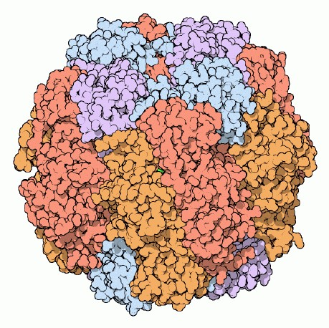
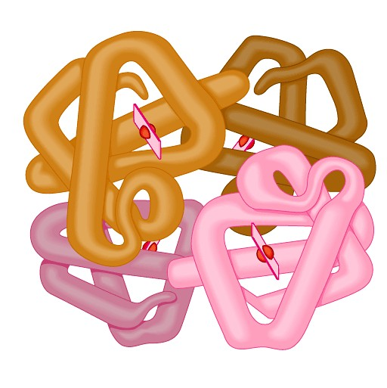
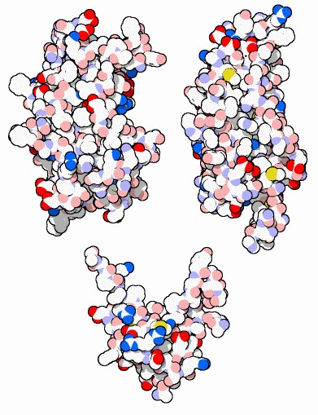
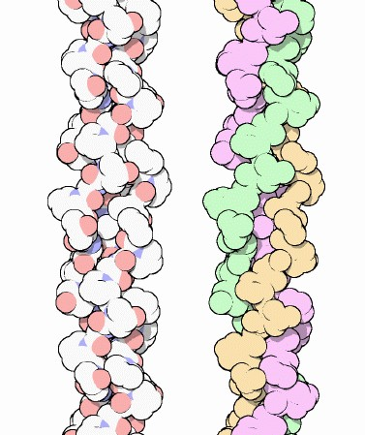
Proteins
Multipurpose molecules
Dr. Navneet Kumar Singh
Associate Professor
Sumandeep Vidyapeeth Deemed University
2006-2007

Slide 2

Interesting Facts about Protein
Approximately one-fifth of our body weight is protein.
Proteins are part of the structure of every cell and body tissue including hair, nails, blood, skin and bones.
How much protein do I need every day?
Dietary Reference Intakes (DRIs) for Protein in grams per day:
Age | Male | Female
4 – 8 years | 19 gm | 19 gm
9 – 13 years | 34 gm | 34 gm
14 – 18 years | 52 gm | 46 gm
19 – 30 years | 56 gm | 46 gm
31years and over | 56 gm | 46 gm

Slide 3
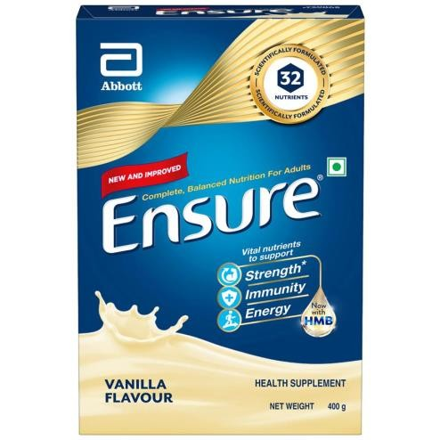
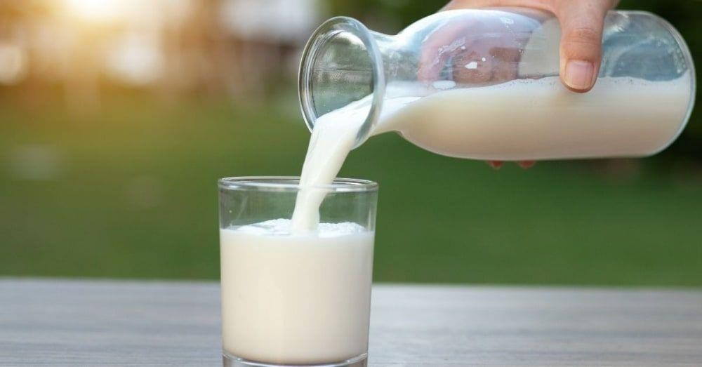
Proteins
Any of a class of nitrogenous organic compounds which have large molecules composed of one or more long chains of amino acids and are an essential part of all living organisms, especially as structural components of body tissues such as muscle, hair, etc., and as enzymes and antibodies.
Most structurally & functionally diverse group of biomolecules
Function:
  involved in almost everything
    Metabolism
    Support
    Transport
    Regulation
    Motion

Slide 4
Amino acids
Structure:
  central carbon (α carbon)
  amino group
  carboxyl group (acid)
  R group (side chain)
    variable group
    confers unique
H
|
O
H
||
chemical properties of the amino acid
N—C— C—OH
|
R
H

Slide 5
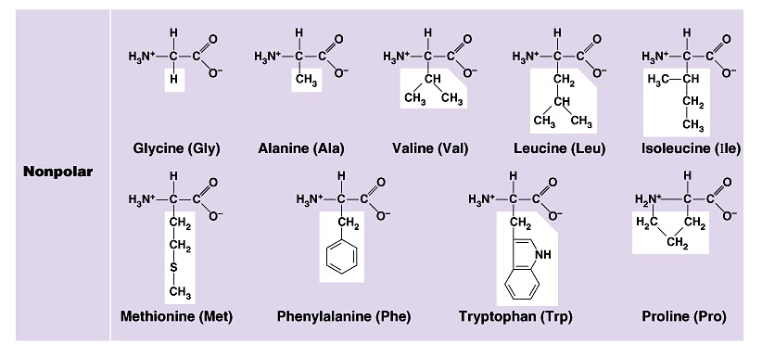

Nonpolar amino acids
nonpolar & hydrophobic

Slide 6
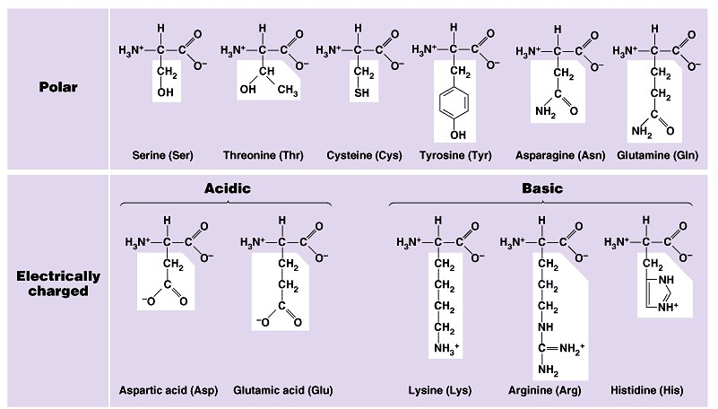

Polar amino acids
polar or charged & hydrophilic

Slide 7
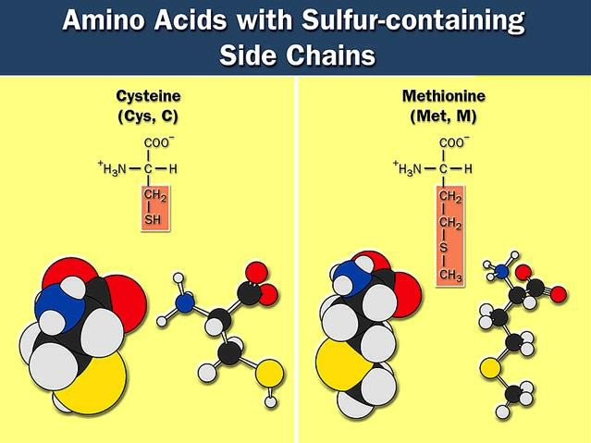




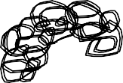

Sulfur containing amino acids
Form disulfide bridges
  cross links betweens sulfurs in amino acids
H-S – S-H
You wondered why perms smelled like rotten eggs?

Slide 8
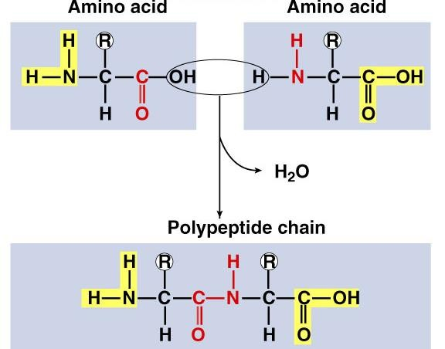
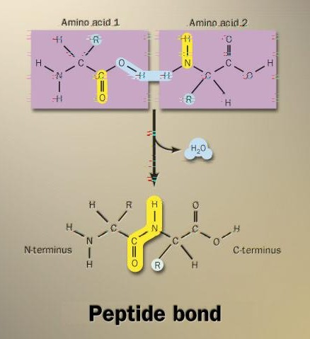

Building proteins
Peptide bonds
  linking NH₂ of one amino acid to COOH of another
  C–N bond
  N terminus – C terminus
dehydration synthesis
peptide
bond

Slide 9
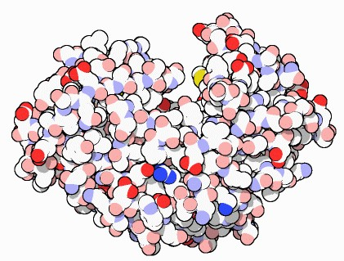
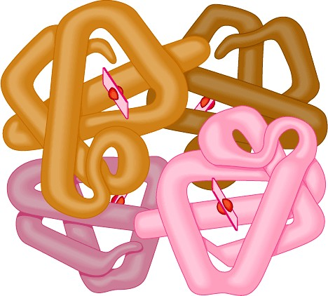
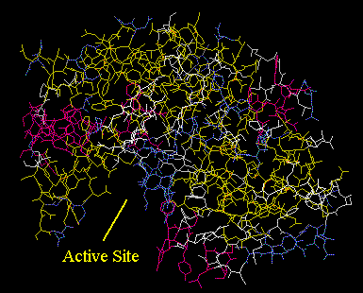
Protein structure & function
Function depends on structure
  3-D structure
    twisted, folded, coiled into unique shape
pepsin
hemoglobin
collagen

Slide 10
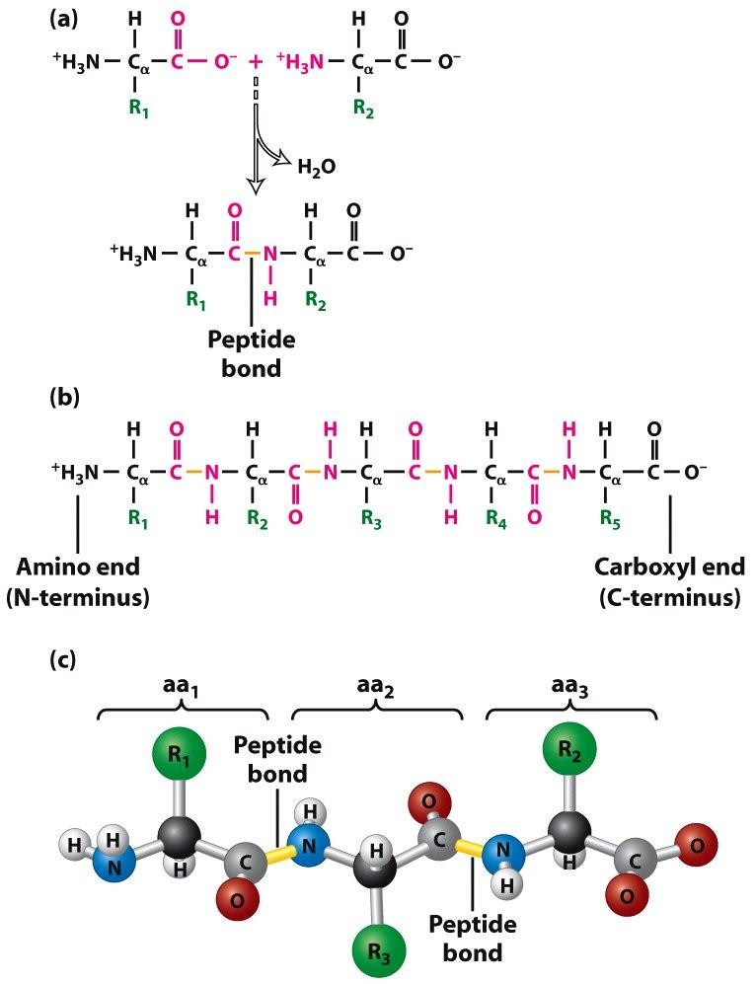
Primary (1°) structure
The primary structure of a protein refers to its amino acid sequence. Amino acids in peptides (<30 aas) and proteins (typically 200 to 1,000 aas) are joined together by peptide bonds (amide bonds) between the carboxyl and amino groups of adjacent amino acids.
The average yeast protein contains 466 amino acids. Because the average molecular weight of an amino acid is 113 daltons (Da), the average molecular weight of a yeast protein is 52,728 Da. Note that 1 Da = 1 a.m.u. (1 proton mass).

Slide 11
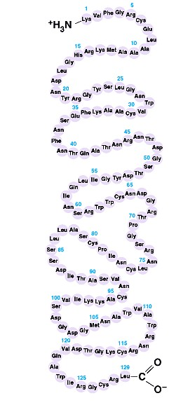
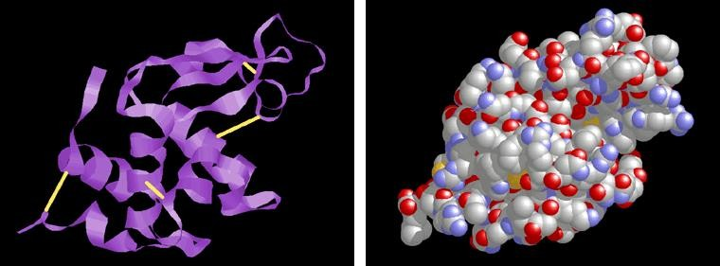
Primary (1°) structure
Order of amino acids in chain
  amino acid sequence determined by gene (DNA)
  slight change in amino acid sequence can affect
protein’s structure & it’s function
    even just one amino acid change can make all the difference!
lysozyme: enzyme in tears & mucus that kills bacteria

Slide 12
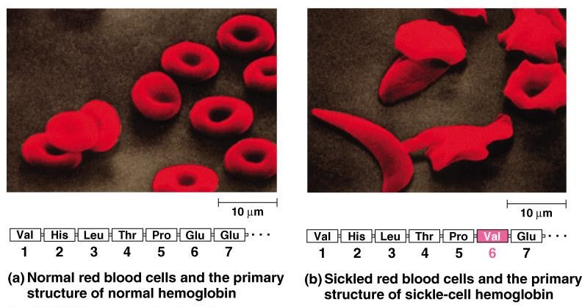
Sickle cell anemia

Slide 13
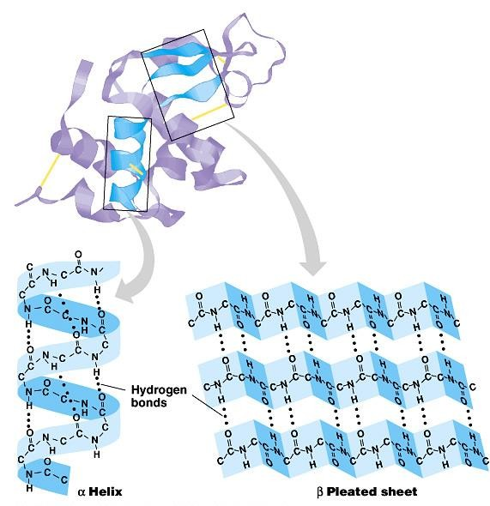
Secondary (2°) structure
“Local folding”
  folding along short sections of polypeptide
    interaction between adjacent
amino acids
    H bonds between backbones (O:H)
    α-helix
    β-pleated sheet
    Fibrous proteins – only have secondary structure
      Keratin
      Silk

Slide 14
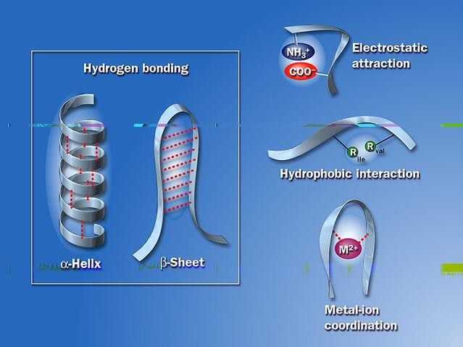

Secondary (2°) structure

Slide 15
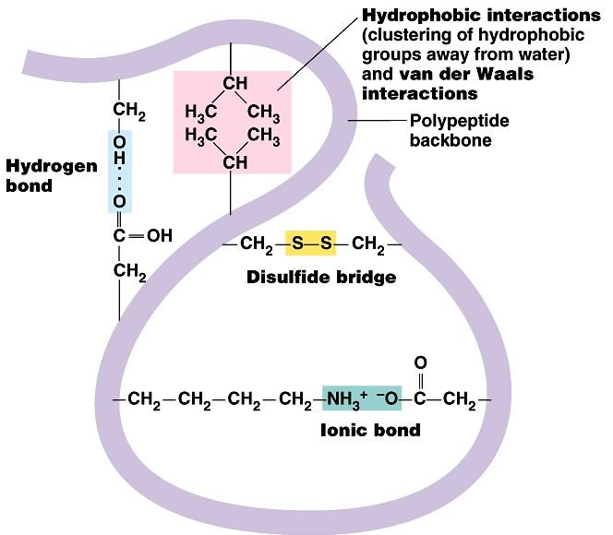
Tertiary (3°) structure
“Whole molecule folding”
  created when the secondary structure fold and form bonds to stabilize the structure into a unique shape
  determined by interactions
between R groups
    Hydrophobic interactions
    anchored by disulfide bridges
    Ionic Bonds between R groups
    Hydrogen bonds between backbones
    Van der Waals Force (velcro)
      Globular (spherical) proteins – have tertiary
structure
        enzymes

Slide 16
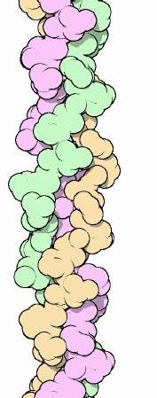
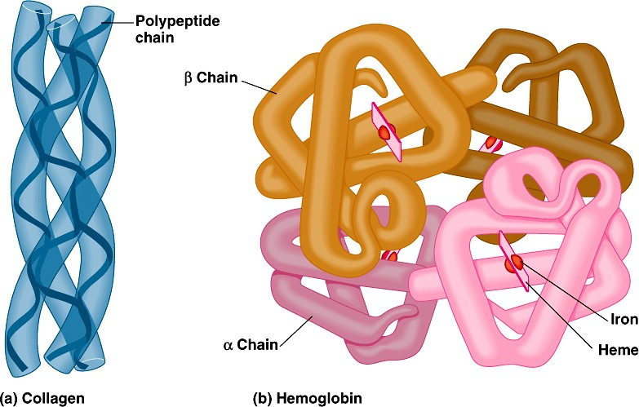
Quaternary (4°) structure
two or more tertiary folded peptide subunits bonded together to make a functional protein
  Hemoglobin – 4 polypeptides
  Collagen – 3 polypeptides
collagen = skin & tendons
hemoglobin

Slide 17
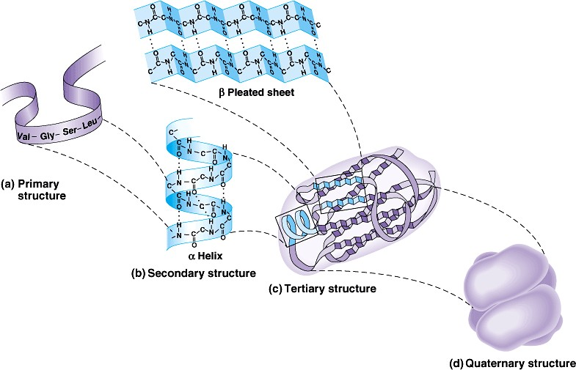
Protein structure (review)
R groups hydrophobic interactions,
disulfide bridges, ionic bonds
3°
multiple polypeptides hydrophobic interactions
1°
aa sequence
peptide bonds
determined
by DNA
2°
4°
H bonds

Slide 18
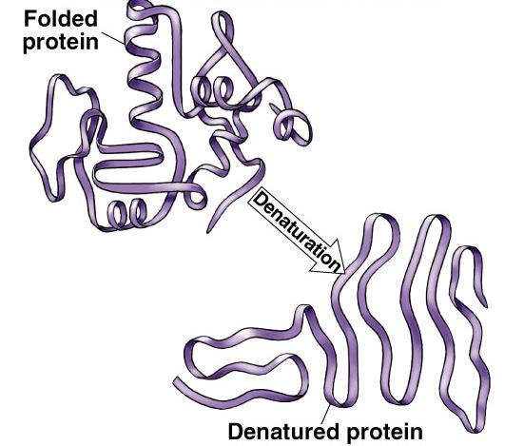
Denature a protein
Unfolding a protein/changes the shape
  disrupt 3° structure
    pH  temperature
  unravels or denatures protein
  disrupts H bonds, ionic bonds & disulfide bridges
  destroys functionality

Slide 19
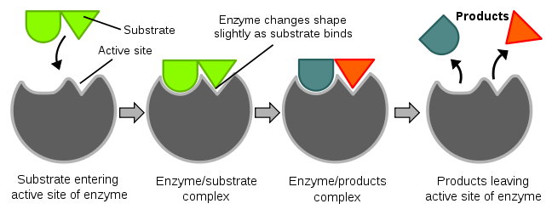
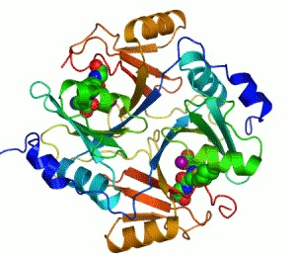
Metabolism
Enzymes
  Biological catalysts – speed up chemical reactions
    Digestive enzymes aid in hydrolysis o Lipase
      Amylase
      Lactase
      Protease
    Molecular Biology
      Polymerase
      Ligase
    Industry
      Dairy, baby food, rubber, beer, photography, contact lense cleaner

Slide 20

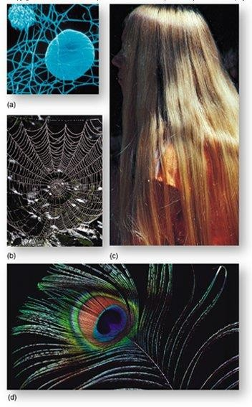

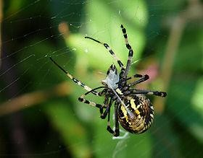
Support
Structural proteins
  Keratin – hair and nails
  Collagen – supports ligaments, tendons, and skin
  Silk – cocoons and spider webs

Slide 21
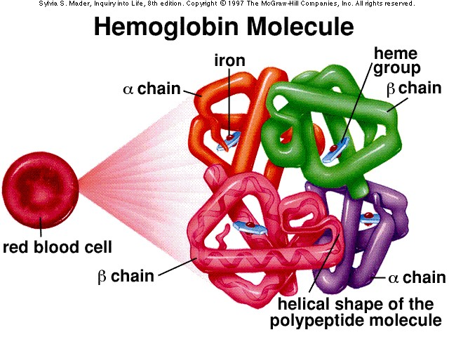
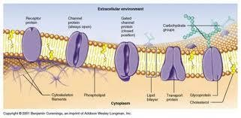
Transport
Channel and carrier proteins in the cell membrane
  Allows substances to enter and exit the cell
Transport molecules in blood
  Hemoglobin – transports oxygen in the blood

Slide 22
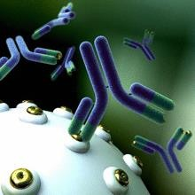
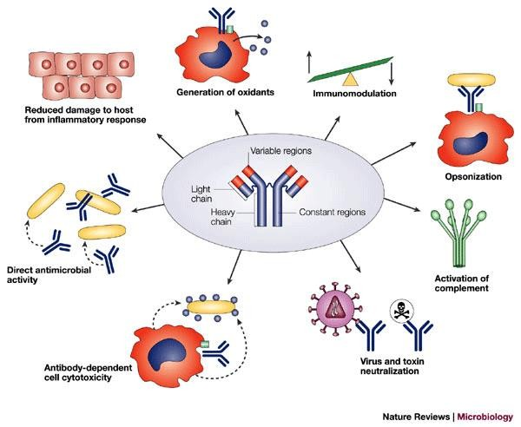
Defense
Antibodies
  Combat bacteria and viruses

Slide 23
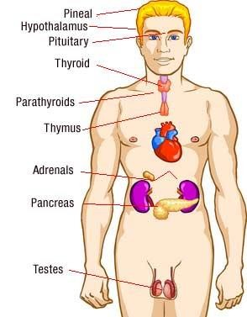
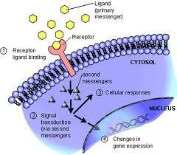
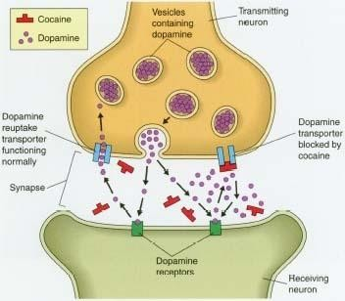
Regulation
Hormones
  Intercellular messengers that influence metabolism
  Insulin – regulates the amount of glucose in the blood and in cells
  Human growth hormone – its presence determines
the height of an individual
Receptor Proteins
  Built into the membranes of nerve cells
  Detect chemical signals (neurotransmitters)
released by other nerve cells

Slide 24
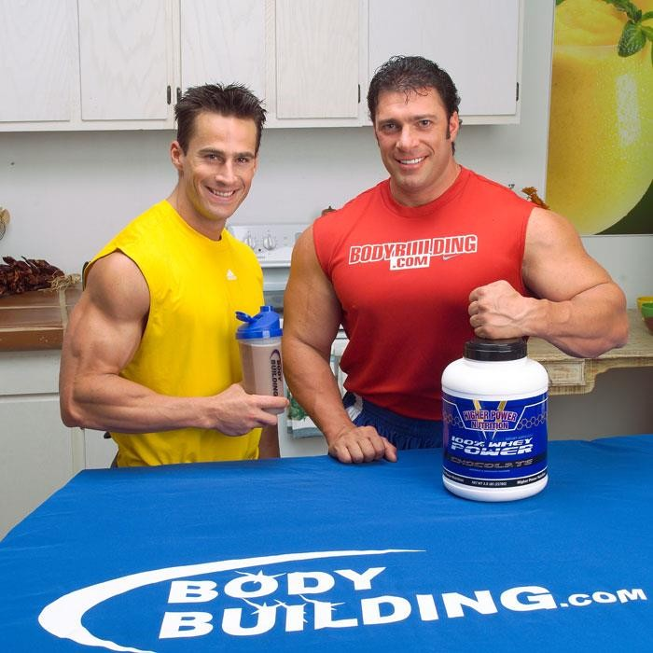
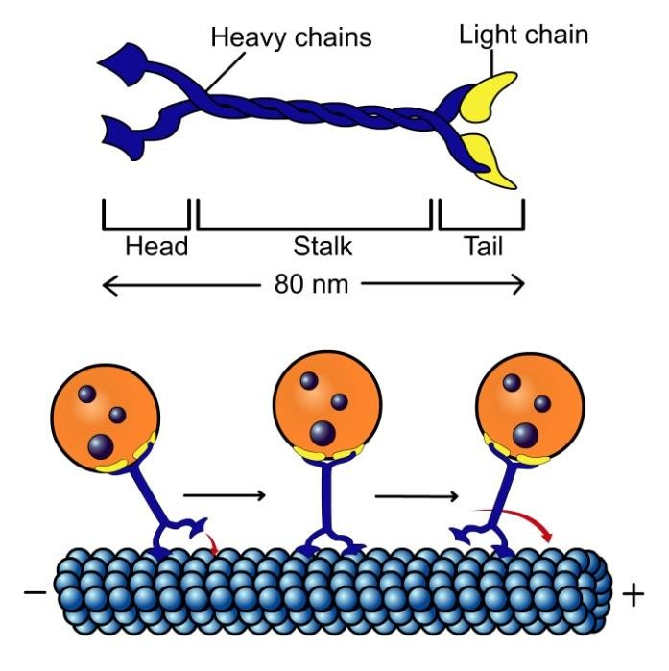
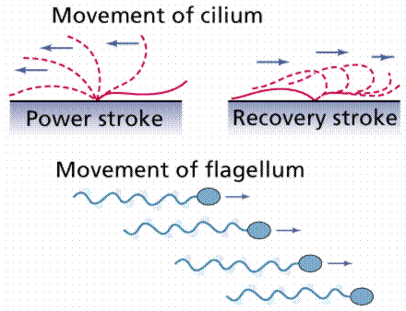
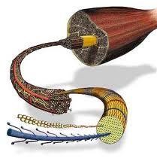
Motion
Muscle contraction
  Actin and myosin – make up muscle fibers
Motor proteins within the cell
  Allow cell components to move from place to place
  Flagella- move the cell
  Cilia- move contents around the cell

Slide 25
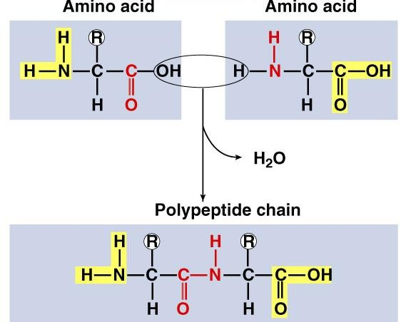
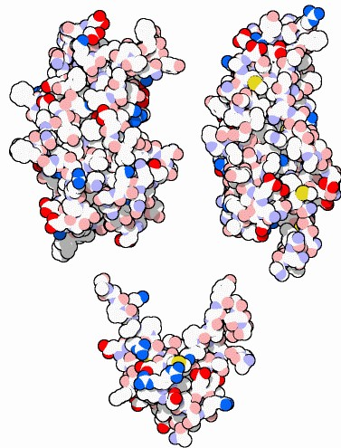
Proteins
Structure:
  monomer = amino acids
    20 different amino acids
      12 made by body
      8 essential amino acids (must get from food)
  polymer = polypeptide
    protein can be one or more polypeptide chains folded & bonded together
    large & complex molecules
    complex 3-D shape
hemoglobin
Rubisco
growth hormones

