Slide 1
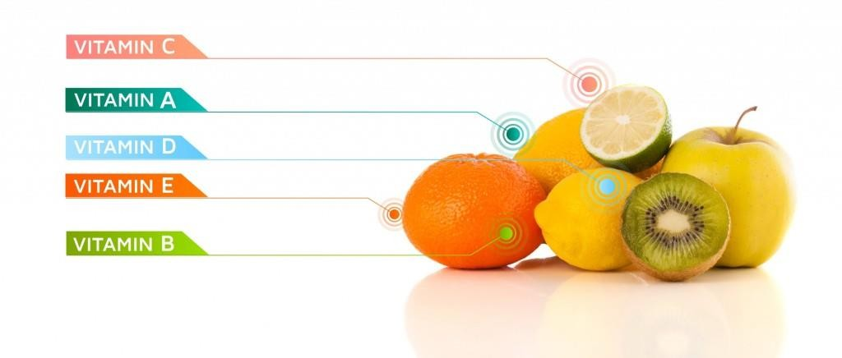
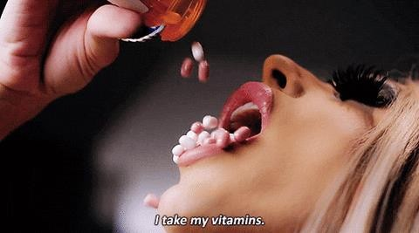
Vitamins
Dr. Navneet Kumar Singh
Associate Professor
Department of Paramedical Sciences
Sumandeep Vidyapeeth
Vadodara

Slide 2
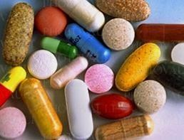


Do you really need a multivitamin supplement?

Slide 3
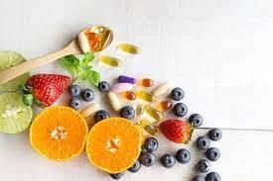
Vitamins
Any of a group of organic
compounds, which are
essential for normal
growth and nutrition and
are required in small
quantities in the diet
because they cannot be synthesized by the
body.

Slide 4

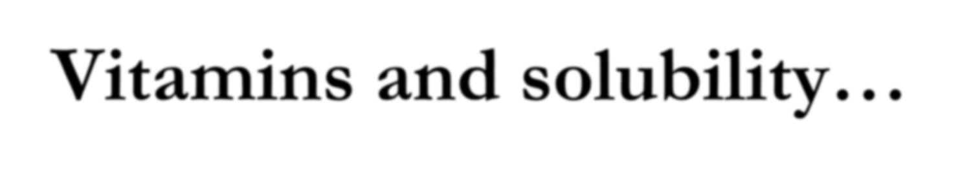
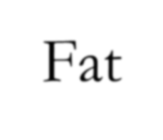

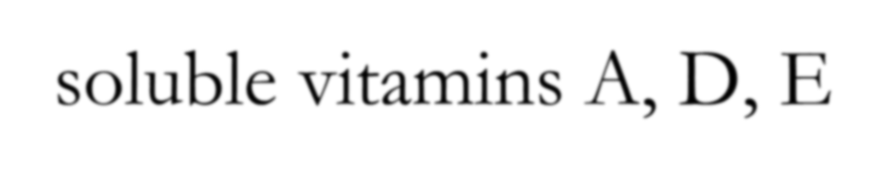

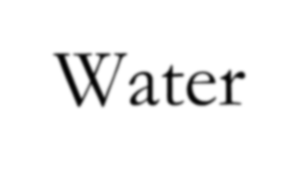
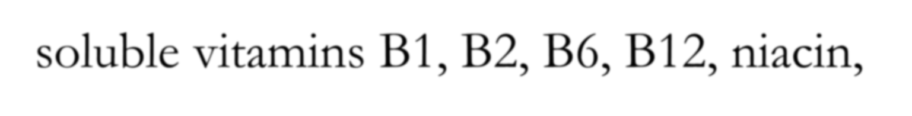


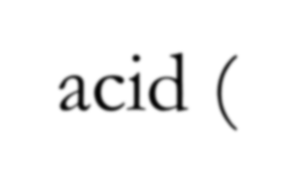
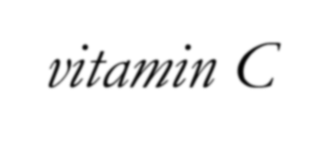

Vitamins and solubility…
Fat-soluble vitamins A, D, E
Water-soluble vitamins B1, B2, B6, B12, niacin, pantothenic acid, biotin, folic acid, and ascorbic acid (vitamin C).

Slide 5
Fat-soluble vitamins are stored in the liver and fatty tissues.
  They are not readily excreted from the
body….toxicity???
Water-soluble vitamins travel in the blood and are stored in limited amounts.
  They are readily excreted from the body through
urine.

Slide 6








Water-soluble vitamins
… B vitamins
B-1, B-2, B-3, B5, B-6, B7, B9, and B-12
Vitamin B4 Adenine

Slide 7
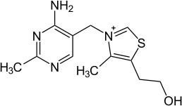
B1 (Thiamin, vitamin F)
Functions:
  Producing energy from carbohydrates
  proper nerve function
  stabilizing the appetite
  promoting growth and good muscle tone
  ATP production

Slide 8
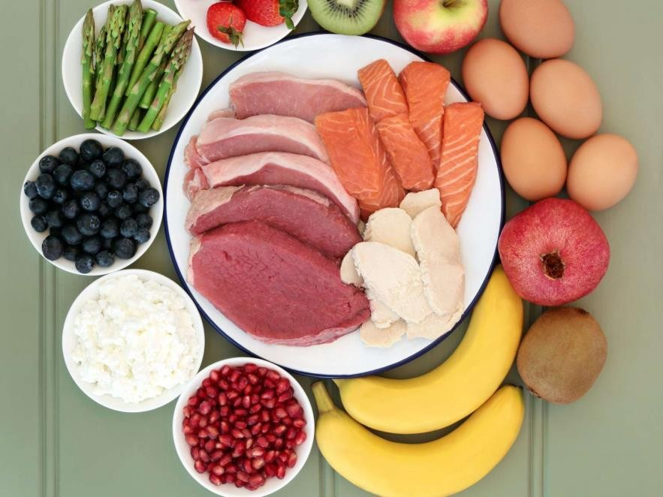
Sources
Pork
Fish
Liver
Legumes
Nuts
Whole grain or enriched breads and cereals

Slide 9

Recommendations
Men (14+): 1.2 mg/day
Women (14-18): 1.0 mg/day
Women (19+): 1.1 mg/day
  1 boiled pork chop,
  1.25 cups corn flakes
or
  1 baked potato
  0.5 cup lentils
  1 cup raisin bran

Slide 10
Deficiency
Loss of appetite
Weakness & Feeling tired
Insomnia
Loss of weight
Depression
Heart and gastrointestinal problems

Slide 11
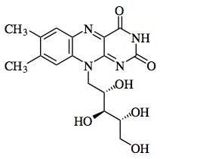
B2 (Riboflavin)
Functions:
  Energy production
  Carbohydrate, fat, and protein metabolism
  Formation of antibodies and red blood cells
  Cell respiration
  Maintenance of good vision, skin, nails, and hair
  Alleviating eye fatigue

Slide 12
B3 (Niacinamide and Niacin)
Functions:
  Energy production
  Maintenance of skin and tongue
  Improves circulation
  Maintenance of nervous system
  Health of the digestive tract

Slide 13
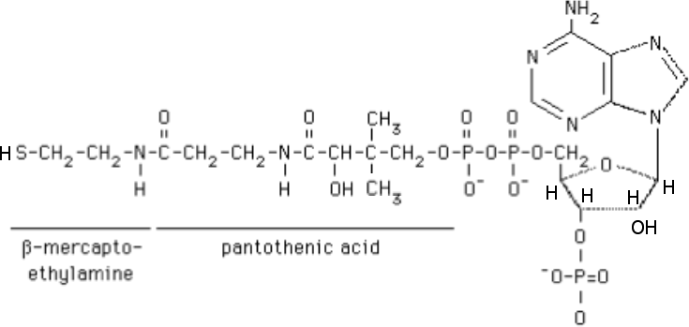
B5 (pantothenic acid)
Biosyntheis of acetyl-CoA

Slide 14
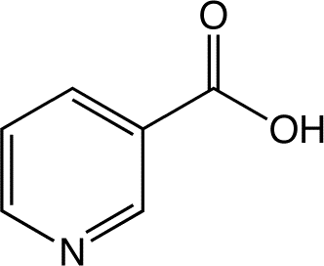
Types
  Niacinamide (nicotinamide)
    does not regulate cholesterol
  Niacin (nicotinic acid)
    highly toxic in large doses
    inosital hexaniacinate is a supplement that gives the cholesterol regulation without high toxicity
Most people get plenty of B3 from their diet because it is added to white flour.

Slide 15
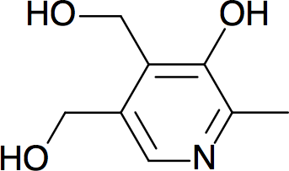
B6 (Pyridoxine)
Functions:
  Production of red blood cells
  conversion of tryptophan to niacin (B3)
  immunity
  nervous system functions
  reducing muscle spasms, cramps, and numbness
  maintaining proper balance of Na and P in the body

Slide 16
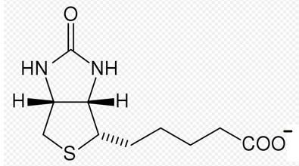

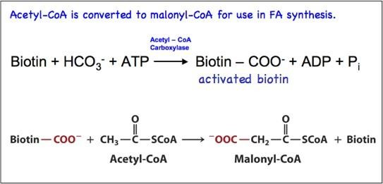
B7 (Biotin)
Fatty acid synthesis

Slide 17
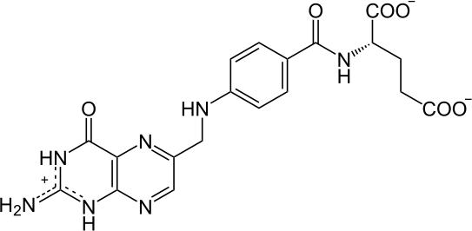
B9 (Folic acid)
Biosynthesis of glycine, methionine, nucleotides T and U
Important for rapidly dividing cells
Very important in early pregnancy. Deficiency in pregnancy causes neural tube defects

Slide 18
B12 (Cobalamin)
Functions:
  proper nerve function
  production of red blood cells
  metabolizing fats and proteins
  prevention of anemia
  DNA reproduction
  energy production?

Slide 19
Warnings
Vegetarians need to look for fortified sources (soy milk, supplements).
Elderly often have trouble absorbing.
Deficiency
  anemia
  nerve damage
  hypersensitive skin

Slide 20
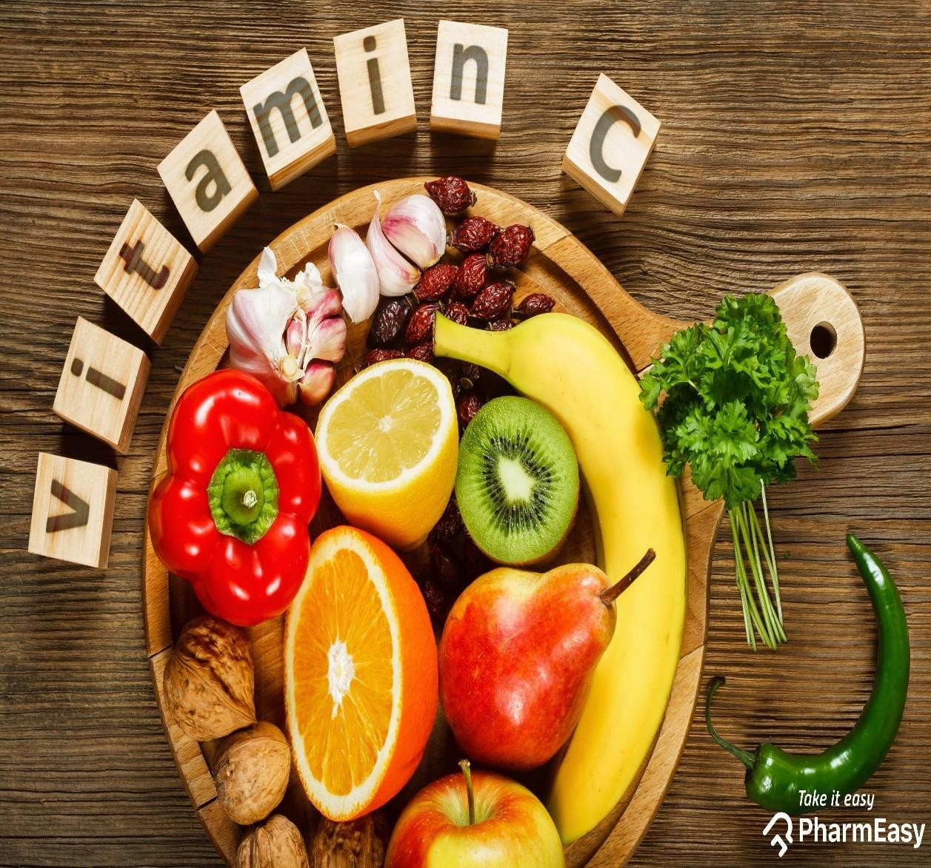

Vitamin C

Slide 21

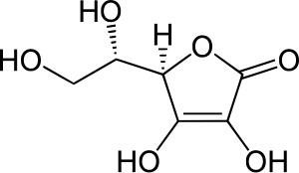
Ascorbic acid
toxic to viruses, bacteria, and some malignant tumor cells
antioxidant

Slide 22
Functions
Protects body from free radicals
helps form connective tissue that hold bones, muscles, and tissues together (collagen)
aids in the healing of wounds
aids the body in absorbing iron from plant sources
helps to keep gums healthy
helps body to fight infections
aids in the prevention of heart disease
helps prevent some forms of cancer

Slide 23
Recommended dietary intake
Men: 60mg/day
Women: 60mg/day
Pregnant women: 95mg/day
Children: 45mg/day
Increase need:
  smoking, oral contraceptives, steroids, excessive alcohol consumption, and analgesics

Slide 24
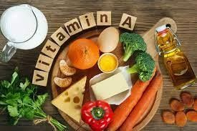
Fat-soluble vitamins
Vitamin A

Slide 25
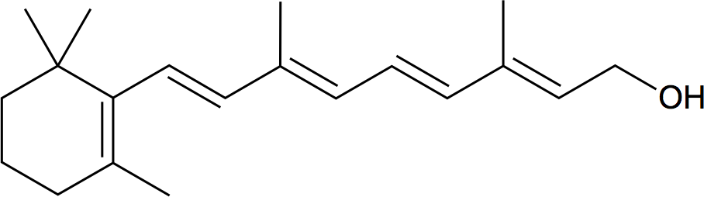
Vitamin A…what is it?
Retinol
  One of the most active, usable forms
Found in animal and plant sources

Slide 26
Functions
Vision
  Generates pigments for the retina
  Maintains surface lining of eyes
Bone growth
Reproduction
Cell division and differentiation
Healthy skin
Regulate immune system

Slide 27
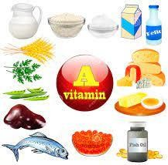
Where does it come from?
Animal sources
  Eggs
  Meat
  Cheese
  Milk
  Liver
  Kidney
  Cod
  Halibut fish oil

Slide 28
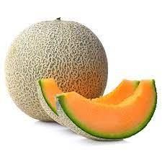
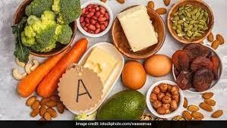
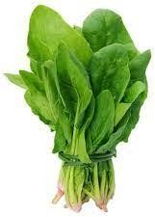
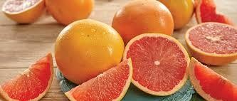
Plant sources
Carrots
Sweet potatoes
Cantaloupe
Pink grapefruit
Apricots
Broccoli
Spinach
Pumpkin

Slide 29

Most plant sources are orange or yellow in color…
Beta-carotene is precursor of vitamin A ….masked in some green plants
Deficiency...???

Slide 30
How much is enough?
Children >> 2000 – 3500 I.U.
Men >> 5000 I.U.
Women >> 4000 I.U.

Slide 31
Signs of deficiency
Night blindness
Decreased resistance to infections
Extremely dry skin, hair or nails

Slide 32
Who is at risk for deficiency?
Young children
Children with inadequate health care
Adults in countries with high incidences of vitamin A deficiency or measles
Adults or children with diseases of the pancreas, liver, intestines, or inadequate fat digestion/absorption

Slide 33
… Foods high in vitamin A
Beta-carotene
Carrot (1 raw)
IU (410% DV)
Carrot juice (1/2 c)
IU (260% DV)
Mango (1 raw)
IU (160% DV)
Sweet Potatoes (1/2 c)
IU (150% DV)
Spinach, boiled (1/2 c)
7,370 IU (150% DV)
Cantaloupe (1 c)
(100%DV)
Vegetable Soup (1 c)
(60% DV)
20,250
12,915
8,050
7,430
5,160 IU
3,005 IU

Slide 34

… just in case
~ 28g of polar bear liver contains enough vitamin A (retinol) to kill a person!

Slide 35
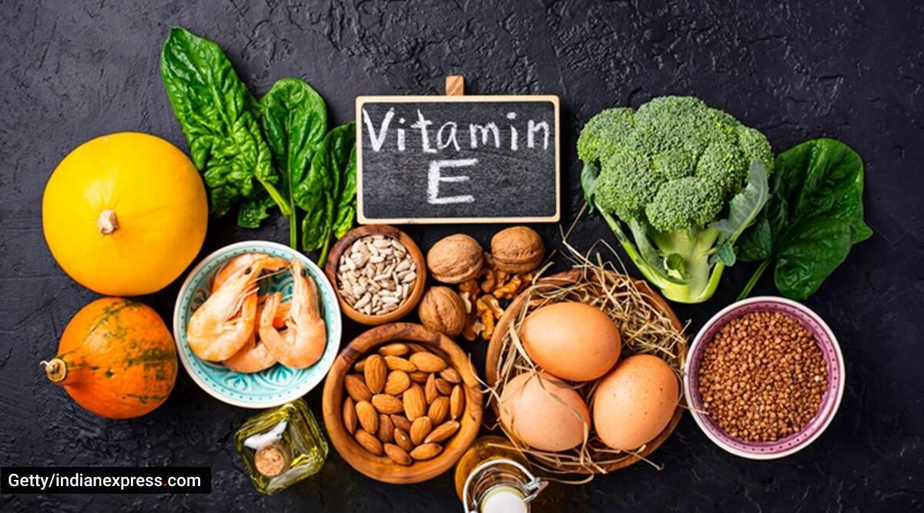
Vitamin E

Slide 36
Vitamin E
What is it?
Antioxidant
Reduce the energy of the free radical
Stop the free radical from forming in the first place
Interrupt an oxidizing chain reaction to minimize the damage of free radicals

Slide 37
Functions?
Protects cell membranes and other fat-soluble parts of the body (LDL cholesterol) from oxidation
  May reduce the risk of heart disease
  May also discourage development of some types of cancer
Promotes normal growth and development
Promotes normal red blood cell formation
Acts as anti-blood clotting agent
Plays some role in the body’s ability to process glucose and aid the process of wound healing

Slide 38
Two studies published in the New England Journal of Medicine by Harvard researchers
Of 127,000 health professionals, those who took large doses of Vitamin E had a 40% lower risk of heart disease

Slide 39
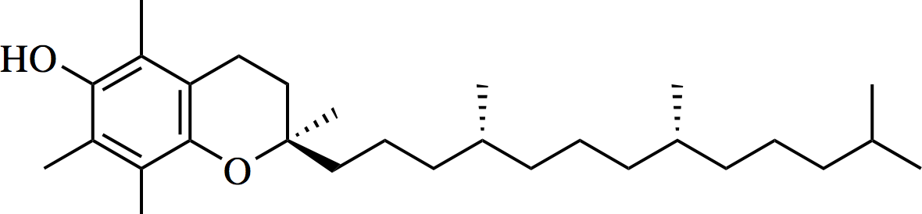
Vitamin E (8 related tocopherols)
Some differences….
Alpha tocopherol
Tocopherol
Tocopheryl (acetate, succinate)

Slide 40
Vitamin E
Sunflower seeds are the best whole food source of vitamin E, an antioxidant important to health, according to the USDA Nutrient Database. One ounce of oil-roasted sunflower seeds provides a whopping 76% of the Recommended Dietary Allowance for vitamin E.
Besides that…
“D” = natural
“DL” = synthetic

Slide 41
International unity (I.U.)
Vitamin A: 1 IU is the biological equivalent of 0.3 μg retinol,
or of 0.6 μg beta-carotene
Vitamin C: 1 IU is 50 μg L-ascorbic acid
Vitamin D: 1 IU is the biological equivalent of 0.025 μg cholecalciferol or ergocalciferol
Vitamin E: 1 IU is the biological equivalent of about 0.67 mg
D-alpha-tocopherol, or 0.9 mg of DL-alpha-tocopherol.

Slide 42

Vitamin D
“Calciferol"
Symptoms when vitamin D is low
Fatigue.
Not sleeping well.
Bone pain or achiness.
Depression or feelings of sadness.
Hair loss.
Muscle weakness.
Loss of appetite.
Getting sick more easily.

Slide 43
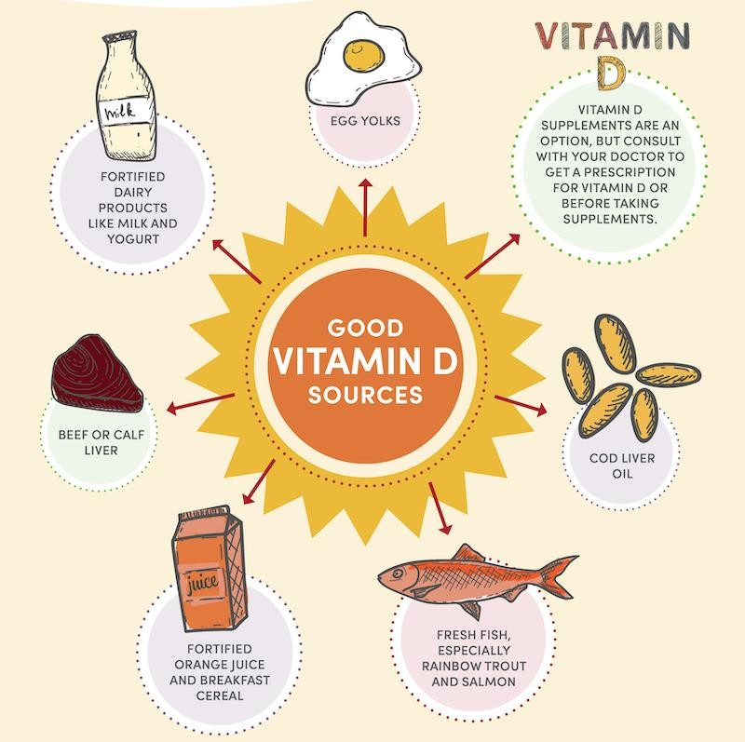

Slide 44
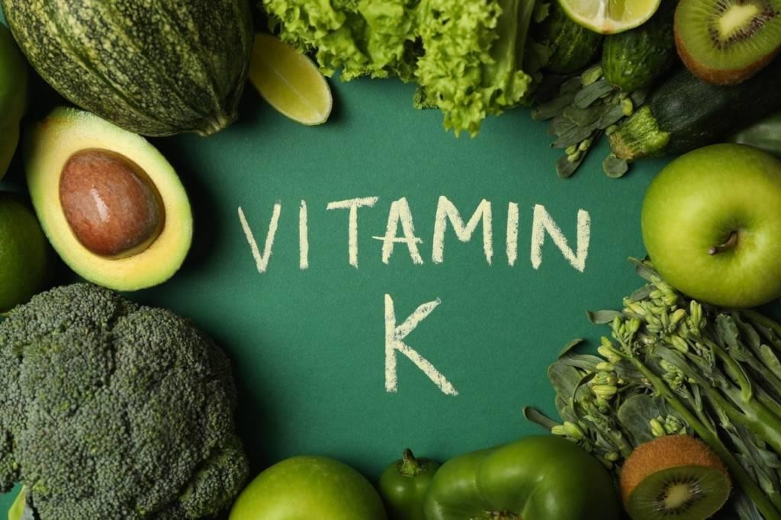
Vitamin K

Slide 45
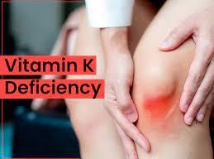
Vitamin K is a family of structurally similar, fat-soluble vitamers found in foods and marketed as dietary supplements.
The human body requires vitamin K for post-synthesis modification of certain proteins that are required for blood coagulation or for controlling binding of calcium in bones and other tissues.

Slide 46
