Slide 1
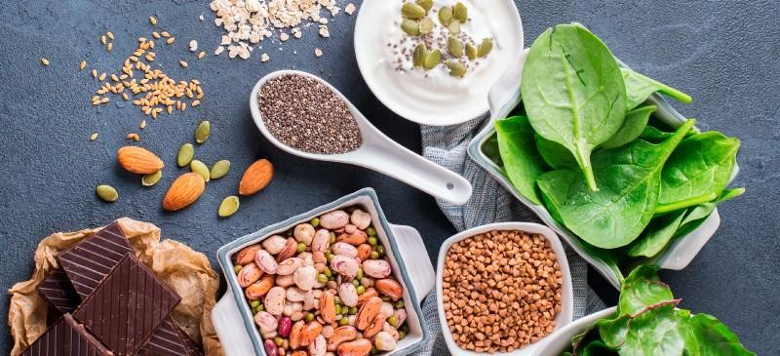
Minerals
Dr. Navneet Kumar Singh
Associate Professor SVDU, Vadodara

Slide 2
Minerals
Minerals are those elements on the earth and in foods that our bodies need to develop and function normally.
Those essential for health include
calcium, phosphorus, potassium, sodium, chloride,
magnesium, iron, zinc, iodine, chromium, copper, fluoride, molybdenum, manganese, and selenium.

Slide 3
Minerals
Inorganic elements
Absorption and transport vary
Can be toxic
Variable bioavailability
Nutrient interactions (mineral-mineral and vitamin-mineral)

Slide 4
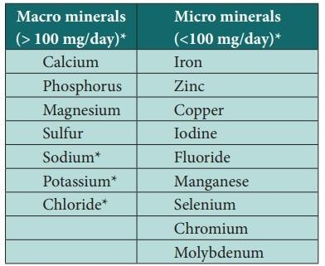
Classification of Minerals

Slide 5

Who is Cap. KS Naclmg?
The Macrominerals
Calcium Ca
Phosphorous P
Potassium K
Sulfur S
Sodium Na
Chlorine Cl
Magnesium Mg

Slide 6
Major Minerals >100 mg/day
Electrolytes—sodium, potassium, chloride
Bone growth and maintenance— calcium, magnesium and phosphorus
Sulfur

Slide 7
Trace Minerals <100 mg/day
Iron, zinc, iodine, selenium,copper,
Chromium, manganese, fluoride, chromium and molybdenum

Slide 8
Fluid and Electrolyte balance
Dissociation of salt in water=electrolyte solution
Positive ions are cations and negative ions are anions
Positive and negative charges balance inside and outside the cell
Count charges in milliequivalents

Slide 9
Fluid and electrolyte balance
Dissociation of water
Electrolytes attract water
Water follows electrolytes
Osmosis is when water moves across a membrane toward more concentrated solutes (proteins regulate flow)

Slide 10
Regulation of fluid and electrolyte balance
Amounts and variation of minerals in body must remain constant
Regulation occurs in GI tract and kidneys
Liver recycles 8 liters of fluids/minerals per day
Kidneys depend on adrenal glands to regulate sodium and potassium

Slide 11
Regulation of blood pressure
Blood pressure drops =renin excreted; kidneys reabsorb sodium
Angiotensin excreted= vasoconstrictor
Aldosterone and sodium retention= retain more sodium and water
High sodium diets aggravate hypertension through water retention (interstitial spaces)

Slide 12
Electrolytes
Cations (positively charged) Calcium (Ca++) Extracellular
Sodium (Na+) Intracellular
Potassium (K+) and Magnesium (Mg++)

Slide 13
Electrolytes
Anions (negatively charged ions)
  Extracellular
    Chloride (Cl⁻)
  Intracellular
Phosphate (HPO ⁻⁻)
4
Bicarbonate (HCO ⁻)
Sulfate (SO ⁻⁻)
3
4

Slide 14
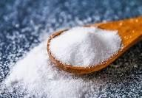
Sodium (Na⁺)
Minimum requirement = 500 mg/day
Chief Functions = extracellular cation
  maintains normal fluid & electrolyte balance; assists in nerve impulse transmission & muscle contraction
Deficiency - rare
  muscle cramps, mental apathy
Toxicity
  edema, acute hypertension
Food Sources

Slide 15
Salt in the diet –are you salt sensitive?
Salt retains water
High sodium intake leads to high blood pressure
Recommend 2400 mg per day
You will adapt to a low-sodium diet

Slide 16
Chloride
Minimum requirement = 750 mg/day
Function = major anion of extracellular fluid
  maintains normal fluid & electrolyte balance; part of HCl-
Deficiency
  not seen
Toxicity
  vomiting

Slide 17
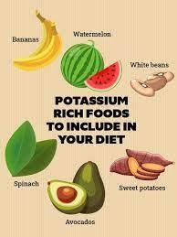
Potassium (K⁺)
Minimum requirement = 2000 mg/day
Function = intracellular cation
  maintains normal fluid & electrolyte balance; facilitates many reactions; assists in nerve impulse transmission & muscle contraction.
Deficiency
  muscular weakness, paralysis, confusion
Toxicity
  muscular weakness, vomiting, heart

Slide 18
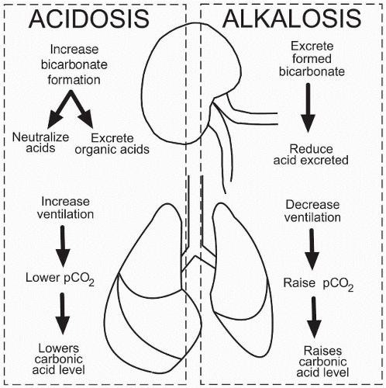
Acid-Base balance
Bicarbonate (base) and carbonic acid (acid) and proteins act as buffers to prevent changes in fluids’ acid-base balance
Kidneys select which ions to retain and which to excrete
Body’s remains urine’s fluctuates
total acid level
constant,
acidity (H+) to
accommodate balance

Slide 19
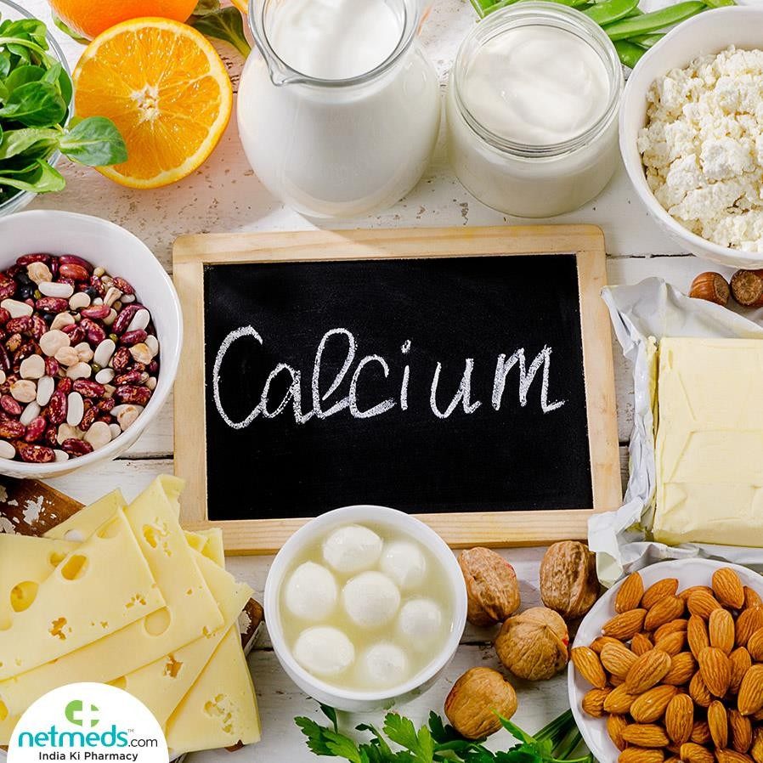
Calcium
Adequate Intake = 1000 - 1200 mg/day
Food sources
  dairy, dark green vegetables, fish w/ bones, tofu w/ calcium citrate, fortified foods
Function
  mineralization of bones & teeth
  muscle contraction
  nerve function
  blood clotting

Slide 20
How is blood calcium regulated?
Blood level is maintained at the price of bone calcium
Parathyroid hormone - increases blood calcium
  Retain calcium from excretion
  Increase calcium absorption via increase calcitriol
  Increase calcium release from bone
Lower blood calcium
  Decrease parathyroid hormone and calcitriol
  Calcitonin

Slide 21
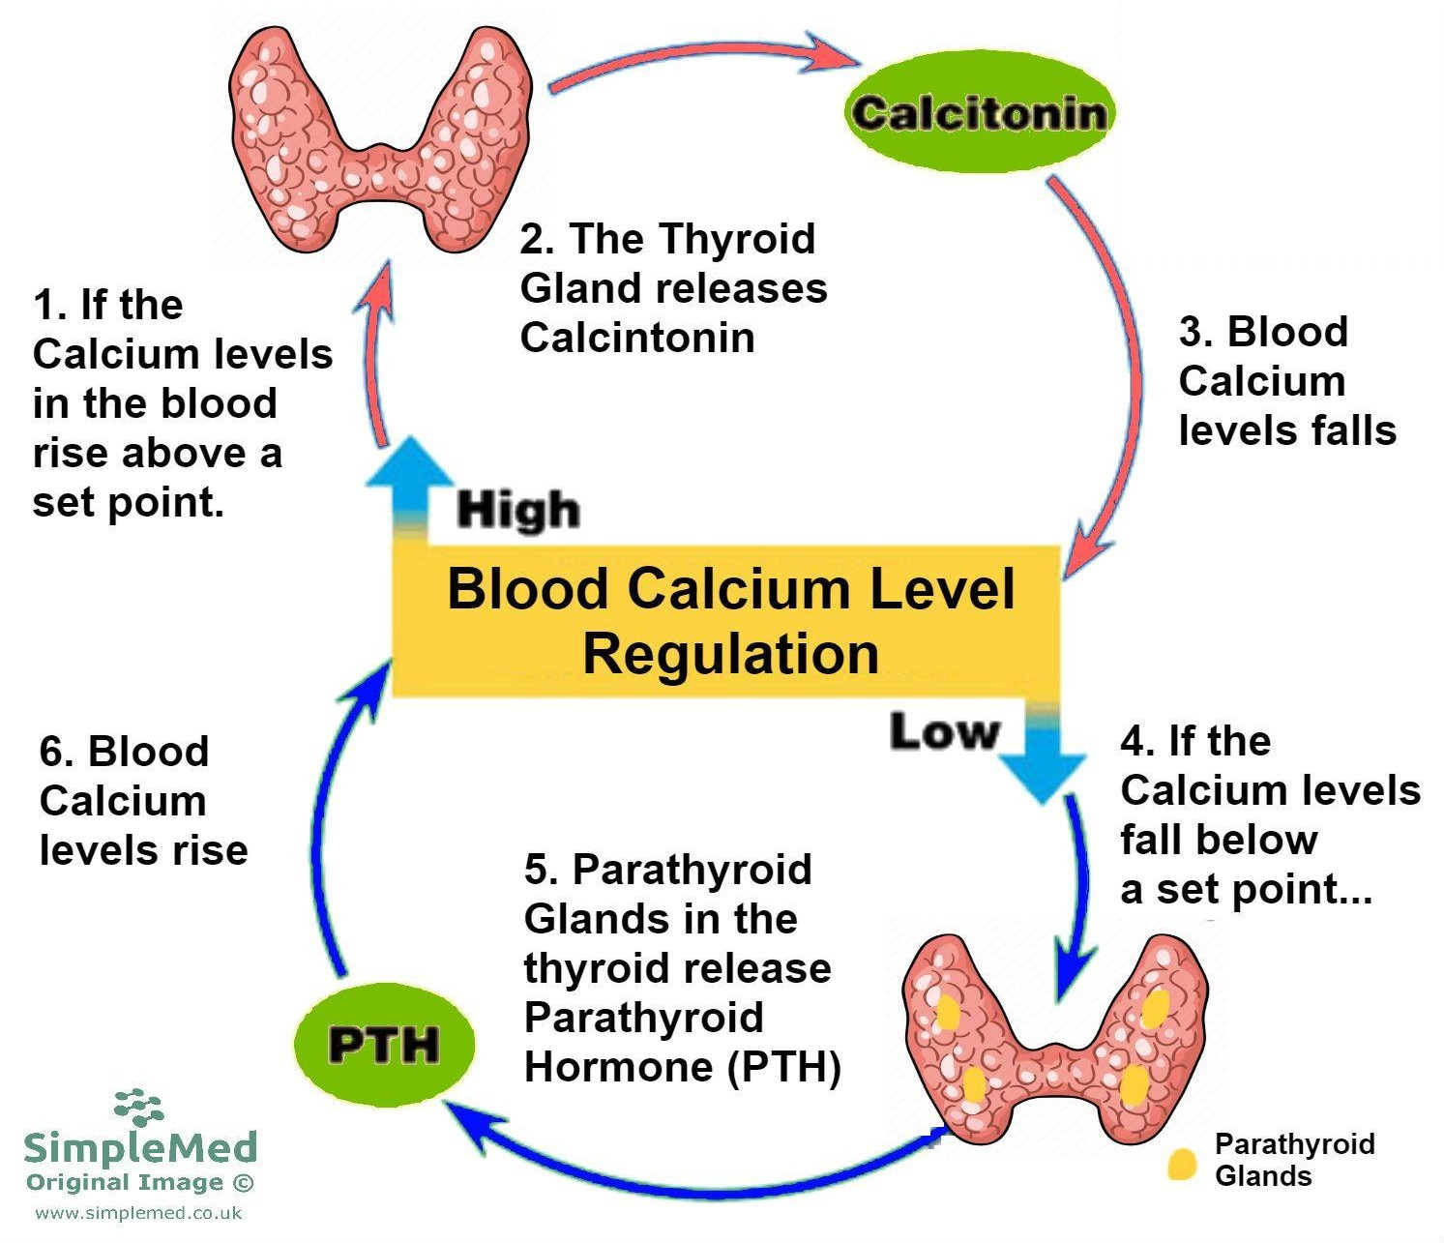

Slide 22
Effects of Chronically Low Calcium Intake
Deficiency
  stunted growth, osteoporosis
Increase in Blood Parathyroid Hormone Concentration-- Persistent
Increase in Bone Resorption, Hence Bone Turnover
Reduction in Bone Mineral Content (BMC) and Density (BMD)
Increased Risk of Fracture of Trabecular and Cortical Bone Tissue in Bones
Increased Risk of Osteoporotic Fractures

Slide 23
Factors that enhance calcium absorption
Stomach acid
Vitamn D
Lactose
Growth hormone

Slide 24
Factors that inhibit calcium absorption
Lack of stomach acid
Vitamin D deficiency
High phosphorus intakes
High fiber diet
Phytates in seeds, nuts and grains
Oxaltates in greens

Slide 25
Most common % calcium)
Calcium supplements
Enhance absorption
Calcium carbonate (40% calcium)
  Found in antacids
Calcium citrate (21due to acidity content
Toxicity
  constipation, increased risk of urinary stone formation & kidney dysfunction

Slide 26
Calcium supplements
Risk of lead toxicity w/ supplementation
  No FDA regulation
  Oyster shell/ Bonemeal
  Look for United States Pharmacopoeia seal of approval
Supplement should include magnesium; ample vitamin D in the diet

Slide 27
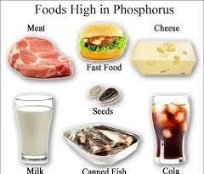
Phosphorus
1997 RDA = 700mg/day
Function
  mineralization of bones & teeth, part of every cell, part of phospholipids, used in energy transfer & in buffering system
Deficiency
  weakness & bone pain
Toxicity
  low blood calcium levels

Slide 28
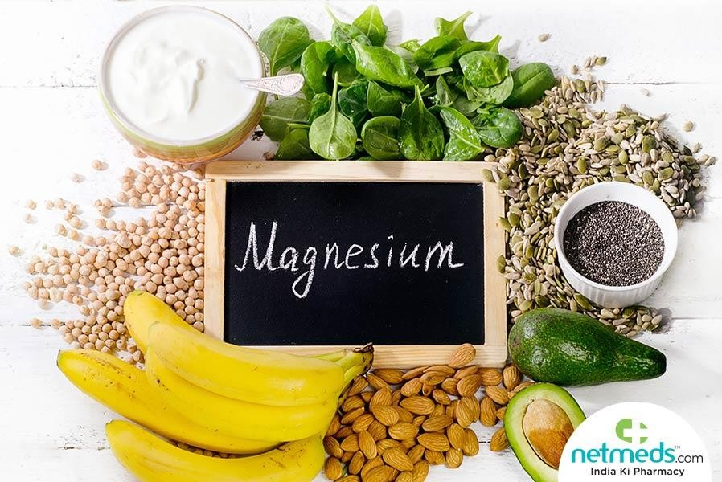
Magnesium
1997 RDA 310 - 400 mg/day
Function
  bone mineralization, building of protein, enzyme action, muscle contraction; protects against hypertension and heart disease
Deficiency
  weakness, confusion, convulsions, growth failure
Toxicity
  not known

Slide 29
Magnesium intake
Average dietary estimates fall below recommendations
Water may contribute some (“hard” water
contains Ca++ and Mg++)
Legumes, seeds and nuts, spinach, broccoli and dairy

Slide 30
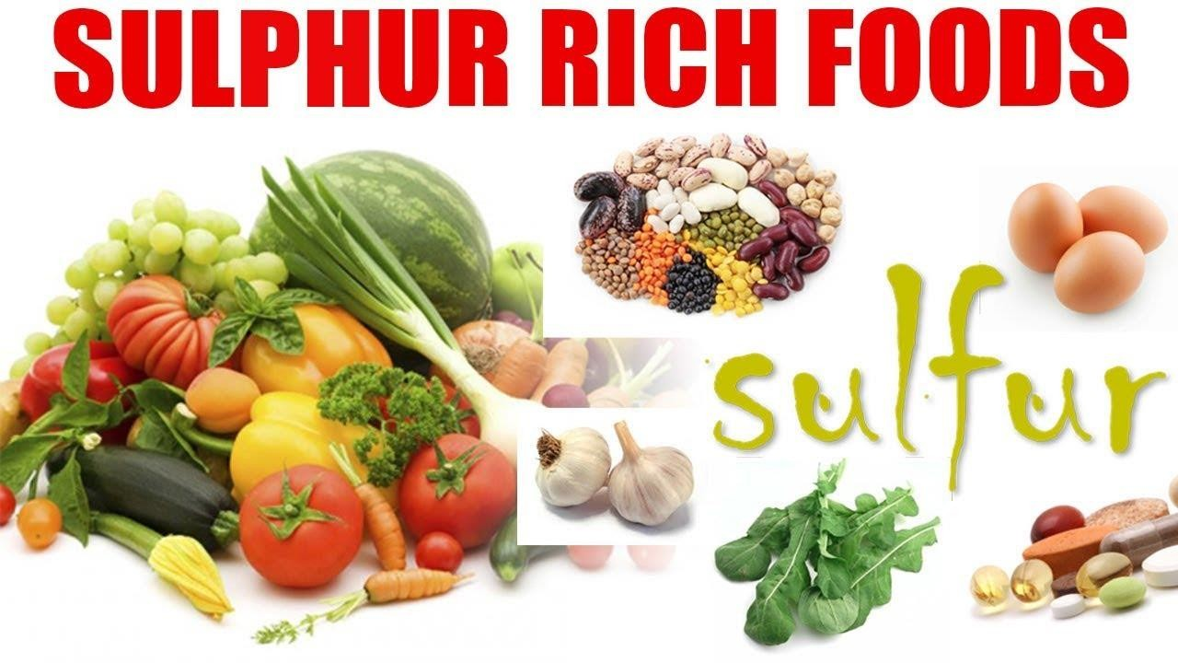
Sulfur
Function
  part of proteins, biotin, thiamin
and insulin
Deficiency
  none known
Toxicity
  depresses growth
Sources
  all protein foods

Slide 31
I Cu FeSe Mn Mozn!
What’s that supposed to mean?
The Microminerals Iodine (I) Copper (Cu) Iron (Fe) Selenium (Se)
Manganese (Mn) Molybedenum (Mo) Zinc (Zn)

Slide 32
Copper (Cu)
Function: should be present in animal tissues for iron to be properly utilized, hemoglobin formation and synthesis of keratin for fair and wool growth.
Deficiency signs: poor pigmentation of feathers, stringy wool, sway back lambs, lack of muscle coordination and anemia.
Sources: forages and copper salts.

Slide 33
Iron (Fe):
Function: essential for the function of every organ and tissue of the body (Hemoglobin).
Deficiency signs: seldom occurs in older animals, nutritional anemia, labored breathing and pale eyelids, ears and nose.
Sources: forages and copper or trace mineral salts. Meat, fish, poultry contribute the most
Legumes and eggs are also good sources Grain foods vary depending on enrichment Dark greens contribute some
Men usually get enough but women may be low

Slide 34

Iron Absorption
Iron Sources to meet RDA 10 - 15 mg/day
  heme iron (meat sources)
    absorption >20%
      meat fish protein factor (MFP)
  nonheme iron (veg & meat sources)
    absorption 2-20%
      Enhance absorption: vitamin C -keeps non-heme iron reduced, as does citric acid, lactic acid, HCl from the stomach, sugars
      Iron deficiency
      Inhibit absorption: phytates & fiber, calcium & phosphorus, EDTA, tannic acid - bind iron
      Pica

Slide 35
Iron Toxicity
Iron Overload = tissue damage
  hemochromatosis
  hemosiderosis
  worsened by ETOH, vit C
Iron & Heart Disease - inconclusive
Iron & Cancer
Iron Poisoning - 200 mg Fe has led to death of young children (5 tablets)
Constipation

Slide 36
Cobalt (Co)
Function: required as a nutrient for the microorganisms in ruminants and thereby aids in rumen synthesis of Vitamin B₁₂. Because swine cannot manufacture B₁₂ from cobalt, the diets are supplemental with vitamin B₁₂ instead.
Deficiency signs: lack of appetite, loss of weight, rough hair coat, anemia, decreased milk and wool production and death in extreme cases.
Sources: legume forages and salt containing cobalt.

Slide 37
Magnesium (Mg)
Function: similar to calcium and phosphorus.
Deficiency signs: Animals are irritable, their heart beat is irregular and there is severe kidney damage.
Sources: mineral supplements and ordinary feeds.

Slide 38
Zinc (Zn)
Function
  cofactor for over 100 enzymes
    helps make DNA/ RNA, helps manufacture heme, helps release vit A from stores, helps metabolize CHO, synthesize proteins, metabolize ETOH...
Absorption & metabolism
  cell storage binding protein = metallothionein
    metallothionein also bind copper
  transport protein = albumin
  transferrin also binds zinc
Excretion via feces

Slide 39
Zinc RDA = 12 to 15 mg/day
Deficiency - growing & elderly
  growth retardation
  arrested sexual maturation
  diarrhea
  poor taste, appetite, impaired immune response
Toxicity—UL 40 mg/day
  >2 gm vomiting, diarrhea, …
  a few mg per day decreases copper leading to heart degeneration & heart disease

Slide 40
Zinc in foods
Protein containing foods
Whole grains, vegetables
Fibers and phytates in cereals bind zinc, limiting absorption
Zinc interactions with iron and copper

Slide 41
Iodine in food, Iodide in body
Function
  part of the hormone thyroxin (T3 & T4)
    regulates body temperature, metabolic rate, reproduction, growth, blood cell production, nerve & muscle fxn, ...
RDA = 150 micrograms/day
  iodized salt, seafood, plant & animals from soil
Deficiency
  Goiter leading to sluggishness & weight gain
  during pregnancy leads to cretinism (MR)
Toxicity > 2000 micrograms
  goiter

Slide 42
Iodine food sources
Antithyroid substance goitrogen
Ocean is world’s major source of iodine
Iodine content of foods further inland
Amount generally reflects the amount in soil
Iodization of salt has eliminated wide spread deficiency

Slide 43
Selenium
Function
  antioxidant working w/ vit E
RDA = 55 to 70 micrograms/day
  seafood, meat, grains
Deficiency
  heart disease from virus
  cancer - lacking evidence
Toxicity
  vomiting, diarrhea, loss of hair & nails,
skin lesions and NS problems

Slide 44

Copper
Function
  many reactions - like iron in metabolic reactions related to release of Energy
RDA = 1.5 - 3.0 mg/day
Deficiency rare
  genetic disorder = Menkes can’t release
copper into the blood so life threatening
Toxicity
  genetic disorder = Wilson’s disease copper accumulates in liver & brain (give chelating agents such as zinc)

Slide 45
Food sources of Copper
Richest sources are legumes, whole grains, nuts, shellfish, organ meats and seeds.
Over half is absorbed
Major route of elimination is bile
Water may provide copper

Slide 46
Manganese
Function
  cofactor of many enzymes
RDA = 2-5 mg/day in most foods
Deficiency rare
  phytates, iron & calcium inhibit absorption
Toxicity
  brain disease

Slide 47

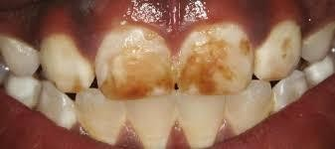
Fluoride
Function
  forms fluorapatite in place of hydroxyapatite crystals in bone
AI 3.1 to 3.8 mg/day TUL = 10 mg/day
Deficiency
  dental carries
Toxicity
  fluorosis (mottled teeth)

Slide 48
Chromium
Function
  CHO & Lipid metabolism
AI = 50-200 microgram/day
Deficiency
  ?diabetes like syndrome
Toxicity
  damage skin & kidneys
  supplements chromium picolinate
Others
  Nickel, Silicon, Vanadium, Cobalt

Slide 49
Molybdenum
Function
  facilitator of many enzymes
AI = 75 - 260
microgram/day
Deficiency
  rare
Toxicity rare
  gout like symptoms w/ exposure

