Slide 1
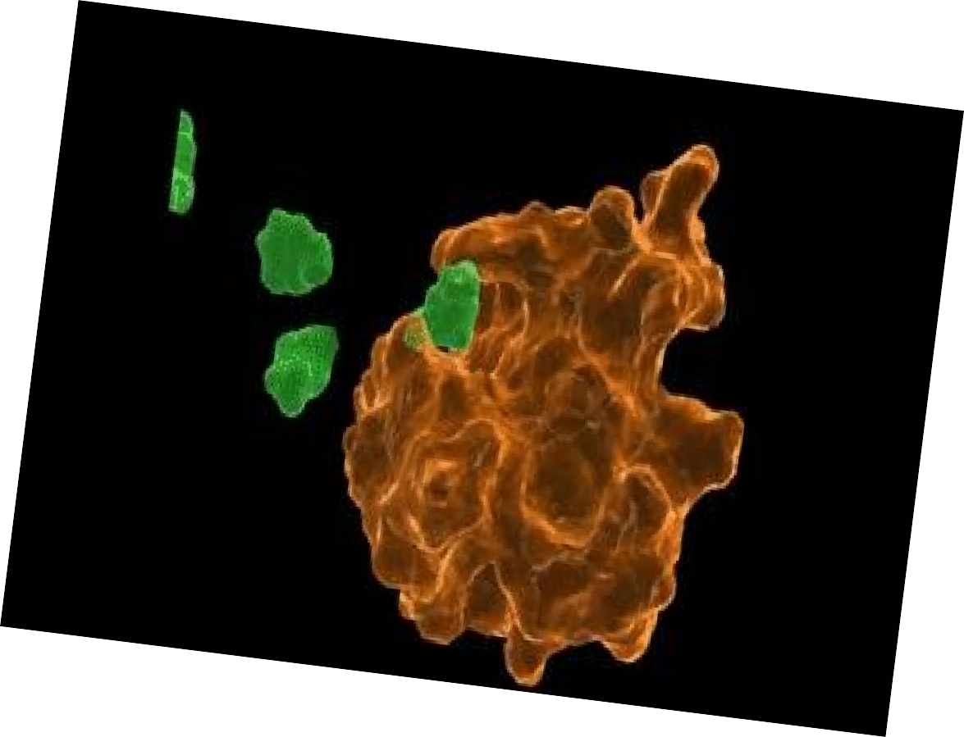






Enzymes

Slide 2

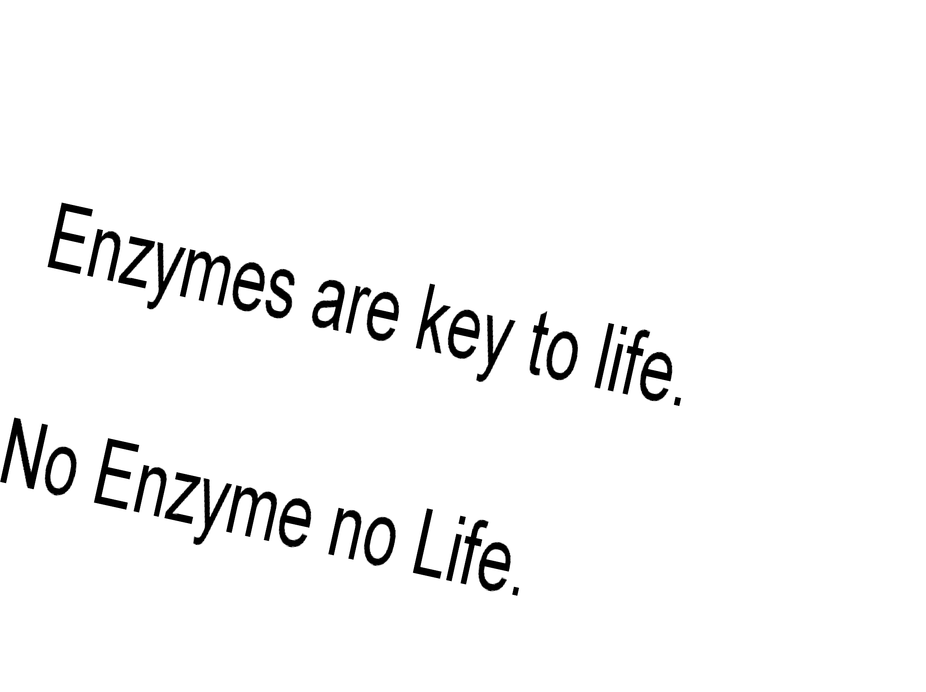

Slide 3
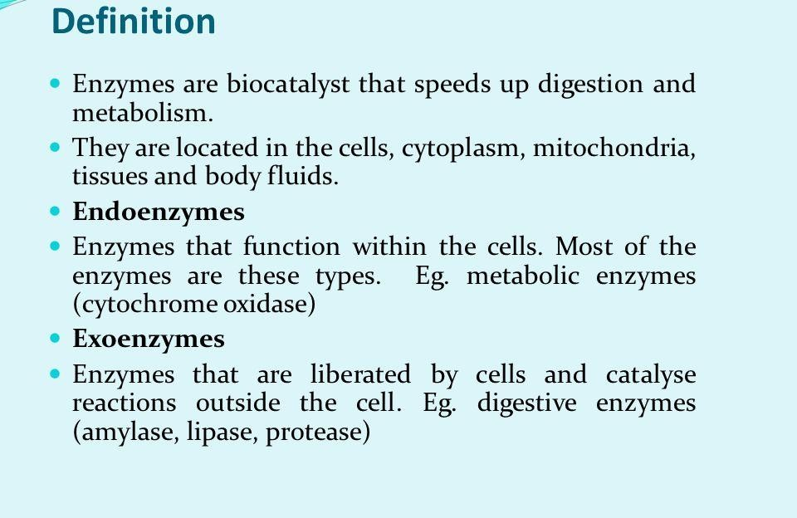
What is an enzyme?
Enzymes are proteins that act upon substrate molecules and decrease the activation energy
necessary chemical
for a
reaction to
occur by stabilizing the
transition stabilization reaction
state. This
speeds up
rates and
makes them happen at physiologically significant rates.

Slide 4
Enzymes are protein in nature (?)
Globular protein.
Ribozymes are RNA molecule with enzymatic activity.
Catalytic behaviour of any enzyme depends upon its primary, secondary, tertiary or quaternary structure.
Enzymes of digestive tract and those found in blood are present in inactive form called zymogen or proezymes.

Slide 5
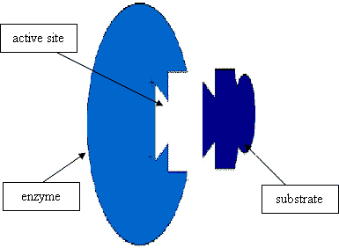
Active site
Enzymes are composed of long chains of amino acids that have folded into a very specific three-dimensional shape which contains an active site.
An active site is a region on the surface of an enzyme to which substrates will bind
and catalyses a chemical reaction.

Slide 6
Enzymes are highly specific for the type of the reaction they catalyze and for their substrate.

Slide 7
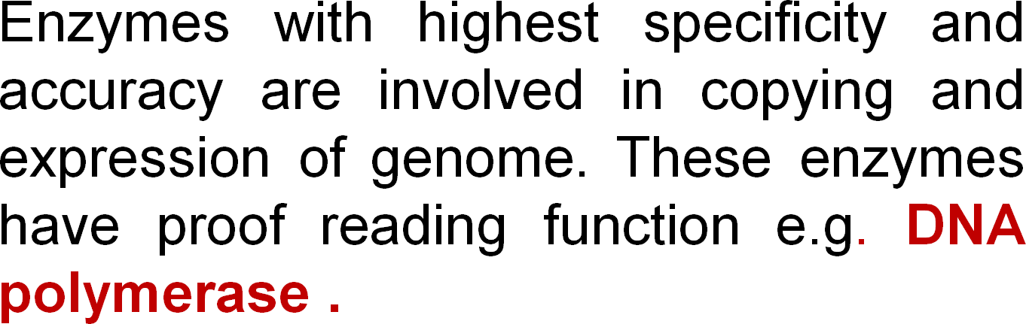

Slide 8
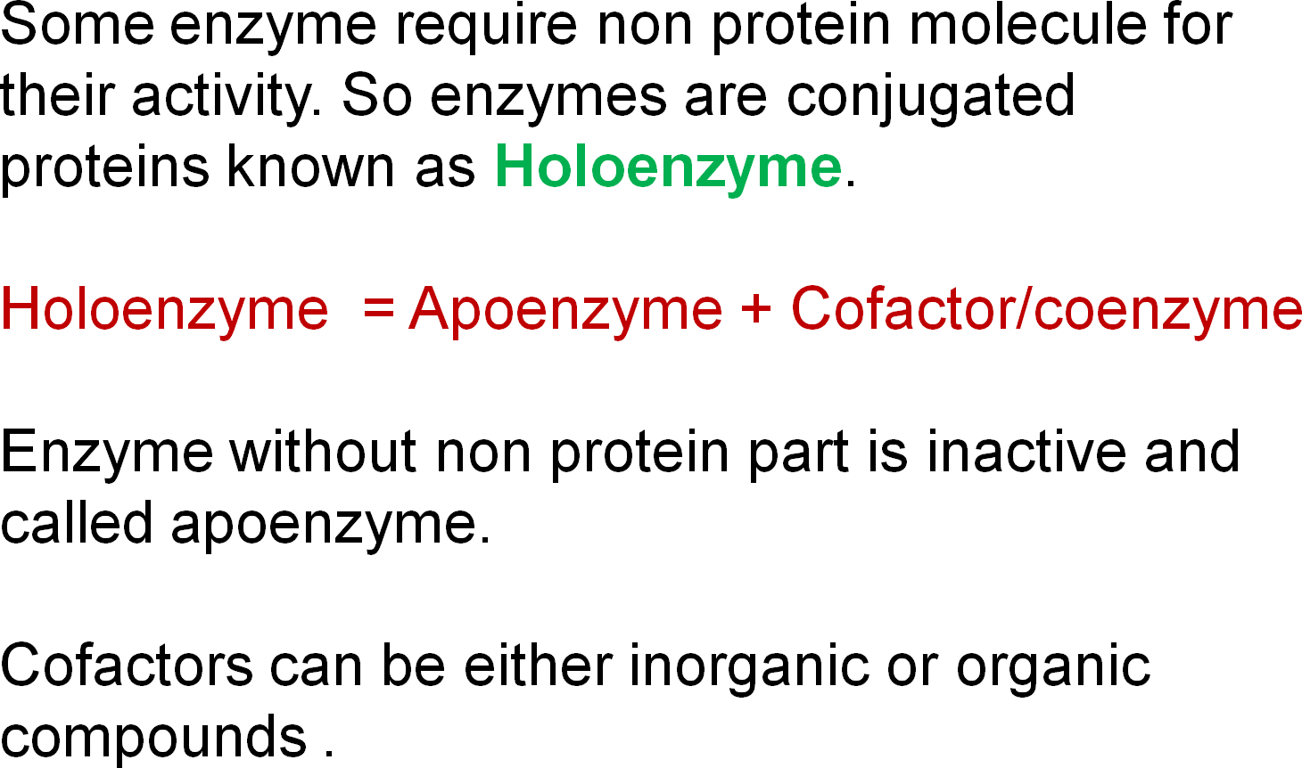

Slide 9
Mechanism of enzyme action
The enzymatic reactions takes place by binding of the substrate with the active site of the enzyme molecule by several weak bonds.
E + S ‹--------› ES --------› E + P
Formation of ES complex is the first step in the enzyme catalyzed reaction then ES complex is subsequently converted to product and free enzyme.

Slide 10
"Lock and key" or Template model

Slide 11
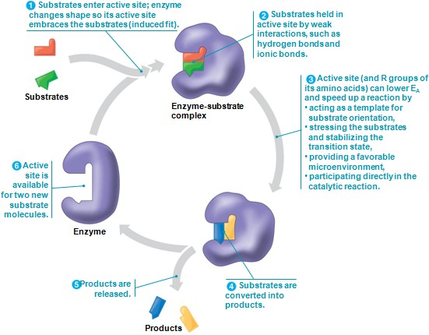
Induced-fit model

Slide 12
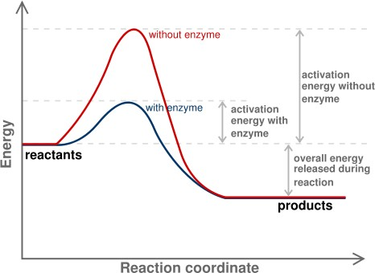
e.g. H₂O₂
e.g. O₂ + H₂O
Progress of Reaction

Slide 13
Nomenclature / enzyme classification
IUBMB has recommended system of nomenclature for enzymes & according to them each enzyme is assigned with two names:
Trivial name (common name, recommended
name).
Systemic name ( official name ).

Slide 14
^{S}E^{y}a^{s}ch^{te}en^{m}zy^{i}m^{c}e^{n}isªc^{m}har^{e}acterized by a code no.called Enzyme Code no. or EC number and contain four
Figure (digit) separated by a dot.
e.g. EC m. n. o. p
First digit represents the class; Second digit stands for subclass ;
Third digit stands for the sub-sub class or subgroup; Fourth digit gives the serial number of the particular enzyme in the list.
e.g. EC 2.7.1.1 for hexokinase.

Slide 15
Systemic name………
According to the IUBMB system of enzyme nomenclature enzymes are grouped into 6 major classes
EC 1 OXIDOREDUCTASES
EC 2 TRANSFERASES
EC 3 HYDROLASES
EC 4 LYASES
EC 5 ISOMERASES
EC 6 LIGASES
-

Slide 16
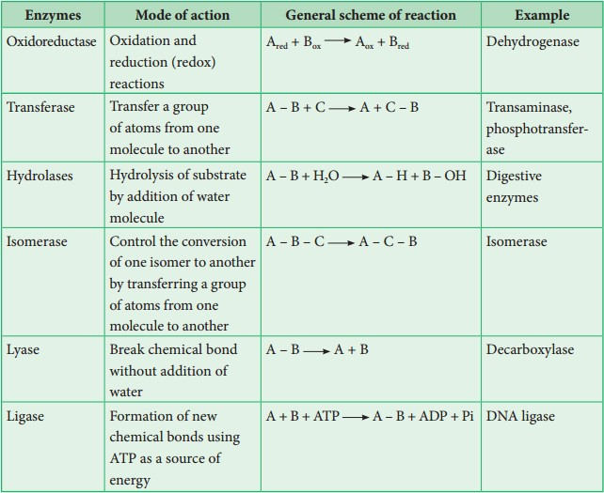

Slide 17
Factors affecting reaction velocity
Temperature
Hydrogen ion concentration (pH) Substrate concentration Enzyme concentration
Products of the reaction Presence of activator/inhibitor Allosteric effects
Time

Slide 18
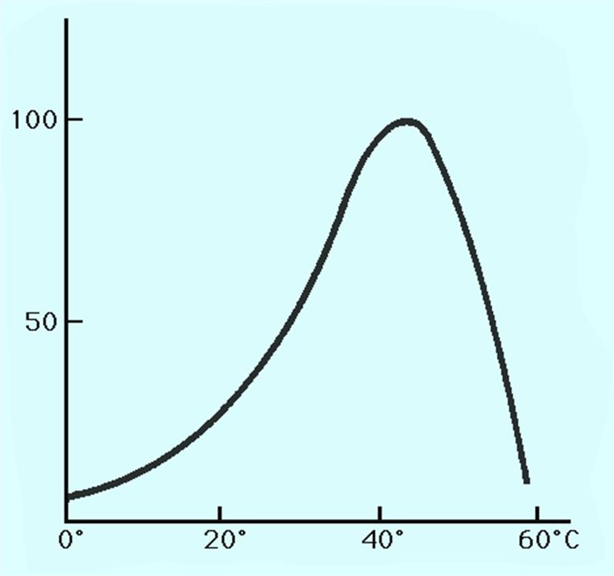
Effect of Temperature
Reaction Velocity (v0)
Temperature(ºC)

Slide 19
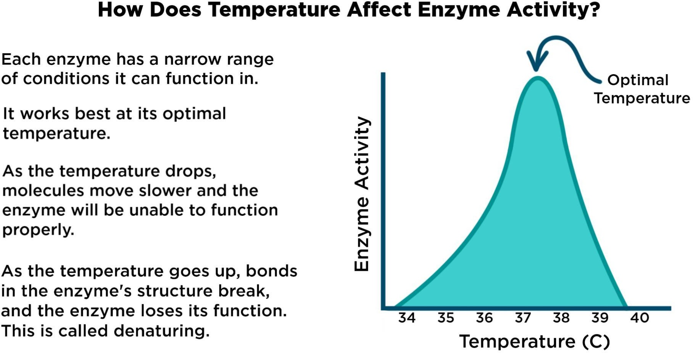

Slide 20
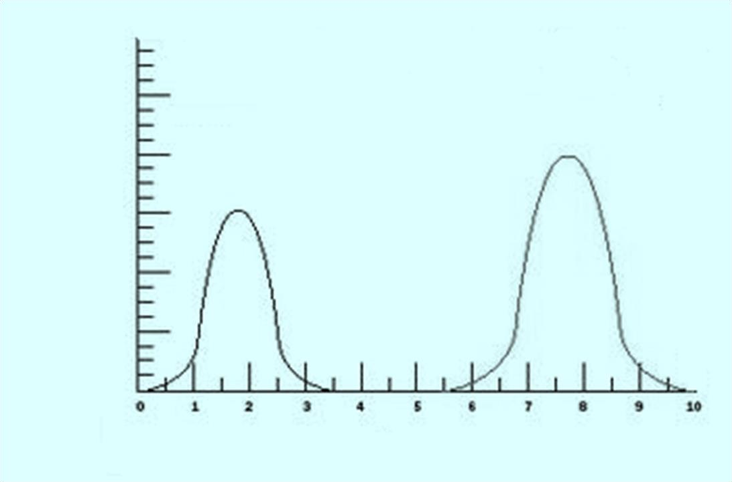
Effect of pH
Trypsin
Pepsin
Reaction Velocity (v0)
q
r
pH

Slide 21
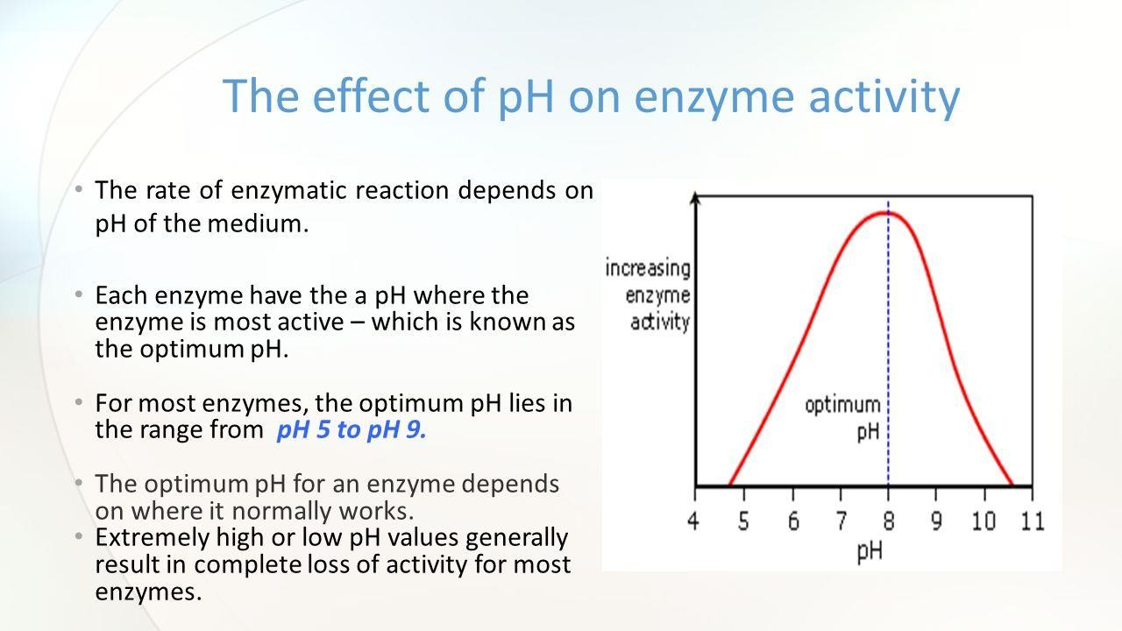

Slide 22
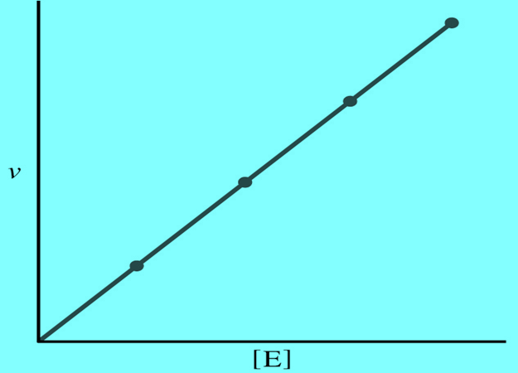
Rate of the reaction or velocity is directly propostional to the Enzyme Concentration when sufficient substrate is present.
Accumulation of Product in a reaction causes inhibition of enzyme activity.

Slide 23
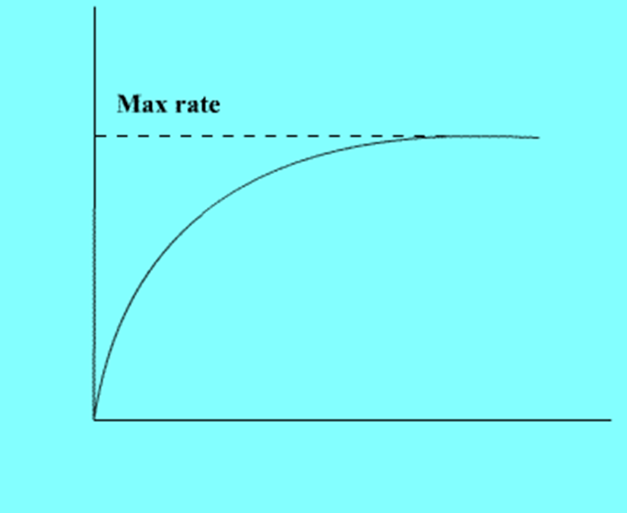
Effect of Substrate Concentration
Reaction Velocity (v0)
Substrate Concentration/arbitrary Units

Slide 24
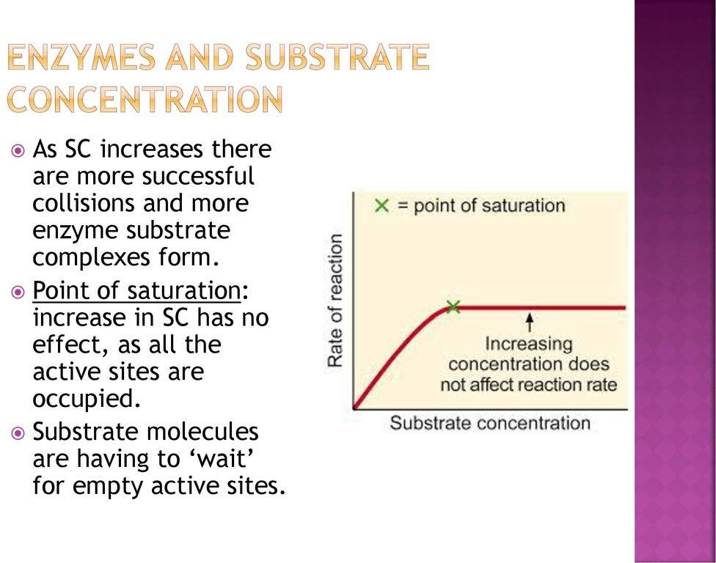

Slide 25
Enzyme Kinetics
Study of reaction rate
and how they to change in is known as
changes in response
experimental parameter
kinetics.
Amount of substrate present is one of the key factor affecting the rate of reaction catalyzed by an enzyme in vitro.

Slide 26
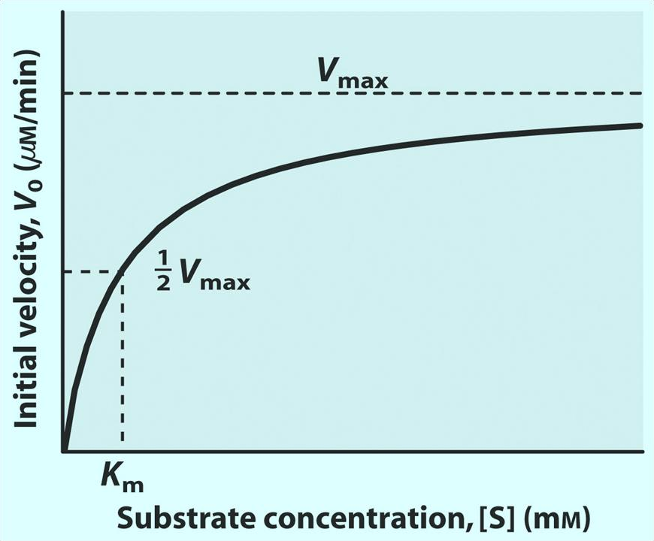
Effect of Substrate Concentration on Reaction Velocity

Slide 27
The m_{M}o_{i}d_{c}e_{h}l i_{a}nv_{e}o_{l}l_{i}v_{s}e₋s _{M}on_{e}e _{n}su_{t}b_{e}s_{n}tra_{K}te_{i}m_{n}o_{e}l_{t}e_{i}c_{c}u_{s}le,
k₁ k₂
E + S ‹-------------› ES ------------ › E + P
^{k}-1
Where
S is the substrate
E is the enzyme
K₁, k₋₁ and k₂ are the rate constants

Slide 28
The mathematical equation that defines the quantitative relationship between the rate of an enzyme reaction and the substrate concentration is the Michaelis-Menten equation:
V_{max} [S]
V₀ = ------------- K_{m} + [S]
V₀ is the observed velocity at the given [S] K_{m} is the Michaelis-Menten constant
K_{m} = (K₋₁ + K₂) / K₁
V_{max} is the maximum velocity at saturating [S] conc.

Slide 29
Lineweaver-Burk (double reciprocal) plot
A linear representation is more accurate and convinient for determining V_{max} and K_{m}.
This equation is reciprocal of both Menton equation.
1/[S] vs. 1/V_{o}
obtained by taking the side of Michelis-

Slide 30
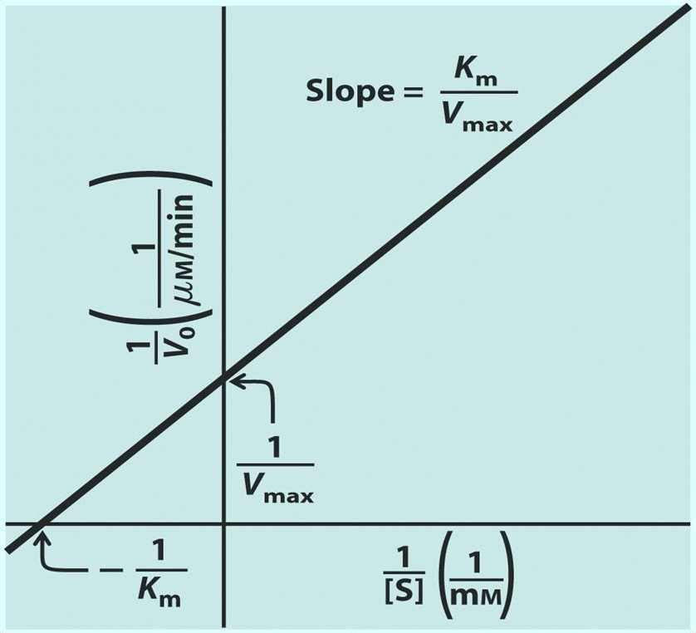
Lineweaver-Burk (Double Reciprocal) Plot
1 ₌ K_{m} 1 ₊ 1
v V_{max} [S]
^{V}max

Slide 31
Any subs^{E}ta^{n}nc^{z}e^{y}t^{m}ha^{e}t c^{I}a^{n}n^{h}d^{i}im^{b}i^{i}n^{t}iºsh^{n}the velocity of an enzyme catalyzed
These include drugs, antibiotics, poisons, and anti-metabolites.
Useful in understanding the sequence of enzyme catalyzed reactions, metabolic regulation, studying the mechanism of cell toxicity produced by toxicants.
Forms the basis of drug designing.

Slide 32
Types of Enzyme Inhibiton
Reversible inhibitors
Irreversible inhibitors

Slide 33
Reversible inhibitors can be classified into :
Competitive
Non-competitive
Un-competitive

Slide 34
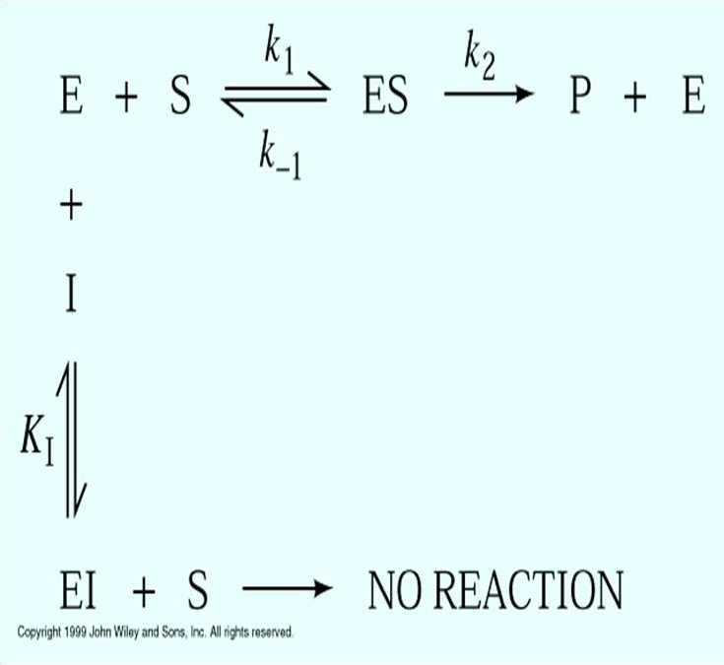
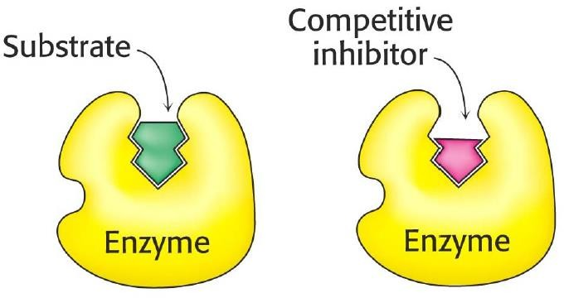
Competitive Inhibition

Slide 35
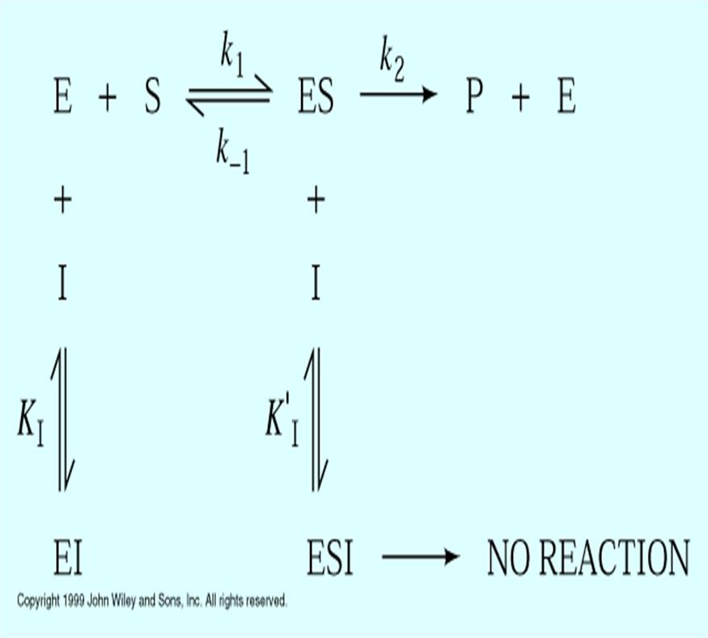
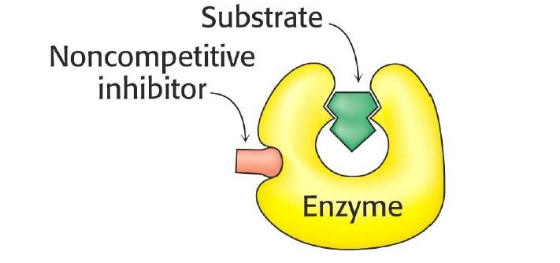
Non-Competitive Inhibition

Slide 36
Un-competitive Inhibiton
Binds only to the enzyme-substrate complex.
Does not have the capacity to bind to the free enzyme.
Not overcome by increasing concentration.
Both the K_{m} and V_{max} are reduced.
substrate

Slide 37
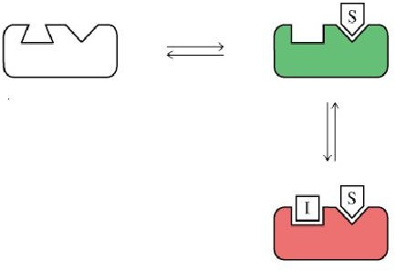
Un-competitive Inhibiton
ES Complex
Enzyme
+ Inhibitor
ESI complex

Slide 38



Enzyme Inhibition (Plots)
I
Competitive ^{I} Non-competitive ^{I} Uncompetitive
^{V}max ^{V}max
^{V}max
^{V}max’
v_{o}
v_{o}
Direct Plots
I I
^{V}max’
I
K_{m} K_{m}’ [S], mM
V_{max} unchanged
K_{m} increased
K_{m} = K_{m}’ [S], mM
V_{max} decreased
K_{m} unchanged
K_{m}’ K_{m}
[S], mM
Both V
max
& K decreased
m
Double Reciprocal
1/v_{o}
I
1/v_{o}
I
1/v_{o}
I
Two parallel
lines
Intersect
at Y axis
1/ V_{max}
Intersect at X axis
1/ V_{max}
1/ V
max
1/K_{m}
1/[S]
1/K_{m}
1/[S]
1/K_{m}
1/[S]

