Slide 1
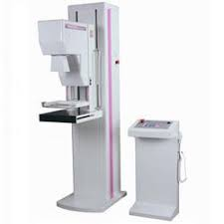
MAMMOGRAPHY
Dr. Jayapandiyan
Dept of Paramedical Sciences

Slide 2
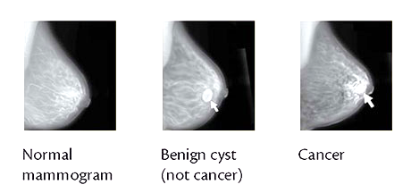
Definition:
Mammography is a specific type of imaging that uses a low-dose x-ray system for examination of breasts.
Mammograms are X-ray images of the breast that can reveal early signs of breast cancer.
Common uses of the procedure:
Diagnostic mammography is used to evaluate a patient with abnormal clinical findings , such as a breast lump or lumps that have been found by the woman or her doctor.

Slide 3
Breast cancer screening programs depend on x-ray mammography because it is a low-cost, low-radiation-dose procedure that has the sensitivity for early detection and improved treatment.
There are two techniques for creating a mammogram. Film-screen mammography creates a photographic film, while digital mammography creates digital images.
Both methods use the same procedure for taking the image.
The person having the mammogram will place their breast between two clear plates, which will squeeze it between them to hold it in place. This flattens the breast for a better image and stops the image from blurring.

Slide 4
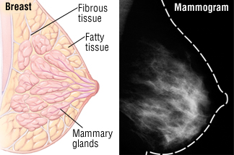
The machine takes a picture of the breast from two angles.
A specialist then checks the mammogram for anything unusual that could be a sign of Cancer
The test takes about 20 minutes. Some people may feel slight pain or discomfort.
How does a normal mammogram
look?
The image of the breast is known
as a mammogram. The background
of the image will be black, and the
breast will show up in grays and whites.
Tissue that is denser, including connective tissue and glands, shows up white.

Slide 5
Some people have more dense tissue in their breasts. This can make it harder to detect abnormalities on a mammogram as a tumour is made up of dense tissue and will also appear white.
The breasts tend to become less dense with age.
Less dense tissue, such as fat, shows up grey on a mammogram.
More white on the image does not always indicate a health problem.
Everyone's breasts are different, so no two mammogram images will be the same.
Healthy mammograms can still vary in appearance.

Slide 6
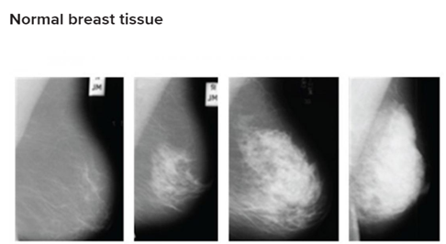
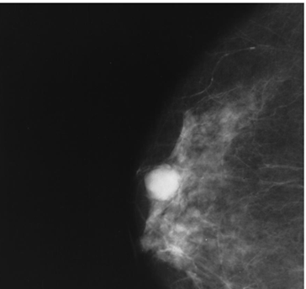
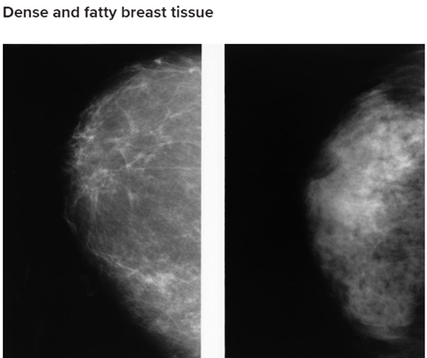
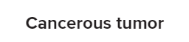
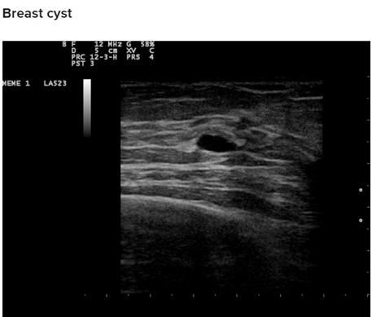

Slide 7
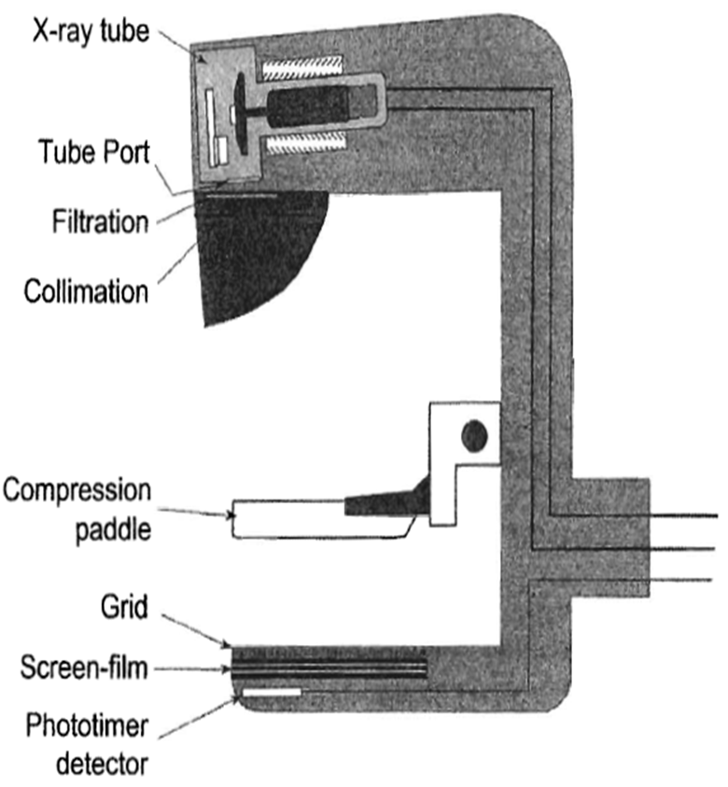
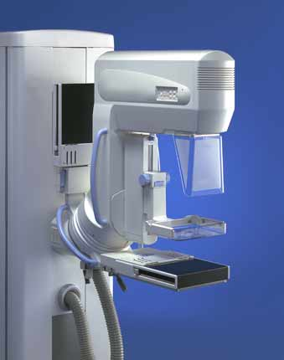
Mammography equipment:
A mammography unit is a rectangular box that houses the tube in which x-rays are produced.
The unit is dedicated equipment because it is used exclusively for x-ray exam of the breast , with special accessories that allow only the breast to be exposed to the x-rays.
Attached to the unit is a device that holds and compresses the breast and positions it so images can be obtained at different angles.

Slide 8
X-ray Tube Design
Cathode and Filament Circuit
  Low operating voltage
    below 35 – 40 kVp
    Typically 23 or 24 kVp at the lowest
  Typical tube currents are
    100 mA (+/- 25 mA) for large focal spot
    25 mA (+/- 10 mA) for small focal spot
Anode
  rotating anode design
  Molybdenum (Mo), and dual track molybdenum/rhodium (Mo/Rh) targets are used
  For molybdenum, characteristic radiation occurs at 17.5 and 19.6 keV
  For rhodium, 20.2 and 22.7 keV

Slide 9
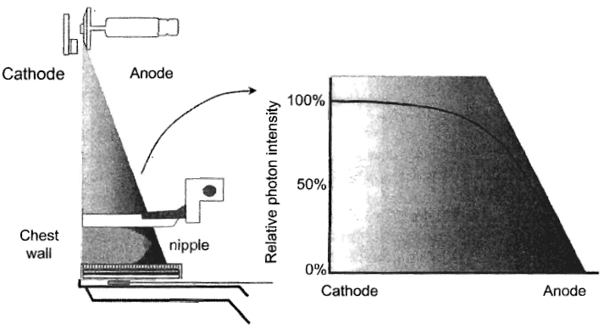
  A source to image distance (SID) of 60 to 66 cm typically used
  The tube is tilted by about 25 degrees to minimize the effective focal spot size
  Thus cathode-anode axis is placed from the chest wall (greater penetration of x-rays) to the nipple in breast imaging
  A more uniform exposure is achieved

Slide 10
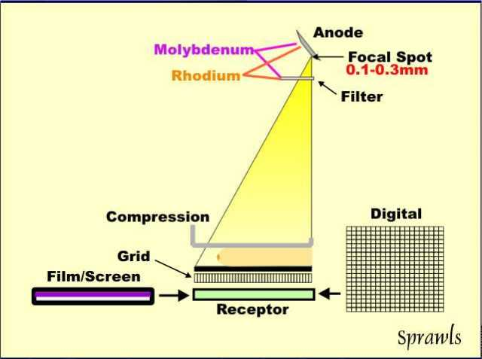
Anti - Scatter Grid
Grids are used to reject scatter.
The grid is placed between the breast and the image receptor.
Organic fiber or carbon fiber are typical interspace materials.
Carbon fiber is preferred because aluminum would attenuate too many of the low-energy x-rays used in mammography

Slide 11
Tube Port, Tube Filtration and Beam Quality
  1-mm thick Beryllium used as the tube port
    Beryllium provides both low attenuation and good structural integrity
  Added tube filters of the same element as the target reduce the low- and high-energy x-rays in the x-ray spectrum and allow transmission of characteristic x-ray energies
  Common target/filters in mammography include
    Mo/Mo
    Rh/Rh
    Mo/Rh

Slide 12
Tube Port, Tube Filtration and Beam Quality
A Mo target with Rh filter are common for imaging thicker and denser breasts
This combination produces slightly higher effective energy than Mo/Mo
Provides 20 and 23 keV leading to increased penetration of thick and/or dense breasts
Rh target with Rh filter provides the highest effective energy beam
2 to 3 keV - higher

Slide 13
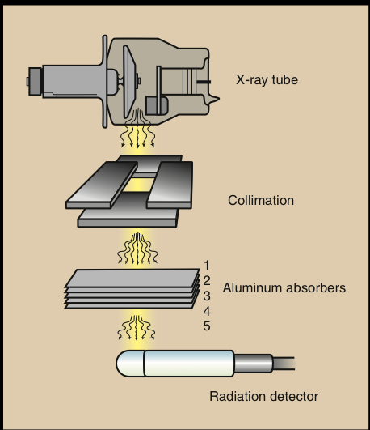
Half Value Layer (HVL)
The half value layer (HVL) measures the quality or intensity of the beam.
The HVL of an x-ray beam is defined as the amount of absorbing material that is needed to reduce the beam to half of its original potential.
HVL is an indirect measure of photon energy or beam hardness

Slide 14
The HVL ranges from 0.3 to 0.45 mm Al in mammography .
It depends on kVp, compression paddle thickness, added tube filtration, target material and age of tube.
HVL increases with higher kVp and higher atomic number targets and filters.
Breast dosimetry relies on accurate HVL measurement
The approximate HVL in breast tissue strongly dependent on tissue composition: glandular, adipose and fibrous.

Slide 15
Generator
A dedicated mammography x-ray generator is similar to a standard x-ray generator in design and function. Differences exist in
  Generator power rating is 3 kW
  The voltage supplied to the x-ray tube (22-40 kVp)
High-frequency generators are the standard for mammography

Slide 16
Automatic Exposure Control (AEC)
The AEC, also called a phototimer, uses a radiation sensor (or sensors), an amplifier, a voltage comparator, to control the exposure
AEC detector is located underneath the cassette in mammography unlike conventional radiography
Normal X Ray AEC

Slide 17
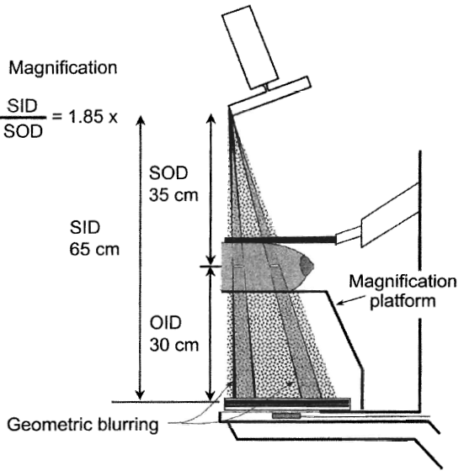
Magnification
Advantages
  Magnification of 1.5x to 2.0x is used
  Increased effective resolution of the image receptor by the magnification factor
  Small focal spot size used
  Reduction of scatter

Slide 18
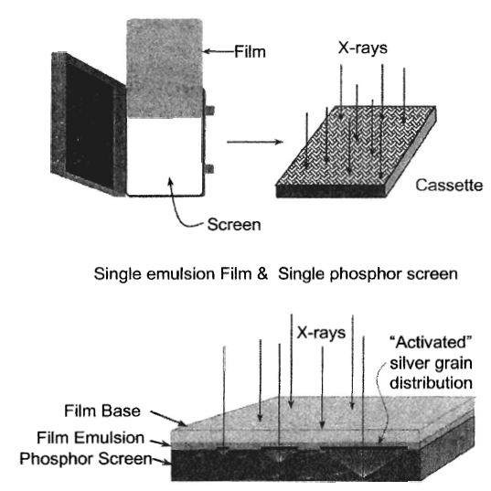
Screen-Film Cassettes
Cassettes have a single phosphor screen and single emulsion film
Mammography screen-film speeds (sensitivity):
  regular (100 speed)
  (12-15 mR required)
  medium (150 – 190 speed)
For comparison, a conventional “100-speed” screen film cassette requires about 2 mR
The sensitivity of a photographic medium (e.g., a radiograph) to light or radiation. The film speed is determined by: the size of its silver halide crystals; the thickness of the emulsion; and the presence of radiosensitive dyes. Higher speed less exposure.

Slide 19
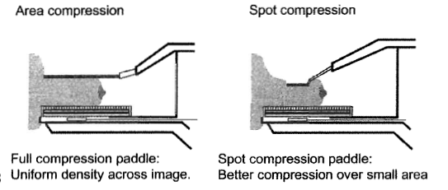
Compression
Compression is achieved with a low attenuating Lexan paddle attached to a compression device
10 to 20 Newtons (22 to 44 pounds) of force is typically used
A flat, 90°paddle (not curved) provides a uniform density image
Parallel to the breast support table
Spot compression uses small paddles
Principal drawback of compression is patient discomfort

Slide 20
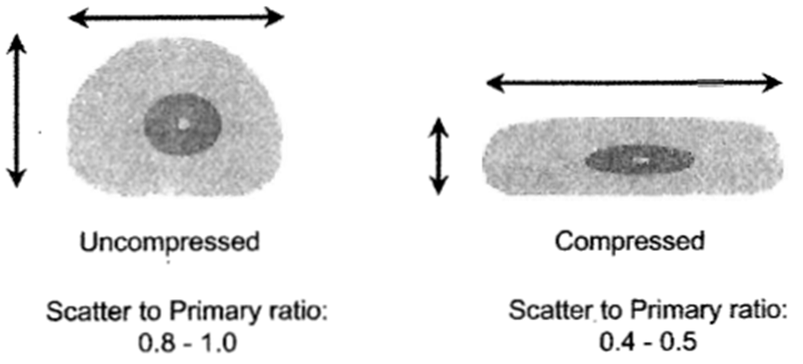
Breast compression is necessary in order to:
Press out the breast thickness so that all of the tissue can be visualized;
Spread out the tissue so that small abnormalities won't be obscured by overlying breast tissue;
Allow the use of a lower x-ray dose since a thinner amount of breast tissue is being imaged;
Hold the breast still in order to eliminate blurring of the image caused by motion;
Reduce x-ray scatter to increase sharpness of picture.

Slide 21
Preparation for a mammogram:
Remove deodorant , talcum powder ,
or lotion under the arms or
on breasts on the day of the exam.
(These can appear on the x-ray film as
calcium spots.)
Patient must describe any breast symptoms or problems to the technologist performing the exam.
Previous mammograms must available to the radiologist at the time of the current exam.
In addition , before the examination , the patient asked to remove all jewelry and clothing above the waist and will be given a gown that opens in the front.

Slide 22
Risks and Benefits
Based on AGD of 3 mGy, the increased breast cancer risk from radiation is 6 per million examined women
This is equivalent to dying in an accident when traveling 5000 miles by airplane or 450 miles by car
Screening in 1 million women is expected to identify 3000 cases of breast cancer.
The breast cancer mortality rate is about 50%.
Screening would reduce the mortality rate by about 40%.
That would potentially mean 600 lives being saved due to screening.
The benefits of getting a mammogram far outweigh the risks associated with the radiation due to the mammogram.

Slide 23
THE END

