Slide 1
BLOOD PUMP
MS. PRACHI SHAH

Slide 2
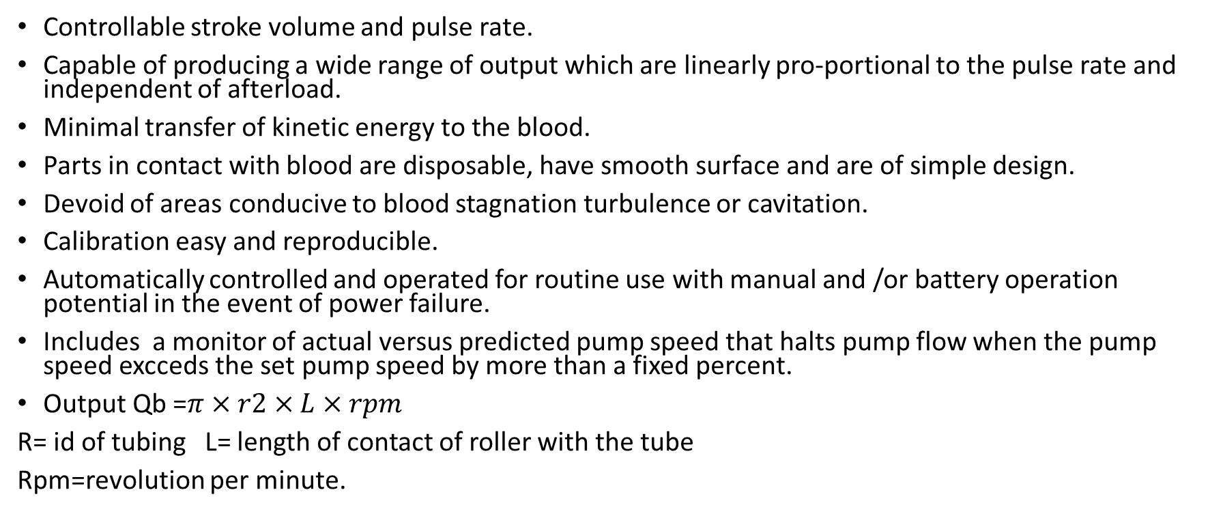
Characteristics of an ideal blood pump
Controllable stroke volume and pulse rate.
Capable of producing a wide range of output which are linearly pro-portional to the pulse rate and independent of afterload.
Minimal transfer of kinetic energy to the blood.
Parts in contact with blood are disposable, have smooth surface and are of simple design.
Devoid of areas conducive to blood stagnation turbulence or cavitation.
Calibration easy and reproducible.
Automatically controlled and operated for routine use with manual and /or battery operation potential in the event of power failure.
Includes a monitor of actual versus predicted pump speed that halts pump flow when the pump speed excceds the set pump speed by more than a fixed percent.
Output Qb =$π×r2×L×rpm$
R= id of tubing L= length of contact of roller with the tube
Rpm=revolution per minute.

Slide 3
Roller pumps
Roller pumps contain mechanical parts that trap a portion of the fluid and propel it forward .
They are one type of positive displacement pump valves are not required to provide unidirectional flow.
The output of the roller pump depends upon the speed of the pump and the volume displaced with each revolution.
Roller pumps use a roller that compresses a segment of blood-filled resilient tubing against a semicircular backing plate,propelling the blood forward.
Depending upon the number of rollers,roller pumps are classified as single ,double and multiple roller pumps.
The basic design of the roller pump was pantented in 1855 by porter and Bradley.
Refinements in pump design and materials engineering have led to the efficient and effective roller pumps used today.

Slide 4
Roller pump
The tubing used in the early pumps had a tendency to move vertically up the backing plate and forward through the pumping chamber as the roller passed over it .
Several techniques used to prevent ventrical movement of the tubing are depicted. The forward movement of tubing has been controlled by having tubing inserts or brushing in the pump head which hold the tubing in place at the inlet and outlet areas of the pump raceway.
This provides a constant stroke volume with each pump cycle .the term “Pump occlustion”refer to the occlusion of tubing as the roller presses the tubing against the raceways.
Most pump allow the operator to set the occlusion of each roller separately. The proper tubing occlusion can be achived using the procedure.
The occlusion of each roller should be checked at different area of the backing plate .it is possible for the backing plate to get “out of round”so that occlustion can vary somewhat at different point of backplate.
If there is a wide discrepancy between different area on the backplate the pump should be repaired.
It was initially felt that a nonocclusive pump would cause less hemolysis than an occlusive one.
It is now felt that a pump which is “just occlusive”cause the lowest hemolysis rates.
A nonocclusive pump allows high backflow velocities increasing the kinetic energy transferred to the blood there by increasing hemolysis.

Slide 5
Roller pump
A nonocclusive pump also requires more revolution per minute for any given forward flow rate compared to an occlusive pump.
Roller pump designs have been altered in an attempt to minimize hemolysis.
This effort has focused upon the speed required to achieve a desired flow ,the number of roller pump contains and the proper occlusion of rollers.
It is generally accepted that as the revolutions per minute and the number for rollers are increased the hemolysis rate increase
This can be attributed to several factors including mechanical compression friction heat and sheer stress.
Revolution per minute can be decreased while maintaining the same flow rate if tubing diameter is increased and the number of rollers is increased ,
Pump calibration should remain relatively constant over a period of months .
The calibration needs to be checked only at 6-months intervals between these checks the output of pump should remain within 5% of the original calibration cure.
If a change is made in tubing a new calibration curve should obviously be generated.
Occlusive roller pumps are quite afterload insensitive the use of the calibration curve in estimating pump flow from revolution per minutes is very accurate.

Slide 6
SINGLE ROLLER PUMP
The single roller pump consists of a circular raceway in which a 360 degree loop of tubing is insersted .
The output of single roller pump is independent of afterload when the pump is properly occluded
Single roller pump produces more pulsatile flow than the conventional twin roller pump.

Slide 7
Double / twin roller pump
The double or twin roller pump has been the most widely used pump in open heart surgical procedures.
This design of the twin –roller pump combines a210 degree semicircular backing plate and two roller that are 180 degree out of phase with one other.
As one roller end its occlusive phase ,the other has already begun its occlusive phase .
The tubing is always compressed by one of the two rollers .
The flow produced is relatively non pulsatile.

Slide 8
MULTIPLE ROLLER PUMP
The multiple roller pump has been proposed for extracorporeal blood handing using three or more roller.
The curvature of the backing plate can be reduced to 120 degree or less
Since it has been shown that an increase in the number of rollers increase hemolysis this design has never gained acceptance in clinical settings.
Advantages:
Occlusive therefore if power goes out the arterial line won’t act as a venous line .
Output is accurate because it is not dependent of the circuits resistance.
Disadvantages
Can cause large amount of damage to blood if over –occluded.

Slide 9
Reciprocating pumps
Pistons
This pump uses motor driven syringes that are equipped with suitable valves ,delivering pulsatile flow
Limited to low output capacity .
Bar compression
Blood moves from the alternate compression and expansion of the tube or bulb between a moving bar and a solid back plate.
Diaphragm pumps
With a flat diaphragm or finger shaped membrane made of rubber ,plastic or metal blood is propelled forward.
Ventricle pumps
A compressible chamber mounted in a casing and are activated by displacement of liquid or gas in the casing .

Slide 10
Ventricular blood pumps
These device are most physiologic method for pulsatile blood flow .
Consists of a compressible sac two one way valves for unidirectional flow .
System is driven by hydrulia (non compressible fluid )as drive medium or pneumatic means .
Blood flow depends on frequency & SV
Any alteration in it when synchronized with patient ECG will affect output of system so it is ensured that flow is maintained independently of all other control demands by compensating software.
System requires substantial reserve capacity to enable out put adjustments.
Architecturally physiologic pulse pressure flow profiles found during experiments.

Slide 11
Centrifugal pumps /rottary pump /diagonal /

