Slide 1
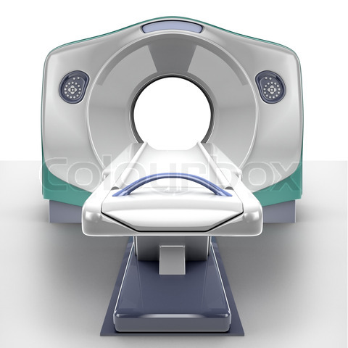
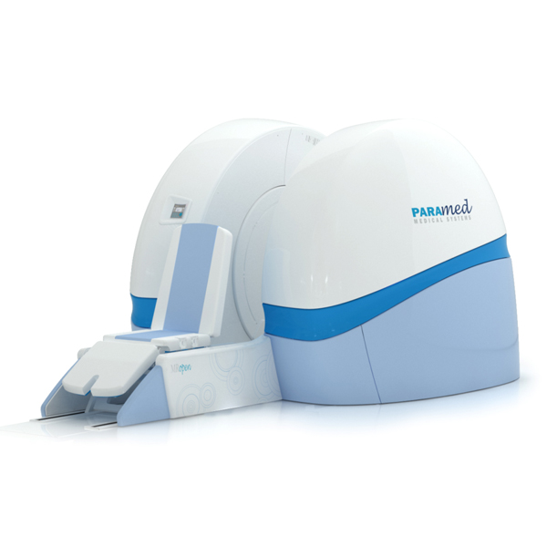
Nuclear Magnetic Resonance
By Mrs. Passang D. Sherpa
Coordinator of
Radio-imaging Technology
Dpt. of paramedical science

Slide 2
STRUCTURE OF AN ATOM
Consists of nucleus and electrons orbiting around the nucleus in shells.
Nucleus contains neutrons and protons that spin around their own axis.
Charged particles that move or spin produce a magnetic field

Slide 3
Mass No – it is the sum of protons and neutrons in the nucleus
Isotope- atoms with difference in no of protons and neutrons
Usually the no of electrons will be same as the no of protons.
protons
neutrons
+ve charge
no charge
electrons
-ve charge

Slide 4
Atoms are stable- if the no of protons and electrons are same
This balance is sometimes altered by applying external energy to knock out an electron from the atom.

Slide 5
MOTION IN THE ATOM
3 types of motion are present:
Electrons spinning on their own axis
Electrons orbiting the nucleus
The nucleus itself spinning about its own axis

Slide 6
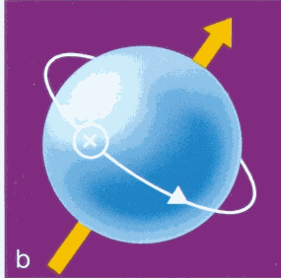
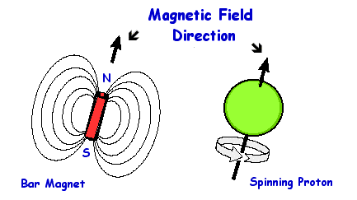
The MRI uses – the spinning motion of specific nuclei present in biological tissues.
This spin derives from the individual spins of protons and neutrons within the nucleus.
This posses- net spin or angular momentum known as MR active nuclei.

Slide 7
Atomic and mass number- Nuclei
The number of spin values depends on the atomic number and mass number.
A nucleus has no spin if it has even atomic and mass number.
Half of the nuclei spin in one direction and half in the other direction-forces of rotation cancel out and the nucleus itself has no net spin.

Slide 8
Nuclei with odd number of proton , an odd number of neutrons or both odd number of protons and neutrons- spin direction are not equal or opposite
So the nucleus itself has a net spin and angular momentum
(angular momentum is the rotational analog of linear momentum)
In general, only nuclei with an odd mass number and atomic weight are used as a MR active nuclei

Slide 9
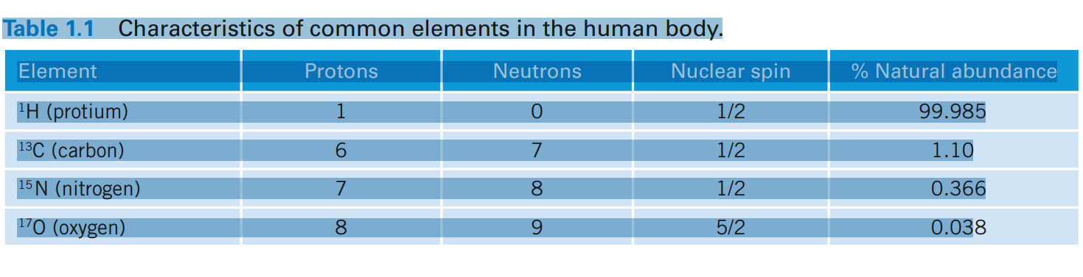
MR-Active nuclei

Slide 10
Hydrogen
Hydrogen makes up to 80% of all atoms in human body.
The H nucleus contains one +vely charged proton that spins. (induced magnetic field around it)
Isotopes of hydrogen called protium (single proton, no neutron)
Hydrogen is the MR active nuclei used in clinical MRI because
  Large magnetic moment
  Great abundance in the body

Slide 11
Faraday’s Law of electromagnetic induction states that magnetic field is created by moving charged particle (that creates an electric field).
Protium nucleus contains one positively charged proton that spins i,e. It moves
Therefore, the nucleus has a magnetic field induced around it and acts as a small magnet.

Slide 12
Angular momentum
Describes the rotational motion of a body.
It is a vector.(has size and direction and is denoted by an arrow)
May be changed by applying torque.
Two types
  Orbital angular momentum.
    Mass ,velocity and radius of rotation
  Spin angular momentum.
Notes:
Vector- has size and direction and denoted by an arrow. The direction of the vector designates the direction of the magnetic moment and the length of the vector designates the size of the magnetic moment.

Slide 13
The magnetic vector
Magnetic field around the nucleus is of the dipole type with a north and south pole (magnet of H nucleus has north and south pole)
Magnetic vector has a definite magnitude and direction.
Direction of vector- the direction of alignment of the magnetic moment
Length of the vector – magnitude of magnetic moment or strength of the magnetic field that sorounds the nucleus
In case of a spinning nucleus , vector is perpendicular to plane of spin.

Slide 14
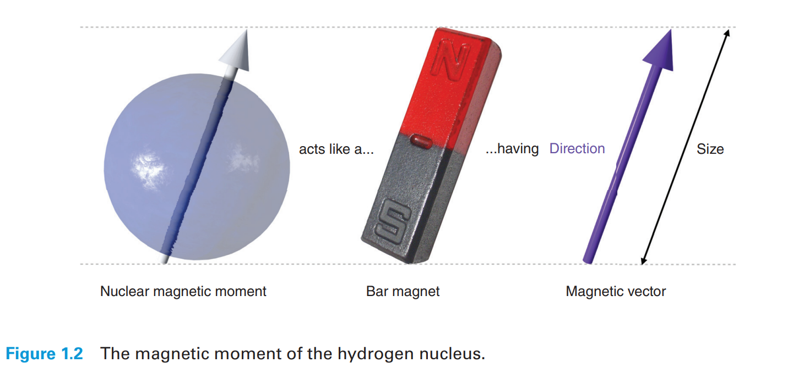

Slide 15
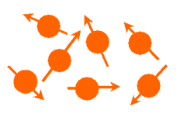
ALLIGNMENT
Thus normally biological tissues have no externally detectable magnetic fields.
Their net magnetic field is zero.
But have the potential especially when properly manipulated.

Slide 16
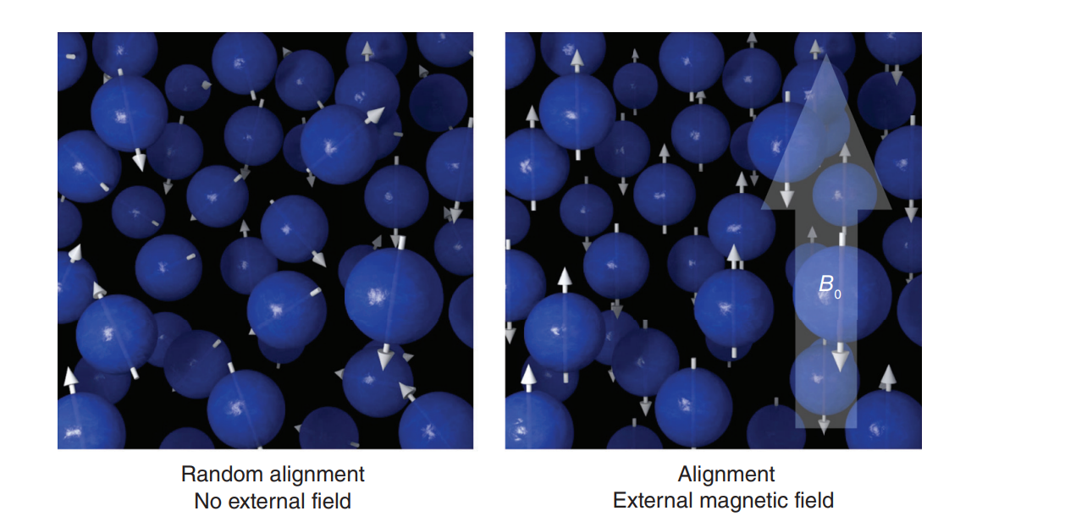

Slide 17
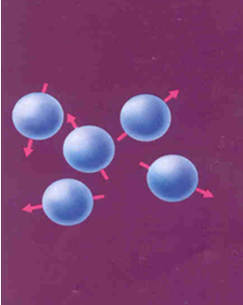
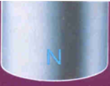
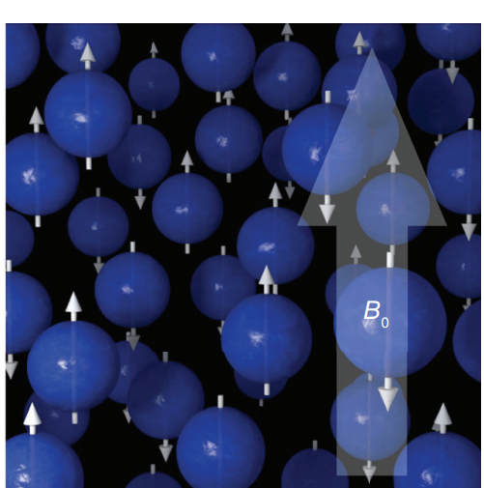
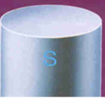
Normally the protons are Randomly oriented.
When placed in the external magnetic field protons align either
Parallel or anti parallel
To the external magnetic
Field.

Slide 18
when we place the protons in an External magnetic field !
The protons (behaving like bar magnets)
align themselves in the external magnetic field.
They may align themselves either parallel or anti-parallel.
Both the types of alignment are at different energy levels.
Low energy- align magnetic moments parallel to the external field(spin up nuclei)
High energy- align anti-parallel to the external field(spin down nuclei)

Slide 19
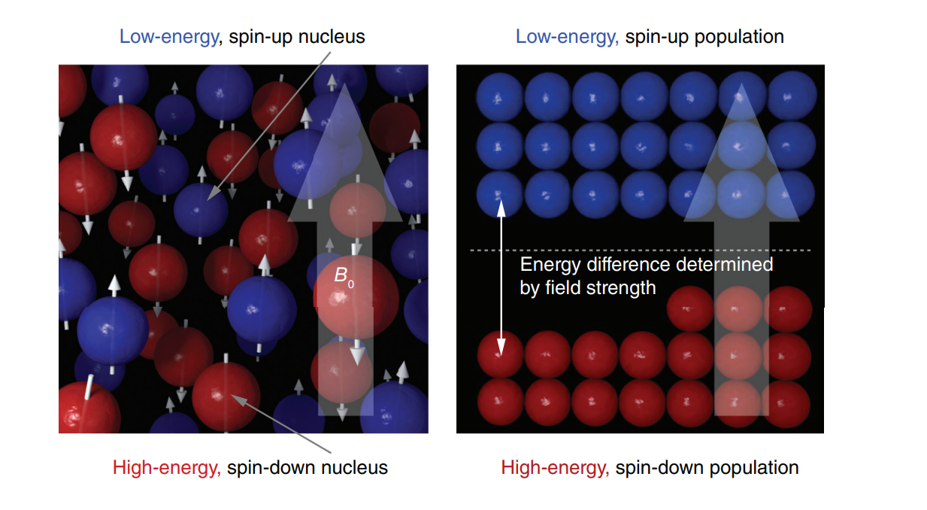

Slide 20
More protons align themselves parallel to the external magnetic field (a lower energy state)
Energy difference between two states is proportional to the strength of external magnetic field.
As main magnetic field increases, difference in energy between states also increases- therefore nuclei require more energy to align their magnetic moment in opposite to the main field.

Slide 21
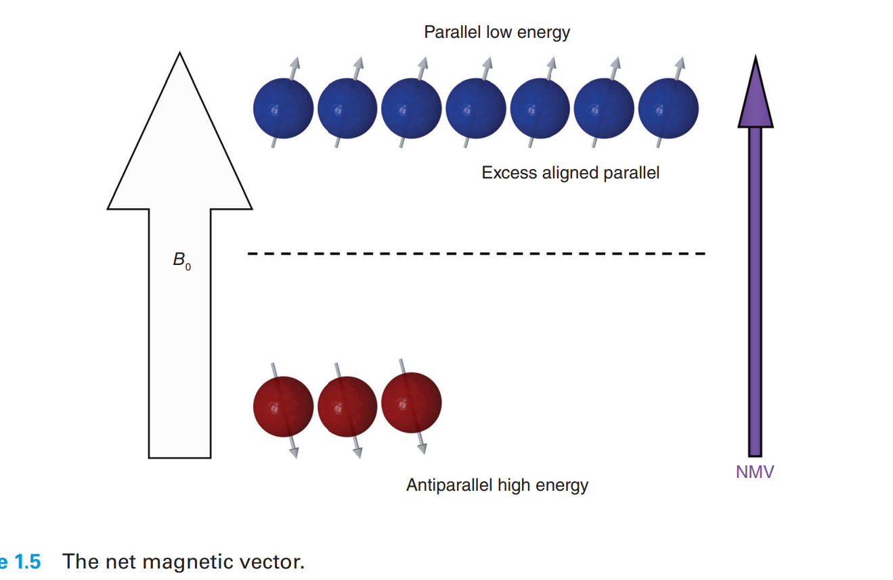

Slide 22
Magnetic moments aligned parallel to the field cancel out smaller no of anti-parallel magnetic moments.
The Net Magnetic vector of the protons points in the direction of the External magnetic field

Slide 23
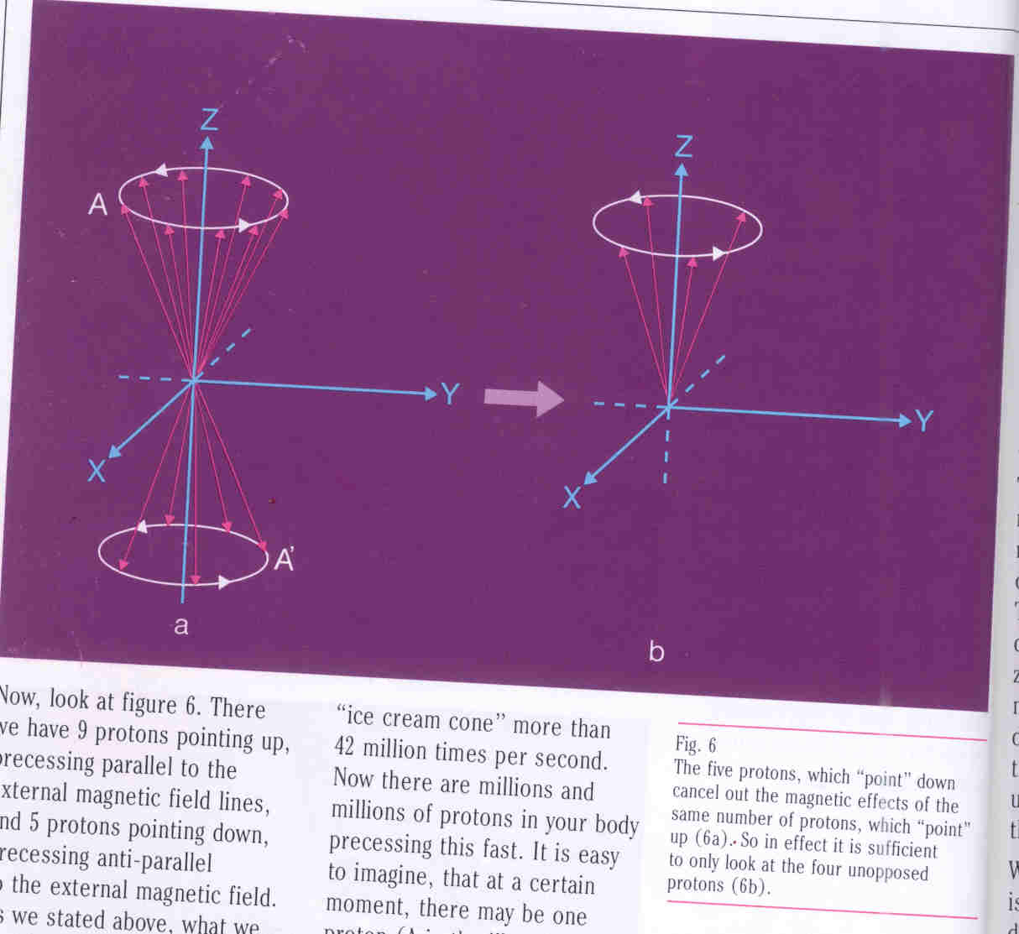
The magnetic vector of the precessing protons in random directions cancel each other
Net magnetic vector in the direction of the external magnetic field
Net magnetization in the direction of the external magnetic field.

Slide 24
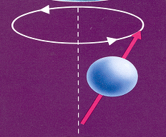
Precession
Each H nucleus spins on its own axis.
External magnetic field(B0) produces additional spin
I.e.. it moves around like a spinning top.
The secondary spin is called precession.
The path is precessional path.
The speed of this movement is called as Precession frequency.
Unit MHz- 1 million cycles per sec.

Slide 25
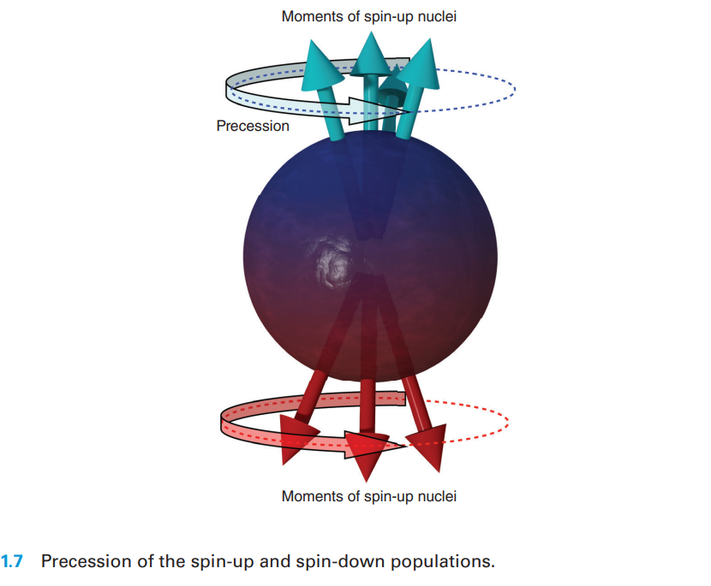
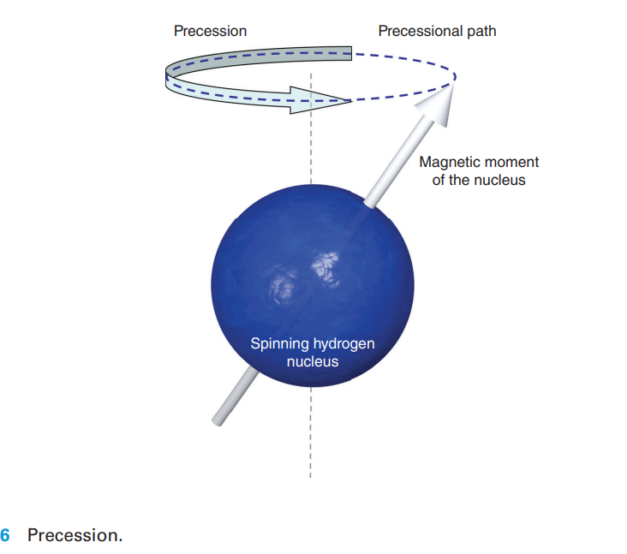
The magnetic moments of all spin up and spin down nuclei precess around B₀ on a precessional path determined by B₀

Slide 26
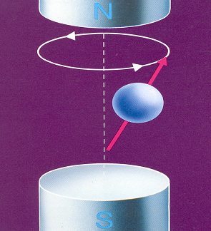
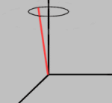
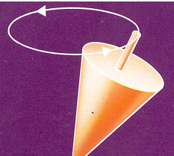
Precession frequency of protons
Protons in external magnetic field show wobbling type of motion
wobbling type of motion.

Slide 27
The precession frequency is directly proportional to the external magnetic field .
The processional frequency is often called larmor frequency because it is determine by the LARMOR EQUATION.
ω= ϒB0
Where
ω- precessional frequency
ϒ – gyro magnetic ratio
B0- Magnet field strength
The gyromagnetic ratio expresses the relationship b/w the angular momentum & the magnetic moment of each MR active nucleus.

Slide 28
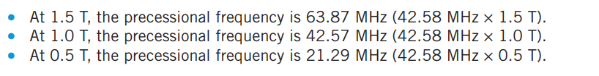
The gyromagnetic ratio of hydrogen is 42.58 MHz/T
Magnetic moments of MR active nuclei have different precessional frequencies at different field strengths.

Slide 29
Precessional phase
Phase is refers to the position of magnetic moments on their precessional path at any moment in the time.
Frequency is the rate of change phase of magnetic moments
Relative phase positions of all magnetic moments of hydrogen are important.
Out of phase or incoherent
In phase or coherent

Slide 30
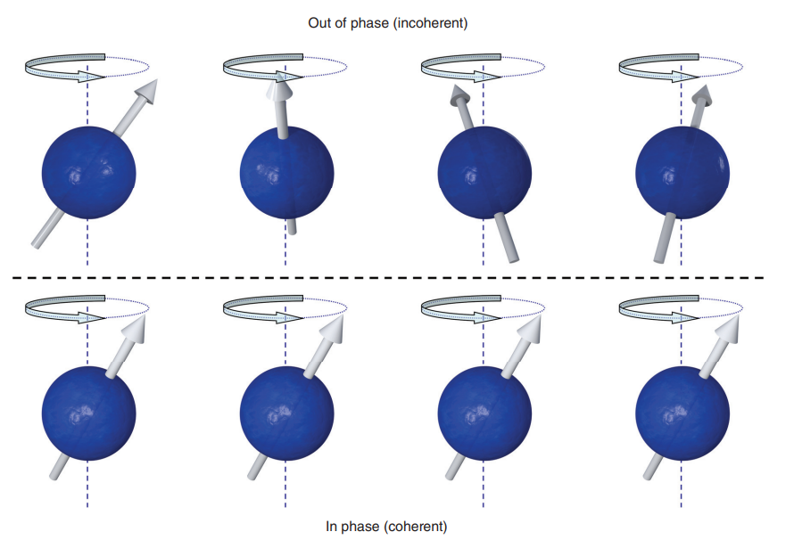
Out of phase or incoherent means that magnetic moments of hydrogen are at different places on their precessional path at a moment in a time.
In phase or coherent means that magnetic moment of the hydrogen are at same place on the precessional path at a moment in time.

Slide 31
Resonance
Resonance is phenomena that occurs when hydrogen nuclei exposed to radiofrequency.
Resonance of hydrogen to occur- RF pulse of energy is applied at the larmor frequency of hydrogen.
Resonance achieved by transmitting RF pulse called an RF excitation pulse

Slide 32
As this magnetization is along the direction of the external magnetic field it is called as Longitudinal Magnetization.
Difficult to measure this longitudinal magnetization
For measurement, a magnetization in the transverse direction or at right angles to the longitudinal one is required

Slide 33
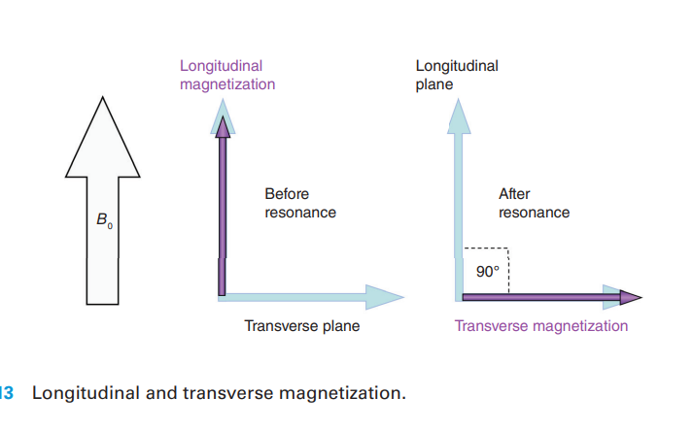
Magnitude of the flip angle depends on the amplitude and direction of the RF Pulse.
Usually flip angle is 90°
NMV is given enough energy by the RF excitation pulse to move through 90° relative to B₀

Slide 34
Magnetization transverse to external magnetic field can be measured
Magnetization along
The external magnetic
Field cannot be measured.

Slide 35
EXITATION
To establish a transverse magnetization –A special radiowave (RF) is sent .
Purpose of radiofrequency pulse -disturb the protons peacefully precessing in alignment with the external magnetic field.
A special RF PULSE is needed which can exchange energy with the protons.

Slide 36
Type of RF pulse
The RF pulse must have the same frequency as the precessing protons.
The Larmor equation gives the precession frequency and thus the frequency of the RF pulse.
when precession frequency of protons = frequency of RF pulse ,energy is transferred. (phenomenon of resonance)

Slide 37
Energy exchange is possible when protons and RF pulse have the
Same frequency.
Applied to MRI, the RF pulse can transmit its energy to the
Protons only when both are of the same frequency.

Slide 38
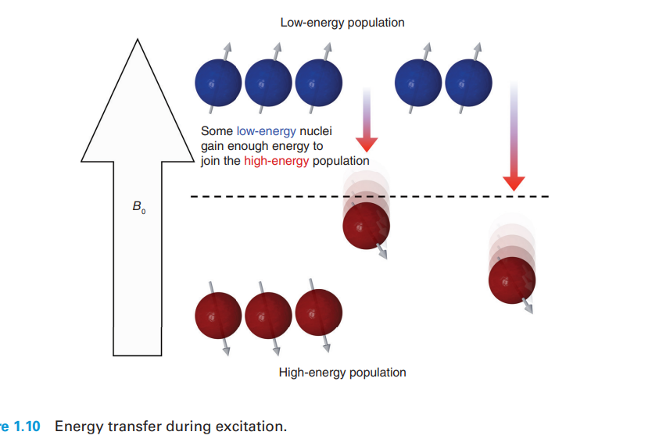
What happens to the protons when they are exposed to the RF pulse?
Some of the protons pick up energy from the RF pulse and go from lower to higher energy level.
This results in more protons pointing anti-parallel to the magnetic field.

Slide 39
Net effect therefore is that the longitudinal magnetization decreases.

Slide 40
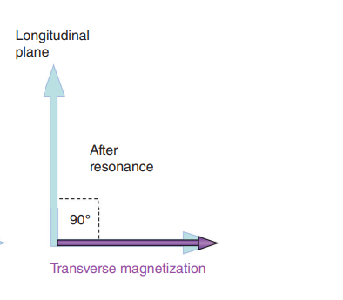
Due to the RF pulse the protons do not precess in random directions anymore.
The protons move in phase or in synchronization that is they point in the same direction at the same time.
Thus a magnetic vector in the direction the precessing protons point is established ,and this is in the transverse direction.
This is called as transverse magnetization.

Slide 41
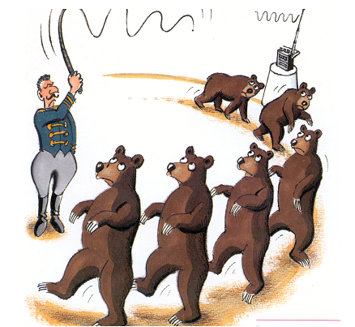
The net effect of the RF pulse is
1. Some protons pick up energy ,align themselves anti-parallel to the magnetic field and thus decrease the amount of longitudinal magnetization.
2. The protons get in synchronization that is start to precess in phase. Their vectors add up in a direction transverse to the external magnetic field and thus a new transverse magnetization is established.
The RF pulse
Gets the protons
In phase

Slide 42
Net effect of RF pulse-decrease in longitudinal and increase in transverse magnetization

Slide 43
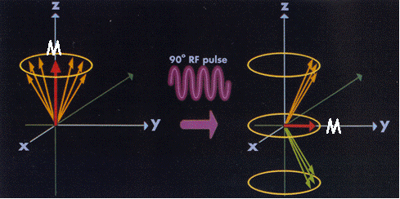
In short, the RF pulse causes the longitudinal magnetization to decrease and transverse magnetization to increase.

Slide 44
The newly established transverse magnetization moves in phase with the precessing protons
The magnetic vector by constantly changing its direction induces an electric current.
This is the MRI signal.

Slide 45
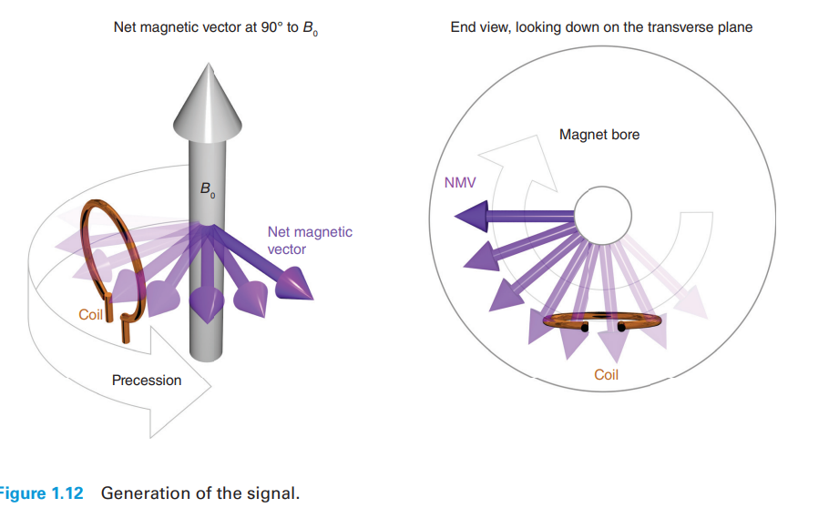

Slide 46
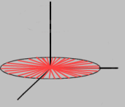
What happens when the RF pulse is switched off?
Whole system is back to its undisturbed state.
The longitudinal magnetization increases ,as the protons go back to their original lower energy levels.
The energy picked up from the RF pulse is handed over to the surroundings (lattice)
Therefore this process also known as Longitudinal relaxation OR Spin lattice relaxation.

Slide 47
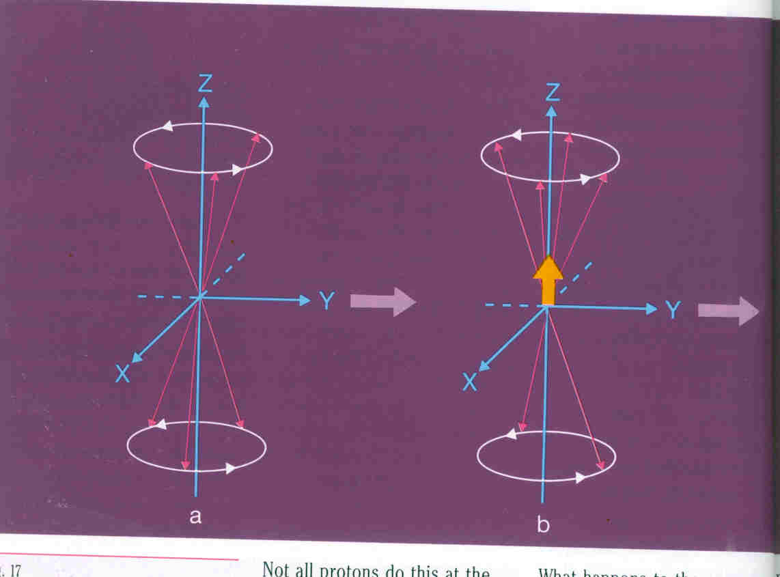
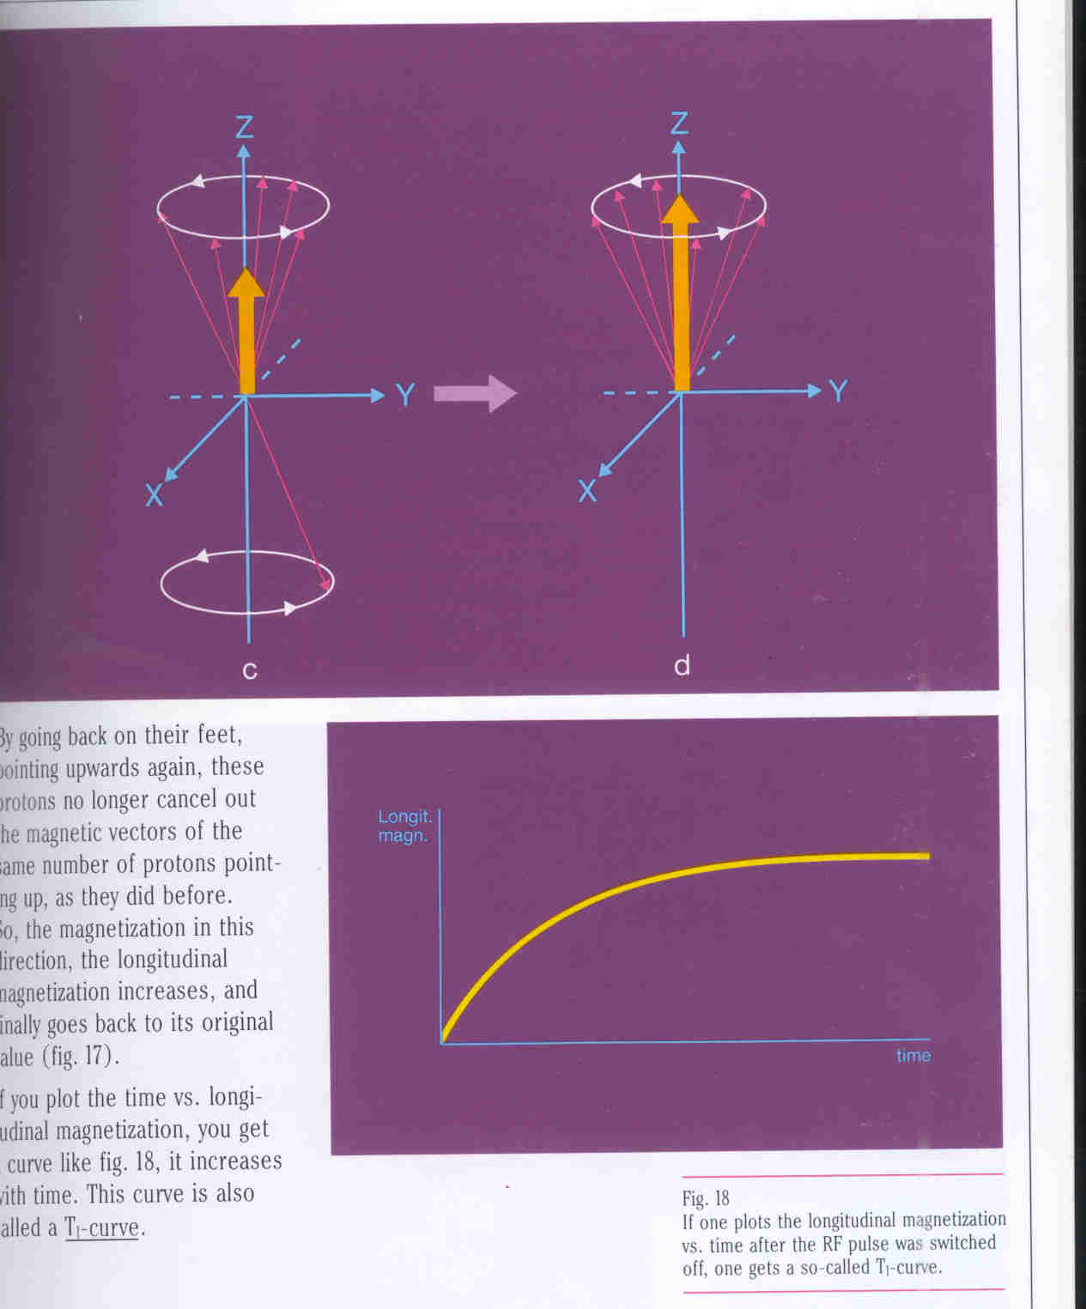
The longitudinal magnetization increases when the RF
Pulse is switched off.

Slide 48
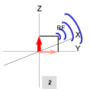
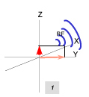
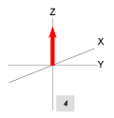
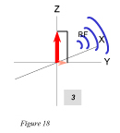
Longitudinal relaxation

Slide 49
The time taken for longitudinal magnetization to resume its original value is the longitudinal relaxation time also called as T1.
In practice it
Impossible to
Know the end
Point. So the
Time taken for
LM to reach
63% of its
Original value.

Slide 50
The transverse magnetization
The protons having different precession frequencies get out of phase soon after the RF pulse is switched off.
The net result therefore is that the transverse magnetization decreases.

Slide 51
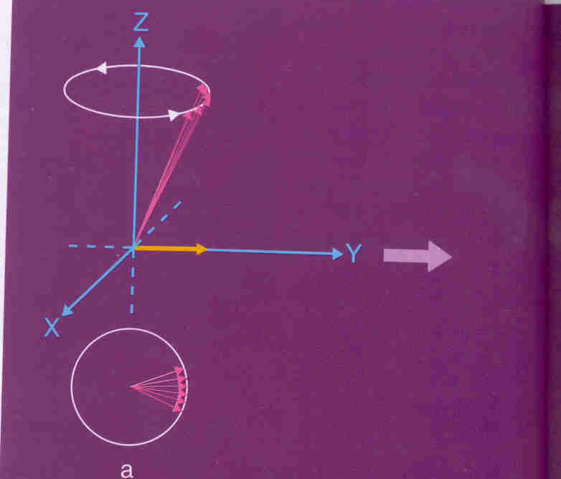
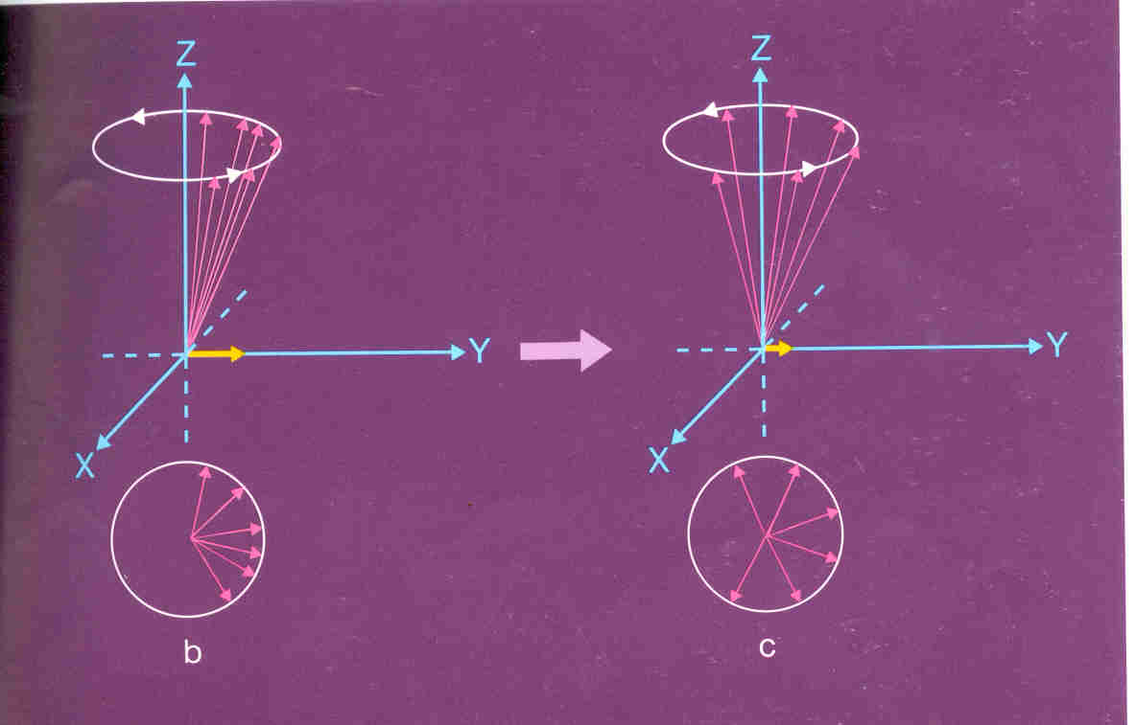
Out of phase
In phase
The transverse magnetization decreases when RF pulse
Is switched off.

Slide 52
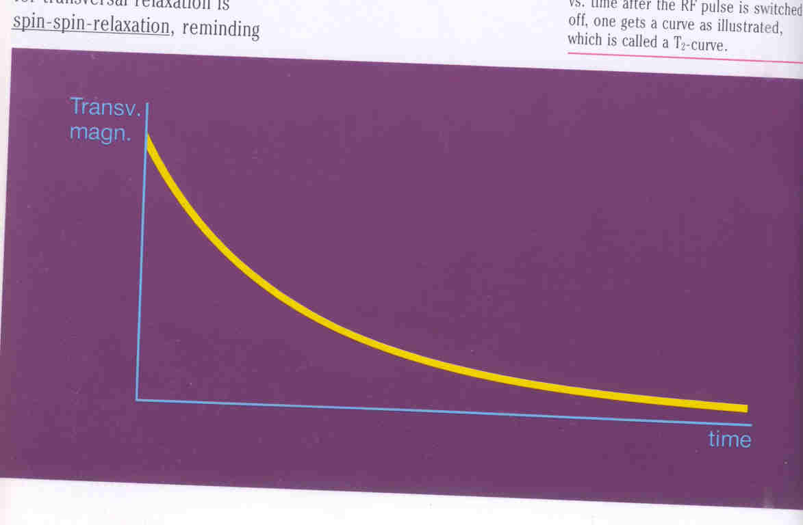
If we plot a graph of transverse magnetization versus time we get a downhill curve.
The time taken for the transverse magnetization to decrease is called as Transverse relaxation or the Spin spin relaxation.

Slide 53
T2 is the time it takes 63 % of the transverse magnetization to be lost.

Slide 54
T1 Recovery in FAT :
T1 recovery occurs due to nuclei giving their energy to the surrounding environment.
The slow molecular tumbling in fat allows the recovery process to be relatively rapid.
So the magnetic moments of the fat are able to relax and regain their longitudinal magnetization quickly .
The NMV of fat realigns rapidly with B0 and the T1 time of the FAT is SHORT

Slide 55
T1 Recovery in WATER:
In water the molecular mobility is high resulting in less T1 recovery.
The magnetic moments of water take longer to relax and regain their longitudinal magnetization .
The NMV of water takes longer to realign with B0 and so the T1 time of water is LONG.

Slide 56
T2 decay of FAT:
The decay occurs as a result of the magnetic fields of the nuclei interaction with each other, exchanging their energy to their neighbors.
As energy exchange is more efficient in the Hydrogen in FAT the T2 time is SHORT.

Slide 57
T2 decay of WATER:
As the energy exchange in water is less efficient than in fat
The T2 time of water is LONG.

Slide 58
THANk YOU

