Slide 1
PARAMETERS AND TRADE-OFFS
By Mrs. Passang D. Sherpa
Coordinator of
Radio-imaging Technology
Dpt. of paramedical science

Slide 2
image quality - aspects
SNR.
CNR.
Spatial resolution.
Scan time.

Slide 3
SIGNAL TO NOISE RATIO (SNR)

Slide 4
SIGNAL TO NOISE RATIO (SNR)
Ratio of the amplitude of the signal received to the average amplitude of the noise.
Signal – induced voltage in receiver coil
Noise – random frequencies in space and time
Noise occurs at all frequencies and is random in time and space.
Signal occurs at time TE

Slide 5
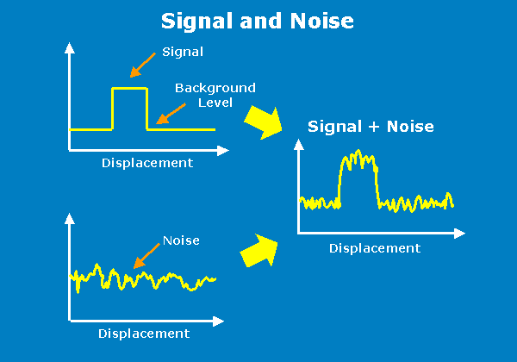

Slide 6
FACTORS THAT AFFECT THE SNR
Magnetic field strength of the system.
Proton density of the area under examination.
Voxel volume.
TR, TE, and flip angle.
NEX.
Receive bandwidth.
Coil type.

Slide 7
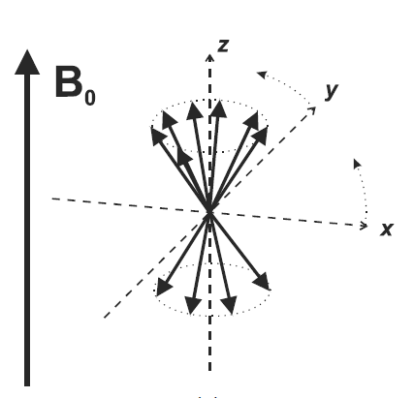
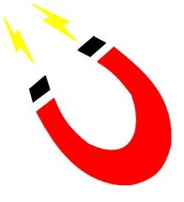
MAGNETIC FIELD STRENGTH OF THE SYSTEM
FACTORS THAT AFFECT THE SNR
magnetic field strength α energy gap
No. of spin up nuclei increases than down nuclei.
NMV increases in size at higher field strength.
As a result there is more available magnetization to image the patient.
SNR therefore increases.

Slide 8
PROTON DENSITY
FACTORS THAT AFFECT THE SNR
No. of protons in the area under examination determines the amplitude of signal received.
areas with a low proton density have low SNR
To Increase SNR by increasing TR ; result in an increase in scan time.

Slide 9
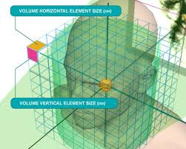
VOXEL VOLUME
FACTORS THAT AFFECT THE SNR
Building unit of digital image is pixel. And volume element is voxel.
Brightness of the pixel represents the strength of MR signal generated by unit volume of tissue (Voxel).

Slide 10
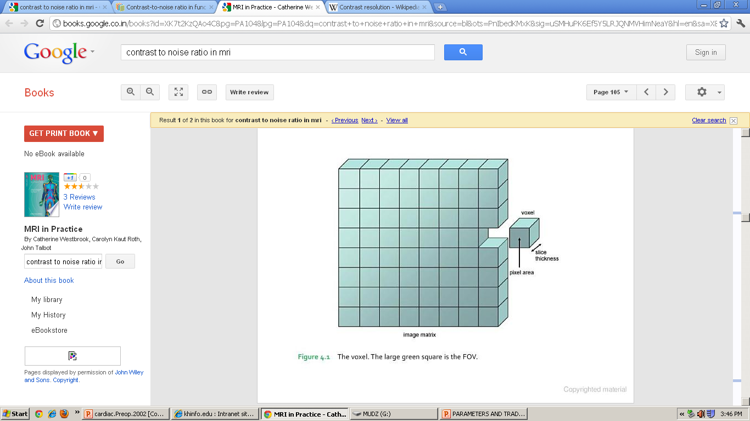
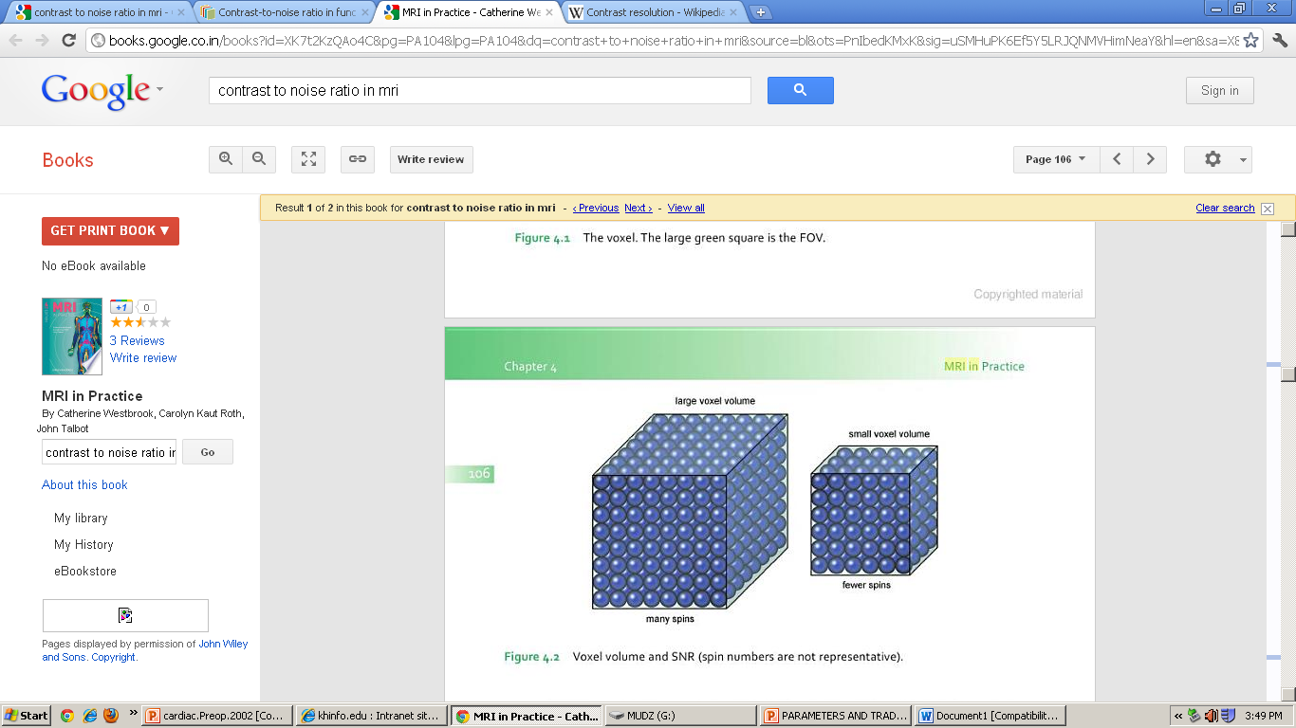

Slide 11
Coarse matrix – low no. of pixels in the FOV.
Fine matrix – large no. of pixels in the FOV.
Size of Voxel α SNR
How to change the size of the voxel?
Changing the slice thickness α voxel thickness
Changing the FOV α SNR

Slide 12
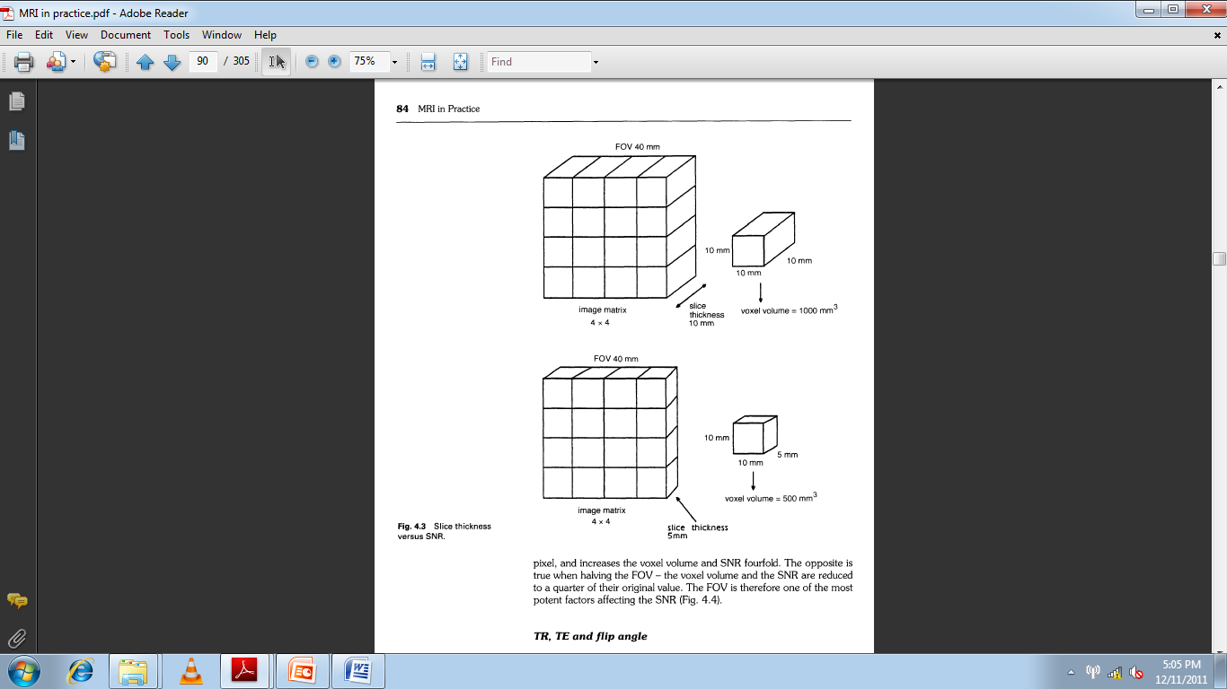

Slide 13
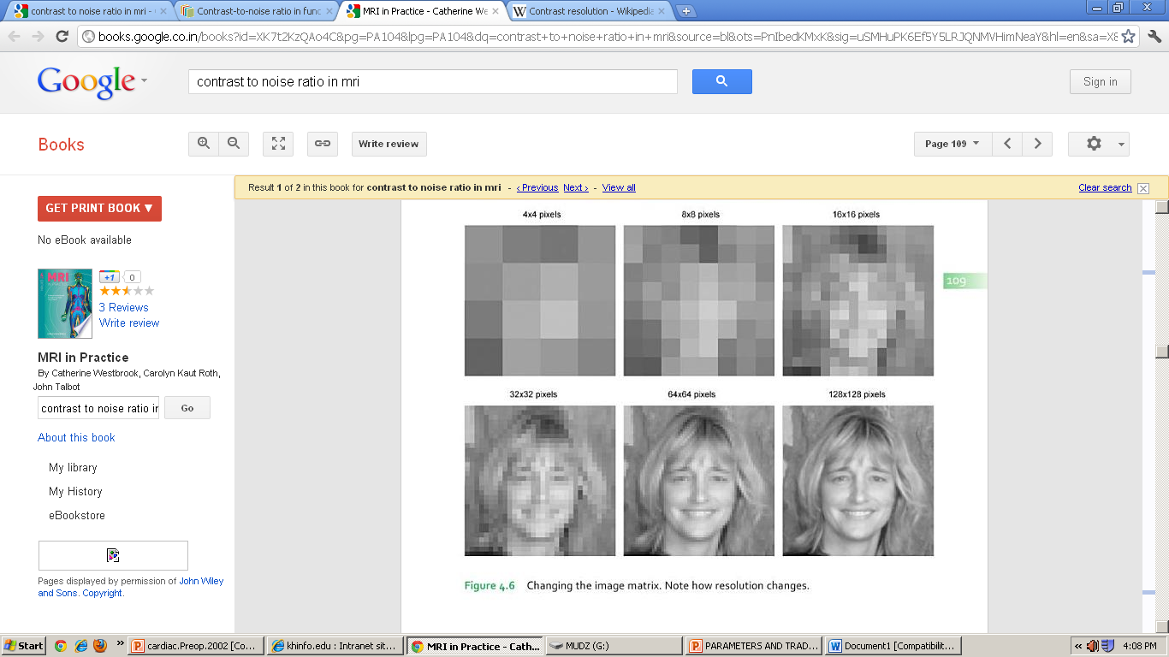

Slide 14
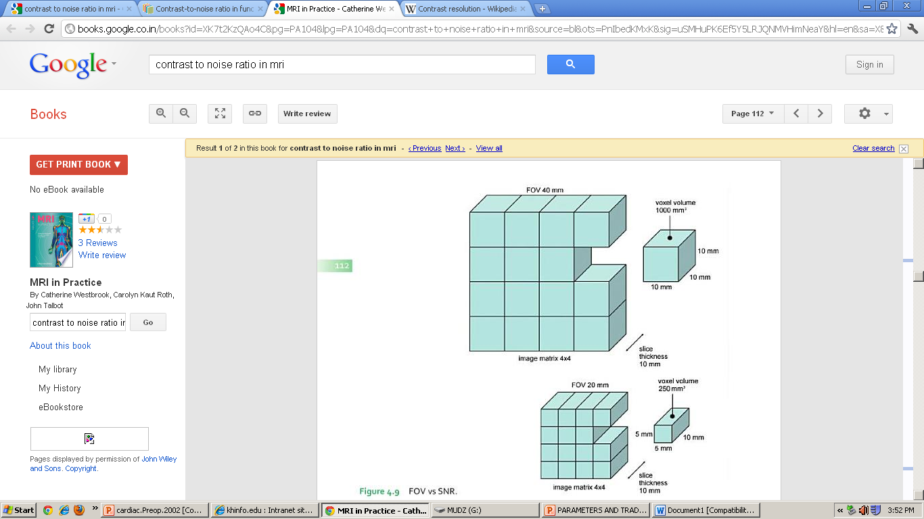
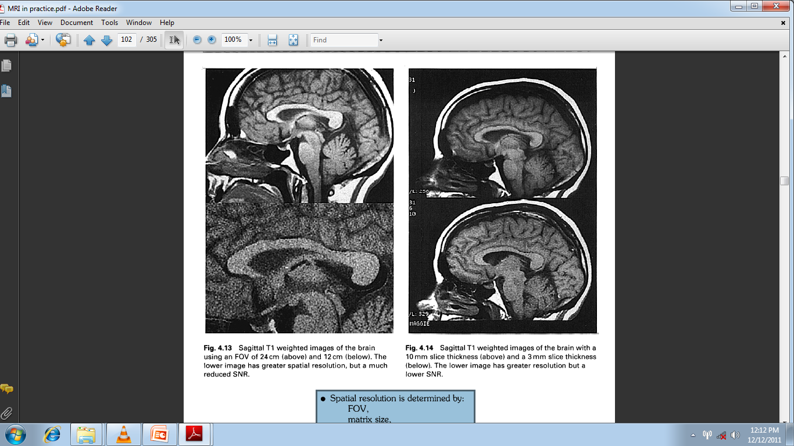

Slide 15
TR, TE AND FLIP ANGLE
FACTORS THAT AFFECT THE SNR
They influence image contrast, SNR and therefore overall image quality.
Spin echo pulse sequences have more signal than gradient echo pulse sequences.

Slide 16
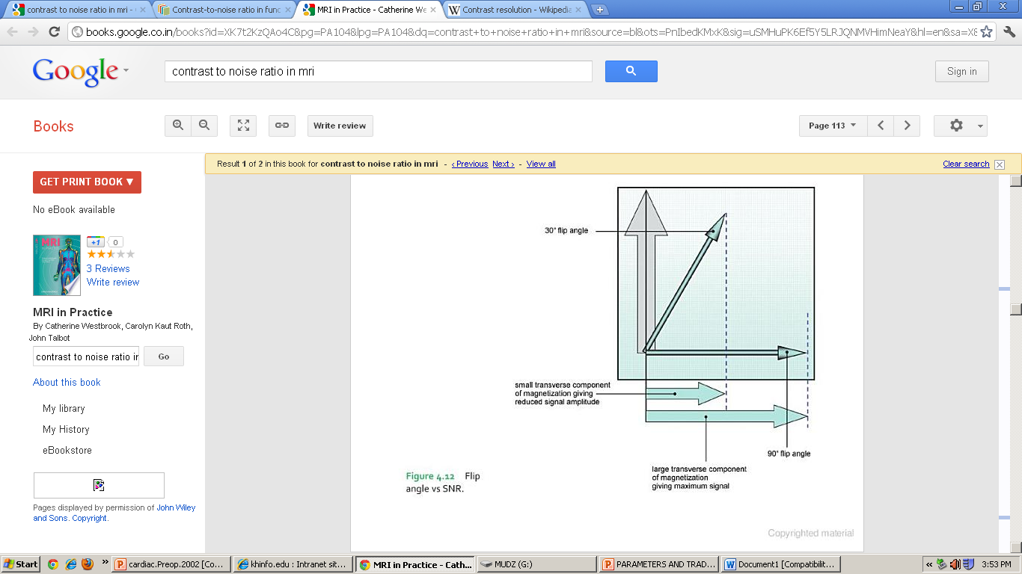
FLIP ANGLE
The size of the flip angle determines how much longitudinal magnetization is converted into transverse magnetization by the excitation pulse.
Low flip angle - low SNR

Slide 17
TR
Controls the amount of longitudinal magnetization that is allowed to recover before the next RF pulse is applied.
Short TRs, very little longitudinal magnetization recovers- low SNR.
Increasing the TR improves the SNR as more longitudinal magnetization, and therefore more transverse magnetization, is created.

Slide 18
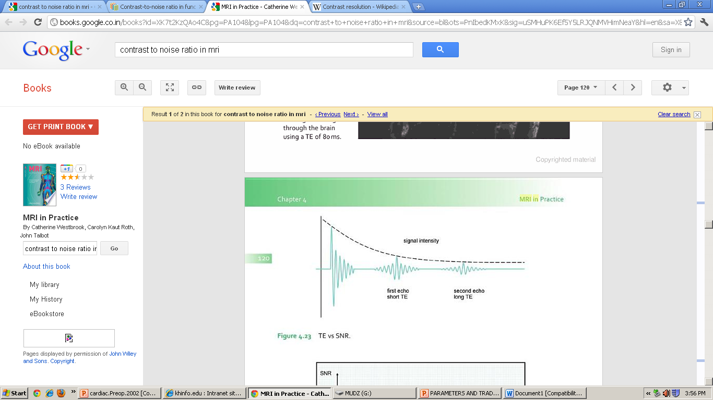
TE
Controls the amount of transverse magnetization that is allowed to decay before an echo is collected.

Slide 19
NUMBER OF SIGNAL AVERAGES (NSA/NEX)
FACTORS THAT AFFECT THE SNR
No. of times each line is filled with data.
Signals can be sampled more than once by maintaining same slope of phase gradients over several TRs.
Each line of K space contains more data.
Data contains both signal and noise.
Presence of Random noise means that doubling the NEX only increases SNR by 1.4 (√2)

Slide 20

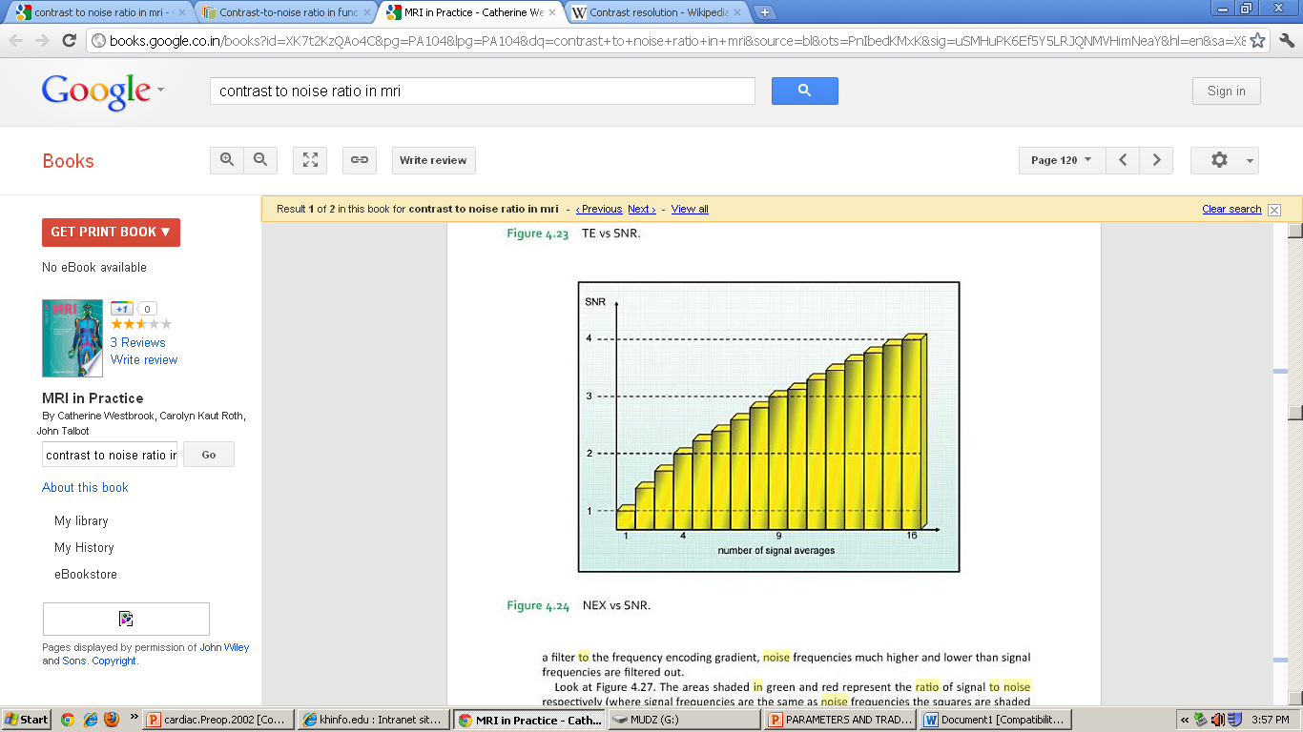

Slide 21
RECEIVE BANDWIDTH
FACTORS THAT AFFECT THE SNR
This is the range of frequencies sampled during readout gradient.
Reducing the receive bandwidth is a very effective way of boosting the SNR.
However, reducing the bandwidth increases:
The minimum TE.
Chemical shift artifact.
SNR increases as the receive bandwidth decreases

Slide 23
TYPE OF COIL
FACTORS THAT AFFECT THE SNR
Type of coil used affects the SNR.
Quadrature coils increases – SNR.
Phased array coils increases – SNR even more.
Surface coils when placed close to the surface increases the SNR.
Receiver coils must be placed in the transverse plane perpendicular to the main field.

Slide 24
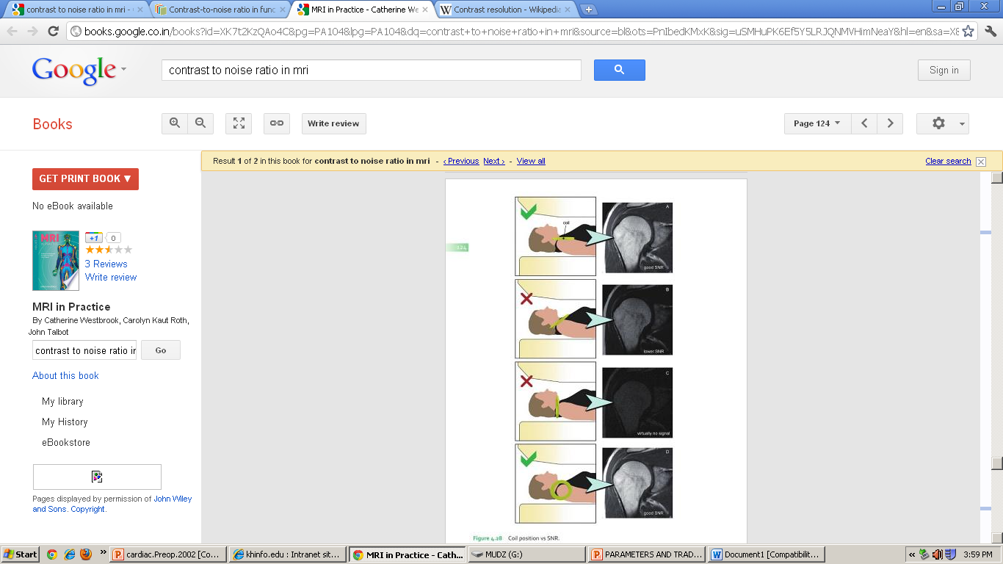

Slide 25
SUMMARY

Slide 26
CONTRAST TO NOISE RATIO

Slide 27
CONTRAST TO NOISE RATIO
CNR is defined as the difference in SNR between two adjacent areas.
Controlled by the same factors that affect SNR.
Most important image quality factor.
Visualization of a lesion increases if the CNR between it and surrounding anatomy is high.

Slide 28
CNR IS INCREASED IN THE FOLLOWING WAYS
Using a T2 weighted image.
Using contrast agent.
Using chemical pre-saturation technique.

Slide 29
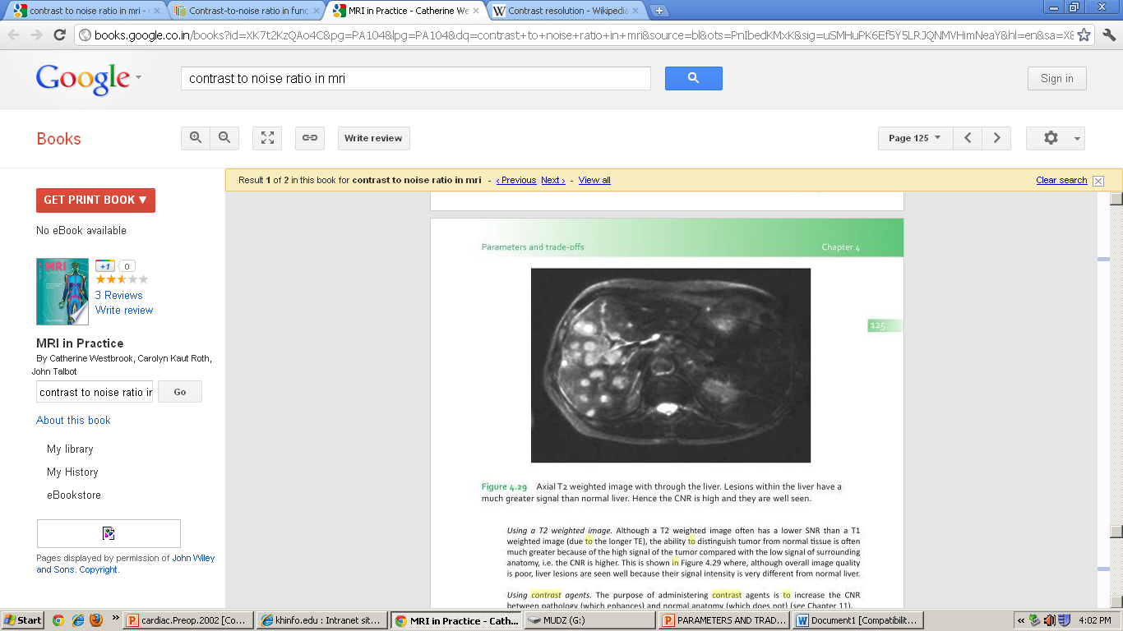
`

Slide 30
MAGNETIZATION TRANSFER CONTRAST (MTC)
Only protons that have sufficiently long T2 time can be imaged are called free protons.
The protons bound to large proteins, membranes, macromolecules are called bound protons.
There is always a transfer of magnetization between bound and free protons.
MTC increases the CNR between pathological and normal tissues useful in angiography and joint imaging.

Slide 31
SPATIAL RESOLUTION

Slide 32
SPATIAL RESOLUTION
It is entirely controlled by the size of the Voxel.
Each slice displays an area of anatomy defined as the field of view(FOV).
Small Voxel result in good spatial resolution.
Large Voxel results in partial voluming.

Slide 33
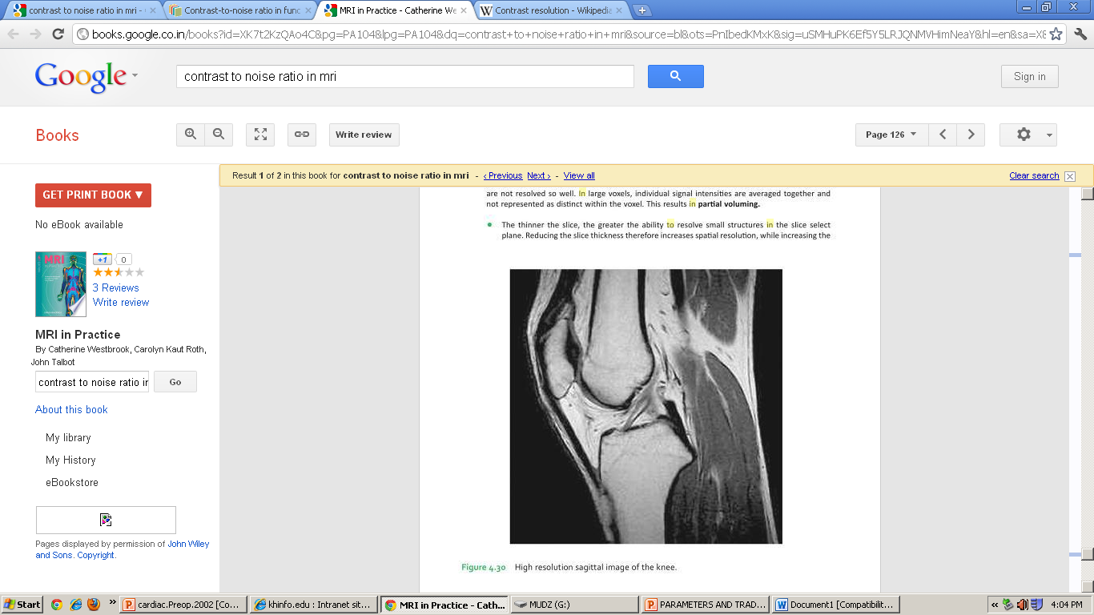

Slide 34
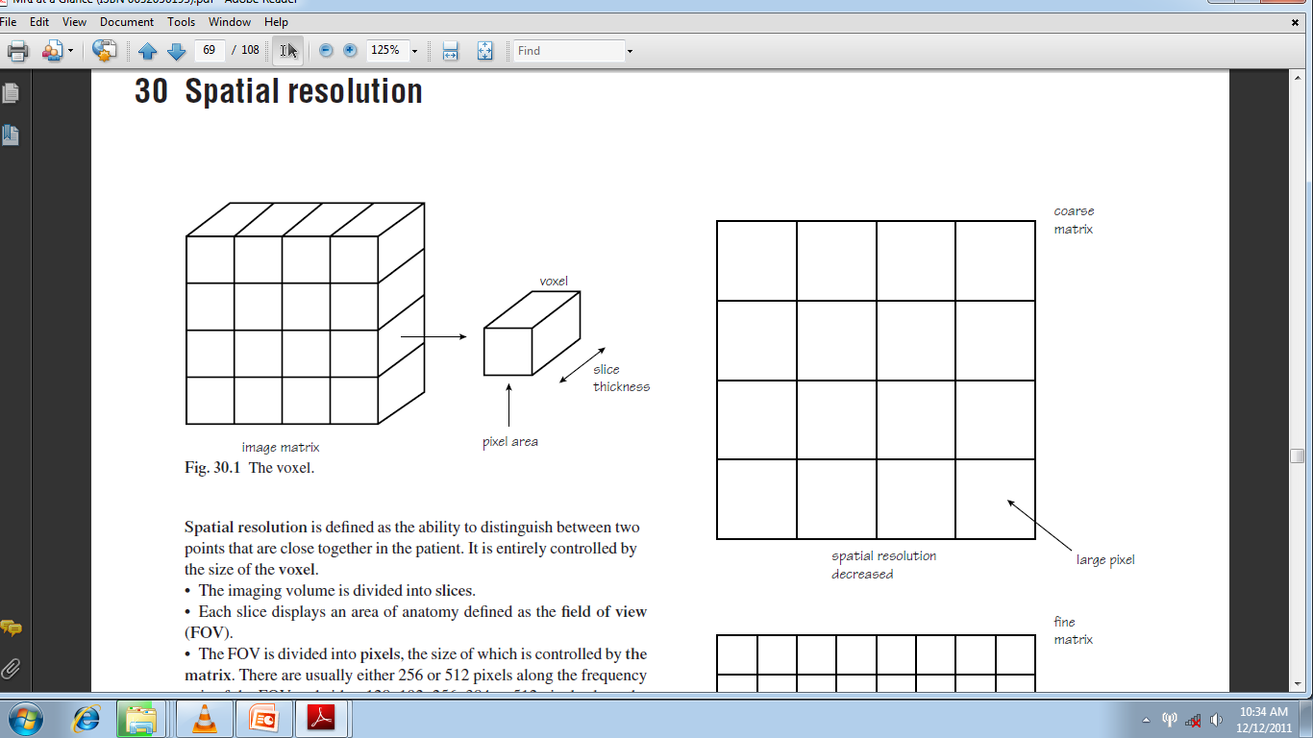
s

Slide 35
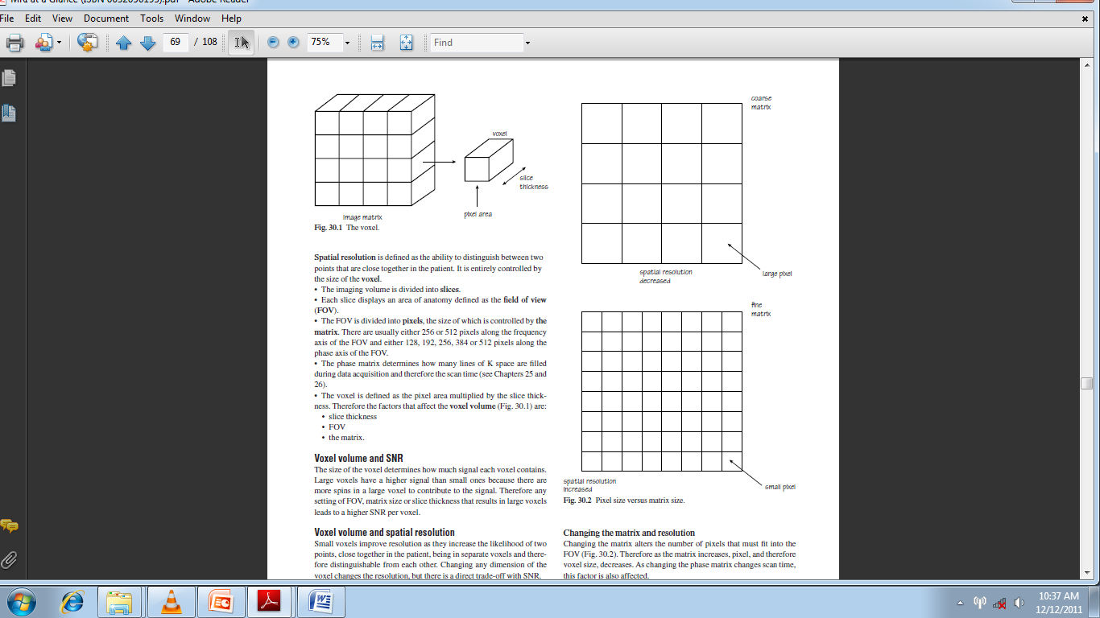
The thinner the slice the greater the ability to resolve small structures in the slice select plane.
Matrix determines the no. of pixels in the FOV.
Increasing the matrix increases the spatial resolution.
Fine matrix – smaller Voxel – reduced SNR.
Size of FOV determines the pixel dimensions.

Slide 36
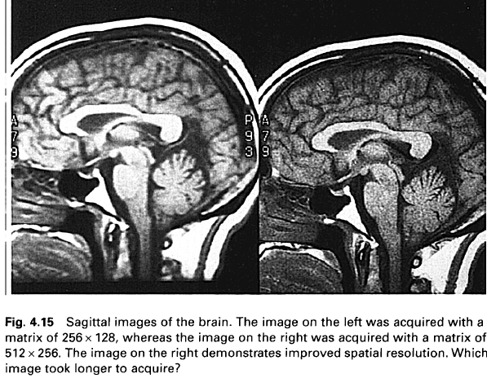

Slide 37


Slide 38
RECTANGULAR FOV
Rectangular FOV maintains spatial resolution but reduces scan time.
As only portion of phase encodings that are normally required are performed.
Dimensions of FOV in phase direction is reduced compared to frequency direction.
So should be used when imaging anatomy that fits into rectangle.

Slide 39
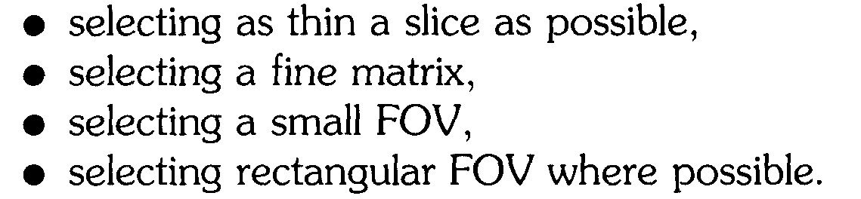

Slide 40
SCAN TIME

Slide 41
SCAN TIME
It is the time to complete data acquisition or the time to fill K- space.
scan time = TR × number of phase encodings × NEX.
TR α scan time
Phase matrix – phase encoding determines the no. of lines of K- space.
NEX – no. of times the data are collected with the same slope of phase encoding gradient.

Slide 42
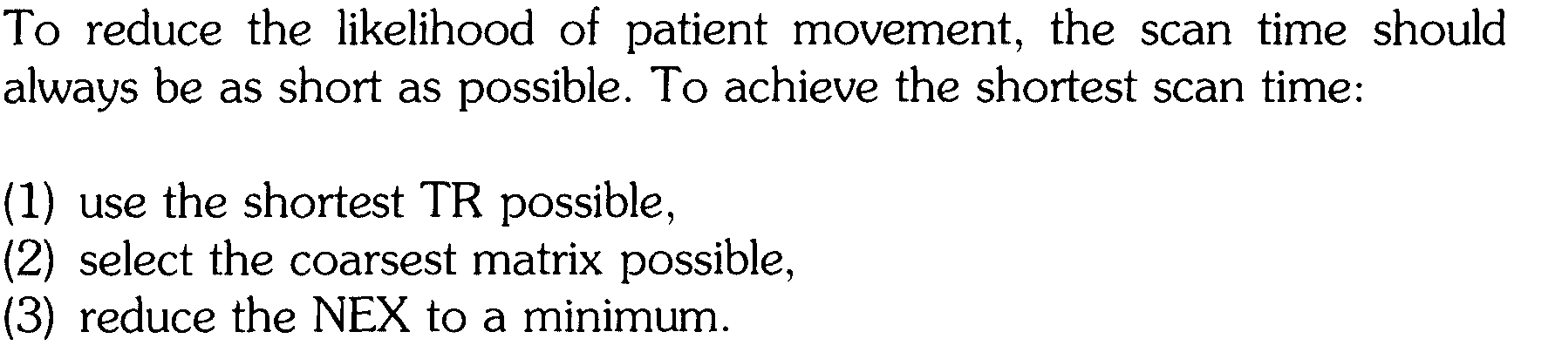

Slide 43
TRADE-OFF

Slide 44
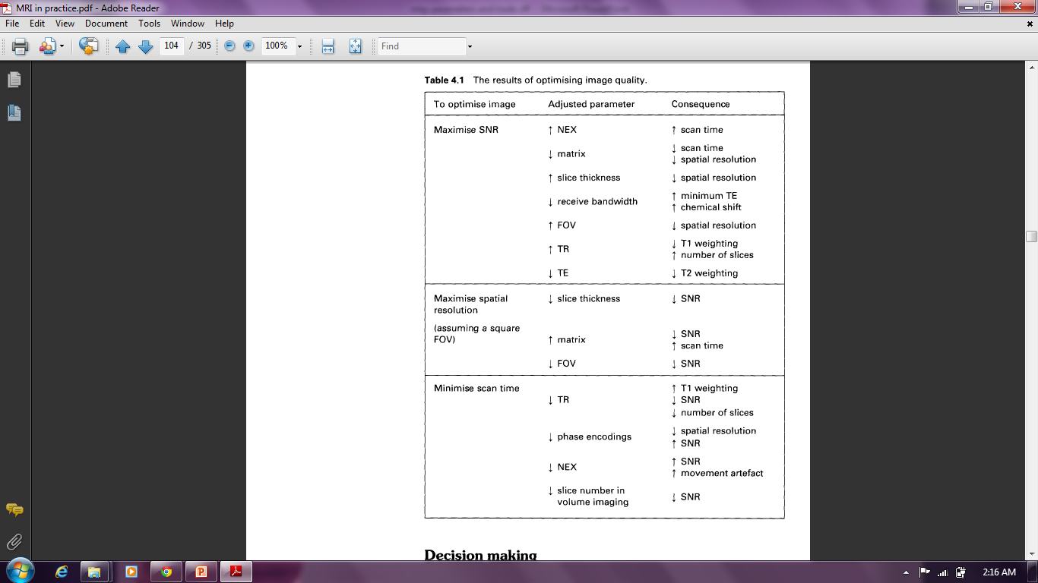
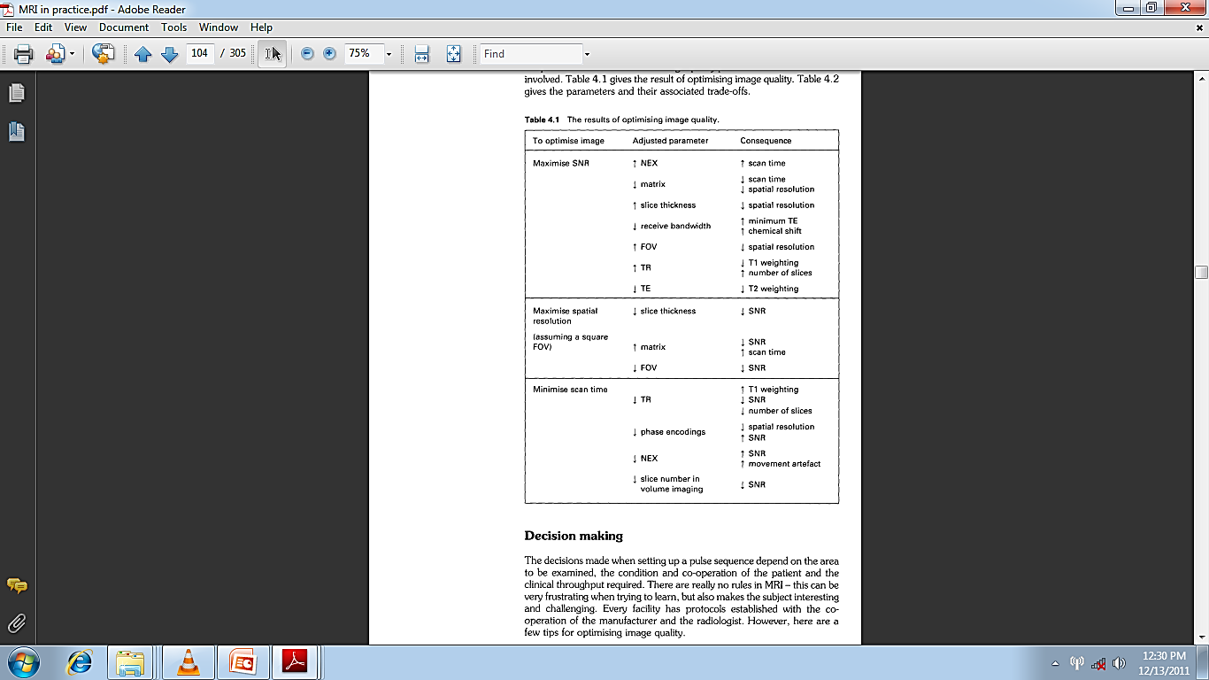

Slide 45
DECISION MAKING
Always chose correct coil and position correctly.
Make sure patient is comfortable.
SNR is most important quality factor.

Slide 46
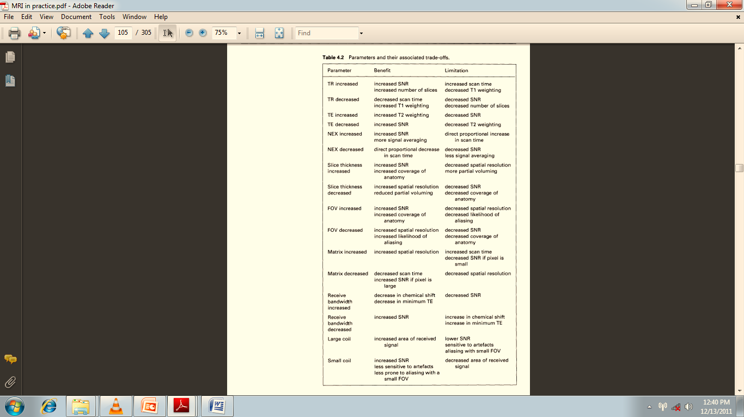

Slide 48
VOLUME IMAGING
Very small lesions can be demonstrated.
Slice thickness is reduced.
There is no slice gap.
Entire volume of tissue is excited and volume contains no gaps.
SNR is superior so fewer NEX can be used.
Data are collected from slab.
Scan time is longer.
Slices are sectioned by technique known as slice encoding.

Slide 49
