Slide 1
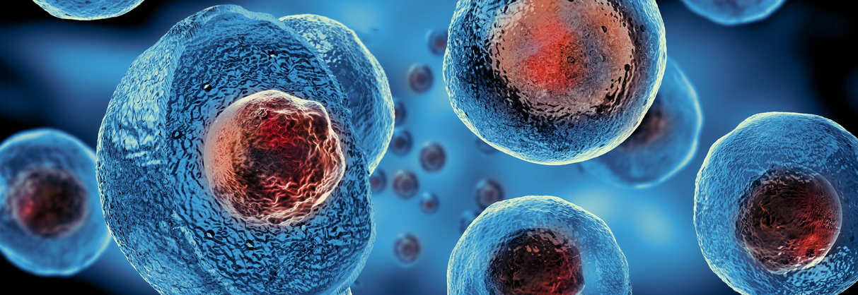
Cell & Cell Organelles
Dr. Smita Vasava
Assistant Professor
Biochemistry Department
SBKS MI

Slide 2
Types of chemical bonds
Or Stabilizing forces in molecules

Slide 3
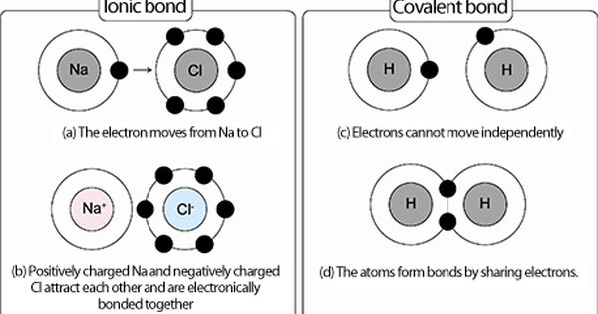
Covalent bonds & Ionic bonds

Slide 4
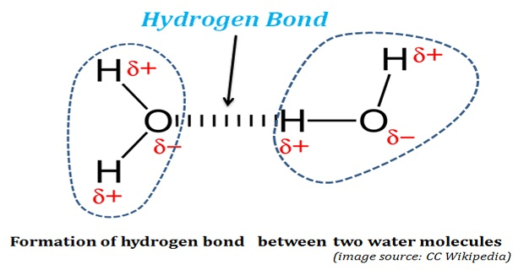
Hydrogen Bond

Slide 5
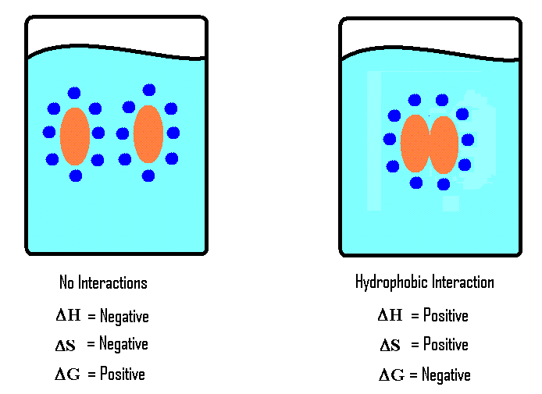
Hydrophobic interaction
Nonpolar groups have a tendency to associate with each other in an aqueous environment, called hydrophobic interaction.

Slide 6
Van der Waals forces
These are very weak forces of attraction between all atoms.
It occurs in all types of molecules, like polar and nonpolar.

Slide 7
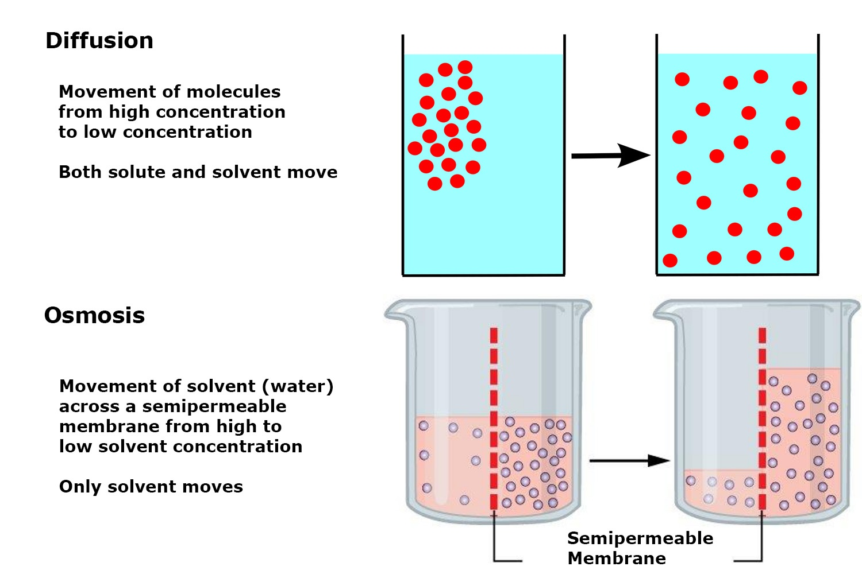
Diffusion and Osmosis

Slide 8
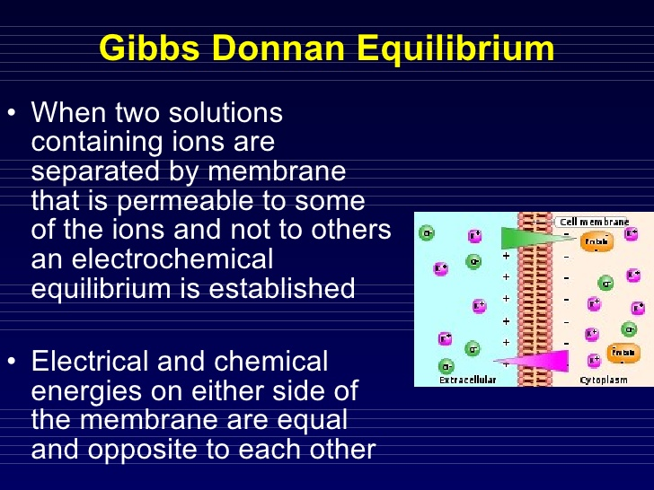

Slide 9
Cell Organelles

Slide 10
The cell is the basic structural, functional and biological unit of all known living organisms.
Cells are the smallest unit of life that is classified as a living thing, and are often called the "building blocks of life".

Slide 11
Cell Theory
The Cell Theory states that:
All living things are composed of a cell or cells.
Cells are the basic unit of life.
All cells come from preexisting cells.

Slide 12
Cell History
The study of cells is called cytology.
Robert Hooke was the first scientist to use the word cell.
Robert Brown discovered the nucleus in 1833.
Theodor Schwann discovered that animals were made of cells in 1838.

Slide 13
Cell Characteristics
Genetic material
  single circular molecule of DNA in prokaryotes
  double helix located in nucleus in eukaryotes – nuclear envelope (double membrane)
Cytoplasm fills cell interior
  sugars, amino acids,
  proteins - organelles
Plasma membrane encloses
  the cell – phospholipid bilayer

Slide 14
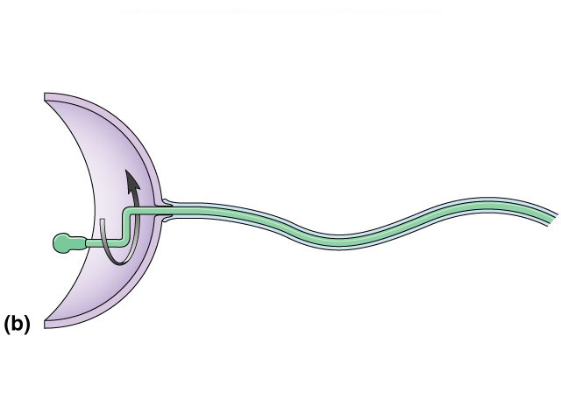
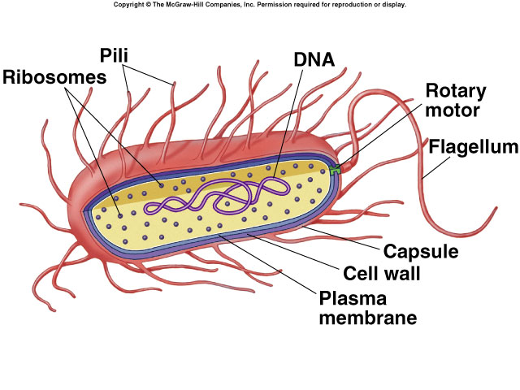
Prokaryotic Cells
Simplest organisms
  Cytoplasm is surrounded by plasma membrane and encased in a rigid cell wall composed of peptidoglycan.
Some use flagellum for locomotion
  Thread like structures protruding from cell surface

Slide 15
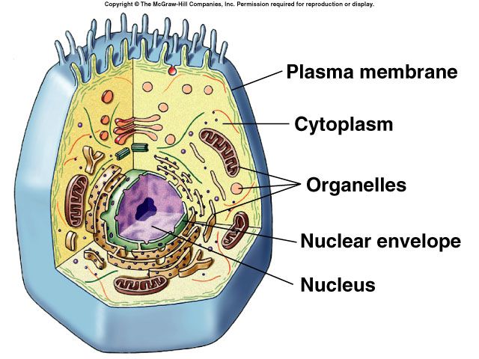
Generalized Eukaryotic Cell

Slide 16
Eukaryotic Cells
Characterized by compartmentalization by an endomembrane system, and the presence of membrane-bound organelles.

Slide 17
Cell Size
Most cells are relatively small because as size increases, volume increases much more rapidly.
  longer diffusion time

Slide 18
Prokaryotic cells are usually independent, while eukaryotic cells are often found in multicellular organisms
Eukaryotic cells are about 10 times the size of a typical prokaryote and can be as much as 1000 times greater in volume.
The major difference between prokaryotes and eukaryotes is that eukaryotic cells contain membrane-bound compartments in which specific metabolic activities take place.
Most important among these is the presence of a cell nucleus, a membrane-delineated compartment that houses the eukaryotic cell's DNA.
It is this nucleus that gives the eukaryote its name, which means "true nucleus”.

Slide 19
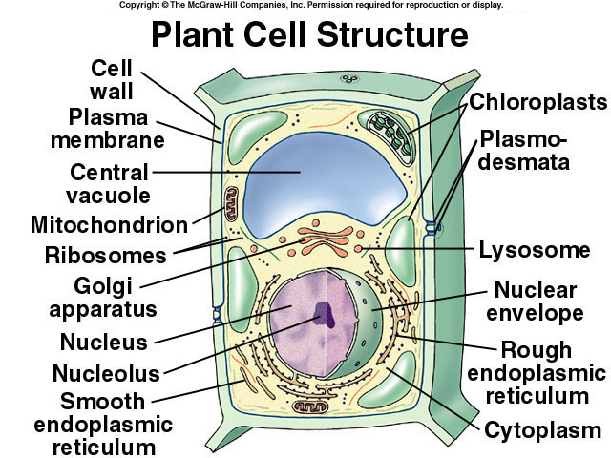

Slide 20
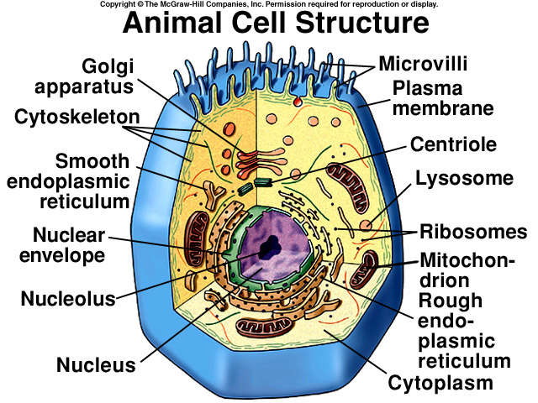

Slide 21
Cell organelles
Cells contain various organized structures called cell organelles.
Can be separated by Density Gradient Centrifugation.
Marker enzymes
Sub cellular Organelles | Pellet formed at centrifugal force of | Marker Enzyme
Nucleus | 600-750 g for 10 min
Mitochondria | 10000-15000 g for 10 min | ATP Synthase
Lysozome | 18000-25000 g for 10 min | Cathepsin
Golgi Complex | 35000-40000 g for 30 min | Galactosyl Transferase
Microsomes | 75000-100000 g for 100 min | Glucose-6- Phosphatase
Cytoplasm | Supernatant | LDH
Notes:
Some enzymes are present in certain organelles only; such specific enzymes are called as marker enzymes. After centrifugation , separated organelles are identified by detection of marker enzymes in the sample.

Slide 22
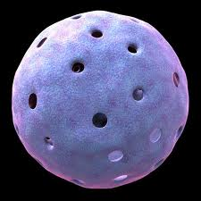
Nucleus
Present in all cells except mature RBC.
Huge nucleus : Lymphocytes & spermatozoa.
Contains DNA.
Surrounded by 2 membranes
  Inner one k/a Perinuclear Membrane with numerous pores.
  Outer one continuous with membrane of endoplasmic reticulum.

Slide 23
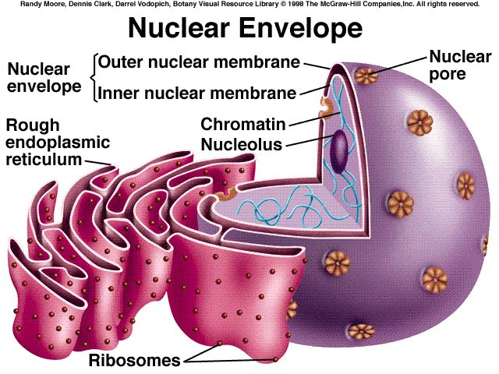

Slide 24
Repository for genetic material
  DNA replication and RNA synthesis occur
Chromosome formation
Directs activities of the cell
Usually single, some cells several, RBC none
  Nucleolus - region of intensive ribosomal RNA synthesis
  Nuclear pores – protein gatekeepers
    Usually proteins going in and RNA going out

Slide 25
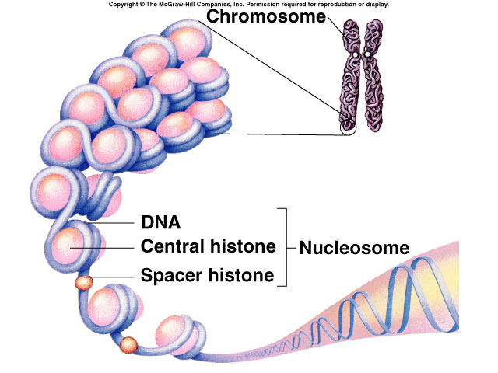
Chromosomes
DNA of eukaryotes is divided into linear chromosomes.
  exist as strands of chromatin, except during cell division
  associated with packaging histones, packaging proteins
    nucleosomes

Slide 26
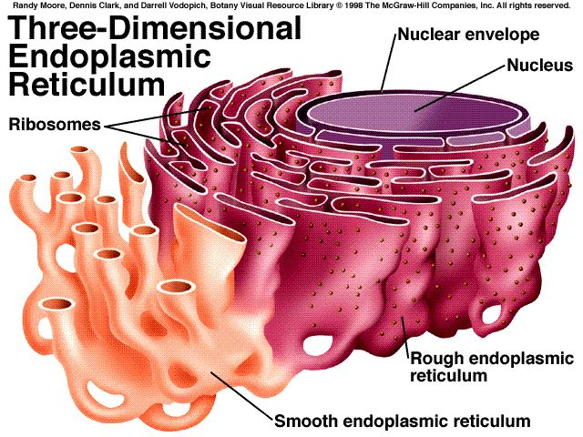
Endoplasmic Reticulum

Slide 27
Definition: Network of interconnecting membranes enclosing channels or cisternae, that are continuous from outer nuclear envelope to outer plasma membrane
Reticular arrangement like ‘RAILWAY TRACK’
Largest internal membrane
Two types : Rough & Smooth
Composed of Lipid bilayer
Prominent in cells actively synthesizing proteins. Eg. Ig secreting Plasma cells

Slide 28
Function of ER
Glycoprotein & Lipoproteins
Detoxification of drugs by hydroxylation by Cyt P450 eg. Morphine, phenobarbitone
Functions in storage and secretion
Rough ER has ribosomes for synthesis of proteins.
Smooth ER - lack associated ribosomes – contained embedded enzymes, catalyze synthesis of carbohydrate and lipid molecules
Endoplasmic reticulum stress:
Diabetes mellitus
-inherited form: beta cell dysfunction , early apoptosis
-DM2 :excess proinsulin synthesis leads to ER

Slide 29
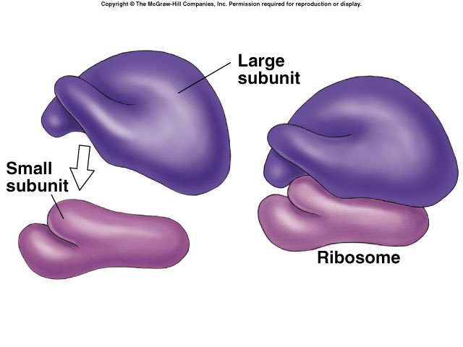
Ribosomes
Ribosomes are RNA-protein complexes composed of two subunits that join and attach to messenger RNA.
  site of protein synthesis

Slide 30
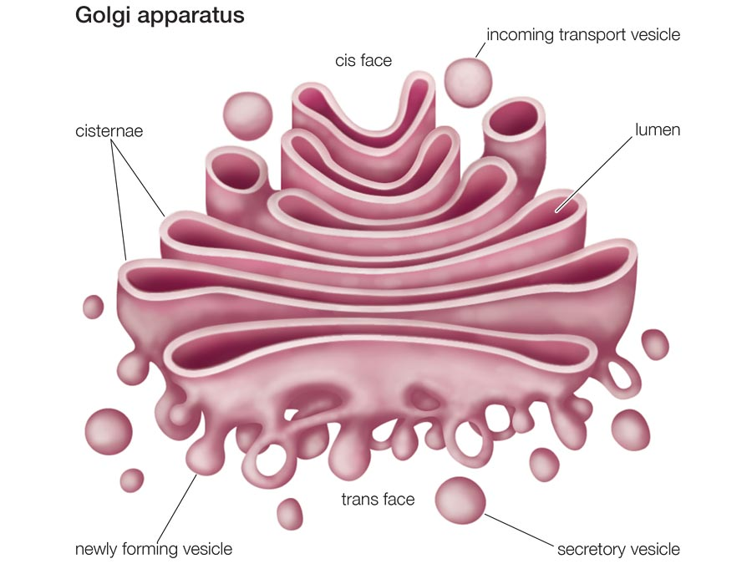
Golgi Apparatus
  Network of flattened smooth membranes and vesicles. Collection of Golgi bodies
    Collect, package, and distribute molecules synthesized at one location in the cell and utilized at another location
    Front - cis , Back – trans
    Cisternae – stacked membrane folds

Slide 31
Function of Golgi
Protein sorting, packaging and secretion.
Golgi bodies are fragmented during mitosis , but get recognized by interaction with microtubules.
Connective tissue disorders like Sjogrens syndrome are found to be associated with Anti-golgi Antibodies.

Slide 32
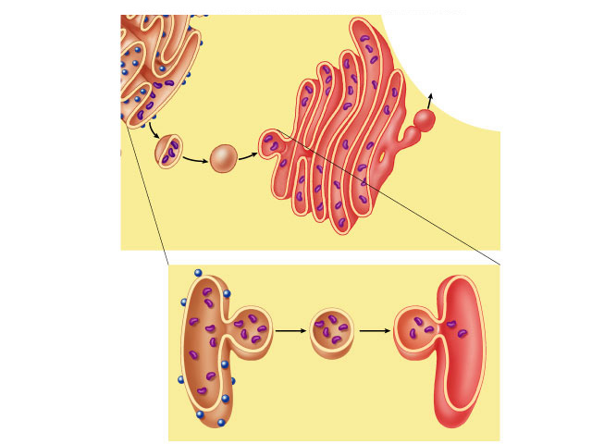
Copyright © The McGraw-Hill Companies, Inc. Permission required for reproduction or display.
Cisternae
cis face
Proteins
trans face
Transport
vesicle
Golgi
apparatus
Protein
Vesicle
budding
from rough
endoplasmic
reticulum
Migrating
transport
vesicle
Fusion
of vesicle
with Golgi
apparatus
Ribosome

Slide 33
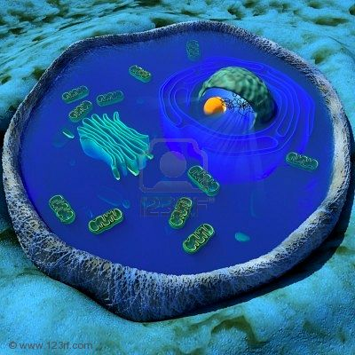
The Cytoplasm
The cytoplasm has three major elements; the cytosol, organelles and inclusions.
The cytosol is the translucent fluid in which the other cytoplasmic elements are suspended
The cytoplasm holds organelles and protects them, such as the vacuole, endoplasmic reticulum, etc.

Slide 34
Cytosol makes up about 70% of the cell and is composed of water, salts and organic molecules
The cytoskeleton, various proteins, ribosomes and enzymes that are necessary for the cell to catalyze reactions are also found throughout the cytosol.

Slide 35
The inner, granular and more fluid portion of the cytoplasm is referred to as endoplasm.
The organelles are the metabolic machinery of the cell and are like little organs themselves.
Some major organelles that are suspended in the cytosol are the mitochondria, the endoplasmic reticulum, the Golgi apparatus, lysosomes.
The inclusions are chemical substances that store nutrients, secretory products and pigment granules.

Slide 36
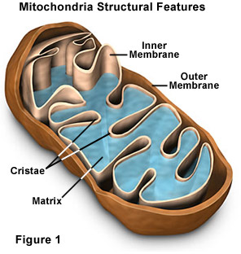
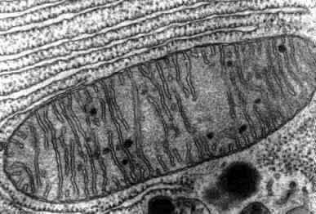
Mitochondria
  .
  Spherical, oval or rod like bodies 0.5-1 micron in diameter and upto 7 microns in length.

Slide 37
Erythrocyte: no mitochondria.
Spermatozoa: Tail part
Powerhouse of the cell
Metabolic functions : ETC, ATP generation, TCA, B-oxidation of fatty acid, ketone body synthesis, urea synthesis, heme synthesis, gluconeogenesis, pyrimidine synthesis
Role in proinflammatory singling and inflammatory diseases.

Slide 38
Two membranes: inner membrane convolutes into cristae which contains enzymes of ETC.
Outer membrane
Fluid matrix contains enzymes of TCA, urea cycle and heme synthesis.

Slide 39
Cytochrome P-450 system –inner mem, involved in steroidogenesis
Superoxide dismutase –cytosol & mitochondria.
Specific DNA: Integral inner mem. Proteins are made by mitochondrial protein synthesizing machinery.
Outer mem. proteins: cellular DNA
Division of mitochondria : mitochondria DNA
TOM & TIM
Antibiotics:
Endosymbiotic theory: Parasite

Slide 40
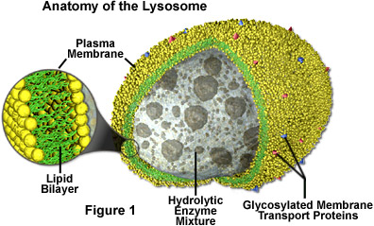
Lysosomes
Tiny organelles.
Incinerators-----Bags of enzymes.
Has acid pH , most enzyme are acid hydrolases

Slide 41
Lysosome function

Slide 42
Exosomes
If the membrane of a lysosome breaks, the enzymes released may also destroy the cell itself, giving lysosomes the name "suicide bag".
Hydrolysis of carbohydrates (glucosidase, fucosidase, hyaluronidase); proteins (cathepsins, collagenase, elastase); lipids (fatty acyl esterase, phopholipase) and nucleic acids (phosphodiesterase).

Slide 43
Clinical applications
Gout
Following cell death: post-mortem autolysis
Tumor metastasis: Lysosomal proteases, cathepsins—degrade the basal lamina by hydrolysing collagen and elastin---distant metastasis
Genetic diseases: lysosomal enzymes def./abs—accumulation of lipids
Silicosis—Fibrosis—decrease in lung elasticity
Inclusion cell (I-cell) disease: a protein targeting defect – accumulation of undegraded molecules – inclusion bodies.

Slide 44
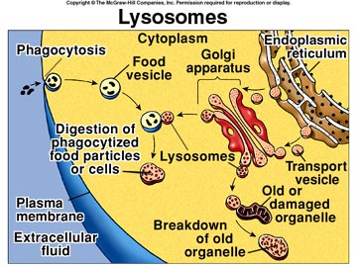

Slide 45
Autophagy
Lysosomes play a central role in autophagy.
Autophagy is a self-digesting mechanism responsible for the removal of damaged organelles, malformed proteins during biosynthesis, and nonfunctional proteins.
There are three general types of autophagy, namely, microautophagy, chaperone-mediated autophagy (CMA), and macroautophagy.

Slide 46
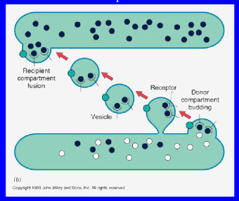
Vesicle
In cell biology, a vesicle is a relatively small intracellular,
membrane-enclosed sac that stores or transports substances
The vesicle is separated from the cytosol by at least one
lipid bilayers.
If there is only one lipid
bilayer, they are called
unilamellar vesicles;
otherwise they are called
multilamellar.
Vesicles store, transport,
or digest cellular products
and waste.

Slide 47
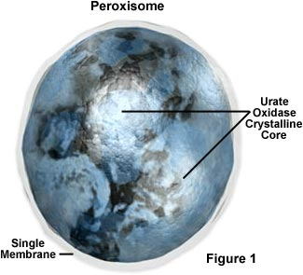
  Peroxisomes
  Have granular matrix, 0.3-1.5 micron
  Contain peroxidases and catalase , prominent in leucocytes and platelets.
  Peroxidation of PUFA
  Free radicals
  Catalase and peroxidase
  Have important role in : neurogdegenerative diseases and cancer

Slide 48
Peroxisomes have got an Important Role in Lipid Metabolism
Metabolism of free oxygen radicals.
Synthesis of cholesterol and ether lipids.
Bile acid formation.
Catabolism of long chain fatty acids.

Slide 49
Peroxisomes has got an Important Role in Lipid Metabolism
Catabolism of purines, prostaglandins, leucotrienes.
Alcohol detoxification in liver.
Metabolism of estradiol.

Slide 50
Peroxisomes are named so because they play unique role in Hydrogen Peroxide metabolism.
Contain enzymes that use molecular oxygen to remove hydrogen atoms from specific substrates
RH₂ + O₂ → R + H₂O₂
Hydrogen peroxide is used up or detoxified.
Catalases in peroxisome convert this hydrogen peroxide to water.
2H₂O₂ → 2 H₂O + O₂

Slide 51
Clinical Significance of peroxisomes
Peroxisomal biogenesis disorders
Deficiency of peroxisomal matrix proteins can lead to adrenoleukodystrophy (ALD) (Brown-Schilder’s disease) characterized by progressive degeneration of liver, kidney and brain. It is a rare autosomal recessive condition. The defect is due to insufficient oxidation of very long chain fatty acids (VLCFA) by peroxisomes.
In Zellweger syndrome, proteins are not transported into the peroxisomes. This leads to formation of empty peroxisomes or peroxisomal ghosts inside the cells.
Primary hyperoxaluria is due to the defective peroxisomal metabolism of glyoxalate derived from glycine

Slide 52


