Slide 1
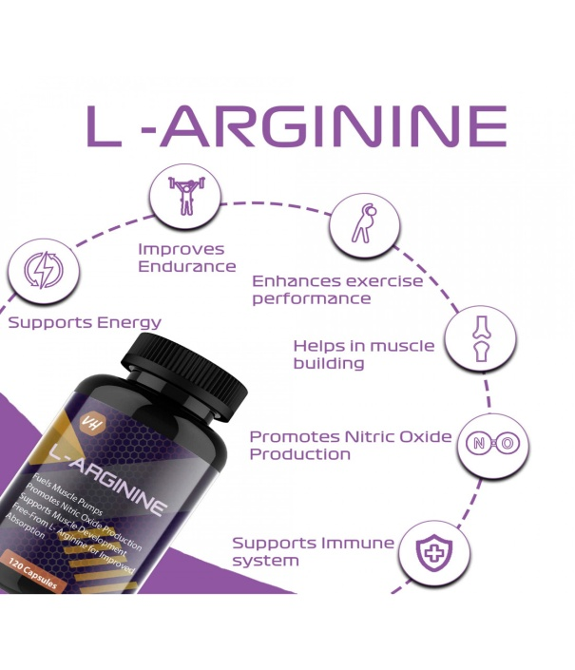
ARGININE (ARG) (R)
Arginine contains guanidinium group.
It is a highly basic, semi-essential amino acid.
Arginine is glucogenic.
In the urea cycle, where arginase splits arginine into urea and ornithine.
Arginine is necessary for the synthesis of creatine.
Arginine is the precursor of nitric oxide which is an important signal molecule in the body.

Slide 2
NITRIC OXIDE (NO˙)
It is a toxic pollutant of air and automobile exhausts.
It is shown to possess more potential biological functions than any other known molecule.
The vasodilatory effect of nitroglycerine is due to the release of NO˙.
“Endothelium derived relaxing factor” (EDRF) is required for arterial dilatation.
EDRF is chemically NO˙.

Slide 4
Metabolic Fate
NO• combines with oxygen to form NO2.
These nitrites are excreted through urine.
On exposure to superoxide anion (O•2–), nitric oxide (NO•) is converted to a highly reactive free radical, peroxynitrite (OONO•), which causes lipid peroxidation, cell injury and cell death.

Slide 5
ISO-Enzymes of NOS
There are 3 isoforms of NOS, these are products of 3 different genes.
All forms are seen in almost all tissues.
1. Neuronal NOS: NOS-1 or nNOS or neuronal NOS is seen in central and peripheral neurons.
Nitrogenic neurons are seen especially in cerebellum and gastrointestinal tract.

Slide 6
Iso-enzymes of NOS Continued
2.Macrophage NOS: NOS-2 or iNOS or inducible NOS or macrophage NOS is mainly seen in macrophages and neutrophils. It is induced by cytokines (interleukin-1 and tumor necrosis factor).
3.Endothelial NOS: NOS-3 or eNOS or endothelial NOS is seen in endothelial cells, platelets, endocardium and myocardium.
In these sites, the NO• is constantly produced and released, so as to have arterial relaxation.

Slide 7
Mechanism of Action of Nitric Oxide
NO• diffuses to the adjacent smooth muscle and activates guanylate cyclase.
Increased level of cyclic GMP activates protein kinase in smooth muscles, kinase in smooth muscles, leading to relaxation leading to relaxation of muscles.
Thus NO• is a vasodilator.

Slide 8
Physiological Actions of Nitric Oxide
1.Blood vessels: NO• is a potent vasodilator.
The normal blood pressure is maintained by the NO•
liberated by endothelial NOS (NOSe).
NO• causes cerebral, coronary, renal and muscle arteries to dilate.
A deficiency of NO˙ is associated with hypertension.
Excessive production of NO• results in refractory hypotension, which may be seen in patients with septicemic shock.
2.Central nervous system: In CNS, NOSn isoform is present.
NO• stimulates the releasing hormones (CRH, GHRH and LHRH).

Slide 9
3.Macrophages: Macrophages contain the isoform NOSi
(i stands for inducible).
This enzyme produces NO˙ and peroxy nitrite; which are lethal to micro-organisms.
NO• production in macrophage is induced by interleukin and tumor necrosis factor.
4.Platelets: NO• inhibits adhesion of platelets and so depresses platelet functions.
5. Intestinal system: NO• is a non-adrenergic and noncholinergic (NANC) neurotransmitter, especially in gastrointestinal tract and urogenital tract.
It relaxes smooth muscles and leads to reduced gastrointestinal motility and relaxation of sphincters.

Slide 10
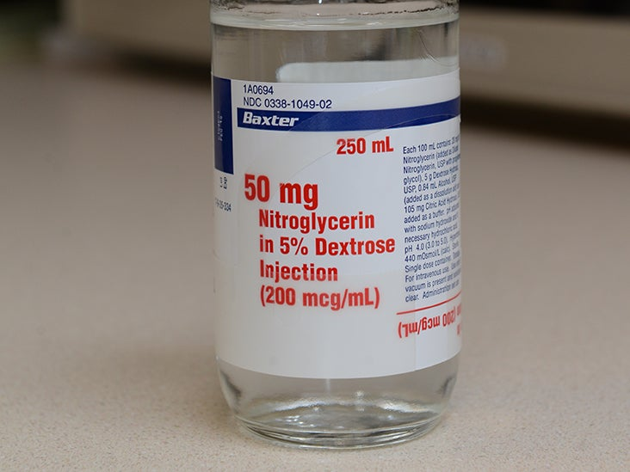
Nitric Oxide in Diseases and Treatment
1. Angina pectoris: Nitroprusside can directly release NO•.
Nitroglycerin (glyceryl trinitrite) requires glutathione to produce NO•.
These will dilate coronary arteries, and are beneficial in treating angina pectoris.
2. Pulmonary hypertension: Inhalation of NO• is useful in the treatment of pulmonary hypertension and high altitude pulmonary edema.
NO• produces pulmonary vasodilatation, without lowering systemic blood pressure

Slide 11
3. Impotence: NO• relaxes smooth muscles in the corpus cavernosum and increases blood flow into the penis and
makes it erect.
Sildenafil citrate (Viagra) selectively inhibits the specific phosphodiesterase type 5 (PDE-5); thus inhibiting hydrolysis of cGMP, and increasing the concentration of cGMP in corpus cavernosum.

Slide 13
Acidic Amino Acids
The acidic amino acids are glutamic acid and aspartic acid.
Glutamine and asparagine are the corresponding amides formed by addition of ammonia to the extra carboxyl group to form an amide.
All the four amino acids are used for protein synthesis and serve important metabolic functions.

Slide 14
GLUTAMIC ACID (GLU) (E)
Transamination reactions: Most amino acids transfer
their amino group to alpha keto glutaric acid to form
glutamic acid.
aminotransferase
Amino acid + Alpha keto glutarate →
Alpha keto acid +
Glutamic acid

Slide 15
Glutamic acid is also formed during the metabolism of histidine, proline and arginine.
Oxidative deamination: Glutamic acid is deaminated to form alpha keto glutarate by the enzyme glutamate dehydrogenase with the help of NAD+.
Glutamic acid -→Alpha ketoglutarate + NH3
Glucogenic: Glutamic acid enters the TCA cycle as α ketoglutarate, gets converted to oxaloacetate and enters the glucogenic pathway.

Slide 17
N-acetyl glutamate (NAG) is a positive modifier of carbamoyl phosphate synthetase-I in the mitochondria.
Glutamic acid + Acetyl-CoA
→ NAG + CoASH
Gamma carboxy glutamic acid (GCGA) is present in prothrombin.
The gamma carboxyl group is added as a post-translational modification, which needs vitamin K

Slide 18
Excitatory neurotransmitter. Neurons contain NMDA
(N-methyl-D-aspartate) receptor.
Stimulation of NMDA receptors by glutamate opens calcium channel, leading to stimulation of NOS (nitric oxide synthase).
This in turn, results in transient production of NO• (nitric oxide).
This raises the cellular level of cyclic GMP and neurons are excited.
Glutathione: Glutamate is a constituent of the tripeptide glutathione.
Glutamic acid is decarboxylated to GABA.

Slide 19
Gamma-Amino Butyric Acid (GABA)
Metabolism: Glutamic acid on decarboxylation gives rise to gamma-amino butyric acid (GABA).
Part of the glutamate in the brain can be shunted through the GABA pathway and catabolized to succinate.
GABA is an inhibitory neurotransmitter because it opens the chloride channels in post-synaptic membranes in CNS.

Slide 20
Pyridoxal phosphate: Both the formation and catabolism of GABA requires pyridoxal phosphate as coenzyme.
Therefore, in pyridoxine deficiency, GABA formation is reduced.
Since GABA is an inhibitory transmitter, a low level of GABA or deficiency
of pyridoxal phosphate would lead to convulsions.
Sodium valproate which inhibits GABA oxidase is used in the treatment of epilepsy.
Congenital deficiencies of GABA amino transferase and succinic semialdehyde dehydrogenase (leading to hydroxy butyric aciduria) are reported, but are very rare.

Slide 22
GLUTAMINE (GLN) (Q)
It is a glucogenic amino acid.
It is synthesized from glutamic acid.
The amidation of glutamic acid to glutamine is catalyzed by glutamine synthetase.
Glutamic acid can react with a molecule of NH3 in presence of ATP.
This reaction is important in ammonia trapping in brain as well as for transport of ammonia in a nontoxic form.
Glutamine is hydrolyzed to glutamate and NH3 by the enzyme glutaminase.
This reaction is seen in the renal tubular cells.
This ammonia reacts with H+ to form NH4+ to excrete hydrogen ions in urine.

Slide 23
Major fate of glutamine is to be hydrolyzed to glutamate and NH3.
Glutamic acid is then deaminated to alpha ketoglutarate and enters TCA cycle for further catabolism.
The N atoms 3 and 9 of purines are derived from glutamine.
Glutamine is the source of 3rd N of pyrimidine.
Glutamine is the source of NH2 group of guanine and cytosine.
Glutamine is a conjugating agent, e.g. production of phenyl acetyl glutamine.
Glutamine donates the amino group of amino sugars and amide group of nicotinamide.

Slide 24
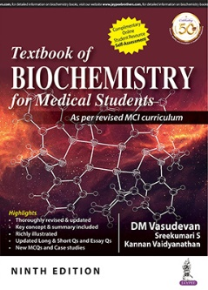
ASPARTIC ACID (ASP) (D)
It is a non-essential, glucogenic amino acid.
Aspartate, on transamination gives rise to oxaloacetate which initiates the TCA cycle.
Aspartate amino transferase (AST) transfers the amino group of aspartate to alpha ketoglutarate to form oxaloacetate.
(AST) (PLP)
Aspartate + -------------------→ Oxalo acetate
alpha ketoglutarate + Glutamate

Slide 25
AST is increased in cardiac ischemia and in hepatic diseases.
Malate aspartate shuttle transfers the cytoplasmic NADH
into mitochondria for oxidation in the electron transport chain.
Aspartic acid is an important member of urea cycle.
It directly contributes its alpha amino group to the urea molecule.
The carbon skeleton of aspartate can also enter the glucogenic pathway as fumarate.
Citrulline + Aspartate →Arginine + Fumarate

Slide 27
Histidine (HIS) (H)
Histidine has an imidazole ring.
It is a semi-essential basic amino acid.
Its pK value is 6.1; and hence in proteins, histidine is responsible for the maximum buffering action.

Slide 28
Metabolism of histidine.

Slide 29
Glutamic acid is transaminated to alpha keto glutarate
which can be converted to glucose.
So histidine is glucogenic.
Histidine contributes to the one-carbon pool.
When folic acid is deficient, FIGLU is excreted in urine.

Slide 30
Metabolism of histamine.

Slide 31
Summary of Action of Histamine
Tissue | Effect
1. Blood vessels | Pulmonary venous dilation; superficial temporal artery dilation (migraine). Large veins, smaller venules and capillaries are dialated
2. Cardiovascular system | Fall in BP; increased capillary permeability
3. Heart | Chronotropic and ionotropic effect on heart, coronary artery flow is increased
4.Smooth muscles | Direct stimulant; contraction of bronchial muscles; bronchospasm
5.Exocrine glands | Stimulates gastric acid secretion

Slide 32
Certain antigens, such as penicillin will elicit IgE
antibodies that are fixed on the mast cells.
When the next dose of penicillin is injected, it reacts with the antibodies; and degranulation of mast cells takes place.
Histamine and slow reacting substance (SRS) are released.
This leads to peripheral vasodilatation, fall in blood pressure and anaphylaxis.
Antihistamines are drugs which block histamine receptors.
They are used to control allergic and anaphylactic reactions.
The stimulant effect of histamine on gastric acid secretion is by acting on H2 receptors.
Hence, H2 receptor antagonists are used in the treatment of acid peptic ulcers of stomach.

Slide 33
Histidinemia
It is an autosomal recessive disease.
The deficiency of histidase leads to accumulation of
histidine in blood and body fluids and increased excretion of imidazole pyruvic acid in urine.
The clinical features include mental retardation and delayed speech development.
A low histidine diet may have some effect.

Slide 34
Urocanic Aciduria
It is due to the deficiency of urocanase.
Urocanic acid and histidine are excreted in urine.
Clinical manifestations are minimal.

Slide 35
Imidazole Aminoaciduria
It has dominant type inheritance. The defect is in the
transport mechanism in kidney tubules. Cerebromacular
and retinal degeneration may cause blindness.

Slide 36
FIGLU Excretion Test
About 5 g of histidine is given three times at 4-hourly
intervals. Urine is collected for 24 hour after the initial dose.
Normally less than 30 mg of FIGLU is excreted within 1 day; the value is increased in folate deficiency.
Since folic acid can be directly estimated by ELISA method, the FIGLU excretion test is rarely done nowadays.

Slide 37
Proline (PRO) (P) and Hydroxyproline
Proline is a non-essential glucogenic amino acid.
Proline does not participate in the transaminase reaction.
Proline is converted to dehydroproline, and then to glutamate, which enters the citric acid cycle for complete oxidation.
Proline is incorporated into the protein, and then hydroxylated to hydroxy proline, by the enzyme prolyl hydroxylase.
The hydroxylation requires molecular oxygen, ascorbate, iron and alpha keto glutarate.

