Slide 1
SPLEEN
Dr Manoj Kulkarni
Professor & Head
Department of Anatomy

Slide 2
Location
The spleen (Latin low spirits) is a wedge-shaped organ lying mainly in the left hypochondrium, and partly in the epigastrium. It is wedged in between the fundus of the stomach and the diaphragm.
Dimensions
• On an average the spleen is 1 inch or 2.5 cm thick
• 3 inches or 7.5 cm broad
• 5 inches or 12.5 cm long
• 7 ounces in weight and is related to 9th to 11th ribs.
• The odd numbers are 1, 3, 5 are 7, 9, 11. Normally, the spleen is not palpable.

Slide 3
Position (Axis of Spleen)
The spleen lies obliquely along the long axis of the 10th rib.
External Features
Two Ends
• The anterior or lateral end
• The posterior or medial end
Three Borders
• The superior border
• The inferior border
• The intermediate border

Slide 4
Two Surfaces
• The diaphragmatic surface
• The visceral surface
Two Angles
Anterobasal angle:
It is the most forward projecting part of spleen.
Posterobasal angle:
Hilum
. It is pierced by branches and tributaries of splenic vessels. Hilum lies between superior and intermediate borders

Slide 5
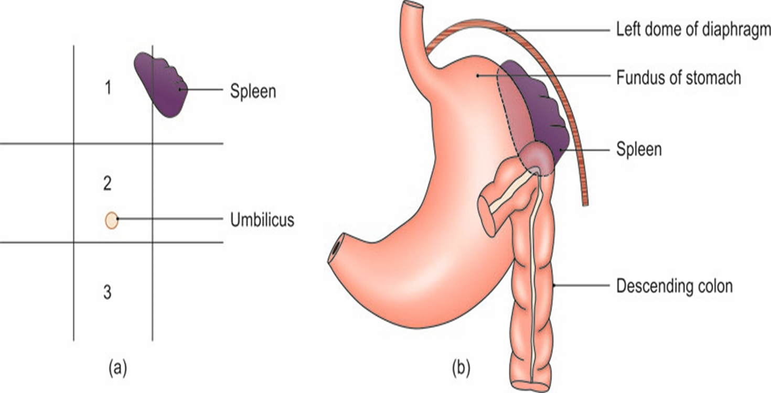
Location of the spleen: (a) In relation to the nine regions of the abdomen: (1) Epigastrium; (2) umbilical region; and (3) hypogastrium, and (b) in relation to the fundus of the stomach and the diaphragm

Slide 6
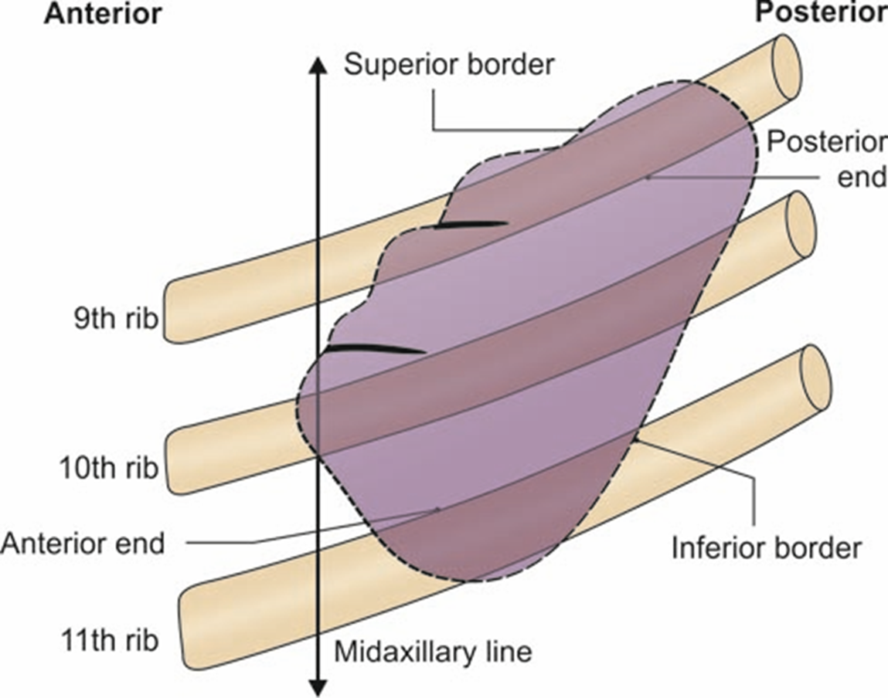

Slide 7
Relations
Peritoneal Relations
The phrenicocolic ligament
Visceral Relations
• Visceral surface
– The gastric impression,
– The renal impression
– The colic impressions,
– The pancreatic impression
– The hilum

Slide 8
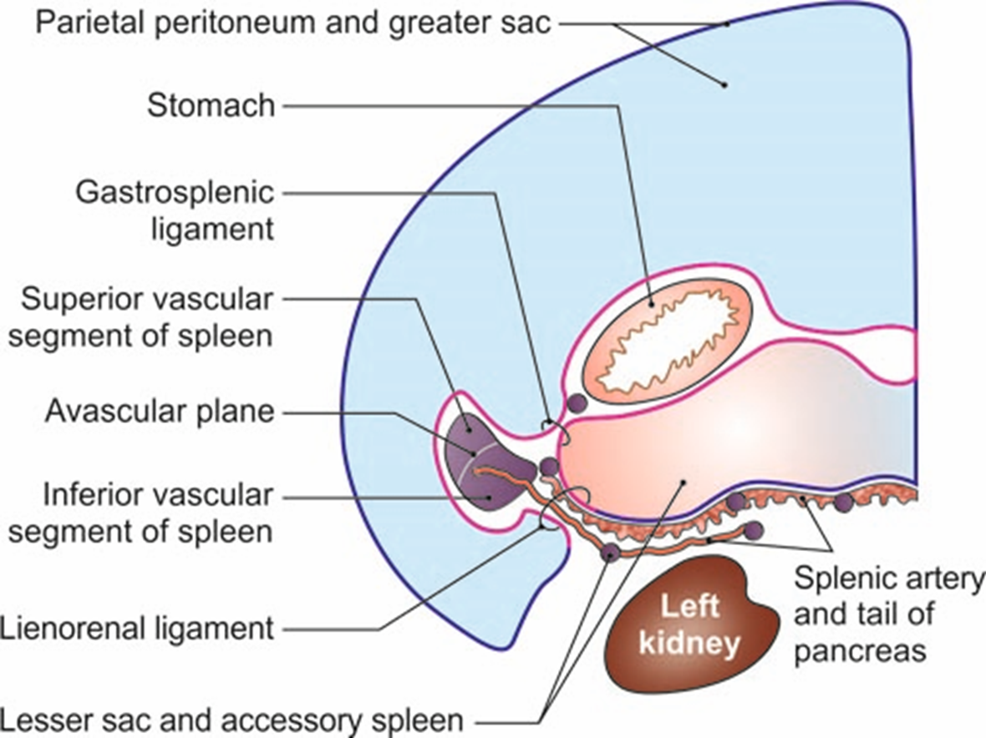
• Diaphragmatic surface
The diaphragmatic surface is related to the diaphragm which separates the spleen from the costodiaphragmatic recess of pleura, lung and 9th, 10th and 11th ribs of the left side.

Slide 9
TITLE | AUTHOR / JOURNAL | MATERIAL | RESULT | CONCLUSION
Late septic complications in adults following splenectomy for trauma: a prospective analysis in 144 patients | Green JB , Shackford SR , Sise MJ , Fridlund P The Journal of Trauma [01 Nov 1986, 26(11):999-1004] | One hundred forty-four patients were prospectively followed through our Asplenic Registry for the development of late septic complications following splenectomy for trauma. There were 114 males and 30 females with a mean age of 28.6 years. | The mortality from major septic complications in this series (7%) is lower than previously reported by other investigators (30-80%). | Our data suggest that adults undergoing splenectomy for trauma are at an increased risk of developing late major septic complications. This risk is significant enough to warrant attempts at splenic salvage, especially when injury is incidental to an elective operative procedure.

