Slide 1
Metabolism Of Branched Chain Amino Acids
Dr Trushna Shah
Professor
SBKSMI&RC

Slide 2
Valine, Isoleucine and leucine are branched essential amino acids.
    Valine: Glucogenic
    Isoleucine : Both glucogenic and ketogenic
    Leucine: Ketogenic

Slide 3
First three catabolic reactions for branched chain amino acids are similar and are catalyzed by common enzymes
Transamination : to yield corresponding α-keto acids.
Oxidative decarboxylation: In the second step, the α -keto acids are oxidatively decarboxylated to the corresponding acyl-CoA thioester by branched-chain α -keto acid dehydrogenase complex. TPP, FAD, Lipoic acid, NAD+ and CoA are required as coenzymes in this reaction.

Slide 4
Dehydrogenation :The third reaction is a FAD dependent dehydrogenation
4. The subsequent reactions of all the three branched chain amino acids differs and is catabolised as follows:
Valine is converted to succinyl-CoA accounting for the glucogenic nature of the valine.
Isoleucine is converted to succinyl-CoA and acetyl- CoA, accounting for the ketogenic and glucogenic nature of the isoleucine.

Slide 5
Leucine forms acetoacetate and acetyl-CoA but does not produce succinyl-CoA, which accounts for exclusively the ketogenic nature of the leucine.
Leucine produces hydroxymethyl glutaryl-CoA (HMG-CoA) intermediate product which is a precursor of cholesterol biosynthesis and ketone body formation.

Slide 6
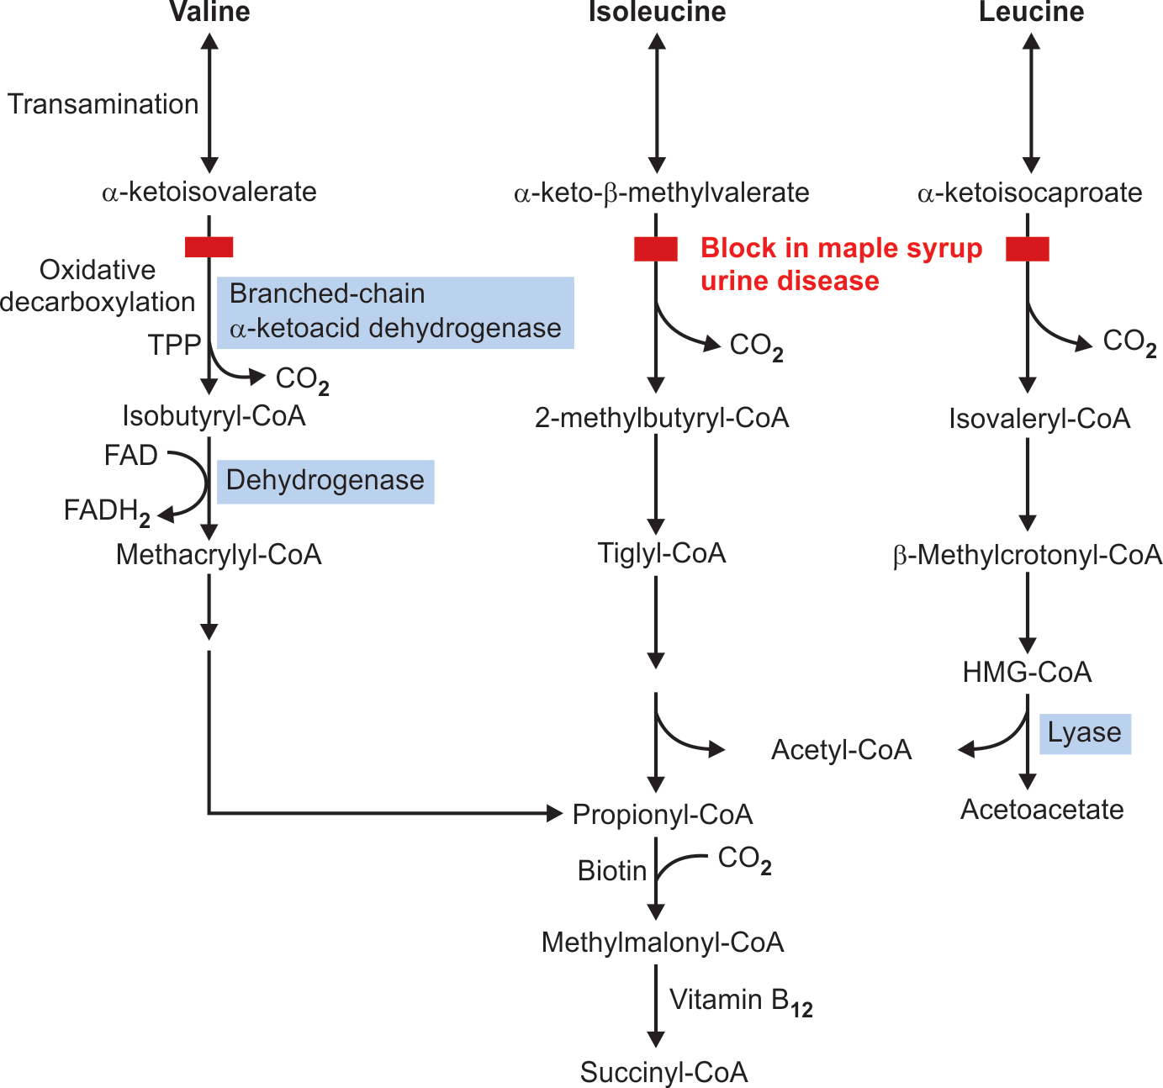

Slide 7
Metabolic Disorder of Branched Chain Amino Acids
Maple syrup urine disease (MSUD) or branched chain
keto aciduria

Slide 8
Inherited defect in the branched chain α-keto acid dehydrogenase.
Branched chain amino acids, leucine, isoleucine and valine, and their α -keto acids accumulate in blood, urine and CSF.
α -keto acids impart a characteristic sweet odour to the urine of the affected individuals which resembles with maple syrup or burnt sugar hence the name.

Slide 9
Symptoms
    Vomiting
    dehydration
    metabolic acidosis
    maple syrup odour to the urine.
    If untreated, it leads to mental retardation, coma and even death within one year after birth.

Slide 10
Diagnosis
Many infants with MSUD are identified through newborn screening programs.
Tandem mass spectrometry, an advanced newborn screening test that screens for more than 30 different disorders through one blood sample, has aided in the diagnosis of MSUD.

Slide 11
Treatment
Treatment involves replacing dietary protein by mixture of amino acids that contain low or no leucine, isoleucine, and valine.
To monitor the effectiveness of the dietary treatment, plasma and urinary levels of branched-chain amino acids with dinitrophenylhydrazine (DNPH) should be measured constantly.

Slide 12
Case study
10-day-old male infant who had cyanotic episodes and recurrent generalized convulsions; the odor of burned sugar from the body and urine was also noted. Plasma and urine amino acid analysis disclosed a marked increase in the concentration of branched chain amino acids (BCAA). As a result of a BCAA-free diet and mega-doses of thiamine, the condition stabilized.

