Slide 1
THE ENDOCRINE SYSTEM
Dr. Hetal Vaishnani
Associate Professor
Dept. of Anatomy

Slide 2
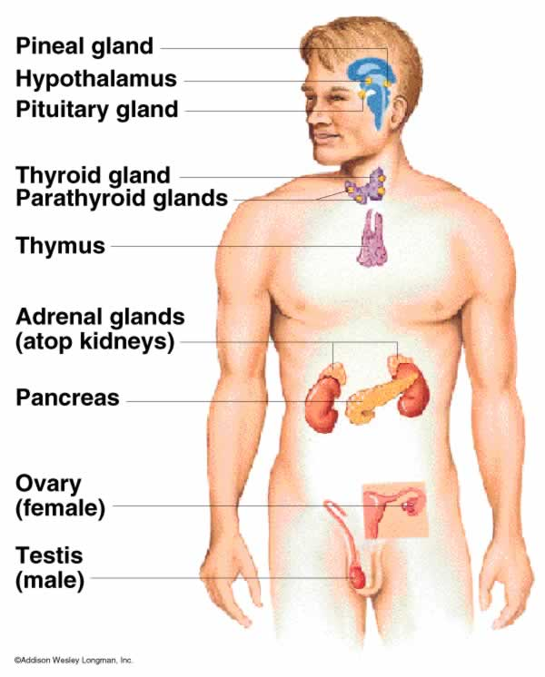

Slide 3
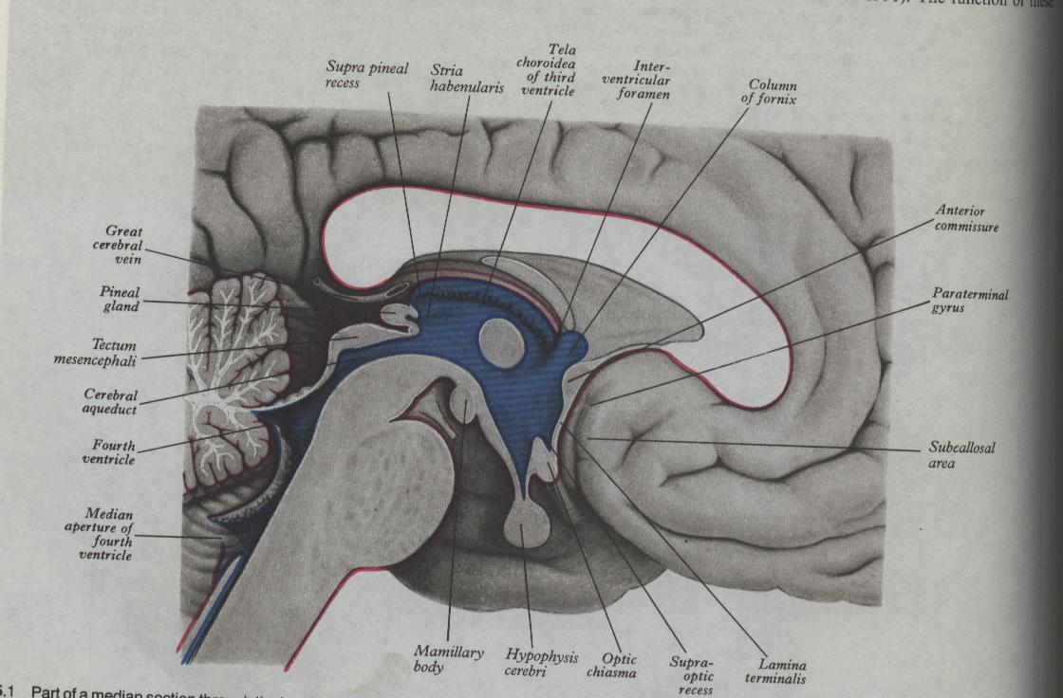
HYPOPHYSIS CEREBRI

Slide 4
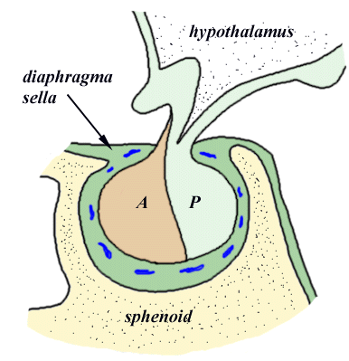
LOCATION OF GLAND

Slide 5
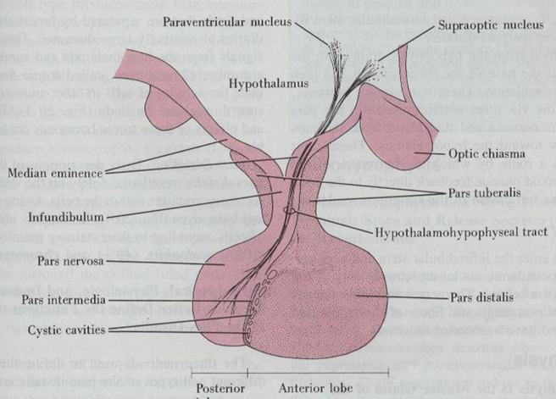
SUBDIVISION OF HYPOPHYSIS

Slide 6
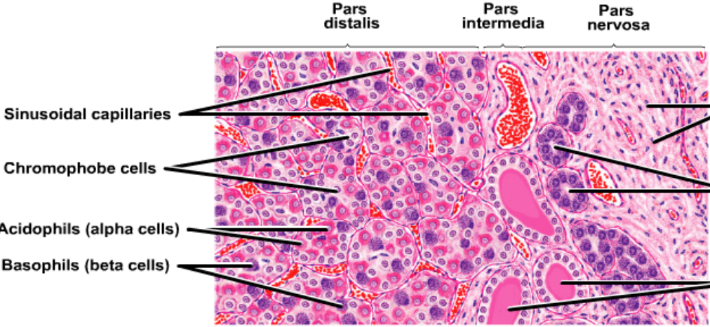
ADENOHYPOPHYSIS

Slide 7
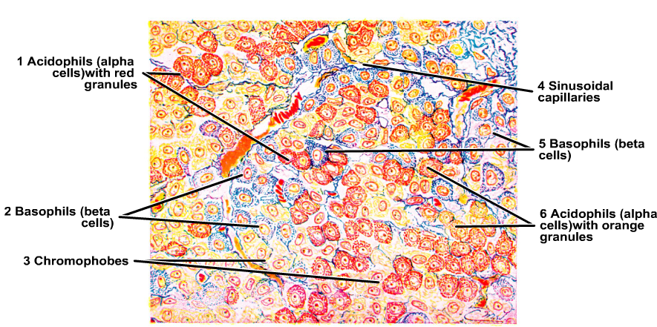
CHROMOPHIL CELLS

Slide 8
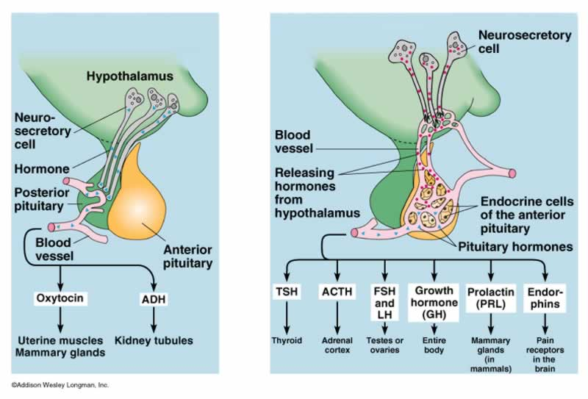
CHROMOPHIL CELLS

Slide 9
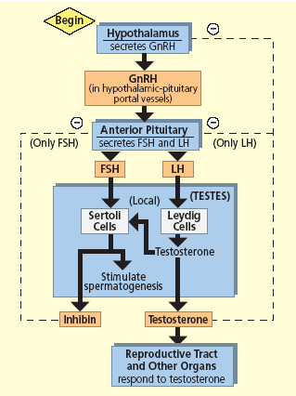

Slide 10
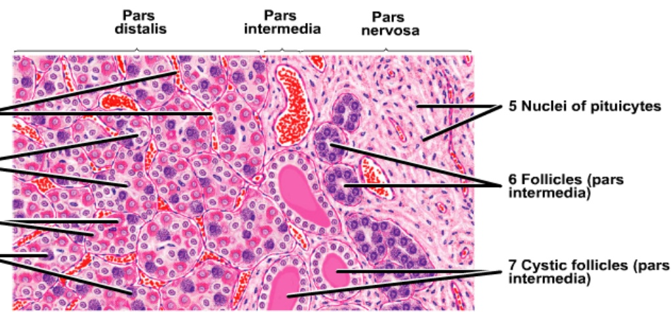
PARS INTERMEDIA & PARS POSTERIOR

Slide 11
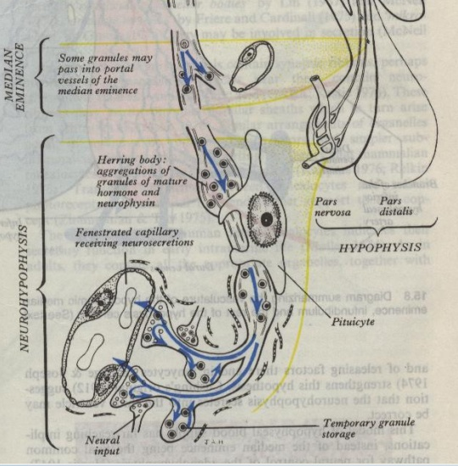
PARS POSTERIOR

Slide 12
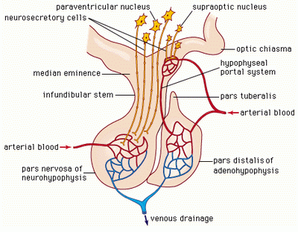
HYPOTHALAMO HYPOPHYSEAL PORTAL SYSTEM

Slide 13
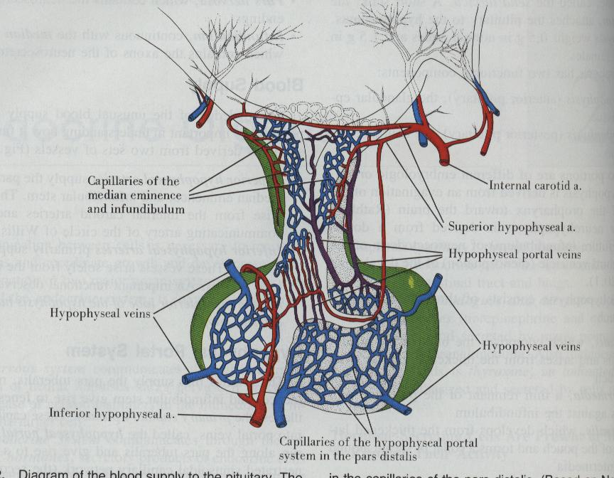
BLOOD SUPPLY OF HYPOPHYSIS

Slide 14
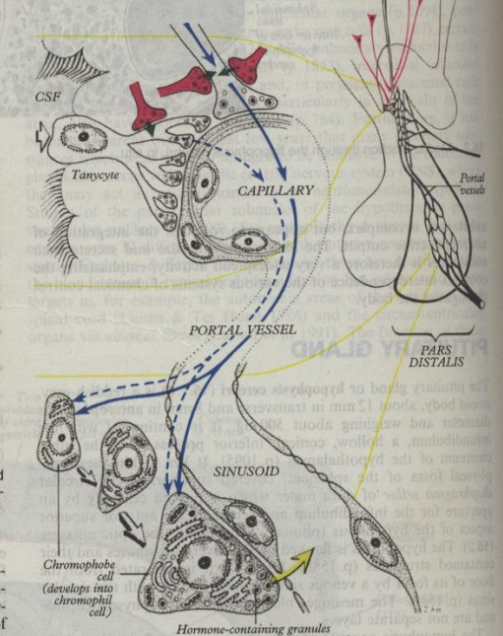
TANYCYTES OF HYP

Slide 15
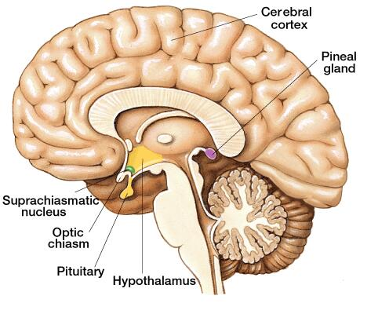
LOCATION OF PINEAL GLAND

Slide 16
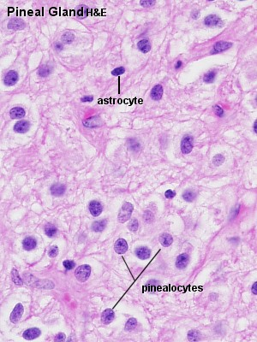
PARENCHYMA OF PINEAL GLAND

Slide 17
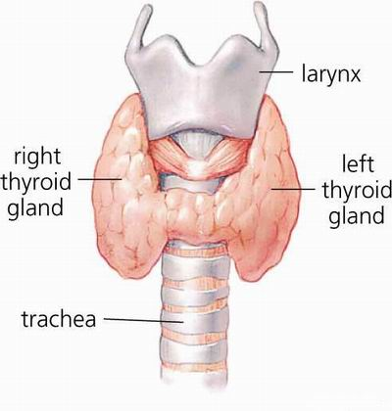
THYROID GLAND

Slide 18
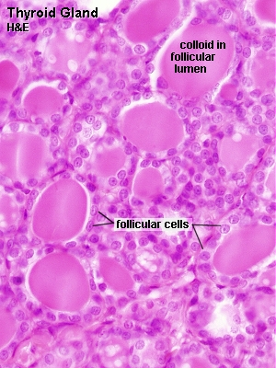
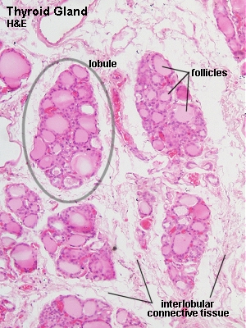
THYROID LOBULE

Slide 19
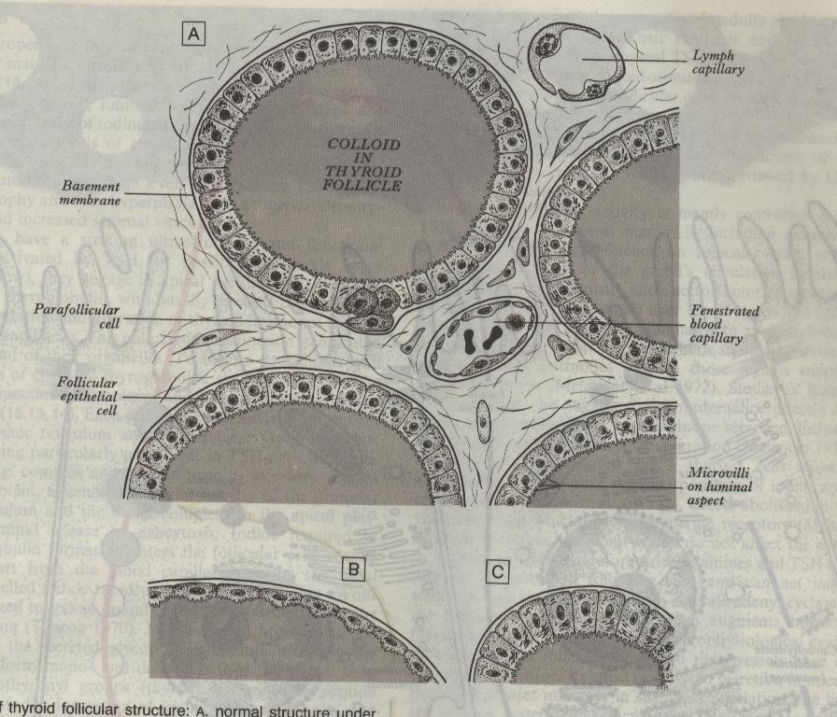
CELLS OF THYROID FOLLICLE

Slide 20
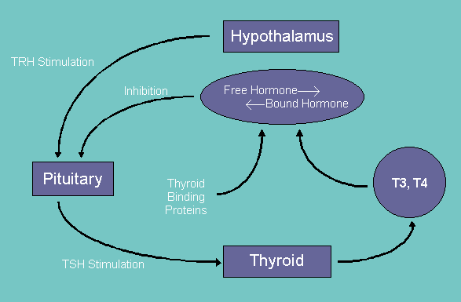
HYPOTHALMO HYPOPHYSIAL THYROID AXIS

Slide 21
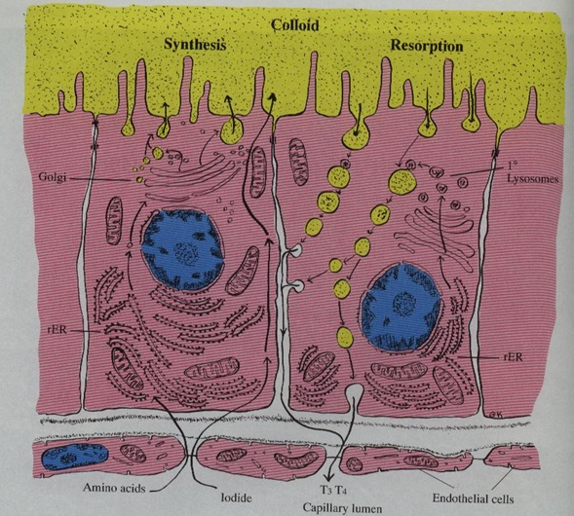
MECHANISM OF ACTION

Slide 22
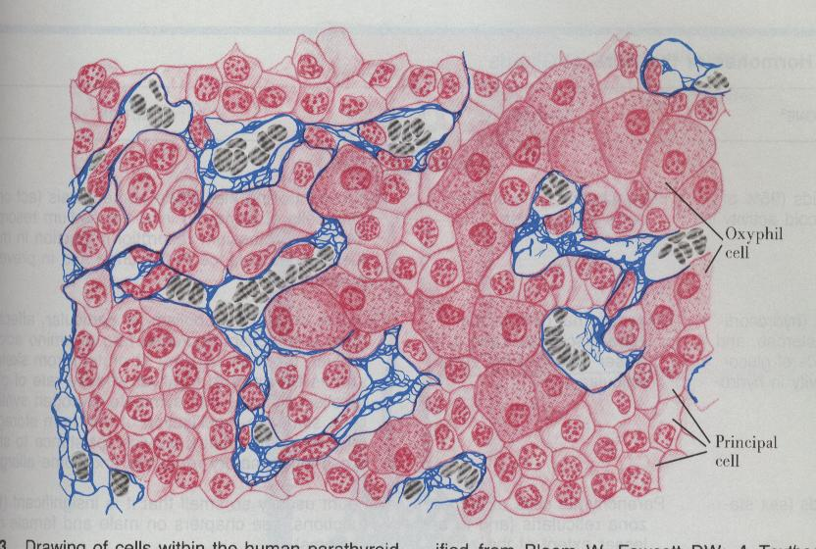
PARATHYROID GLAND

Slide 23
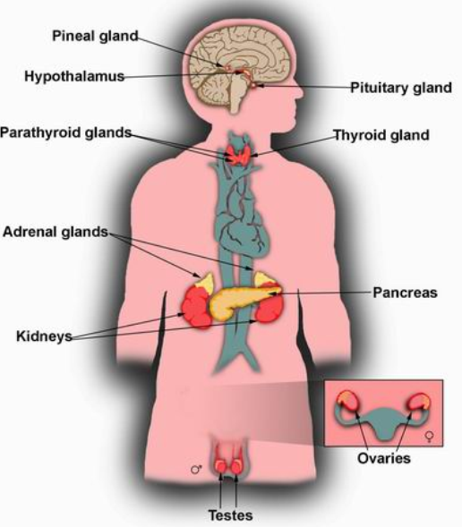
SUPRARENAL GLAND

Slide 24
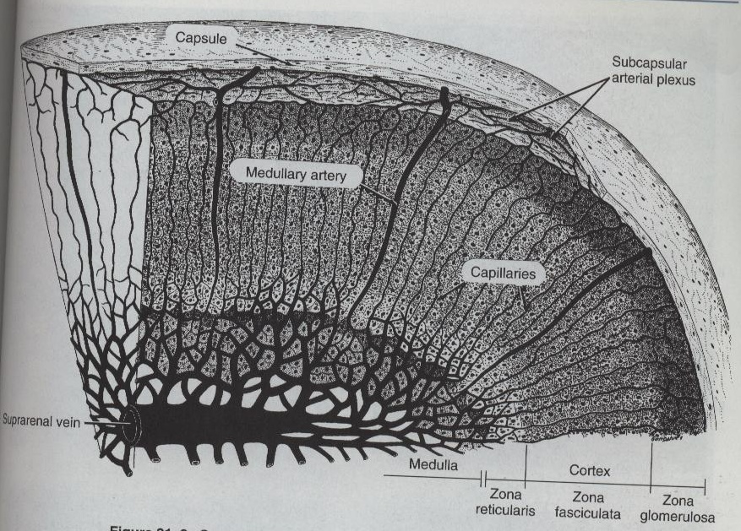
LAYERS OF CORTEX

Slide 25
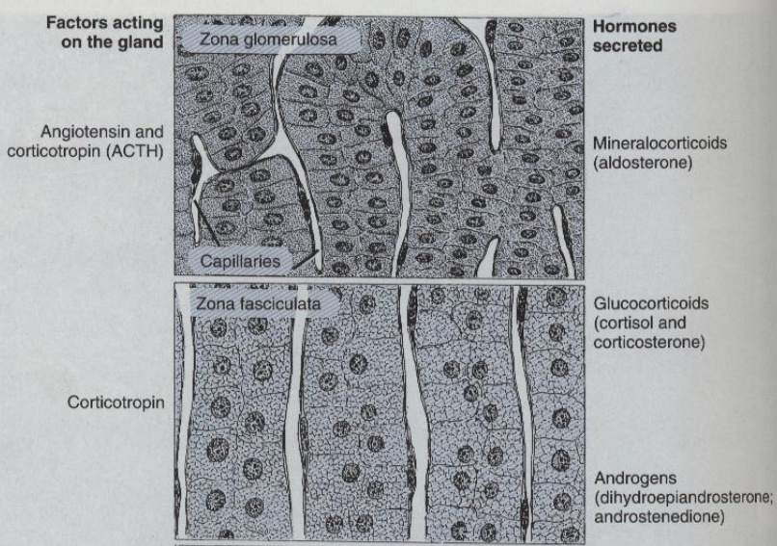
LAYERS OF CORTEX

Slide 26
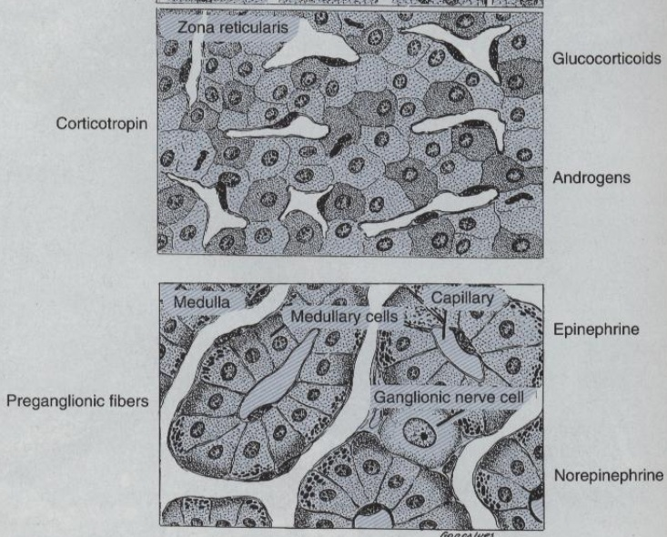
LAYERS OF CORTEX

Slide 27
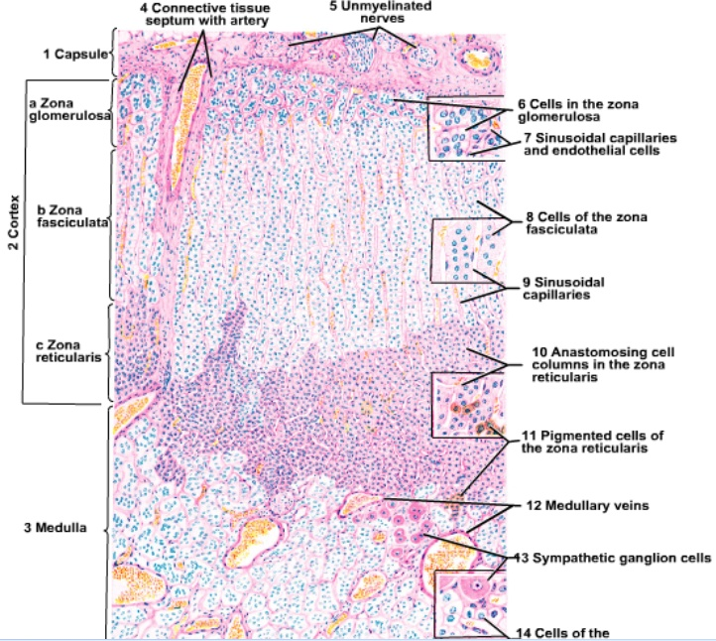

Slide 28
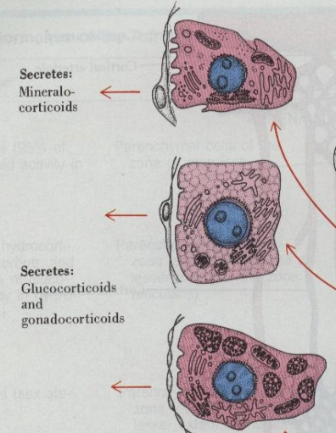
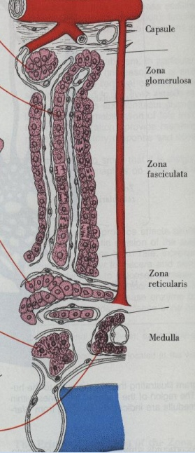

Slide 29
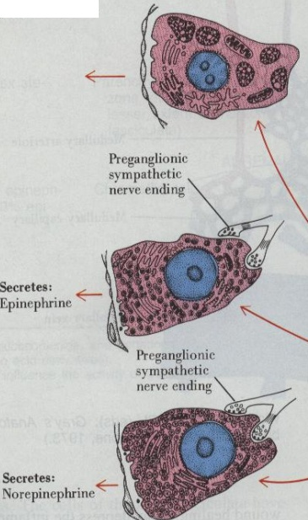

Slide 30
THANK YOU

Slide 31
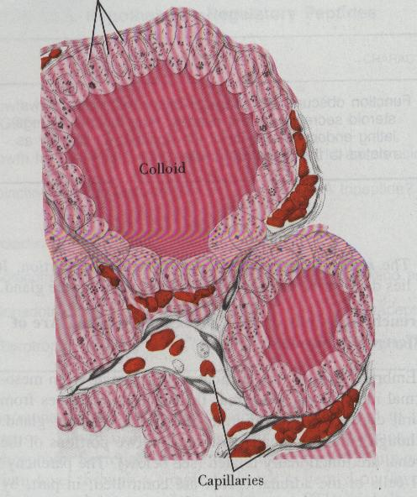

Slide 32
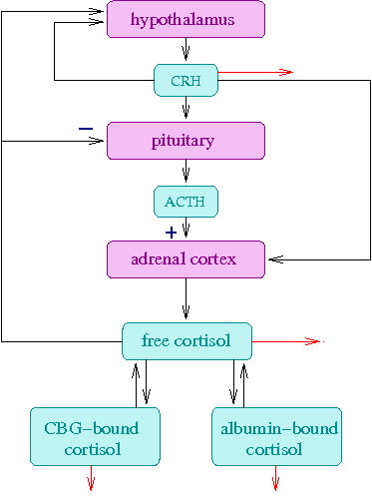

Slide 33
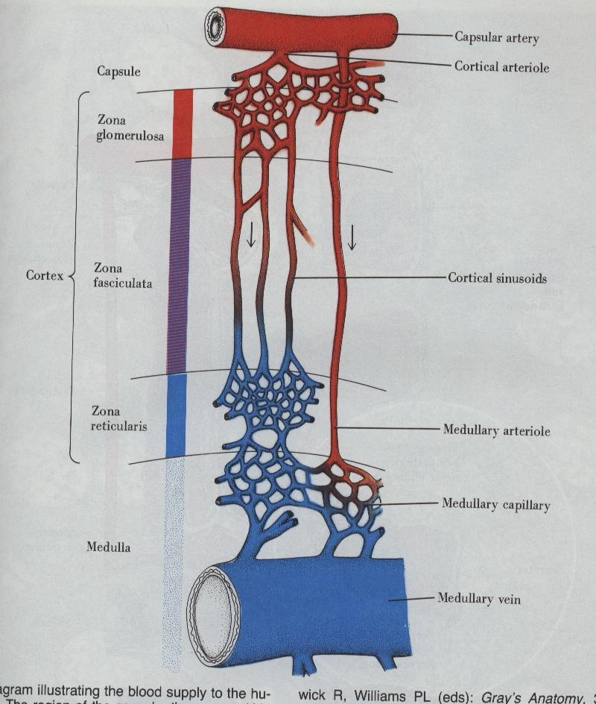

Slide 34
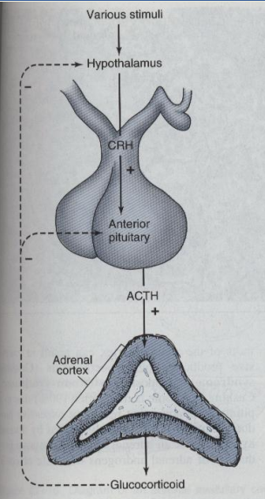
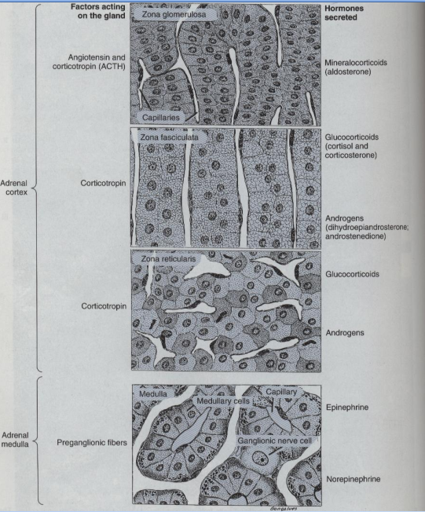

Slide 35
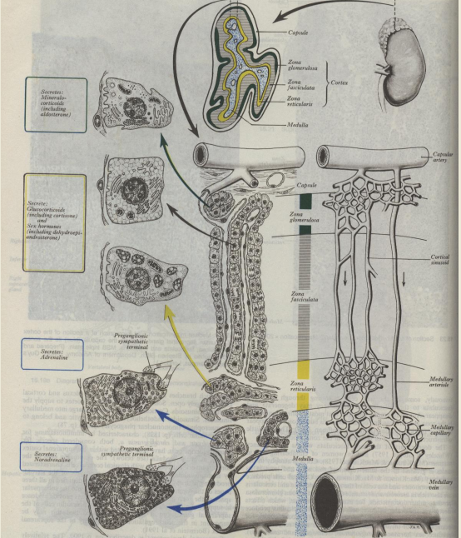

Slide 36
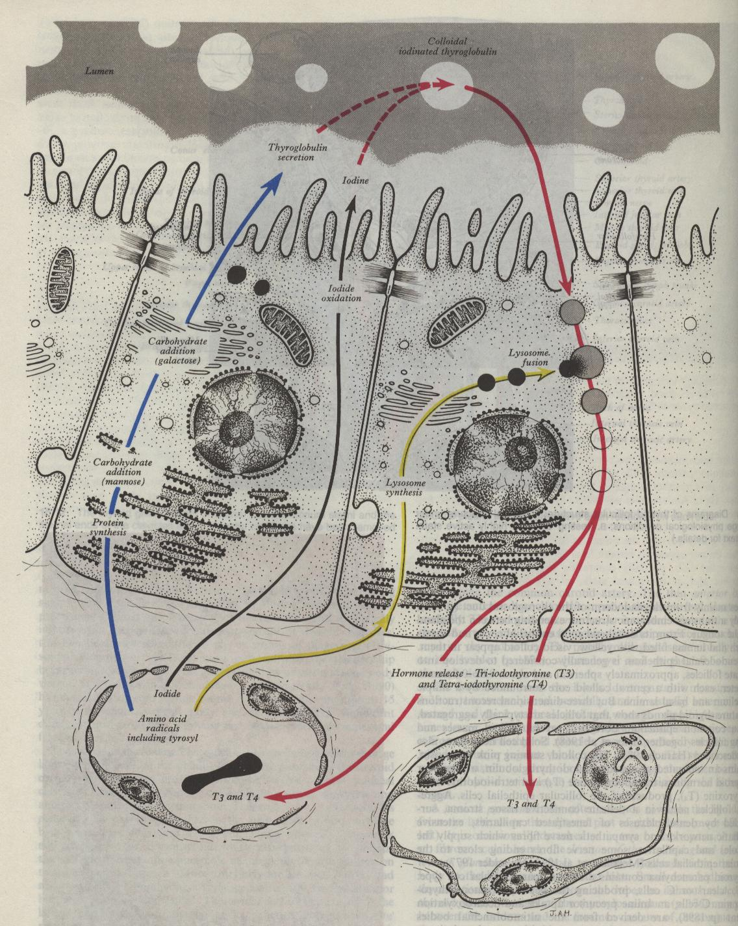

Slide 37
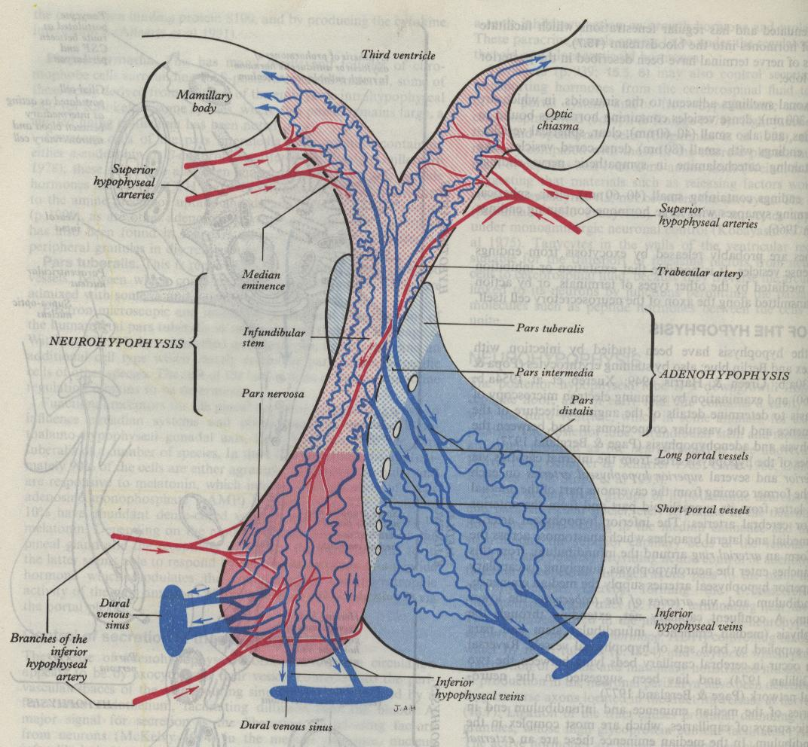

Slide 38
Dr. Belen Perez-Pevida, Section of Investigative Medicine, Division of Diabetes, Endocrinology and Metabolism, Imperial College London, 6th Floor, Commonwealth Building, Du Cane Road, London W12 0NN, UK, J Clin Exp Endocrinol, Vol 1(1): 101
Dr. Belen Perez-Pevida, | “Obesity, TSH and β-cell Function: An Intriguing Relationship” | We selected 490 obese subjects >18-year-old in whom thyroid function test and a 75 g oral glucose tolerance test (OGTT) was performed. Insulin sensitivity and beta cell function were assessed by OGTT | Mean age (SD) was 44.8 (13.7) years and mean BMI (SD) was 37.8 (7.1) kg/m2. 55.7% were women. Serum TSH was not independently correlated with insulin sensitivity after adjustment (HOMA-IR (ß=0.04; p=ns), ISI (ß= -0.07; p=ns), QUICKI (ß= -0.001; p=ns). However, TSH was positively associated with pancreatic β-cell function assessed by the DI (ß=0.338; p=0.013) and IGI (ß=0.095; p=0.013) but not with HOMA-β (ß=1.6; p=0.716) after multivariable adjustment. | In conclusion, within this study we found a positive relationship between TSH and β-cell function even after adjusting by important confounders including body fat content and distribution supporting the potential role of thyroid hormones in the development of beta-cell dysfunction.

