Slide 1
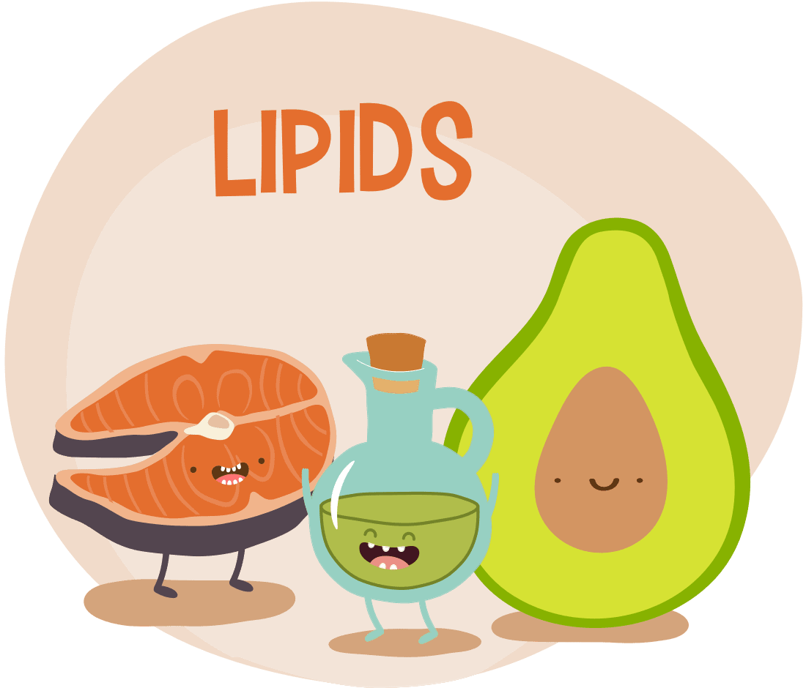
Chemistry of Lipids

Slide 2
The learner will be able to:
Classify lipids and list their functions in the body
Classify fatty acids and enumerate the properties of SFA, MUFA and PUFA
Describe the structure, properties and functions of triacylglycerol
Classify phospholipids and enumerate their function
Differentiate the structure of different phospholipids
Mention the action of phospholipases
Explain the role of Pulmonary surfactants and their clinical applications
Classify the sphingolipids and outline their basic structural features

Slide 3
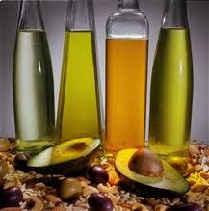
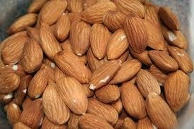
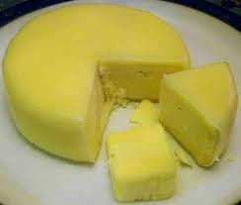
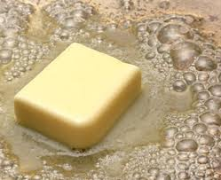
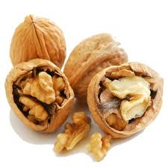
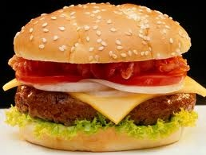
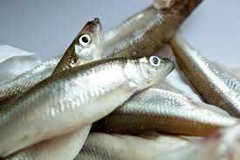
Sources of Lipids:

Slide 4
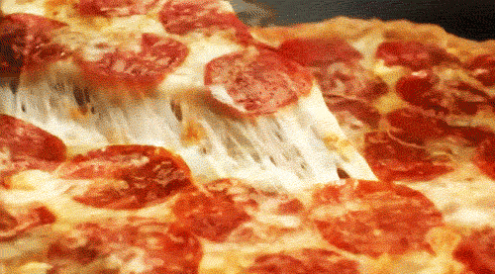
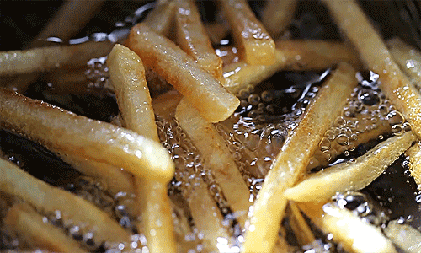
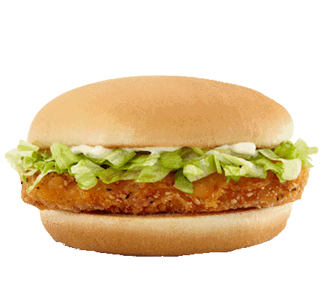
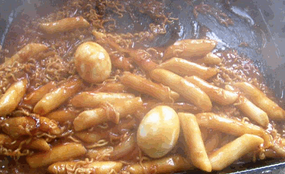


Slide 5
Definition
Lipids may be defined as compounds which are relatively insoluble in water, but freely soluble in nonpolar organic solvents like benzene, chloroform, ether, hot alcohol, acetone, etc

Slide 6

ARE LIPIDS BAD? DO THEY HAVE ANY FUNCTION?

Slide 7
Functions of Lipids
Storage form of energy (triglycerides)
Structural components of biomembranes
Metabolic regulators (steroid hormones)
Act as surfactants, detergents and emulsifying agents (amphipathic lipids)
Act as electric insulators in neurons
Provide insulation against changes in external temperature (subcutaneous fat)
Give shape and contour to the body
Protect internal organs (pads of fat)
Help in absorption of fat soluble vitamins (A, D, E and K)

Slide 8
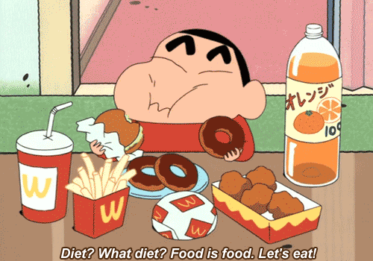
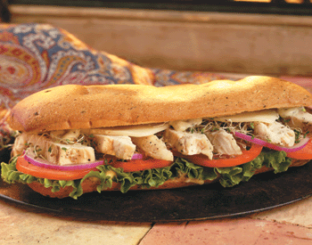
If you take Excess Fat ????

Slide 9
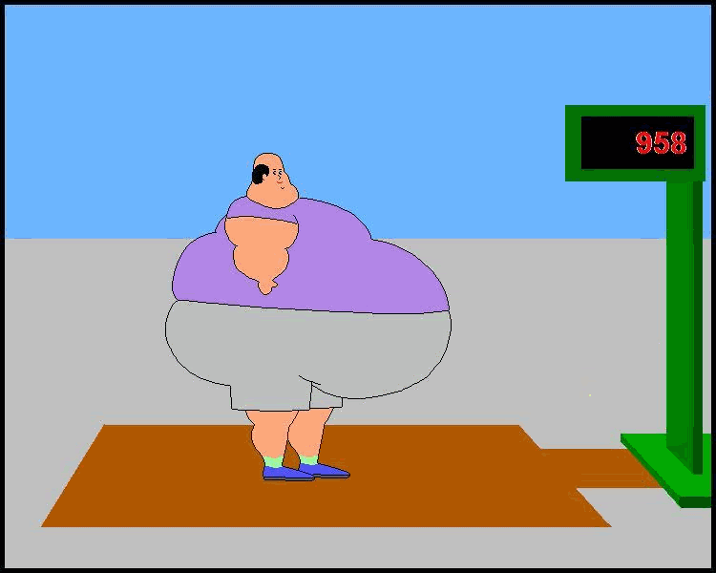

Slide 10
Clinical Applications of Lipids
Excessive fat deposits cause obesity. Truncal obesity is a risk factor for heart attack.
Abnormality in cholesterol and lipoprotein metabolism leads to atherosclerosis and cardiovascular diseases.
In diabetes mellitus, the metabolisms of fatty acids and lipoproteins are deranged, leading to ketosis and dyslipidemia.
Clinical Applications of Lipids

Slide 11
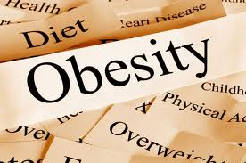
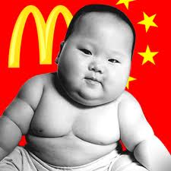
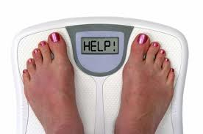
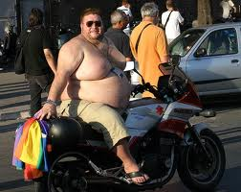
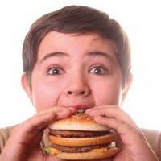
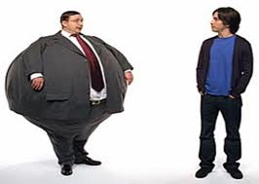
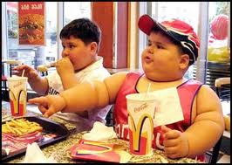

Slide 12
Classification of Lipids
Simple lipids
Triacylglycerol or triglycerides or neutral fat
Waxes

Slide 13
Compound Lipids
A) Phospholipids, with phosphoric acid.
1. Nitrogen containing glycerophosphatides
i) Lecithin (phosphatidyl choline)
ii) Cephalin
iii) Phosphatidyl serine
2. Non-nitrogen glycerophosphatides
i) Phosphatidyl inositol
ii) Phosphatidyl glycerol
iii) Diphosphatidyl glycerol
3. Plasmalogens, having long chain alcohol
i) Choline plasmalogen
ii) Ethanolamine plasmalogen
4. Phospho sphingosides, with sphingosine
Sphingomyelin

Slide 14
Compound Lipids Continued
Non-phosphorylated lipids
1. Glycosphingolipids (carbohydrate)
i) Cerebrosides (ceramide monohexosides)
ii) Globosides (ceramide oligosaccharides)
iii) Gangliosides (having N-acetyl neuraminic acid)
2. Sulpholipids or sulfatides
i) Sulphated cerebrosides
ii) Sulphated globosides
iii) Sulphated gangliosides

Slide 15
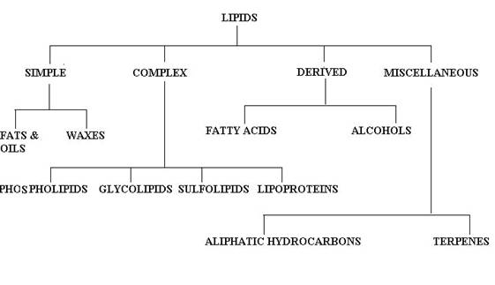
Classification of Lipids

Slide 16
I Simple lipids
Triacyl glycerol or Triglycerides or neutral fat
Waxes

Slide 17
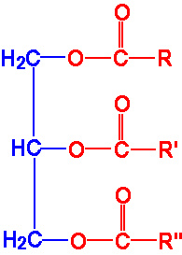

1 .SIMPLE LIPIDS
Def: ESTERS OF FATTY ACIDS WITH DIFFERENT ALCOHOLS. (Glycerol)
a). FATS & OILS
b). WAXES

Slide 18
2. COMPOUND (COMPLEX) LIPIDS
Def: Esters of F.A with different alcohols but carry in addition other substances such as phosphate, nitrogenous bases, carbohydrates & proteins.

Slide 19
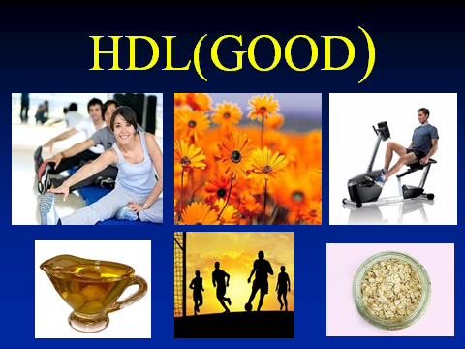

Slide 20
3. DERIVED LIPIDS
They are lipids that are derived from simple or compound lipids or their precursors by hydrolysis.
Ex:
FATTY ACIDS
GLYCEROL
CHOLESTEROL
VITAMIN D, BILE SALTS,
ISOPRENE COMPOUNDS.

Slide 21
Essential fatty acid deficiency (EFAD) may occur in both the inpatient and outpatient setting.
Patients with malabsorptive disorders as a result of pancreatic insufficiency or massive bowel resection are at risk, and it is important to recognize that other patient populations may develop EFAD.
A relatively new risk factor for EFAD is the shortage of intravenous fat emulsions in those requiring parenteral nutrition.

Slide 22
Fatty Acids
Definition
Fatty acids are carboxylic acids with hydrocarbon chains (–CH₂–CH₂–CH₂–).
Represented by a chemical formula R-COOH
Fatty acids are amphipathic in nature.

Slide 24
Classification of Fatty Acids
Depending on total number of carbon atoms:
Even chain: They have carbon atoms 2, 4, 6 and similar series.
Odd chain: They have carbon atoms 3, 5, 7, etc. They are present in milk.
Depending on length of hydrocarbon chain:
Short chain with 2 to 6 carbon atoms
Medium chain with 8 to 14 carbon atoms
Long chain with 16 and above, usually up to 24 carbon atoms
d. Very long chain fatty acids (more than 24 C).
Depending on nature of hydrocarbon chain:
Saturated fatty acids
Unsaturated fatty acids
i) Monounsaturated (monoenoic)
ii) Polyunsaturated (polyenoic)

Slide 25
Functions of Fatty Acids
1. They serve as building blocks of phospholipids and glycolipids, components of membranes.
2. Fatty acid derivatives serve as hormones, e.g. prostaglandins.
3. Fatty acids serve as a major fuel for most cells.

Slide 26
Numbering of Fatty Acid Carbon Atoms
Carbon atoms of fatty acid are numbered starting at the carboxyl terminus
Carbon atoms 2 and 3 are referred to as α and β respectively
The methyl carbon atom at the distal end of the chain is called ω carbon.

Slide 27
6 5 4 3 2 1
CH3 — CH2 — CH2 — CH2— CH2 — COOH
ω1 ω2 ω3 ω4 ω5

Slide 28
Figure 4.1: Numbering of fatty acid carbon.

Slide 29
C-system
C1 being the carboxyl carbon
Position of double bond is represented by the symbol Δ (delta), followed by a superscript number.
Oleic acid is a C18 fatty acid with one double bond between carbon number 9 and 10 is represented as C: 18:1: Δ9

Slide 30
ω– or n-System
Carbon of terminal methyl group of fatty acid is refer to ‘ω’
Oleic acid is denoted as C: 18:1: ω-9
ω-9 represents the double bond position which is found between 9th and 10th carbon atoms from ω carbon.
This method is widely used by nutritionists.

Slide 32
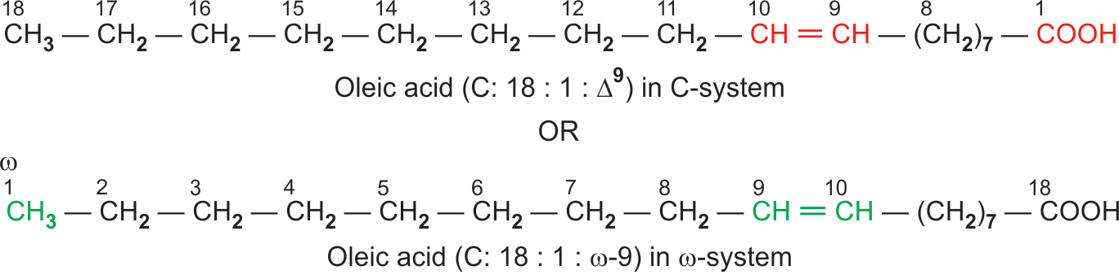
Figure 4.2: Representation of double bonds of unsaturated
fatty acids.

Slide 33
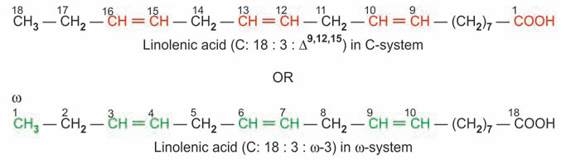
Figure 4.2: Representation of double bonds of unsaturated
fatty acids.

Slide 34
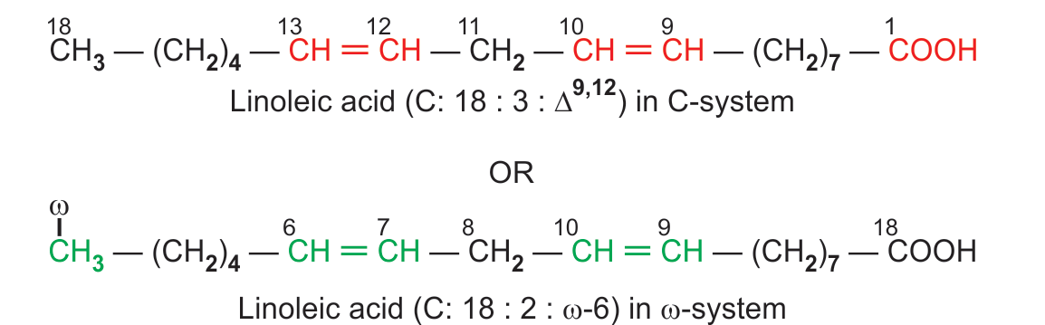
Figure 4.2: Representation of double bonds of unsaturated
fatty acids.

Slide 35
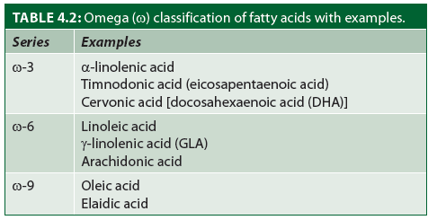

Slide 36
Name | Saturated fatty acids(%) | Mono-unsaturated fatty acids(%) | PUFA (%)
Coconut oil | (*)86 | 12 | 2
Groundnut oil | 18 | 46 | 36
Gingelly oil (Til oil) | 13 | 50 | 37
Palm oil | 42 | 52 | 6
Corn oil | 13 | 25 | 62
Cotton Seed oil | 26 | 19 | 55
Mustard oil (rapeseed) | 34(**) | 48 | 18
Safflower oil (Kardi) | 9 | 12 | 79
Sunflower oil | 12 | 24 | 64
Butter | 75 | 20 | 5
Ox (Tallow) | 53 | 42 | 5
Pig (Lard) | 42 | 46 | 12
Fish oil | 30 | 13 | 57
( * ) these saturated fatty acids are medium chain fatty acids.
( ** ) contains erucic acid, 22 C, 1 double bond)

Slide 37
Common No Chemical nature Occurrence
name carbon
atoms
Even chain, Saturated fatty acids
Acetic 2 Saturated; small chain Vinegar
Butyric 4 do Butter
Caproic 6 do Butter
Lauric 12 do Coconut oil
Palmitic 16 Saturated; long chain Body fat
Stearic 18 do do
Odd-chain fatty acids
Propionic 3 Saturated; Odd chain Metabolism

Slide 38
Unsaturated fatty acids
Common name | No. of carbon atoms | Chemical nature | Occurrence
Palmitoleic | 16 | Monounsaturated (w7) | Body fat
Oleic | 18 | do (w9) | do
Erucic | 22 | do (w9) | Mustard oil
Nervonic | 24 | do (w9) | Brain lipids
Linoleic | 18 | 2 double bonds (w6) | Vegetable oils
Linolenic | 18 | 3 double bonds (w3) | do
Arachidonic | 20 | 4 double bonds (w6) | Vegetable oils

Slide 39
ESSENTIAL FATTY ACIDS
Fatty acids, that are required for optimal health and cannot be synthesized by the body and should be supplied in the diet are called essential fatty acids.
They are: 1. Linoleic acid (18: 2: D^{9,12})
2. Linolenic acid. (18: 3: D^{9,12,15})
3 . Arachidonic acid (C: 20: 4: D^{5,8,11,14})

Slide 40
In deficiency of linoleic acid, arachidonic acid also becomes essential fatty acid.
Humans lack the enzymes to introduce double bonds at carbon atoms beyond C9 in the fatty acid chain

Slide 41
Functions of Essential Fatty Acids (EFA)
1. Synthesis of Eicosanoids:
-- Prostaglandins
-- Thromboxanes
-- Leukotrienes.
2. Maintenance of Structural Integrity

Slide 42
Development of Retina and Brain
Docosahexaenoic acid (DHA: ω-3), synthesized from linolenic acid is needed for development of the brain and retina during the neonatal period.
4. Skin protector
EFA helps to make the skin impermeable to water

Slide 43
5. Antiatherogenic Effect
Essential fatty acids increase esterification and excretion of cholesterol, thereby lowering the serum cholesterol level.

Slide 44
Essential Fatty Acid Deficiency
Deficiency of EFAs is characterized by scaly skin, eczema (in children), loss of hair and poor wound healing.
Impaired lipid transport and fatty liver may occur
Decreases efficiency of biological oxidation

Slide 45
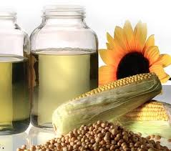
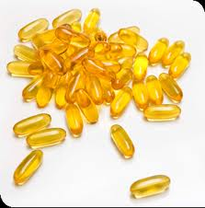
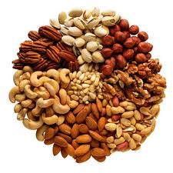
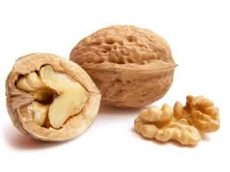
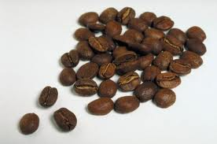
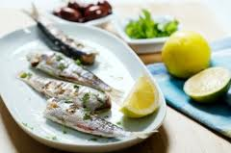
Sources Essential fatty acids(PUFA)

Slide 46
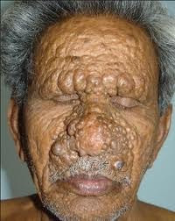
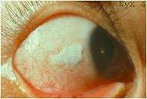
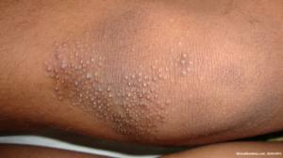
Deficiency : Phrynoderma.

Slide 47
Properties of Fatty Acids
Hydrogenation
Unsaturated fatty acids may be converted to the corresponding saturated fatty acids by hydrogenation of the double bond.
(+)2H (+)2H (+)2H
Linolenic —→ Linoleic —→ Oleic —→ Stearic
Hydrogenation of oils can lead to solidification and saturation, e.g. Vanaspathi.

Slide 48
Halogenation
Halogenation
When treated with iodine, the unsaturated fatty acids can take
up two halogen atoms, at each double bond.
For example,
Oleic acid + I2 → Di-iodo oleic acid
The number of halogen atoms taken up will depend on the number of double bonds and is an index of the degree of unsaturation.

Slide 49
Physical Characteristics
The short and medium chain fatty acids are liquids, whereas
long chain fatty acids are solids at 25oC.
Melting and boiling points increase, with increase in chain length.
The unsaturated fatty acids have lower melting point compared to saturated fatty acids with the same chain length.

Slide 50
Melting Point
The short and medium chain fatty acids are liquids,
whereas long chain fatty acids are solids at 25°C.
The solubility in water decreases, while melting and boiling points increase with increase in chain length.
The unsaturated fatty acids have lower melting point compared to saturated fatty acids with the same chain length.
For example, stearic acid (C18 fatty acid, no double bond) has the melting point 69°C, oleic acid (C18, 1 double bond) has 13°C; linoleic acid (C18, 2 double bonds) has –5°C and linolenic (C18, 3 double bonds) has –10°C.

Slide 51
Salt Formation
Saturated and unsaturated fatty acids form salts with alkali.
CH3—COOH + NaOH → CH3—COONa + H2O
Sodium and potassium salts of long chain fatty acids are called soaps.
Calcium and magnesium soaps are insoluble.

Slide 52
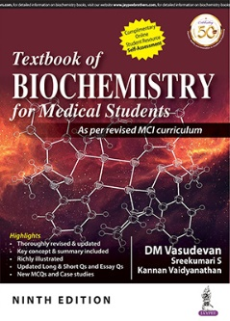
Ester Formation
Glycerol + fatty acid → Mono acyl glycerol
Monoglyceride + fatty acid → Di acyl glycerol
Diglyceride + fatty acid → Triglyceride
or tri acyl glycerol
or neutral fat
When a PUFA is present, it is esterified to the 2nd or beta carbon atom.

Slide 53
Saponification
When triglycerides are hydrolysed by alkali, the process is
known as saponification. The products are glycerol and soaps.
Saponification number is defined as the number of milligrams of potassium hydroxide required to saponify one gram of fat.
It is an indication of the molecular weight of the fat, and is inversely proportional to it.

Slide 54
Iodine Number of a Fat
It is defined as the number of grams of iodine taken up by 100 grams of fat.
It is an index of the degree of unsaturation and is directly proportional to the content of unsaturated fatty acids. Higher the iodine number, higher is the degree of unsaturation.
e.g., iodine number of butter is 28, and that of sunflower oil is 130.

Slide 55
Rancidity of Fat
Fats and oils have a tendency to become rancid.
The term rancidity refers to the appearance of an unpleasant smell and taste for fats and oils.
Hydrolytic rancidity is due to partial hydrolysis of the triacylglycerol molecules due to traces of hydrolytic enzymes present in naturally occurring fats and oils.

Slide 56
Oxidative rancidity is the result of partial oxidation of unsaturated fatty acids with resultant formation of epoxides
and peroxides of small molecular weight fatty acids by peroxides and free radicals.
The same process, if it occurs in vivo will affect the integrity of biomembranes, leading to cell death.

Slide 57
Many natural fats and oils may contain antioxidants (e.g.
vitamin E), which prevent the occurrence of oxidative
rancidity.
PUFA are more easily oxidized; so vegetable oils with a high content of PUFA are usually preserved with addition of antioxidants.
Repeated heating of oils would lead to the formation and polymerization of cyclic hydrocarbons.
These will impart an unpleasant taste and color to the oil.
Coconut oil having medium chain saturated fatty acids will withstand such polymerization.

Slide 58
Waxes
They form the secretions of insects, leaves and fruits of
plants, e.g. Lanolin or wool fat, beeswax, whale sperm oil,
etc.
They are esters of higher fatty acids with higher monohydroxy aliphatic alcohols and so have very long straight chains of 60–100 carbon atoms.
They are used as the base for the preparation of cosmetics, ointments, polishes, lubricants and candles.

Slide 59
Phospholipids
Lecithin
Chemistry
Action of Phsopholipases
Pulmonary surfactant
Composition of surfactant
Clinical

Slide 60
Phosphatidyl Choline or Lecithin
Nitrogen containing phospholipid.
It contains the glycerol group.
The alpha and beta positions are esterified with fatty acids. (beta-carbon with a PUFA molecule)
Phosphoric acid is added to 3 position
Phosphate group is esterified to the quaternary nitrogen base, Choline

Slide 61
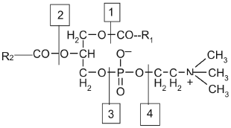
Action of Phospholipases
Phospholipases are lipolytic enzymes that hydrolyze phospholipid substrates at specific ester bonds.
Phospholipases are widespread in nature and play very diverse roles from aggression in snake venom to signal transduction, lipid mediator production, and metabolite digestion in humans.

Slide 62
Lecithin. R1 and R2 are fatty acids. Red rectangle depicts glycerol group. The blue rectangle is choline which shows polar or hydrophilic property.
1 = Site of action of phospholipase A1;
2 = Site of action of phospholipase A2;
3 = Site of action phospholipase C;
4 = Site of action of phospholipase D.

Slide 64
Pulmonary Surfactants
Pulmonary surfactant is a surface-active lipoprotein (phospholipoprotein) formed by alveolar cells. The molecule
is seen at the air-water interface of alveoli.
The hydrophilic head dips in water and the hydrophobic tail faces towards the air, so that the surface tension is reduced.
Pulmonary surfactant reduces surface tension at the air-liquid interface of the alveolus, thus preventing its collapse during end-exhalation.
Surfactant also participates in innate host defence against inhaled pathogens.

Slide 65
Composition of Surfactant
Dipalmitoylphosphatidylcholine (DPPC), 40%; other
phospholipids, 40%; surfactant proteins(SP-A,SP-B,SP-C,
SP-D) 5%; cholesterol 5% .
Phosphatidylcholine forms 85% of the lipid in surfactant. Phosphatidyl glycerol forms about 10% of the lipids in the surfactant.

Slide 66
Case study
A 2-day-old boy born with complication at 27 weeks’ gestation to a healthy mother via C- Section presented to the emergency department with 2 episodes of apnea(when infant stop breathing while asleep or have almost no airflow) and cyanosis after discharge from the newborn nursery. One episode had occurred during breastfeeding, and the other hours after feeding.
Infant having low surfactant level(DPL) on investigation and developed Respiratory distress syndrome.

Slide 67
Case study 2
Female new-born, born in the 40th week of pregnancy by emergency C-section with green amniotic fluid. Immediately upon the C-section, without heart function.
Heavily aspirated with green liquid content in the apparatus, cardiopulmonary reanimation started immediately, achieved heart rhythm with bradycardia.
On the X-ray image, lungs bilaterally have small grainy confluating shadows. Despite the nasal oxygen therapy, the death has occurred during transport to the appropriate medical institution

Slide 68
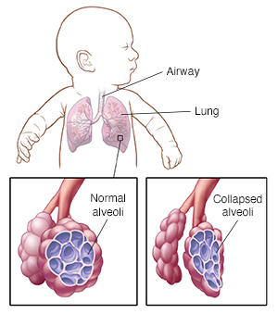
Clinical
Respiratory distress syndrome (RDS):
Morbidity in preterm neonates. Patients present shortly after birth with apnea, cyanosis, grunting. The preterm infant who has RDS has low amounts of surfactant. It is due to a defect in the biosynthesis of dipalmitoyl lecithin (DPL), the main pulmonary surfactant.

Slide 69
Acute Respiratory Distress Syndrome (ARDS)
It is a syndrome of acute pulmonary inflammation. A life-threatening lung injury that allows fluid to leak into the lungs. It is characterized by sudden onset, impaired gas exchange, and pulmonary edema.
Infection is the most common cause of development of ARDS in children.
There is an increase in the permeability of the alveolar capillary arrier as a result of injury to the endothelium.
Damage to the alveolar cells leads to an influx of edema fluid into the alveoli, as well as decreased fluid clearance from the alveolar space.

Slide 70
Meconium is the early stool passed by a newborn soon after birth, before the baby starts to feed and digest milk or formula.
Meconium aspiration syndrome occurs when a newborn breathes a mixture of meconium and amniotic fluid into the lungs around the time of delivery

Slide 71
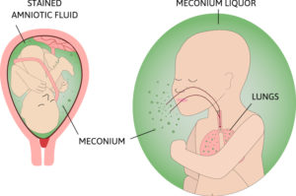

Slide 72
Meconium Aspiration Syndrome
It is characterized by airway obstruction, pneumonitis, pulmonary hypertension, acidosis Meconium destroys surfactant and decreases its surface adsorption rate.

Slide 73
Phosphatidyl Ethanolamine or Cephalin
The nitrogen base ethanolamine is present (instead of choline
in lecithin)
Thromboplastin (coagulation factor III),required for clotting process is composed mainly cephalins.

Slide 74
Non Nitrogen containing

Slide 75
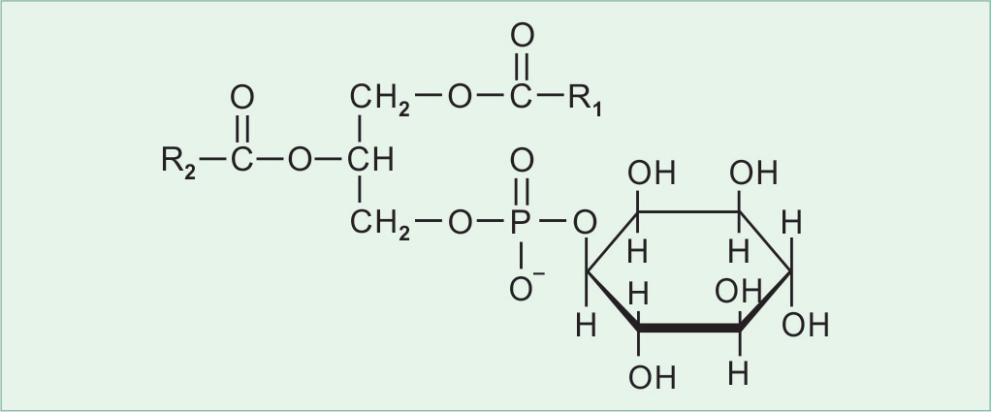
Phosphatidyl Inositol
Phosphatidic acid is esterified to inositol.
Phosphatidyl inositol bisphosphate or PIP2 is present in biomembranes. Act as a second messenger for the action of hormones like oxytocine and vasopressin.

Slide 76
Cardiolipin (Diphosphatidyl glycerol)
Two molecules of phosphatidic acid connected by
a molecule of glycerol.
Major lipid of mitochondrial membrane and is necessary for the electron transport process.
This is only antigenic phospholipid .

Slide 77
Phosphatidyl Glycerol
It is formed by esterification of phosphatidic acid to glycerol.
When two molecules of phosphatidic acid are linked with a molecule of glycerol, diphosphatidyl glycerol or cardiolipin is formed.
This phospholipid is found in myocardium.

Slide 78
.
Plasmalogens

Slide 79
Plasmalogens
Fatty acid chain at C1 of glycerol is linked through an ether, rather than an ester bond and found in myelin and in cardiac muscle. The phosphoric acid is attached to choline or ethanolamine.
Platelet activating factor (PAF) is a plasmalogen and involved in platelet aggregation
Plasmalogens are found in biomembranes in brain and muscle.

Slide 80
Sphingophospholipids
Alcohol sphingosine an amino alcohol instead of glycerol.
Amino group of the sphingosine is linked to a fatty acid to yield ceramide.

Slide 81
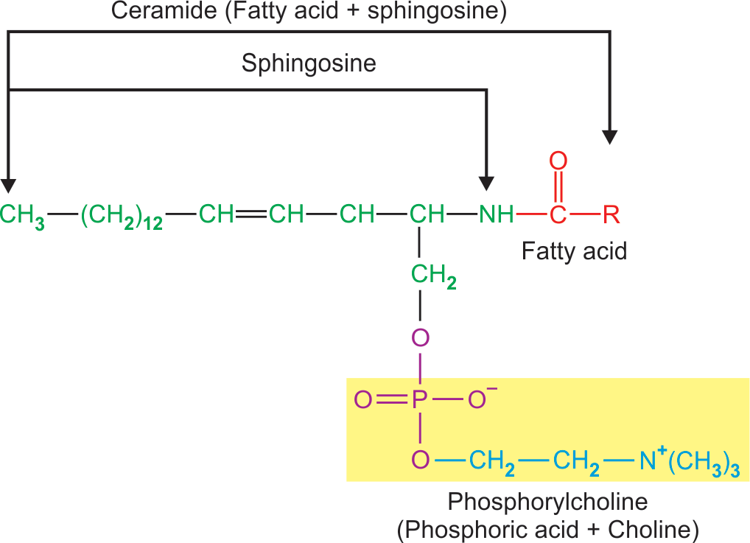
Figure 4.12: Structure of sphingomyelin.

Slide 82
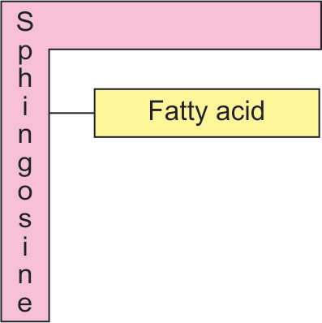
Figure 4.13: Schematic structure of ceramide.

Slide 83
Sphingomyelin is one of the principal structural lipids of membranes of nerve tissue.
Sphingomyelin act as electrical insulators around nerve fibers.

Slide 84
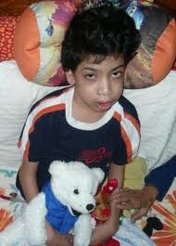
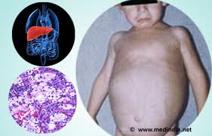
When sphingosine + Fatty acid = ceramide
‘Sphingomylinase’ is an enzyme hydrolyze esphingomylin in to ceramide and phosphoryl choline.
Clinical: deficiency of ‘Sphingomylinase’ leads to ‘Niemann-pick disease’. Children are affected
Symptoms:
Hepatomegali
Splenomegali
Mental retradation.

Slide 85
Functions Of Phospholipids
Major lipid constituents of cellular membranes
Regulate permeability of membranes and activation of some membrane bound enzymes
Sphingomyelin act as electrical insulators around nerve fibers.
Constituent of lipo­proteins.

Slide 86
Act as a lipotropic factor. Lecithin represents a storage form of lipotropic factor choline and methyl group
Good emulsifying agents and help in intestinal absorption of lipids.
Plasmalogens (platelet activating factor) involved in platelet aggregation.

Slide 87
Thromboplastin (coagulation factor III), is composed mainly of cephalins
Lecithin acts as lung surfactant, which prevents alveolar collapse
Phosphatidylinositol is a second messenger
Cardiolipin is necessary for the electrons transport process.

Slide 88
GLYCOLIPIDS
Sugar containing lipids
Glycolipids consist of alcohol sphingosine.
One or more sugar units attached to sphingosine
Glycolipids are widely distributed in every tissue of body, particularly in nervous tissue.

Slide 89
Classification Of Glycolipids
          Cerebrosides
          2. Sulfatides
          3. Globosides
          4. Gangliosides.

Slide 90
Cerebrosides
Ceramide + Monosaccharides ( glucose or galactose )
Galactocerebroside is found in high
concentration in nerve tissue membrane.
Glucocerebroside is found in non-neural tissues.
It acts as a precursor for the synthesis of more complex glycolipids, e.g. gangliosides.
.

Slide 91
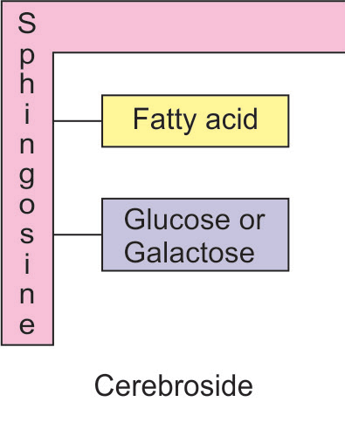

Slide 92
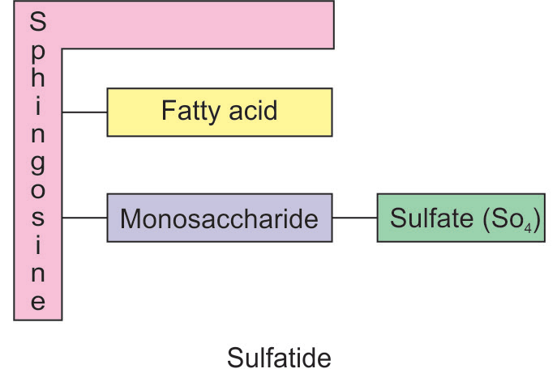
Sulfatides
Ceramide + Monosaccharide + Sulfate.
For exam : sulfogalactoceramide found in myelin.

Slide 93
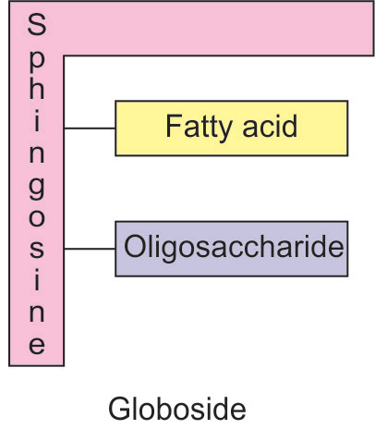
Globosides
Ceramide +Oligosaccharide
    Constituents of the RBC-membrane
    Determinants of the A,B,O blood group

Slide 94
Gangliosides
(Cerebroside + Oligosaccharides + N-acetylneuraminic acid, NANA)
• Gangliosides are complex glycolipids, derived from glucocerebroside.
• Ganglioside contains oligosaccharides and one or more molecules of N- acetylneuraminic acid (NANA) attached to ceramide.

Slide 95
Types of gangliosides are:
GM₁, GM_{2,}GM_{3,} etc.
G : represents Ganglioside
M : represents mono which indicate presence of one
residue of NANA
Subscript number: assigned on the basis of
chromatographic migration of ganglioside

Slide 96


Slide 97
Structure of sialic acid or NANA
Mannosamine + Pyruvate ————>
Neuraminic acid

Slide 98
FUNCTIONS OF GLYCOLIPIDS
Constituent of the nervous tissue, such as, brain and outer leaflet of cell membrane.
Constituent of specific receptors for polypeptide hormones.
Antigenic and have been identified as a source of blood group antigens.
Play role in regulation of cellular interactions, growth and development

Slide 99
CHOLESTEROL (ANIMAL STEROL)
Cholesterol, a class of steroid containing 27-carbon
atoms.
Cholesterol contains:
- 8-carbon side chain attached to the D ring at C17
- a hydroxyl group attached to C3 of the A ring
- one double bond between carbon atoms 5 and 6
- methyl side chains at position C10 and C13.

Slide 100

Figure 4.15: The steroid nucleus, phenanthrene (rings A, B, and C), to which cyclopentane D-ring is attached.

Slide 101

Figure 4.16: The structure of cholesterol.

Slide 102
Cholesterol is amphipathic
It occurs in animal fats, but not in the plant fats.
Most of the cholesterol in the body exists as a
cholesterol ester.
Cholesterol is widely distributed in all the cells of the
body, but particularly in nervous tissue.

Slide 103
Functions of the Cholesterol
Structural constituent of the cell membranes and
plasma lipoproteins
Precursor for Steroid hormones
-- Progesterone
-- Glucocorticoids
-- Mineralocorticoids
-- Androgens (male sex hormones)
-- Estrogen (female sex hormones).

Slide 104
Precursor for Bile acids, emulsify dietary fats
Precursor for Vitamin D, essential in calcium and phosphate metabolism.

Slide 105
Lipoproteins
Lipoproteins are formed by a combination of lipid
and protein that transport lipids.
Lipoproteins consist of :
lipid core containing nonpolar triacylglycerol
cholesterol ester surrounded by a single layer of amphipathic phospholipids and free cholesterol molecules with some proteins
.
.

Slide 106

Figure 4.18: Structure of lipoprotein.

Slide 107
The protein components are referred to as apoprotein or apolipoprotein.
There are four major types of apolipoproteins designated by letters A, B,C and E with subgroups given in Roman numerals I, II, III, etc.

Slide 108
Classes of Lipoproteins
1. Chylomicrons
2. Very low density lipoproteins (VLDL)
3. Low density lipoprotein (LDL)
4. High density lipoprotein (HDL).

Slide 109
Lipoprotein complexes contain diffèrent proportions of lipids and proteins
The density of these lipoproteins is inversely
proportional to triacylglycerol content.
As the density increases, the diameter of the particle
decreases

Slide 110

Figure 4.19: Diagrammatic representation of lipoprotein with
increasing densities and their composition.

Slide 111
Triacylglycerol is the predominant lipid in
chylomicrons and VLDL.
Cholesterol is the predominant lipid in LDL
Phospholipid is the predominant lipid in HDL.

Slide 112


Slide 113
EICOSANOIDS
Prostaglandins ,thromboxanes and leukotrienes,
are collectively known as eicosanoids.
Synthesized from arachidonic acid

Slide 114

Prostaglandins (PGs)
Group of compounds derived from arachidonic acid
Prostaglandins are abbreviated as PG.

Slide 115
PGs are structurally related to prostanoic acid, having :
      Cyclopentane ring
      Two aliphatic side chains R1 and R2
      A hydroxyl group at carbon 15
      A double bond between carbons13 and 14
      Various substituents on the ring.

Slide 117
Classification of prostaglandins
Classified into groups designated by capital letter
A, B, C, D, E, F, G, H and I depending on the
substituents on the cyclopentane ring.

Slide 118


Slide 119
Sub-classified by a subscript number 1, 2,or 3
corresponding to the number of double bonds in
the side chains but not in the cyclopentane ring.

Slide 120
Sixteen naturally occurring prostaglandins have
been described but only seven are found commonly
through out the body. These are :
PGE1, PGE2, PGF1α, PGF2α, PGG2, PGH2, PGI2.
Prostaglandins are not stored, instead the precursor C-20 arochidonic acids are stored in tissues.

Slide 121
Functions of Prostaglandins
Prostaglandins have hormone like actions.
Prostaglandins in many tissues act by regulating
the synthesis of cyclic AMP (c-AMP).
As c-AMP mediates the action of many hormones,
and affect tissue functions. Some of these are :

Slide 122
Smooth muscle contraction and relaxation
- PGF2α stimulate uterine contraction.
- PGE2 are involved in relaxation of
bronchial smooth muscle.
Inflammatory response causing pain, oedema,
swelling and erythema

Slide 123
Platelet aggregation:
-- PGE₂ promote aggregation and are thus, involved in the blood clotting
-- whereas PGI₂ inhibits platelet aggregation

Slide 124
Blood pressure regulation: PGE2 decrease blood pressure.
Body temperature: Prostaglandins elevate body temperature producing fever and cause inflammation, resulting in pain.
Gastric secretion: PGE2 suppress gastric secretion.

Slide 125
Nonsteroidal anti-inflammatory drugs (nsaids) such as:
-- aspirin
-- ibuferon
-- indomethacin, etc.
block the formation of prostaglandins from arachidonic acid by
inhibiting the enzyme cyclooxygenase (cox).

Slide 126

Figure 4.20: Synthesis of eicosanoids and inhibitors of eicosanoid synthesis.

Slide 127
THANK YOU

Slide 128
When sphingosine + Fatty acid = ceramide
‘Sphingomylinase’ is an enzyme hydrolyze esphingomylin in to ceramide and phosphoryl choline.
Clinical: deficiency of ‘Sphingomylinase’ leads to ‘Niemann-pick disease’. Children are affected
Symptoms:
Hepatomegali
Splenomegali
Mental retradation.

Slide 129

1. Nitrogenous base in cephalin is
Choline
Glycerol
Ethanlomine
Thymine

Slide 130
2. Example of Non Nitrogen containing phospholipid
Phosphotidyl choline
Cephalin
Cardiolipin
Phosphotidydyl Serine

Slide 131
3. Antigenic property containing phospholipid
Phosphotidyl choline
Cephalin
Phosphotidydyl Serine
Cardiolipin

Slide 132
4.Deficency of Sphingomylinase leads to
Niemann-pick disease
Cirrhosis
Liver failure
Phrynoderma.

Slide 133
5. Deficiency of Essential fatty acid leads to
Respiratory distress syndrome’(RDS)
Cirrhosis
Liver failure
Phrynoderma.

Slide 134


Slide 138
3. Examples of PUFA (Polyunsaturated fatty acid )
Lecithin
Palmitic acid
Linoleic fatty acid
Stearic acid

Slide 139
4. Which form of lecithin act as surfactant
Palmitic acid
Dipalmitoyl lecithin
Cephalin
Choline

Slide 140
5. Low level of surfactant Dipalmitoyl lecithin leads to
Night blindness
Diabetes
Respiratory distress syndrome’(RDS)
Phrynoderma.

