Slide 1
ONE CARBON METABOLISM
Groups, containing a single carbon atoms are called one carbon groups. One carbon groups are formed from several amino acids during their metabolism.
These include serine, glycine, histidine and tryptophan.

Slide 2
One carbon groups formed during metabolism are:
– Methyl (CH₃)
– Methylene (CH₂)
– Methenyl (CH)
– Formyl (CHO)
– Formimino (CH=NH)
These one carbon groups are transferred by way of
tetrahydrofolate (THF).

Slide 3
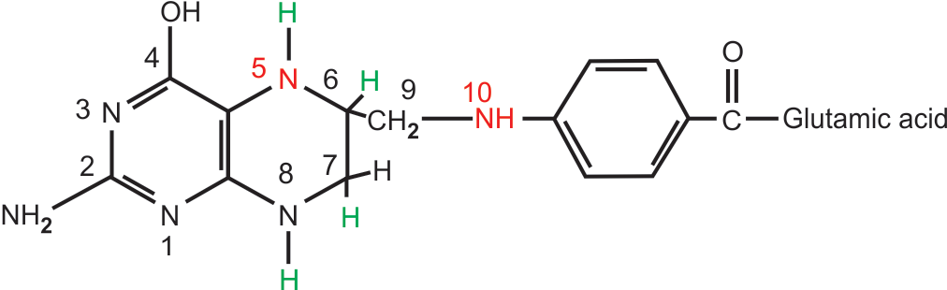
Structure of tetrahydrofolate

Slide 4
One carbon groups carried by THF are attached either to nitrogen N⁵ or N¹⁰ or to both N⁵ and N¹⁰
The different one carbon derivatives of THF are
– N⁵-methyl THF
– N⁵, N¹⁰ -methylene THF
– N⁵, N¹⁰ -methenyl THF
– N⁵-formyl THF
– N⁵-formimino THF.
These different derivatives of THF are interconvertible.

Slide 5
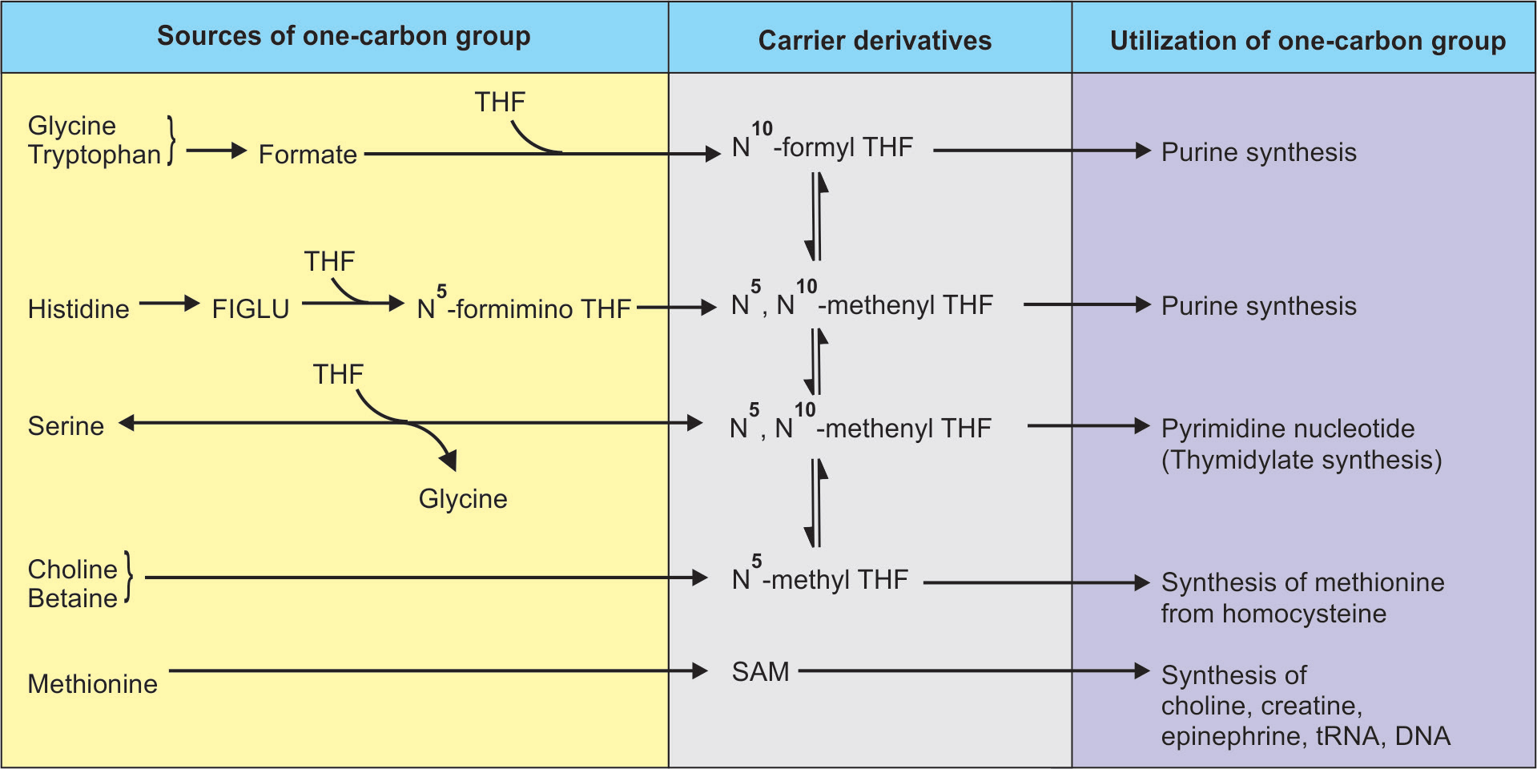

Slide 6
Importance of one carbon group metabolism
One carbon groups at different levels of oxidation are transferred and made available by way of the tetrahydrofolate and vitamin B₁₂ coenzymes for use in a wide variety of vital anabolic processes.

Slide 7
Biogenic amines
Decarboxylation of amino acids results in the formation of amines. These amines are called biogenic amines. They have diverse biological function.
Decarboxylation reactions are catalyzed by PLP dependent decarboxy­lases.

Slide 8
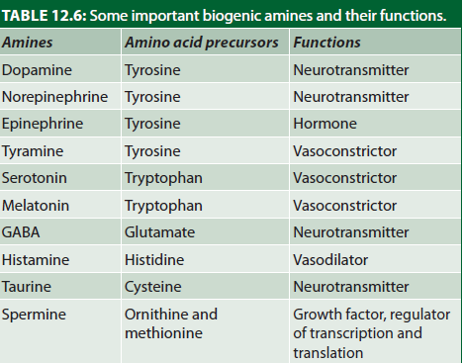

Slide 9
Polyamines
Biological amines made up of multiple amino acids called polyamines, e.g.
– Putrescine
– Spermidine
– Spermine.
Polyamines are positively charged at physiological pH and associate with negatively charged nuclear DNA.
These are present in high concentration in semen. The concentration of polyamines in brain is about 2 mM.

Slide 10
Putrescine, spermidine and spermine are derived from ornithine and methionine.
It is presumed that the 15% of methionine is used for polyamine synthesis.
Polyamines are involved in regulation of transcription and translation.

Slide 11
They act as a growth factor and function in cell proliferation and growth.
Polyamines are involved in stabilization of intact cells, subcellular organelles and membranes.

Slide 12
Catabolism and excretion of polyamines
The enzyme polyamine oxidase present in liver peroxi­somes oxidizes spermine to spremidine and spermidine to putrescine.
Putrescine is then oxidized by a copper containing diamine oxidase to CO₂ and NH₃.
Major portions of putrescine and spermidine are excreted in urine after conjugation with acetyl-CoA as acetylated derivatives.

Slide 13
Clinical significance of polyamines
Polyamines and their derivatives have application in diagnosis and treatment of cancer.
Their levels have been shown to increase in response to cell growth and differentiation.
Their concentration is elevated in body fluids of cancer patients.
Assays of urinary and blood polyamines have been used to detect cancer and to determine the success of therapy (diagnostic indicator).

Slide 14
Thank you

