Slide 1
Cell membrane & Transport system

Slide 2
PLASMA MEMBRANE
The Cell Membrane, “plasma membrane”, "phospholipid bilayer“
It is a selectively permeable lipid bilayer found in all cells.
It separates the cell from the external environment.
Membranes are mainly made up of lipids(40%), proteins (50%)and small amount of carbohydrates(10%).

Slide 3
The contents of these compounds vary according to the nature of the membrane.
The carbohydrates - as glycoproteins and glycolipids.
Phospholipids are the most common lipids present and they are amphipathic in nature.
Cell membranes also contain cholesterol.

Slide 4
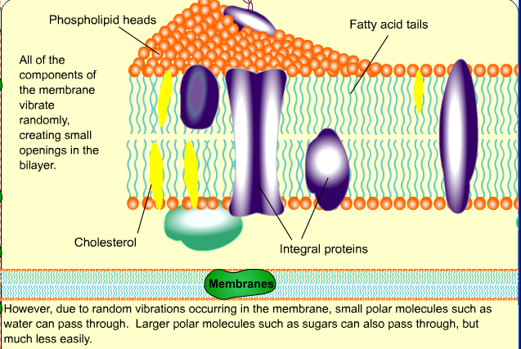

Slide 6
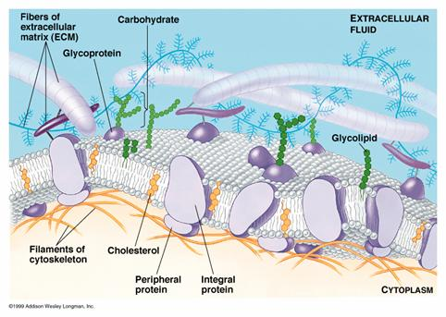
Plasma Membrane- Nicolson Singer Fluid Mosaic Model
The concept that membranes are fluid with proteins
floating in them like icebergs was proposed by Sanger and Nicolson in their "fluid mosaic model".

Slide 7
Fluid mosaic model:
The phospholipids are arranged in bilayers with the polar head groups oriented towards the extracellular side and the cytoplasmic side with a hydrophobic core.
The distribution of the phospholipids :
choline containing phospholipids - in the external layer and
ethanolamine and serine containing phospholipids- in the inner layer

Slide 8
Each leaflet is 25 Å thick, with the head portion 10 Å and tail 15 Å thick. The total thickness is about 50 to 80 Å.
The lipid bilayer shows free lateral movement of its components, hence the membrane is said to be fluid in nature.
However, the components do not freely move from inner to outer layer, or outer to inner layer.
Fluidity enables the membrane to perform endocytosis and exocytosis.

Slide 9
FLUID- because individual phospholipids and proteins can move around freely within the layer, like it’s a liquid.
MOSAIC- because of the pattern produced by the scattered protein molecules when the membrane is viewed from above.

Slide 10
However, the components do not freely move from inner to outer layer, or outer to inner layer (flip-flop movement is restricted).
During apoptosis (programmed cell death), flip-flop movement occurs.

Slide 11
Factors affecting fluidity of membrane
Cholesterol
When cholesterol concentration increases, the membrane becomes less fluid on the outer surface, but more fluid in the hydrophobic core.
In alcoholic cirrhosis, spur cells are seen because of increased RBC cholesterol content leading to less fluidity.
The effect of cholesterol on membrane fluidity is different at different temperatures.
At temperature below the Tm cholesterol increases fluidity and there by permeability of the membrane.
At temperatures above the Tm, cholesterol decreases fluidity.

Slide 12
II. Degree and nature of fatty acids
the more unsaturated cis fatty acids increase
the fluidity.
Trans Fatty acids(TFA) decrease the fluidity of membranes due to close packing of hydrocarbon chains.
Cis double bonds create a kink in the hydrocarbon chain and have a marked effect on fluidity.

Slide 13
Composition of Different Membranes:
Different Lipids as Percentage of Total Lipids
Type of membrane | Various types of lipids
 | Cholesterol | Lecithin | Cephalin | Phosphatidyl Serine | Sphingomyelin | Glycolipid
Plasma membrane | 20 | 19 | 12 | 7 | 12 | 10
Nuclear membrane | 3 | 45 | 20 | 3 | 2 | 0
Outer mitochondrial membrane | 8 | 45 | 20 | 2 | 4 | 0
Inner mitochondrial membrane | 0 | 35 | 25 | 0 | 3 | 0
Endoplasmic reticulum | 5 | 48 | 19 | 4 | 5 | 0
Myelin | 28 | 11 | 17 | 6 | 7 | 29

Slide 14
Lipid Rafts
Sphingomylin and glycolipids cluster to form semisolid
patches called “lipid rafts”
Enriched in cholesterol
Specific role endocytosis and receptor mediated signaling

Slide 15
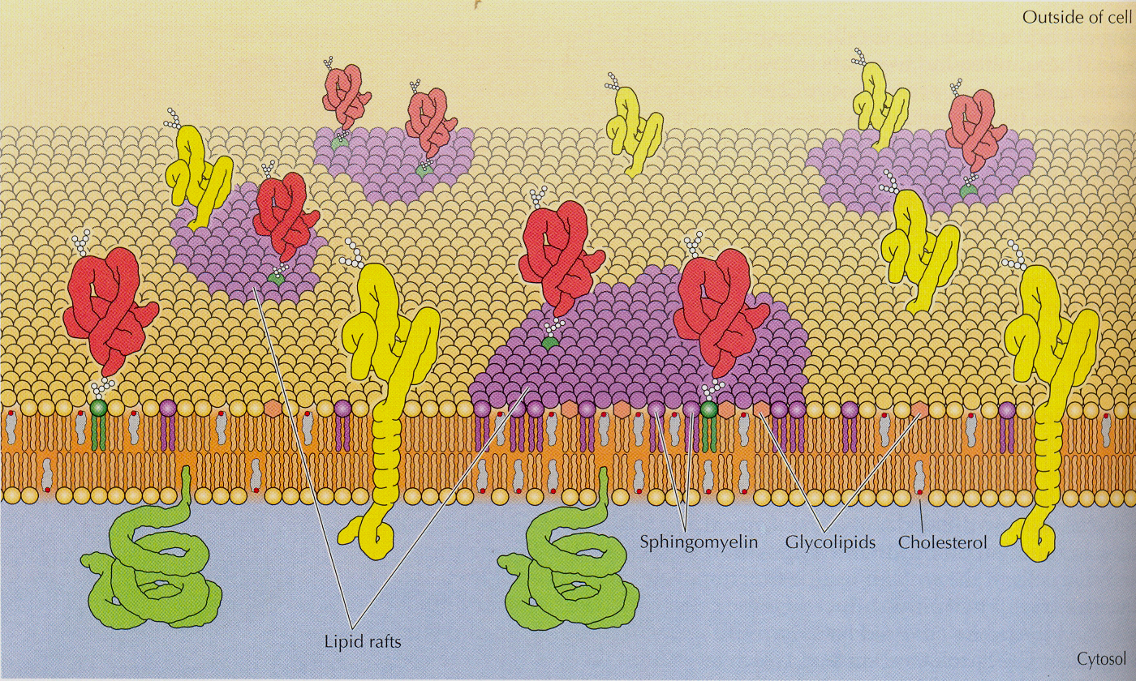
Lipid Rafts

Slide 16
MEMBRANE PROTEINS
1. Peripheral proteins :
exists on the surfaces of the bilayer.
They are attached by ionic and polar bonds to polar heads of the lipids.
2. Integral membrane proteins:
deeply embedded in the bilayer
They are attached by hydrophobic bonds or van der Waals forces.

Slide 17
3. Transmembrane proteins:
Some of the integral membrane proteins span the whole bilayer.
The hydrophobic side chains of the amino acids are embedded in the hydrophobic central core of the membrane.
It can serve as receptors (for hormones, growth factors, neurotransmitters), tissue specific antigens, ion channels etc.

Slide 18
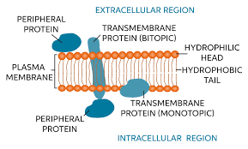

Slide 19
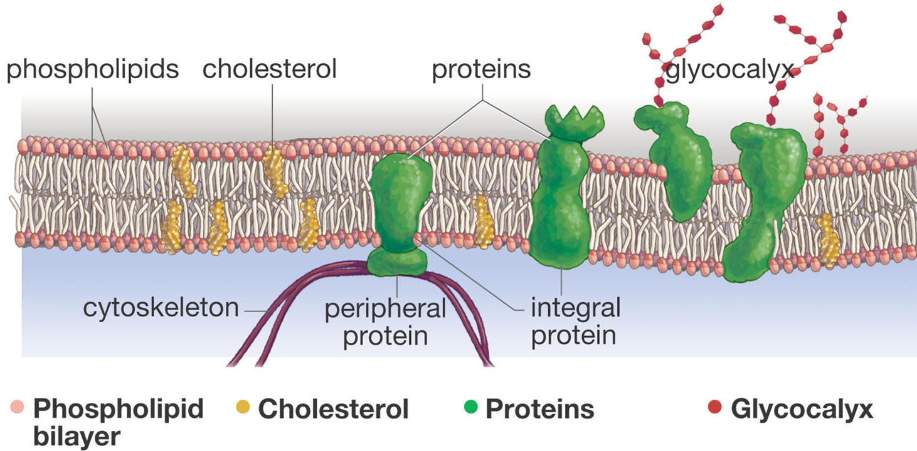
Composition

Slide 20
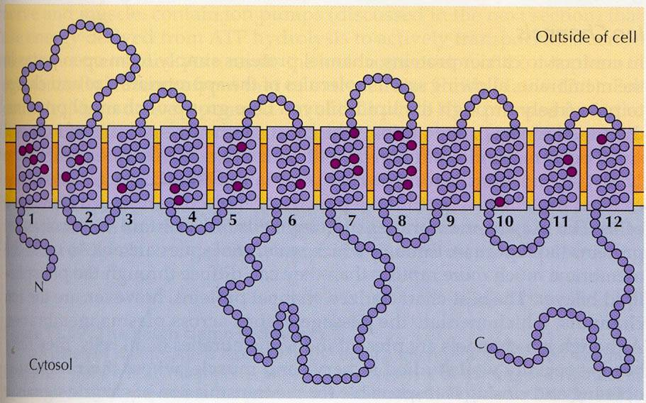
Glucose transporter

Slide 22
Carbohydrates
Only 2 - 8% by weight
Associated with proteins or lipids (glycoproteins or glycolipids)
Always towards the outer side
N-terminal on external surface carries carbohydrates
    Glycophorin

Slide 23
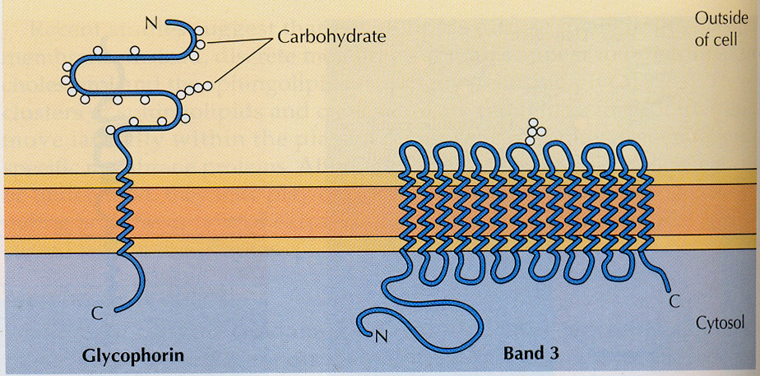
Carbohydrates
RBC membrane

Slide 24
Functions of Plasma Membranes
Protective sheath
Selective transport of ions and molecules.
Recognition of various stimuli.
Contains receptors for bio molecules like hormones, neurotransmitters etc.
Cell morphology and movement.
Compartmentalization
Membrane is very active metabolically
Contains the ecto-enzymes 5’ nucleotidase (nucleotide phosphatase) and alkaline phosphatase on the OUTER membrane

Slide 25
Cell Transport Mechanisms
The permeability of substances across the cell membrane is dependent on their solubility in lipids and not on their molecular size.
Water soluble compounds are generally impermeable and require carrier mediated transport.
An important function of membrane is to withhold unwanted molecules, while permitting entry of molecules necessary for cellular metabolism.

Slide 26
Transport mechanisms
Passive
Simple diffusion
Facilitated diffusion
Active
Ion channels

Slide 27
Simple Diffusion
Solutes and gases enter into the cells passively.
Driven by the concentration gradient.
From higher to lower concentration.
Does not require any energy or any carrier protein.
very slow process
it operates uni-directionally.

Slide 28
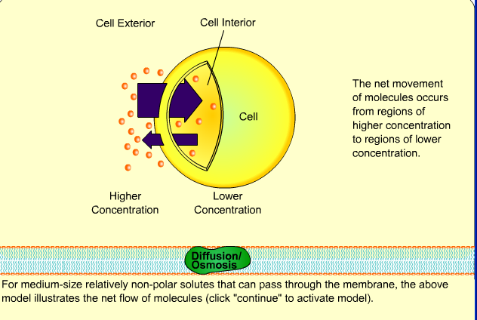

Slide 29
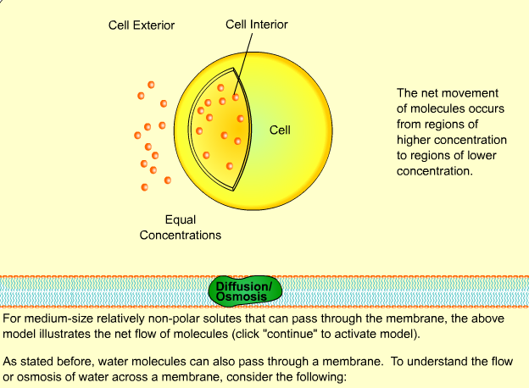

Slide 30
Facilitated Diffusion
Carrier mediated process.
Important features:
The carrier mechanism could be saturated which is similar to the Vmax of enzymes.
Structurally similar solutes can competitively inhibit the entry of the solutes.
Can operate bi-directionally.
Does not require energy, but the rate of transport is more rapid than diffusion process.
It is dependent on concentration gradient.

Slide 31
The carrier molecules can exist in two conformations, Ping and Pong states.
Pong state – Active sites exposed to outer side of membrane, solute binds. Binding leads to conformational changes.
Ping state – Active sites face interior, releases solute molecules into the cell. Reverts proteins back to pong state.
E.g. Glucose and amino acid transport

Slide 32
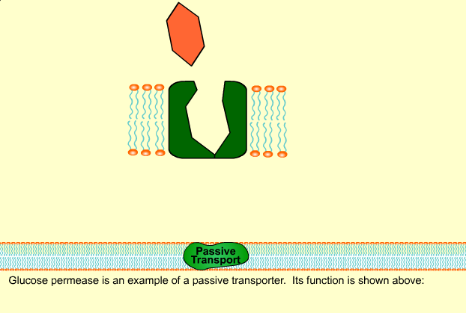

Slide 33
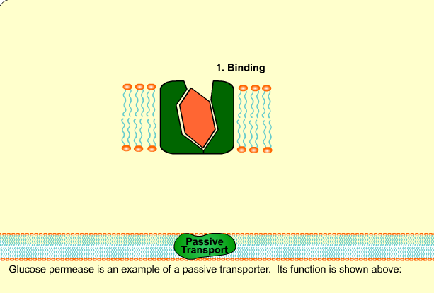

Slide 34
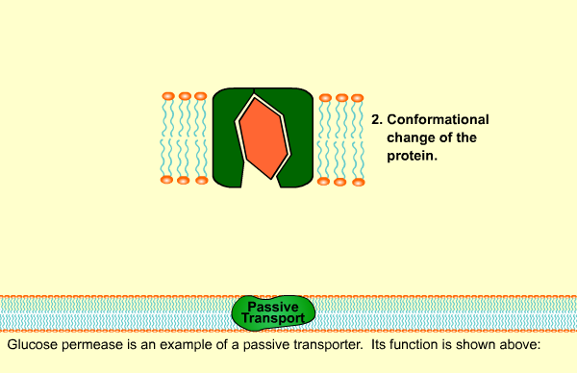

Slide 36
Aquaporins
Water channels that serve as selective pores, through which water crosses the plasma membranes of cells.
They form tetramers in the cell membrane and facilitate the transport of water. They control the water content of cells.
Diseases such as nephrogenic diabetes insipidus is due to impaired function of these channels.
Channelopathies are a group of disorders that result from abnormalities in the proteins forming the ion pores or channels.
A few examples are cystic fibrosis (chloride channel), Liddle’s syndrome (sodium channel) and periodic paralysis (potassium channel).

Slide 38
Ion Channels
For quick transport of electrolytes like Ca, K, Na and Cl.
Selective ion conductance pores.
Span the membrane.
3 states – Open, closed and inactivated.
Important for nerve conduction, synaptic transmission and secretion of biologically active substances.

Slide 39
Salient Features of ion Channels
They are transmembrane proteins.
Selective transport for one particular ion.
Regulation of activity is done by voltage-gated, ligand-gated or mechanically gated processes.
Different channels are available for Na+, K+, Ca++ and Cl–.
Transport through the channel is very quick.

Slide 40
Cation Conductive Channels
Generally remains closed, but in response to stimulus, they open allowing rapid influx of ions down the gradient.
Hence the name “gated”.
Based on nature of stimuli that trigger opening of gate, known as ‘voltage gated’ and ‘ligand gated’.
Voltage gated – Opened by membrane depolarization.
Ligand gated – Opened by binding of effectors.

Slide 41
Left side, voltage-gated channels; on the right side, ligand gated channels; closed and open positions.

Slide 42
Ligand gated channels
  Ligand gated channels are opened by binding of effectors.
  The binding of a Ligand to a receptor site on the channel results in the opening (or closing) of the channel.
  The Ligand may be an molecule or an.
  extracellular signaling intracellular messenger

Slide 43
  A. Acetyl choline receptor:
Acetylcholine receptor is the best example for ligand-gated ion channel.
It is present in postsynaptic membrane.
It has 5 subunits, consisting of acetylcholine binding site and the ion channel.
Acetylcholine released from the presynaptic region binds with the receptors on the postsynaptic region, which triggers
Opening of the channel and influx of Na+. This generates an action potential in the postsynaptic nerve.

Slide 44
Acetyl Choline Receptor

Slide 45
Calcium channels:
In the muscle cells, under appropriate stimuli, calcium channels are opened in the sarcoplasmic reticulum membrane, leading to an elevated calcium level in the cytosol.
Calcium channel blockers are therefore widely used in the management of hypertension.

Slide 46
Voltage gated channels
opened by membrane depolarization.
The channel is usually closed in the ground state.
The membrane potential change switches the ion channel to open, lasting less than 25 milliseconds.
e.g. sodium channel and potassium channel are seen in the nerve cells and are involved in the conduction of nerve impulses.

Slide 47
Active transport
Salient features of active transport are –
Requires energy
Uni-directional
Requires specialized integral proteins called transporters
Saturated at higher concentration of solutes
Susceptible to inhibition

Slide 48
ACTIVE TRANSPORT

Slide 49
Sodium Pump
Active transport
Cell has low intra-cellular sodium and high potassium.
Maintained by sodium-potassium activated ATPase or sodium pump.
Integral membrane protein
Binding sites for ATP and sodium inside and potassium outside.

Slide 50
Hydrolysis of one ATP leads to expulsion of 3 Na and
influx of 2 K ions.
Sodium binds to pump, leading to phosphorylation by ATP and release of Na.
K binding removes phosphate and reverts it back and K is released.
Ion transport and ATP hydrolysis are tightly coupled.
Digoxin and ouabain inhibits pump.

Slide 51
Calcium Pump
An ATP dependent calcium pump also functions to regulate muscle contraction.
A specialized membrane system called sarcoplasmic reticulum is found in skeletal muscles which regulates the Ca++ concentration around muscle fibers.
In resting muscle the concentration of Ca++ around muscle fibers is low.
But stimulation by a nerve impulse results in a sudden release of large amounts of Ca++. This would trigger muscle contraction.
For each ATP hydrolyzed, 2 Ca++ ions are transported.

Slide 52
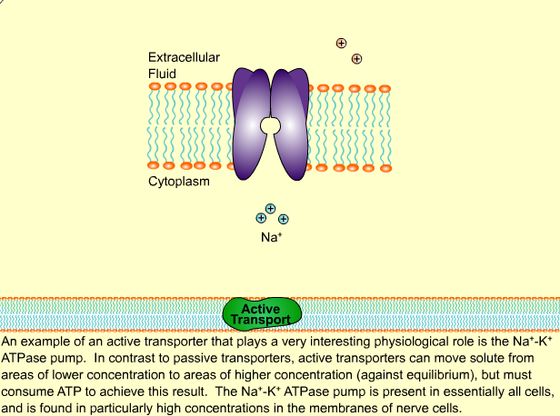

Slide 53
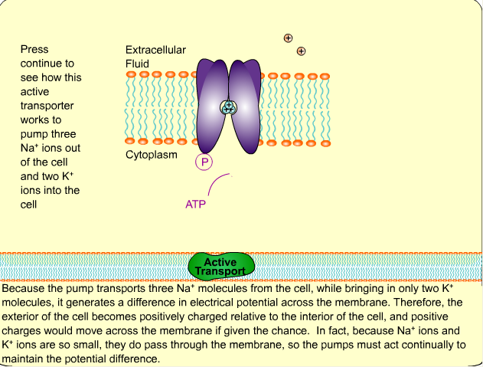

Slide 54
Uniport, symport, and antiport
Uniport – Carries single solute across membrane. E.g.
Calcium pump, glucose transporter.
Co-transport – If transport depends on simultaneous or sequential transfer of another molecule.
Active transport may be coupled with energy indirectly.

Slide 55
Co-transport may be symport or antiport.
Symport – If transporter carries two solutes in the same direction across the membrane. E.g. Sodium dependent glucose transport , amino acid transport.
Antiport – Carries two solutes or ions in opposite direction. E.g. Sodium pump, chloride – bicarbonate exchange in RBC.

Slide 56
(A) Uniport; (B) Symport and (C) Antiport transport systems.

Slide 57
Transport Mechanisms
Simple
Facilitated
diffusion
Primary
active
Secondary
active
Ion channels
Carrier
No
Yes
Yes
Yes
Yes
Gradient
No
No
Yes
Yes
No
Energy
No
No
Direct
Indirect
No

Slide 58
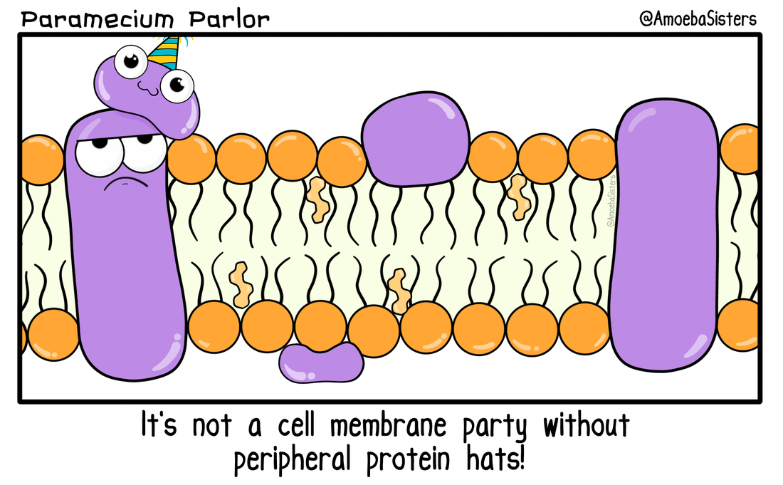

Slide 59
Thank you

