Slide 1
Implantation
Dr Kinjal Jethva
Professor
Department of Anatomy

Slide 2
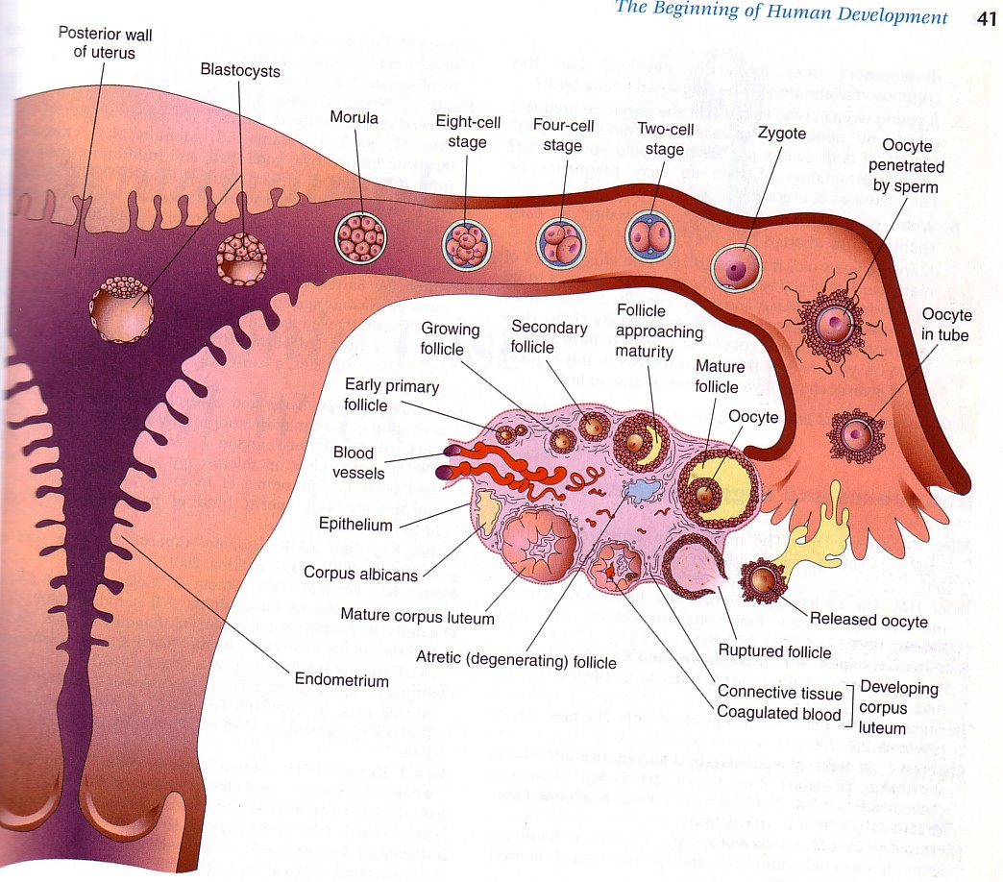
Implantation
By. Prof. Saeed Abuel Makarem

Slide 3
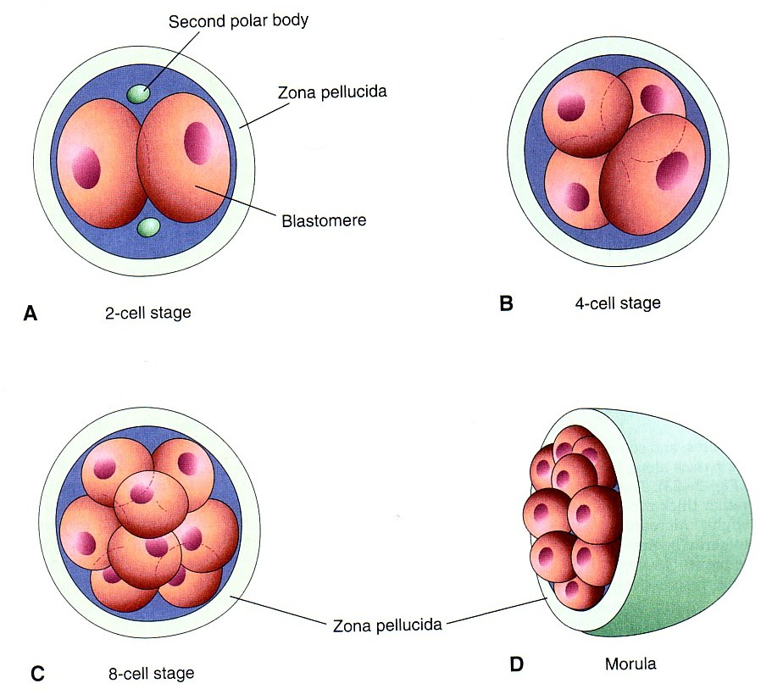
Cleavage of Zygote
Begins about 30 hrs after fertilization
Zygote divides first into 2 then 4 then 8 & 16 cells
Zygote is within the thick zona pellucida during cleavage
Zygote migrates in the uterine tube from its lateral end to its medial end.
Zona pellucida is translucent under light microscope

Slide 4
Definition of implantation:
It is the process by which the Blastocyst penetrates the superficial (Compact) layer of the endometrium of the uterus.
Site:
The normal site of implantation is the posterior wall of uterus near the fundus.
Time:
It begins about the 6th day after fertilization.
It is completed by the 11th or 12th day.

Slide 5
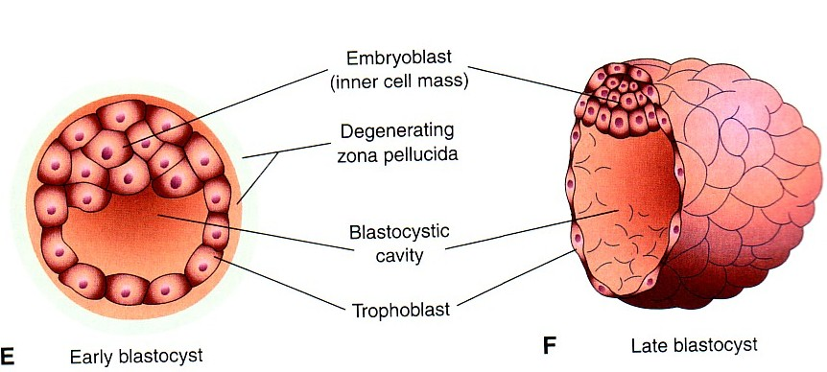
Mechanism:
The Morula reaches the uterine cavity by the 4th day after fertilization, & remains free for one or two days
Fluid passes from uterine cavity to the Morula through the zona pellucida.
Now the Morula is called Blastocyst, its cavity is called blastocystic cavity, its cells divided into Embryoblast & Trophoblast.

Slide 6
The embryoblast projects into the blastocystic cavity, while the trophoblast forms the wall of the blastocyst.
Zona pellucida degenerates & disappears by the 5th day to allows the blastocyst to increase in size and penetrates the endometrium.
By 6th day the blastocyst adheres to the endometrium
By 7th day, Trophoblast differentiated into 2 layers:
Cytotrophblast, inner layer, mitotically active.
Syncytiotrophoblast (outer multinucleated mass, with indistinct cell boundary.
By 8th day the blastocyst is superficially embedded in the compact layer of the endometrium.

Slide 7
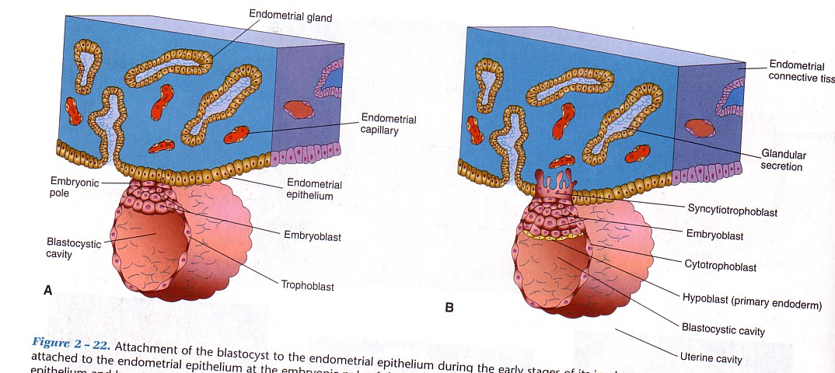
By the 5th day the Zona pellucida degenerates.
Blastocyst begins implantation by the 6th day, (20 day of a 28 day menstrual cycle).
Trophoblast cells penetrate the epithelium of the endometrium.
Penetration results from proteolytic enzymes (eg.COX-2) produced by trophoblast.

Slide 8
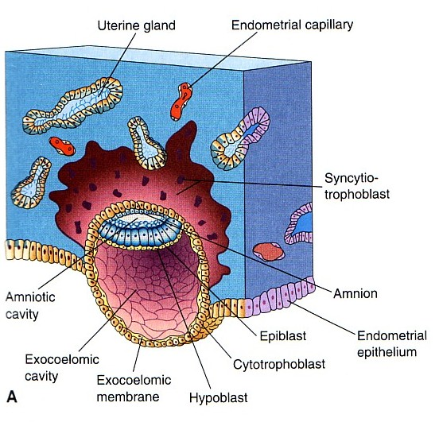
Blood-filled Lacunae appear in the Syncytiotrophoblast
which communicate forming a network by the day 10th or 11th
Syncytiotrophoblast
erodes the endothelial lining of maternal capillaries which known as sinusoids.
Now blood of maternal capillaries reaches the lacunae so
Uteroplacental circulation is established by 11th or 12th day.

Slide 9
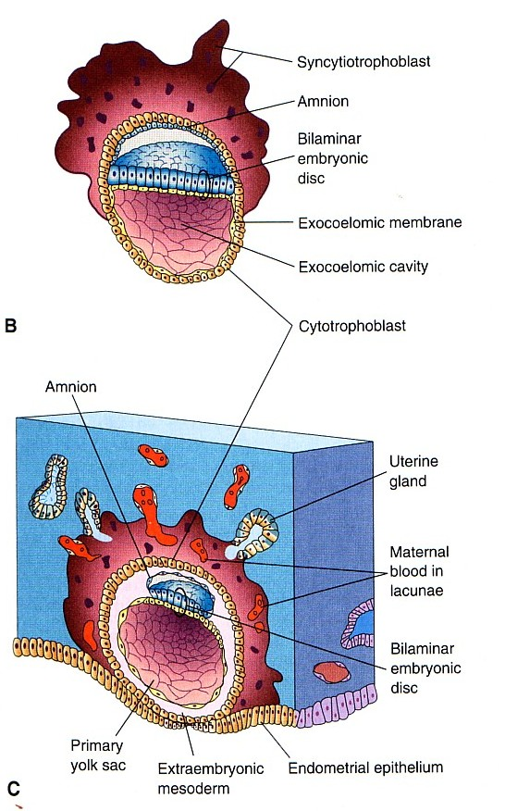
Endometrial cells undergo apoptosis (programmed cell death) to facilitates invasion of endometrium by the Syncytiotrophoblast.
Syncytiotrophoblast engulf these degenerating cells for nutrition of the embryo.
Implantation
can be detected by:
1- Ultrasonography.
2- hCG (human chorionic gonadotrophin which is secreted by the Syncytiotrophoblast) about the end of 2nd week

Slide 10
Early Pregnancy Factor
Is an immunosuppressant protein
Secreted by trophoblastic cells
Appears in maternal serum within 24-48 hrs
It is the basis for EPT in the first 10 days of development.

Slide 11
By the tenth day conceptus is completely embedded in the endometrium.
For about 2 days the site of penetration shows a defect in the endometrium.
A fibrinous coagulum of blood closes this defect till the endometrial epithelium creeps over the closing plug by the 12th day to cover the defect.

Slide 12
Formation of embryonic disc
Embryoblast cells arranged into 2 layers:
1- High columnar cells towards the amnion, called Ectoderm, (Epiblast).
2- Low- cuboidal cells towards the blastocystic cavity called endoderm, (Hypoblast).
Now it is called bilaminar embryonic disc.
Formation of amniotic cavity.
A space appears between the ectoderm and the trophoblast.
Its floor is formed by the ectoderm while its roof is formed by a layer of flat cells called amniogenic cells which secretes the amniotic fluid.

Slide 13
Formation of Primary Chorionic villi
By the 13th day Proliferation of Cytotrophblast cells produce extension inside Syncytiotrophoblast to form primary chorionic villi,
Formation of the yolk sac
Flat cells originate from the endoderm, form a membrane called exocoelomic membrane which lines the blastocystic cavity.
Now it is called Exocoelomic cavity. The exocoelomic cavity and the exocoelomic membrane is called now primary yolk sac.

Slide 14
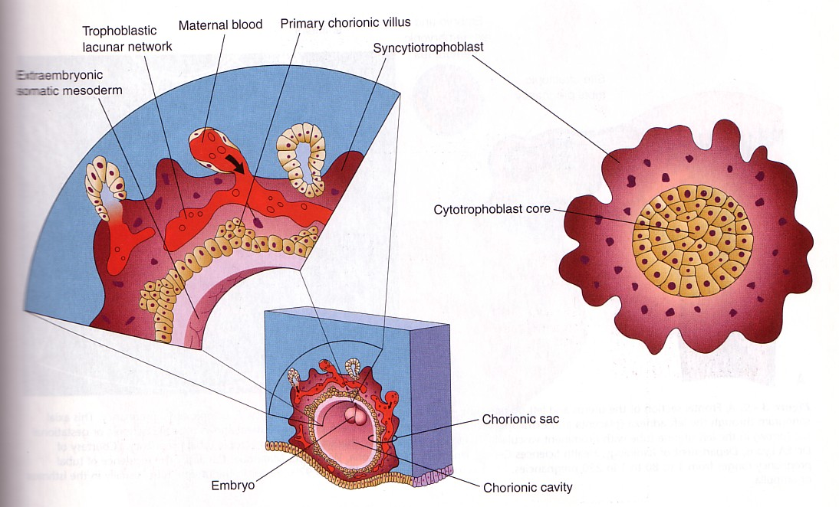
Primary chorionic Villi

Slide 15
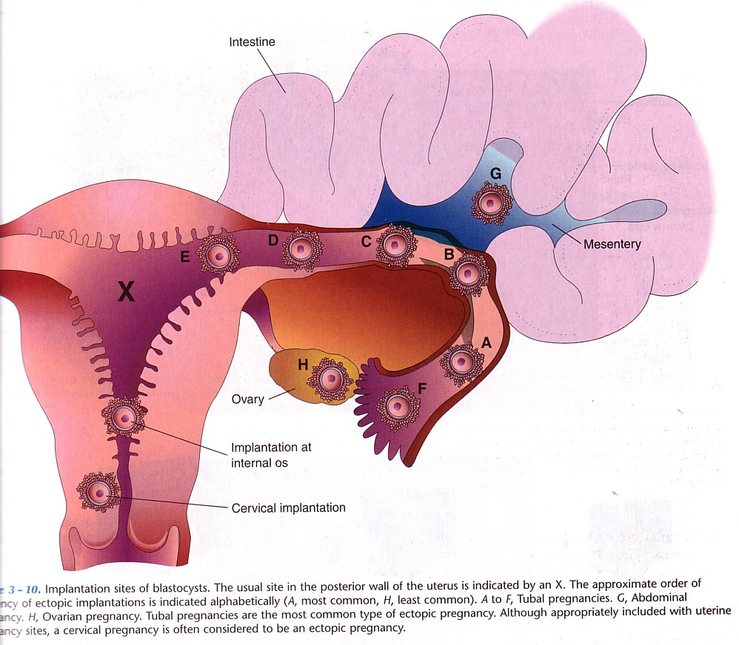
Ectopic Implantation (Pregnancy)

Slide 16
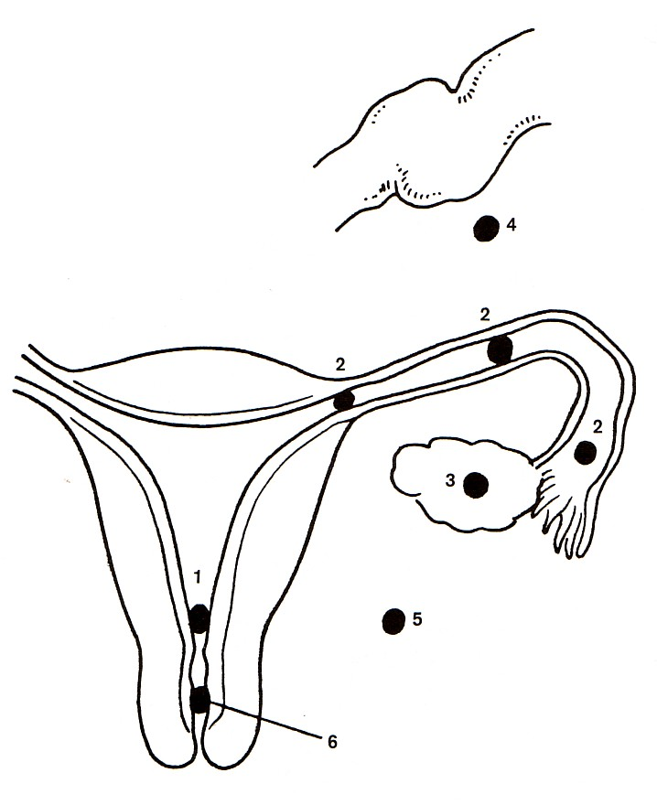
Ectopic Pregnancy:
1- Placenta Previa.
2- Tubal.
3- Ovarian.
4- Abdominal.
5- Pelvic.
6- Cervical.

Slide 17
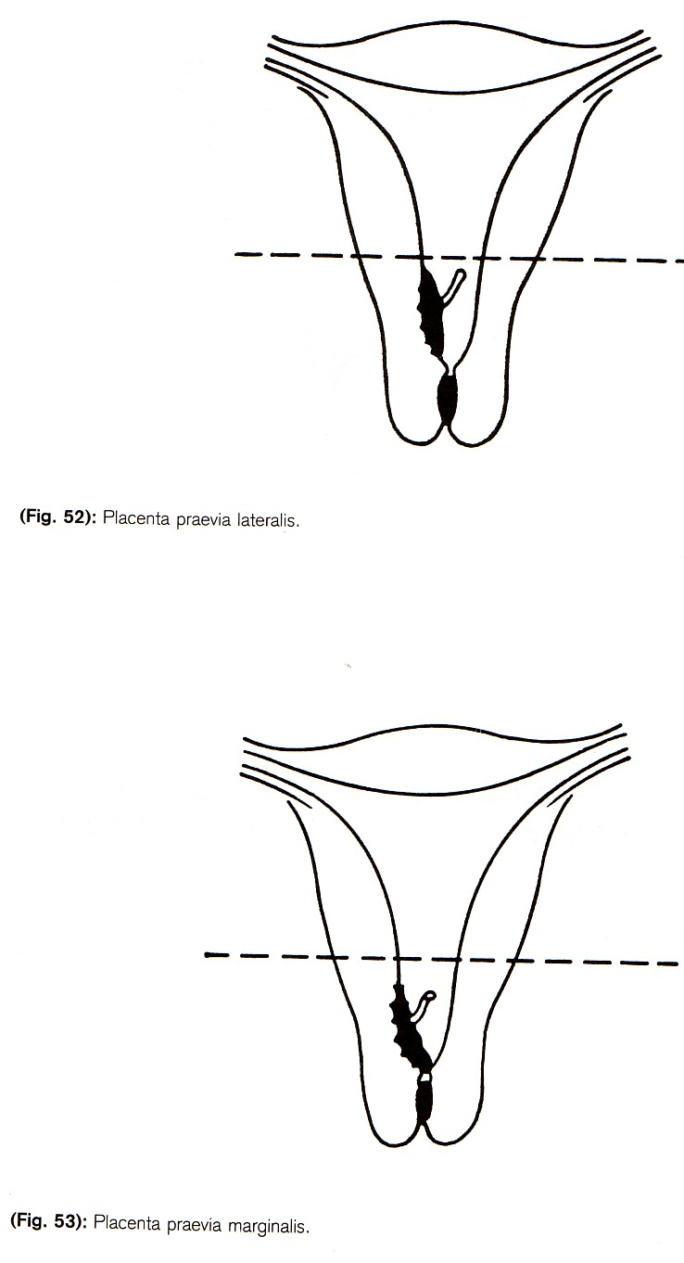
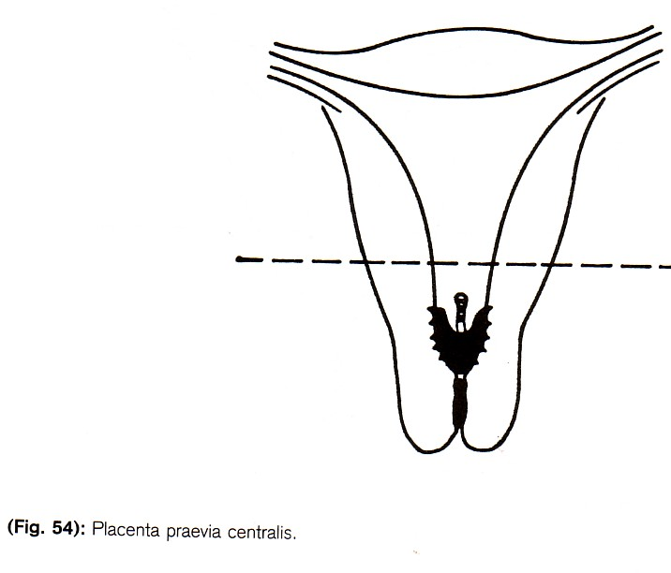
Types 0f Placenta Praevia

Slide 18
Ectopic Pregnancy
It means implantation outside the uterus.
95 to 97% of ectopic pregnancies occurs in the uterine tube.
Most are in the ampulla & isthmus.
Placenta previa:
Implantation occurs in the lower uterine segment.

Slide 19
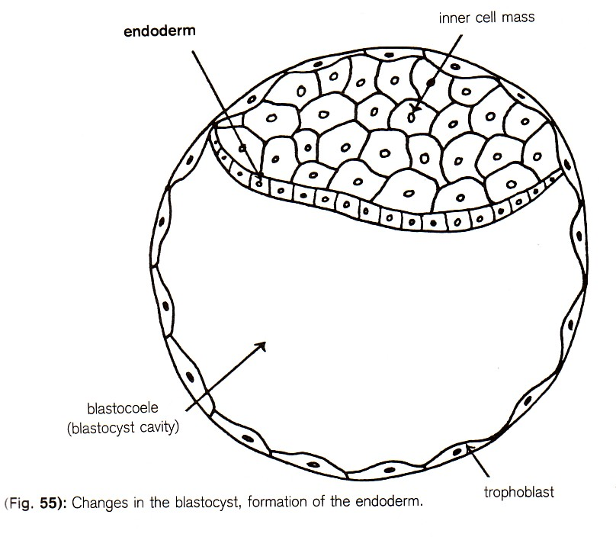
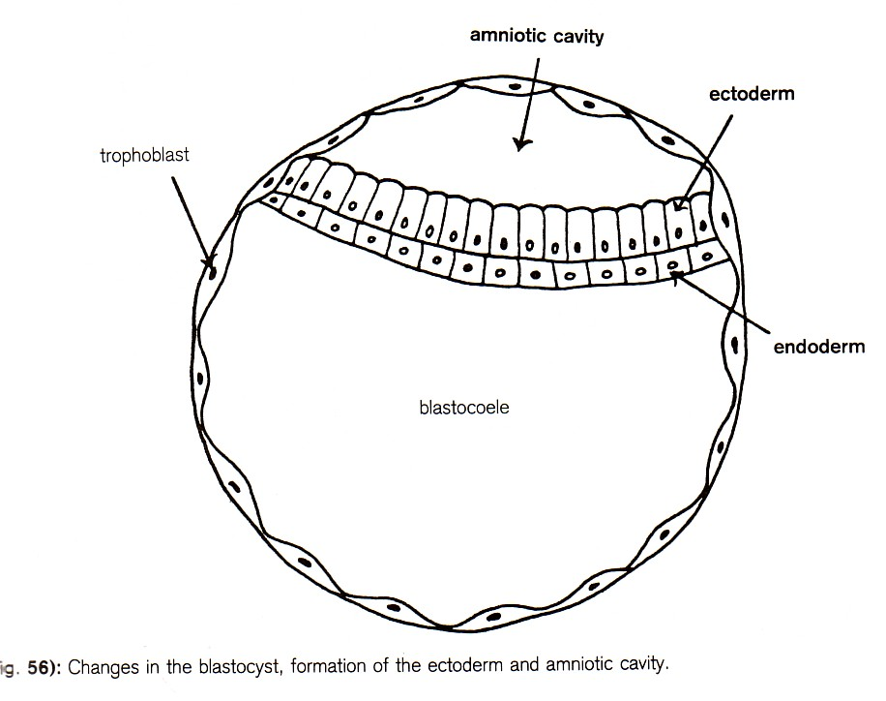

Slide 20
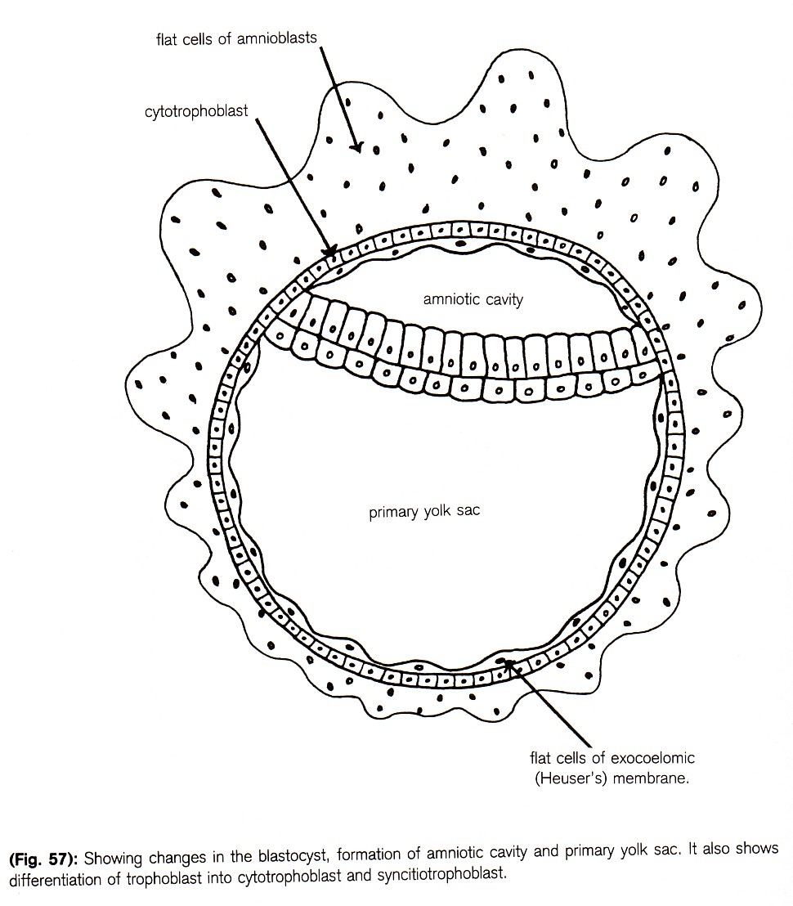
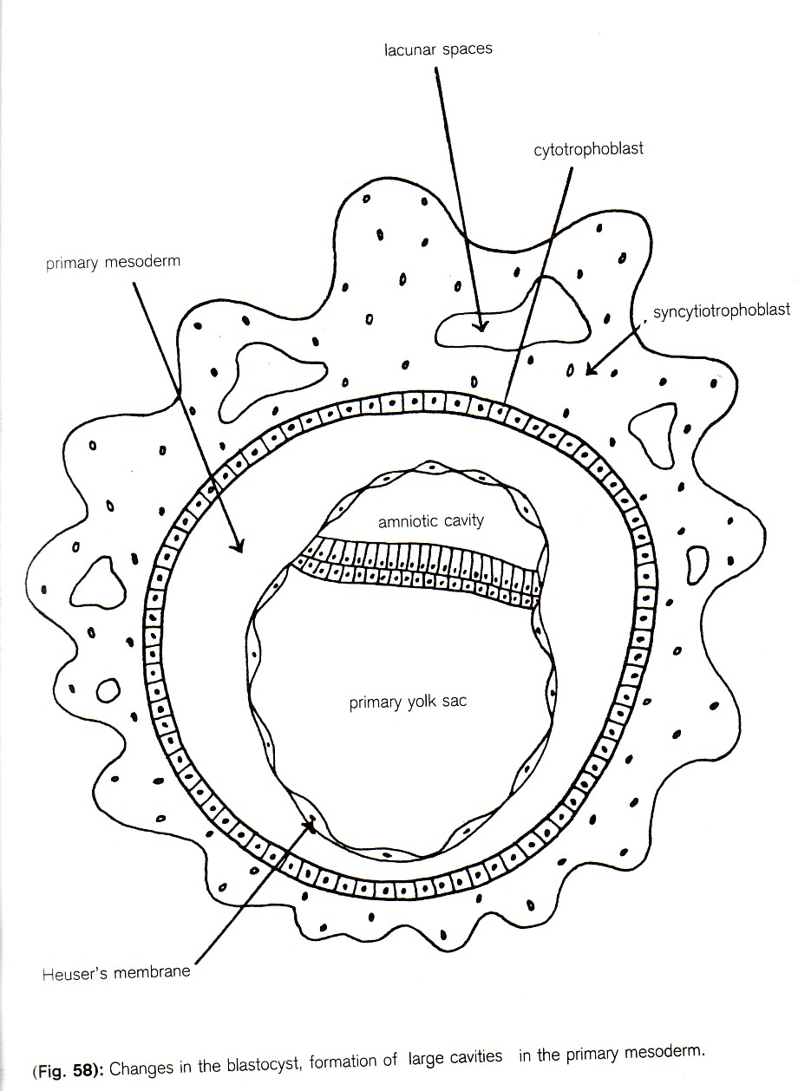

Slide 21
Tanya Timeva,^{1,*} Atanas Shterev,¹ and Stanimir Kyurkchiev^{2,} J Reprod Infertil. 2014 Oct-Dec; 15(4): 173–183
Tanya Timeva,^{1,*} Atanas Shterev,¹ and Stanimir Kyurkchiev² | Recurrent Implantation Failure: The Role of the Endometrium Medium level of evidence | The most important and discussed ones in the literature are maternal age, the causes of infertility, the ovarian response to stimulation, the influence of the male factor and sperm quality, embryo quality and the various uterine pathologies. Some couples fail repeatedly after transferring good quality embryos without any obvious reason and this becomes a major continuing problem after IVF/ICSI procedures. | It can be speculated that in these couples, insufficiency of the endometrium might be a possible reason for implantation failure. This review article summarized current literature describing the consecutive endomertial procedures involved in successful embryo implantation. | It is believed that efforts to align criteria for definition of recurrent implantation failure (RIF) and attempts to classify different RIF types would develop guidelines for treatment procedures which would result in an increase in patients’ opportunities to conceive.

