Slide 1
TWINNING
Dr. Hetal Vaishnani
Professor
Dept. of Anatomy
S.B.K.S.M.I.& R.C.

Slide 2
Competency
AN 80.4 Twinning

Slide 3
Specific learning objective
Describe formation of amnion, constituents, function and volume of amniotic fluid
Describe oligohydramnios and polyhydramnios
Describe types of twinning
Explain differences between monozygotic and dizygotic twins.
Enumerate congenital anomalies of twins

Slide 4
Integration
Vertical integration with obstetrics and gynecology department
Faculty of obstetrics and gynecology department will discuss the congenital anomalies of twins

Slide 5
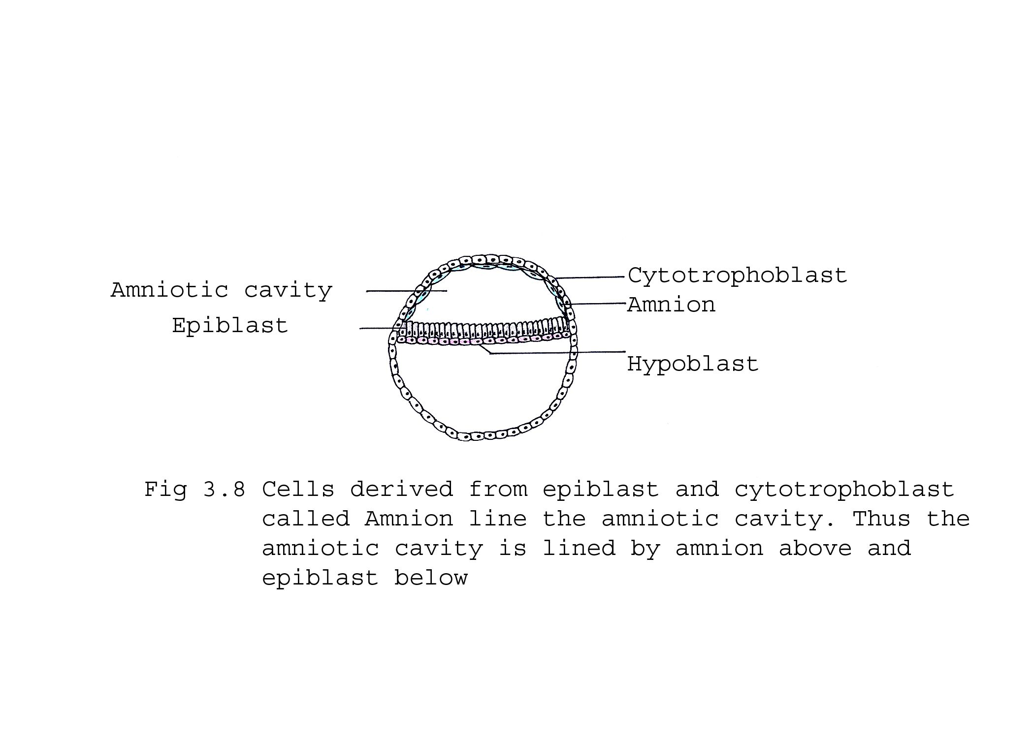
Amnion- is a thin extraembryonic membrane is filled with the amniotic fluid.

Slide 6
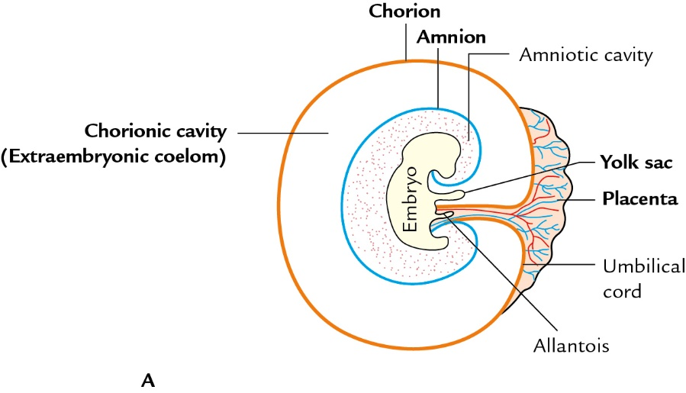
Schematic diagrams to show extraembryonic membranes A. Outside the uterine cavity

Slide 7
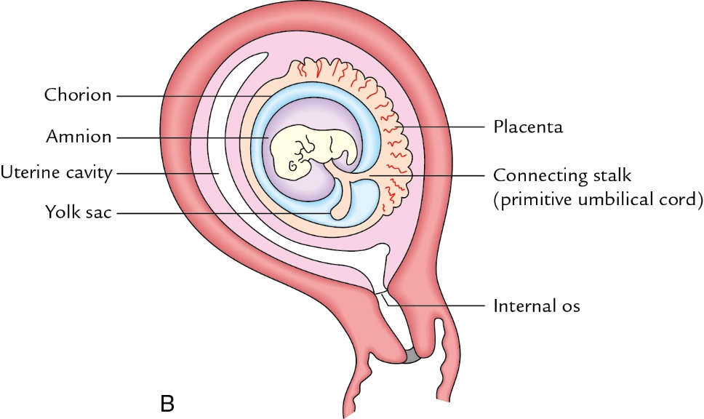
Schematic diagrams to show extraembryonic membranes. B. Within the uterine cavity

Slide 8
Amniotic fluid
Clear, watery fluid containing salt, sugar, urea and proteins.
AF at full term is 700-1000ml
It is derived from:
Amniotic cells by filtration or secretion
Fetal urine when kidneys start functioning
Secretion of lung cells
Secretion by placenta

Slide 9
Oligohydramnios
It is a clinical condition in which the volume of AF is less than normal
If this volume becomes 400ml or less
Causes:
Placental insufficiency with reduced placental blood flow
Agenesis of kidneys
Loss of AF due to preterm rupture of amnion

Slide 10
Polyhydramnios
The excessive accumulation of AF is more than 2000ml
Causes:
Esophageal atresia
Defect of CNS
Fetus is unable to swallow the AF and is not absorbed in the GIT

Slide 11
Twinning – when mother gives birth to 2 young individuals in single pregnancy
Twinning in human - hereditary trait, 1 in 8 birth

Slide 12
3 classes of mammals are included-
Eutherian and Metatherian mammals- are poly-ovulatory and shed multiple ova in single ovarian cycle, multiple birth in these species
Marmosets- are diovulatory and discharge two ova in each cycle
Primates including Man- are mono-ovulatory and shed single ovum in each cycle.
-Twinning or multiple birth are accidental and sporadic by genetic and environmental factors

Slide 13
Superfecundation- it is a process of multiple births affecting poly-ovulatory mammals.
Superfoetation- Aberrant ovulation when takes place during pregnancy, in this case embryos are of different ages.
- If ovulation when takes place during pregnancy may lead to multiple birth at subsequent period, but embryos are of different ages.

Slide 14
Causes of Multiple Gestation
Spontaneously
In Vitro fertilization
  Intrauterine insemination
  Assisted Hatching
  GIFT, ZIFT
  Frozen Embryo Transfer, Blastocyst Embryo Transfer
Fertility Drugs
  Clomiphene citrate (clomid, serrophene)
  Gonadotropins (GonalF, follistim, humagon)

Slide 15
Twinning in women
2 Types: Monozygotic
Dizygotic- M.C.
In twin birth (2 babies): Boys- M.C.
Boy and Girl
Girls- L.C.
Triplets (three babies)
Quadruplets (four babies)

Slide 16
Twins
Monozygotic twin
  Ova division:
    < 72 hours: Dichorionic, diamniotic
    4-8 days: Monochorionic, diamniotic
    8-13 days: Monochorionic, monoamniotic
    > 13 days: conjoined twins
Dizygotic twins
  Dichorionic – separate chorion (placenta)
  Diamniotic – separate amnion (amniotic sac)

Slide 17
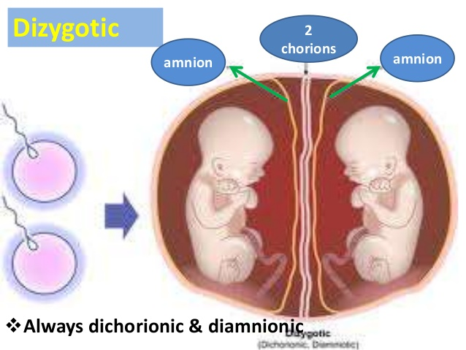
Dizygotic twinning-
Incidences are increase with the age of the mother
2 ova are discharged at the same time in a single ovarian cycle
Non identical, may be of different sex
Two chorion and two amnion.
Placenta may be separate or fused.

Slide 18
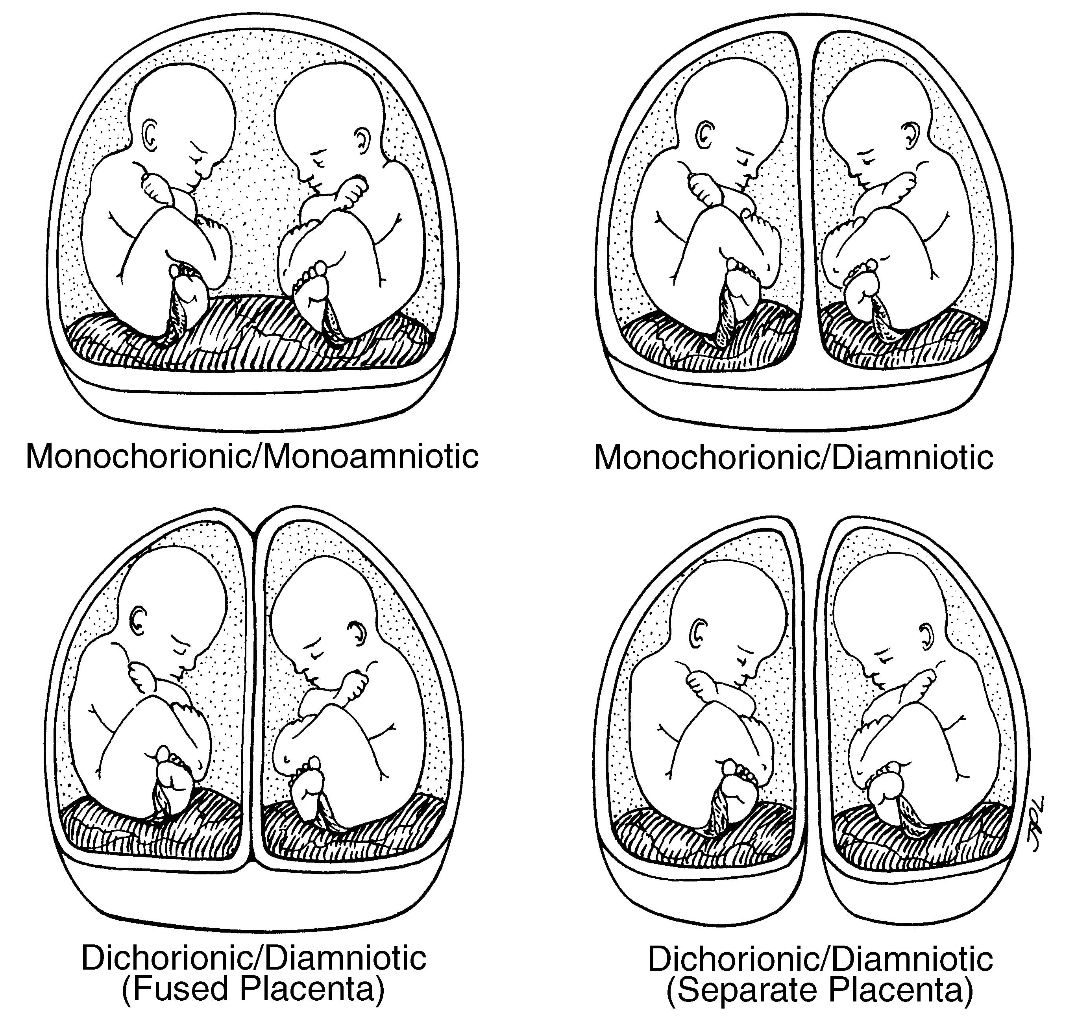
Monozygotic twins

Slide 19
Conjoined Twins
Craniopagus
Pygopagus
Thoracopagus- M.C.
Cephalopagus
Parapagus
Omphalopagus
Parasitic twins
Fetus in fetu

Slide 20
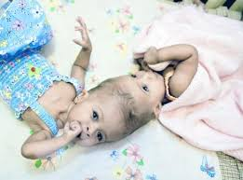
Craniophagus

Slide 21
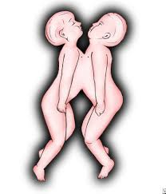
Thoracophagus- M.C.

Slide 22
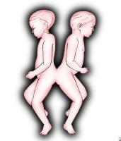
Pyophagus

Slide 23
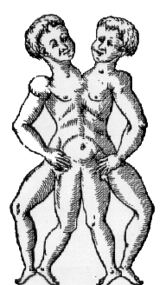
Conjoined Twins
(paraphagus)
http://www.conjoined-twins.i-p.com

Slide 24
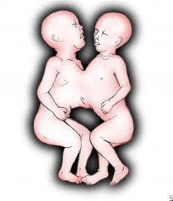
Omphalophagus

Slide 25
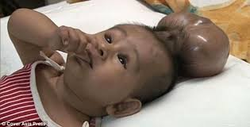
Parasitic twins

Slide 26
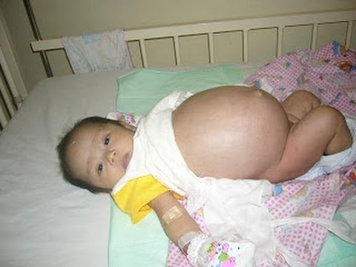
Foetus in foetu

Slide 27
THANK YOU

Slide 28
Franka Cadée, Marianne J. Nieuwenhuijze,
A. L. M. Lagro-Janssen, Raymond De Vries
Globalization and Health
Franka Cadée, Marianne J. Nieuwenhuijze, A. L. M. Lagro-Janssen & Raymond De Vries Globalization and Health volume 12, Article number: 66 (2016) | The state of the art of twinning, a concept analysis of twinning in healthcare Medium level of evidence | We conducted a Concept Analysis (CA) of twinning in healthcare using Morse’s method. A qualitative study of the broad literature was performed, including scientific papers, manuals, project reports, and websites. We identified relevant papers through a systematic search using scientific databases, backtracking of references, and experts in the field | Our CA of the literature resulted in four main attributes of twinning in healthcare. First, and most frequently mentioned, was reciprocity. The other three attributes were that twinning: 2) entails the building of personal relationships, 3) is dynamic process, 4) is between two named organisations across different cultures. The literature also indicated that these four attributes, and especially reciprocity, can have an empowering effect on healthcare professionals | A greater understanding and a mature definition of twinning results in clear expectations for participants and thus more effective twinning. This can be the starting point for new collaborations and for further international studies on the effect of twinning in healthcare.

Slide 30
1. Splitting of single fertilized ovum between 8 to 13 days results in
Conjoined twins
Monochorionic monoamniotic twin
Dichorionic diamniotic twin
Monochorionic diamniotic twin

Slide 31
2. Variety of twins with 2 ova which is fertilized by 2 spermatozoa
Dizogotic tiwns
Monochorionic diamniotic twin
Monochorionic monoamniotic twin
Conjoined twin

Slide 32
3. Most common variety of conjoined twins is
Craniopagus
Thoracopagus
Omphalopagus
pyopagus

Slide 33
4. Which is the most common type of the twinning?
Dizygotic
Monozygotic
Both
None

Slide 34
5. Which type of ovulation occur in the human?
Poly-ovulatory
Di-ovulatory
Mono-ovulatory
None

