Slide 1
DIAGNOSIS OF ATYPICAL PNEUMONIA
Dr.Vidya Date
Professor
Department of Microbiology

Slide 2
INTRODUCTION
DEFINITION: It is type of pneumonia not caused by one of the pathogen most commonly associated with disease. It also have milder symptoms as compared to typical pneumonia
It is known as “walking pneumonia”

Slide 3
Etiological agents
BACTERIA:
Mycoplasma pneumoniae
C. psittaci, C. pneumoniae
Legionella
F. tularensis
Y. pestis
B. anthracis
RESPIRATORY TRACT VIRUS:
Influenza
Adenovirus
Respiratory syncytial virus
Parainfluenza virus
SARS-COVID
OTHER VIRAL AGENTS:
Varicella-zoster
Measles
Epstein-Barr virus
CMV
Hantavirus
FUNGI:
Histoplasma
Blastomyces
Coccidiodes
Pneumocystis
Rickettsia
C. burnetti

Slide 4
CLINICAL FEATURES
Non productive cough
Low grade Fever
Tachypnea
Dyspnea
Interstitial pneumonia
Gastrointestinal symptoms: may be seen up to 20% of patients such as nausea, vomiting, and/or diarrhea
Other symptoms may include fatigue, headache, myalgia, and arthralgia

Slide 5
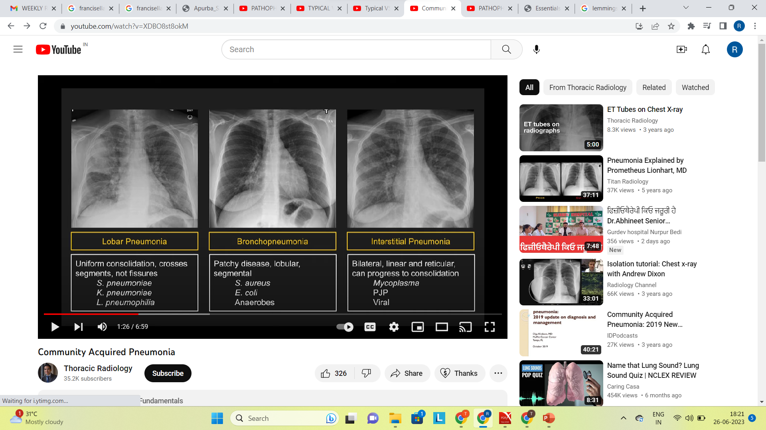
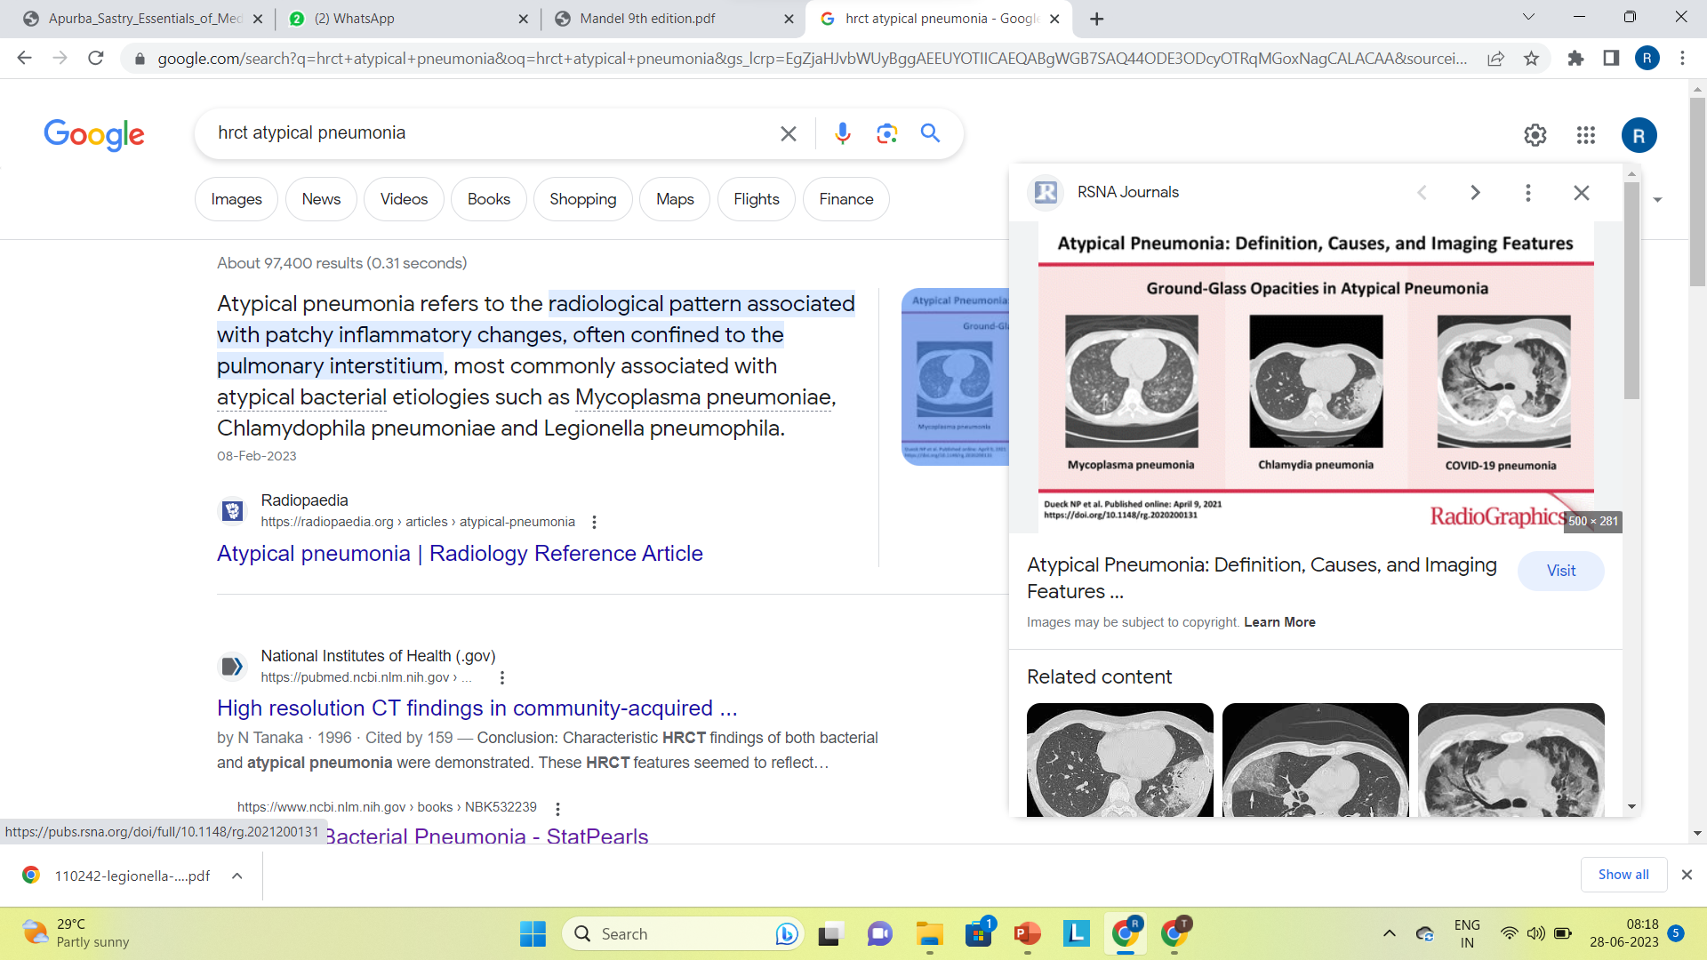
HRCT
CHEST X-RAY

Slide 6
Chlamydia spp.
Obligate intracellular
Order Chlamydiales
Family Chlamydiaceae
One genus: Chlamydia
Nine species:
Human pathogenic species -Chlamydia trachomatis, Chlamydia psittaci, Chlamydia pneumoniae
Non-pathogenic; animal species -Chlamydia pecorum ,Chlamydia muridarum ,Chlamydia suis ,Chlamydia abortus ,Chlamydia caviae, and Chlamydia felis.

Slide 7
Chlamydia pneumoniae
TWAR (Taiwan acute Respiratory Agent)
Exclusive a human pathogen.
Accounts 10-15% cases of community acquired pneumonia.
Most common in elderly people.
Transmission is by person to person via respiratory secretions with an incubation period of several weeks.
Most adults hospitalized with C. pneumoniae have recurrent infection.

Slide 8
People at increased risk
Schools
College residence halls
Military barracks
Hospitals
Prisons

Slide 9
CLINICAL FEATURES
Cough
Fever
Headache
Malaise
Laryngitis
Pharyngitis

Slide 10
DIAGNOSIS
Specimen Collection
Nasopharyngeal Swab (Dacron-tipped swabs is mandatory because calcium alginate on cotton-tipped swabs inhibit the growth of the organism in tissue culture and may be toxic to cells).
Respiratory secretions.
Serum

Slide 11
MICROSCOPY
Gram staining: chlamydiae are gram negative, poorly stained.
Direct lmmuno-fluorescence Test (DIF)
Enzyme lmmuno-assays (Antigen Detection)
Culture: Chlamydiae cannot be cultivated in artificial media.
They can grow only in embryonated egg (yolk sac), animal (mice) and cell line.
Choice of the cell line depends on the species:
C. pneumoniae :HEp2 or human fibroblast cell line.
C. psittaci: although grow well in cell culture, isolation should not be attempted in the routine laboratory because of the risk of laboratory infection.

Slide 12
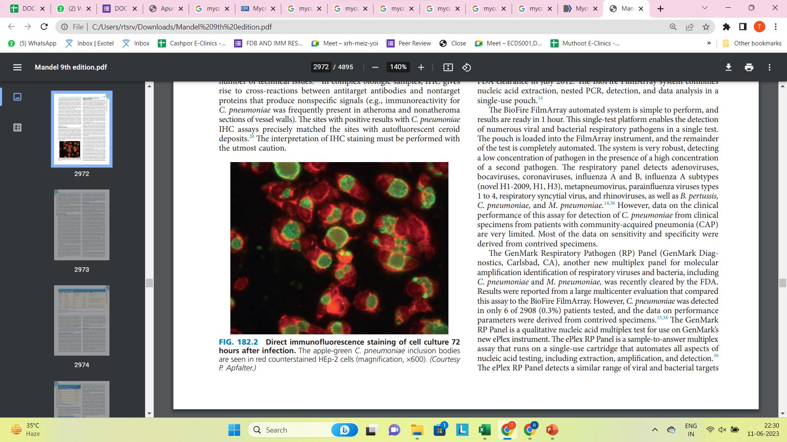
Direct immunofluorescence staining of cell culture 72 hours after infection. The apple-green C. pneumoniae inclusion bodies are seen in red counterstained HEp-2 cells

Slide 13
Nucleic Acid Amplification Tests
Diagnostic assays of choice for chlamydial infection as recommended by the CDC
Polymerase chain reaction (PCR)
Real time PCR
Bio-fire Film Array respiratory panel

Slide 14
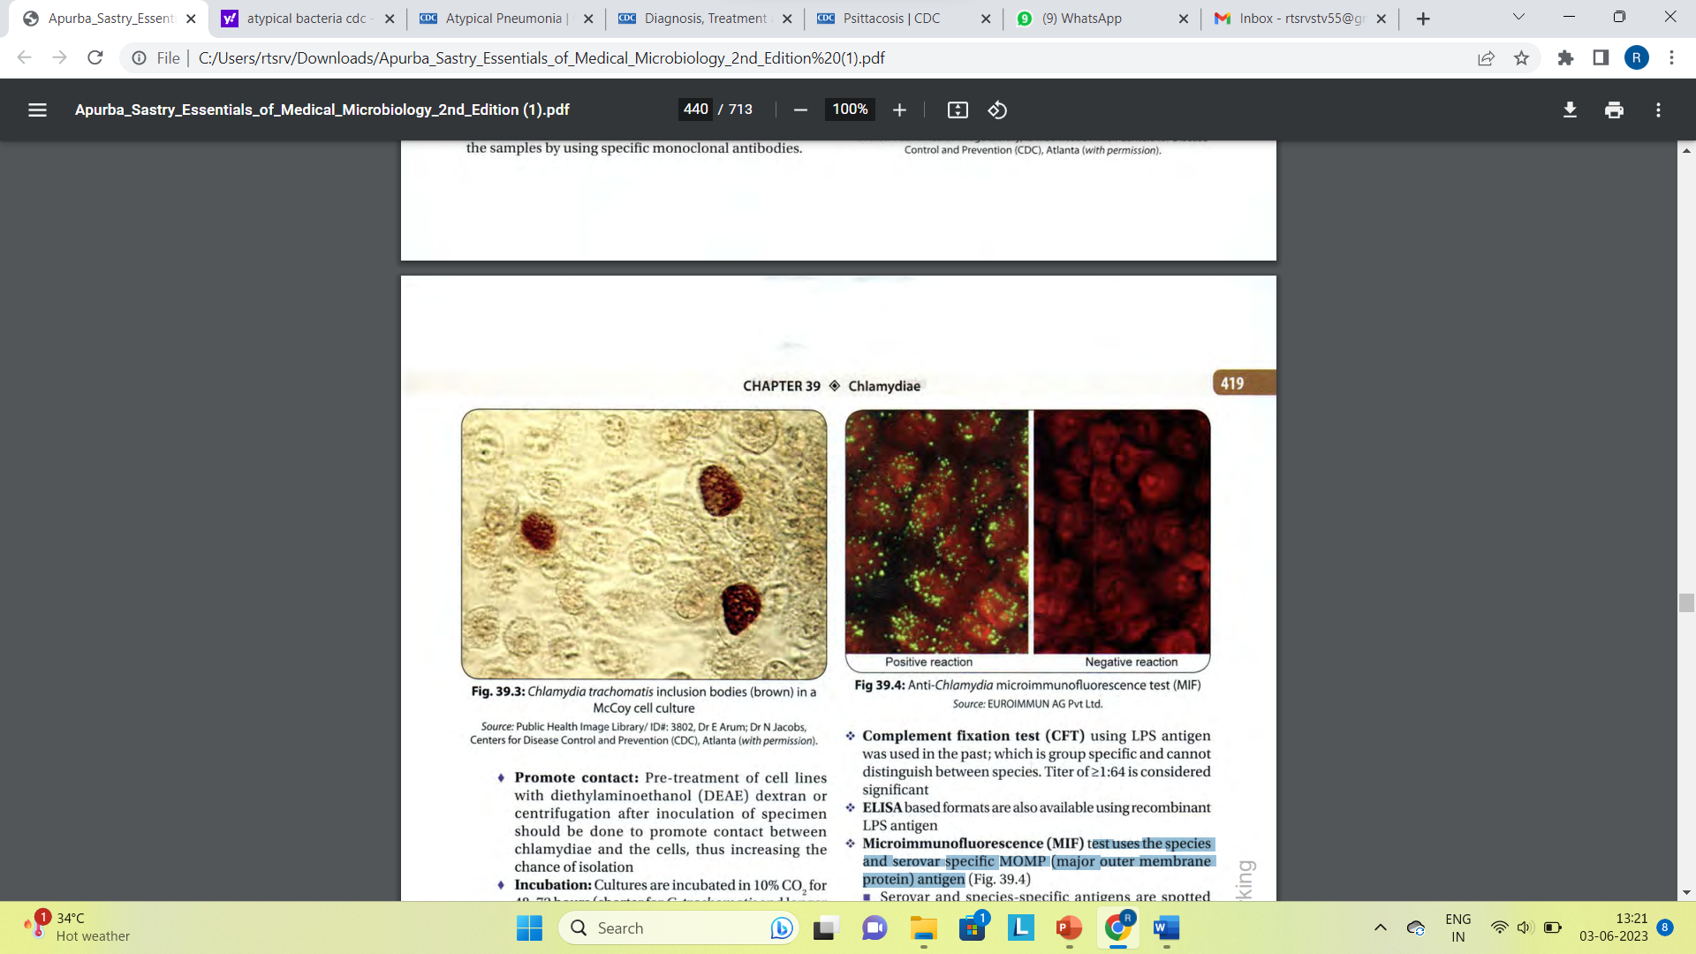
Serology (Antibody Detection):
Complement fixation test (CFT) :Titer of >l:64 is considered significant
ELISA
Micro-immunofluorescence (MIF) test- best antibody detection test available at present.
Single high titer of ≥ l :512 is diagnostic; fourfold rise of titer at 2-3 weeks interval is more significant.

Slide 15
TREATMENT
Tetracycline
Doxycycline
Macrolides
Fluroquinolones
Erythromycin

Slide 16
Legionella pneumonia

Slide 17
INTRODUCTION
It is primarily associated with two clinically distinct syndromes: Legionnaires disease(LD), a potentially severe pneumonia, and Pontiac fever a self limited, non-pneumonic illness.
Many clinical features of LD are more typical of pyogenic
(bacterial) pneumonias.
Legionella is not spread by person to person but usually by exposure to water.
The incubation period is 2 to 10 days.

Slide 18
CLINICAL MANIFESTATIONS
The onset of LD is often acute; with high fever, myalgias, anorexia, and headache.
Temperature often exceeds 40 C.
Gastrointestinal symptoms are prominent, especially diarrhoea.
Hyponatremia and elevated lactate dehydrogenase levels(LDH) were common abnormal laboratory studies observed in our experience.

Slide 19
LAB DIAGNOSIS
SPECIMENS
Sputum
BAL
Bronchial wash
Pleural fluid

Slide 20
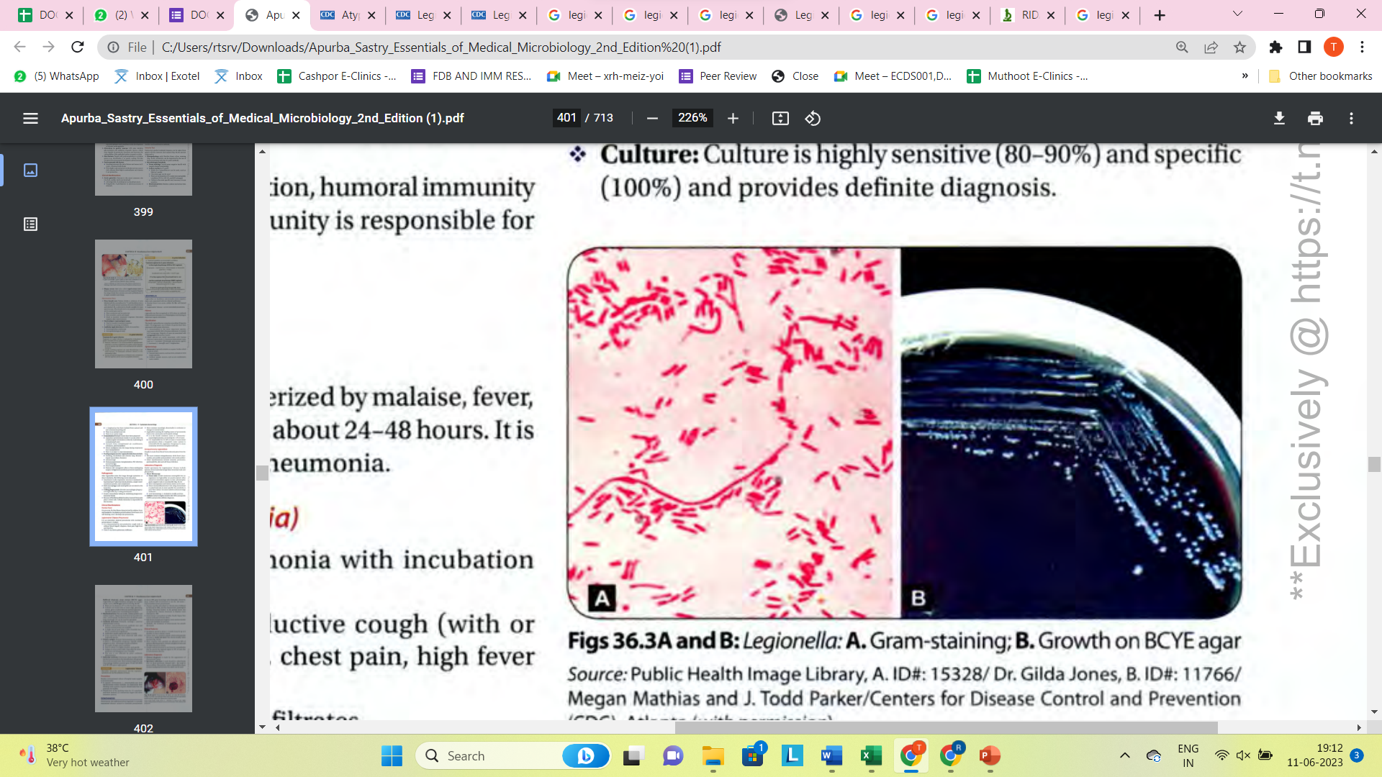
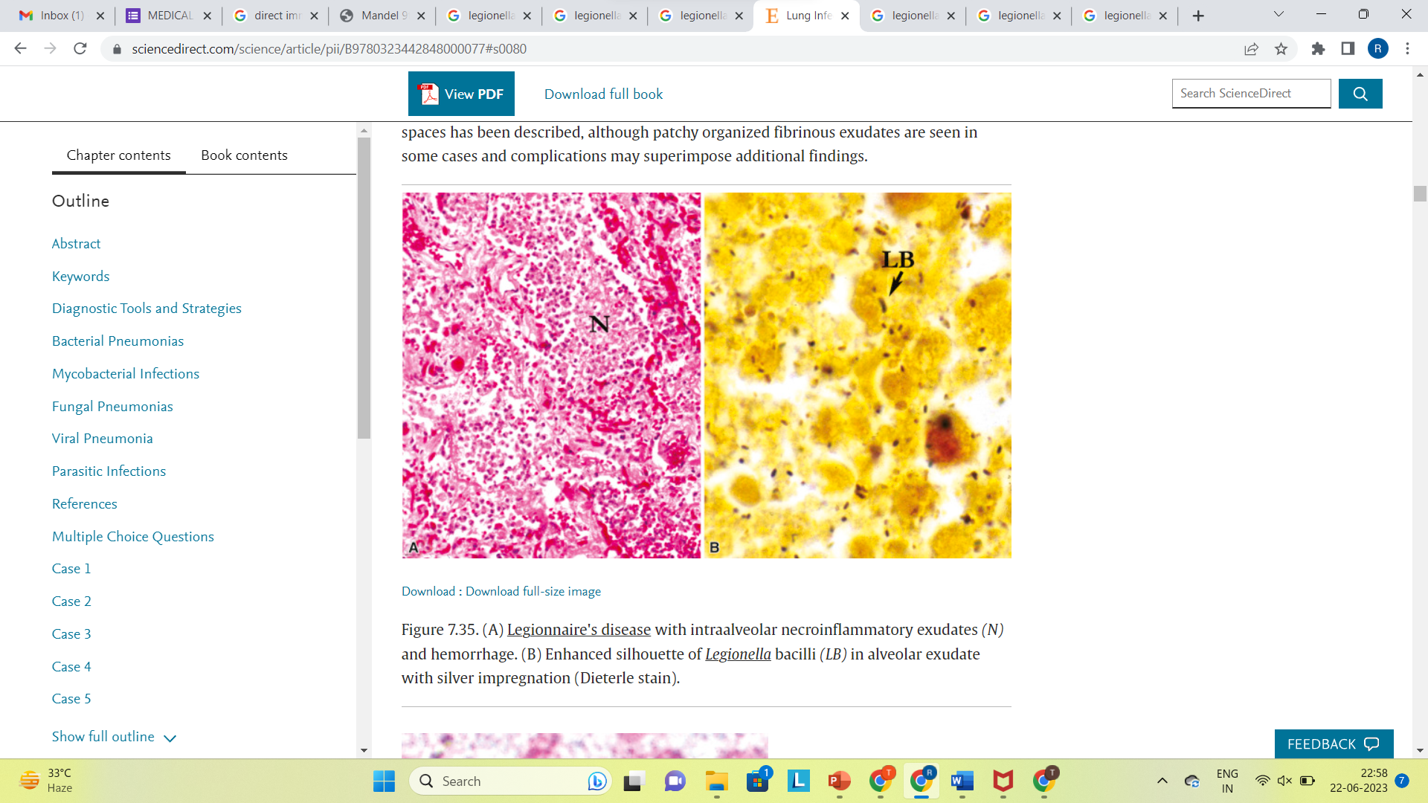
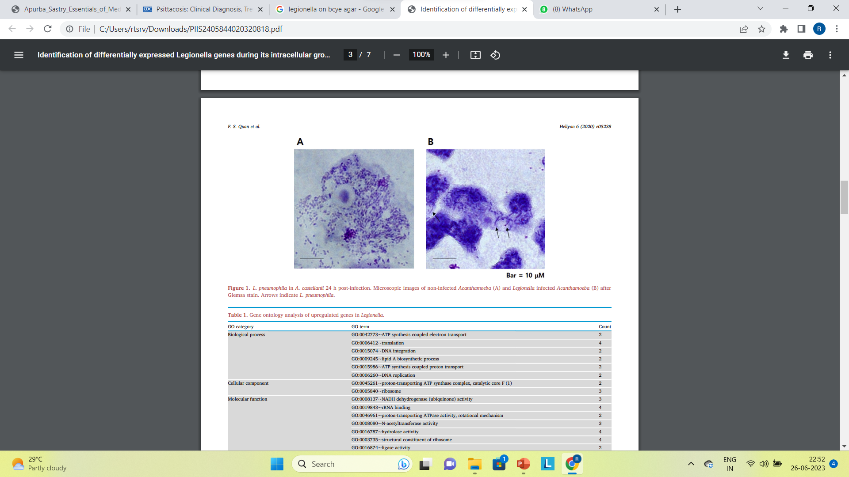
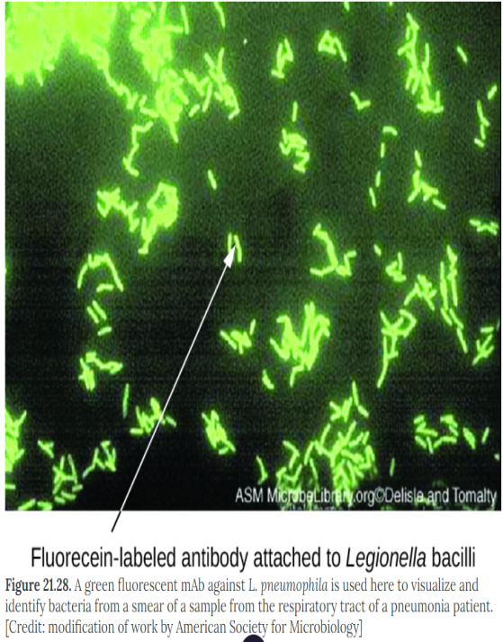
DIRECT MICROSCOPY
Gram stain- poorly stained, pleomorphic gram-negative rods or coccobacilli
Silver impregnation and Giemsa stains can be used
Direct immunofluorescence test
Acid-fast staining: L. micdadei is weakly acid fast.

Slide 21
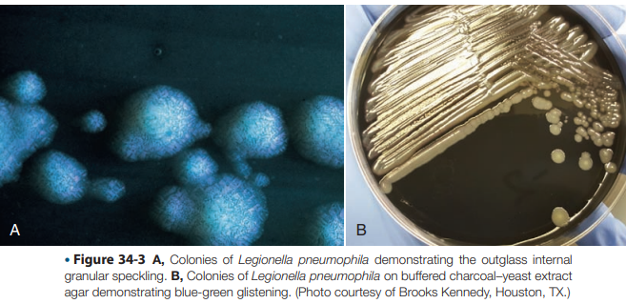
Culture on Buffered Charcoal yeast extract (BCYE)agar

Slide 22
Antibody detection
Indirect immunofluorescent antibody test and enzyme immunoassays.
A single titer of more than 1:128 or fourfold rise in titer is considered as significant .
Antibodies usually appear late after 12 weeks

Slide 23
Urinary antigen
Enzyme immunoassays are available to detect L. pneumophila serogroup 1 specific soluble antigens in urine.
Antigen in urine is detectable 3 days after the onset of symptoms and disappears over 2 months.
The test is not affected by prior antibiotic administration.

Slide 24
Molecular methods
Polymerase chain reaction
5S and 16S rRNA and 16S-23S spacer region genes.

Slide 25
TREATMENT
Macrolides (especially Azithromycin and Clarithromycin)
Respiratory Quinolones(Levofloxacin)
Rifampin is known to be very active in vitro and could be given in addition to erythromycin in patient who are seriously ill.

Slide 26
Mycoplasma pneumoniae

Slide 27
Smallest microbes capable of free living in the environment and self-replicating on artificial culture media.
Lack a rigid cell wall.
Sterol in cell membrane.
Resistant to antibiotics acting on cell wall such as beta lactams.
Poorly gram-negative, better stained by Giemsa stain
Non-sporing and non-flagellated, usually nonmotile. ( Gliding motility in some species which is due to their specialized tip structures).

Slide 28
Transmission: Respiratory droplets expectorated during coughing.
Facilitating factors: close contacts as
Families
Military bases
Boarding schools
Summer camps
Incubation period is about 2-4 weeks.

Slide 29
CLINICAL MANIFESTATIONS
URTI
Pneumonia
“Atypical" community acquired interstitial pneumonia
Walking pneumonia.

Slide 30
A fulminant pneumonia due to Mycoplasma pneumoniae – Case report
A 19-year-old female, previously healthy, college student with a travel history to a hill station one week ago with friends, was brought to the nearest hospital with h/o abdominal pain, vomiting and fever of one day.
Initially the case was managed with antiemetic and IV fluids and was referred to our hospital due to worsening of the abdominal pain.
She gave a history of sudden onset of persistent pain in the epigastrium of one day, with radiation to right iliac fossa and high-grade fever.

Slide 31
Patient was shifted to the OT for appendicectomy. Intra-operatively, patient developed respiratory distress with increased work of breathing, saturation fall and bilateral rales on auscultation.
She was started on oxygen via face mask. Post-operatively she was shifted to ICU and intubated and ventilated due to the worsening respiratory distress.
Multiple injection marks were noted over the left forearm.
Though initial POCUS on admission showed normal cardiac status, repeated from ICU showed severe LV dysfunction, global hypokinesia, lung-B profile and minimal pleural effusion bilaterally.

Slide 32
She was started on antibiotics and antiviral (Piperacillin Tazobactam, Levofloxacin, Azithromycin, Oseltamivir).
Blood culture and tracheal aspirate culture, Virology panel of respiratory pathogens and Multiplex PCR were sent. Blood and Tracheal aspirate cultures came negative.
Mycoplasma PCR from tracheal aspirate reported as positive. Serum IgM ELISA - Leptospirosis, Scrub typhus, Dengue fever, Hepatitis A & E Virus were reported negative.
Peripheral smear, Rapid malarial antigen also reported normal.
Cold agglutination test came positive

Slide 33
She had a progressively deteriorating course in the ICU, clinically progressed to multiorgan dysfunction [MODS] with Acute Kidney Injury, coagulopathy and myocarditis.
She succumbed to the illness after 7 days. Autopsy revealed ARDS findings in the lungs and there was diffuse shower of emboli in bilateral cerebral cortex.

Slide 34
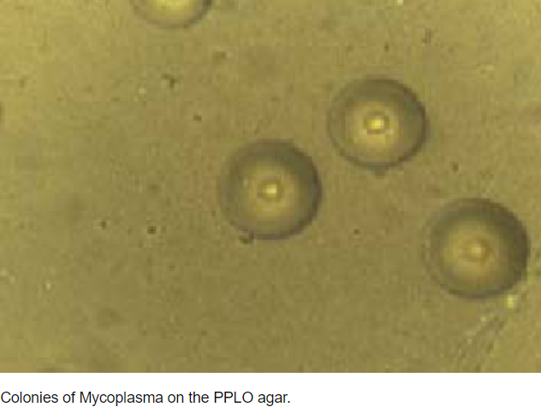
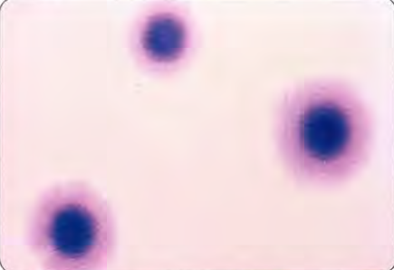
DIAGNOSIS
CULTURE:
Incubated at 37°C for 5-7 days or sometimes even up to 1-3 weeks
In liquid medium: M . pneumoniae growth is detected by turbidity and a color change ( red to yellow) of phenol red indicator due to fermentation of glucose.
In solid medium (PPLO agar) : Fried egg appearance.
Size :200-500µm

Slide 35
Antigenic Detection
Direct immunofluorescence test
ELISA

Slide 36
Antibody Detection
Nonspecific Antibody Detection (Heterophile antibodies)
Cold agglutination test
Streptococcus MG tests (group F Streptococcus)
Specific antibody detection
Complement fixation test
Immunofluorescence assays
Latex agglutination assays
ELISA

Slide 37
Molecular Methods
PCR -16S rRNA gene and P 1 adhesion gene
Multiplex PCR
Real-time PCR

Slide 38
TREATMENT
Macrolides are the drug of choice (oral Azithromycin 500mg on Day 1, then 250mg on Day 2 to 5)
Alternative drugs are as follows:
Doxycycline
Respiratory fluroquinolones such as Levofloxacin, Moxifloxacin, Gemifloxacin (NOT ciprofloxacin)

Slide 39
Francisella tularensis

Slide 40
Source: contaminated environments, insects, and animal.
Transmission: Human infection is zoonotic, results from:
Biting or blood-sucking insects ( especially ticks and tabanid flies)
Contact with animals
Ingestion of contaminated water or food
Inhalation of infective aerosols.

Slide 41
CLINICAL MANIFESTATIONS
Ulceroglandular tularemia
Pulmonary tularemia: result from aerosol inhalation (laboratory workers) or can spread to the lungs following bacteremia. Patients present with Atypical pneumonia
Oropharyngeal tularemia-Lemming fever
Oculoglandular tularemia
Typhoid-like illness
Agent of bioterrorism: category A

Slide 42
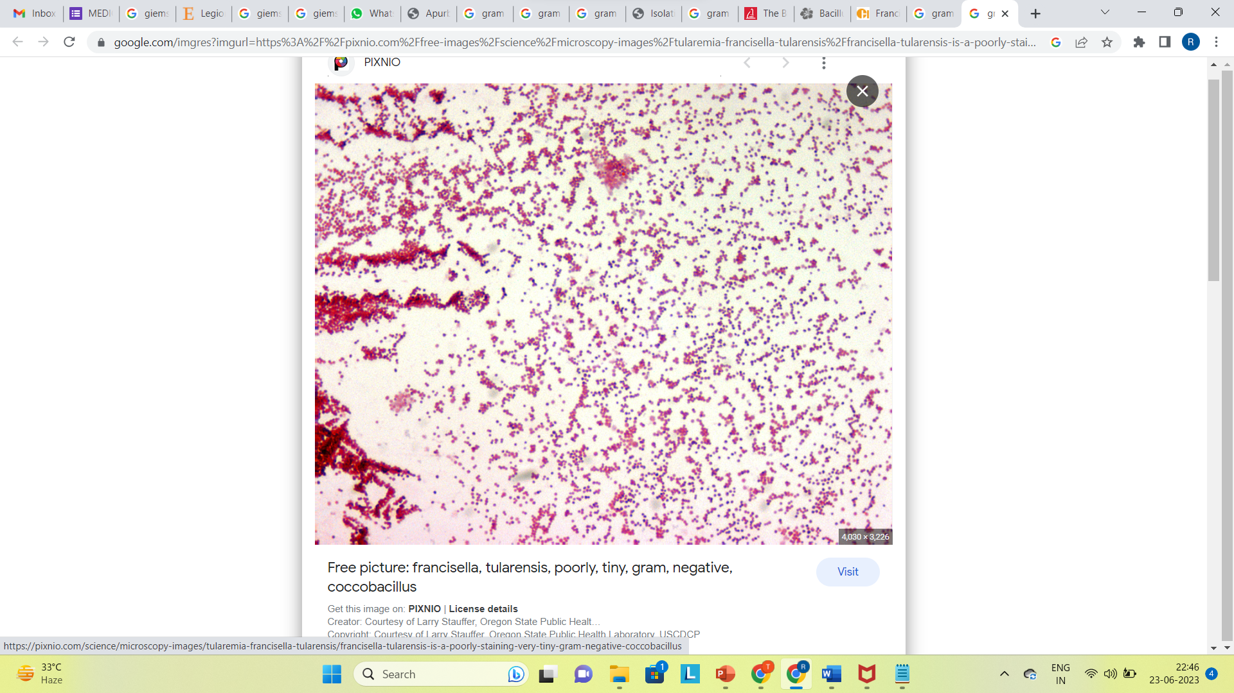
LAB DIAGNOSIS
Specimen: sputum and blood are inoculated onto the media and incubated at 37°C for 2-4 days aerobically.
It is weakly catalase positive, oxidase negative and H2S positive
It produces acid but not gas from glucose, maltose and mannose
Gram Staining :small gram-negative coccobacillus

Slide 43
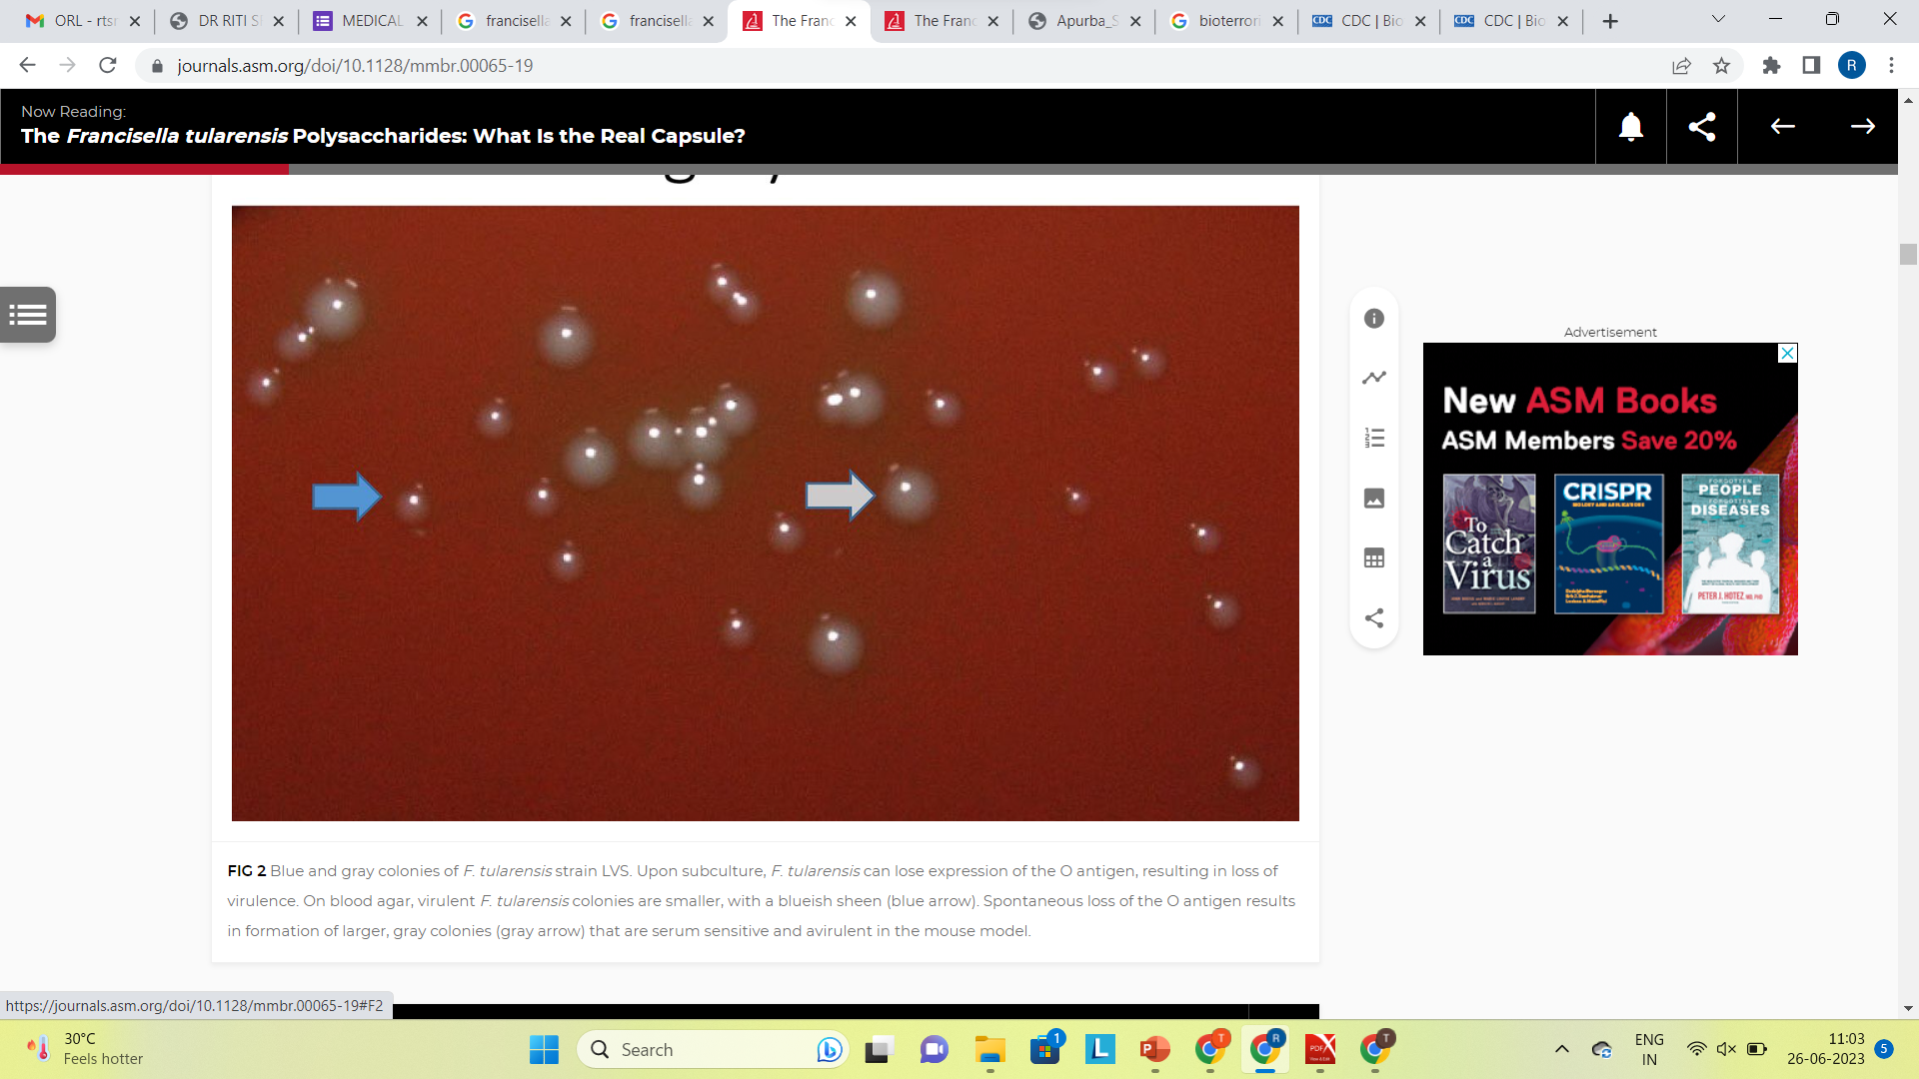
Culture:
Blood cysteine glucose agar
Cysteine heart agar supplemented with 9% heated sheep blood
Colonies are blue-gray, round, smooth, and slightly mucoid with small zone of a.-hemolysis

Slide 44
Direct fluorescent antibody.
Antibody detection
Agglutination tests
ELISA
PCR assay: FT-1 targeting Tul4 (lipoprotein gene).
Safety precautions such as biosafety level III

Slide 45
Coxiella burnetii

Slide 46
Obligate intracellular organism that causes Q fever
History
Causative agent was unknown, hence was referred to as 'Query' or Q fever by Edward Derrick.
Coxiella burnetii (formerly named as Rickettsia diaporica) as named after the two scientists Cox and Burnet.

Slide 47
MODE OF TRANSMISSION
Inhalation of infected dust from soil, previously contaminated by urine and feces of diseased animals
By ingestion of contaminated milk
Rarely, transplacental, blood transfusion or through skin abrasions/mucosa.

Slide 48
CLINICAL MANIFESTATION
Acute Q fever: After an incubation period of 3-30 days, patients present with hepatitis, interstitial pneumonia, fever, CNS involvement and pericarditis or myocarditis .
Post Q fever fatigue syndrome: Profound myalgia, headache, sweating, arthralgia, myalgia.
Latency: 2-3 years
Chronic Q fever : endocarditis

Slide 49
LAB DIAGNOSIS
Gram Stain: pleomorphic gram-negative coccobacillus.
Does not grow on routine media
Processing -Biosafety level 3 laboratory.
Isolation: cell cultures (monkey kidney cells, Vero cells) or by shell vial cell culture using human embryonic lung fibroblasts cell line, or yolk sacs (egg) or animals such as hamsters, mice or guinea pigs
Antibody detection:
Indirect immunofluorescence assay (IFA)- method of choice
IgM (7-10 days) of infection followed by IgG(after 14-20 days)
Chronic infections, the IgG antibodies to phase I antigens are elevated (>1:6400 titer)
Acute Q fever, rise of antibodies to phase II antigens (IgG ≥1:200 and IgM ≥ 1:50).
Complement fixation test IgG antibodies to phase II antigens

Slide 50
Molecular methods
QpHl plasmids are found in acute Q fever isolates.
QpRS plasmids are found on the strains isolated from endocarditis patients.
Other genes targeted are 16S rRNA, 23S rRNA, superoxide dismutase and htpAB genes.

Slide 51
VIRUS CAUSING ATYPICAL PNEUMONIA
PATHOGEN | ETIOLOGY | CLINICAL FEATURES | TREATMENT
Influenzae Adenovirus Respiratory syncytial virus Hantavirus MERS-CoV | Infuenza in community (Avian-poultry exposure) Adults: cardiopulmonary disease, COPD Exposure to rodent excreta Travel to Arabian peninsula | Influenza pneumonia usually follows tracheobronchitis Pharyngitis prominent Bronchospasm Febrile prodrome; followed by non cardiogenic pulmonary edema with shock; thrombocytopenia severe respiratory syndrome | Oseltamivir(orally), zanamivir(via inhalation) No approved antiviral No antiviral agent currently recommended(ribavirin possibly for selected cases) Supportive care

Slide 52
DIAGNOSIS
VIRUSES | RAPID TEST | CULTURE OR MICROBIOLOGICAL TEST | SEROLOGY
Influenza RSV Adenovirus | Rapid antigen detection(EIA), PCR Antigen detection(IF or EIA); mainstay of diagnosis), PCR | Virus isolation | CF(Compliment Fixation) or HAI(Hemagglutination Inhibition), ELISA

Slide 53
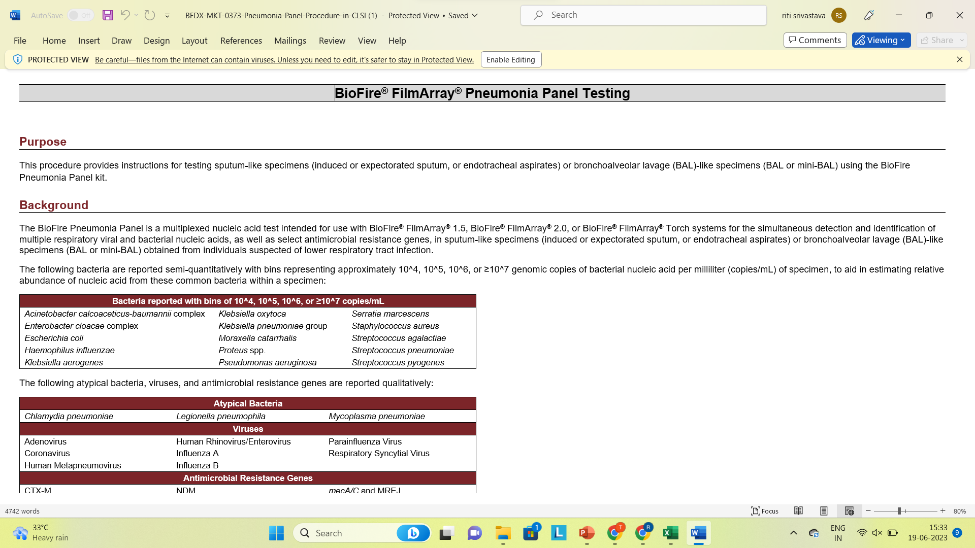

Slide 54
FUNGAL ATYPICAL PNEUMONIA
It is caused by:
Histoplasma develop from the droppings of certain bird and bat species typically found in central and eastern United States.
Blastomyces live in rotting wood, leaves, and damp soil in Midwestern, south-central and southeastern states.
Coccidioides are native to the soil of American Southwest, as well as parts of Central American and South America.
Pneumocystis develops in patients with HIV, or bone marrow transplant or take high doses of corticosteroids.

Slide 55
CLINICAL FEATURES
Fever
Chills
Cough with thick, colored phlegm
Shortness of breath
Pain while breathing or coughing
Nausea/vomiting
diarrhea

Slide 56
Diagnosis
Specimen: Sputum, BAL
Direct Examination: the conventional KOH wet mount, prepared from clinical sample, shows tiny yeast cells.
Stains: Calcofluor white, Giemsa or Wright stains.
The fungus appears as small, oval yeast cells, 2-4um, within mono-nuclear or polymorphonuclear cells and occasionally in giant cells.

Slide 57
MICROSCOPY
Histoplasma | Blastomyces | Coccidioides | Pneumocystis
Small oval yeast cells 2-4um Within mono-nuclear or polymorphonuclear cells and occasionally in giant cells | Double-contoured Thick walled Multi-nucleated yeast cells With single broad based budding daughter cell. | Doubly refractile thick walled globular spherules 20-80um. Mature spherules contain endospores | GMS stain: cyst wall stains black in color. Ping pong ball appearance Flurocent monoclonal antibody stain: Honey-comb appearance of the cyst.

Slide 58
CULTURE
Histoplasma | Blastomyces | Coccidioides | Pneumocystis
SDA with antibiotic, BHI agar with same antibiotic at 25 C. Yeast extract phosphate agar with ammonium hydroxide. White-cottony mycelial growth at 25 C on SDA. | In blood agar, SDA, BHI agar and blood-glucose cystine agar. 25 and 37 C On SDA: yeast-like at early stage, later on hyphal projections develop on surface and finally entire surface become downy or fluffy white within 14 days | It is cultured in slants or narrow-neck bottles. SDA, blood-agar and BHI agar with actidione. Grows at 25 C as well as 37 C. Colony are moist, smooth initially but become suede-like to downy greyish white with tan to brown underside. | It is not cultivable in vitro

Slide 59
OTHER TESTS
Histoplasma
Histoplasmin skin test: Delayed type hypersensitivity.
Serological test:
Immunodiffusion test
Histoplasma antigen detection test
Pneumocystosis:
Immuno-diagnosis:
Antibody detection
CFT, Indirect Fluorescent test, EIA.
β- D-glucan level > 31pg/mL in serum- is useful marker for diagnosis.

Slide 60
Blastomyces
Immuno-diagnosis:
Immunodiffusion, Enzyme immunoassay, RIA – all using antigen A.
Blastomycin skin test: delayed type hypersensitivity.
Coccidioides
Skin test: Coccidioidin antigen.
Serological test: Antibody detection.
Precipitin test, CFT, Latex agglutination.

Slide 61
References
A textbook of Medical Mycology by Jagdish Chander 4th Edition.
MLA. Tille, Patricia M., author. Bailey & Scott's Diagnostic Microbiology. St. Louis, Missouri :Elsevier, 2014.
Apurba S Sastry, Sandhya Bhat. Essential of Medical Microbiology. 4th Edition New Delhi, Jaypee brothers Medical Publishers; 2023.
Centers for Disease Control and Prevention.
Athira Unni, P.K. Hidayathulla, K.P. Kavitha, Mohammed Niyas Paloth, Priyanka Raveendranadhan Nair, Jayesh Kumar P, Chandni Radhakrishnan,
A fulminant pneumonia due to Mycoplasma pneumoniae – Case report and literature review, ID Cases, Volume 29, 2022, e01552, ISSN 2214-2509.

Slide 62
MCQs
Typical bacterial pneumonia is caused by:
Mycoplasmal pneumonia
Legionnaires pneumonia
Pneumocystis carinii
Staphylococcus aureus

Slide 63
2. An 8 year old child boy came to the hospital complaining from fever and cough with sputum, his doctor diagnosed his condition as CAP, which organism is most likely to be seen in his case?:
H. influenzae type B.
Group A hemolytic streptococci
Mycoplasma pneumoniae
S.aureus

Slide 64
3. All of the following can be used to diagnose atypical CAP EXCEPT?
ESR and C­reactive protein.
X­rays.
Gram stain.
All the above apply.

Slide 65
4. Pneumococcal resistance to β­lactams can be overcome by increasing β­lactam doses EXCEPT for:
Sinusitis
Meningitis
Bacteremia
Pneumonia

Slide 66
5. A person with Legionella pneumophila can be best treated with:
Vancomycin
Linezolid
Erythromycin
ceftazidime

Slide 67
THANK YOU

